Slide 1
Git/GitHub Basics

Slide 2
What is Git? What is GitHub?
Git is a distributed Version Control System (VCS)
Version Control System : a tool that tracks changes to a file or set of files over time
Repository : a central place where files are kept and maintained in an organized way
GitHub is a host to Git repositories

Slide 3
How Git works?
Remote Repository
Most operations in Git are local.
.git directory is created by git init or cloned from an existing repository by git clone.
Files in Git are in 3 main states: modified, staged and committed. Use git status to check which files in which state.
git push
git pull
.git directory (Local Repository)
Staging
Area
git commit
git add
Working Directory

Slide 4
Lab

Slide 5
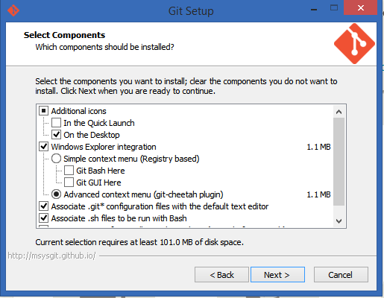
Set Up Git
1. Install Git for Windows
http://git-scm.com/download/win
Suggest to create a desktop shortcut
Others use default configuration

Slide 6

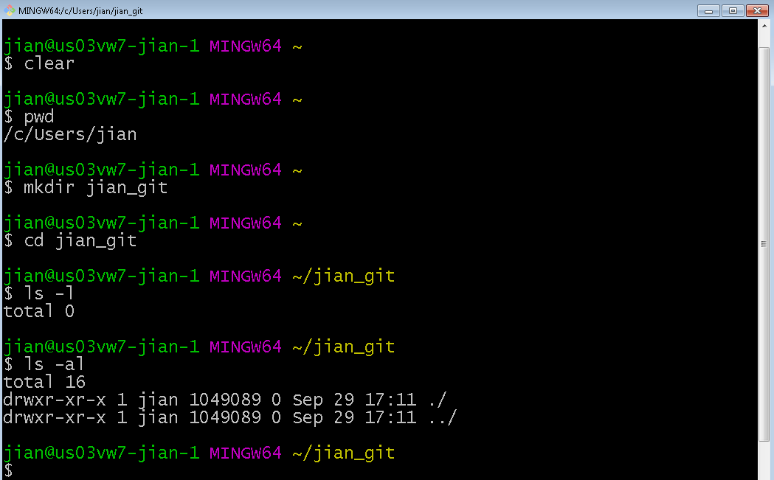
2. Run Git Bash
Double click on desktop to bring up Git Bash window. Create a project directory.
Basic Bash commands:
$ mkdir : make a directory (folder)
$ cd : go to a directory
$ ls –al : list content of current directory, including hidden files

Slide 7
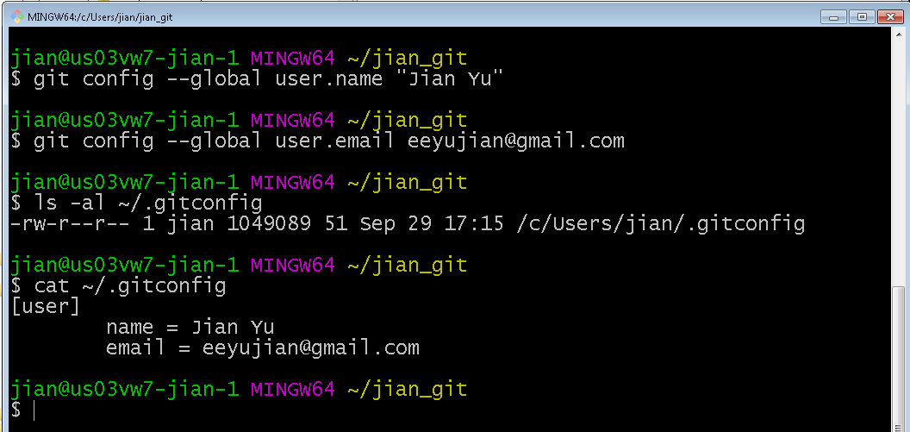
3. Config git
$ git config -–global user.name “you_name”
$ git config -–global user.email your_email
You’ll see a .gitconfig file created in your home directory.

Slide 8
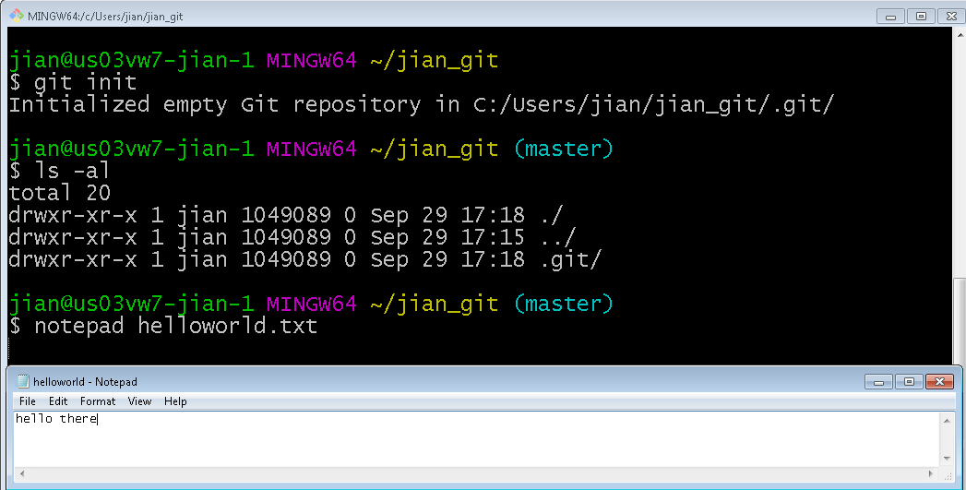
Work with Local Repository
1. Create a local repository
$ git init
A .git directory is created in current directory.
2. Create a new file
$ notepad helloworld.txt

Slide 9
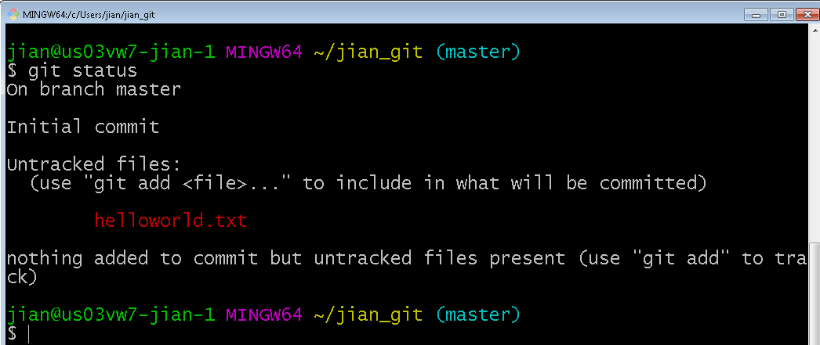
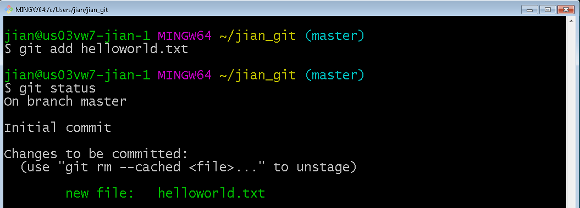
3. Check file status
$ git status
The file is untracked.
4. Stage the file
$ git add helloworld.txt
Now check the status again. The file is staged and to be committed.

Slide 10
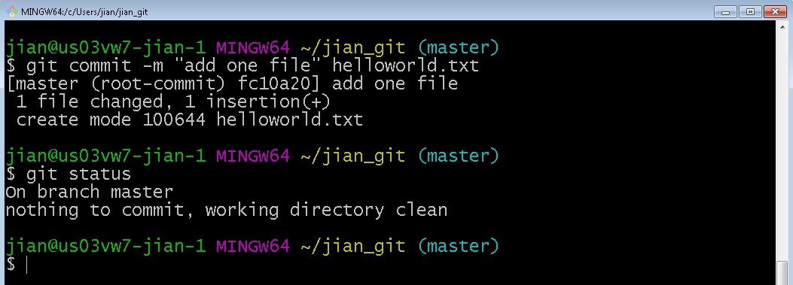
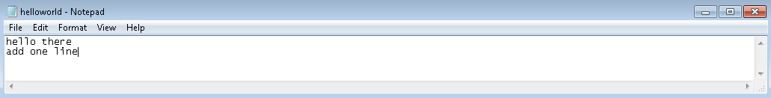
5. Commit the file
$ git commit –m “first hello” hello.txt
Now check the status, the file is committed.
6. Modify the file

Slide 11
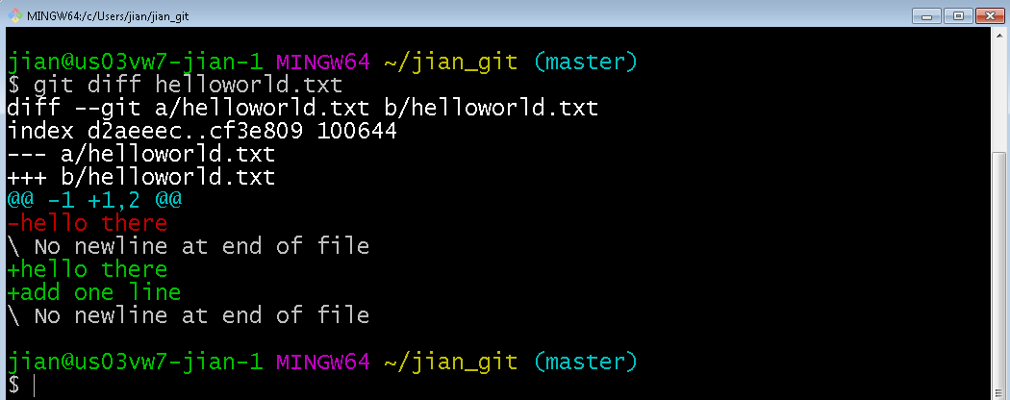
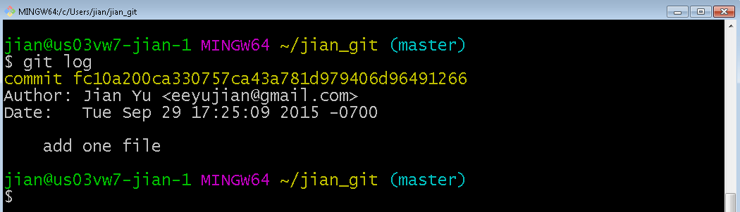
7. Check difference on modified but not staged file
$ git diff
8. Stage and commit, then check the history
$ git log

Slide 12
Work as a team with Remote Repository
Create an account in github and sign up at https://github.com
Send the user name to me so that I can add you as contributor.
2. Get a copy of an existing Git repository
$ git clone https://github.com/eeyujian/FLL2015.git

Slide 13
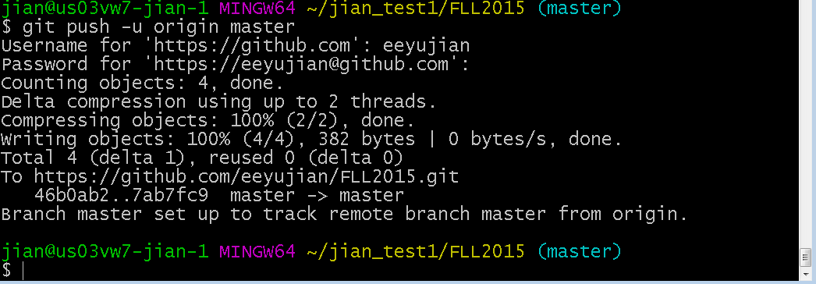
3. Add/Modify the file, then stage, commit
$ git add newfile.txt
$ git commit –m “more file”
4. Push the local repository to remote server
$ git push -u origin master
On github.com, you’ll see the file in remote repo.

