Slide 1
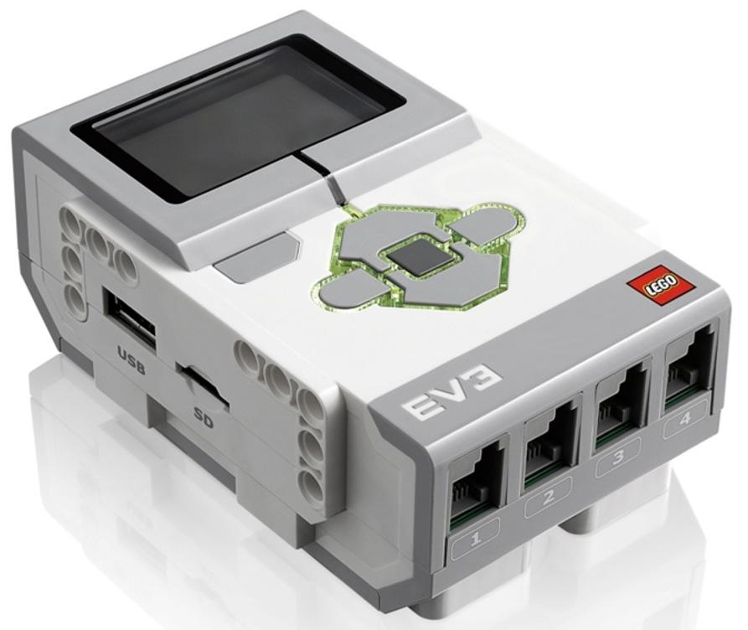
Lego Robotics
By: Me

Slide 2
Introduction
People don't care about trash
People don’t use the trash bin
People don’t sort the trash
Pollution and global warming

Slide 3
Introduction: The Problems
There are many problems in our world with the STINKY, UNPOPULAR, TRASH! One reason why trash is avoided is because it is dirty and nobody (Except dirty people) like trash. So, a way to stop this from happening is to reuse, so less trash goes away, never seen again in the landfill. One of these problems is people throwing trash everywhere instead of the trash cans. Another is that people throw the trash in the recycling and the recyclables in the trash so we should try to stop that, and sort it.

Slide 4
Conclusion
Rescue earth from being trash land
Change people's minds and behavior when young
protect earth

Slide 5
Conclusion
The conclusion is that people should pay more attention on the little (or big) useless thing that everybody thinks is gross and NOT care about. Our goal is to let young minds to have the habit of throwing away things. Later in hundreds or thousands of years our world wouldn't be Earth it would be Trash Land! So we should start protecting our world now instead of trying to later. Earlier is better than later.

Slide 6
intro + conclusion
People don't care about trash
People don’t use the trash bin
People don’t sort the trash
Pollution and global warming
Starting conclusion very different don't mistake it for the intro thank you (3 c’s 4 i’s)
Rescue earth from being trash land
Change people's minds and behavior when young
protect earth

