Slide 4
Introduction
We are the ultimate programming dragons, in our group, we have 4 people. There is Andrew, Angela, Daniel, and me, Kevin. We are all 9 years olds and we are engaged in this years Trash Trek. We have learned and understood the waste and landfills around us. Used to, we were thinking of a high tech trash can. But we discovered it was humans nature to not recycle. So after lots of research, we found out that people are too lazy and confused, or they think it’s too costly. People are lazy because they don’t like to read the signs even though they Know how to read. By confusion, we mean that elders or blind people can’t read what the trash can says. For example: they read trash as recycle or recycle as trash. For cost People say that they want to save money for other things instead of paying the money for throwing trash away.

Slide 10
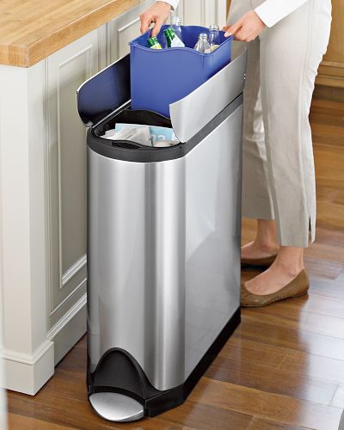
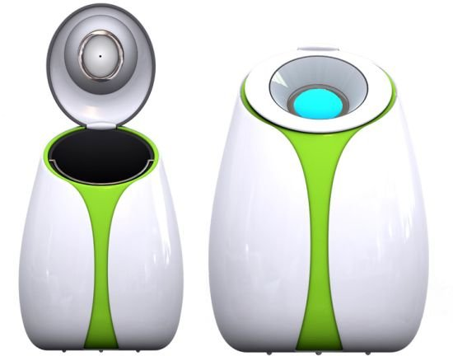


Problem
People are lazy sometimes. And it’s okay. We make silly mistakes sometimes. So to make people aware, we will make noises for the blind people, noises to alert the people who aren’t paying attention. And to make some neighborhood trash cans for the taxes due to trash.

Slide 11
