Slide 1



Dpt. of System Engineering
and Automation
University of Málaga
(Spain)
Efficient Probabilistic Range-Only SLAM
Jose-Luis Blanco, Juan-Antonio Fernández-Madrigal, Javier González
Sep 22-26
Nice, France

Slide 2
Outline of the talk
1. RO-SLAM: the RBPF approach
2. Map update
3. Observation model
4. Experiments
5. Conclusions

Slide 3
Outline of the talk
1. RO-SLAM: the RBPF approach
2. Map update
3. Observation model
4. Experiments
5. Conclusions

Slide 4
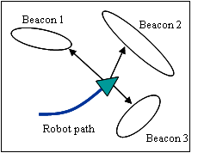
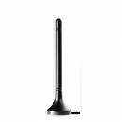
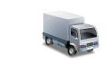
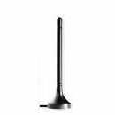
1. RO-SLAM: the RBPF approach
Range Only (RO) SLAM:
Localization & Mapping with range-only devices.
Our purpose:
To enable a vehicle to localize itself using RO devices, without any
previous information about the 3D location of the beacons.
Typical technologies:
Radio, sonars.

Slide 5
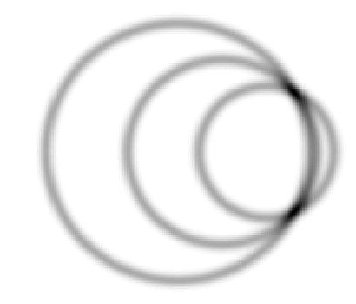
1. RO-SLAM: the RBPF approach
Advantages of RO-SLAM (depending on technologies):
  No need for line-of-sight between vehicle-beacons.
  Artificial beacons, can identify themselves: no data-association problem.
Drawback of RO-SLAM (always):
  The high ambiguity of localization from ranges only.
Two likely positions
Robot poses

Slide 6
1. RO-SLAM: the RBPF approach
Why is it difficult to integrate RO-SLAM in a probabilistic framework?
Multi-modality: With RO sensors, everything is multimodal by nature:
- In global localization → vehicle location hypotheses [not in this work]
- In SLAM → beacon location hypotheses [addressed here].

Slide 7
1. RO-SLAM: the RBPF approach
Why is it difficult to integrate RO-SLAM in a probabilistic framework?
Multi-modality: With RO sensors, everything is multimodal by nature:
- In global localization → vehicle location hypotheses [not in this work]
- In SLAM → beacon location hypotheses [addressed here].
Strongly non-linear problem, with non-Gaussian densities.
- Classic approach to SLAM (EKF) is inappropriate to RO-SLAM:
a covariance matrix is incapable of capturing the relations between
all the variables (at least in Cartesian coordinates! [Djugash08]).
Alternative implementation in this work:
Rao-Blackwellized Particle Filter (RBPF)

Slide 8
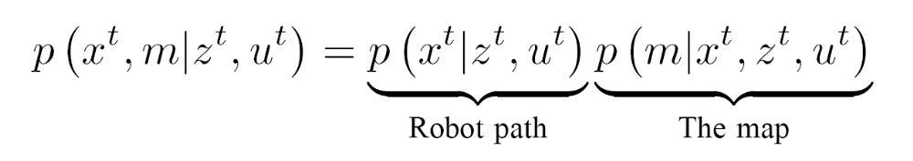
1. RO-SLAM: the RBPF approach
The Rao-Blackwellized Particle Filter (RBPF) approach
The full SLAM posterior can be separated into:
- Robot path: estimated by a set of particles.
- The map: only conditional distributions, for each path hypothesis.
The covariances are represented implicitly by the particles,
rather than explicitly → easier!

Slide 9
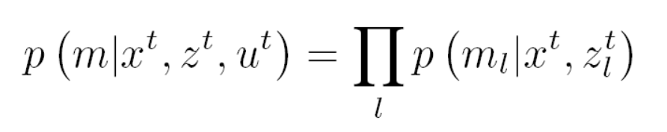
1. RO-SLAM: the RBPF approach
Taking advantage of conditional independences
Instead of keeping the joint map posterior, we can estimate each beacon
independently:
Beacon 1
Beacon 2
Robot path
Beacon 3
Beacon 1
Beacon 2
Robot path
Robot path
Robot path
Beacon 3

Slide 10
1. RO-SLAM: the RBPF approach
The key insight of our approach:
Each beacon, at each particle, can be represented by a different kind of
probability density to fit the actual uncertainty.
→ The first time a beacon is observed, a sum of Gaussians is created.
→ With new observations, unlikely Gaussian modes are discarded.
Eventually, each beacon is represented by a single EKF.
Robot path
Robot path

Slide 11
1. RO-SLAM: the RBPF approach
Works related to RO-SLAM:
[Kantor, Singh ICRA02], [Kurth, et al. 2003]: EKF, assuming initial gross estimate of beacons.
[Singh, et al. ICRA03]: Delayed initialization of beacons.
[Newman & Leonard ICRA03]: Least square, batch optimization.
[Olson et al. 2004], [Djugash et al. ICRA06]: Two steps, first probability grid for beacons,
then converge to EKF.
[Djugash et al. ICRA08]: EKF in polar coordinates, fits perfectly to RO problems.
Problems: predicted uncertainty of ranges, must decide when to create multimodal pdfs.
Benefits of our approach:
New beacons can be inserted into the map at any time: they are immediately used to improve robot localization.
Computational complexity dynamically adapts to the uncertainty.
Unified Bayesian framework: it’s not a two-stage algorithm.
More robust and efficient, in comparison to a previous work [Blanco ICRA08].

Slide 12
Outline of the talk
1. RO-SLAM: the RBPF approach
2. Map update
3. Observation model
4. Experiments
5. Conclusions

Slide 13
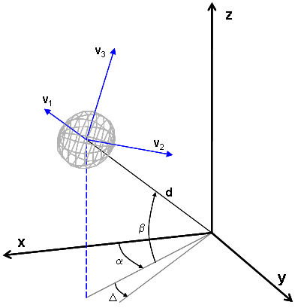
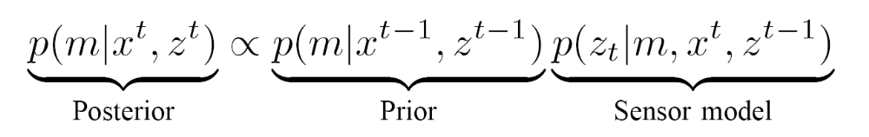
2. Map update
With each iteration, new measurements are integrated into the map:
We can find two different situations to implement this:
- The beacon is inserted into the map for the first time.
- The beacon is already represented by a sum of Gaussians (SOG).

Slide 14

2. Map update
Case 1: First insertion into the map
Gaussians are created to approximate the actual density: a “thick ring”
centered at the sensor:
In 2D it’s a ring:
Sigma: sensor noise
Beacon PDF
Radius:
sensed range

Slide 15
2. Map update
Case 1: First insertion into the map
In 3D, a sphere of Gaussians is created around the sensor. Covariance matrix:
z
v₃
v₁: In the direction sensor to sphere.
v₁
v₂ and v₃ : Tangent to the sphere.
v₂
d
β
x
α
y
Δ

Slide 16
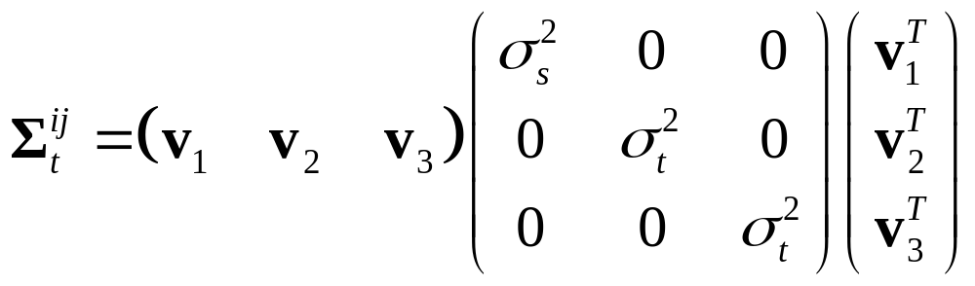


2. Map update
Case 1: First insertion into the map
In 3D, a sphere of Gaussians is created around the sensor. Covariance matrix:
Transformation of uncertainties:
z
v₃
v₁
v₂
→ Uncertainty of sensor ranges (“thickness”).
d
β
→ Variance in both tangent directions.
x
α
y
How to compute ?
Δ

Slide 17
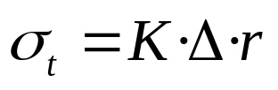




2. Map update
Case 1: First insertion into the map
How to compute ?
Proportional to the separation between Gaussians:
K=0.3
K=0.5
10
0
Kullback-Leibler divergence to analytical density
10
-1
10
-2
Different ranges r
10
-3
0.3
0.4
0.5
0.6
0.7
0.8
0.9
K
1

Slide 18
2. Map update
Case 2: Update of a beacon represented by a SOG

Slide 19
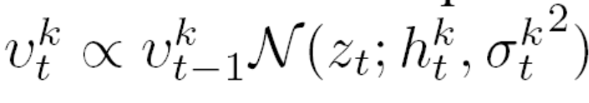

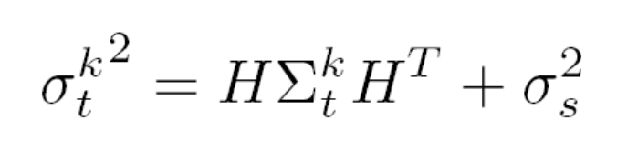
2. Map update
Case 2: Update of a beacon represented by a SOG
Only the weights of the individual Gaussians are modified, using the
predictions from each Gaussian:
Observed range

Slide 20
2. Map update
Case 2: Update of a beacon represented by a SOG
When weights become insignificant, some SOG modes are discarded.
→ The complexity adapts to the actual uncertainty in the beacon.
Robot path
Robot path

Slide 21
Outline of the talk
1. RO-SLAM: the RBPF approach
2. Map update
3. Observation model
4. Experiments
5. Conclusions

Slide 22
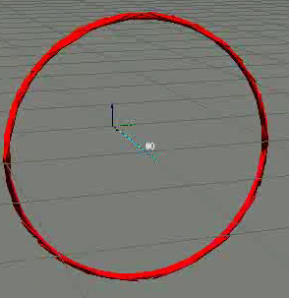

3. The observation model
Sensor model: (optional) bias + additive Gaussian noise
p(z)
Bias
z (sensed range)
Actual range

Slide 23
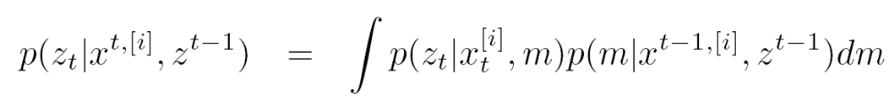
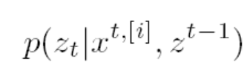
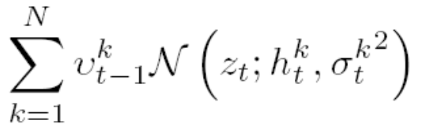
3. The observation model
Sensor model:
In general, it is the integral over all the potential beacon positions:
Beacon pdf: SOG
z _{t}

Slide 24
3. The observation model
Example (2D estimate): A path on a planar surface → 1 symmetry.
Beacon PDF
Two symmetrical
modes
t₁
t₃
Robot path
t₂
A single Gaussian
t₄

Slide 25
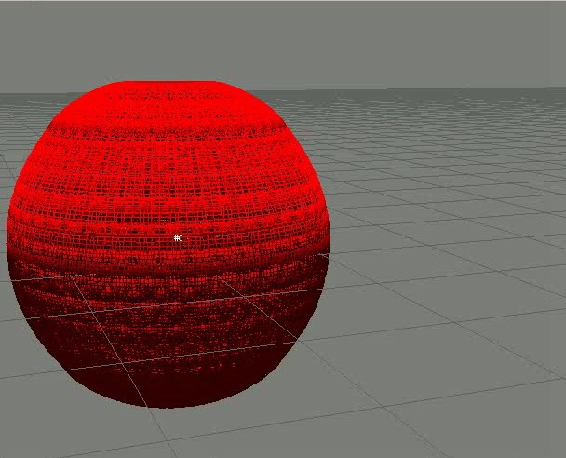
3. The observation model
Example (3D estimate): A path on a planar surface → 2 symmetries.

Slide 26
Outline of the talk
1. RO-SLAM: the RBPF approach
2. Map update
3. Observation model
4. Experiments
4.1. Real robot with UWB beacons
4.2. Comparison to MC method
5. Conclusions

Slide 27
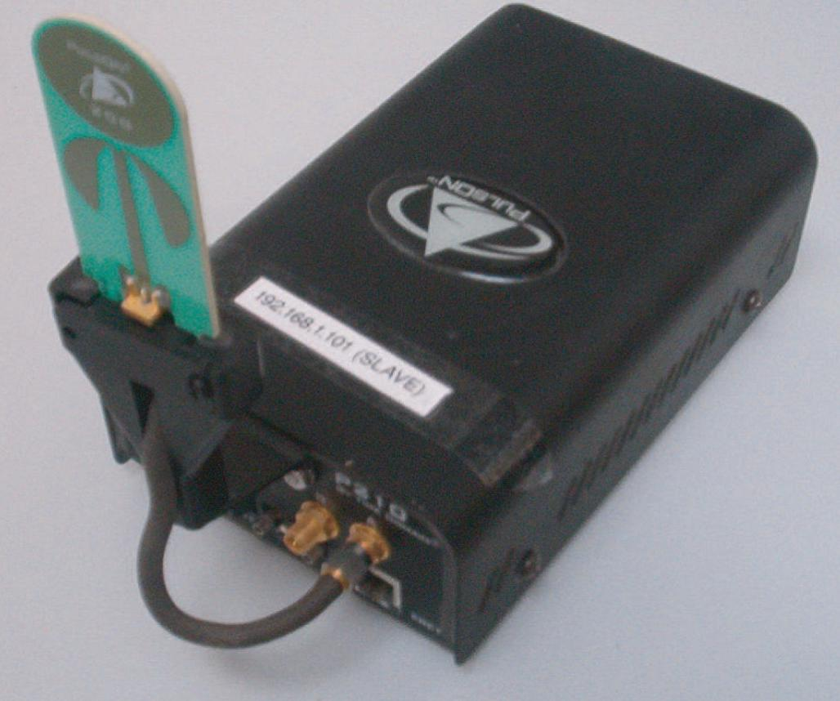
4.1. Experiments: UWB radio beacons
Ultra Wide Band (UWB) technology:
Measure time-of-flight of short radio pulses.
Spread spectrum for robustness against multi-path.
It does not require line-of-sight.

Slide 28
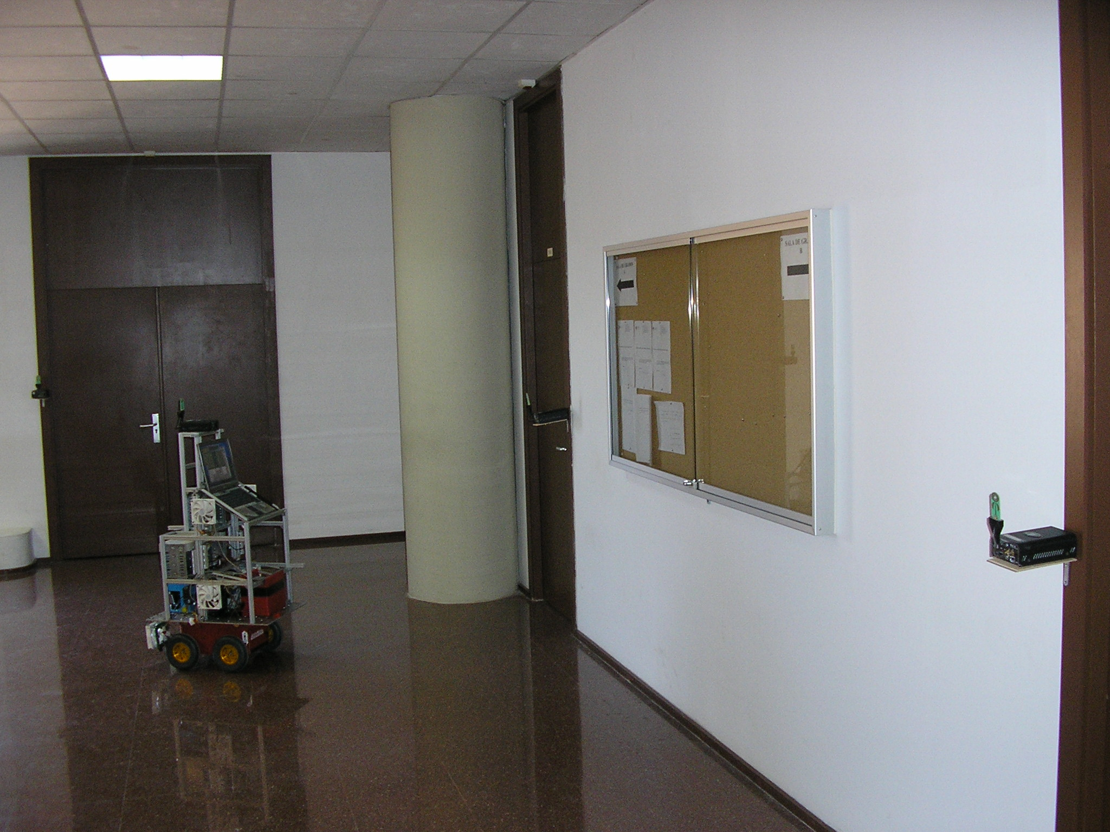
4.1. Experiments: UWB radio beacons
The experimental setup:
We have used 1 mobile transceiver on the robot + 3 beacons.
Mobile unit
Static beacon
[Timedomain – PulsOn]

Slide 29
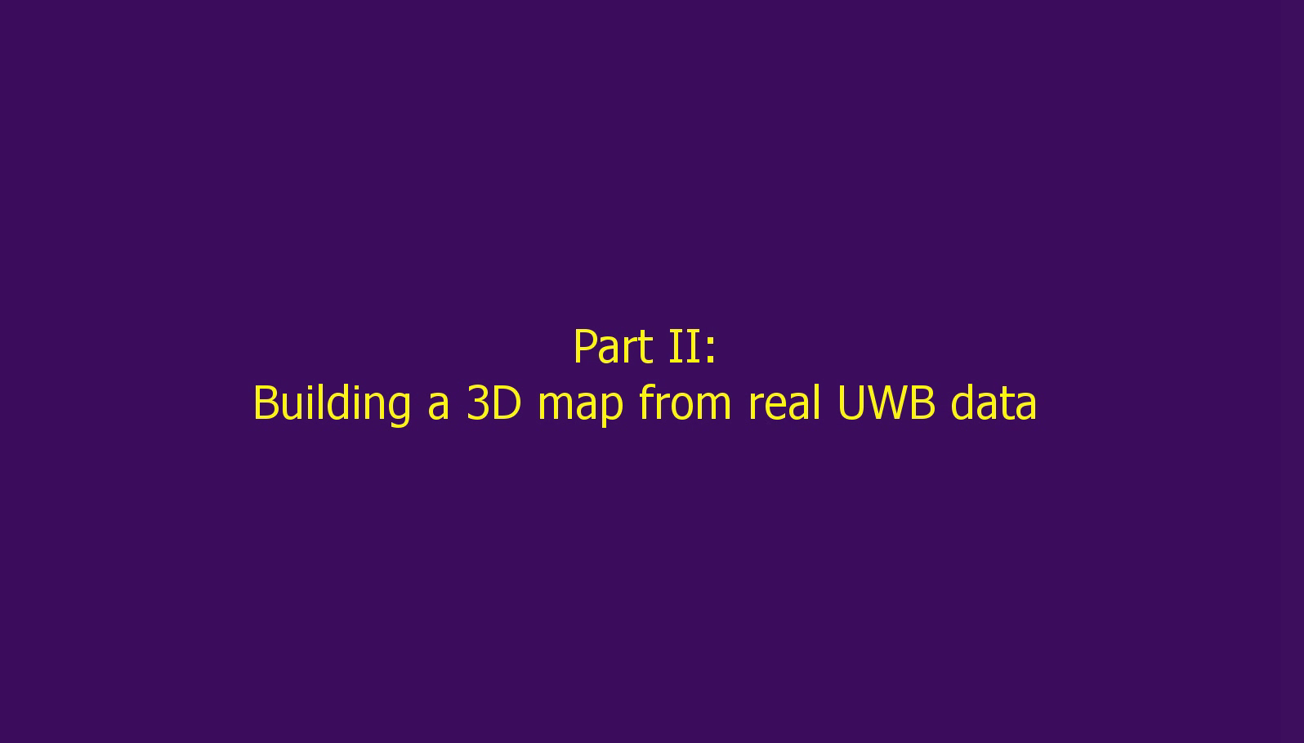
4.1. Experiments: UWB radio beacons

Slide 30
Outline of the talk
1. RO-SLAM: the RBPF approach
2. Map update
3. Observation model
4. Experiments
4.1. Real robot with UWB beacons
4.2. Comparison to MC method
5. Conclusions

Slide 31
4.2. Experiments: simulations
Experiment:
Comparison to a previous work of the authors, where beacons
are modeled by a set of weighted samples:
Robot path
Robot path
Monte-Carlo
[Blanco et al. ICRA08]
Sum of Gaussians
(This work)

Slide 32
4.2. Experiments: simulations
Comparison: Monte-Carlo (MC) vs. Sum-of-Gaussians (SOG)
Errors for similar time:
Time for similar errors:
Errors for outliers & high noise:
SOG
SOG
SOG
0
0.2
0.4
0.6
0.8
1
1.2
1.4
1.6
1.8
2
0
5
10
15
20
25
30
35
40
45
50
0
0.5
1
1.5
2
2.5
3
3.5
4
4.5
5
Average beacon error (m)
Average time per particle (ms)
Average beacon error (m)
MC
MC
MC
0
0.2
0.4
0.6
0.8
1
1.2
1.4
1.6
1.8
2
0
5
10
15
20
25
30
35
40
45
50
0
0.5
1
1.5
2
2.5
3
3.5
4
4.5
5
Average beacon error (m)
Average time per particle (ms)
Average beacon error (m)

Slide 33
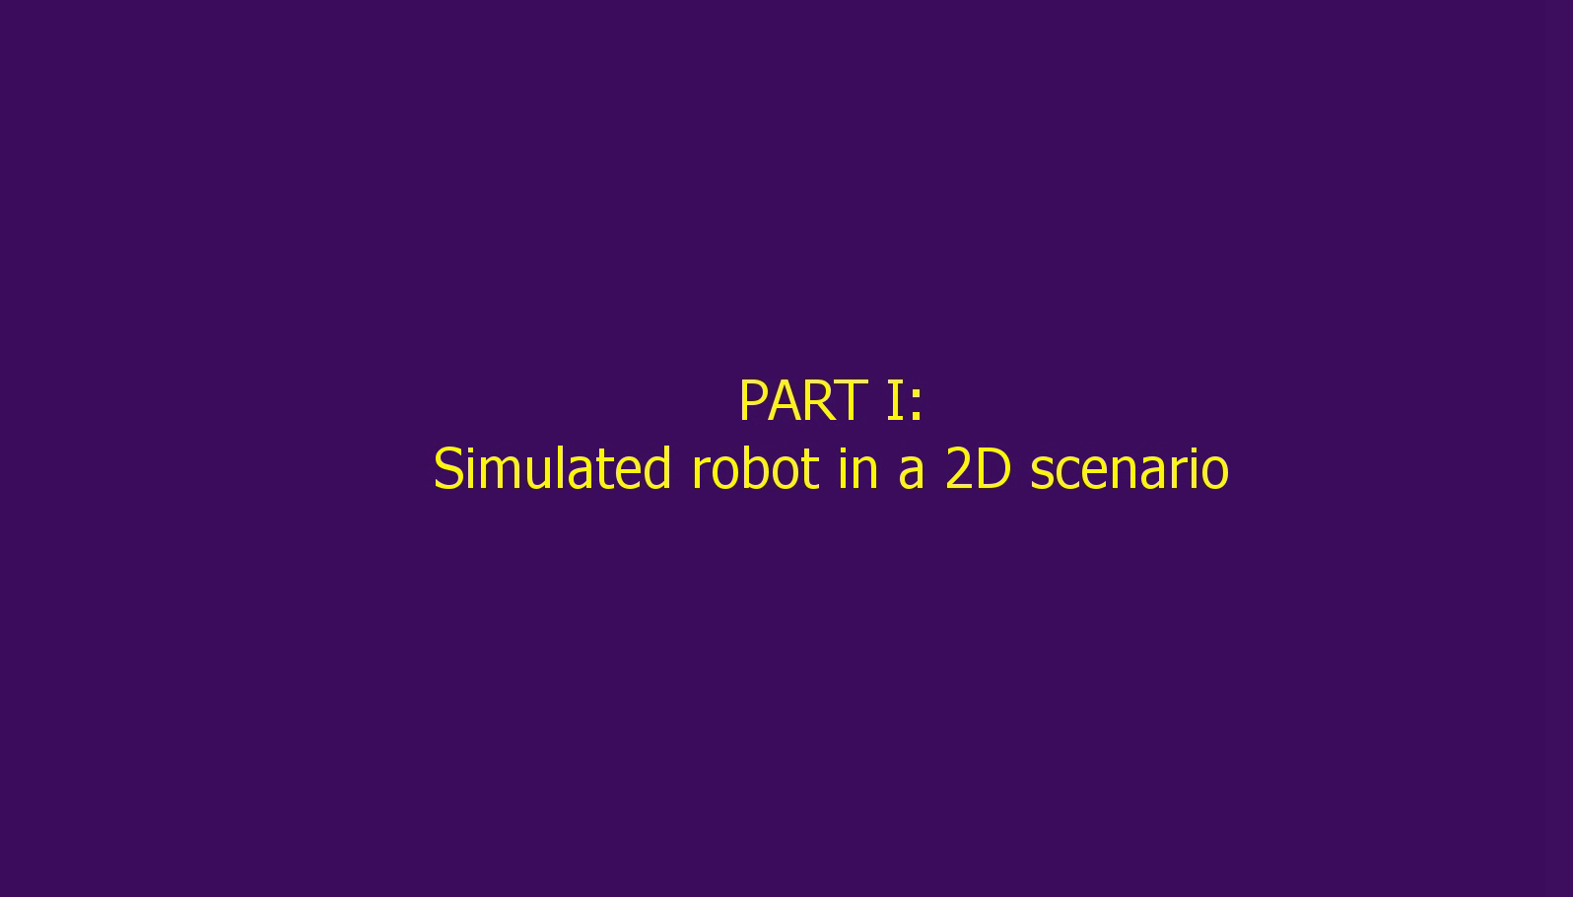
4.2. Experiments: simulations
One experiment instance:

Slide 34
Outline of the talk
1. RO-SLAM: the RBPF approach
2. Map update
3. Observation model
4. Experiments
5. Conclusions

Slide 35
5. Conclusions
We have presented a consistent probabilistic
framework for Bayesian RO-SLAM.
The density representations adapt dynamically.
Tested with real UWB sensors.
Much more efficient than the Monte-Carlo method:
allows 3D beacon estimations in real-time.
Robust to large noise and outliers.

Slide 36
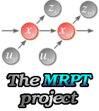
Final remarks
Source code (C++ libs), datasets, slides and instructions to reproduce the experiments available online:
The Mobile Robot Programming Toolkit:
http://mrpt.sourceforge.net/
papers
IROS 08

Slide 37
Dpt. of System Engineering
and Automation
University of Málaga
(Spain)
Efficient Probabilistic Range-Only SLAM
Jose-Luis Blanco, Juan-Antonio Fernández-Madrigal, Javier González
Thanks for your attention!

