Slide 1
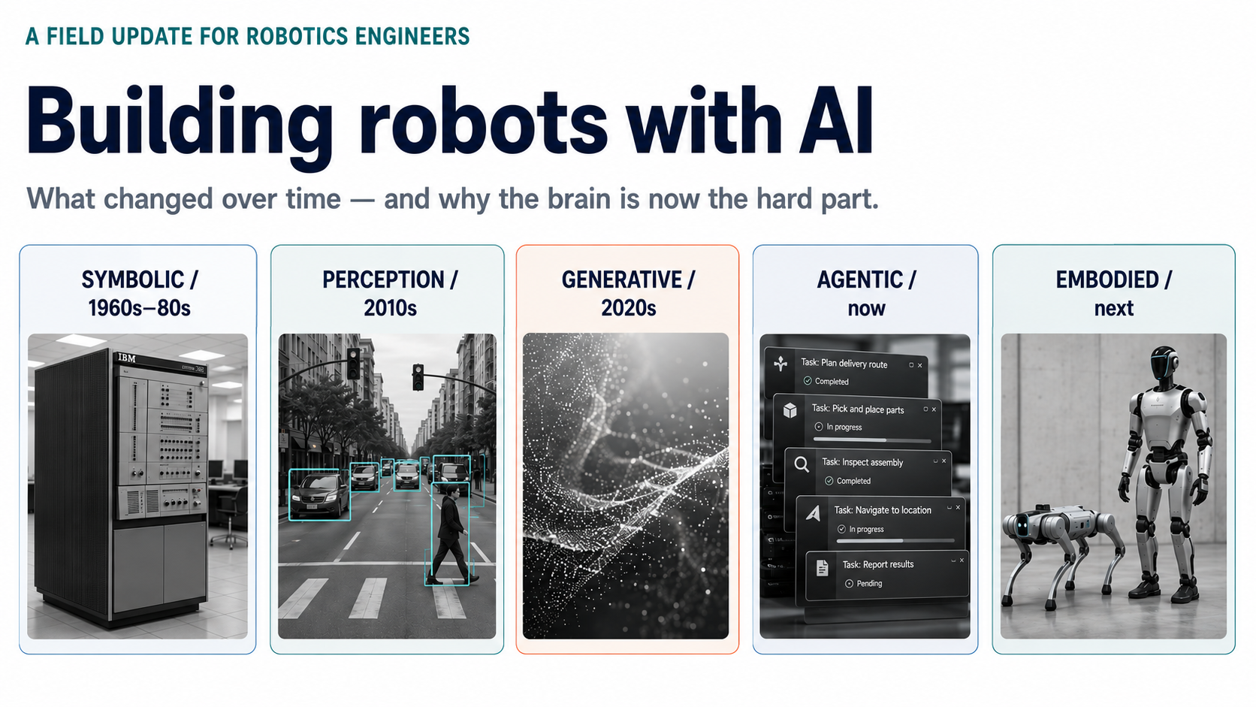
Notes:
Cover. The eyebrow line in the source image is masked with a white block.

Slide 2
WHERE THIS STARTED
Six eras, and what each one unlocked
1920s–40s
The idea
Čapek names it from robota, forced labour; cybernetics gives machines feedback.
1954–70s
The arm
Unimate at a GM plant: one motion, repeated, in a jig that never moves.
1966–72
The first thinker
SRI's Shakey plans multi-step tasks — and still cannot pick up a mug.
1986–2000s
Sense and react
Subsumption, then SLAM: robots that cope with a world they did not model.
2005–15
Autonomy at scale
DARPA Grand Challenge, ROS, and deep learning finally cracks vision.
2022–
Instructable robots
Foundation models arrive already knowing the world; you speak to them.
Task planning got a body in 1972. Seeing and handling took another forty years — that is the whole story.

Slide 3
WHAT ACTUALLY MOVED IT
Eight techniques, still all in use
Feedback control
1950s
Teach and repeat
1960s
PID holds a joint where you put it. The bottom layer of every robot ever built.
Record a trajectory, play it back. Exact, cheap, and helpless if anything moves.
Planning and search
1970s–90s
Probabilistic estimation
1986–2000s
STRIPS and A*, later RRT: reasoning about actions, then routes through clutter.
Kalman filters and SLAM. The robot finally knows where it is without being told.
Open middleware
2007
Deep learning for vision
2012
ROS makes drivers, planners and tools reusable across labs instead of rewritten.
Perception starts working — the seeing half of the problem, a decade before genAI.
Learned control
2013–
Simulation at GPU scale
2017–
Reinforcement and imitation learning: policies trained from data, not written.
Domain randomisation and parallel physics: training data without buying hardware.
Embodied AI is the ninth layer, not a replacement for the other eight. PID still holds the joint, SLAM still says where the robot is, ROS still moves the messages — the new model only decides what to do next.

Slide 4
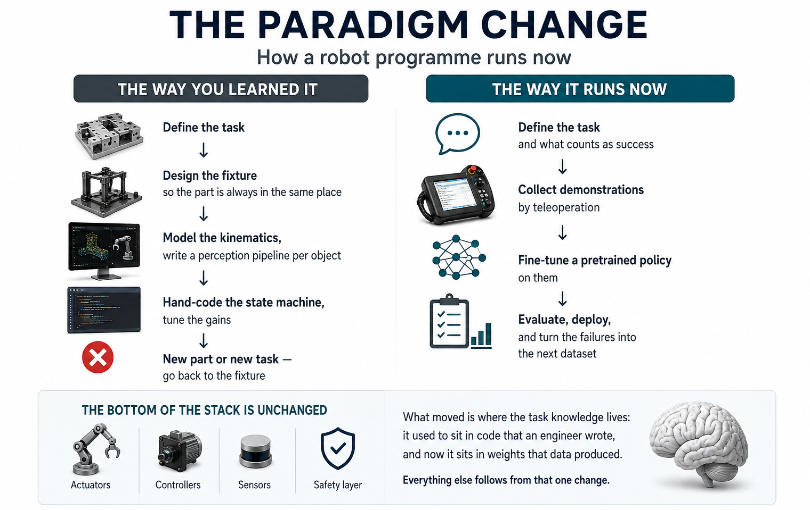
Notes:
Full-page infographic version of the paradigm-change slide.

Slide 5
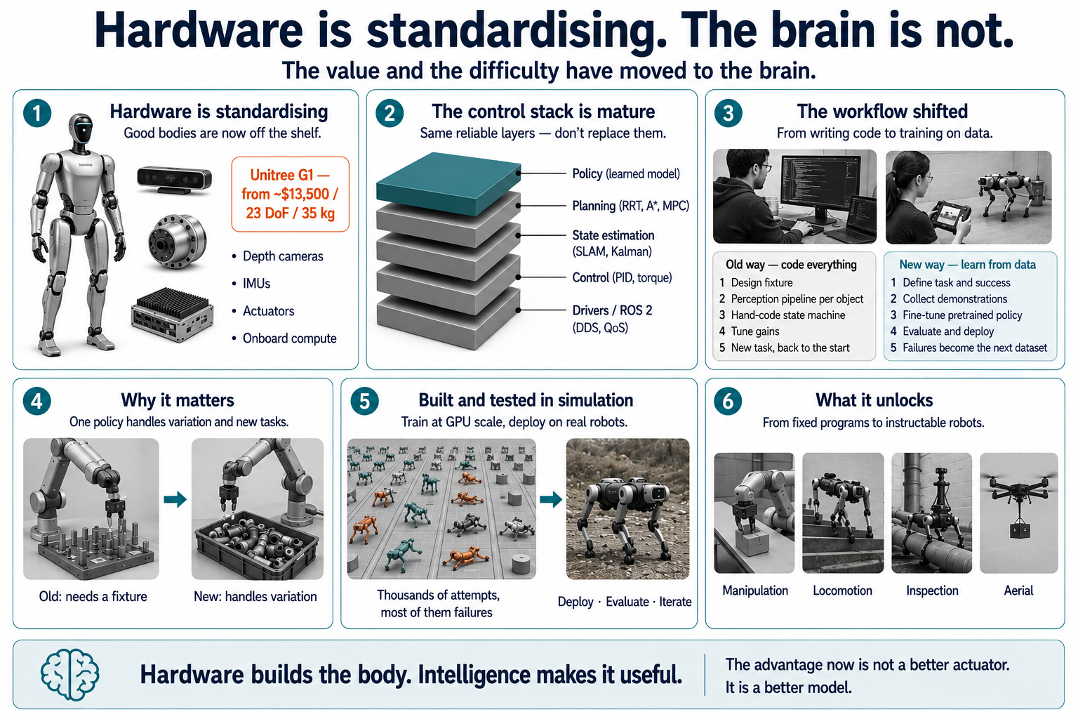
Notes:
Hardware is standardising. The brain is not.

Slide 6
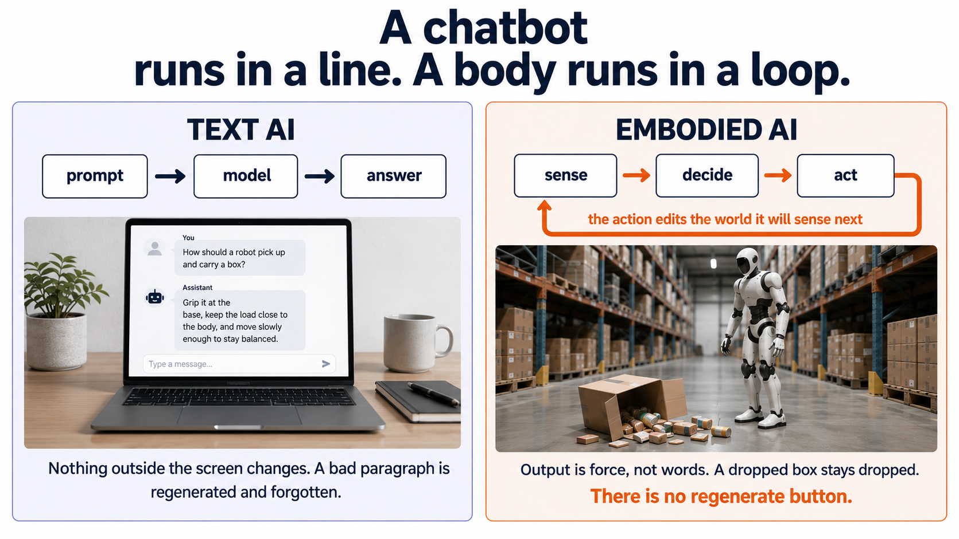
Notes:
A chatbot runs in a line. A body runs in a loop.

Slide 7
ONE TRIP AROUND THE LOOP
What happens on every pass
SENSORS
PERCEPTION
STATE
POLICY
ACTUATORS
cameras, lidar,
microphones, touch
raw signal becomes
a usable picture
what is true now,
and a moment ago
the decision-maker:
what do I do next?
motors, wheels,
brakes, grippers
the loop closes here — what the robot did decides what it will see next
Only one box is being replaced
How fast the loop runs
Drivers, state estimation and low-level control stay classical. What foundation models change is the policy — and, increasingly, perception folded into it.
A driving stack closes it 10–50 times a second. A walking robot's balance controller closer to 1,000 — late is the same as wrong.

Slide 8
WHY IT IS HARD — 1 OF 4
The easy things turned out to be the hard things
EASY FOR COMPUTERS
EASY FOR PEOPLE
• Winning at chess
• Integrating a function
• Passing a bar exam
• Recalling a million facts
• Picking a towel off a cluttered table
• Walking over gravel
• Opening a door with full hands
• Catching a glass before it lands
100s of millions
5,000
Moravec's paradox: the skills that feel effortless to us have the most machinery underneath — so they have the most to rebuild.
of years of evolution behind perception and dexterity
years behind arithmetic and logic

Slide 9
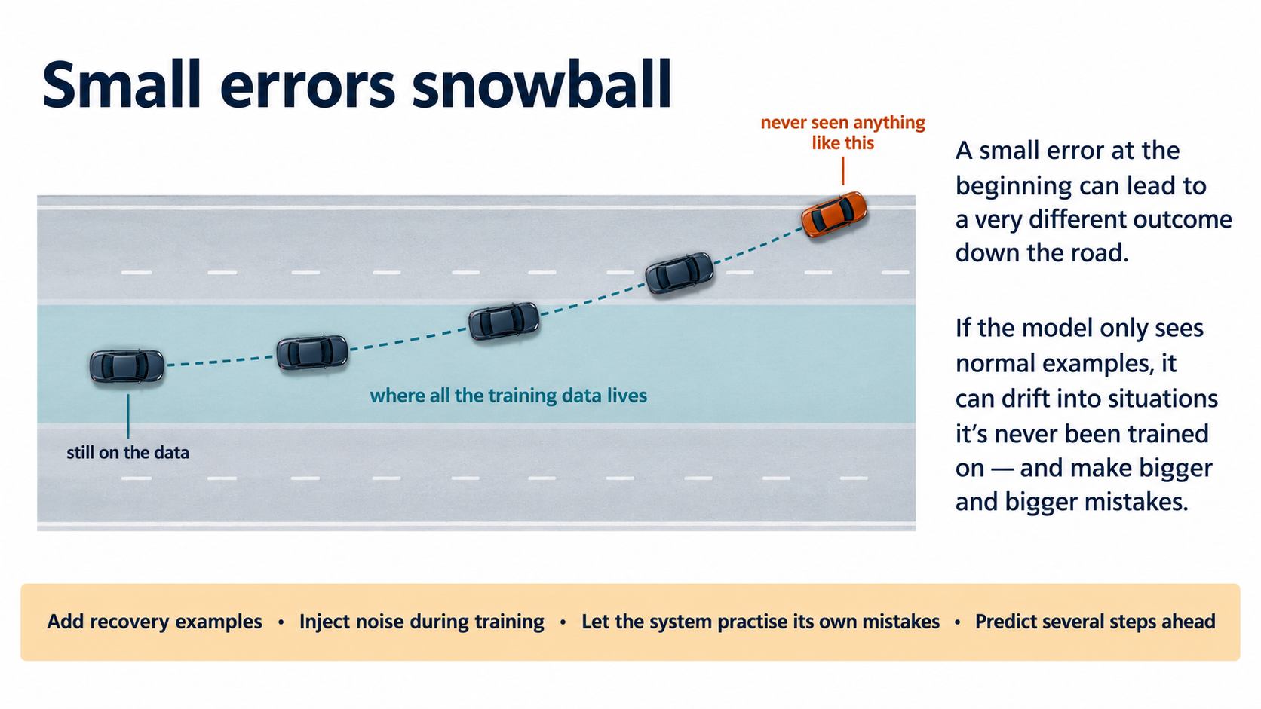
Notes:
Small errors snowball.

Slide 10
WHY IT IS HARD — 3 OF 4
99% reliable is a failing grade
Ten broken items a day is not a product.
Every extra nine costs about as much effort as all the nines before it — and there is no natural stopping point.
THE LONG TAIL
A wet floor. A child's balloon. Low sun through fog. Each is rare. Together they are constant.

Slide 11
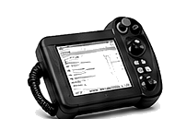
WHY IT IS HARD — 4 OF 4
There is no internet of robot data
Text is free and infinite
Robot data is hand-made
The web is a warehouse of language somebody else already paid to write.
Someone teleoperates a real machine, hour by hour. Data is a real moat in robotics, and not in text.
SIMULATION
THE REALITY GAP
REALITY
perfect in sim,
fails on the machine
cheap, safe, repeatable, infinite
friction, squish, glare, wear
The standard fix — domain randomisation: train across thousands of slightly wrong physics settings, so reality looks like one more variation the system already handled.

Slide 12
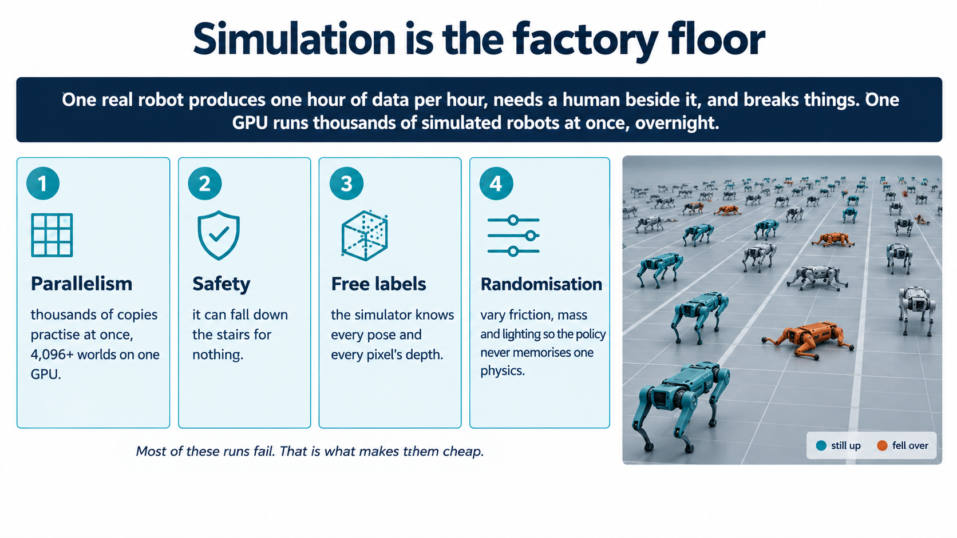
Notes:
Simulation is the factory floor.

Slide 13
THE TOOLS PEOPLE ACTUALLY USE
The simulation landscape
MuJoCo
Isaac Sim
Isaac Lab
physics engine · open, Apache 2.0
full simulator · NVIDIA
learning framework, not a simulator
DeepMind's contact-rich workhorse and the academic default. Easy to install, gold standard for grasping. MJX is the JAX rewrite that runs it on GPU.
Built on Omniverse with PhysX 5 and RTX rendering. Photoreal cameras, lidar and depth, aimed at synthetic data and digital twins as much as control.
Sits on Isaac Sim and holds the reinforcement-learning workflow. Replaces the deprecated Isaac Gym and Orbit — don't start new work on those.
Omniverse + OpenUSD
Newton
Also in use
scene layer · NVIDIA
new open engine
the rest of the field
Not a physics engine: the format where robots, rooms, sensors and materials live, so scenes move between tools instead of being rebuilt.
GPU-accelerated and differentiable, built on Warp with a MuJoCo Warp backend. Jointly built by NVIDIA, Google DeepMind and Disney Research.
Genesis for speed, Robosuite and MuJoCo Playground for benchmarks, Gazebo and PyBullet in older stacks, Drake for control theory.
Rule of thumb: MuJoCo to prototype and to evaluate, Isaac Lab when you need thousands of parallel worlds and photoreal sensors.

Slide 14
THE TREND
Where simulation is heading
01
GPU-parallel is the baseline
Running one world at a time is now only for prototyping. Every serious training stack simulates thousands of worlds at once, and the engines are being rewritten to make that the default rather than a feature.
02
Consolidation on shared standards
Growing convergence on shared scene standards and GPU-accelerated physics — OpenUSD, and now Newton. That NVIDIA, DeepMind and Disney fund it jointly says the industry would rather share a physics layer than each maintain its own.
03
The simulator becomes a data factory
The output people want is no longer a demo but a dataset. Digital twins get reconstructed from scans, then varied endlessly. NVIDIA reports its synthetic-motion pipeline cut generation from months to about 36 hours.
04
Learned simulators start eating the edges
World models now generate interactive scenes directly from video. A 2026 survey of 200 systems finds they already substitute for hand-built simulators in narrow cases, but still lose on guaranteed physics and long-horizon consistency.

Slide 15
THE OTHER HALF OF THE STACK
ROS — the plumbing between model and machine
camera driver
lidar driver
the learned policy
planner: Nav2, MoveIt
ROS 2 message bus — topics, services and actions over DDS
ros2_control → joints
base / wheel driver
gripper driver
rosbag · rviz
What it actually is
What you get for free
Where it stops
Not an operating system. A message bus plus a package ecosystem: one program publishes a topic, others subscribe, and nobody needs to know who is listening.
Drivers for most sensors and arms, MoveIt for motion planning, Nav2 for navigation, ros2_control for joints, rviz to see what the robot thinks, rosbag to replay a failure.
The fast loop usually runs outside it — a 100 Hz policy will not wait on middleware. Several humanoid stacks use almost none of ROS, keeping it for hardware I/O and logging.
ROS 1 is over: Noetic hit end of life in May 2025. ROS 2 only — Jazzy is LTS, supported to 2029.

Slide 16
HOW THESE SYSTEMS GET BUILT
Three approaches, roughly in historical order
Hand-built
pipeline
sense
detect
predict
plan
track
Every box written and tuned by engineers. Inspectable — and brittle: each new situation needs a new rule.
End-to-end
policy
sense
one big learned network
act
Learned from demonstrations or trial and error. Handles mess nobody wrote a rule for — but it is opaque and data-hungry.
Vision-language-
action
camera + instruction
pretrained model
motor commands
Starts from a model already trained on internet images and text, then taught to output motion. It already knows what a mug is.
Approach 3 is where the frontier is — and it is why generative AI and robotics stopped being separate conversations.

Slide 17
HOW THE BRANCHES RELATE
Three jobs, not three technologies
READ IT AS ROLES
THE OVERLAPS
Perceptual: world → understanding
Generative: understanding → content
Embodied: understanding → action
Most systems do more than one, which is why the circles overlap.
PERCEPTUAL
vision · speech
multimodal
GENERATIVE
text · images
Multimodal — sees, then describes: captioning, visual Q&A
Robot sensing — perceive well enough to control safely
World models — generation aimed at the physical world
VLA models — all three at once, the current frontier
VLA
models
robot
sensing
world
models
EMBODIED
robots · cars · drones

Slide 18
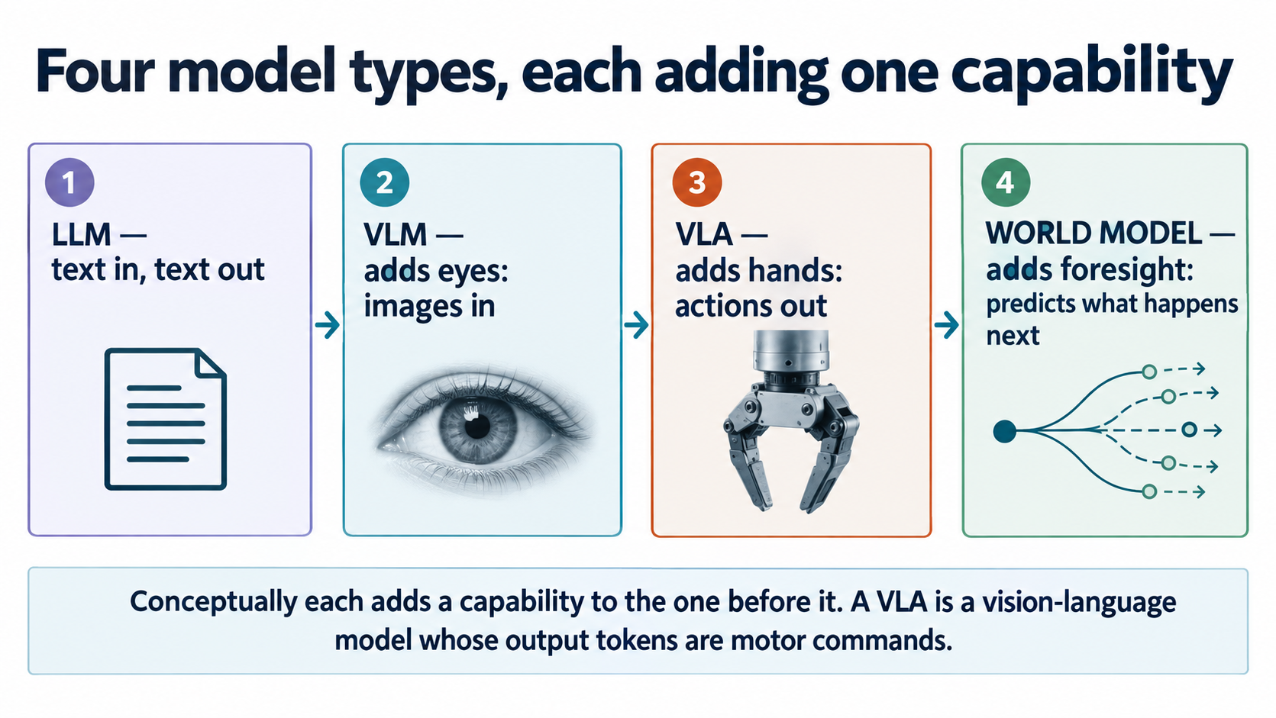
Notes:
Four model types, each adding one capability.

Slide 19
THE MODEL FAMILY — 1 OF 4
LLM — the reasoning backbone
text: an instruction,
a question, a document
LLM
text: an answer,
a plan, some code
what goes in
what comes out
What it adds
Where it stops
Where you meet it
Language. It can break “tidy the kitchen” into steps, argue about which order they go in, and write code to call a robot's existing skills.
It has never seen the kitchen. With no eyes it cannot tell whether the mug is where it assumed, so its plan is only as good as whatever description it was handed.
As the high-level planner sitting above a robot stack, and as the backbone every other model on the next three slides is built from.
Examples: the GPT, Claude and Gemini families — general-purpose models, used in robotics as planners rather than controllers.

Slide 20
THE MODEL FAMILY — 2 OF 4
VLM — the model that can see
images or video,
plus text
VLM
text: a description,
an answer, a plan
what goes in
what comes out
What it adds
Where it stops
Where you meet it
Grounding. It can say what is on the table, roughly where it is, and whether the drawer is open — tying the words to the actual scene in front of the robot.
The output is still language. It can tell you the mug is left of the kettle; it cannot move an arm 12 centimetres to reach it.
As an increasingly common perception-and-reasoning component in modern robot policies, and on its own for inspection and visual question answering.
Examples: Gemini, GPT and Qwen-VL class models; in robotics, Eagle-style backbones sit frozen inside GR00T, and Gemini Robotics-ER adds spatial reasoning.

Slide 21
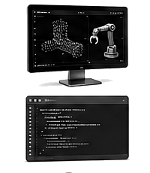
THE MODEL FAMILY — 3 OF 4
VLA — vision, language, action
camera images, an instruction,
and the robot's joint positions
VLA
actions: joint targets
and gripper commands
what goes in
what comes out
What it adds
Where it stops
Where you meet it
The last channel. It keeps the VLM's web knowledge and adds an action head — usually diffusion or flow matching — that emits motion instead of words.
Reliability and speed. A big model cannot think at 100 Hz, so most designs split it: the VLM plans at 5–10 Hz, a small action expert runs at 50–100 Hz.
The leading frontier architecture, and what people mean when they say “robot foundation model.” Production deployment is still early.
Examples: RT-2 coined the term in 2023 · OpenVLA put an open 7B model in every lab · π0 and π0.5 · NVIDIA GR00T N1.x · Gemini Robotics · Figure's Helix · SmolVLA for consumer hardware.

Slide 22
THE MODEL FAMILY — 4 OF 4
World model — imagine first, then act
reach across the top
imagined outcome:
knocks the glass
what I see now
grip and lift straight
imagined outcome:
works
pick this one
push it to the edge
imagined outcome:
falls off
It learns to predict what would happen if it acted — imagination, used to check a plan before spending a real action on it, and to generate training data.
Examples: NVIDIA Cosmos world foundation models · DeepMind Genie 3, interactive 3D scenes from a prompt · JEPA-style predictors · 1X's in-house world model.

Slide 23
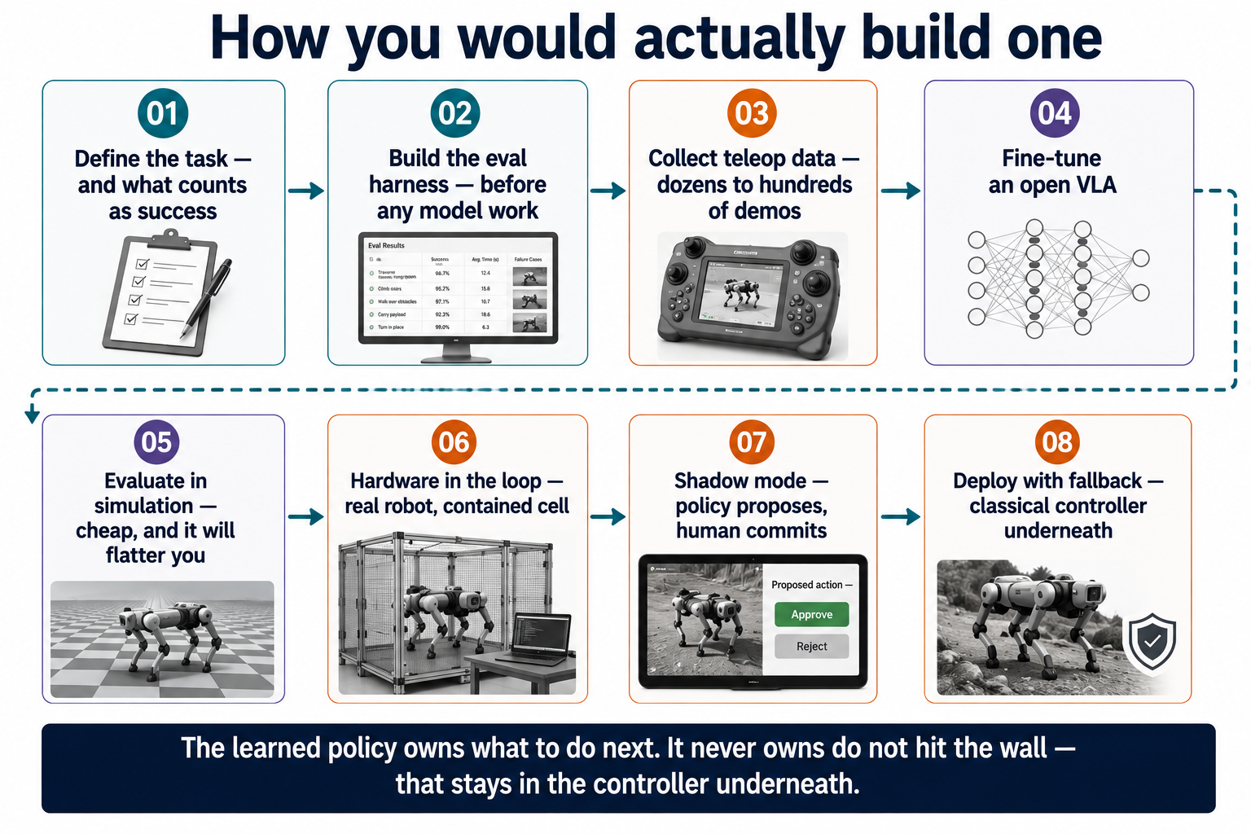
Notes:
How you would actually build one.

Slide 24
WHO IS BUILDING THIS — THE BRAINS
Model labs and the platform underneath
Google DeepMind
NVIDIA
Founded 2010 · London, UK · part of Alphabet
Founded 1993 · US · public, 30,000+ staff
Frontier AI research; robotics is one arm of it. Ships the Gemini Robotics family, including a version small enough to run on the robot. Partnered with Boston Dynamics in 2026 to put it on Atlas and Spot.
Sells the ground everyone else stands on: GPUs, Isaac Sim and Isaac Lab, and models. GR00T N1 in March 2025 was the first open foundation model for humanoids; Cosmos does the world-model half.
Physical Intelligence
Skild AI
Founded 2024 · San Francisco · ~$400M raised
Founded 2023 · Pittsburgh, US · ~$1.4B raised
Sells the brain and no body. The π0 and π0.5 models are partly open and have become the default baseline other labs compare against.
Chasing an “omni-bodied” model meant to drive any robot. One of the largest rounds in the category, led by SoftBank — with public deployment evidence still thinner than the funding.
The structural split: some sell the body, some sell the brain — and one company sells the ground both stand on.

Slide 25
WHO IS BUILDING THIS — THE BODIES, US
American humanoid makers
Boston Dynamics
Figure AI
Founded 1992 · Waltham, US · Hyundai-owned
Founded 2022 · San Jose, US · ~$39B valuation
The oldest name here, out of MIT. Spent three decades setting the hardware benchmark with Atlas and Spot, and has now handed the thinking half to DeepMind's models.
The best-funded pure-play in the field. Builds both the body and the Helix model that drives it, and runs a pilot on a BMW line. In June 2026 it reported more robots operating than employees.
Agility Robotics
Apptronik
Founded 2015 · Oregon, US · $641M+ raised, SPAC
Founded 2016 · Austin, US · $935M+ at ~$5.5B
Digit is the least humanoid-looking robot here and the furthest along in paid work: warehouse deployments with real customers and reported contracted orders above $300M.
Out of a University of Texas lab. Apollo is aimed at manufacturing and logistics, sold as a service, with Mercedes-Benz and GXO as named partners, and runs Gemini Robotics on-device.
Also American: Tesla (Optimus, founded 2003) and 1X (NEO, founded 2014 in Norway, now largely US-based).

Slide 26
WHO IS BUILDING THIS — THE BODIES, ASIA AND EUROPE
Where the units are actually shipping
Unitree
AgiBot
Founded 2016 · Hangzhou, China · ~$5.9B IPO
Founded 2023 · Shanghai, China · CATL-backed
Sets the price floor for the whole industry: the G1 base price has fallen to around $13,500. Quadrupeds first, humanoids now, and roughly 5,000 units shipped in 2025.
The volume leader: about 5,100 units shipped in 2025 and its 10,000th humanoid produced by March 2026. Also publishes the AgiBot World dataset, which other labs train on.
UBTech
NEURA Robotics
Founded 2012 · Shenzhen, China · HK-listed
Founded 2019 · Germany · up to $1.4B at ~$7B
Walker S2 works in electric-vehicle plants. Unusually candid about the limits — the company has described the robots as no more than half as efficient as a human worker.
Europe's standard-bearer, and suddenly far ahead of other European startups on funding. Strong industrial demand behind it, with less public manufacturing proof than the Chinese makers.
Also here: Fourier and Galbot in China, Toyota Research Institute in Japan and the US, Sanctuary AI in Canada.

Slide 27
THE MAP
Which countries lead, and at what
China
volume and price
Most companies, most units: Unitree and AgiBot are ~80% of shipments.
United States
capital and models
Largest valuations, nearly all the model labs. Autonomy over unit count.
Germany · Europe
industrial demand
Smaller funding, serious factory demand. NEURA leads; the UK has DeepMind.
Japan
parts and ownership
At least 45 companies across 9 countries; the split is directional, not a census.
Actuators, sensors, factories. Hyundai owns Boston Dynamics.
North America took 58.7% of 2026 physical-AI venture dollars.

Slide 28
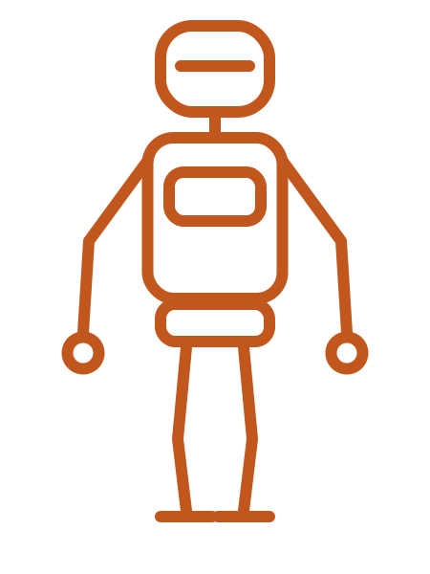
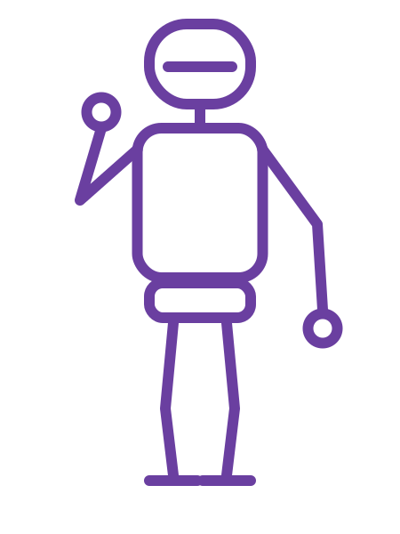
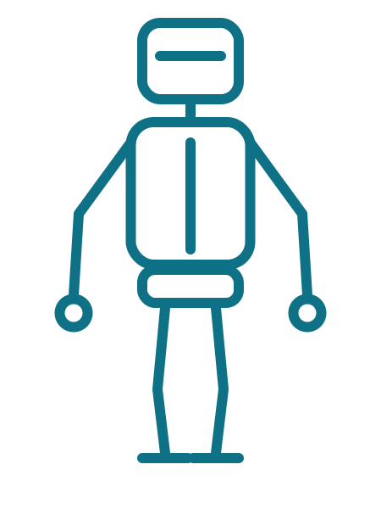
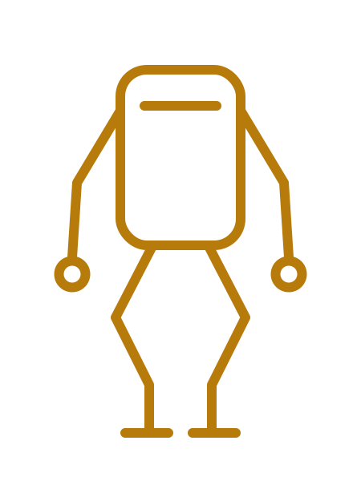
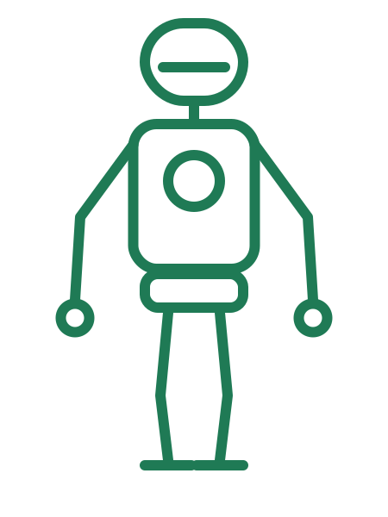
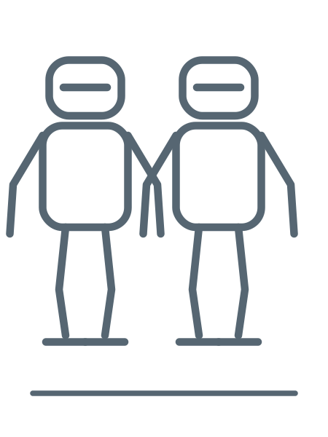
WHAT IS ACTUALLY DEPLOYED
Robots running on these models
Figure 02
Atlas
Optimus
Helix, in-house VLA
Gemini Robotics
in-house VLA
Builds the body and the model. Reported more robots running than employees in 2026.
Hardware from Boston Dynamics, brain from DeepMind — the clearest split of the two.
Architecture descends from the driving stack: camera in, joint commands out.
Digit
Apollo
Unitree G1 · AgiBot
in-house policies
Gemini Robotics On-Device
open and in-house models
The least humanoid-looking here, and furthest along in paid warehouse work.
Automotive work; the on-device model runs locally and learns from ~50 demos.
Volume manufacturing and open datasets. AgiBot passed 10,000 humanoids in 2026.
Read this with the evidence ladder in mind: almost all of it is pilots and early paid deployments.

Slide 29
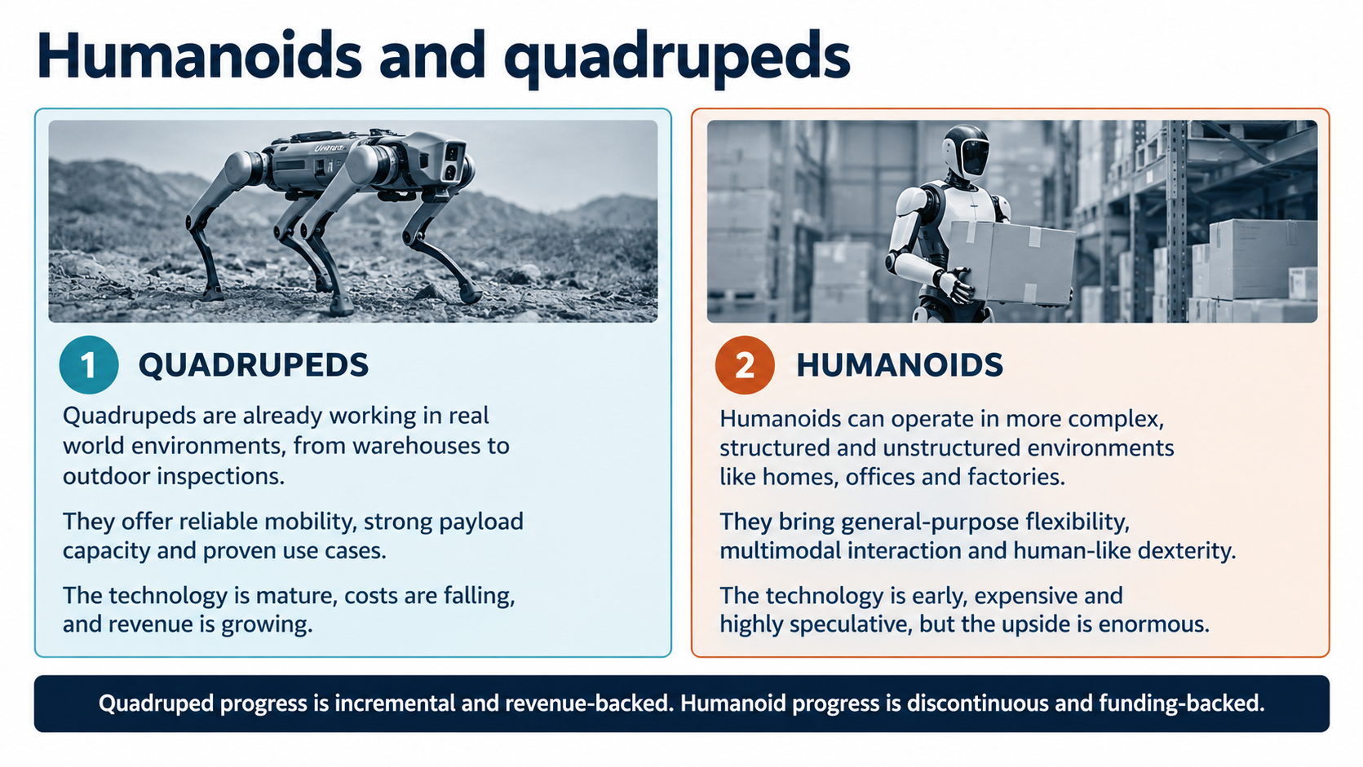
Notes:
Humanoids and quadrupeds.

Slide 30
OPEN PROBLEMS
The frontiers — what is actually unsolved
Hands and touch
Cross-embodiment
Long-horizon autonomy
Legs are close to solved; hands are not. Dexterous manipulation needs tactile sensing that is still expensive, fragile and thinly covered by data.
One model, many bodies. Transferring a policy between robots with different arms and joint counts still costs far more retraining than the pitch suggests.
Most demos are seconds long. Tasks that run for minutes need memory, failure recovery and the judgement to notice that something has already gone wrong.
Evaluation
Learned simulators
Latency, watts, cost
There is no agreed benchmark. Success rates are reported on private task sets, so numbers between labs rarely compare, and simulation scores overstate real performance.
Can a world model replace a physics engine? Today it substitutes in narrow cases but cannot guarantee physical law or stay consistent over long rollouts.
A policy has to run onboard at 50–100 Hz inside a power budget, and the whole thing has to beat the cost of the person currently doing the job.
Only two of these are model problems. The rest are data, measurement, hardware and economics.

Slide 31
WHERE THE MONEY ACTUALLY IS
Generative AI dominates today
Embodied AI is being funded, not bought.
$47.4bn
into physical AI in H1 2026 alone — about 4× the previous half-year
65%
of organisations already use generative AI in at least one function
The gap in one line
Roughly 60× apart. Estimates vary widely by research firm — read the ratio, not the digits.
It is raising far more than it sells — a bet on the next decade, not a description of this one.
Sources: IDC, Menlo Ventures, McKinsey, MarketsandMarkets, Crunchbase (2025–26).

Slide 32
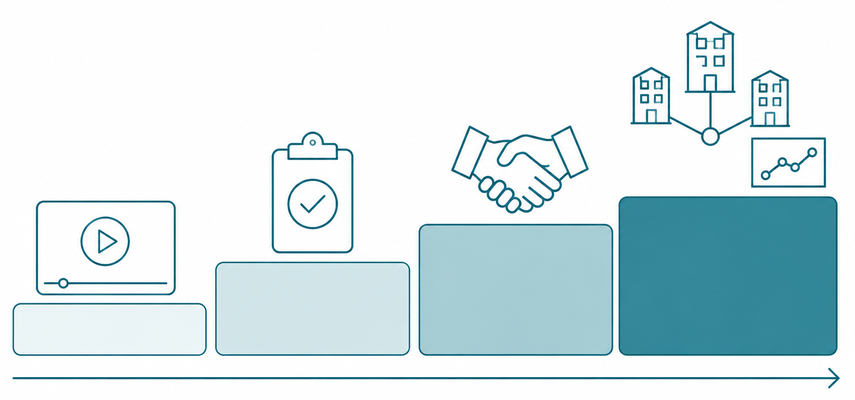
WHERE THINGS ACTUALLY STAND — 2026
Rank the evidence before you believe the demo
Demos are cheap. The last stretch of reliability is not.
THE HONEST SUMMARY
What holds deployment back is not missing ideas. It is the final few percent of reliability, safety validation, and the lab-to-field gap.
• Architecture looks settled: pixels plus an instruction, actions out.
• Deployments cluster where failure is tolerable — plants, warehouses.
• Humanoids are mostly pilots. No home robot.
• Reliable unattended autonomy: around 2028–2030.
Vendor video
Controlled pilot
Paid deployment
Multi-site running
weakest → strongest evidence

Slide 33
WHY THIS MATTERS TO THIS ROOM
Where your edge actually is
IN LLM AND AGENT WORK
IN EMBODIED AI
You enter the largest and most crowded talent market in software, and almost nothing you learned about machines counts there. Kinematics, calibration, latency budgets, safety cases — none of it is priced in.
The work is also crowded and largely settled: the architectures are known, the leaders have the compute, and the differentiation is in product, not in engineering.
What does transfer is the loop intuition. Agents suffer the same compounding-error problem — they just get to undo their mistakes.
The bottleneck is increasingly data, evaluation and reliability rather than model quality — teleoperation rigs, demonstration quality, system identification, latency budgets, safety cases, honest test protocols.
That list is a description of a robotics engineer. The people flooding into AI cannot do any of it, and the field cannot ship without it.
And it is early: capital has arrived, revenue has not, and no standard for evaluation exists yet. Early is where a scarce skill is worth the most.
This is not “ignore generative AI.” A VLA is a generative model — you have to learn transformers, fine-tuning and flow matching either way. It is about where you point them: at a chatbot, where you are one of a million, or at a body, where you are one of very few.

Slide 34
WHAT TO ACTUALLY DO
Four steps, in this order
Get a simulator running this week
01
MuJoCo installs with pip and MuJoCo Playground gives you tasks to run the same afternoon. Move to Isaac Lab only when you need thousands of parallel worlds or photoreal sensors — not before.
Run an open VLA end to end
02
LeRobot with SmolVLA fits on a consumer GPU; OpenVLA, π0 or GR00T if you have more compute. Fine-tune it on a small dataset. The point is to feel how much data a single new task costs.
Collect a hundred demonstrations yourself
03
Teleoperate a low-cost arm, or a simulated one. How many you need swings by orders of magnitude with task complexity. Nothing else teaches as fast that data quality dominates model choice, and that this is where the real hours go.
Build the evaluation harness first
04
Fixed task list, fixed trial count, randomised initial states, interventions counted. It is the scarcest artefact in the field and the only way to know whether anything you did worked.
Also worth an hour: read the Open X-Embodiment and AgiBot World dataset cards, to see what real robot data actually looks like.

Slide 35
HOW TO ANTICIPATE WHAT HAPPENS NEXT
Signals worth tracking, and noise
LEADING INDICATORS
NOISE
• Intervention rate and uptime, per site, over months
• Cost per robot-hour against the wage it replaces
• Cross-embodiment: same policy, new body, little retraining
• Hardware price curve — a G1 at $13,500 moves the maths
• Whether an evaluation standard gets adopted across labs
• On-device latency and watts at 50–100 Hz
• Learned simulators reaching production use
• Demo videos, especially cut ones
• Valuations and round sizes
• Unit shipment counts with no utilisation figure attached
• Teleoperated demonstrations presented as autonomy
• Benchmark scores on a task suite the same lab designed
• “AGI for robots” framing, in either direction
The timing question is not when the models get better — they will. It is when the last few percent of reliability arrives, and the honest signals above are the only ones that measure it.

Slide 36
Four things to carry away
01
The loop is the whole difference
Output is force, not words. What the system does decides what it sees next, so errors compound instead of being regenerated.
02
Embodied sits on top of generative
Not a rival wave, the hardest layer of the same stack. Learn the models — then point them at a body rather than a chat window.
03
The bottleneck is your field, not theirs
Data, evaluation and reliability decide when this ships. That is robotics work, and the people arriving from AI cannot do it.
04
Judge by deployments, not demos — including your own
Working once is not working. Build the harness, count the interventions, and be early where being early still pays.

