Slide 1
Analysis for papers relating sentiment categorization
-- Sentiment Computing of Internet Text course presentation
Jerry Yang

Slide 2
Selected papers
Thumbs up? Sentiment classification using machine learning techniques. (Bo Pang & Lillian Lee, 2002)
Thumbs up or thumbs down? Semantic orientation applied to unsupervised classification of reviews. (Turney, 2002)
Effective LSTMs for Target-Dependent Sentiment Classification. (Duyu Tang, Bing Qin, Xiaocheng Feng, Ting Liu, 2016)

Slide 3
Content
Looking for The Roots of Sentiment Computing: How did it start?
A Brief Introduction
Effective LSTMs for Target-Dependent Sentiment Classification.

Slide 4
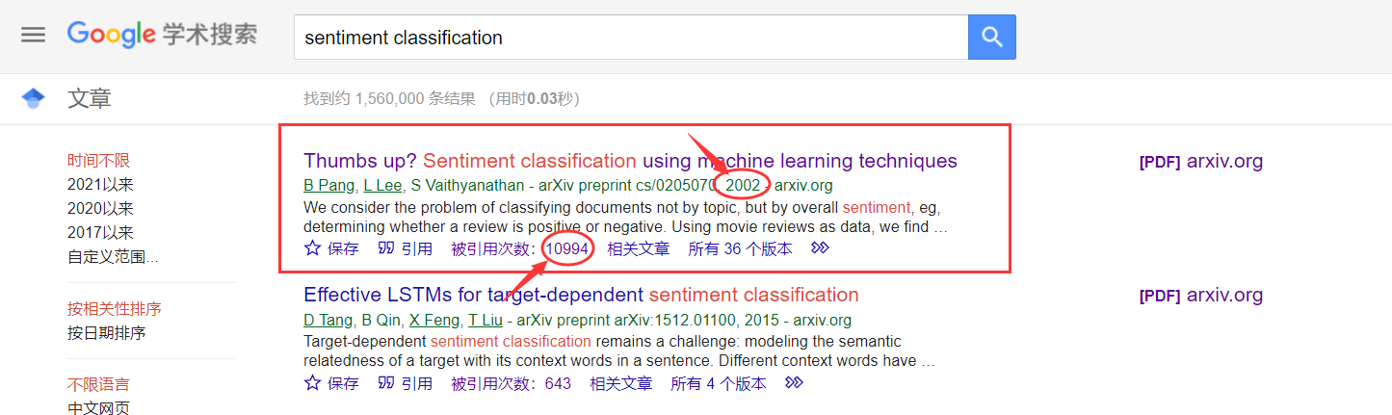
How did sentiment classification start?

Slide 5
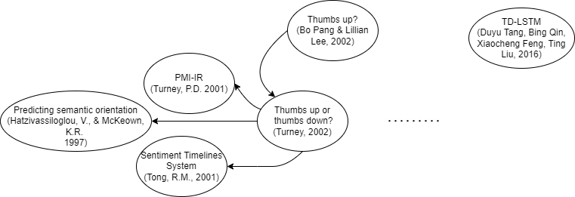
Description about the sources

Slide 6
A Brief Introduction
Thumbs up? (Bo Pang & Lillian Lee, 2002)
Thumbs up or thumbs down? (Turney, 2002)
Target-Dependent LSTM. (Duyu Tang, Bing Qin, Xiaocheng Feng, Ting Liu, 2016)

Slide 7
Thumbs up? (Bo Pang & Lillian Lee, 2002)
Previous work mainly focus on topics categorization
Tried three machine learning models
Verified the differences between topics categorization and sentiment classification
An assumption about next step

Slide 8
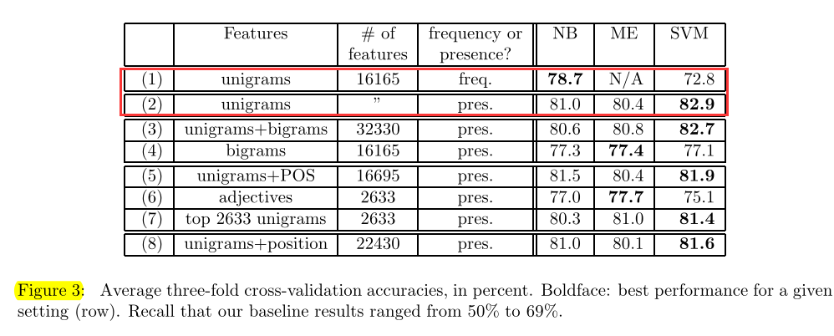
Thumbs up? (Bo Pang & Lillian Lee, 2002)

Slide 9
Thumbs up or thumbs down? (Turney, 2002)
Computing sematic orientation
Mentioned Tong's work
Advantages of their PMI-IR algorithm

Slide 10
Target-Dependent LSTM. (Duyu Tang, Bing Qin, et al., 2016)
Long short-term memory network (LSTM)
Target-dependent LSTM (TD-LSTM)
Target-connection LSTM (TC-LSTM)
Tried attention but not work

Slide 11
Effective LSTMs for Target-Dependent Sentiment Classification.

Slide 12
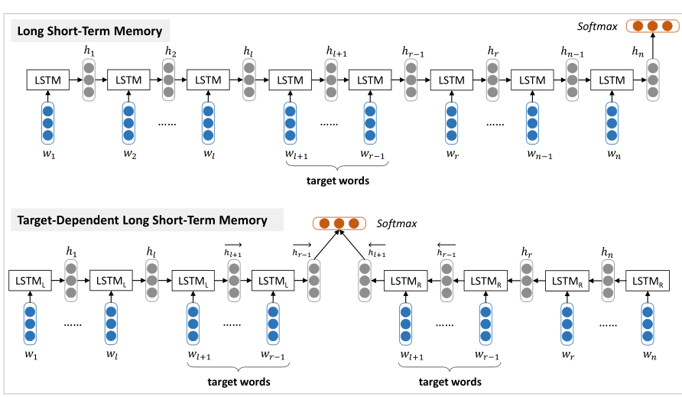
Effective LSTMs for Target-Dependent Sentiment Classification.

Slide 13
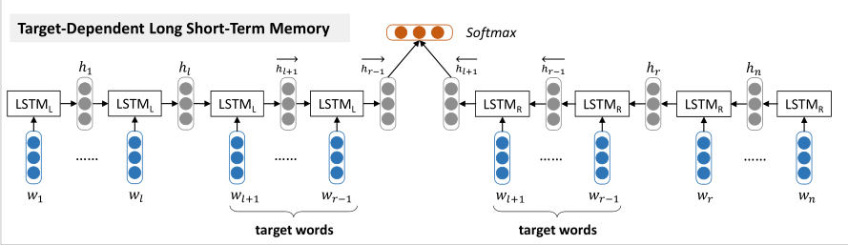
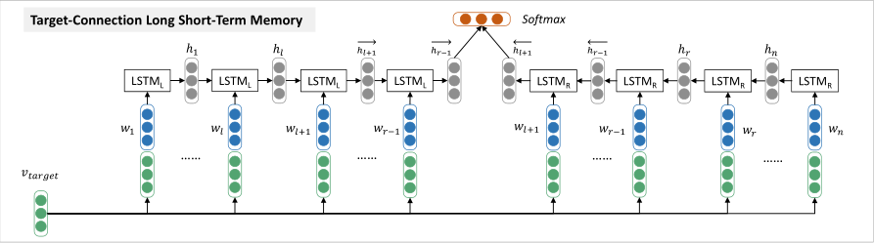

Slide 14
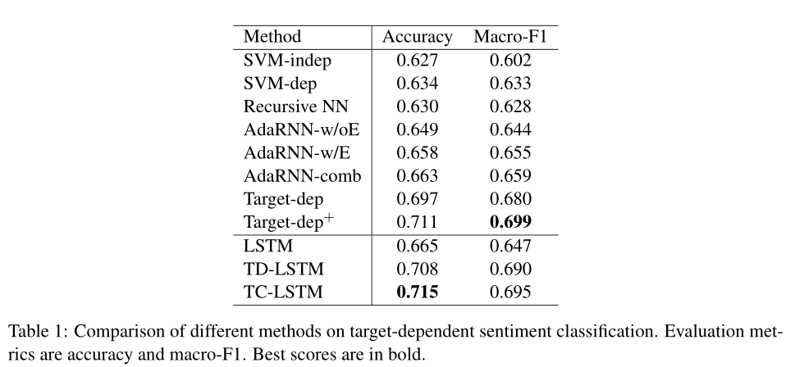
Effective LSTMs for Target-Dependent Sentiment Classification.

Slide 15
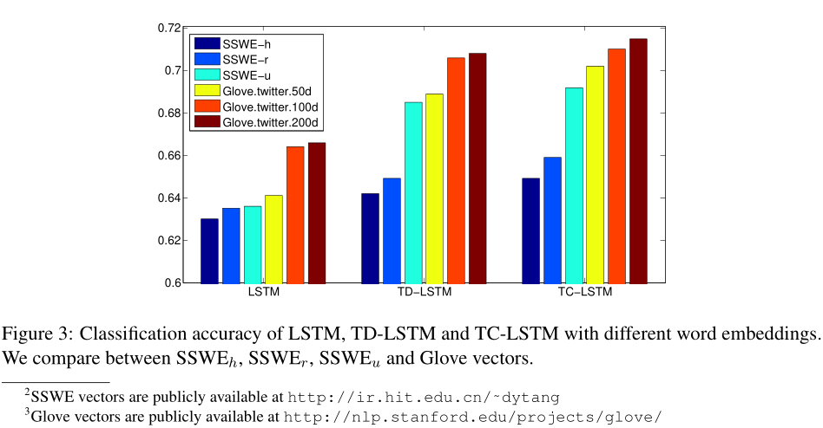
Effective LSTMs for Target-Dependent Sentiment Classification.

Slide 16
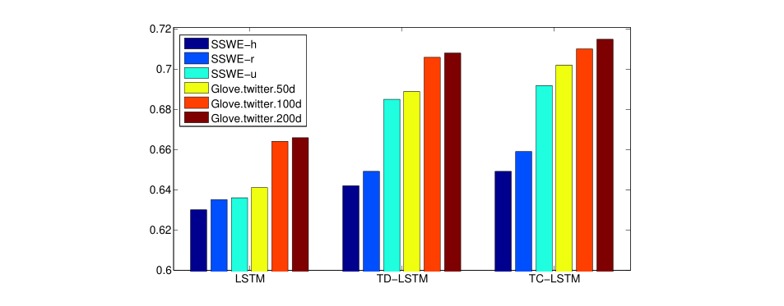
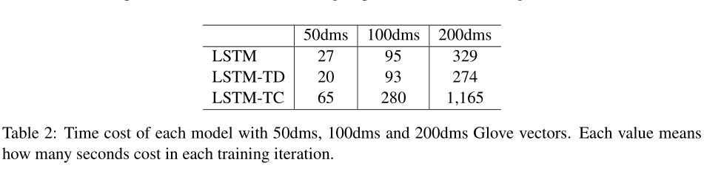

Slide 17
Model structure
network: LSTM * 2 + softmax
parameter: randomize with uniform distribution U(−0.003, 0.003)
optimizer: SGD
learning rate: 0.01
word embedding: 100-dimensional Glove vector from twtter

Slide 18
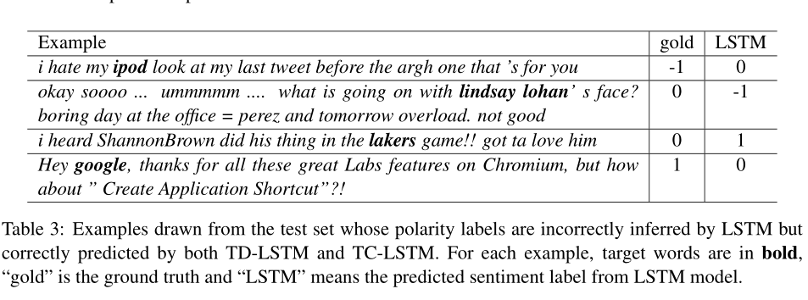
Effective LSTMs for Target-Dependent Sentiment Classification.

Slide 19
Summary
Standard LSTM
Target-dependent LSTM
Target-connection LSTM
Attention not work

Slide 20
References
[Thumbs up? Sentiment Classification using Machine Learning Techniques](https://arxiv.org/pdf/cs/0205070)
[Thumbs Up or Thumbs Down? Semantic Orientation Applied to Unsupervised Classification of Reviews](https://arxiv.org/ftp/cs/papers/0212/0212032.pdf)
[Effective LSTMs for Target-Dependent Sentiment Classification.](https://arxiv.org/pdf/1512.01100)

Slide 21
Thank you!

