Slide 1
Portugal´s Connected Solar Park- Analysis
Data set Overview:
Source: e-redes.opendatasoft.com
The dataset provides details about renewable energy production centers in Portugal, including the following columns:
Ano: The year of operation (2021–2024).
Semestre: The semester (1st or 2nd half of the year).
Concelho: The municipality where the production center is located.
Potência de Ligação (kW): Connection power in kilowatts (likely reflecting the capacity of the solar park).
Pedidos de Ligação à Rede Executados (#): Number of grid connection requests executed (possibly indicating how many systems are connected).

Slide 2
Index:
1.Competitive Landscape Analysis
1.1 Top 10 Municipalities- Installed Solar Capacity
1.2 Bottom 10 Municipalities- Installed Solar Capacity
1.3 Trends- Solar Park Establishment
2.Capacity Benchmarking
2.1 Top 5 Municipalities – Market Share Solar Capacity
2.2 Municipalities – Less than 1% Market Share
3.Partnership Opportunities
3.1 Top Municipalities for BESS Partnerships
3.2 Municipalities with Significant Growth
4.Key Considerations

Slide 3
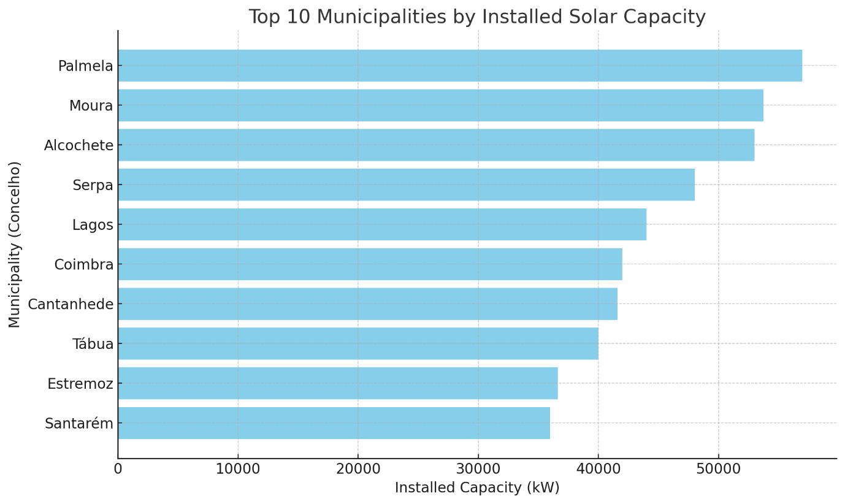
Competitive Landscape Analysis:
1.1 Top 10 Municipalities- Installed Solar Capacity
Competitors by Municipality:
The municipalities with the highest installed solar capacity are Palmela, Moura, Alcochete, Serpa, and Lagos. These regions hold significant solar capacity, which may represent strong competitors in the solar park market.

Slide 4
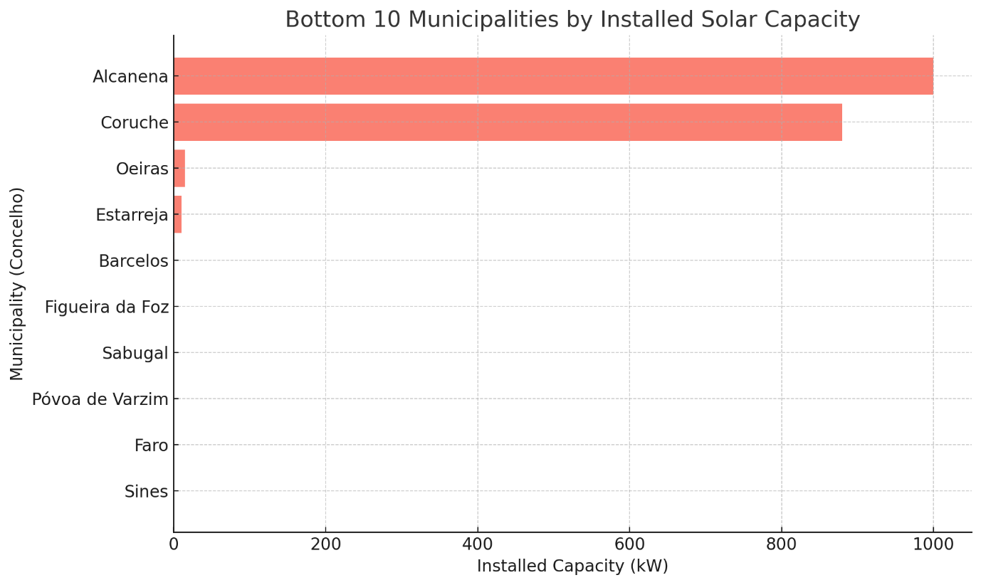
Competitive Landscape Analysis:
1.2 Bottom 10 Municipalities- Installed Solar Capacity
Municipalities with the least installed power:
The municipalities with the least installed solar power capacity include those with minimal or even zero capacity, such as Sines, Faro, Póvoa de Varzim, and Sabugal. The chart also highlights some regions with very low capacity, like Oeiras and Barcelos. These areas could present opportunities for market expansion or partnerships, as they currently have minimal solar infrastructure.

Slide 5
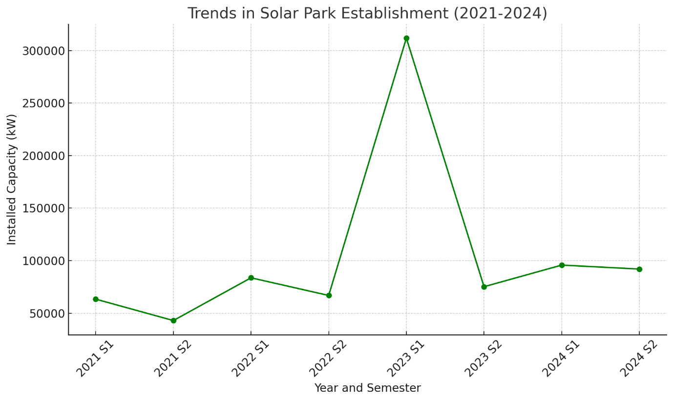
Competitive Landscape Analysis:
1.3 Trends- Solar Park Establishment
Trends in the Establishment of New Solar Parks (2021–2024):
The dataset shows a clear upward trend in solar capacity installations over time. For example:
2021 (1st semester) saw approximately 63.4 MW of new capacity added.
By 2023 (1st semester), there was a sharp increase, with over 311.8 MW of capacity added, indicating accelerated growth in the industry.
This suggests a growing market and possibly increasing competition, but also potential for collaboration in areas with high solar activity.

Slide 6
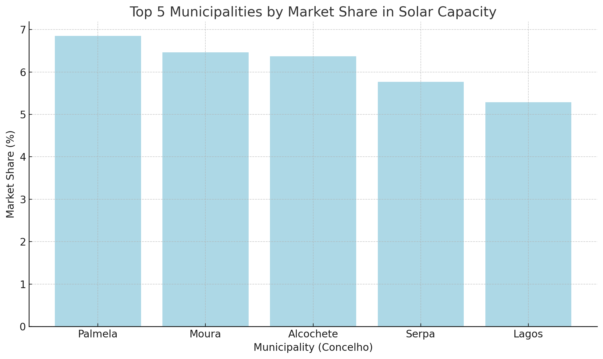
Capacity Benchmarking:
2.1 Top 5 Municipalities – Market Share Solar Capacity
Top Competitors by Share:
The municipalities of Palmela, Moura, Alcochete, Serpa, and Lagos have the largest installed capacities, each holding between 5-7% of the total market share. These regions dominate the Portuguese solar market and have significant influence.

Slide 7
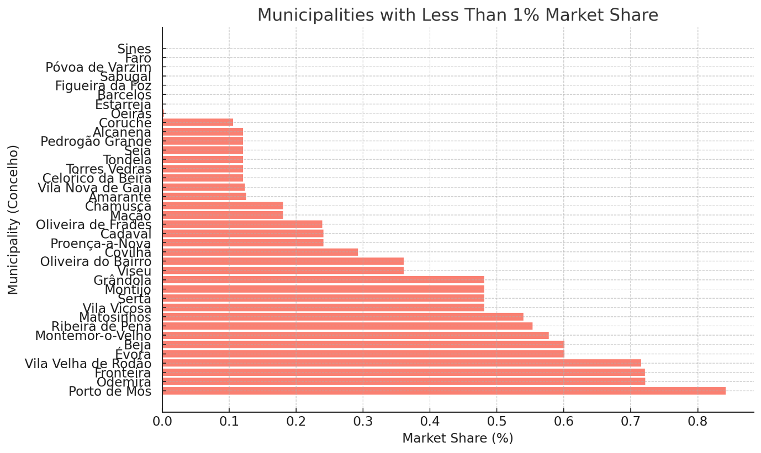
Capacity Benchmarking:
2.2 Municipalities – Less than 1% Market Share
Small Market Players by Share:
Municipalities with less than 1% market share include Porto de Mós, Odemira, Fronteira, Vila Velha de Rodão, and Évora. These areas have lower installed capacities and represent potential growth opportunities for new solar park developments or partnerships, especially if local conditions are favourable.

Slide 8
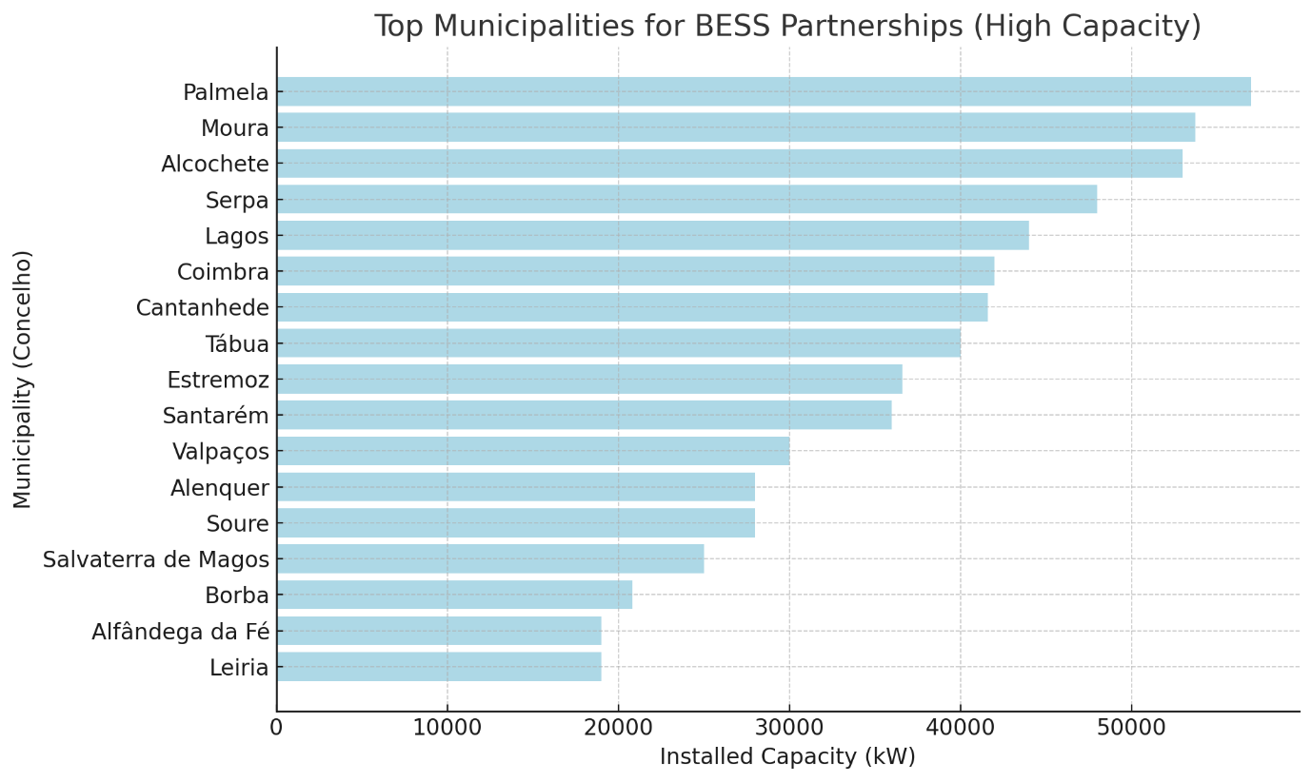
3. Partnership Opportunities:
3.1 Top Municipalities for BESS Partnerships
Prime Candidates for BESS Partnerships (High Capacity):
Municipalities like Palmela, Moura, Alcochete, Serpa, and Lagos have significant installed solar capacity, making them ideal candidates for BESS partnerships to enhance energy storage and balance the power supply.

Slide 9
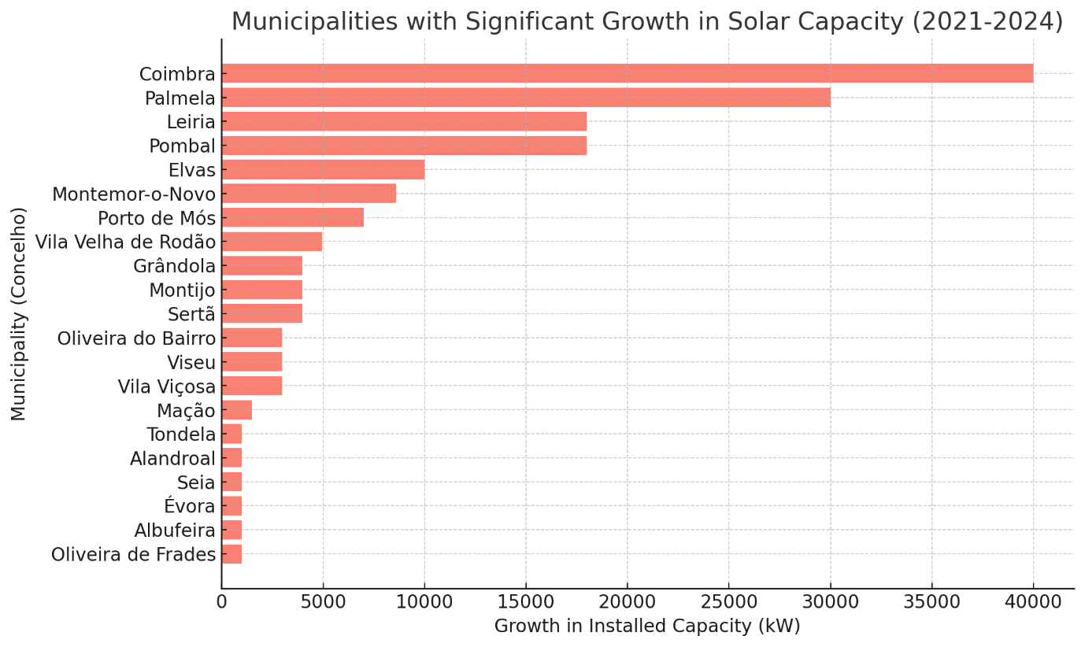
3. Partnership Opportunities:
3.2 Municipalities with Significant Growth
Significant Growth in Solar Capacity (2021–2024):
Coimbra, Palmela, Leiria, Pombal, and Elvas have seen substantial growth in solar capacity over the 2021-2024 period. For instance, Coimbra added 40 MW, and Palmela added 30 MW, indicating a strong need for BESS to manage this increasing capacity efficiently.

Slide 10


4. Key Considerations
1.High-Capacity Municipalities for BESS Partnerships
Municipalities like Palmela, Moura, Alcochete, Serpa, and Lagos have emerged as the top regions with the highest installed solar capacity. These areas are prime candidates for Battery Energy Storage Systems (BESS) partnerships.
These regions could benefit from energy storage solutions to balance energy supply, reduce grid congestion, and optimize the use of renewable energy.
2. Municipalities with High Growth Potential
Coimbra, Palmela, Leiria, and Elvas have shown rapid growth in installed solar capacity over recent years. Expanding BESS solutions in these areas can help optimize energy distribution, especially as their capacity increases.
Partnering with solar park operators in these high-growth regions could provide mutual benefits—ensuring that their energy production remains sustainable and efficient with proper storage solutions.
3. Opportunities in Municipalities with Low Installed Capacity
Municipalities with low installed capacity, such as Sines, Faro, and Póvoa de Varzim, represent potential gaps in the market where we could develop new solar parks. These regions have untapped potential, and new projects could establish a foothold with less competition.
Implementing solar projects with integrated BESS solutions in these regions could provide a unique opportunity to grow our presence in areas with less saturation.
4.Industrial and Commercial Solar Projects
Regions with industrial hubs like Sines and high tourism rates like Faro offer a unique opportunity to develop larger commercial or industrial solar parks. These regions, though currently underdeveloped, could benefit from large-scale BESS solutions to meet industrial and commercial energy demands.

