Slide 1
Predicting the Number of Citations a Patent will Receive
Enver Ferit Akın

Slide 2
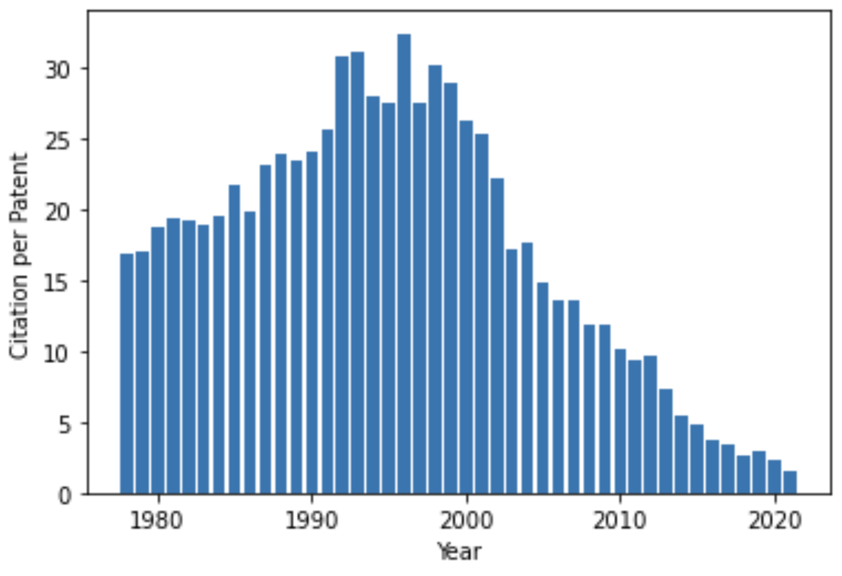
Motivation
Patents are powerful tools used to understand the dynamics behind innovation.
Recent patents have fewer citations. Thus, we have truncated data.
Using these patents in analysis leads to biased results regarding patent quality.

Slide 3
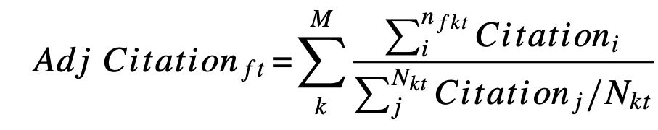
In the literature, there are different solution concepts for this problem. For example,
However, it has been proven that these methods do not fully resolve the bias.
Predicting newly published patents’ total citations with machine learning may be a solution.

Slide 4
Data
USPTO (United States Patent and Trademark Office) disambiguated patent, assignee, citation, and classification data between 1975-2022.
The citation dataset has about 130 million rows.

Slide 5
Methodology
From the assignee data, 10000 assignees (firms, universities, etc.) were randomly selected.
From the citation data, the patents of these assignees were selected.
Additional information on these patents was taken from the other two datasets.
The patents that were filed between 1975 and 2002 are used as the input since, after 2002, there is a truncation problem.
In the final dataset, there are 65839 patents and their total citations.
Features are the number of patent claims, assignee type, patent class, pendency (grant year – application year), circulation, logarithm total citations the assignee received, and grant year of the patent.
Lasso, Ridge, Random Forest, KNN, ElasticNet, Decision Tree, XGBoost.

Slide 6
Results
 | RMSE | R²
Lasso | 45 | -21
Ridge | 45.1 | -22
Random Forest | 44.4 | -1.83
KNN | 44.8 | -9
ElasticNet | 45.2 | 0.035
Decision Tree | 45.4 | -14

Slide 7
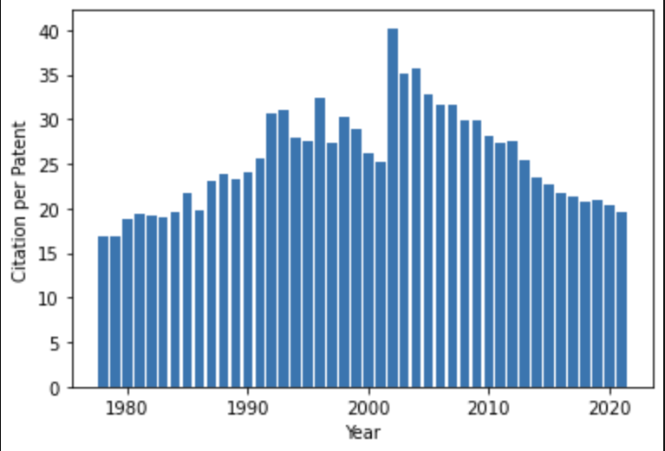
After predicting the number of citations between 2002-2022 with ElasticNet, we have:

