Slide 1
Biweekly Report #1
Efaz Hossain
Sahithi Mutyala

Slide 2
Agenda
Introduction
Data Overview
Explanatory Data Analysis (EDA)
Data Cleaning
Data Preprocessing Techniques
Data Augmentation

Slide 3
Introduction
Biweekly Summary
Focuses on the data preparation efforts undertaken during the first two weeks of the project
Highlights key activities involved in the exploratory data analysis (EDA), data cleaning, preprocessing and augmentation
Significance
A well-prepared dataset is crucial for accurate model training
Outlines the steps taken to ensure data quality for next phase

Slide 4
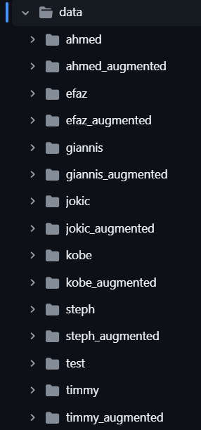
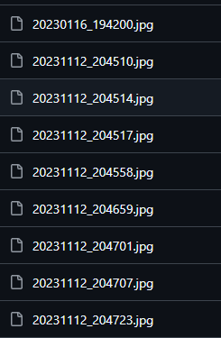
Overview
Dataset Composition
Total Images: 10,000
Facial Images: at least 2,000 with 41 classes
Object Images: roughly 500
Data Sources
As of currently, we’re using a dynamic dataset which has images uploaded constantly and updated
This includes faces of project members, objects and etc

Slide 5
Exploratory Data Analysis (EDA)
Key Findings
Class Distribution: uneven distribution of images across classes
Image Quality: Most images meet required resolution standards
Lighting conditions/Angle variations were noted
Visualizations
Will be added in actual report

Slide 6
Data Cleaning
Steps Taken
Identification and Handling of Missing Values
Conducted thorough examination of dataset
Addressed through removal of images
Impact of Cleaning
Significantly improved quality of dataset
Enhanced reliability of training data

Slide 7
Data Preprocessing
Image Resizing
All images were resized to 224x225 pixels to ensure uniformity across all images
Normalization
Pixel values were scaled to a range of [0,1] to enhance training
Reduces risk of saturation in activation functions
Rationale behind Preprocessing
We want to ensure all images are able to be ran through the model efficiently and learn features better

Slide 8
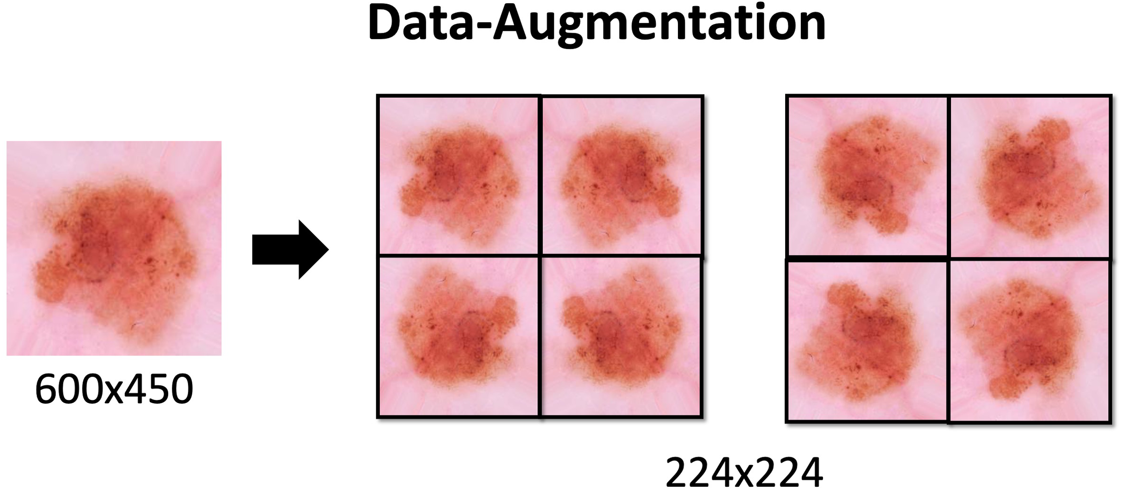
Data Augmentation
Techniques Used
Rotation/Flipping/Brightness/Zooming/Cropping
Benefits
Increased size of dataset
Provides more training examples
Improved model generalization
Exposes model to wider variety of image scenarios
Enhanced robustness
Model is more resilient to variations in real-world scenarios which is critical for the Tortoise system

Slide 9



a

Slide 10
Next Steps
Continue more EDA
Analyze relationships between features and target labels
Identify any additional patterns/anomalies if possible
Evaluation of Initial Model Deployment
Evaluate models on accuracy, precision, recall and F1 score to determine effectiveness
Hyperparameter Tuning
Optimize settings like learning rate, batch size and architecture-specific parameters to improve performance
Integration Testing (Likely will be done in Capstone 2)
User Feedback and Iteration (also likely will be done in Capstone 2)

Slide 11
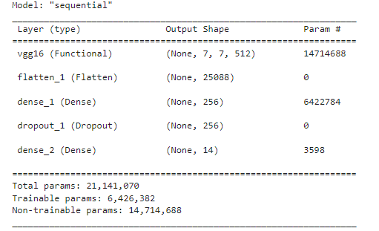
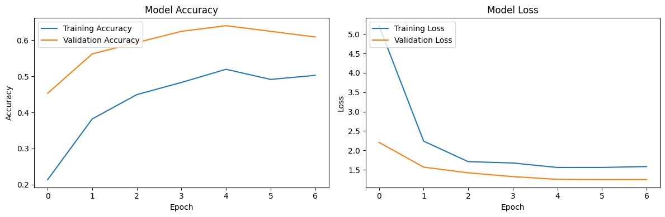

Slide 12
Conclusion
Summary
Comprehensive approach was taken to prepare dataset for effective model development
Significance
Project is poised to develop multiple robust models capable of accurate facial/object recognition

Slide 13

THANK YOU

