Slide 1
Project Tortoise: An Assistive System for All
Efaz Hossain
Sahithi Mutyala

Slide 2
Agenda
Background Information
Overview of Project
Previous Work
Current Work
Methodology
Outcome

Slide 3
Background Information
Prevalence: Over 50 million people worldwide have memory loss conditions, with about 10 million new cases a year
How does this project affect those with these conditions?
Affects the ability to recognize faces and objects
Safety during navigation
Reducing dependence on others and inspiring independence
Solutions
Assistive technologies that can delay full-time care and enhance daily task management

Slide 4
Overview
Key Features
Facial and Object Recognition
Wandering Prevention
Impact
Enhances independence and safety for those with memory loss conditions
Restores confidence in daily interactions

Slide 5
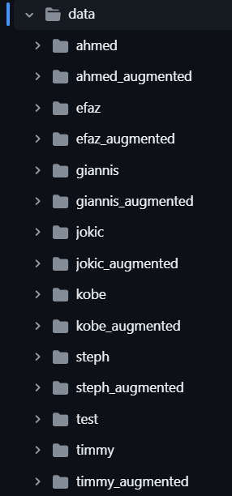
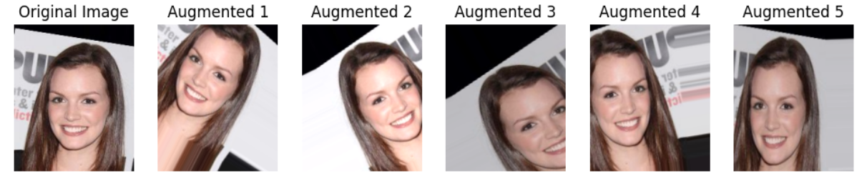
Dataset
~ 300,000 images
224x224 pixel size, 41 different attributes (Brow_shape, etc)
Each image is trained upon 1000x
There are roughly 1000 additional augmentations
Dataset will be dynamically updated
Roughly 3.3 million images will be included in the dataset
~ 15.8 GB

Slide 6
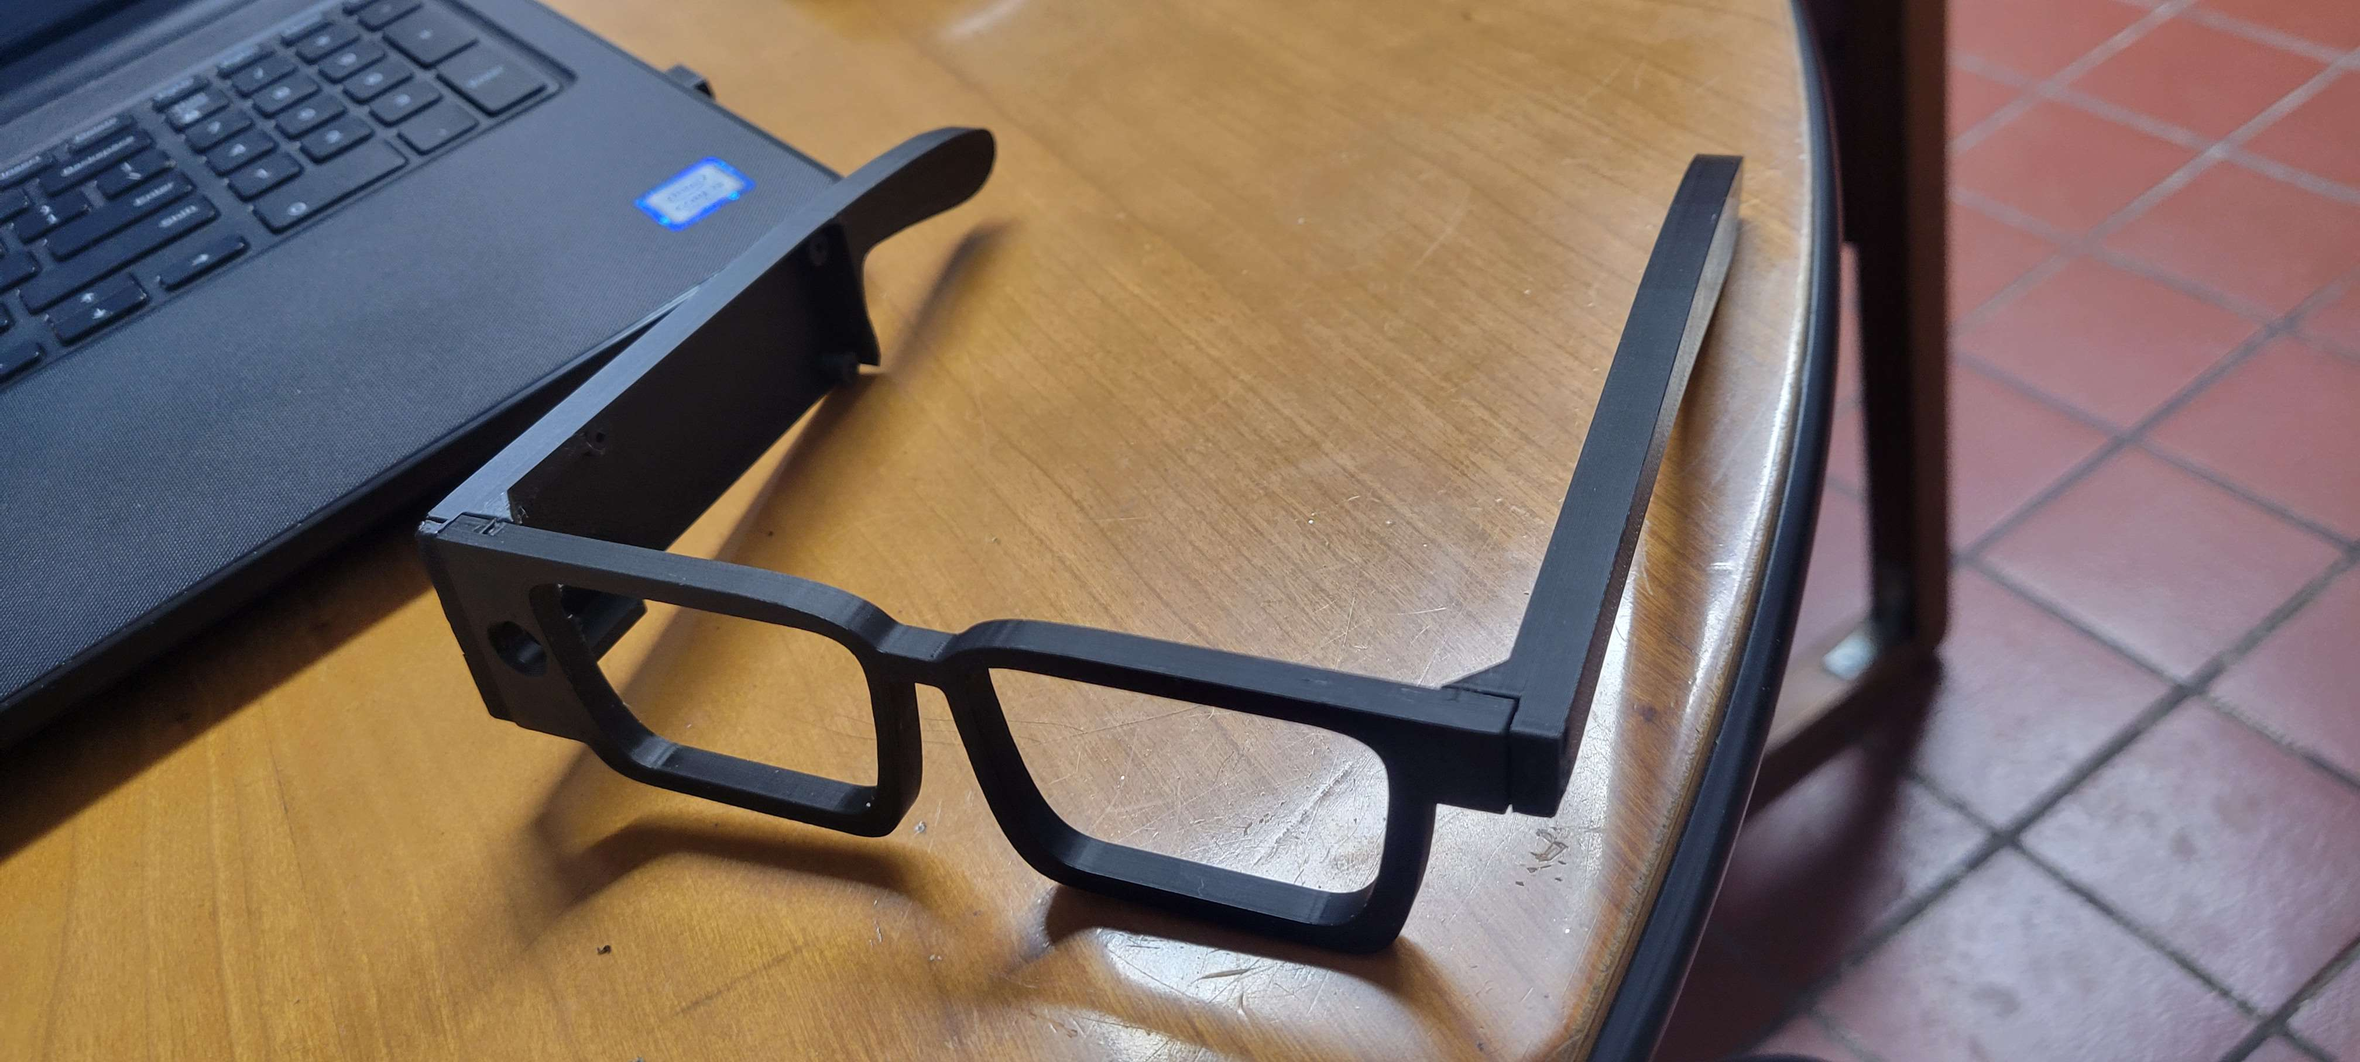
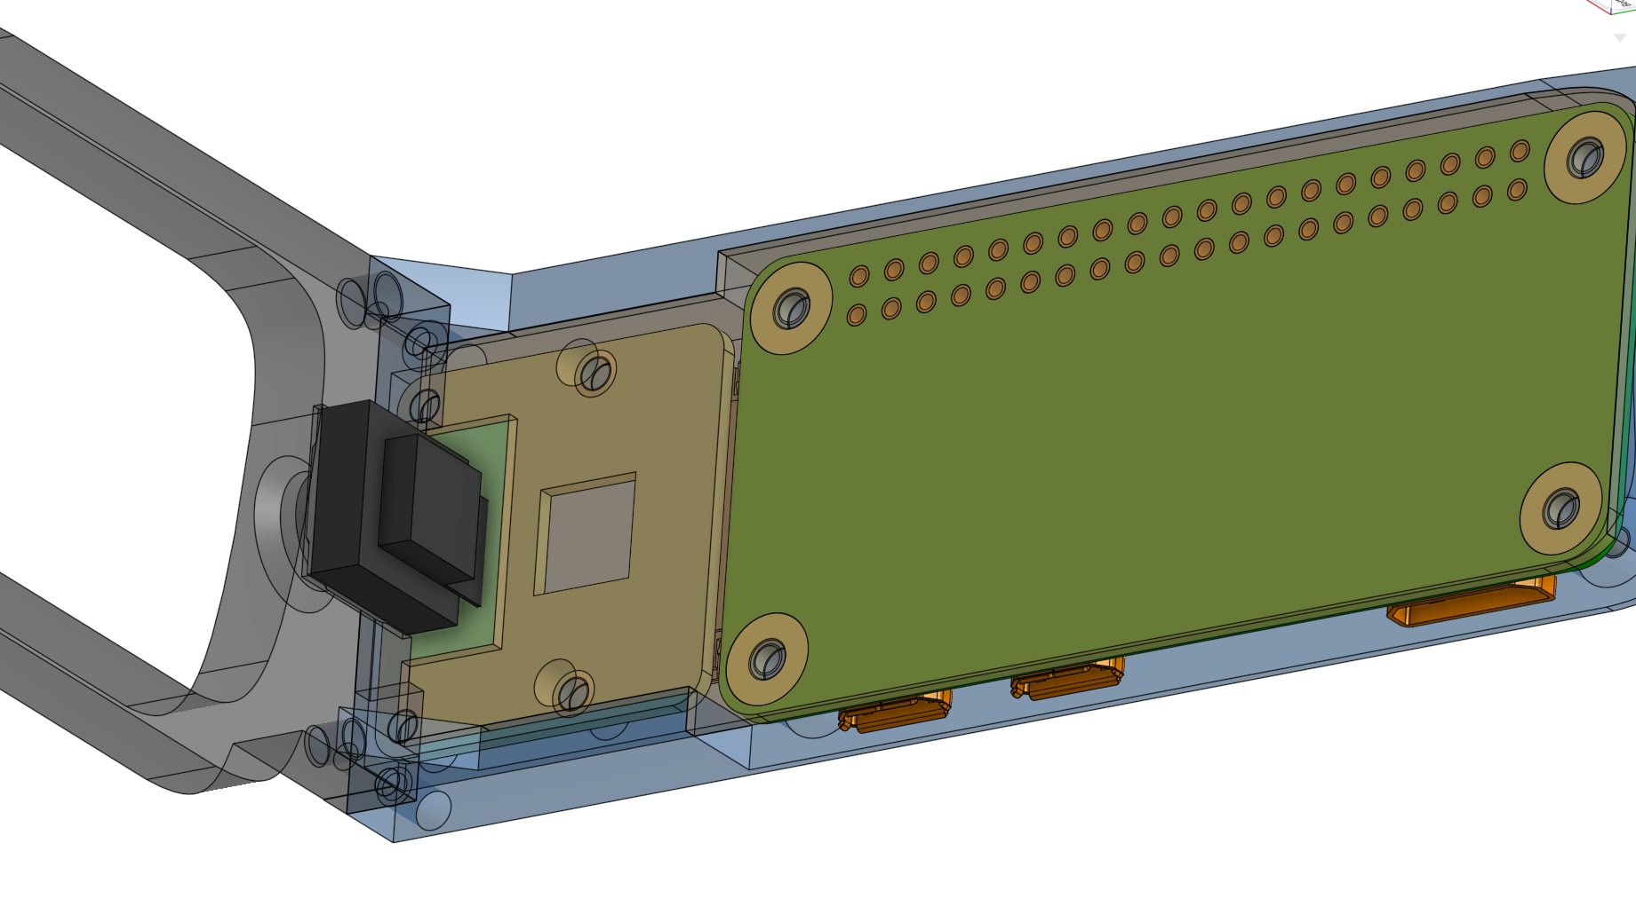
Previous Work
Tortoise System Alpha Phase:
Summer 2023: Originally started as a project to create a prototype that assists in grocery shopping
Fall 2023 – Spring 2024: Advanced to a smart glass prototype in order to assist those with memory loss conditions
Summer 2024: Improvements to prototype design, addition of a server to store and retrieve dataset via Amazon FireServers

Slide 7
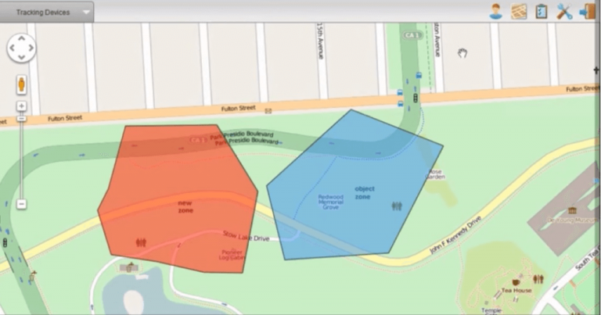
Current Work
Tortoise Beta Prototype Improvements
Design Change:
Move from smart glasses to a smart headset
Incremental Learning:
Optimized training for dynamically expanding class sizes
Geofencing
Introduce a geofencing alert system for real-time monitoring and timely caregiver alerts in case of wandering incidents
Working on applying Apple’s device location tracker to work together

Slide 8
Methodology
Face and Object History: This feature records detected faces and objects, including their classifications and locations, enabling users to review this information as needed.
Geofencing Alerts: Caregivers receive notifications when users breach predefined geofencing boundaries, along with real-time GPS location updates.
User Input: Users can upload images of family members and friends, enriching the system’s facial recognition database and improving the model's accuracy.
Additional Functionalities: The application is designed to accommodate future expansions, allowing for the integration of additional features that enhance the user experience.

Slide 9
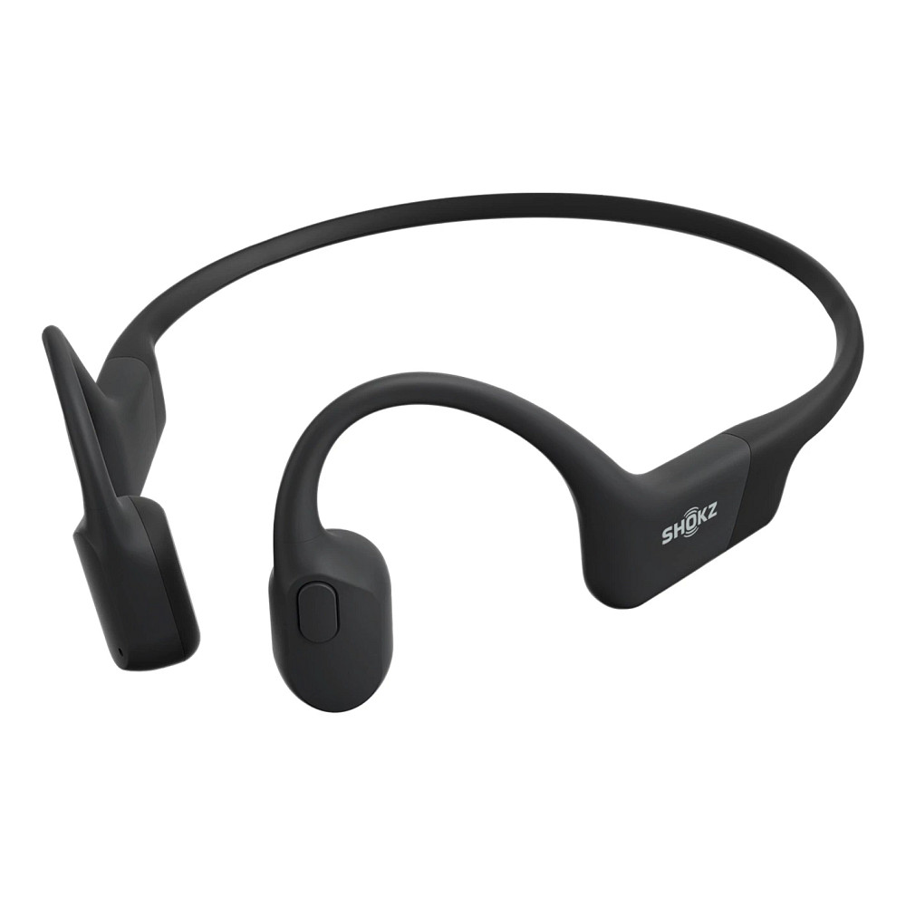
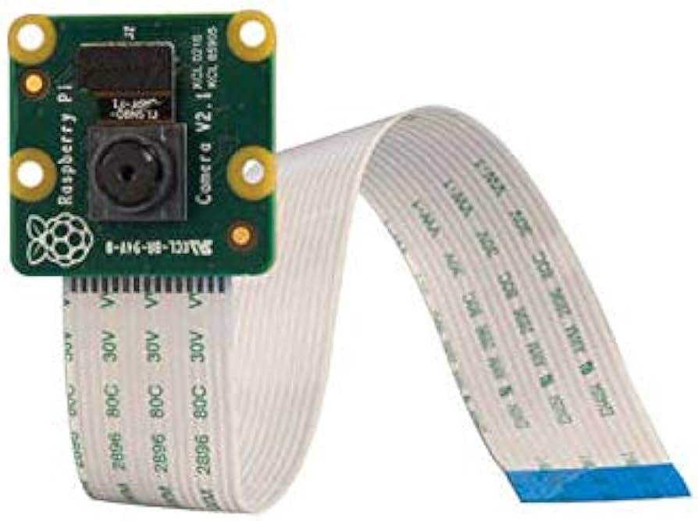
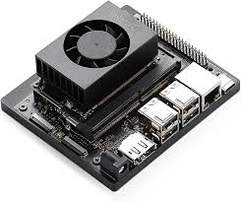
Tortoise System: Hardware & Software Overview
Hardware:
Raspberry Pi Pico: Core processor for image acquisition and processing.
RPi Camera Module v3: Captures live image feeds for facial and object recognition.
Battery Pack: Ensures portable, all-day power.
Software (Hosted on NVIDIA Jetson Orin Nano):
OS: Lightweight Linux distribution optimized for real-time processing.
Face Detection: OpenCV face detector identifies faces in the image feed.
Facial Recognition: VGG16-based pre-trained CNN for recognizing faces.
Object Detection: CNN model (EfficientNet or YOLO v8) for identifying household objects.

Slide 10
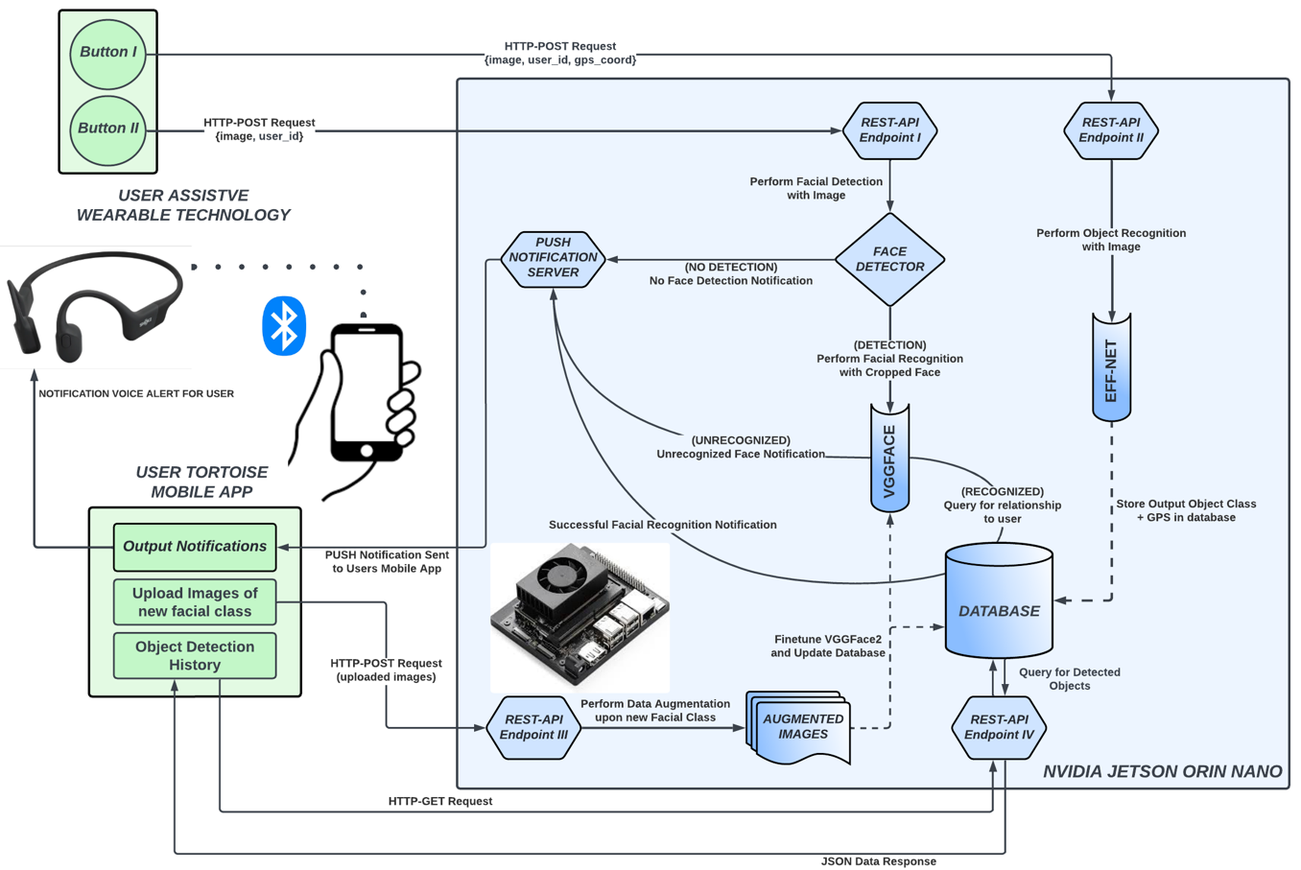

Slide 11
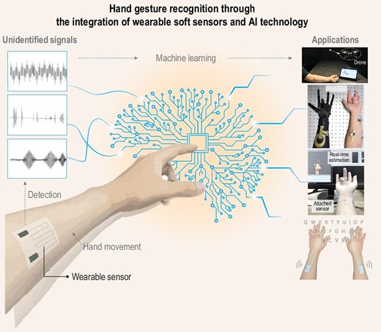
Outcome
Progress & Potential
System Success: Demonstrate a viable product that can be sold and used by all
Impact: Supporting facial and object recognition via new additions to dataset
Technological Strengths: Robust performance in distinguishing faces and recognizing objects
Research Based Upon:
Machine-learned wearable sensors for real-time hand-motion recognition: toward practical applications :
https://academic.oup.com/nsr/article/11/2/nwad298/7452905

Slide 12

THANK YOU

