Slide 1

Project Tortoise
A smart system for all

Slide 2
Agenda
What is Tortoise?
Project Checkpoint # 1
Project Checkpoint # 2
Project Checkpoint # 3
Current Progress
Challenges Encountered
What’s Up Next

Slide 3
What is Project Tortoise?

Slide 4
Background Information
Memory loss conditions such as Alzheimer’s disease and dementia impact millions worldwide. According to the World Health Organization, approximately 50 million people currently live with dementia, with nearly 10 million new cases diagnosed annually. These conditions impair an individual’s ability to recognize faces, locate everyday objects, and navigate safely, leading to reduced independence and quality of life.
Traditional caregiving solutions often fall short in addressing these needs, prompting the exploration of assistive technologies. Recent advancements in AI, computer vision, and wearable technology have opened new opportunities to develop innovative solutions that support individuals with memory loss.

Slide 5
Primary Objectives
Enhance safety and independence for individuals with memory loss.
Support facial recognition to identify familiar individuals.
Assist with object location memory for frequently used items.
Prevent wandering through real-time GPS monitoring.
Provide caregivers and family members with peace of mind via alerts and location tracking.
What These Objectives Aim to Achieve:
Restoring Confidence: By assisting with facial recognition and memory recall, users can feel more secure and capable in their daily interactions and routines.
Reducing Risk: The GPS tracking and object location memory features aim to mitigate risks associated with wandering and misplaced essential items.
Improving Quality of Life: The integration of assistive technologies supports users in maintaining their independence and dignity while navigating memory-related challenges.
Providing Caregiver Support: Tortoise equips caregivers with tools to monitor and assist their loved ones more effectively, fostering peace of mind and reducing stress.

Slide 6
Methodology
What we plan to do
Smart Headset: Facilitates facial recognition to aid in identifying known individuals.
Smartwatch Application: Helps with locating everyday objects and prevents wandering.
Real-Time Monitoring: Delivers timely alerts and tracks user locations to support caregivers.
In-Depth Methodology:
System Design and Development: Develop a cohesive system that integrates a smart headset with facial recognition software and a smartwatch application for object tracking and GPS monitoring.
AI Model Training: Train machine learning models on large datasets to ensure accurate facial recognition and object identification tailored to individual users.
User Testing and Feedback: Conduct extensive testing with individuals experiencing memory loss and their caregivers to refine system usability and performance.
Safety Protocols: Implement robust GPS monitoring and alert systems to ensure real-time accuracy and reliability in wandering prevention.
Continuous Updates and Improvements: Regularly update software to incorporate user feedback, improve functionality, and adapt to technological advancements.

Slide 7
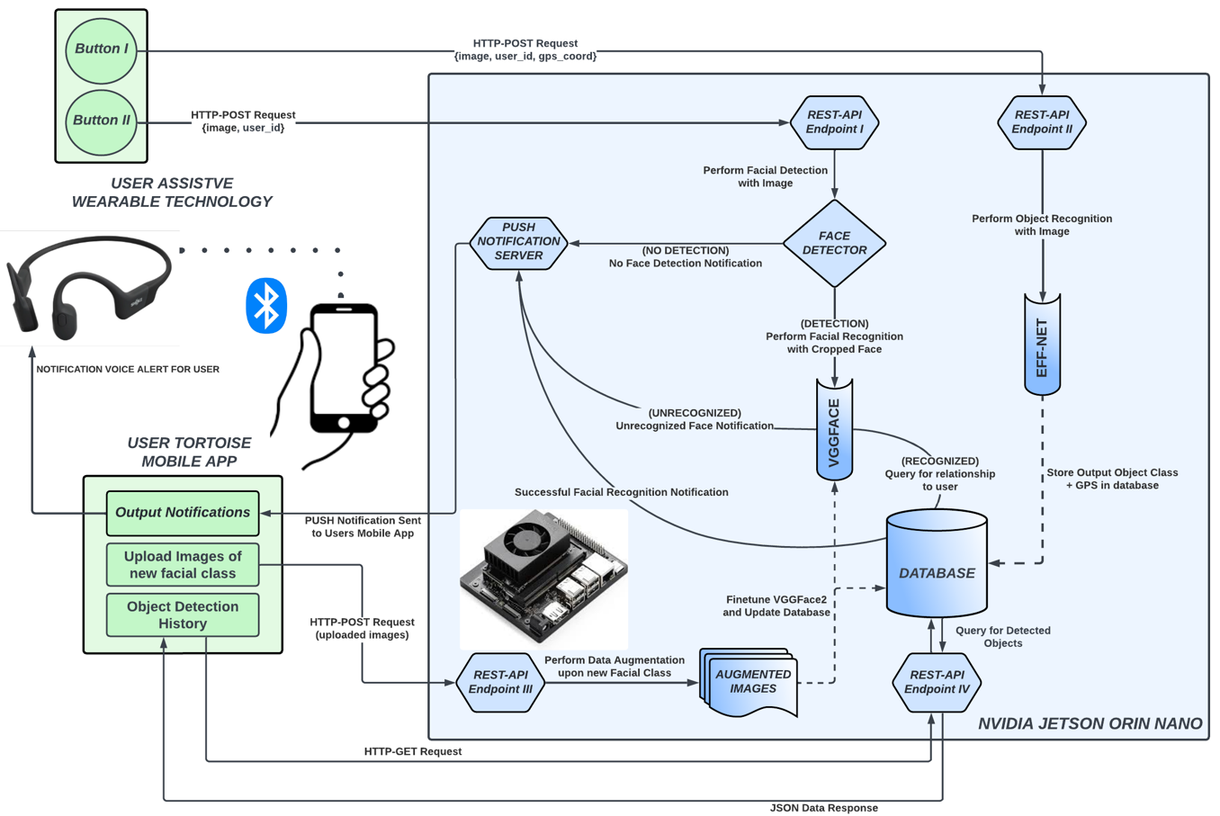
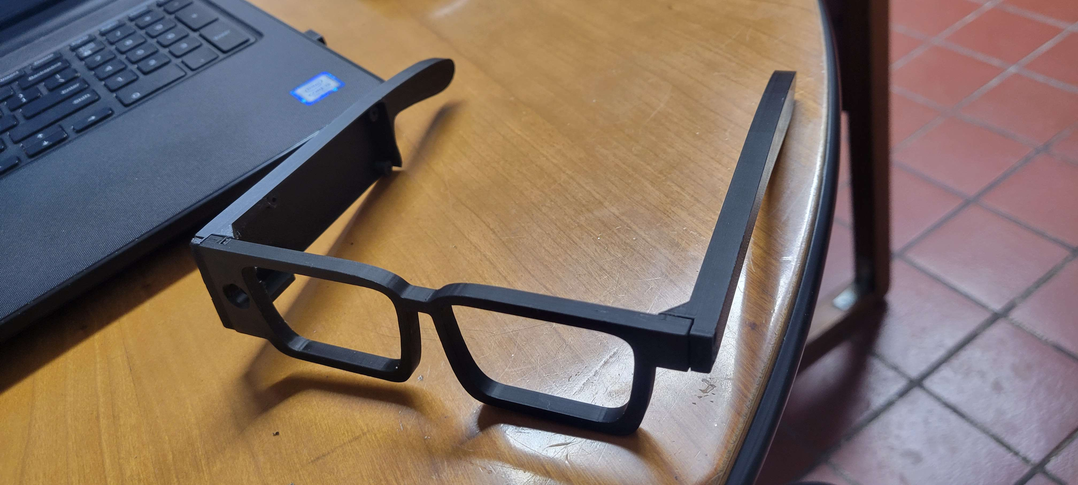
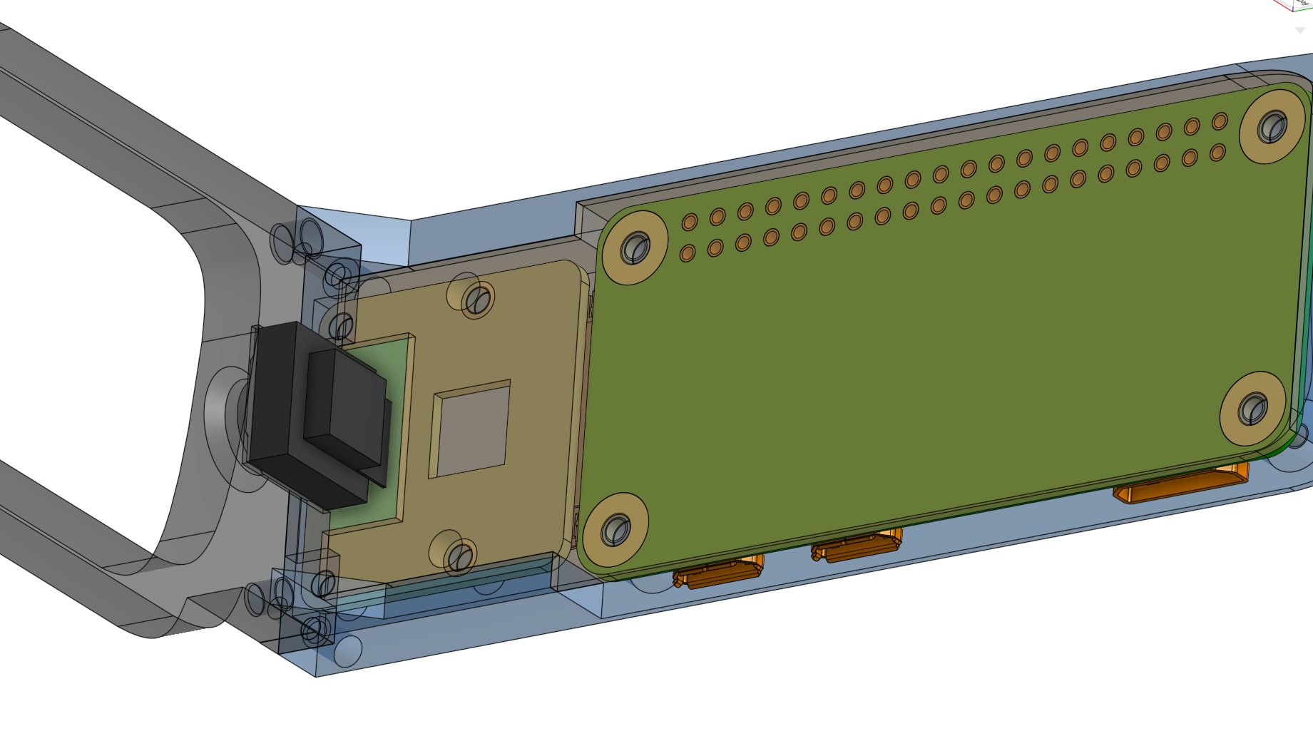

Slide 8
Project Checkpoint #1

Slide 9
Dataset Overview
Dataset is organized into train, validation and test splits using a ratio of 70-15-15
Classes are ensured to have a minimum of number of 10 images
Initially was a minimum of 3, but decided it was too less
Augmentation was done initially but was undone to test benchmark
Final preprocessing includes resizing all images to 224x224 pixels and normalizing pixel values to [0,1]

Slide 10
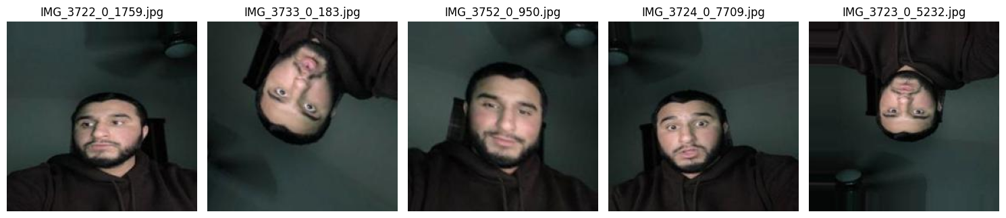
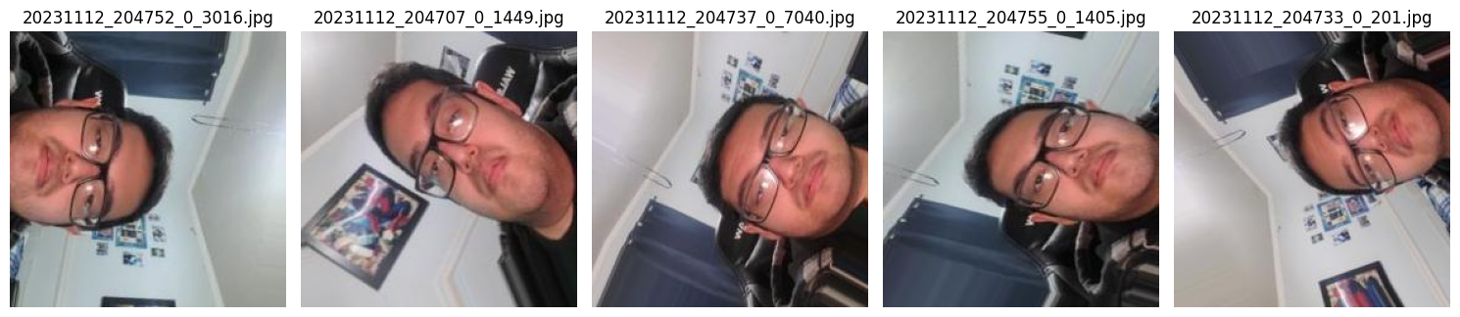
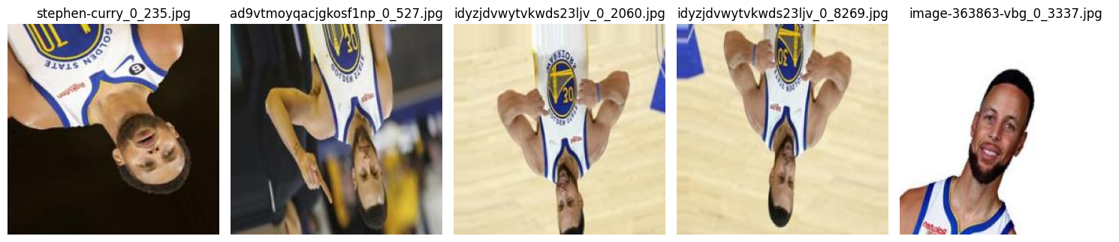
Exploratory Data Analysis (EDA)
Methods for EDA
Identified corrupt/empty files during initial inspection
Balanced via augmentation/splitting
Visualization of augmented samples ->

Slide 11
Initial Model Benchmark
Steps Taken for Model Benchmark
Use VGG16 pre-trained model
Train upon training set, conduct cross-validation and then test upon the test set
Visualize accuracy
Plan fine-tuning and hyperparameter tuning procedures
Base Model: VGG16 pre-trained on ImageNet.
Modified for 14 classes with a dense layer and softmax activation.
Trained upon 7 -> 10 epochs
Initial Accuracy: ~62%
Test Accuracy: ~64.75%
Fine-tuning strategy:
Unfreezing the last four convolutional layers of VGG16 for domain-specific learning.
Achieved test accuracy of 64% after fine-tuning.
Hyperparameter tuning:
Optimized learning rate, filter size, and dense units using Keras Tuner.
Best model achieved improved accuracy of ~68%.

Slide 12
Project Checkpoint #2

Slide 13
Base Model Improvements
Initial model used a bare-bones VGG16 model as the base architecture
Fine-tuned to classify custom data by adding fully connected dense layers
Dense Layer with 256 neurons
Output layer with softmax activation for multi-class classification
Epochs: 20 -> 50
Batch Size: 32
Learning Rate: 1e-4

Slide 14
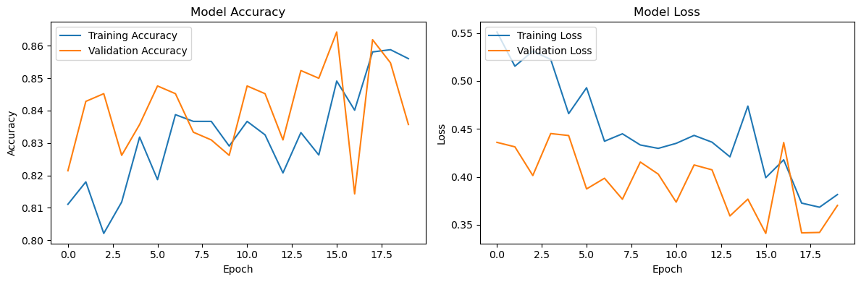
Results
Validation Accuracy: 83.57%
Test Accuracy: 84.07%
Test Loss: 0.3879
This shows that the model demonstrated steady improvements in accuracy while avoiding overfitting as much as possible.

Slide 15
Project Checkpoint #3

Slide 16
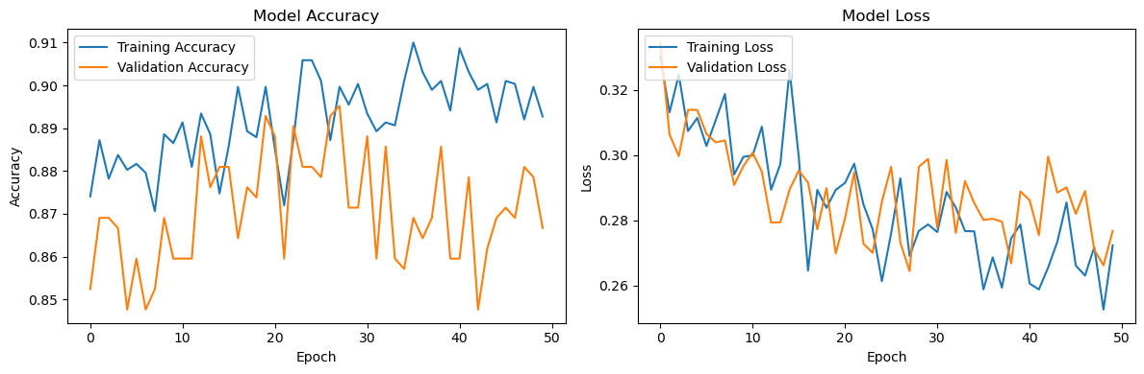
Initial Hyperparameter Tuning
Before Tuning
VGG16 base layers were frozen
Initial Tuning
Last four layers were unfrozen
Training Details
50 Epochs
Adam Optimizer

Slide 17
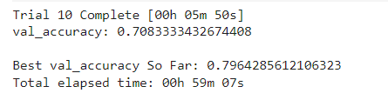
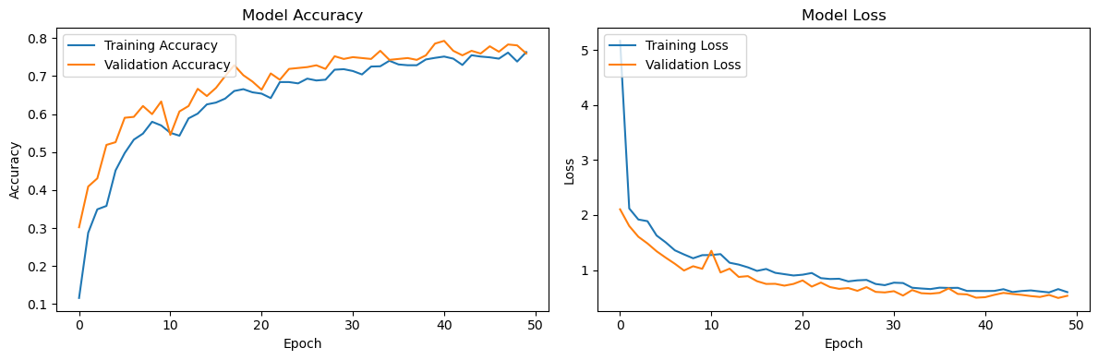

Best Hyperparameters
Best Hyperparameters:
Conv_Filters_1: 128
Kernel Size: 5
Conv_Filters_2: 192
Kernel Size 2: 5
Dense Units: 320
Learning Rate: 0.001

Slide 18

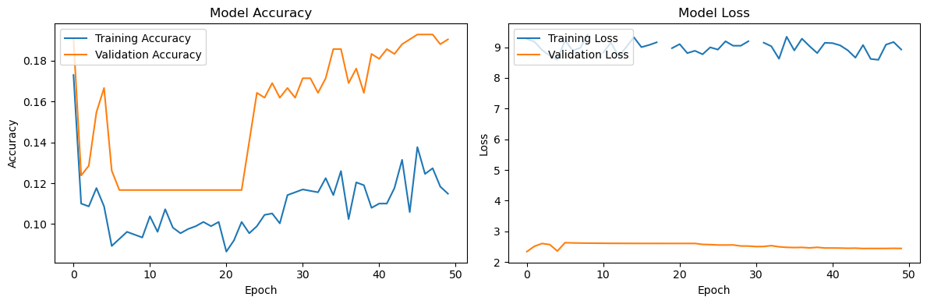
Regularization/Optimizer Changes
Regularization Improvements
Adjusted dropout layers in densely connected layers
L2 regularization was applied to further reduce likelihood of overfitting
Optimizer Adjustments
Switched to AdamW for better weight decay control and improved convergence
Something terrible happened here, still figuring it out….

Slide 19


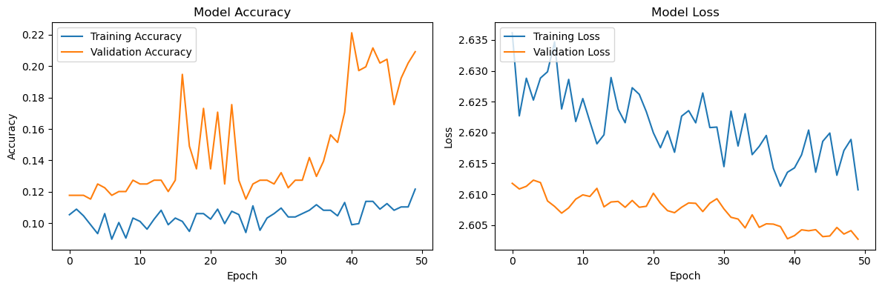
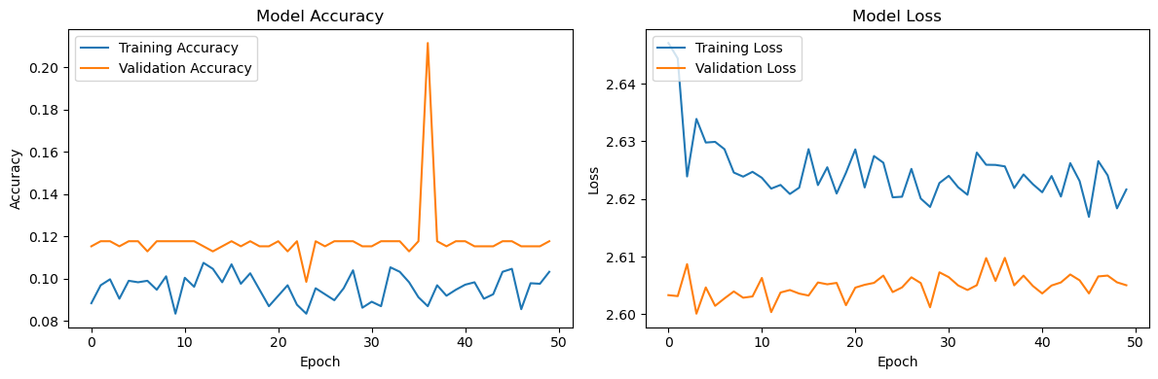
Transfer Learning
Background Information
VGG16 has proven itself for its high accuracy and robustness but is rather computationally expensive
Why EfficientNet?
Combines accuracy with computational efficiency
Scales uniformly in width/depth/resolution

Slide 20
Challenges Encountered

Slide 21
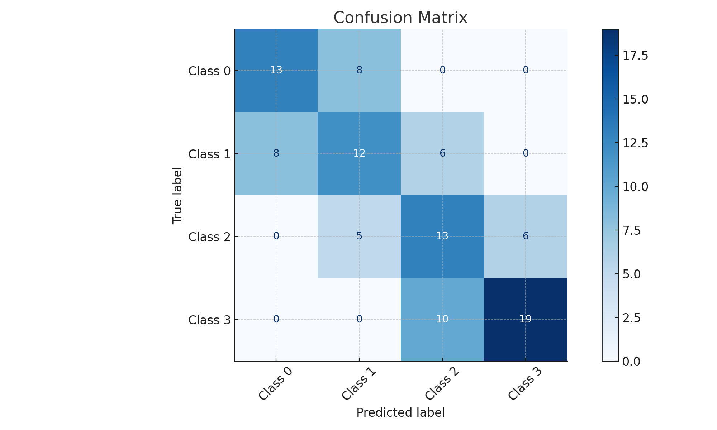
Challenge 1: Two Types of Datasets
Dataset Diversity
Facial set had limited variability in expressions, angles and lighting
Object set had high variability in size, orientation, and background clutter
Preprocessing and Augmentation
Augmentation had slightly improved accuracy

Slide 22
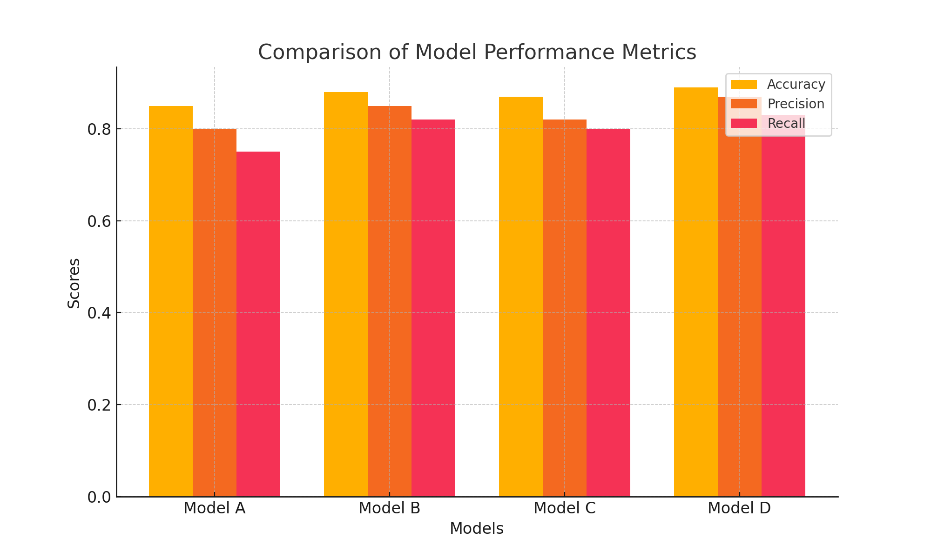
Challenge 2: training/testing process
Computational Resource Limitations and Validation Performance
Large datasets in general mean significant resources are needed to train properly upon
7 -> 10 -> 20 -> 50 -> 100 epochs
Validation accuracy plateaued after certain amount of epochs

Slide 23
Current Progress

Slide 24
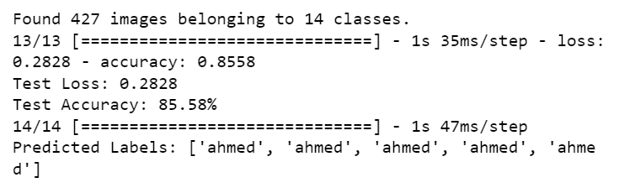
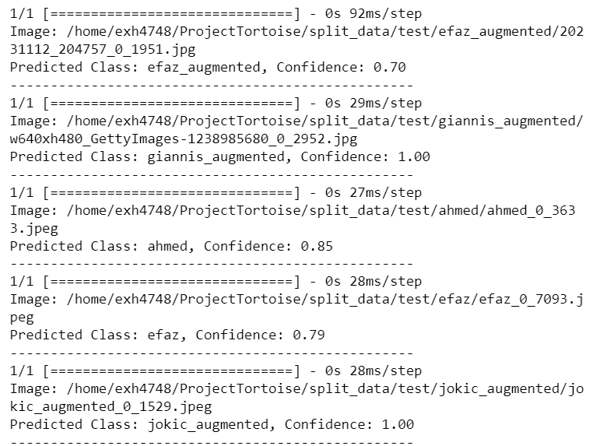
Prediction Testing
Setup Environment:
Imported necessary libraries (Keras, Tensorflow, Flask)
Load Model onto GPU
Trained model for 100 epochs and evaluated results
Inference Setup:
Load saved model, create preprocess and predict functions
Test by using predict(image_path) and print out predicted class and confidence score

Slide 25
Next Steps

Slide 26
Next steps
Finish Alpha Phase hopefully by the end of the year
Begin work on object dataset during the winter break
Start integration of facial model with device beta prototype
Prepare server for admin testing (software people will deal with that)
Compile everything and possibly start real-world testing
Write and publish a paper based on testing and findings?
**Figure out the economics for future marketing attempts**

Slide 27
THANK YOU
From the team at Boros Lab, Efaz and Sahithi
Check out the modeling code at our GitHub repository @ : https://github.com/data-4381-capstone/ProjectTortoise

