Slide 1
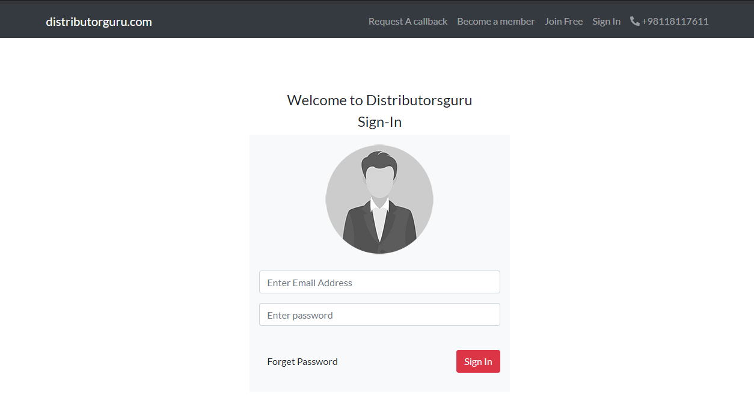
Sign In
Shift mobile no here (top header).
Create a top header and add email id and phone no here.
info@distributorguru.com
This page is ok

Slide 2
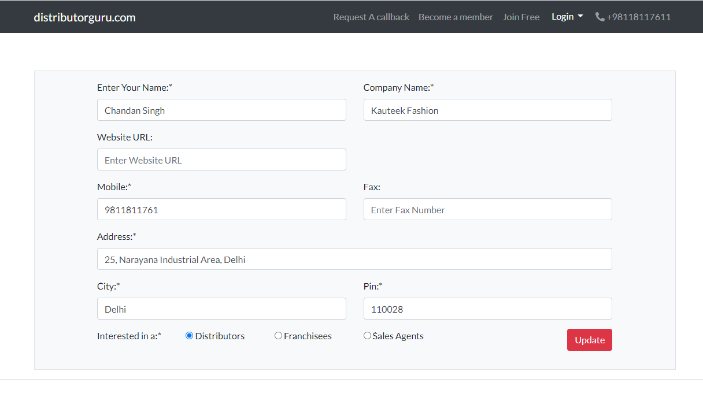
Step 2
After Login here should be user name.
Delete

Slide 3
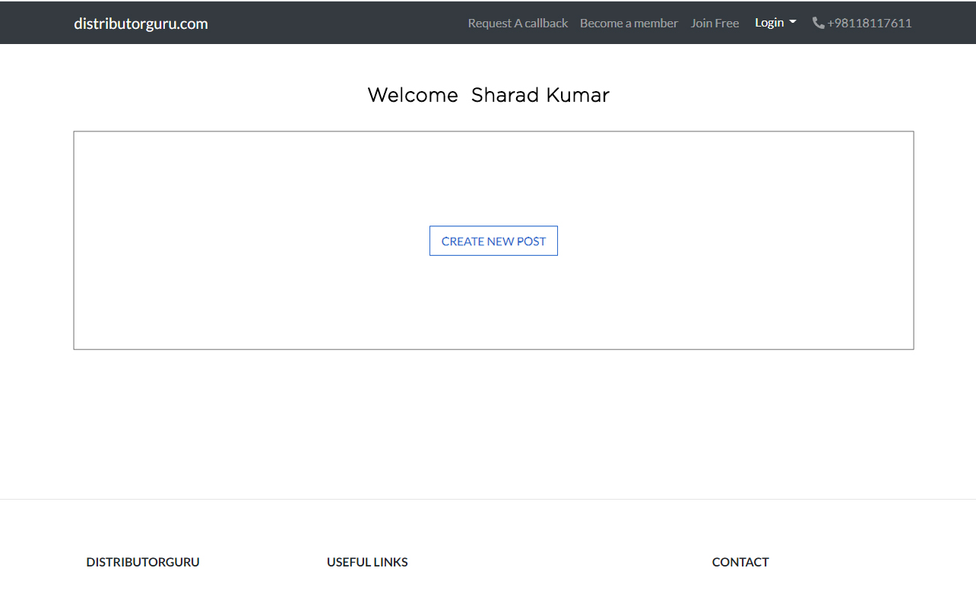
Step 3

Slide 4
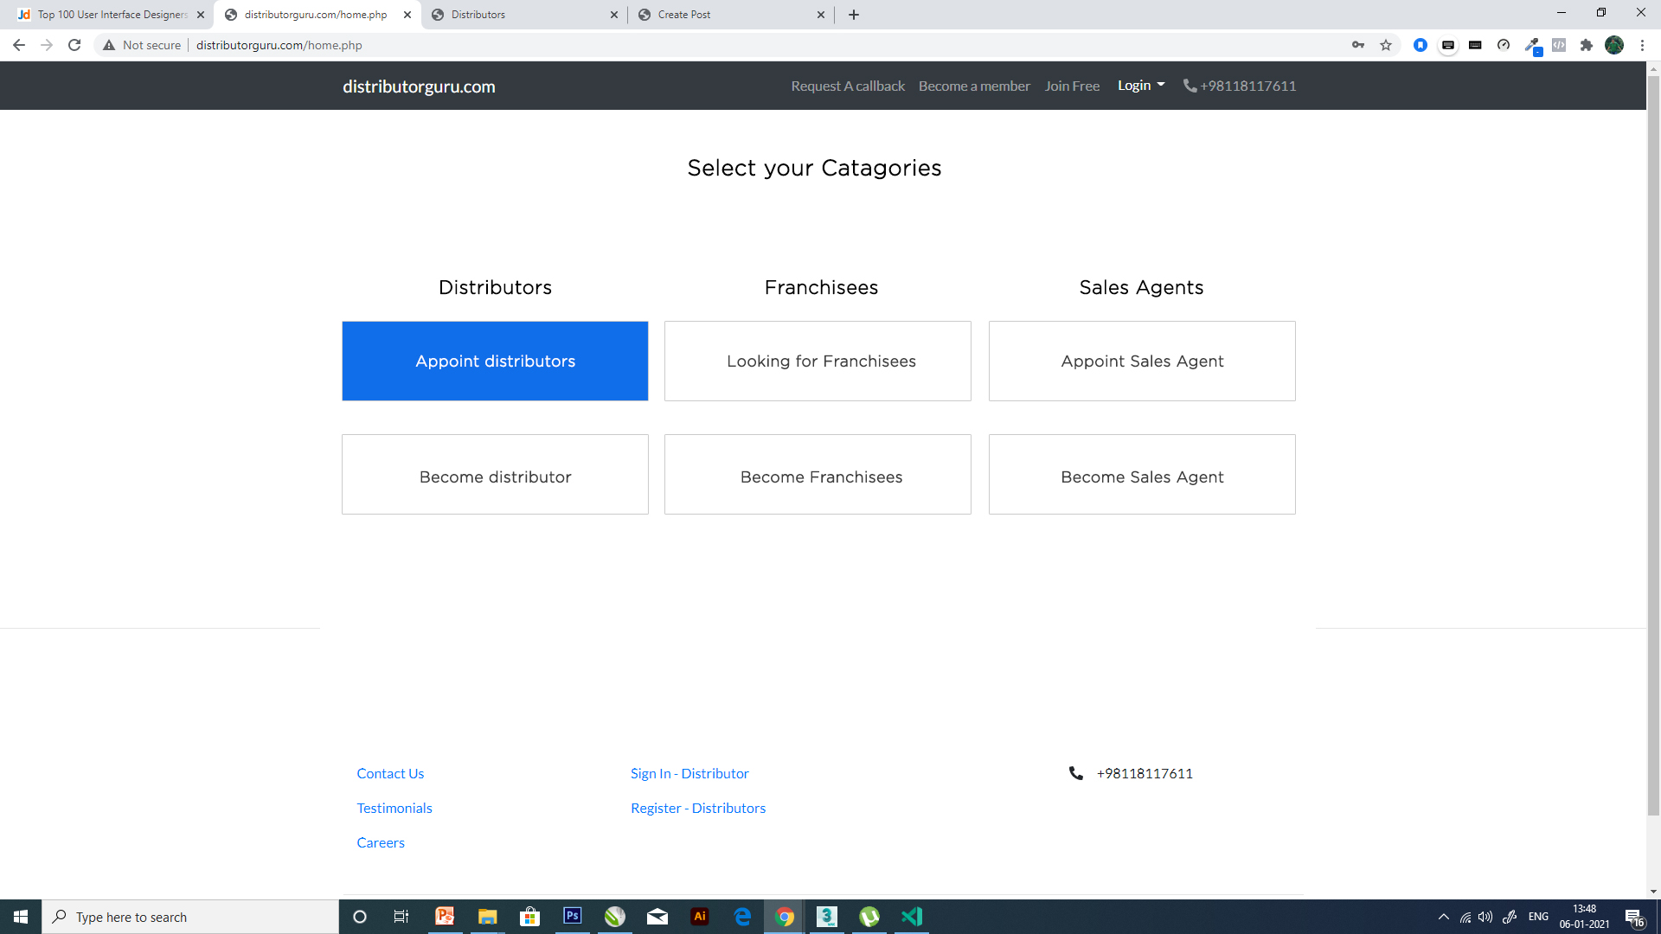
Step 4

Slide 5
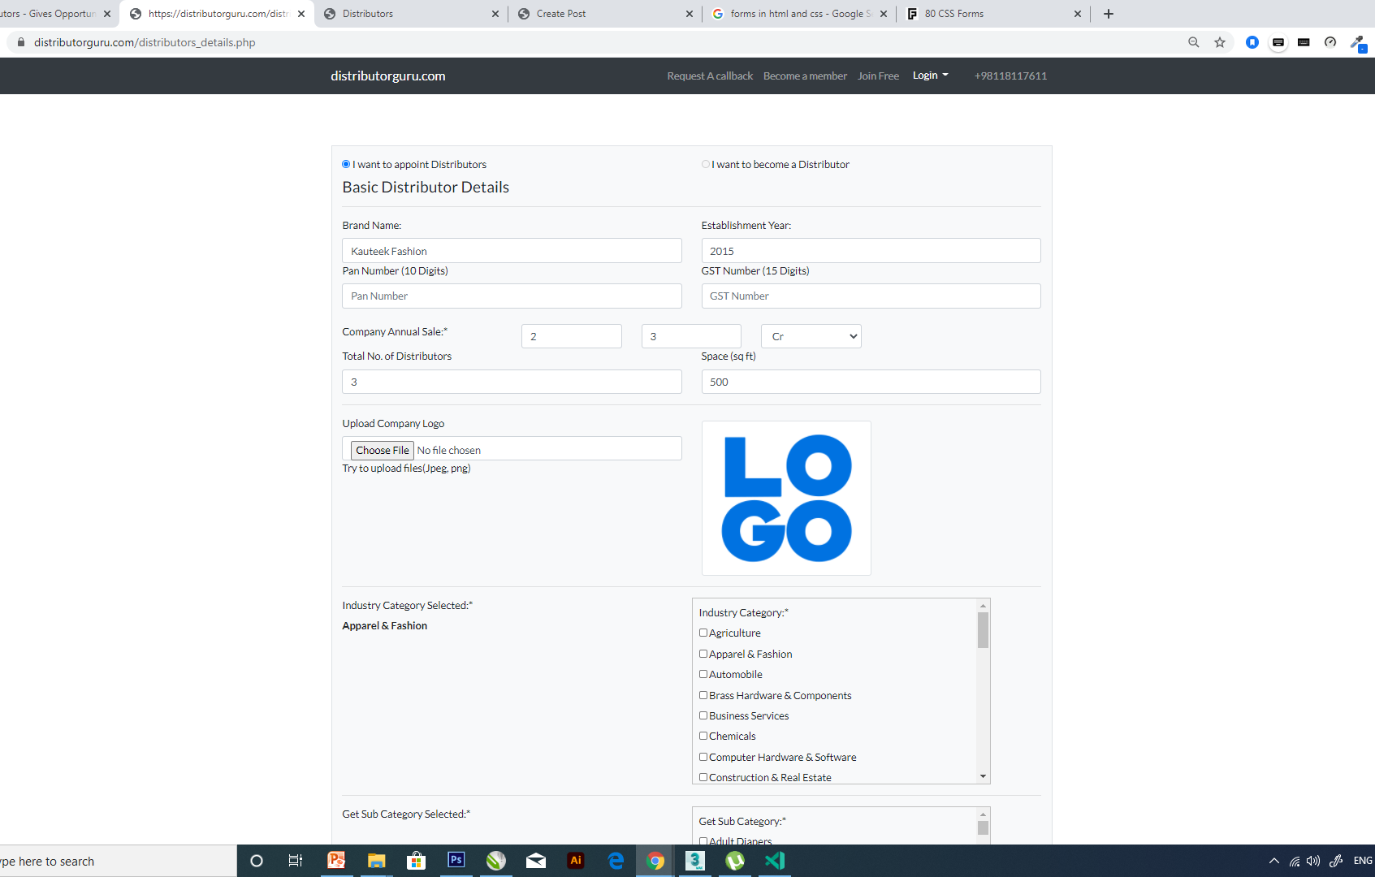
Step 5
Delete
Top Center

Slide 6
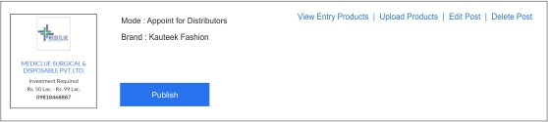
Step 5

