Slide 1
Evaluation:
Spearman rank
Split:
Train: 60 alleles
Test: 15 alleles
12 super-types of alleles, equally represented in train/test

Slide 2
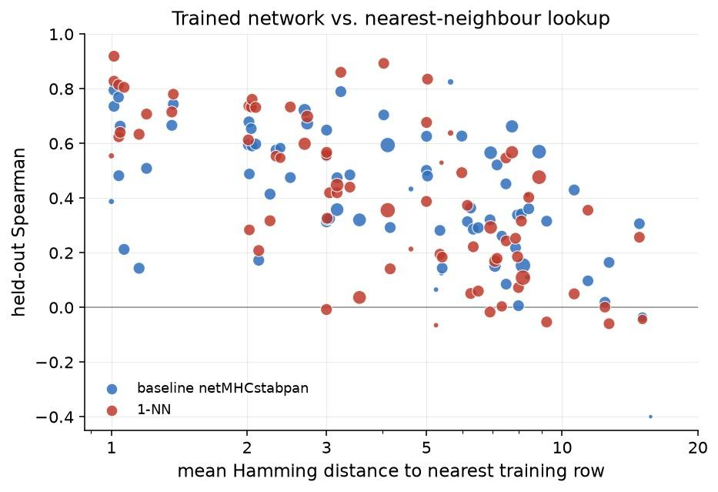
Nearest neighbour model
New (allele, peptide) input:
find sample with most similar peptide/allele sequence
Copy its half life

