Slide 1
Percolation

Slide 2
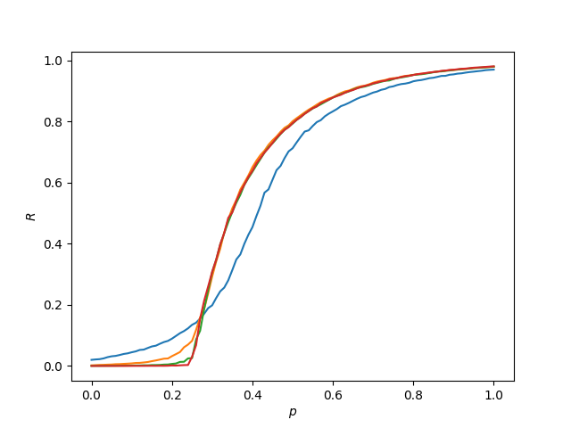
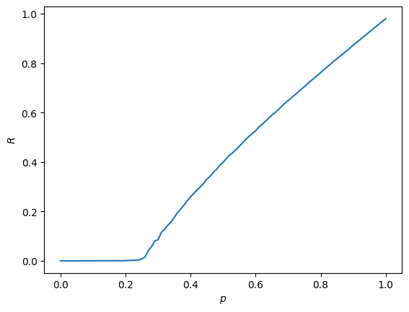
Percolation on Random Networks
Link percolation - c=4
Node percolation - N = 100,000and c=4
N = 100 – repeated 1000 times
N = 1000 – repeated 100 times
N = 10000 – repeated 10 times
N = 100000 – repeated 1 times
For both, the critical threshold is p =0.25.
The larger the network, the sharper this transition is.
Node percolation leads to a less sharp transition for the same N.

Slide 3
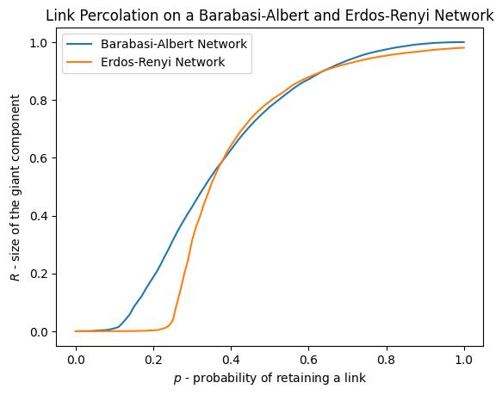
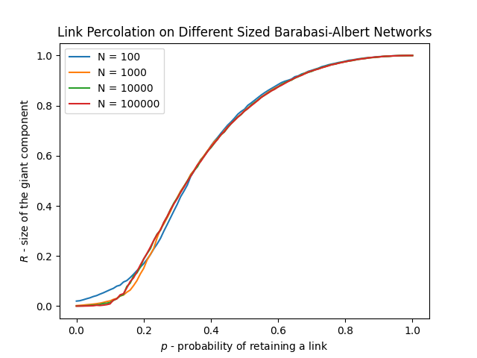

Barabási-Albert Networks
Link percolation - N = 10,000and m=2 (So c$≈$4)
The critical threshold for the BA network is lower than that of an ER network with the same average degree. This shows that BA networks are more robust since they have a few hubs and many nodes with few links.

Slide 4
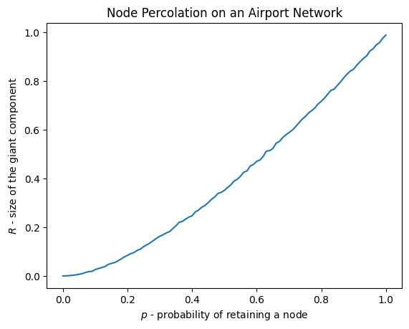
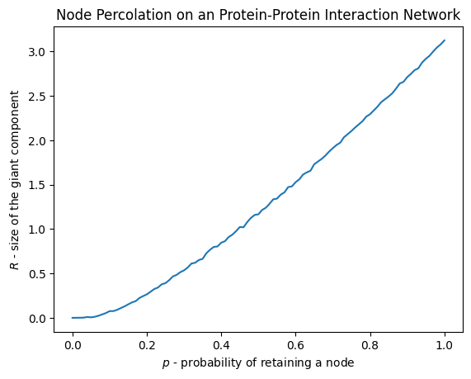
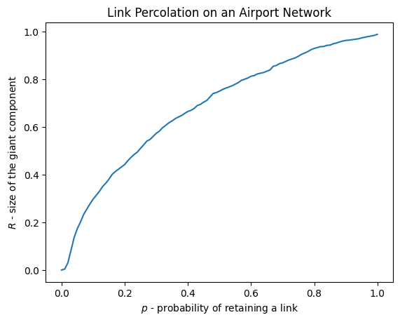
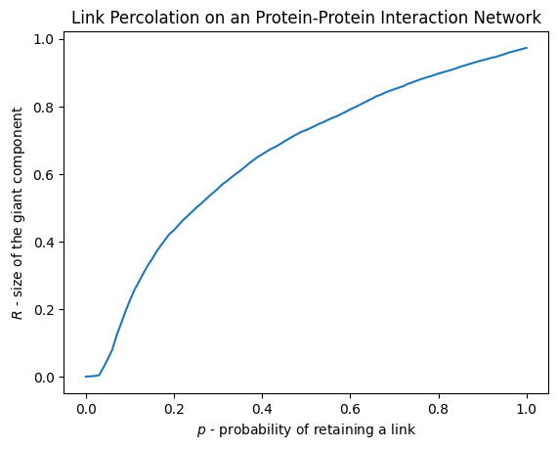

Slide 5
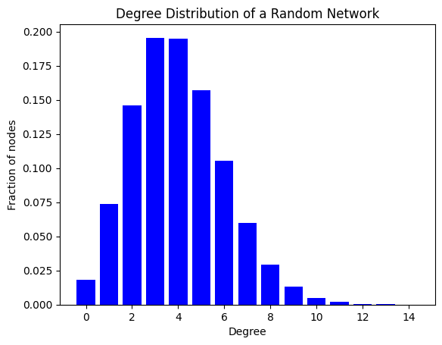
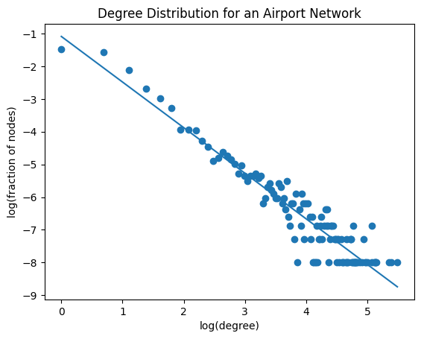
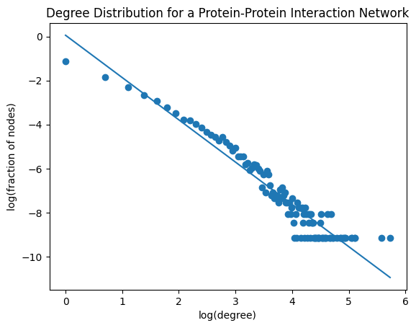

Slide 6
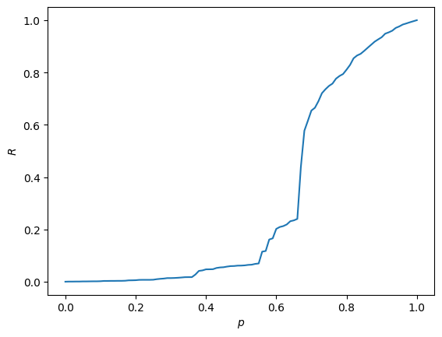
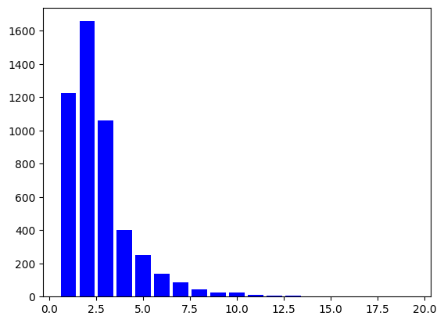
Power Grid
https://networkrepository.com/inf-power.php
Link percolation – N = 4941
Degree distribution of the power grid network

Slide 7
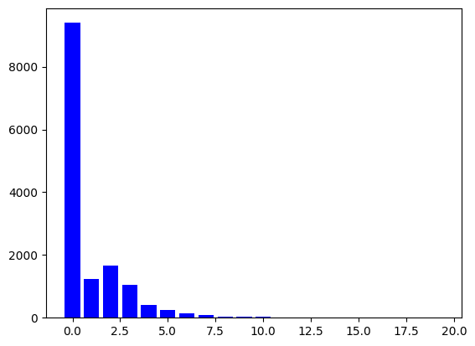
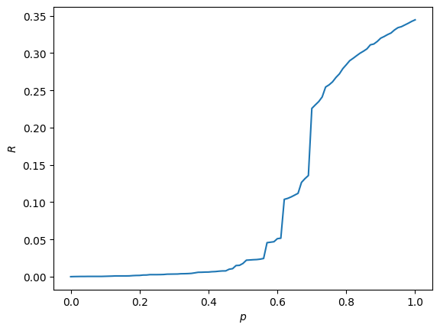
Gene Network
https://networkrepository.com/bio-human-gene2.php
Link percolation – N = 14340
Degree distribution of the gene network

Slide 8
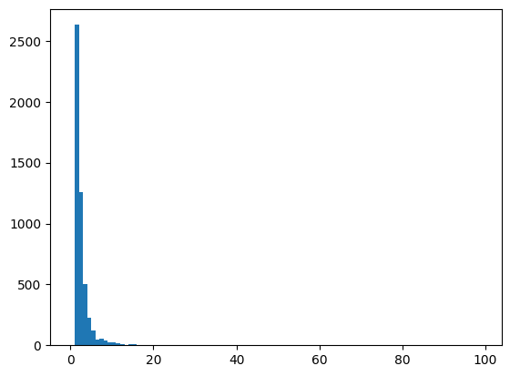
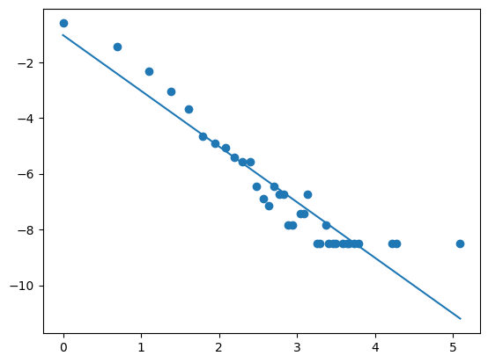
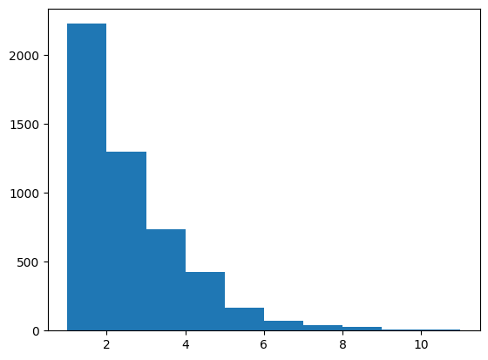
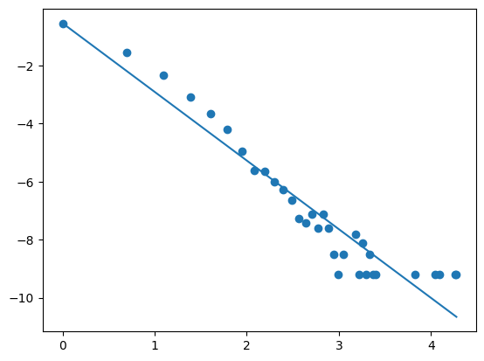
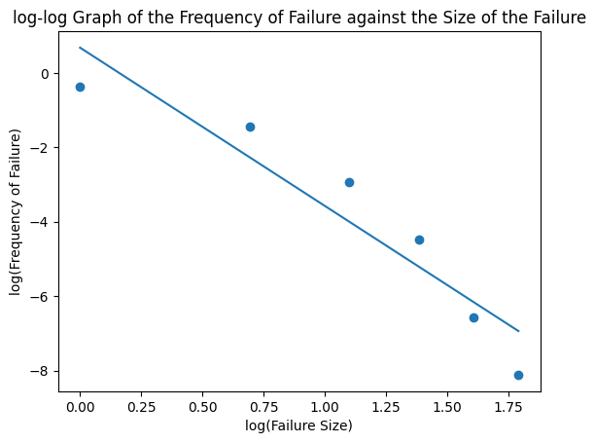
Failure propagation model
http://networksciencebook.com/chapter/8#modeling-cascading
Histogram of the frequency of failure against the size of the failure for an Erdos Renyi graph with N = 5000, c = 2, threshold = 0.4.
Histogram of the frequency of failure against the size of the failure for an BA graph with N = 5000, m = 1, threshold = 0.4.

Slide 9
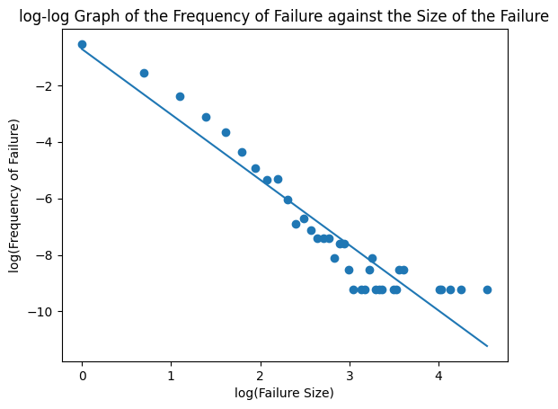
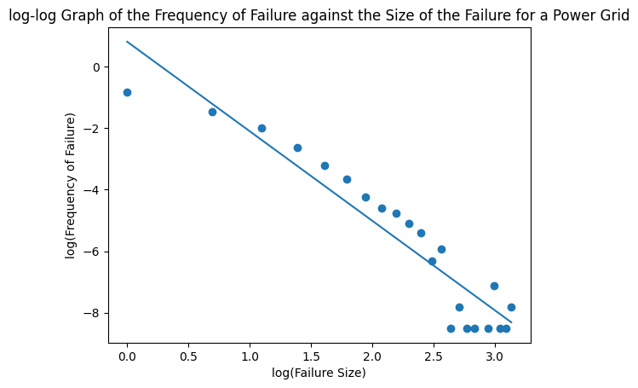
G = -2.3, N =10,000 m = 2

Slide 10
Threshold = 0.4
inactive
active
f=1/2
f=1/2

Slide 11
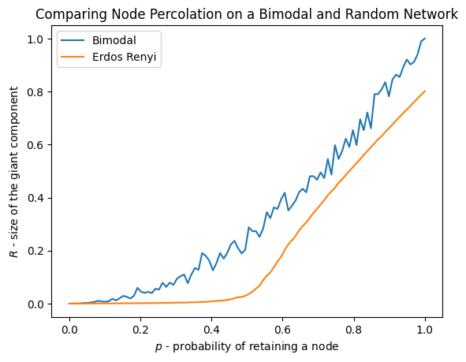
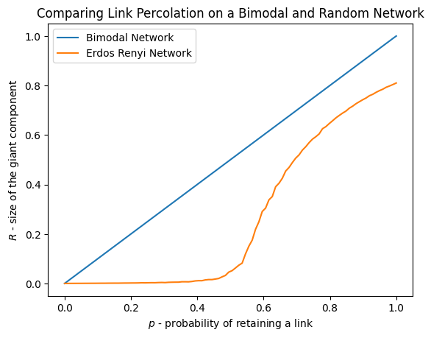
Building Robustness
N = 5000, c_min = 1, repeat = 100

