Slide 1
Boolean directed network which mimics regulatory feedback networks

Slide 2
The Setup
An Erdös-Renyi random graph is generated with directed edges. The edges either have a positive effect(weight = +1) or a negative effect(weight = -1).
Each node is either ON or OFF and all nodes start ON.
For example:
1
2
0

Slide 3
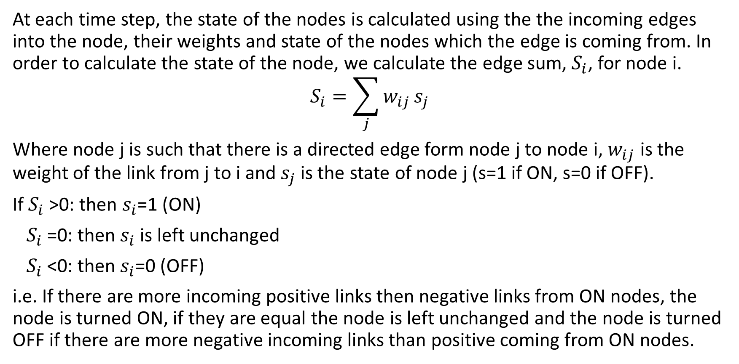
The Rules
At each time step, the state of the nodes is calculated using the the incoming edges into the node, their weights and state of the nodes which the edge is coming from. In order to calculate the state of the node, we calculate the edge sum, $S_{i}$, for node i.
$$S_{i}=\sum_{j}{w_{ij}}s_{j}$$
Where node j is such that there is a directed edge form node j to node i, $w_{ij}$ is the weight of the link from j to i and $s_{j}$ is the state of node j (s=1 if ON, s=0 if OFF).
If $S_{i}$>0: then $s_{i}$=1 (ON)
$S_{i}$=0: then $s_{i}$ is left unchanged
$S_{i}$<0: then $s_{i}$=0 (OFF)
i.e. If there are more incoming positive links then negative links from ON nodes, the node is turned ON, if they are equal the node is left unchanged and the node is turned OFF if there are more negative incoming links than positive coming from ON nodes.

Slide 4
Example
Time step | State of node 0 | State of node 1 | State of node 2
t=0 | 1 | 1 | 1
t=1 | S=0 unchanged 1 | S=(+1)*1+(-1)*1=0 unchanged 1 | S=(-1)*1=-1 Set to OFF 0
t=2 | S=0 unchanged 1 | S=(+1)*1+(-1)*0=1 Set to ON 1 | S=(-1)*1=-1 Set to OFF 0
t=3 | S=0 unchanged 1 | S=(+1)*1+(-1)*0=1 Set to ON 1 | S=(-1)*1=-1 Set to OFF 0
1
2
0
Stable state reached – no change happens
.
.
.

Slide 5
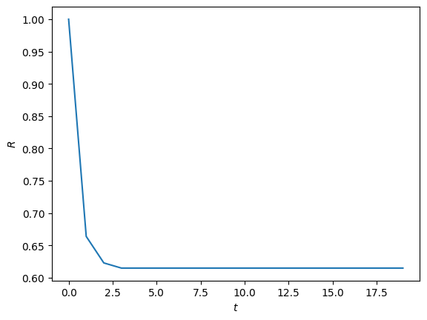
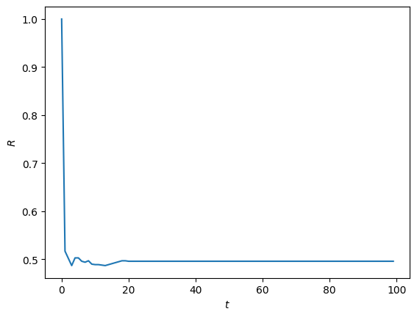
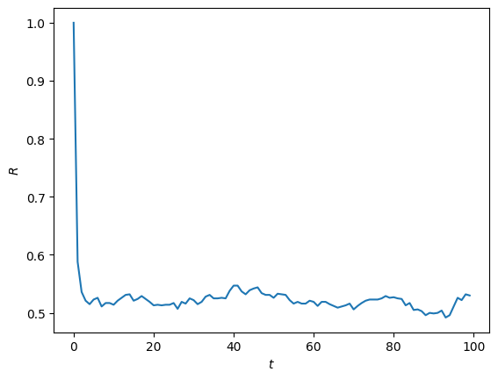
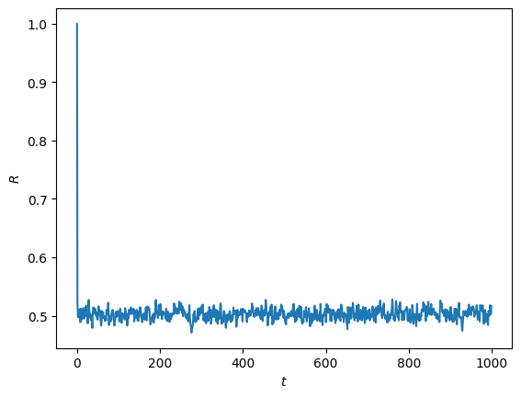
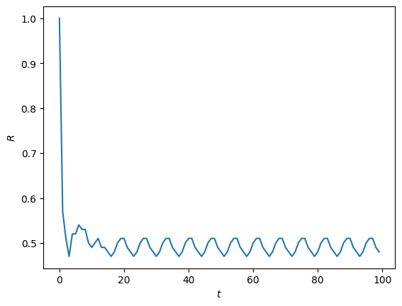
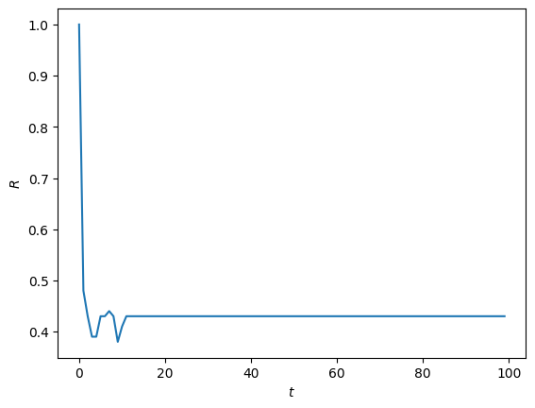
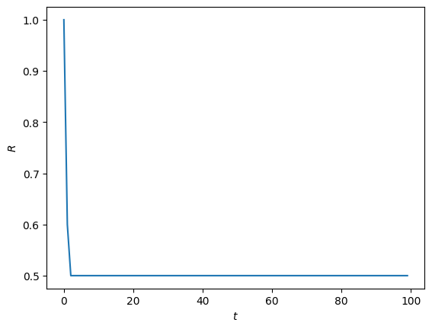

Investigating ratio of ON nodes
N=1000, c=2
N=1000, c=15
N=1000, c=20
N=1000, c=50
N=100, c=20
N=100, c=20
N=10, c=2
N=100, c=10

Slide 6
Observations
Sometimes there is a quick decline in the ratio and stabilisation to a single value, sometimes there is periodic behaviour and sometimes the R value shifts around chaotically around 0.5.
For low c values, the graph settles on ratios other than 0.5. This ratio seems to be relatively constant across many networks and doesn’t fluctuate too much with the size of the network.
Larger the c value, the more the chaotic behaviour lasts.
The larger the size, the longer it takes to stabilise.

Slide 7
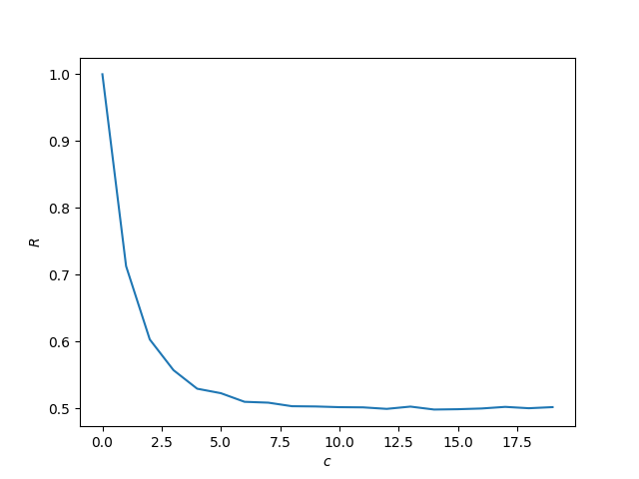
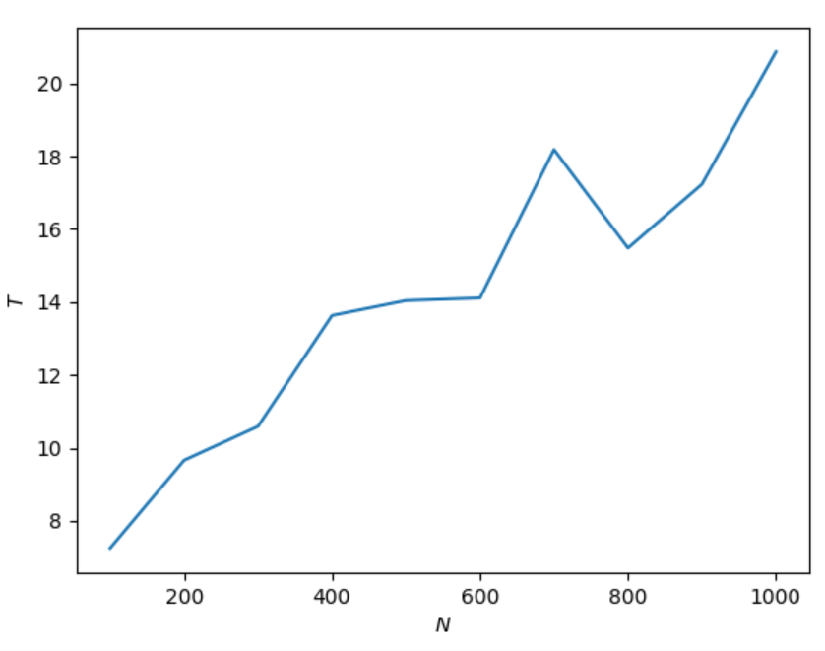
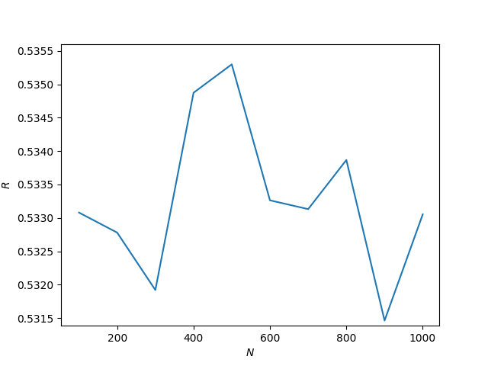
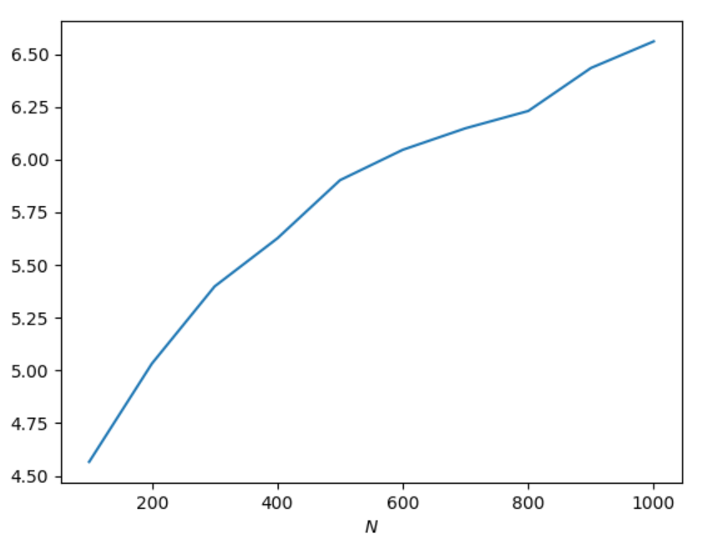
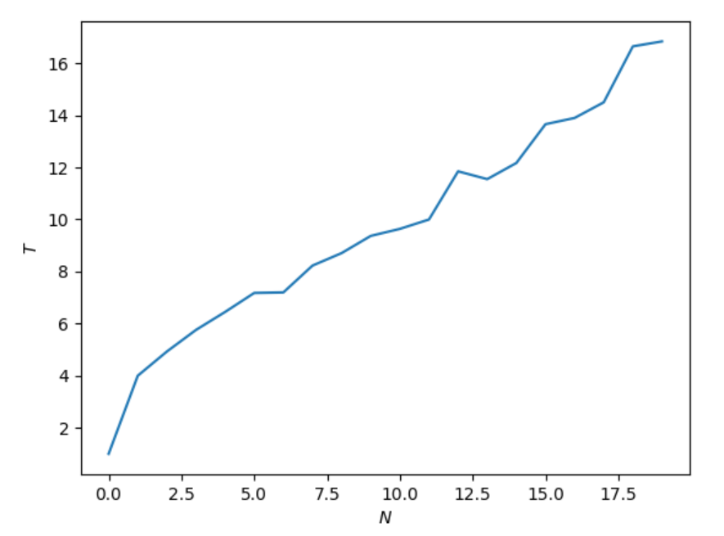
Data
The ratio of ON nodes which the network stabilises to against the number of nodes
The number of time steps taken for the network to stabilise against the number of nodes
The number of time steps taken for the network to stabilise against the average degree of nodes
The ratio of ON nodes which the network stabilises to against the average degree of nodes
N=1000, repeat per c value = 100
c=4, repeat per N value = 500
N=1000, repeat per c value = 100
c=4, repeat per N value = 500

Slide 8
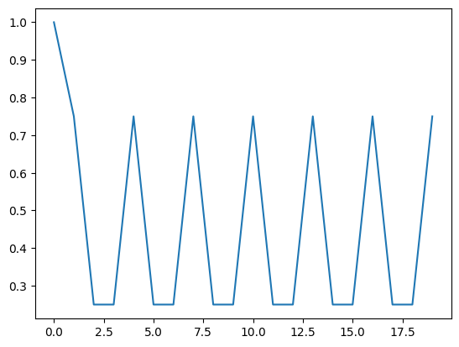
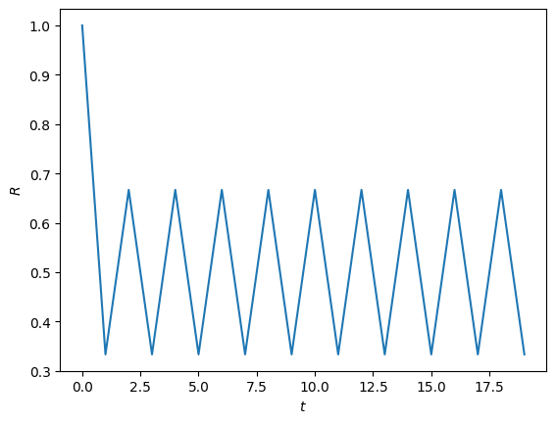
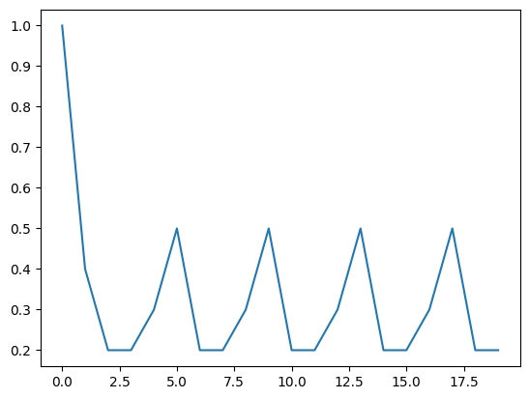
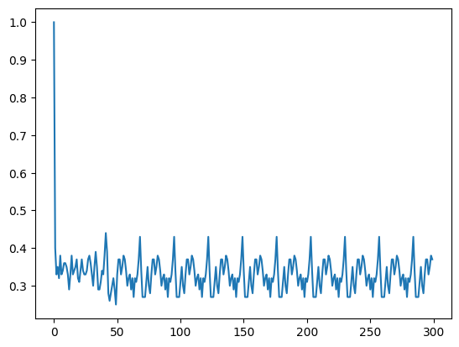
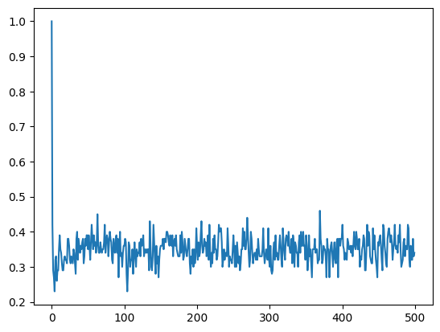
Perceptron
[(0, {'active': 1}), (1, {'active': 1}), (2, {'active': 0})] [(0, 1, {'weight': -1}), (0, 2, {'weight': 1}), (1, 0, {'weight': -1}), (1, 2, {'weight': 1}), (2, 0, {'weight': 1}), (2, 1, {'weight': 1})] – N=3,c=3
[(0, 1, {'weight': -1}), (0, 2, {'weight': 1}), (0, 3, {'weight': 1}), (1, 0, {'weight': 1}), (1, 2, {'weight': 1}), (1, 3, {'weight': 1}), (2, 0, {'weight': -1}), (2, 1, {'weight': 1}), (2, 3, {'weight': -1}), (3, 0, {'weight': 1}), (3, 1, {'weight': -1}), (3, 2, {'weight': 1})] - N=4,c=4
[(0, 1, {'weight': -1}), (0, 2, {'weight': 1}), (0, 3, {'weight': 1}), (0, 5, {'weight': 1}), (0, 6, {'weight': -1}), (0, 7, {'weight': 1}), (1, 4, {'weight': -1}), (1, 6, {'weight': -1}), (1, 7, {'weight': 1}), (1, 9, {'weight': -1}), (1, 0, {'weight': -1}), (2, 3, {'weight': 1}), (2, 5, {'weight': -1}), (2, 6, {'weight': 1}), (2, 8, {'weight': -1}), (2, 9, {'weight': 1}), (2, 1, {'weight': 1}), (3, 4, {'weight': 1}), (3, 5, {'weight': 1}), (3, 6, {'weight': -1}), (3, 7, {'weight': -1}), (3, 9, {'weight': 1}), (3, 1, {'weight': 1}), (3, 2, {'weight': -1}), (4, 5, {'weight': -1}), (4, 6, {'weight': -1}), (4, 7, {'weight': 1}), (4, 8, {'weight': 1}), (4, 1, {'weight': -1}), (4, 2, {'weight': -1}), (4, 3, {'weight': -1}), (5, 6, {'weight': -1}), (5, 7, {'weight': -1}), (5, 8, {'weight': 1}), (5, 9, {'weight': 1}), (5, 2, {'weight': 1}), (5, 3, {'weight': -1}), (5, 4, {'weight': 1}), (6, 8, {'weight': 1}), (6, 9, {'weight': -1}), (6, 0, {'weight': -1}), (6, 1, {'weight': 1}), (6, 3, {'weight': 1}), (6, 4, {'weight': -1}), (7, 8, {'weight': -1}), (7, 9, {'weight': -1}), (7, 0, {'weight': 1}), (7, 5, {'weight': 1}), (7, 6, {'weight': 1}), (8, 0, {'weight': -1}), (8, 1, {'weight': 1}), (8, 2, {'weight': -1}), (8, 3, {'weight': -1}), (8, 4, {'weight': -1}), (8, 7, {'weight': -1}), (9, 0, {'weight': 1}), (9, 2, {'weight': 1}), (9, 4, {'weight': 1}), (9, 6, {'weight': 1}), (9, 7, {'weight': 1}), (9, 8, {'weight': 1})]
N=10,c=5
Instead of the rule with S=0 no change we have S > 0 turns ON, else OFF.
Simple oscillation:
N=100,c=4
N=3, c=3 N=10, c=5 N=100, c=4 N=100, c=5
N=100,c=5

Slide 9
Time step | State of node 0 | State of node 1 | State of node 2
t=0 | 1 | 1 | 1
t=1 | S=(-1)*1+(+1)*1=0 Set to OFF 0 | S=(+1)*1+(-1)*1=0 Set to OFF 0 | S=(+1)*1+(+1)*1=2 Set to ON 1
t=2 | S=(+1)*1=1 Set to ON 1 | S=(+1)*1=1 Set to ON 1 | S=0 Set to OFF 0
t=3 | S=(-1)*1+(+1)*1=0 Set to OFF 0 | S=(+1)*1+(-1)*1=0 Set to OFF 0 | S=(+1)*1+(+1)*1=2 Set to ON 1
t=2 | S=(+1)*1=1 Set to ON 1 | S=(+1)*1=1 Set to ON 1 | S=0 Set to OFF 0
1
2
0
.
.
.

