Slide 1
Multidimensional Scaling

Slide 2
Introduction
A method for transformed multivariate data in low-dimensional space.
MDS deal with the following problem:
For a set observed similarities between every pair of N items, find a representation of items in few dimensions such that interitem proximities ‘‘ near match ” the original similarities .
Two basic mechanism of MDS procedure:
Metric (Classical) MDS
Non-metric MDS

Slide 3
Deriving proximities
Proximities indicate the overall (dis)similarity of the objects under investigation.
An MDS program looks for a spatial conﬁguration of the objects, so that the distances between the objects match their proximities as closely as possible.
●重要名詞解釋
Proximity : 鄰近度
Similarity : 相似度

Slide 4
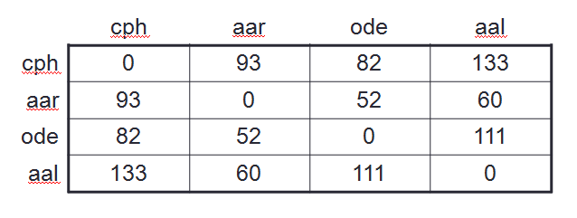

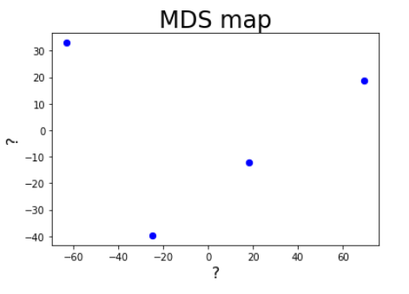
Just like this…

Slide 5
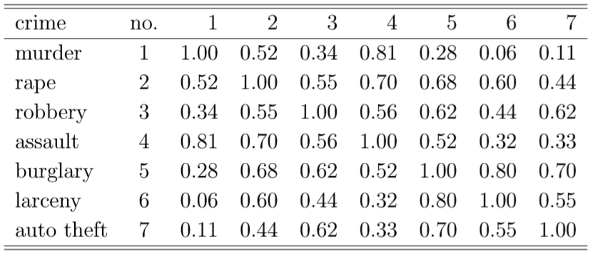
Deriving proximities
Often the data(proximities) are arranged in a square matrix (the proximity matrix).
There are two major groups of methods for deriving proximities:
Direct methods
Indirect methods

Slide 6
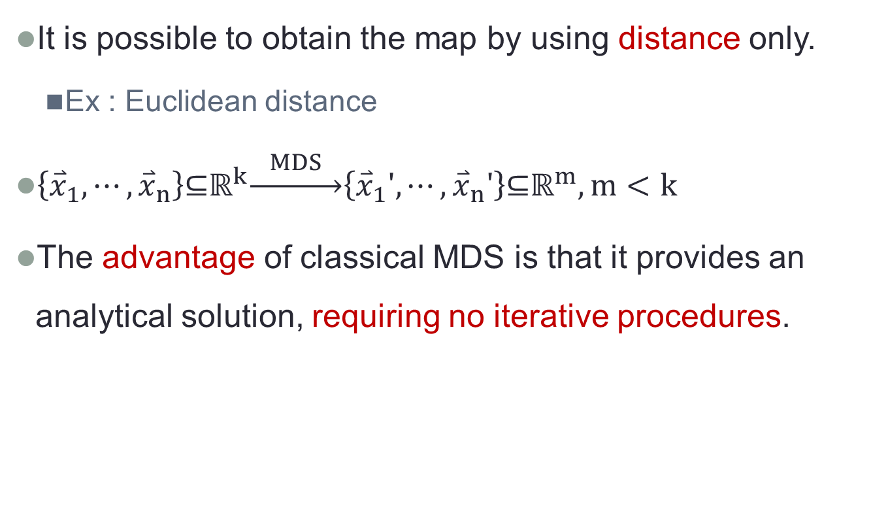
Metric (Classical) MDS
It is possible to obtain the map by using distance only.
Ex : Euclidean distance
$\left\{{\overset{⃑}{x}}_{1},⋯,{\overset{⃑}{x}}_{n}\right\}\text{⊆}{\text{ℝ}}^{k}\underset{→}{ MDS }\left\{{\overset{⃑}{x}}_{1}',⋯,{\overset{⃑}{x}}_{n}'\right\}\text{⊆}{\text{ℝ}}^{m}, m<k$
The advantage of classical MDS is that it provides an analytical solution, requiring no iterative procedures.

Slide 7
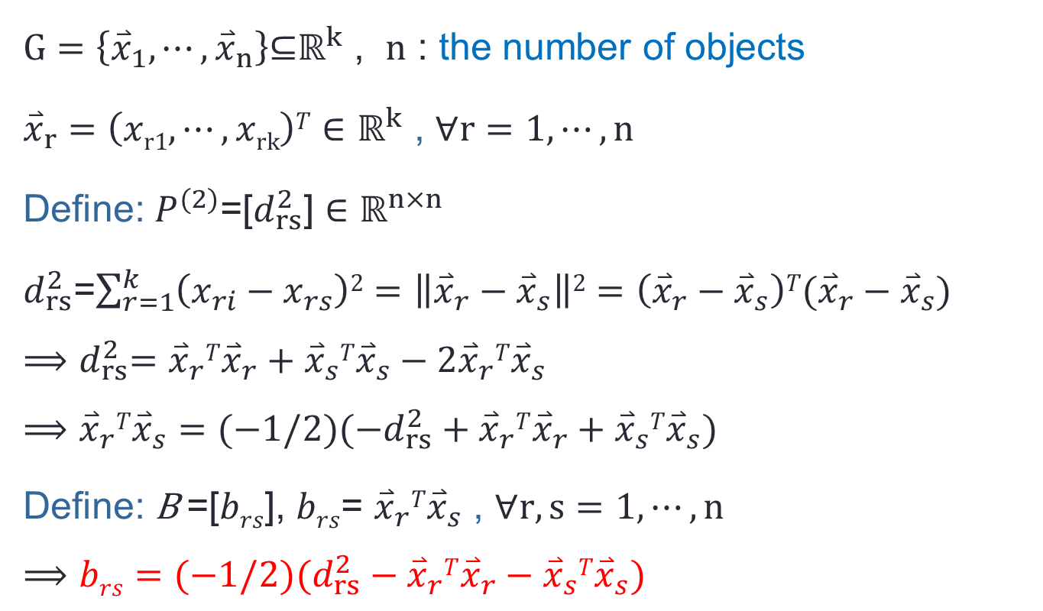
Deriving metric MDS
$G=\left\{{\overset{⃑}{x}}_{1},⋯,{\overset{⃑}{x}}_{n}\right\}\text{⊆}{\text{ℝ}}^{k}$ , $n$ : the number of objects
${\overset{⃑}{x}}_{r}=\left(xr1,⋯,xrk\right)T∈$ ${\text{ℝ}}^{k}$ , $∀r=1,⋯,n$
Define: $P^{(2)}$=[$d_{rs}^{2}$] $∈{\text{ℝ}}^{n×n}$
$d_{rs}^{2}$=$\sum_{r=1}^{k}{\left(x_{ri}−x_{rs}\right)2}=\left\|{\overset{⃑}{x}}_{r}−{\overset{⃑}{x}}_{s}\right\|2=\left({\overset{⃑}{x}}_{r}−{\overset{⃑}{x}}_{s}\right)T({\overset{⃑}{x}}_{r}−{\overset{⃑}{x}}_{s})$
$${⟹d}_{rs}^{2}={\overset{⃑}{x}}_{r}T{\overset{⃑}{x}}_{r}+{\overset{⃑}{x}}_{s}T{\overset{⃑}{x}}_{s}−{2{\overset{⃑}{x}}_{r}T\overset{⃑}{x}}_{s}$$
$$⟹{{\overset{⃑}{x}}_{r}T\overset{⃑}{x}}_{s}=(−1/2)(−d_{rs}^{2}+{\overset{⃑}{x}}_{r}T{\overset{⃑}{x}}_{r}+{\overset{⃑}{x}}_{s}T{\overset{⃑}{x}}_{s})$$
Define: B =[$brs$], $brs$= ${{\overset{⃑}{x}}_{r}T\overset{⃑}{x}}_{s}$ , $∀r,s=1,⋯,n$
$$⟹brs=(−1/2)(d_{rs}^{2}−{\overset{⃑}{x}}_{r}T{\overset{⃑}{x}}_{r}−{\overset{⃑}{x}}_{s}T{\overset{⃑}{x}}_{s})$$

Slide 8
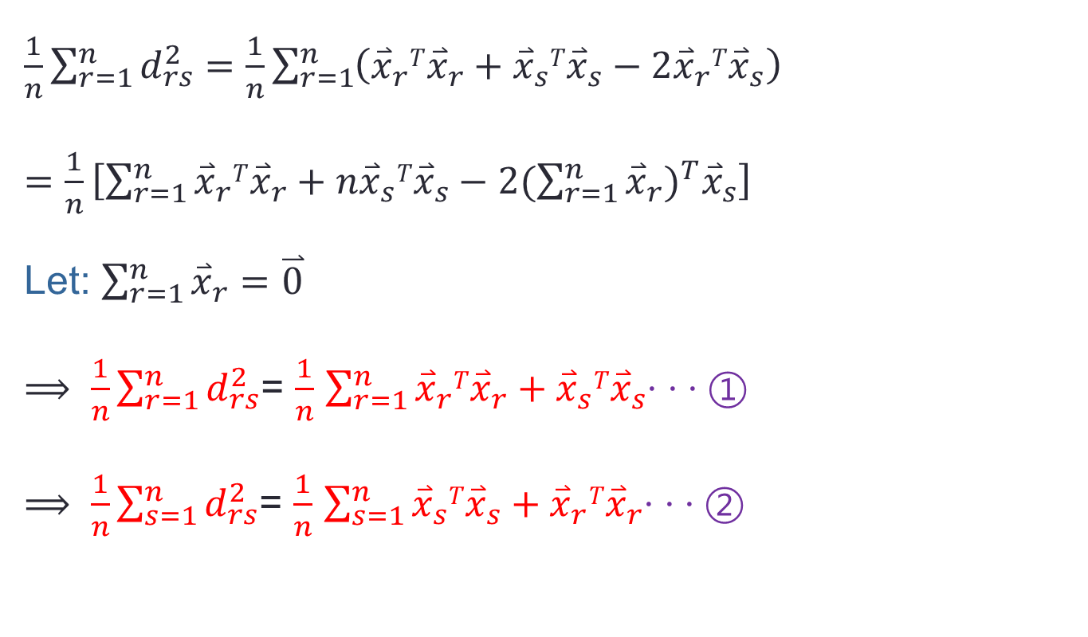
Deriving metric MDS
$\frac{1}{n}\sum_{r=1}^{n}{d_{rs}^{2}}=\frac{1}{n}\sum_{r=1}^{n}{\left({\overset{⃑}{x}}_{r}T{\overset{⃑}{x}}_{r}+{\overset{⃑}{x}}_{s}T{\overset{⃑}{x}}_{s}−{2{\overset{⃑}{x}}_{r}T\overset{⃑}{x}}_{s}\right)}$
$=\frac{1}{n}\left[\sum_{r=1}^{n}{{{\overset{⃑}{x}}_{r}T\overset{⃑}{x}}_{r}}+n{\overset{⃑}{x}}_{s}T{\overset{⃑}{x}}_{s}−2{(\sum_{r=1}^{n}{{\overset{⃑}{x}}_{r}})}^{T}{\overset{⃑}{x}}_{s}\right]$
Let: $\sum_{r=1}^{n}{{\overset{⃑}{x}}_{r}=\overset{⃑}{0}}$
$⟹ \frac{1}{n}\sum_{r=1}^{n}{d_{rs}^{2}}$= $\frac{1}{n}$ $\sum_{r=1}^{n}{{{\overset{⃑}{x}}_{r}T\overset{⃑}{x}}_{r}}+{\overset{⃑}{x}}_{s}T{\overset{⃑}{x}}_{s}\text{‧ ‧ ‧ }①$
$⟹ \frac{1}{n}\sum_{s=1}^{n}{d_{rs}^{2}}$= $\frac{1}{n}$ $\sum_{s=1}^{n}{{{\overset{⃑}{x}}_{s}T\overset{⃑}{x}}_{s}}+{\overset{⃑}{x}}_{r}T{\overset{⃑}{x}}_{r}\text{‧ ‧ ‧ }②$

Slide 9
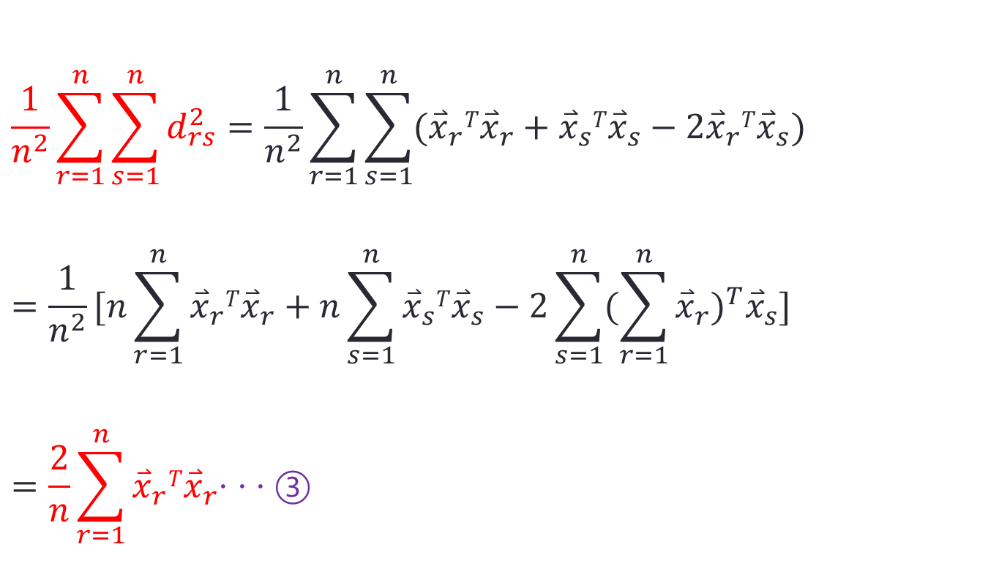
Deriving metric MDS
$$\frac{1}{n^{2}}\sum_{r=1}^{n}{\sum_{s=1}^{n}{d_{rs}^{2}=\frac{1}{n^{2}}\sum_{r=1}^{n}{\sum_{s=1}^{n}{({\overset{⃑}{x}}_{r}T{\overset{⃑}{x}}_{r}+{\overset{⃑}{x}}_{s}T{\overset{⃑}{x}}_{s}−{2{\overset{⃑}{x}}_{r}T\overset{⃑}{x}}_{s})}}}}$$
$$=\frac{1}{n^{2}}[n\sum_{r=1}^{n}{{\overset{⃑}{x}}_{r}T{\overset{⃑}{x}}_{r}}+n\sum_{s=1}^{n}{{\overset{⃑}{x}}_{s}T{\overset{⃑}{x}}_{s}}−2\sum_{s=1}^{n}{{(\sum_{r=1}^{n}{{\overset{⃑}{x}}_{r}})}^{T}{\overset{⃑}{x}}_{s}]}$$
$$=\frac{2}{n}\sum_{r=1}^{n}{{\overset{⃑}{x}}_{r}T{\overset{⃑}{x}}_{r}\text{‧ ‧ ‧ }③}$$

Slide 10
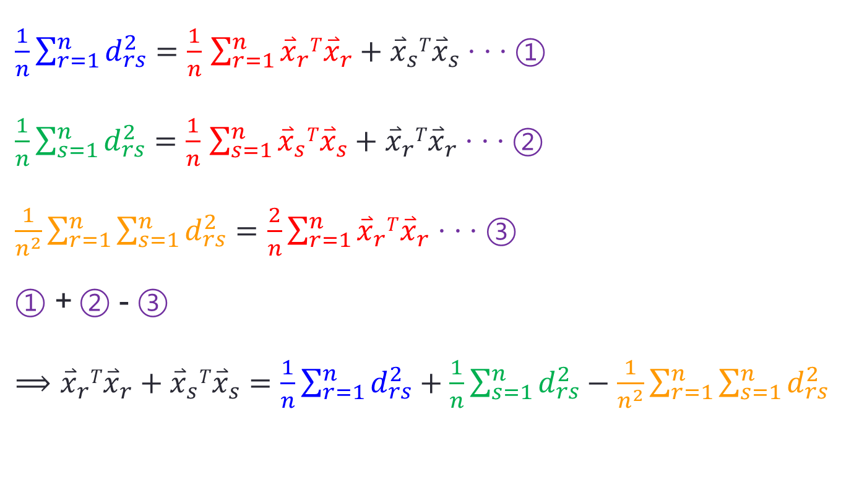
Deriving metric MDS
$\frac{1}{n}\sum_{r=1}^{n}{d_{rs}^{2}}=$ $\frac{1}{n}$ $\sum_{r=1}^{n}{{{\overset{⃑}{x}}_{r}T\overset{⃑}{x}}_{r}}+{\overset{⃑}{x}}_{s}T{\overset{⃑}{x}}_{s}$ $\text{‧ ‧ ‧ }①$
$\frac{1}{n}\sum_{s=1}^{n}{d_{rs}^{2}}=$ $\frac{1}{n}$ $\sum_{s=1}^{n}{{{\overset{⃑}{x}}_{s}T\overset{⃑}{x}}_{s}}+{\overset{⃑}{x}}_{r}T{\overset{⃑}{x}}_{r}$ $\text{‧ ‧ ‧ }②$
$\frac{1}{n^{2}}\sum_{r=1}^{n}{\sum_{s=1}^{n}{d_{rs}^{2}}}=\frac{2}{n}\sum_{r=1}^{n}{{\overset{⃑}{x}}_{r}T{\overset{⃑}{x}}_{r}}$ $\text{‧ ‧ ‧ }③$
$①$ +$②$ - $③$
$⟹{\overset{⃑}{x}}_{r}T{\overset{⃑}{x}}_{r}+{\overset{⃑}{x}}_{s}T{\overset{⃑}{x}}_{s}=\frac{1}{n}\sum_{r=1}^{n}{d_{rs}^{2}}+\frac{1}{n}\sum_{s=1}^{n}{d_{rs}^{2}}−\frac{1}{n^{2}}\sum_{r=1}^{n}{\sum_{s=1}^{n}{d_{rs}^{2}}}$

Slide 11
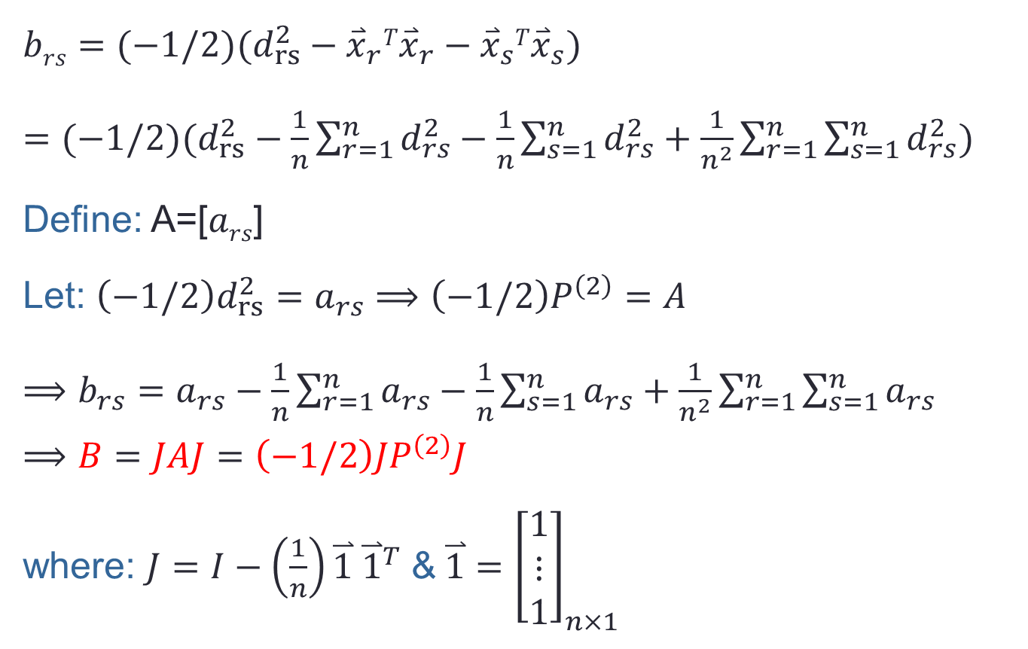
Deriving metric MDS
$$brs=(−1/2)(d_{rs}^{2}−{\overset{⃑}{x}}_{r}T{\overset{⃑}{x}}_{r}−{\overset{⃑}{x}}_{s}T{\overset{⃑}{x}}_{s})$$
$=(−1/2)(d_{rs}^{2}−\frac{1}{n}\sum_{r=1}^{n}{d_{rs}^{2}}−\frac{1}{n}\sum_{s=1}^{n}{d_{rs}^{2}}+\frac{1}{n^{2}}\sum_{r=1}^{n}{\sum_{s=1}^{n}{d_{rs}^{2}}})$
Define: A=[$ars$]
Let: $\left(−1/2\right)d_{rs}^{2}=a_{rs}⟹\left(−1/2\right)P^{\left(2\right)}=A$
$⟹{b_{rs}=a}_{rs}−\frac{1}{n}\sum_{r=1}^{n}{a_{rs}}−\frac{1}{n}\sum_{s=1}^{n}{a_{rs}}+\frac{1}{n^{2}}\sum_{r=1}^{n}{\sum_{s=1}^{n}{a_{rs}}}$
$$⟹B=JAJ=\left(−1/2\right){JP}^{\left(2\right)}J$$
where: $J=I−\left(\frac{1}{n}\right)\overset{⃑}{1} {\overset{⃑}{1}}^{T}$ &$\overset{⃑}{1}={\left[\begin{aligned}1 \\ ⋮ \\ 1\end{aligned}\right]}_{n×1}$

Slide 12
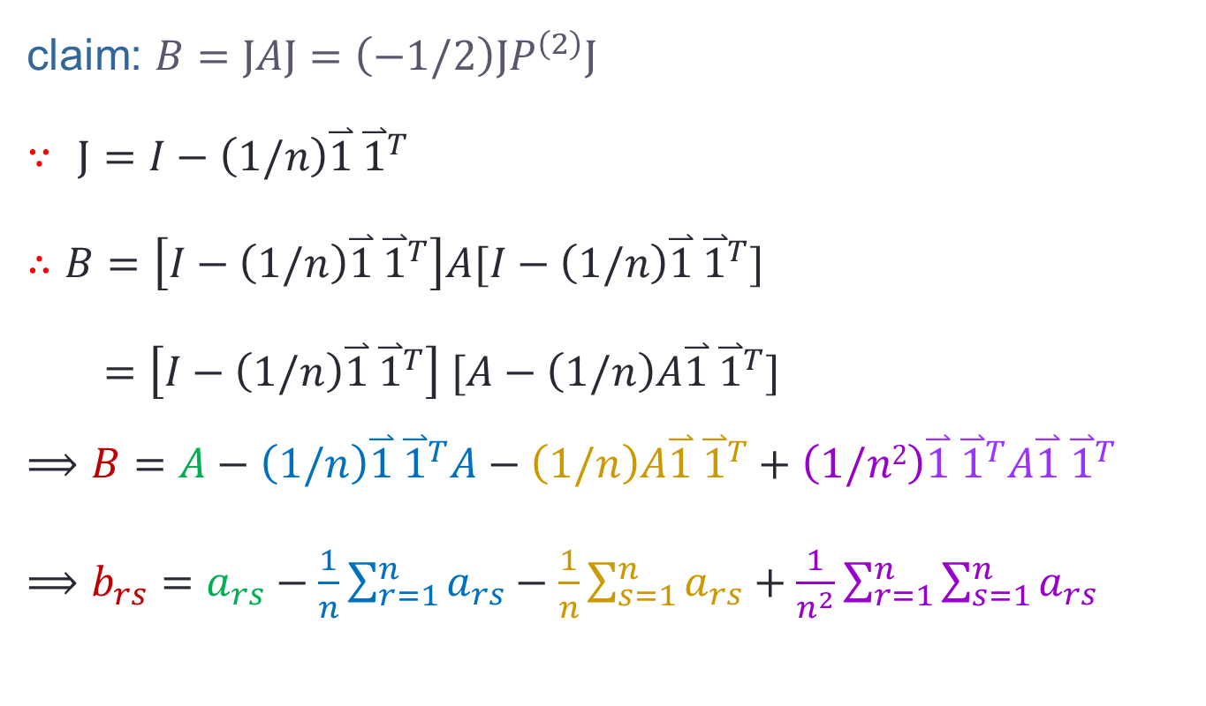
Deriving metric MDS
claim: $B=JAJ=\left(−1/2\right){JP}^{\left(2\right)}J$
$∵$ $J=I−\left(1/n\right)\overset{⃑}{1} {\overset{⃑}{1}}^{T}$
$∴$ $B=\left[I−\left(1/n\right)\overset{⃑}{1} {\overset{⃑}{1}}^{T}\right]A[I−\left(1/n\right)\overset{⃑}{1} {\overset{⃑}{1}}^{T}]$
$=\left[I−\left(1/n\right)\overset{⃑}{1} {\overset{⃑}{1}}^{T}\right] [A−\left(1/n\right)A\overset{⃑}{1} {\overset{⃑}{1}}^{T}]$
$$⟹B=A−\left(1/n\right)\overset{⃑}{1} {\overset{⃑}{1}}^{T}A−\left(1/n\right)A\overset{⃑}{1} {\overset{⃑}{1}}^{T}+\left(1/n2\right)\overset{⃑}{1} {\overset{⃑}{1}}^{T}A\overset{⃑}{1} {\overset{⃑}{1}}^{T}$$
$⟹{b_{rs}=a}_{rs}−\frac{1}{n}\sum_{r=1}^{n}{a_{rs}}−\frac{1}{n}\sum_{s=1}^{n}{a_{rs}}+\frac{1}{n^{2}}\sum_{r=1}^{n}{\sum_{s=1}^{n}{a_{rs}}}$

Slide 13
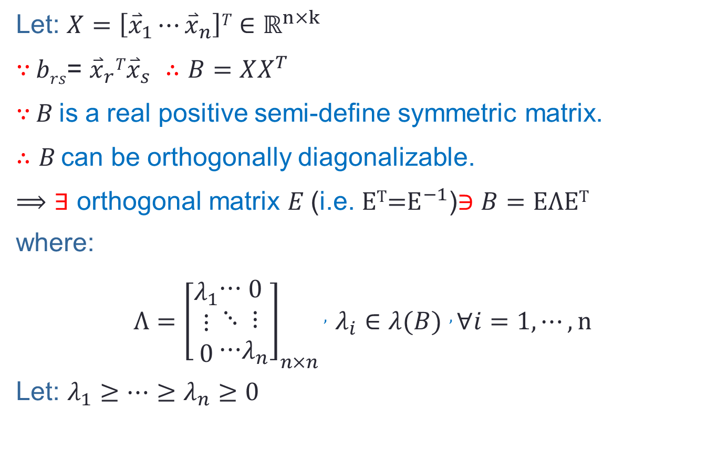
Deriving metric MDS
Let: $X=\left[{\overset{⃑}{x}}_{1}⋯{\overset{⃑}{x}}_{n}\right]T∈{\text{ℝ}}^{n×k}$
$∵$ $brs$= ${{\overset{⃑}{x}}_{r}T\overset{⃑}{x}}_{s}$ $∴$ $B=XX^{T}$
$∵$ $B$ is a real positive semi-define symmetric matrix.
$∴$ $B$ can be orthogonally diagonalizable.
$⟹$ ∃ orthogonal matrix $E$(i.e. $\text{E}\text{T}\text{=}E^{−1}$)∋ $B=E\text{Λ}\text{E}\text{T}$
where:
$Λ={\left[\begin{aligned}λ_{1} \\ ⋮ \\ 0\end{aligned}\begin{aligned}⋯ \\ ⋱ \\ ⋯\end{aligned}\begin{aligned}0 \\ ⋮ \\ λ_{n}\end{aligned}\right]}_{n×n}$ , $λ_{i}∈λ(B)$ , $∀i=1,⋯,n$
Let: $λ_{1}≥⋯≥λ_{n}≥0$

Slide 14
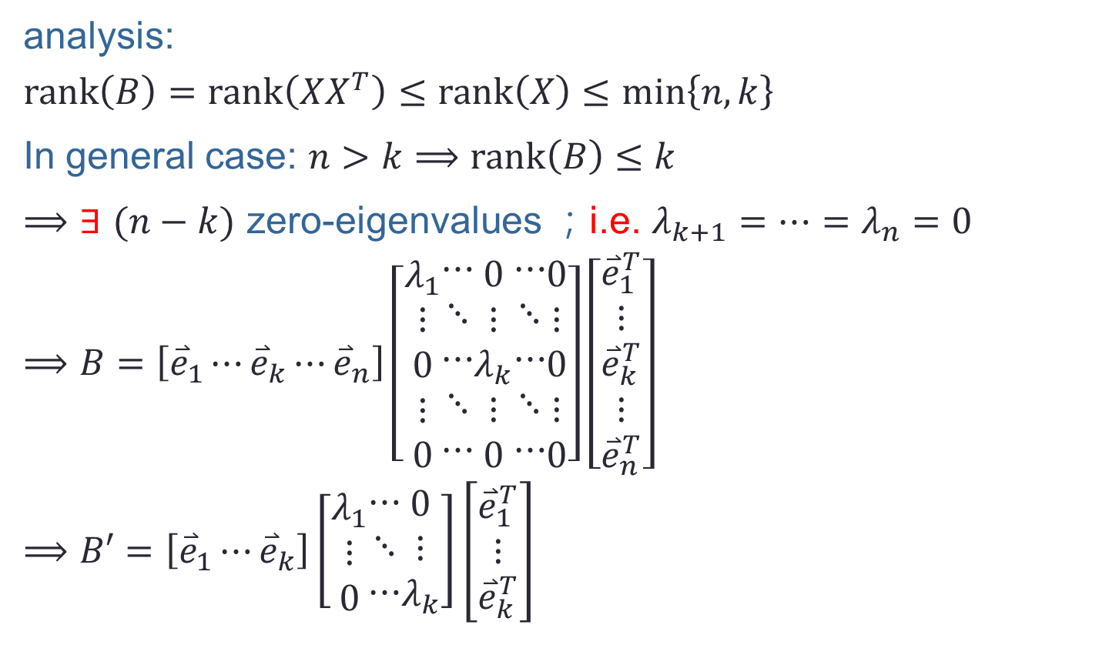
Deriving metric MDS
analysis:
$$rank\left(B\right)=rank\left(XX^{T}\right)≤rank\left(X\right)≤min\left\{n,k\right\}$$
In general case: $n>k$ $⟹$ $rank\left(B\right)≤k$
$⟹$ ∃ $(n−k)$ zero-eigenvalues ；i.e. $λ_{k+1}=⋯=λ_{n}=0$
$$⟹B=\left[{\overset{⃑}{e}}_{1}⋯{\overset{⃑}{e}}_{k}⋯{\overset{⃑}{e}}_{n}\right]\left[\begin{aligned}λ_{1} \\ ⋮ \\ 0 \\ ⋮ \\ 0\end{aligned}\begin{aligned}⋯ \\ ⋱ \\ ⋯ \\ ⋱ \\ ⋯\end{aligned}\begin{aligned}0 \\ ⋮ \\ λ_{k} \\ ⋮ \\ 0\end{aligned}\begin{aligned}⋯ \\ ⋱ \\ ⋯ \\ ⋱ \\ ⋯\end{aligned}\begin{aligned}0 \\ ⋮ \\ 0 \\ ⋮ \\ 0\end{aligned}\right]\left[\begin{aligned}{\overset{⃑}{e}}_{1}^{T} \\ ⋮ \\ {\overset{⃑}{e}}_{k}^{T} \\ ⋮ \\ {\overset{⃑}{e}}_{n}^{T}\end{aligned}\right]$$
$$⟹B′=\left[{\overset{⃑}{e}}_{1}⋯{\overset{⃑}{e}}_{k}\right]\left[\begin{aligned}λ_{1} \\ ⋮ \\ 0\end{aligned}\begin{aligned}⋯ \\ ⋱ \\ ⋯\end{aligned}\begin{aligned}0 \\ ⋮ \\ λ_{k}\end{aligned}\right]\left[\begin{aligned}{\overset{⃑}{e}}_{1}^{T} \\ ⋮ \\ {\overset{⃑}{e}}_{k}^{T}\end{aligned}\right]$$

Slide 15
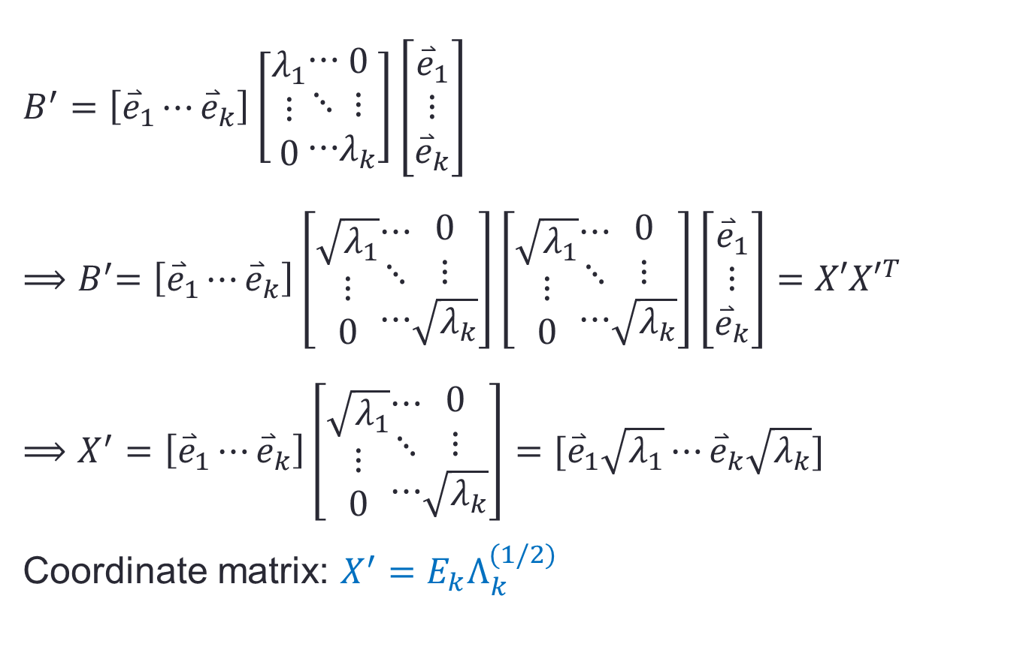
Deriving metric MDS
$$B^{′}=\left[{\overset{⃑}{e}}_{1}⋯{\overset{⃑}{e}}_{k}\right]\left[\begin{aligned}λ_{1} \\ ⋮ \\ 0\end{aligned}\begin{aligned}⋯ \\ ⋱ \\ ⋯\end{aligned}\begin{aligned}0 \\ ⋮ \\ λ_{k}\end{aligned}\right]\left[\begin{aligned}{\overset{⃑}{e}}_{1} \\ ⋮ \\ {\overset{⃑}{e}}_{k}\end{aligned}\right]$$
$${⟹B}^{′}=\left[{\overset{⃑}{e}}_{1}⋯{\overset{⃑}{e}}_{k}\right]\left[\begin{aligned}\sqrt{λ_{1}} \\ ⋮ \\ 0\end{aligned}\begin{aligned}⋯ \\ ⋱ \\ ⋯\end{aligned}\begin{aligned}0 \\ ⋮ \\ \sqrt{λ_{k}}\end{aligned}\right]\left[\begin{aligned}\sqrt{λ_{1}} \\ ⋮ \\ 0\end{aligned}\begin{aligned}⋯ \\ ⋱ \\ ⋯\end{aligned}\begin{aligned}0 \\ ⋮ \\ \sqrt{λ_{k}}\end{aligned}\right]\left[\begin{aligned}{\overset{⃑}{e}}_{1} \\ ⋮ \\ {\overset{⃑}{e}}_{k}\end{aligned}\right]=X′{X′}^{T}$$
$$⟹X^{′}=\left[{\overset{⃑}{e}}_{1}⋯{\overset{⃑}{e}}_{k}\right]\left[\begin{aligned}\sqrt{λ_{1}} \\ ⋮ \\ 0\end{aligned}\begin{aligned}⋯ \\ ⋱ \\ ⋯\end{aligned}\begin{aligned}0 \\ ⋮ \\ \sqrt{λ_{k}}\end{aligned}\right]=[{\overset{⃑}{e}}_{1}\sqrt{λ_{1}}⋯{\overset{⃑}{e}}_{k}\sqrt{λ_{k}}]$$
Coordinate matrix: $X^{′}=E_{k}Λ_{k}^{(1/2)}$

Slide 16
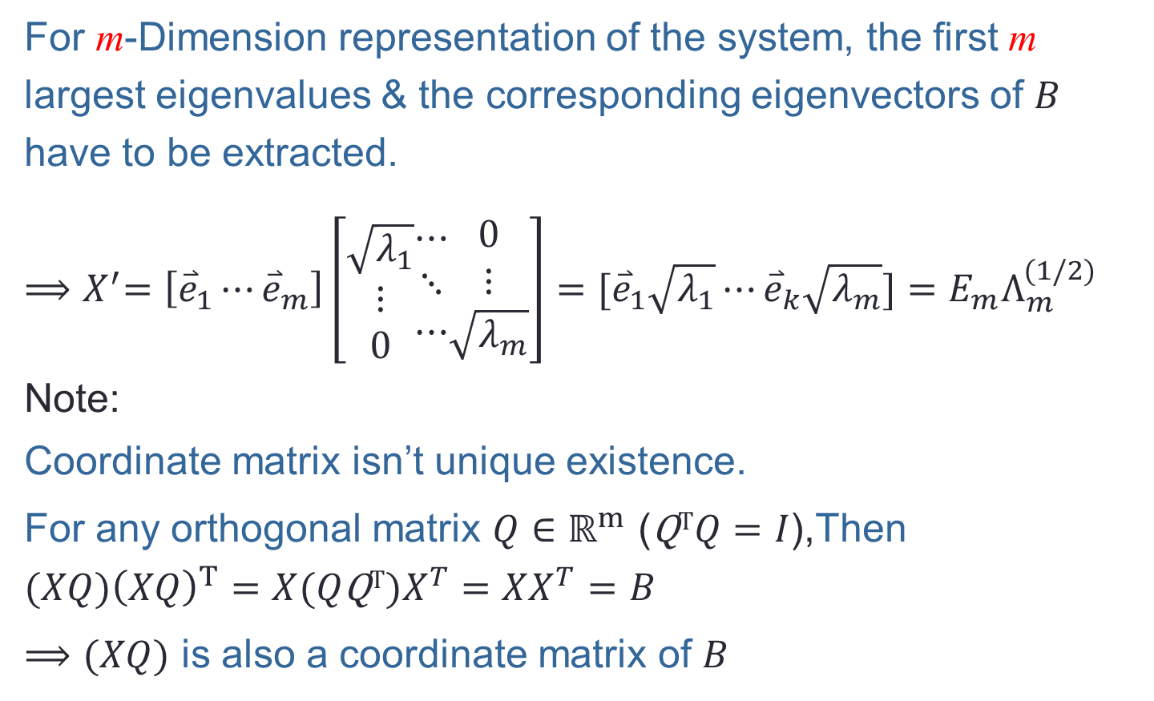
Deriving metric MDS
For m-Dimension representation of the system, the first m largest eigenvalues & the corresponding eigenvectors of $B$ have to be extracted.
${⟹X}^{′}=\left[{\overset{⃑}{e}}_{1}⋯{\overset{⃑}{e}}_{m}\right]\left[\begin{aligned}\sqrt{λ_{1}} \\ ⋮ \\ 0\end{aligned}\begin{aligned}⋯ \\ ⋱ \\ ⋯\end{aligned}\begin{aligned}0 \\ ⋮ \\ \sqrt{λ_{m}}\end{aligned}\right]=[{\overset{⃑}{e}}_{1}\sqrt{λ_{1}}⋯{\overset{⃑}{e}}_{k}\sqrt{λ_{m}}]=$ $E_{m}Λ_{m}^{(1/2)}$
Note:
Coordinate matrix isn’t unique existence.
For any orthogonal matrix $Q∈{\text{ℝ}}^{m}$ ($\text{Q}\text{T}Q=I$),Then
$$(XQ){\left(XQ\right)}^{T}=X(Q\text{Q}\text{T})X^{T}=XX^{T}=B$$
$⟹(XQ)$ is also a coordinate matrix of $B$

Slide 17
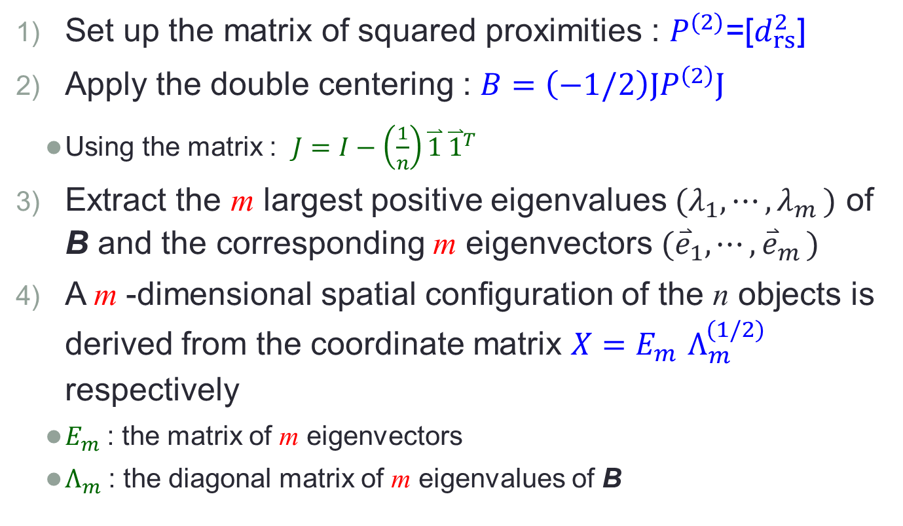
Steps of a metric MDS algorithm
Set up the matrix of squared proximities : $P^{(2)}$=[$d_{rs}^{2}$]
Apply the double centering : $B=\left(−1/2\right){JP}^{\left(2\right)}J$
Using the matrix : $J=I−\left(\frac{1}{n}\right)\overset{⃑}{1} {\overset{⃑}{1}}^{T}$
Extract the m largest positive eigenvalues ${(λ}_{1},⋯,λ_{m })$ of B and the corresponding m eigenvectors ${(\overset{⃑}{e}}_{1},⋯{,\overset{⃑}{e}}_{m})$
A m -dimensional spatial conﬁguration of the n objects is derived from the coordinate matrix $X{=E}_{m}Λ_{m}^{(1/2)}$ respectively
$E_{m}$: the matrix of m eigenvectors
$Λ_{m}$: the diagonal matrix of m eigenvalues of B

Slide 18

Metric MDS -- example
The proximity matrix of 4 cities in Denmark :
The matrix of squared proximities is
$$P^{(2)}=\left[\begin{aligned}0 \\ 8649 \\ 6724 \\ 17689 \end{aligned}\begin{aligned} 8649 \\ 0 \\ 2704 \\ 3600 \end{aligned}\begin{aligned} 6724 \\ 2704 \\ 0 \\ 12321 \end{aligned}\begin{aligned} 17689 \\ 3600 \\ 12321 \\ 0\end{aligned}\right]$$
 | cph | aar | ode | aal
cph | 0 | 93 | 82 | 133
aar | 93 | 0 | 52 | 60
ode | 82 | 52 | 0 | 111
aal | 133 | 60 | 111 | 0

Slide 19
Steps of a metric MDS algorithm
Set up the matrix of squared proximities : $P^{(2)}$=[$d_{rs}^{2}$]
Apply the double centering : $B=\left(−1/2\right){JP}^{\left(2\right)}J$
Using the matrix : $J=I−\left(\frac{1}{n}\right)\overset{⃑}{1} {\overset{⃑}{1}}^{T}$
Extract the m largest positive eigenvalues ${(λ}_{1},⋯,λ_{m })$ of B and the corresponding m eigenvectors ${(\overset{⃑}{e}}_{1},⋯{,\overset{⃑}{e}}_{m})$
A m -dimensional spatial conﬁguration of the n objects is derived from the coordinate matrix $X{=E}_{m}Λ_{m}^{(1/2)}$ respectively
$E_{m}$: the matrix of m eigenvectors
$Λ_{m}$: the diagonal matrix of m eigenvalues of B

Slide 20
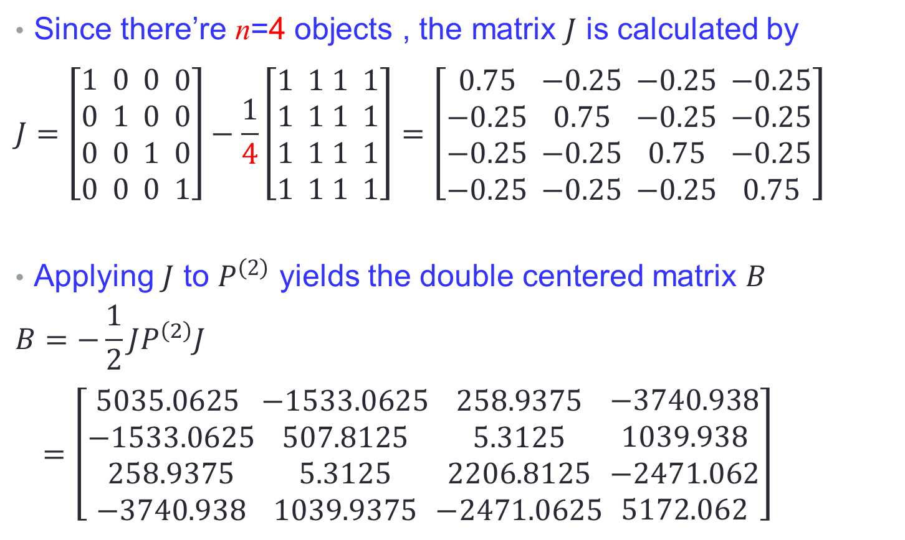
Metric MDS -- example
Since there’re n=4 objects , the matrix $J$ is calculated by
$$J=\left[\begin{aligned}1 \\ 0 \\ 0 \\ 0 \end{aligned}\begin{aligned} 0 \\ 1 \\ 0 \\ 0\end{aligned}\begin{aligned} 0 \\ 0 \\ 1 \\ 0\end{aligned}\begin{aligned} 0 \\ 0 \\ 0 \\ 1\end{aligned}\right]−\frac{1}{4}\left[\begin{aligned}1 \\ 1 \\ 1 \\ 1 \end{aligned}\begin{aligned} 1 \\ 1 \\ 1 \\ 1\end{aligned}\begin{aligned} 1 \\ 1 \\ 1 \\ 1 \end{aligned}\begin{aligned} 1 \\ 1 \\ 1 \\ 1\end{aligned}\right]=\left[\begin{aligned}0.75 \\ −0.25 \\ −0.25 \\ −0.25 \end{aligned}\begin{aligned} −0.25 \\ 0.75 \\ −0.25 \\ −0.25\end{aligned}\begin{aligned} −0.25 \\ −0.25 \\ 0.75 \\ −0.25\end{aligned}\begin{aligned} −0.25 \\ −0.25 \\ −0.25 \\ 0.75\end{aligned}\right]$$
Applying $J$ to $P^{\left(2\right)}$ yields the double centered matrix $B$
$$B=−\frac{1}{2}JP^{\left(2\right)}J$$
$$=\left[\begin{aligned}5035.0625 \\ −1533.0625 \\ 258.9375 \\ −3740.938\end{aligned}\begin{aligned} −1533.0625 \\ 507.8125 \\ 5.3125 \\ 1039.9375\end{aligned}\begin{aligned} 258.9375 \\ 5.3125 \\ 2206.8125 \\ −2471.0625\end{aligned}\begin{aligned} −3740.938 \\ 1039.938 \\ −2471.062 \\ 5172.062\end{aligned}\right]$$

Slide 21
Steps of a metric MDS algorithm
Set up the matrix of squared proximities : $P^{(2)}$=[$d_{rs}^{2}$]
Apply the double centering : $B=\left(−1/2\right){JP}^{\left(2\right)}J$
Using the matrix : $J=I−\left(\frac{1}{n}\right)\overset{⃑}{1} {\overset{⃑}{1}}^{T}$
Extract the m largest positive eigenvalues ${(λ}_{1},⋯,λ_{m })$ of B and the corresponding m eigenvectors ${(\overset{⃑}{e}}_{1},⋯{,\overset{⃑}{e}}_{m})$
A m -dimensional spatial conﬁguration of the n objects is derived from the coordinate matrix $X{=E}_{m}Λ_{m}^{(1/2)}$ respectively
$E_{m}$: the matrix of m eigenvectors
$Λ_{m}$: the diagonal matrix of m eigenvalues of B

Slide 22
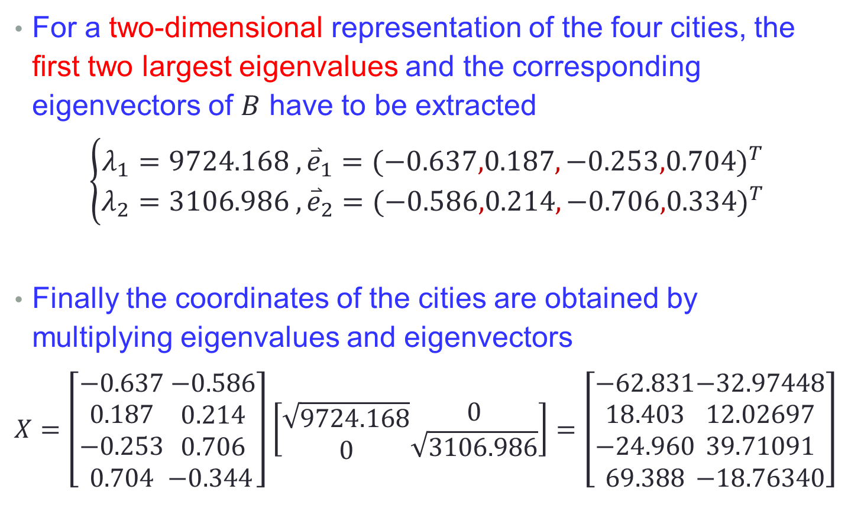
Metric MDS -- example
For a two-dimensional representation of the four cities, the ﬁrst two largest eigenvalues and the corresponding eigenvectors of $B$ have to be extracted
$$\left\{\begin{aligned}λ_{1}=9724.168 , {\overset{⃑}{e}}_{1}={(−0.637,0.187,−0.253,0.704)}^{T} \\ λ_{2}=3106.986 ,{\overset{⃑}{e}}_{2}={(−0.586,0.214,−0.706,0.334)}^{T}\end{aligned}\right.$$
Finally the coordinates of the cities are obtained by multiplying eigenvalues and eigenvectors
$$X=\left[\begin{aligned}−0.637 \\ 0.187 \\ −0.253 \\ 0.704\end{aligned}\begin{aligned} −0.586 \\ 0.214 \\ 0.706 \\ −0.344\end{aligned}\right]\left[\begin{aligned}\sqrt{9724.168} \\ 0\end{aligned}\begin{aligned}0 \\ \sqrt{3106.986}\end{aligned}\right]=\left[\begin{aligned}−62.831 \\ 18.403 \\ −24.960 \\ 69.388\end{aligned}\begin{aligned}−32.97448 \\ 12.02697 \\ 39.71091 \\ −18.76340\end{aligned}\right]$$

Slide 23
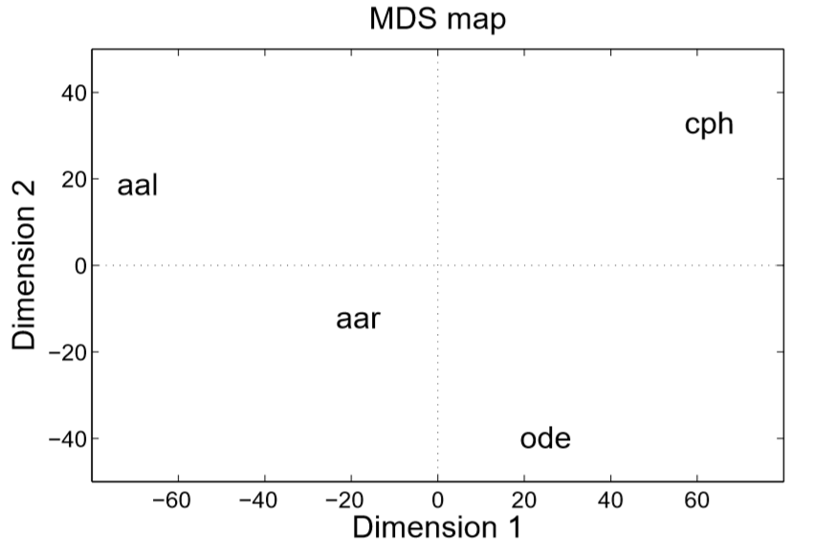
Metric MDS -- example

Slide 24
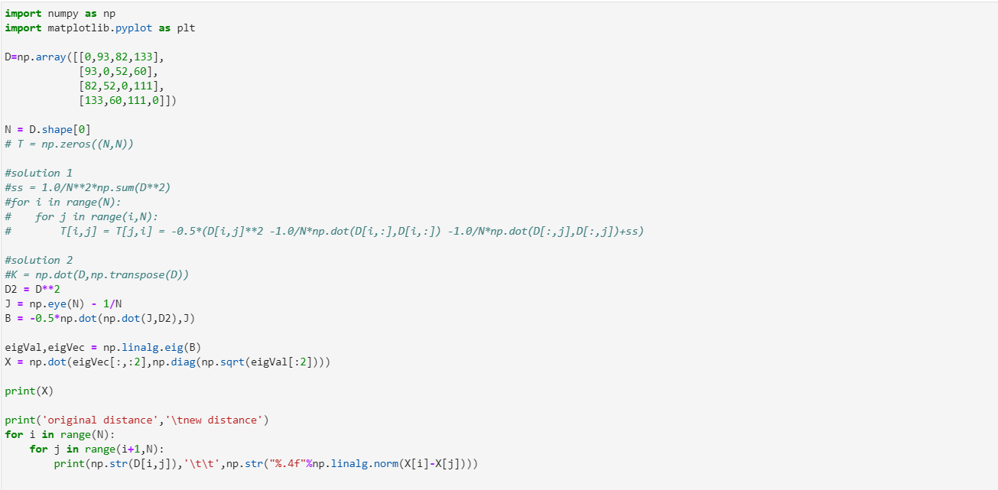
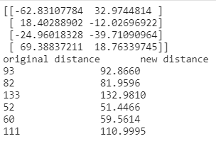
MDS code -- example

Slide 25
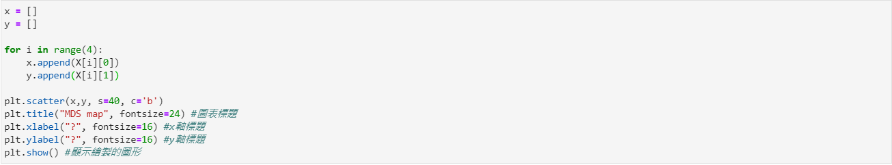
MDS code -- example
cph
aal
aar
ode

Slide 26
Nonmetric MDS
In order to solve the problem which comes to employing MDS for exploring the perceptual space of human subjects. Shepard and Kruskal developed a method known as nonmetric multidimensional scaling.
In nonmetric MDS, only the ordinal information in the proximities is used for constructing the spatial conﬁguration.
For example : Do you like optimization?
A : hate, B : so so, C : like
like→so so→hate
1 → 2 → 3

Slide 27


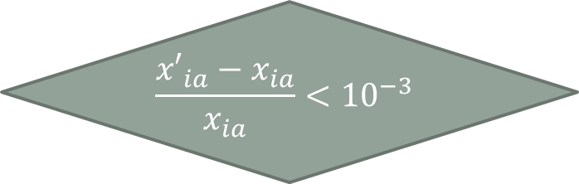



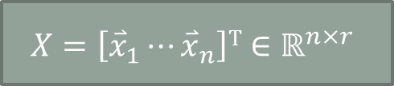
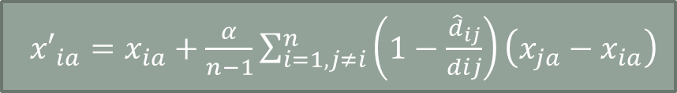
Basics of a nonmetric MDS algorithm
Proximities matrix : $p_{ij}$
distance matrix : $d_{ij}$
Try r-1
classical MDS
$$X=\left[{\overset{⃑}{x}}_{1}⋯{\overset{⃑}{x}}_{n}\right]T∈{\text{ℝ}}^{n×r}$$
$$STRESS=\sqrt{\frac{\sum{{(d_{ij}{−\hat{d}}_{ij})}^{2}}}{\sum{d_{ij}2}}}$$
Disparities : $f\left(p_{ij}\right)={\hat{d}}_{ij}$
${x′}_{ia}=x_{ia}+\frac{α}{n−1}\sum_{i=1,j≠i}^{n}{\left(1−\frac{{\hat{d}}_{ij}}{dij}\right)\left(x_{ja}−x_{ia}\right)}$
$$\frac{{x′}_{ia}−x_{ia}}{x_{ia}}<{10}^{−3}$$
No
Yes
$$r=1$$
Yes
End
No

Slide 28
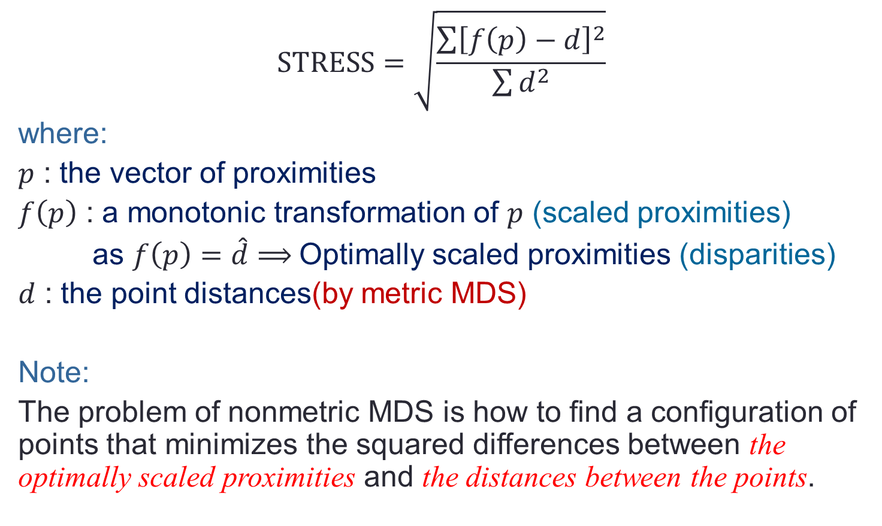
Nonmetric MDS
$$STRESS=\sqrt{\frac{\sum{{\left[f\left(p\right)−d\right]}^{2}}}{\sum{d^{2}}}}$$
where:
$p$ : the vector of proximities
$f\left(p\right)$ : a monotonic transformation of $p$ (scaled proximities)
as $f\left(p\right)=\hat{d}⟹$Optimally scaled proximities (disparities)
$d$ : the point distances(by metric MDS)
Note:
The problem of nonmetric MDS is how to ﬁnd a conﬁguration of points that minimizes the squared diﬀerences between the optimally scaled proximities and the distances between the points.

Slide 29
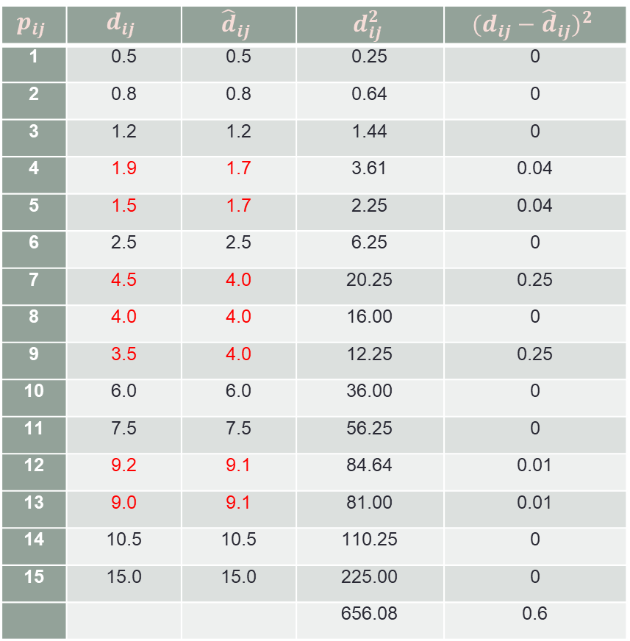
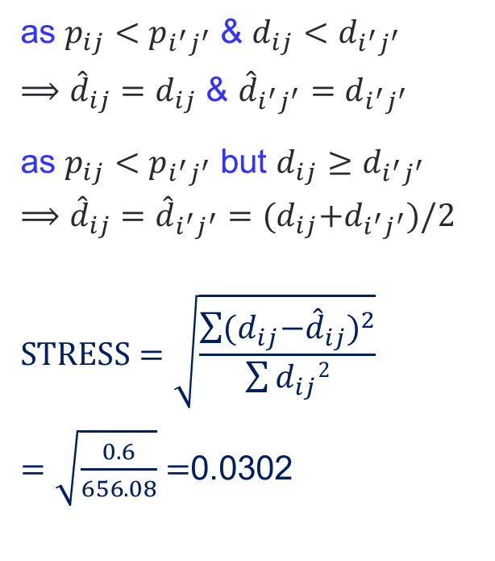
Nonmetric MDS -- example of monotonic transformation
$$p_{ij}$$ | $$d_{ij}$$ | $${\hat{d}}_{ij}$$ | $$d_{ij}^{2}$$ | $${(d_{ij}−{\hat{d}}_{ij})}^{2}$$
1 | 0.5 | 0.5 | 0.25 | 0
2 | 0.8 | 0.8 | 0.64 | 0
3 | 1.2 | 1.2 | 1.44 | 0
4 | 1.9 | 1.7 | 3.61 | 0.04
5 | 1.5 | 1.7 | 2.25 | 0.04
6 | 2.5 | 2.5 | 6.25 | 0
7 | 4.5 | 4.0 | 20.25 | 0.25
8 | 4.0 | 4.0 | 16.00 | 0
9 | 3.5 | 4.0 | 12.25 | 0.25
10 | 6.0 | 6.0 | 36.00 | 0
11 | 7.5 | 7.5 | 56.25 | 0
12 | 9.2 | 9.1 | 84.64 | 0.01
13 | 9.0 | 9.1 | 81.00 | 0.01
14 | 10.5 | 10.5 | 110.25 | 0
15 | 15.0 | 15.0 | 225.00 | 0
 |  |  | 656.08 | 0.6
as $p_{ij}<p_{i^{′}j^{′}}$ & $d_{ij}<d_{i^{′}j^{′}}$
$⟹{\hat{d}}_{ij}=d_{ij}$ & ${\hat{d}}_{i^{′}j^{′}}=d_{i^{′}j^{′}}$
as $p_{ij}<p_{i^{′}j^{′}}$ but $d_{ij}≥d_{i^{′}j^{′}}$
$$⟹{\hat{d}}_{ij}={\hat{d}}_{i^{′}j^{′}}={(d}_{ij}{+d}_{i^{′}j^{′}})/2$$
$$STRESS=\sqrt{\frac{\sum{{(d_{ij}{−\hat{d}}_{ij})}^{2}}}{\sum{d_{ij}2}}}$$
$=\sqrt{\frac{0.6}{656.08}}$ $=$0.0302

Slide 30
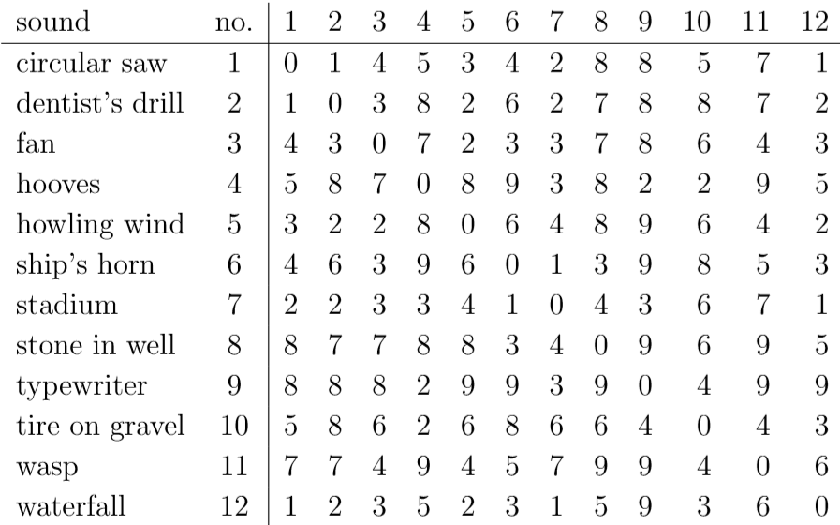
Nonmetric MDS -- example of monotonic transformation

Slide 31
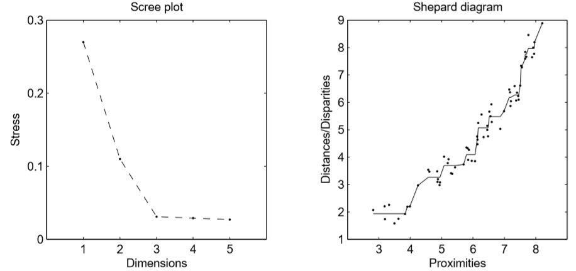
Nonmetric MDS -- stress and goodness of fit
Stress | >0.20 | 0.10 | 0.05 | 0.025 | 0.00
Goodness of fit | poor | fair | good | excellent | perfect

Slide 32
Basics of a nonmetric MDS algorithm
Proximities matrix : $p_{ij}$
distance matrix : $d_{ij}$
Try r-1
classical MDS
$$X=\left[{\overset{⃑}{x}}_{1}⋯{\overset{⃑}{x}}_{n}\right]T∈{\text{ℝ}}^{n×r}$$
$$STRESS=\sqrt{\frac{\sum{{(d_{ij}{−\hat{d}}_{ij})}^{2}}}{\sum{d_{ij}2}}}$$
${x′}_{ia}=x_{ia}+\frac{α}{n−1}\sum_{i=1,j≠i}^{n}{\left(1−\frac{{\hat{d}}_{ij}}{dij}\right)\left(x_{ja}−x_{ia}\right)}$
$$\frac{{x′}_{ia}−x_{ia}}{x_{ia}}<{10}^{−3}$$
No
Yes
$$r=1$$
Yes
End
No

Slide 33
Decisions to take before analysis
Proximities
similarities vs. dissimilarities
direct vs. indirect methods
symmetric vs. asymmetric data
MDS model
metric vs. nonmetric
Euclidean vs. non- Euclidean
Type of stress
Dimensions
1,2,3 or more dimensions
Number of objects⁽*⁾
Analysis
Individual analysis
Aggregate analysis
Software
Note ⁽*⁾ a k-dimensional representation requires at least 4k objects(Borg & Groenen,1997)

Slide 34
Deriving proximities -- direct methods
(Dis)Similarity ratings
Often a 7- or a 9-point scale is used.
Sorting tasks:
method 1 : Write each object pair on a card and let the participant sort the cards from the lowest similarity to the highest
method 2 : Let the subject put cards with pairs of low similarity into one pile, cards with pairs of higher similarity in the next pile and so on.
method 3 : Write only one object on each card and ask the participants to sort the cards with the most similar objects into piles. Counting how many times two objects appear together in a pile, yields the similarity matrix.

Slide 35
Deriving proximities -- indirect methods
Indirect methods for proximity data do not require that a subject assigns a numerical value to the elements of the proximity matrix directly.
The proximity matrix is derived from other measures. Ex:
Confusion Data
Correlation matrices

Slide 36
Deriving proximities -- indirect methods
Confusion data arise when the researcher records how often subjects mistake one stimulus for another.
Consider an experiment where the letters of the alphabet are brieﬂy presented via loudspeaker : letters that are rarely confused get a high dissimilarity value, letters that are often confused a low one.
Confusion data are often asymmetric .
Correlation matrices
When objects are measured on diﬀerent scales and the measurements are correlated with each other, a matrix of correlation coeﬃcients evolves.

Slide 37
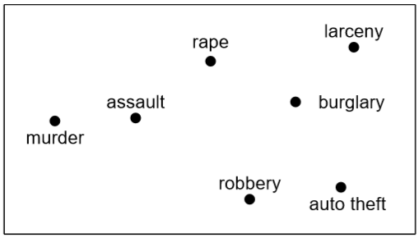
Example of correlation matrices
MDS analysis provides an explanation of the correlations by interpreting the axes of the MDS space: the x-axis might be interpreted as “person versus property”, the y-axis as “hidden versus street”.
A drawback of this method is
that the proximities need to
be constructed from
additional measurements.

Slide 38
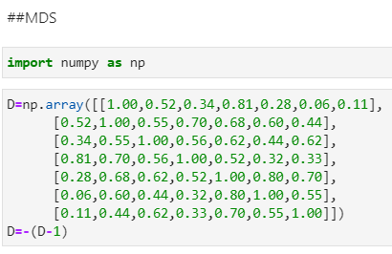
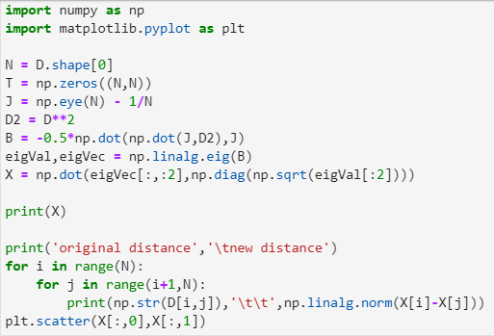
Metric MDS --example

Slide 39
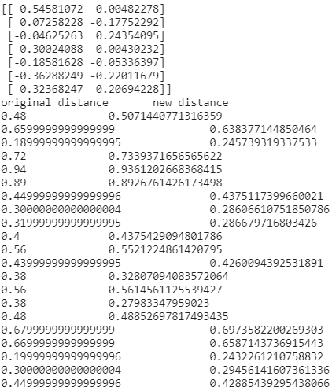
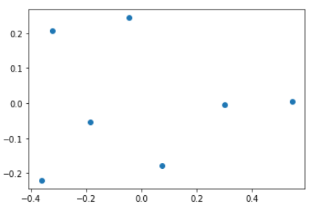
Metric MDS -- example

Slide 40
Sound quality evaluation
The data were collected at the Sound Quality Research Unit (SQRU), Aalborg University, in the summer of 2002 by Christian Schmid.
Subjects : 77
Environmental sounds (stimuli) : 12
the dissimilarity of each two sounds on a scale from 1 (very similar) to 9 (very dissimilar).
Diﬀerent types of MDS analyses in sound quality research.
Individual analysis
Aggregate analysis

Slide 41
Sound quality evaluation -- individual analysis
Consider subject 37 as an example.
With 12 stimuli it is possible to look for a spatial representation in at most three dimensions

Slide 42
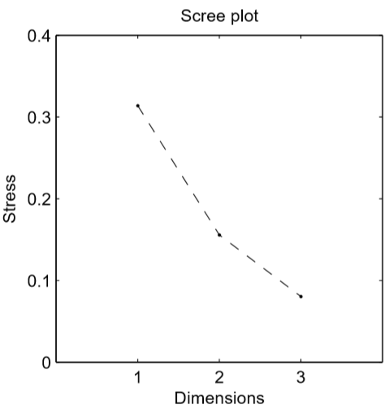
Sound quality evaluation -- individual analysis
1-D representation is not adequate (stress > .30).
The scree plot doesn’t display a clear elbow, but the largest improvement in terms of stress occurs when changing from 1 to 2 dimensions.
The stress for the 2-D solution is 0.156.
elbow : 肘

Slide 43
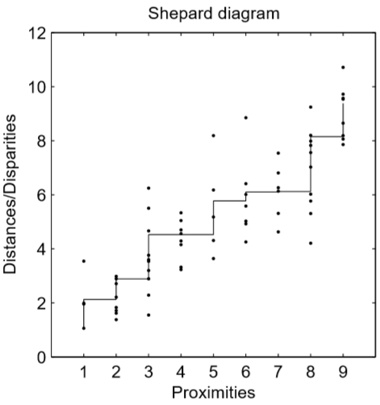
Sound quality evaluation -- individual analysis
The Shepard diagram displays the goodness of ﬁt of the 2-D solution.
The points of a perfectly ﬁtting solution would lie on the monotonically increasing line.
The spread in the Shepard diagram indicates some deviation from a perfect ﬁt; it was, however, considered small enough to carry out further analyses.

Slide 44
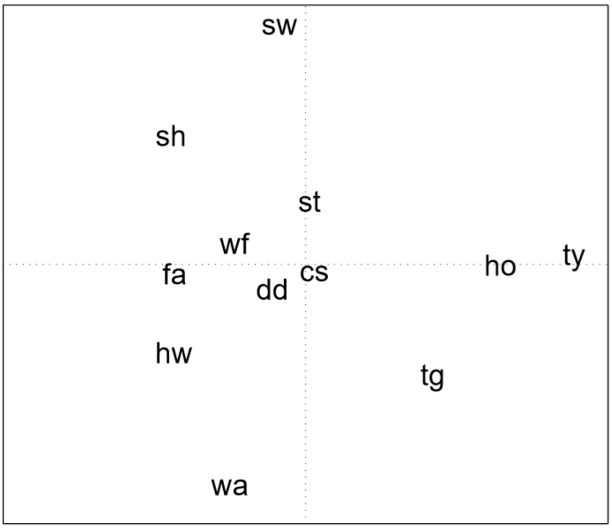
Sound quality evaluation -- individual analysis
The 3 objects ‘ty’, ‘tg’, and ‘hw’ seem to form a group, since they are closer to each other than to any other sound.
The sounds ‘sw’ and ‘wa’ seem to be very diﬀerent on dimension two, but rather similar on dimension one.
The substantial interpretation of these dimensions isn’t obvious.
○
○
○

Slide 45
Sound quality evaluation -- aggregate analysis
The 77 single proximity matrices were combined by computing the average value for each cell.
nonmetric MDS model with Euclidean distances was chosen to represent the data.
The largest improvement in terms of stress occurs when changing from 1 to 2 dimensions.
Stress(2-D)=0.106

Slide 46
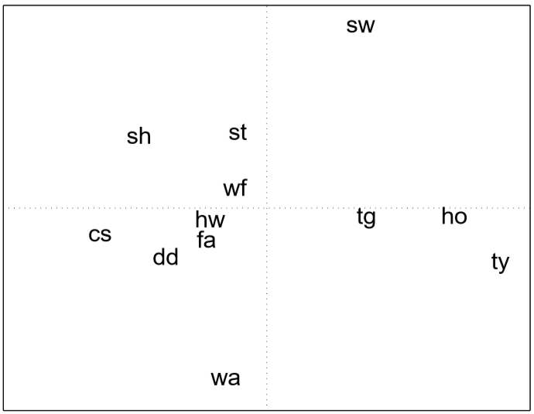
Sound quality evaluation -- aggregate analysis
From another experiment with the same sounds and largely the same subjects, an unpleasantness scale was derived.
Correlating the values on the x-axis with the unpleasantness scale using Spearman’s rank correlation yields a statistically signiﬁcant correlation of 69% .
Half of the variance along the x-axis can be explained by the unpleasantness of the sounds.

Slide 47
Sound quality evaluation
Conclusion :
The subjects used largely the same dimensions when evaluating environmental sounds
One of the evaluative dimensions was highly related to the perceived unpleasantness of the sounds

Slide 48
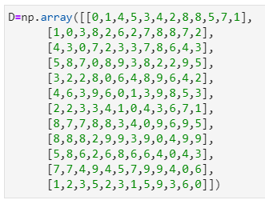
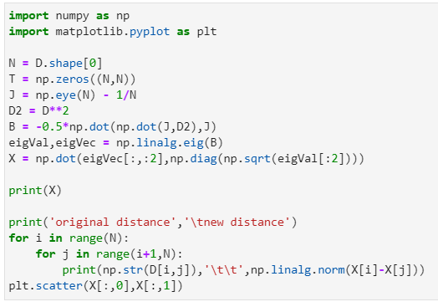
Metric MDS -- example

Slide 49
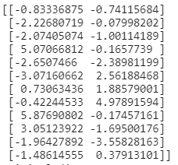
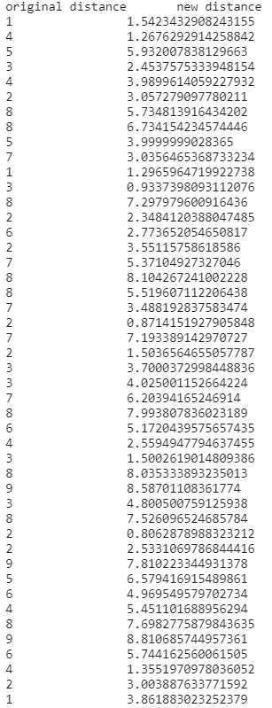
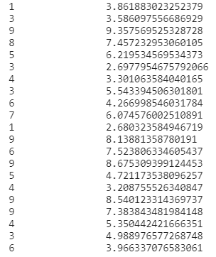
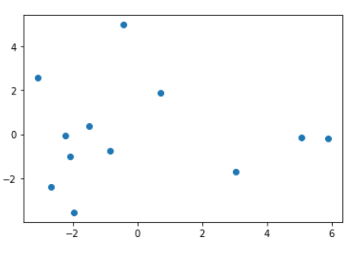
Metric MDS -- example

Slide 50
~The END ~

