Slide 1

CMPE 593: Deep Learning for Computer Vision
Fine Grained Image Classification on CUB-200 Dataset with Vision Transformers
Efekan Kavalcı

Slide 2
Problem Definition
The main goal of the project is to apply vision transformers to a fine grained classification task with CUB-200-2011 dataset [1]. The approaches for this include:
Utilizing pre-trained vision transformers [2] as static feature extractors
Fine-tuning some layers of the architecture from pre-trained weights
Fine-tuning only attention layers through all encoder blocks
Fine tuning the whole architecture from pre-trained weights
Visualising attention maps to get some understanding of how attention in vision transformers works is another goal of the project. Approaches for this include:
Visualisation of attention maps through all layers separately
Visualisation of the attention-rollout technique proposed by Abnar and Zuidema [3]
[1] C. Wah, S. Branson, P. Welinder, P. Perona, and S. Belongie, “The Caltech-UCSD Birds-200-2011 Dataset”.
[2] A. Dosovitskiy et al., “An Image is Worth 16x16 Words: Transformers for Image Recognition at Scale.”, 2021.
[3] S. Abnar and W. Zuidema, “Quantifying Attention Flow in Transformers.”, 2020.

Slide 3
Method
Dataset
PyTorch and Torchvision are used for training and other utilities.
A CUB-200-2011 dataset on Huggingface Hub is created, the dataset is retrieved from there for convenience.(https://huggingface.co/datasets/efekankavalci/CUB_200_2011)
A validation set is obtained by retrieving 5 samples per class from the training set. This results in 4994, 1000, and 5794 samples in training, validation, and test set, respectively. Unfortunately, initially this process was repeated independently for each run, thus the train and validation sets differ in different settings (e.g. fine tuning attention layers setting vs. static feature extractor setting). Ideally, the same validation and training set should have been used for the different settings. For the final run (fine-tuning through all layers), validation and train indices are saved but the other experiments could not be repeated with the same train/validation split.

Slide 4
Method
Dataset
The images are preprocessed using torchvision.transforms to convert to tensors. Normalization constants are used according the transforms specified for the ViT models in PyTorch.
Some augmentation is applied for the training set with RandomHorizontalFlip, ColorJitter, and RandomAffine transformations.
train_preprocess = transforms.Compose([
transforms.Lambda(lambda x: x.convert('RGB')), # Convert grayscale to RGB if needed
transforms.Resize((384,384), interpolation=InterpolationMode.BICUBIC), # Resize the image to 384x384
transforms.RandomHorizontalFlip(p=0.5), # Randomly flip the image horizontally
transforms.ColorJitter(brightness=0.2, contrast=0.2, saturation=0.2, hue=0.1), # Randomly change brightness, contrast, and saturation
transforms.RandomAffine(degrees=10, translate=(0.05, 0.05), scale=(0.95, 1.05)), # Random affine transformation
transforms.ToTensor(), # Convert the image to a tensor
transforms.Normalize(mean=[0.485, 0.456, 0.406], std=[0.229, 0.224, 0.225]), # Normalize the image
])
Preprocessing function for the training set

Slide 5
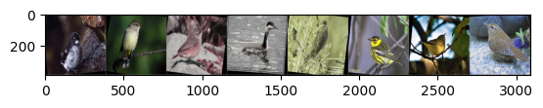
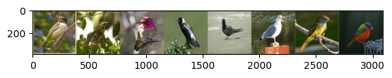
Method
Dataset
Preprocessed and augmented image examples from the training set
Preprocessed image examples from the test set

Slide 6
Method
Model & Implementation
PyTorch and Torchvision are used for training and other utilities.
ViT-B/16 models are loaded via torchvision.models. Torchvision also provides the pretrained weights for these models: https://pytorch.org/vision/main/models/vision_transformer.html
ViT-B/16 has 86 million parameters, and divides the input image to 16x16 patches. The versions that use 32x32 patches are not preferred since the resolutions cannot be kept very large due to computational constraints, and large patches may negatively affect the classification task considering the fine-grained nature of the task.

Slide 7
Experiments & Results
Static Feature Extractors
As the first approach, pre-trained ViT models are used as feature extractors without fine-tuning the internal parameters. Only the classification head is replaced with a layer with 200 output neurons to match the number of classes in the CUB-200-2011 dataset, and this layer is trained.
The experiments in this section showed that using 384x384 images instead of 224x224 images considerably improves the results, thus 384x384 images are used in the later experiments.
To compare with a CNN-based architecture, a ResNext [4] model is also used as a feature extractor and trained similarly by replacing the classification head. However, this did not lead to good results in the preferred setting and no further tuning is done for this training process.
All of the experiments are run on Google Colab with T4 GPUs. You can reach the Google Drive folder that includes all of the Colab notebooks and model checkpoints here: https://drive.google.com/drive/folders/1puXuxrsq-k4q6t7wSC6K_oltQ90e0NhJ?usp=sharing
[4] S. Xie, R. Girshick, P. Dollár, Z. Tu, and K. He, “Aggregated Residual Transformations for Deep Neural Networks.”, 2017

Slide 8
Experiments & Results
Static Feature Extractors
Both models are trained for 30 epochs using Adam optimizer, learning rate of 5e-4, and a linear learning rate scheduling. The best models in terms of validation accuracy are loaded from checkpoints and evaluated with full training set and test set. Each epoch takes about 5 minutes.
Training loss and validation accuracy through training are given in the next page. Training accuracy is not calculated each epoch since the inference takes considerable time (about 4-5 minutes for the training set)
ViT-B16 with 224x224 inputs (with IMAGENET1K_V1 weights):
Best validation accuracy is 64.8% (epoch 30)
Training accuracy: 79.66%
Test accuracy: 66.82%
ViT-B16 with 384x384 inputs (with IMAGENET1K_SWAG_E2E_V1 weights):
Best validation accuracy is 83.8% at (epoch 24)
Training accuracy: 94.42%
Test accuracy: 83.65

Slide 9
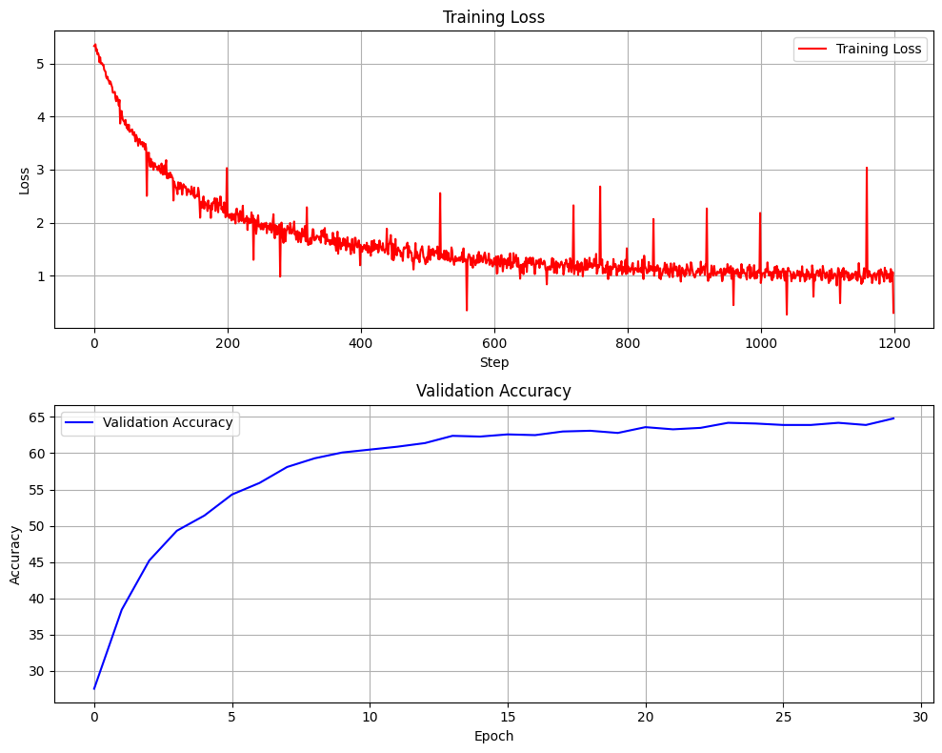
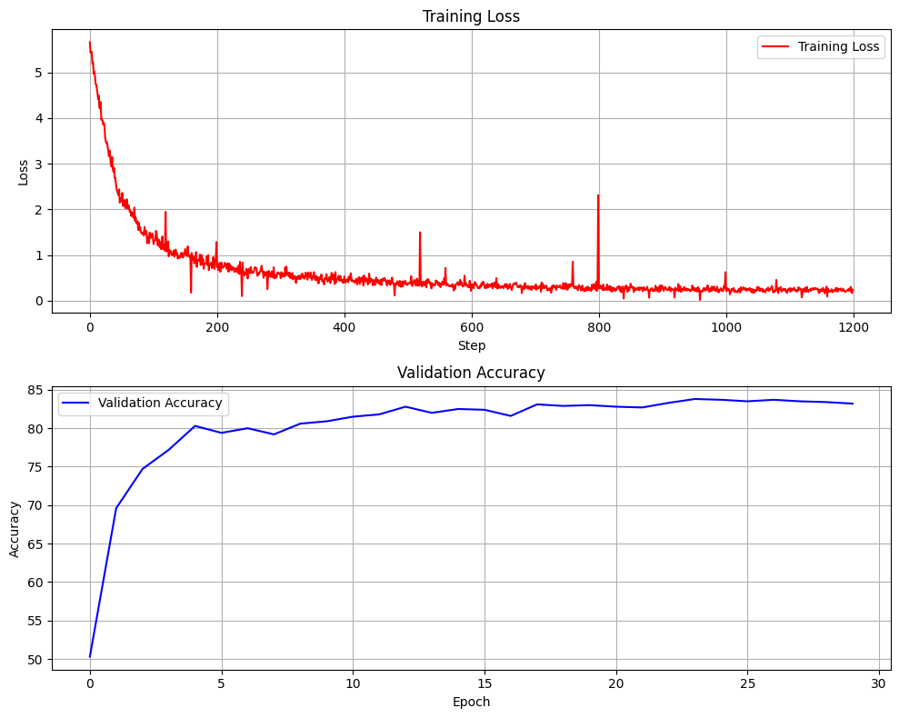
Experiments & Results
Static Feature Extractors
ViT-B16 with 224x224 inputs (with IMAGENET1K_V1 weights)
ViT-B16 with 384x384 inputs (with IMAGENET1K_SWAG_E2E_V1 weights)

Slide 10
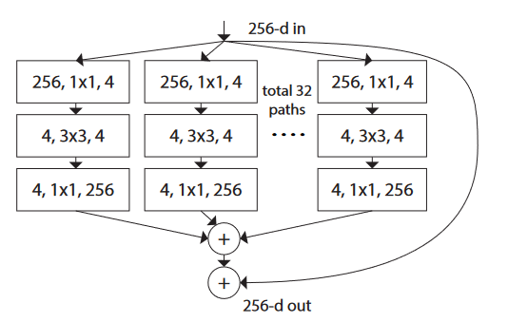
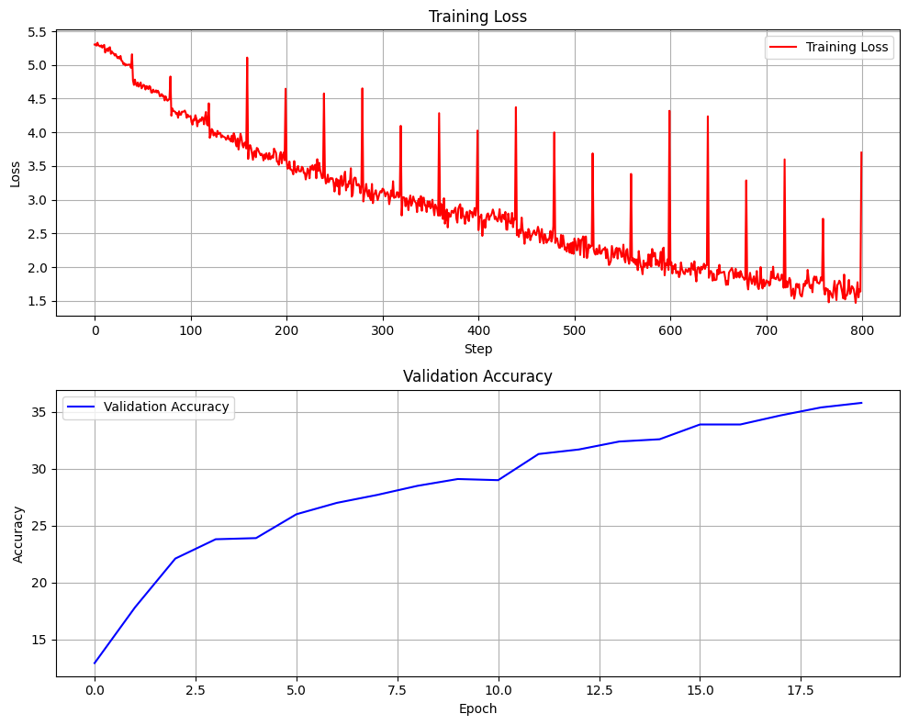
Experiments & Results
Static Feature Extractors
A ResNext [4] model is also used as a feature extractor for comparison with ViT. The last fully connected layer is replaced with a layer with 200 output neurons.
ResNeXt is a convolutional neural network architecture that extends the ResNet model by organizing in a multi-branch architecture.
The model is trained for 32 epochs. The learning was slow and validation accuracies were not satisfactory, thus the training is not extended nor any tuning is done for the training.
A ResNext block
Training loss and validation accuracies for ResNext training

Slide 11
Experiments & Results
Fine-tuning Last Encoder Block
In this approach, all of the encoder blocks are frozen except the last one in the ViT model. This bears similarities with fine-tuning of a CNN-based architecture.
This approach results in 7.24 million trainable parameters. Each epoch takes about 6 minutes.
Two models are trained with this approach. A small weight decay (0.001) was used in the first one, and the model tended to overfit quickly. Another model is trained with 0.01 weight decay. Adam optimizer and a learning rate of 0.001 is used for both models.
The best model with weight decay 0.001 results in 84.02% test accuracy , and the best model with weight decay 0.01 results in 84.86% test accuracy.

Slide 12
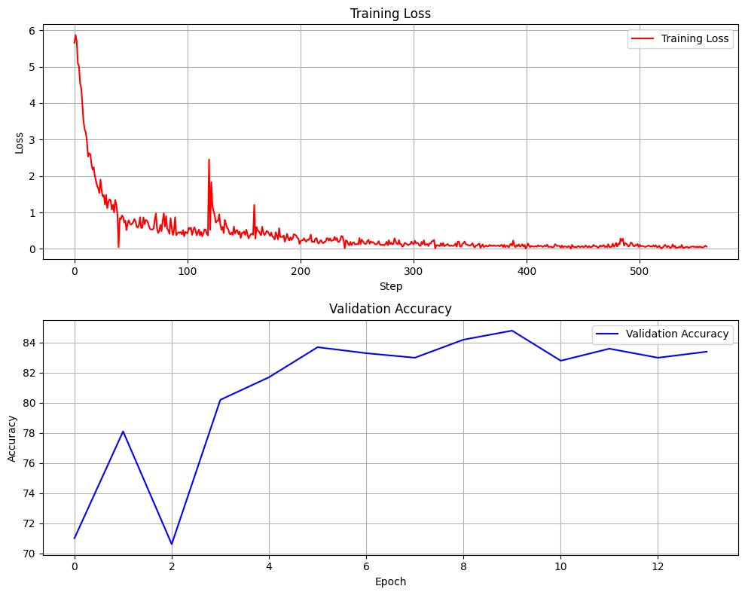
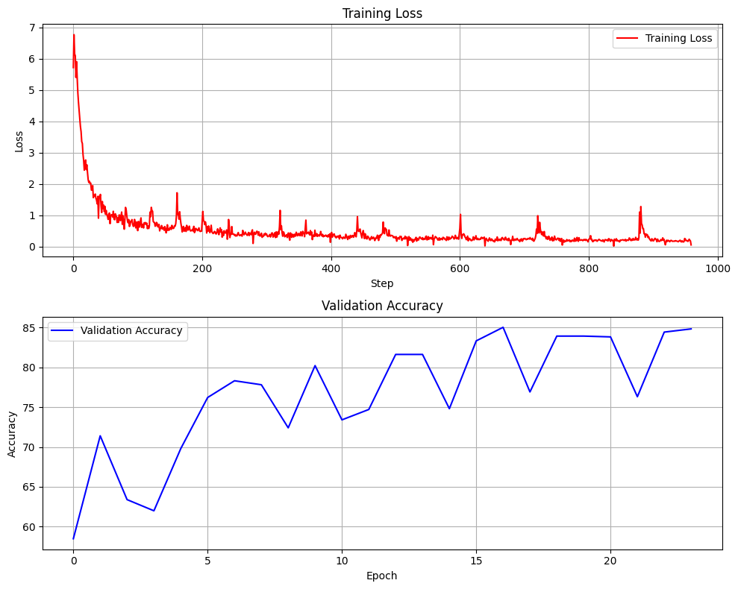
Experiments & Results
Fine-tuning Last Encoder Block
ViT-B16 with 384x384 inputs, last encoder block fine-tuned (weight decay = 0.001)
ViT-B16 with 384x384 inputs, last encoder block fine-tuned (weight decay = 0.01)

Slide 13
Experiments & Results
Fine-tuning All Attention Layers
This approach is inspired by the work of Touvron et al. [5], where they reported that fine-tuning only attention layers in a ViT may lead to similar results with full fine-tuning.
In this approach, the multi-head attention layer of each block is set to be trainable and all the other encoder parameters are frozen.
This approach leads to 28.5 million trainable parameters. Each epoch takes about 10 minutes.
Training is done for 30 epochs with AdamW optimizer with learning rate 1e-4 and weight decay 0.01. Batch size is set to 16 due to the memory limitations in the GPU.
Best validation accuracy is obtained at epochs 23 and 25 with 85.8% accuracy. The closest checkpoint is at epoch 24, it is loaded as the best model. This gives a 85.88 test accuracy.
[5] H. Touvron, M. Cord, A. El-Nouby, J. Verbeek, and H. Jégou, “Three Things Everyone Should Know About Vision Transformers,”, 2022

Slide 14
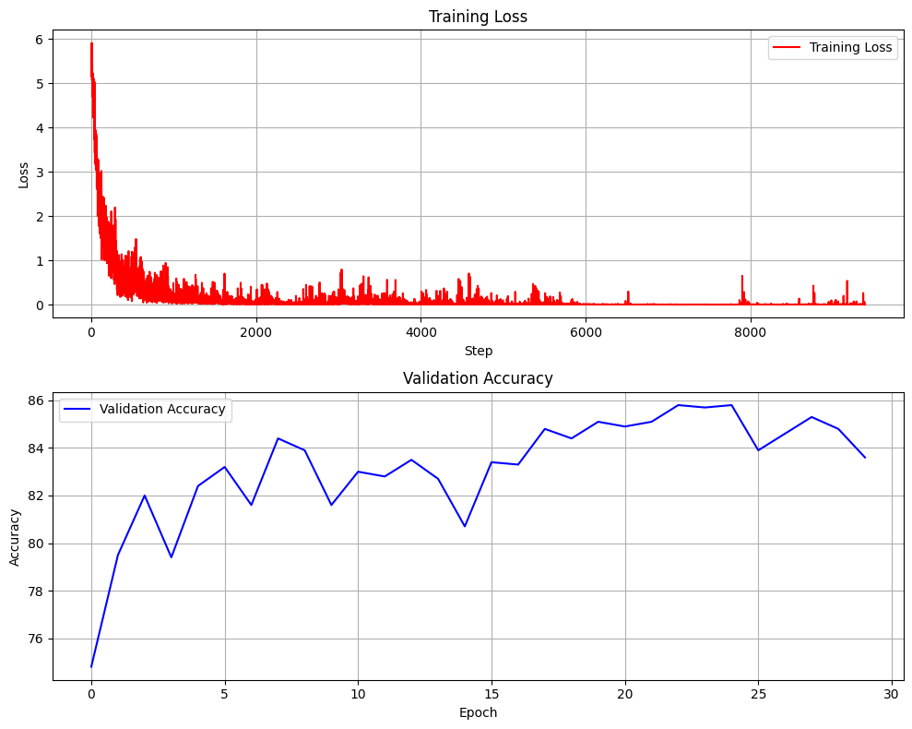
Experiments & Results
Fine-tuning All Attention Layers
ViT-B16 with 384x384 inputs, all attention layers fine-tuned

Slide 15
Experiments & Results
Fine-tuning Full ViT
An attempt to fine-tune all parameters of the ViT is made, but the results were unsatisfactory. The process could not be optimized further due to high computational cost
This approach leads to 86 million trainable parameters. Each epoch takes about 12 minutes.
Training is done for 50 epochs with AdamW optimizer with learning rate 1e-4 and weight decay 0.01. Batch size is set to 16 due to the memory limitations in the GPU.
Model severely overfits to the training data, training accuracy was 99.7% where the validation accuracies were about 50%

Slide 16
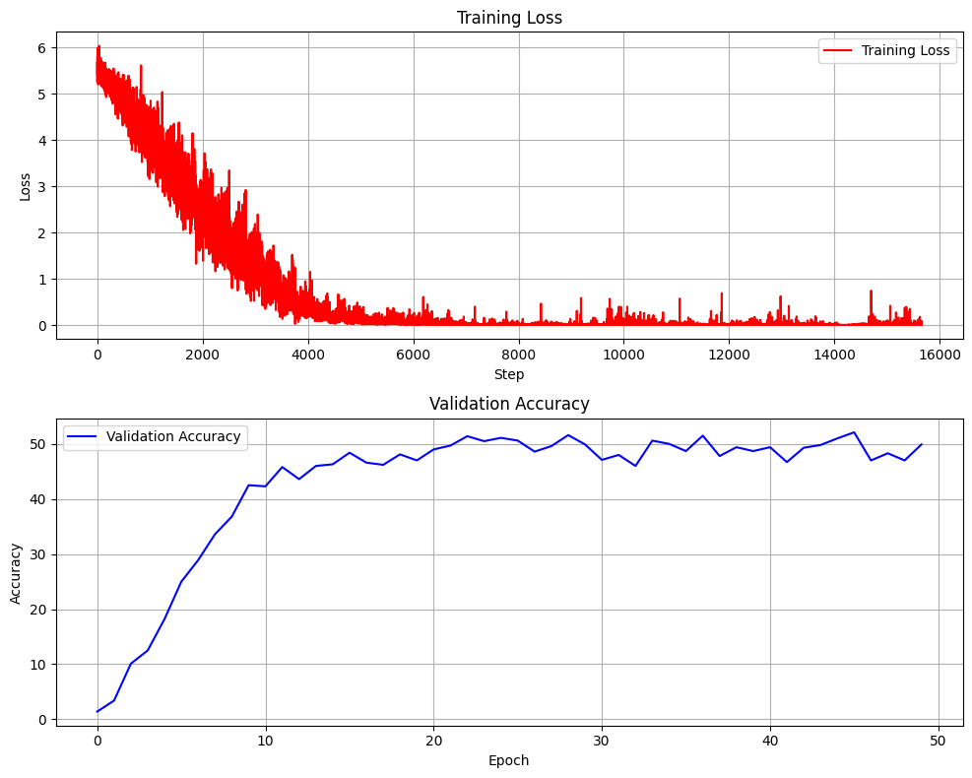
Experiments & Results
Fine-tuning Full ViT
ViT-B16 with 384x384 inputs, fully fine-tuned

Slide 17
Experiments & Results
Attention Map Visualizations
The imported Vision Transformer model is modified using a technique called monkey patching [6] to dynamically change the behaviour of the class. Normally, attention weights are not returned in the forward process of the class. With monkey patching, attention weights are returned and added to a global list for further investigation.
Individual attention maps for each multihead attention layer through 12 encoder blocks are provided for input images. The weights in a multihead attention are the average of the single head attentions in the layer.
Additionally, attention rollout weights are obtained by applying consecutive matrix multiplications to the attention weight matrices, starting from the initial attention layer.
Several examples are given in the next slides, both for static feature extractor approach where the attention parameters are the original pre-trained weights of ViT, and for the model where attention layers are fine tuned.

Slide 18
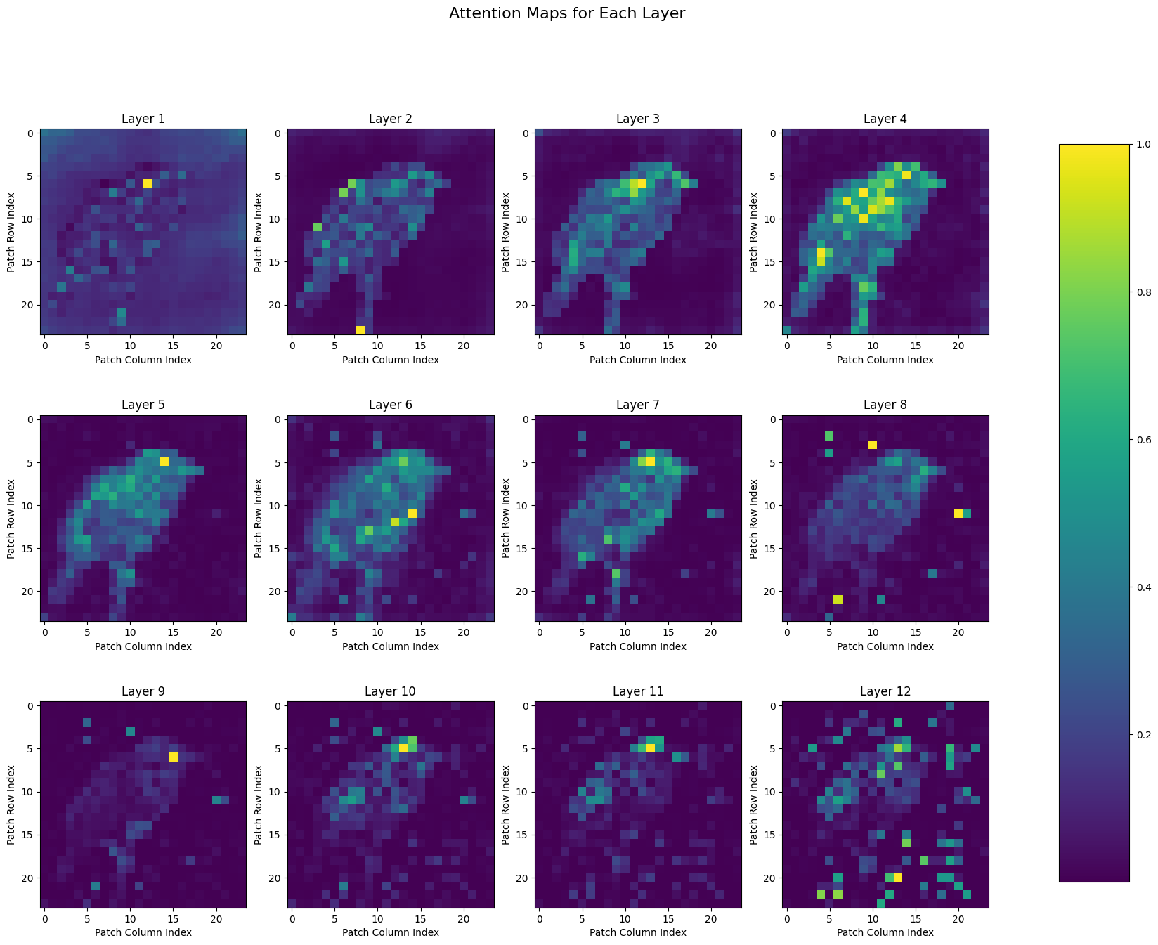
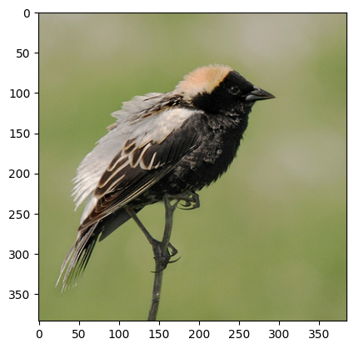
Experiments & Results
Attention Map Visualizations (Static Feature Extractor)
Input Image (test index = 306)
True label: 12 / Predicted label : 12

Slide 19
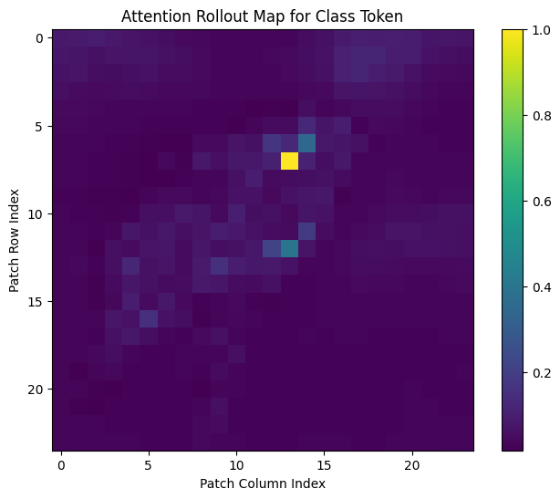
Experiments & Results
Attention Map Visualizations (Static Feature Extractor)
Input Image (test index = 306)
True label: 12 / Predicted label : 12

Slide 20
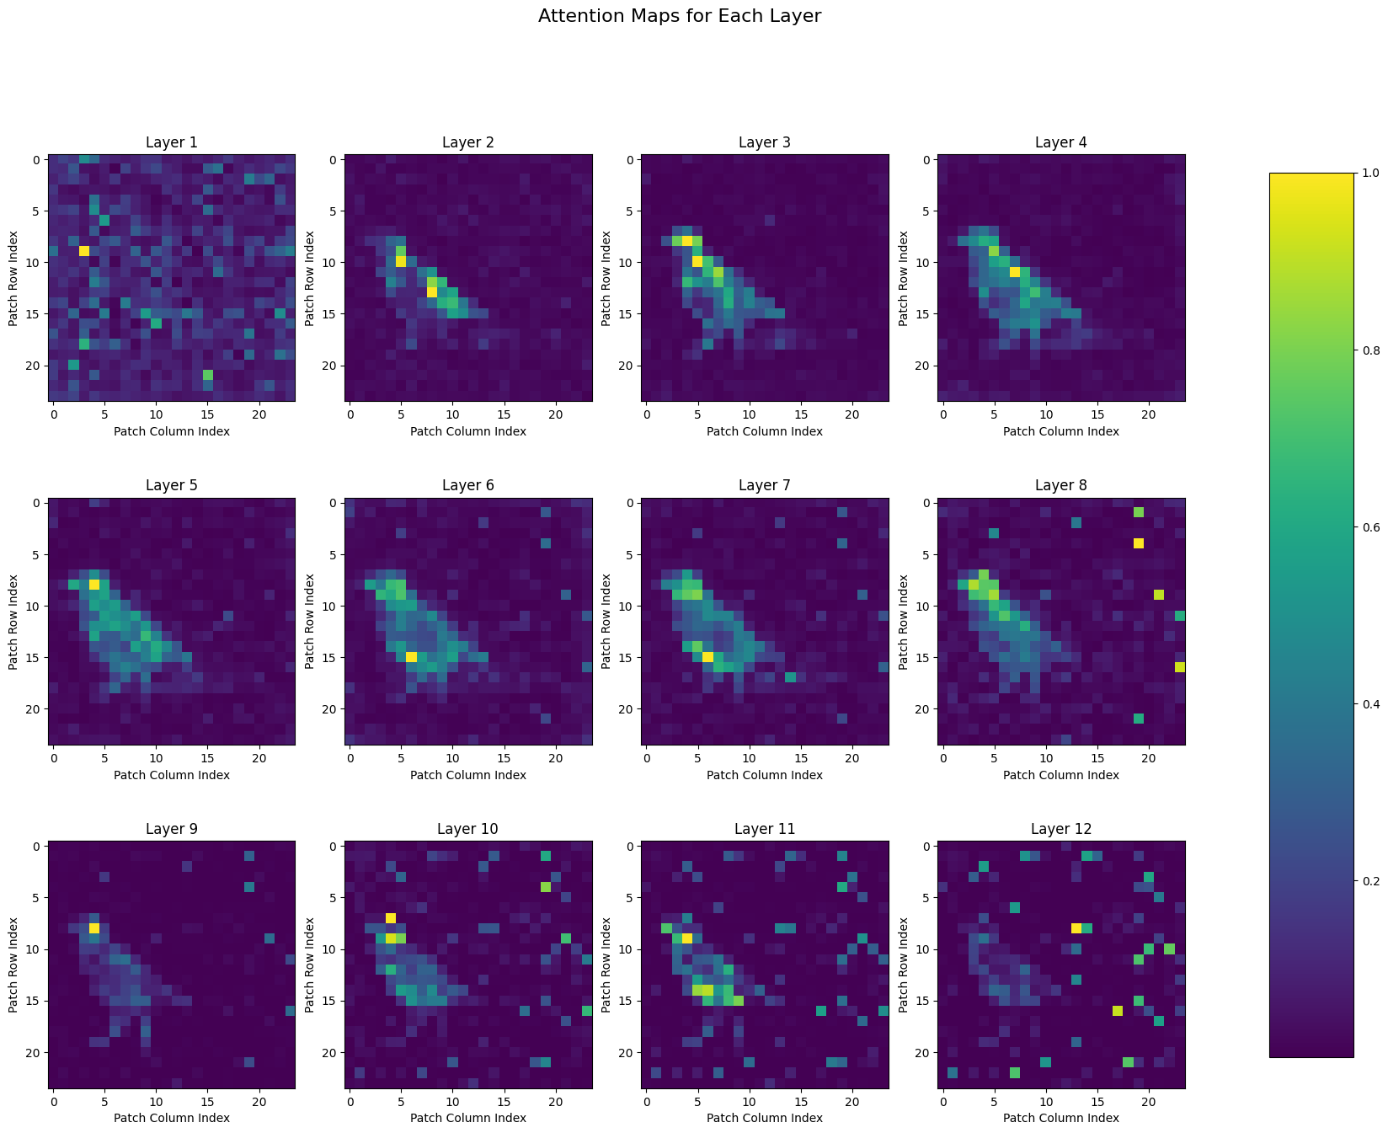
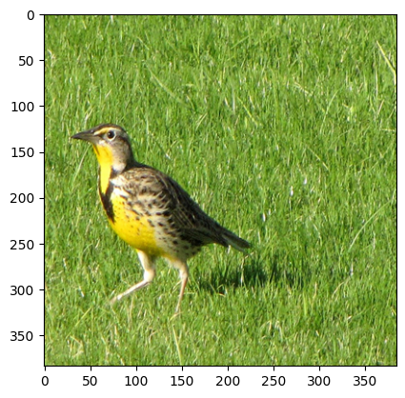
Experiments & Results
Attention Map Visualizations (Static Feature Extractor)
Input Image (test index = 2500)
True label: 87 / Predicted label : 87

Slide 21
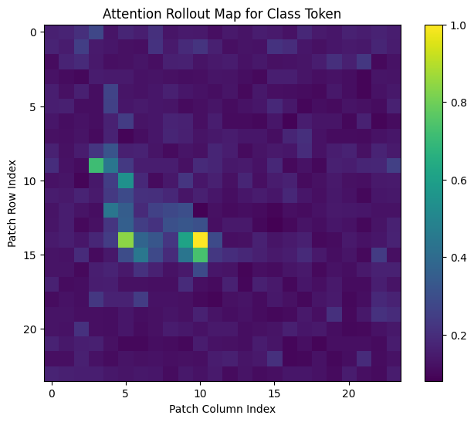
Experiments & Results
Attention Map Visualizations (Static Feature Extractor)
Input Image (test index = 2500)
True label: 87 / Predicted label : 87

Slide 22
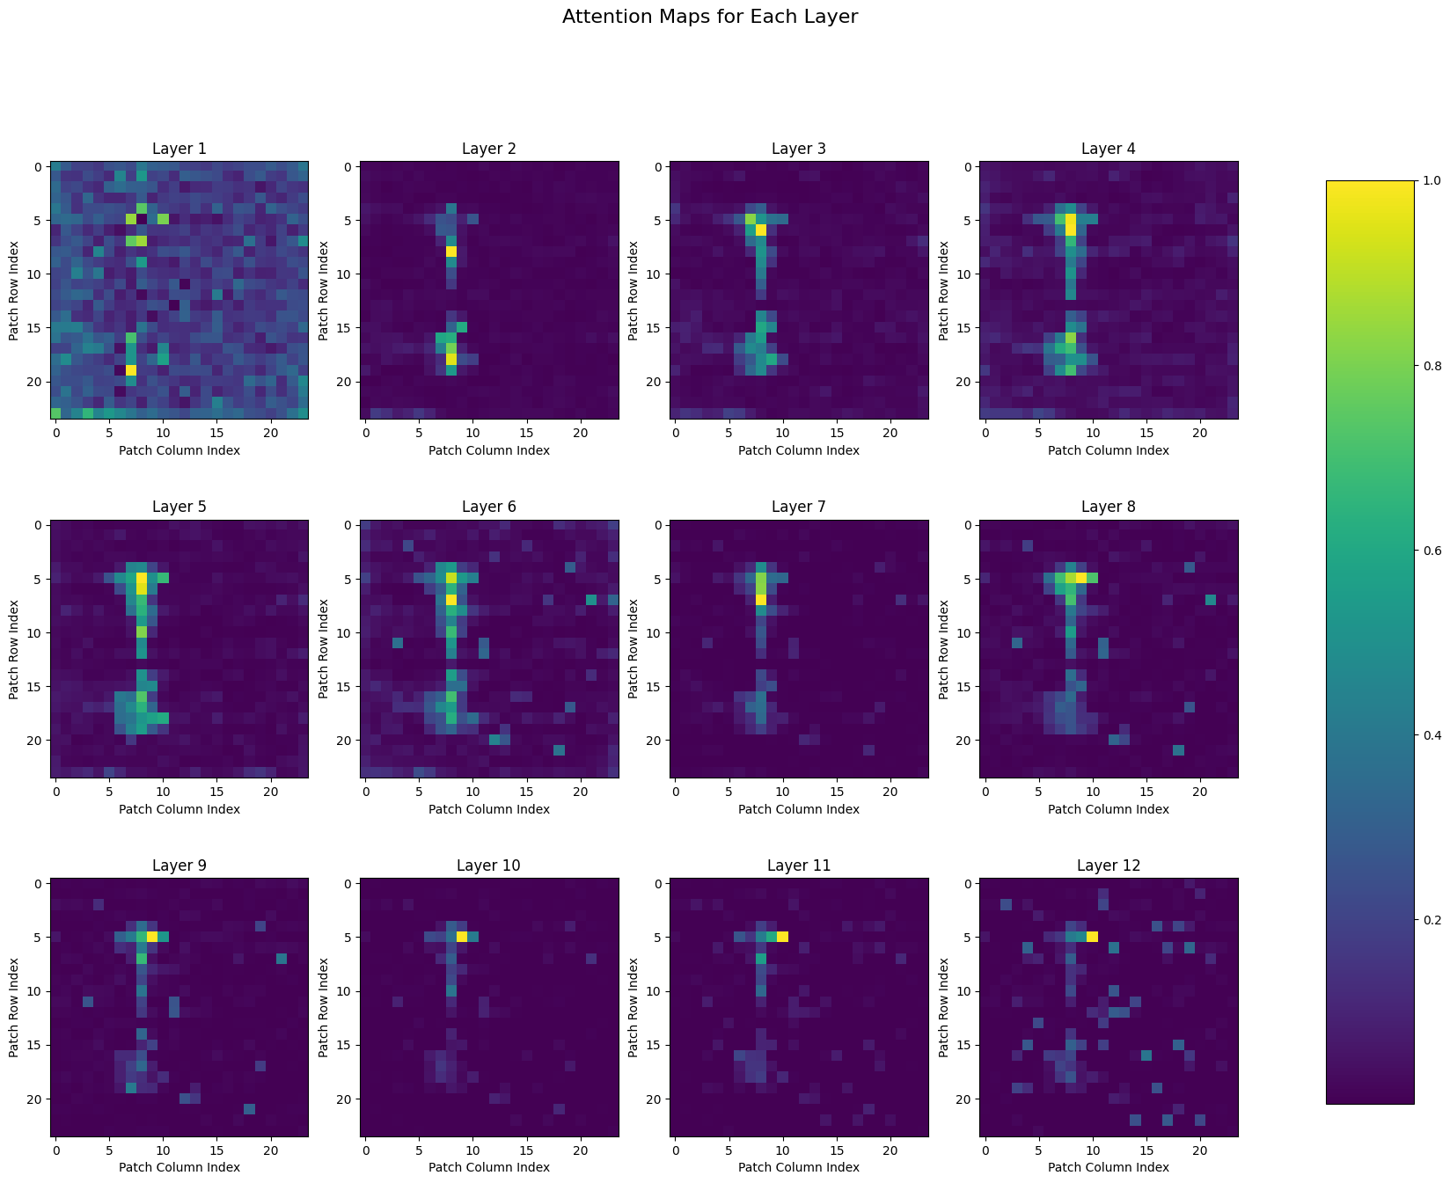
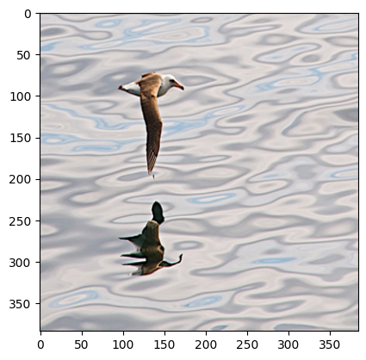
Experiments & Results
Attention Map Visualizations (Static Feature Extractor)
Input Image (test index = 59)
True label: 1 / Predicted label : 143
This is a misclassified sample. The attention maps show that reflection of the bird on the sea also attends to the class token, which may be the reason of false classification.

Slide 23
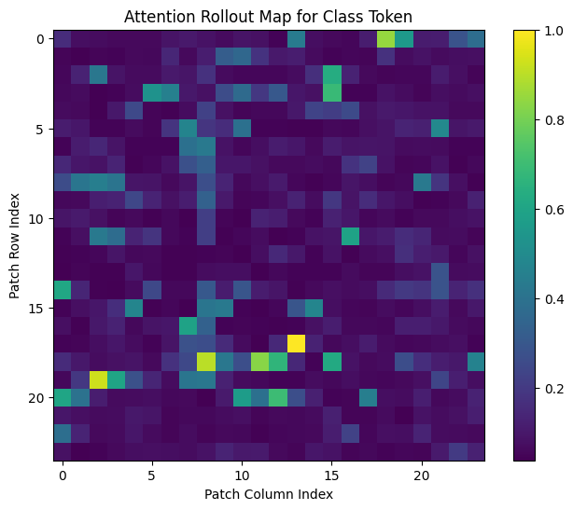
Experiments & Results
Attention Map Visualizations (Static Feature Extractor)
Input Image (test index = 59)
True label: 1 / Predicted label : 143
The attention rollout map is complex due to the reflection on the sea.

Slide 24
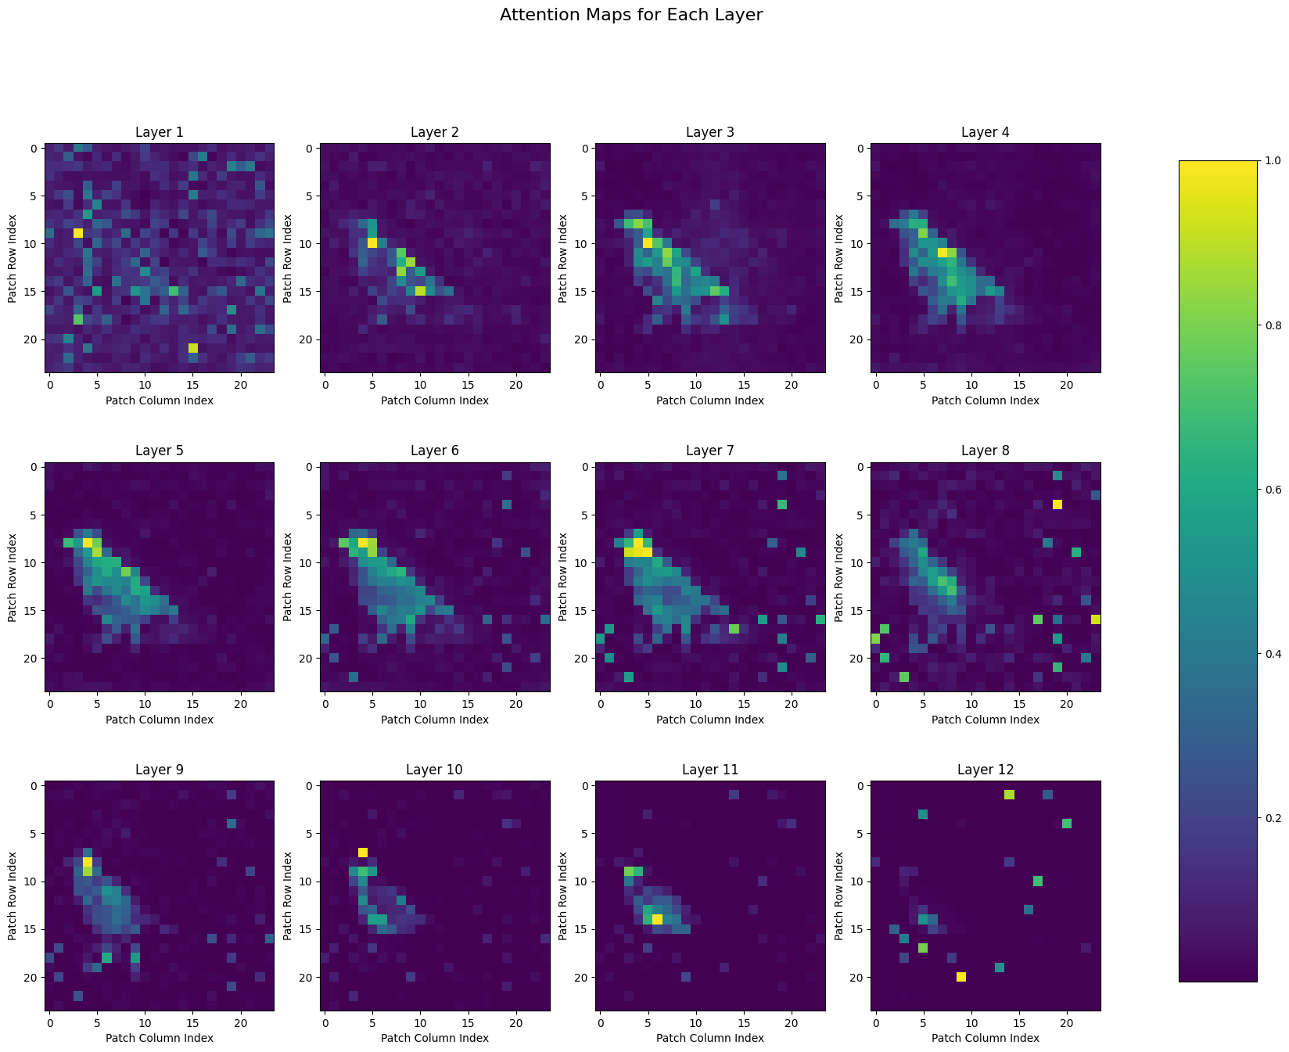
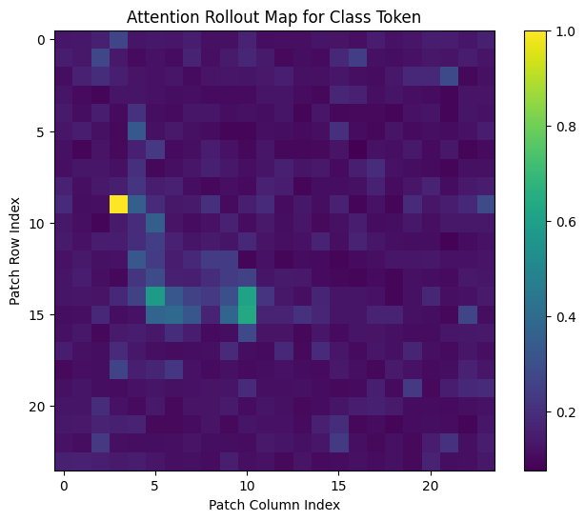
Experiments & Results
Attention Map Visualizations (Fine-tuned Attention Layers)
Input Image (test index = 2500)
True label: 87 / Predicted label : 87

Slide 25
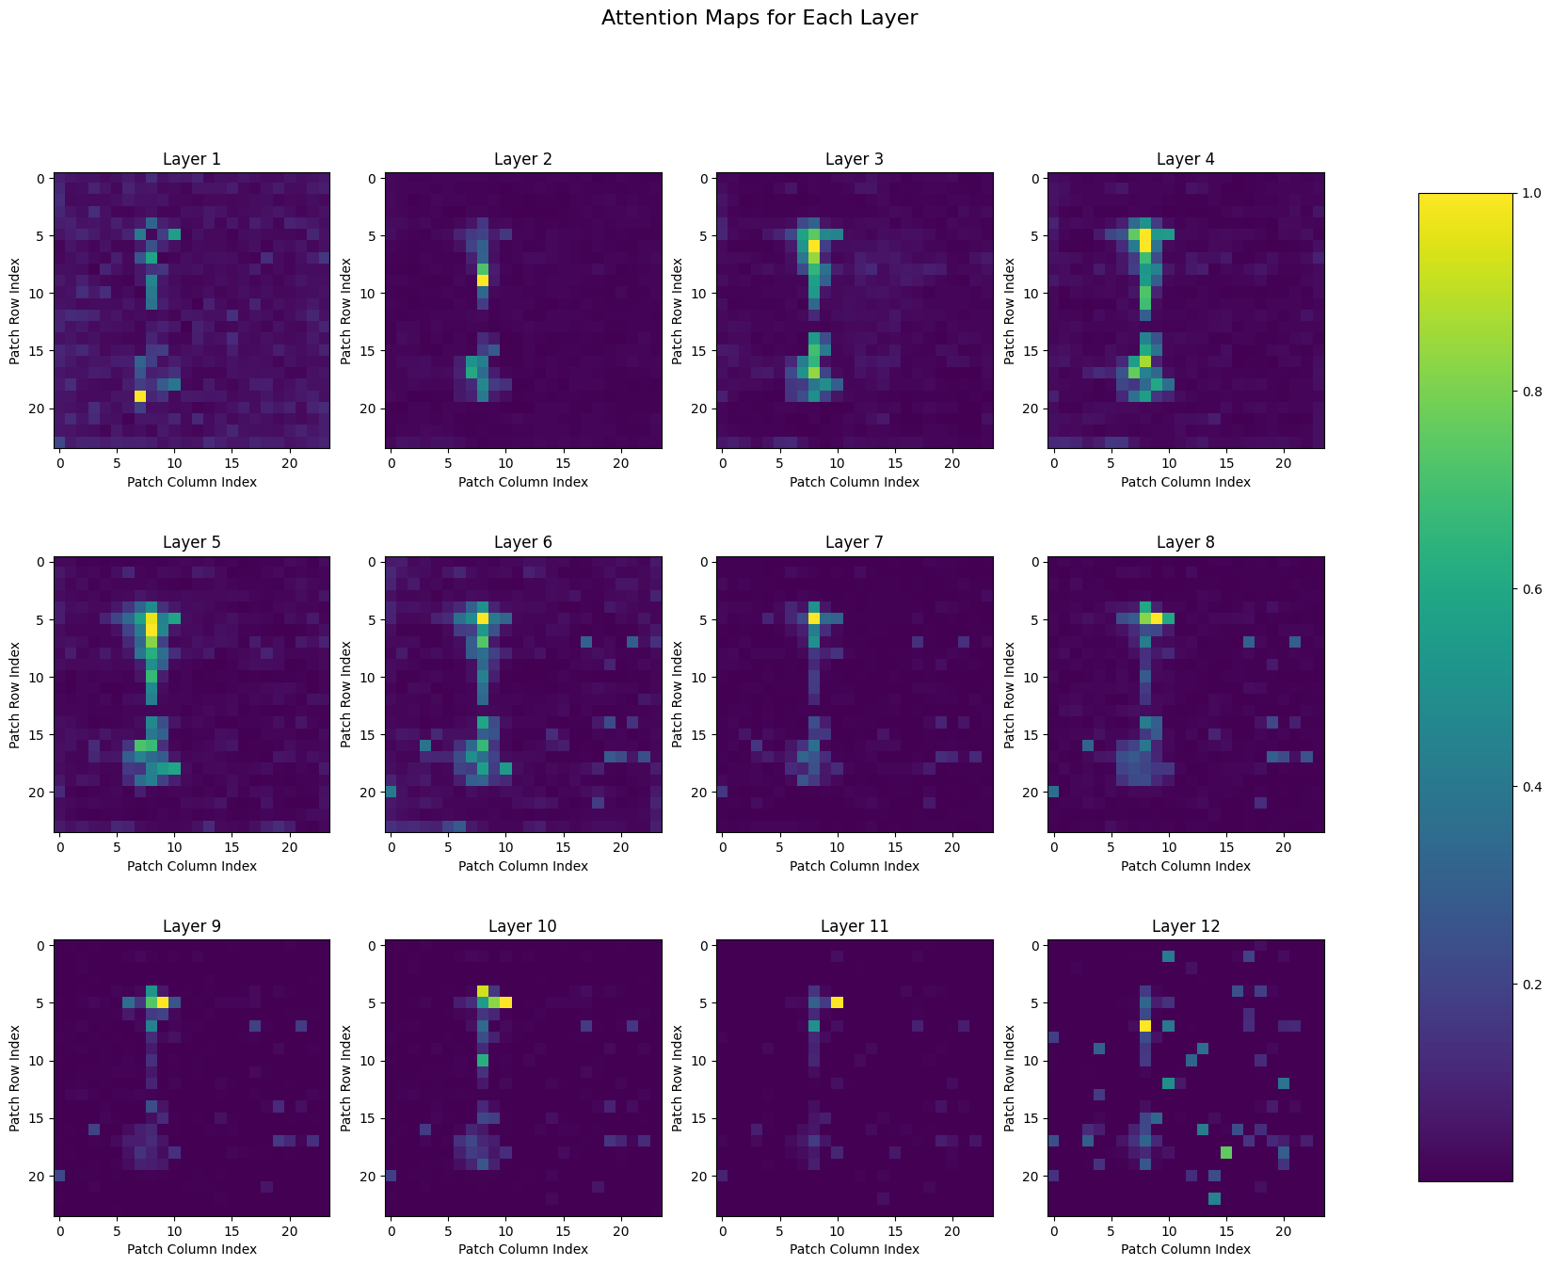

Experiments & Results
Attention Map Visualizations (Fine-tuned Attention Layers)
Input Image (test index = 59)
True label: 1 / Predicted label : 1
The model with fine-tuned attention correctly classifies this sample which is misclassified by the static feature extractor method. However, attention maps do not differ drastically, there are subtle differences. On the next page two versions are given side-by-side.

Slide 26
Experiments & Results
Static feature extractor model (misclassifies the example)
Model with fine-tuned attention layers (correct classification)

Slide 27
Conclusion
The best performing model has a test accuracy of 85.88% and is obtained via fine-tuning all the attention layers of ViT.
Obtained accuracies are considerably lower than SOTA values, which are about 92-93%. He et al. [7] reports a 90.3% accuracy via using ViT-B/16 model, but they use a 448x448 input size. The potential reasons of relatively low accuracies may include the following:
Lower input dimensionality
Sub-optimal training conditions (learning rate, weight decay etc.)
Sub-optimal augmentation choices for the training set
Poor utilization of training examples due to the validation split (1000 images were reserved from 5994 images in training set)
[7] J. He et al., “TransFG: A Transformer Architecture for Fine-grained Recognition.”, 2021.

Slide 28
References
[1] C. Wah, S. Branson, P. Welinder, P. Perona, and S. Belongie, “The Caltech-UCSD Birds-200-2011 Dataset”.
[2] A. Dosovitskiy et al., “An Image is Worth 16x16 Words: Transformers for Image Recognition at Scale.” arXiv, Jun. 03, 2021. Accessed: Mar. 22, 2024. [Online]. Available: http://arxiv.org/abs/2010.11929
[3] S. Abnar and W. Zuidema, “Quantifying Attention Flow in Transformers.” arXiv, May 31, 2020. Accessed: Mar. 26, 2024. [Online]. Available: http://arxiv.org/abs/2005.00928
[4] S. Xie, R. Girshick, P. Dollár, Z. Tu, and K. He, “Aggregated Residual Transformations for Deep Neural Networks.” arXiv, Apr. 10, 2017. Accessed: May 26, 2024. [Online]. Available: http://arxiv.org/abs/1611.05431
[5] H. Touvron, M. Cord, A. El-Nouby, J. Verbeek, and H. Jégou, “Three Things Everyone Should Know About Vision Transformers,” in Computer Vision – ECCV 2022, vol. 13684, S. Avidan, G. Brostow, M. Cissé, G. M. Farinella, and T. Hassner, Eds., in Lecture Notes in Computer Science, vol. 13684. , Cham: Springer Nature Switzerland, 2022, pp. 497–515. doi: 10.1007/978-3-031-20053-3_29.
[6] https://www.geeksforgeeks.org/monkey-patching-in-python-dynamic-behavior/
[7] J. He et al., “TransFG: A Transformer Architecture for Fine-grained Recognition.” arXiv, Dec. 01, 2021. Accessed: Mar. 22, 2024. [Online]. Available: http://arxiv.org/abs/2103.07976
Notes:
ImageNet Large Scale Visual Recognition Challenge (ILSVRC)

