Slide 1

Inventory Management System
Gökay Şendil 17070006020
Efe Nerman 17070006023

Slide 2
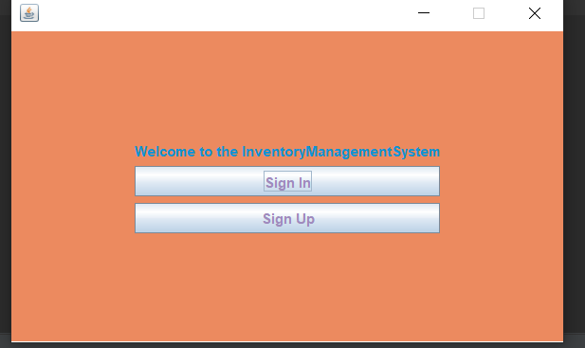
This is the entrance window you if you already sign up you can sign in easily but if you did not register you have to press sign up button firstly

Slide 3
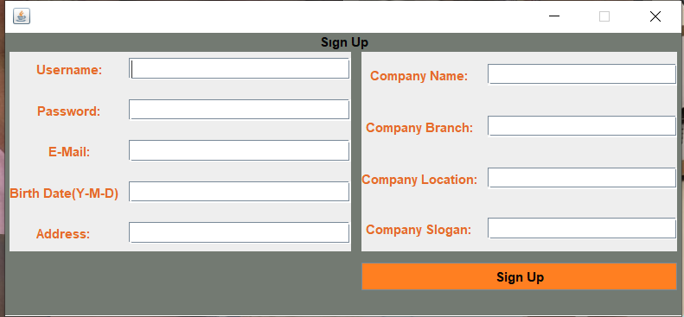
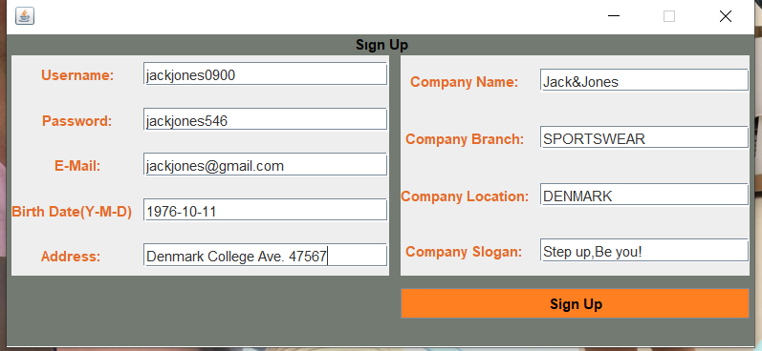
This window is the Sign up window.
The user has to fill in all this information completely and transfer the information about his/her company to the database.

Slide 4
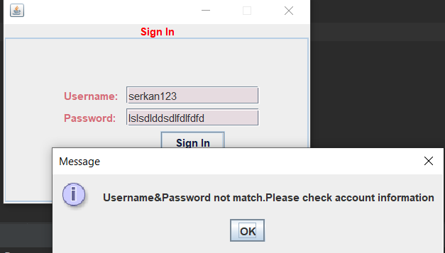
If the user enters the wrong username or password, he/she will get an error like this.

Slide 5
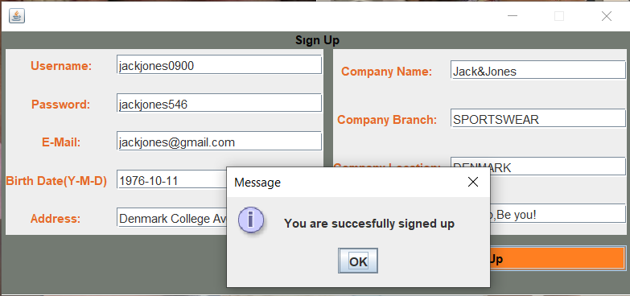
After press the sign up button this message will appear and your information will be registered in the database.

Slide 6
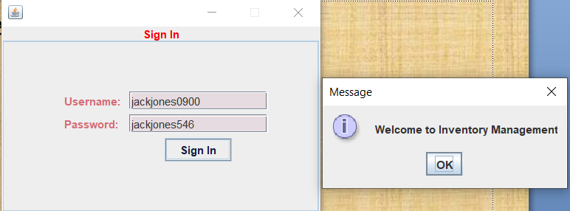

Slide 7
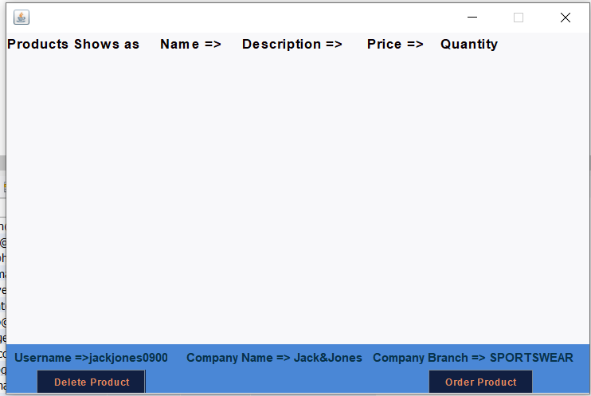
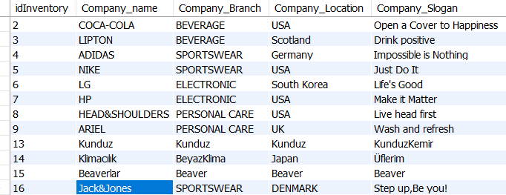
The user does not have the product because he/she is new, he/she can fill the list after clicking the order product button and entering the information.
On this screen, username, company name and company_branch appear below according to the information entered in the registration screen.

Slide 8
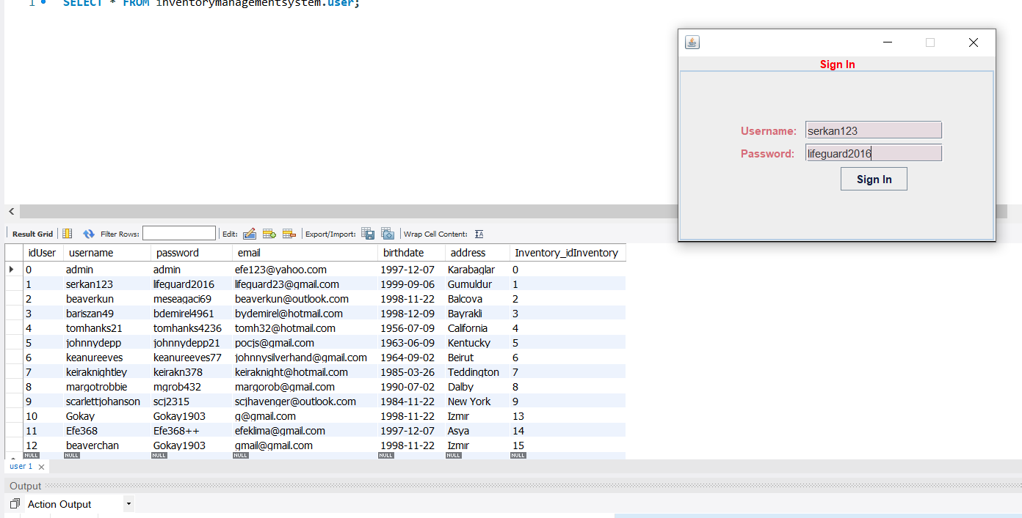
This is the sign in page If the information you entered matches the information in the database, you can easily log in.

Slide 9
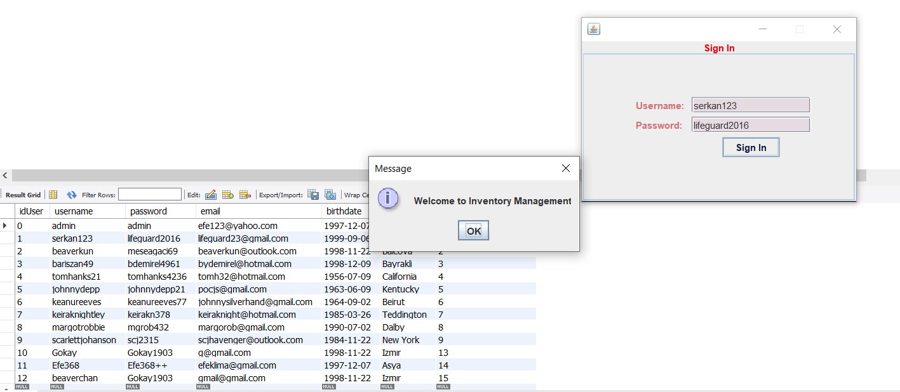
As you can see, the information matched and we saw the welcome text on the screen

Slide 10
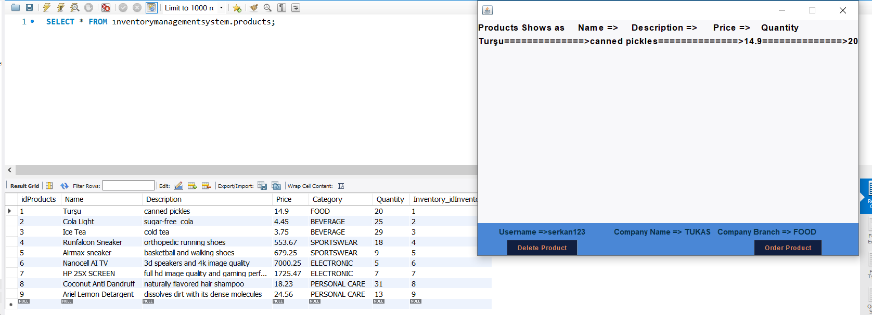
This page shows products It lists the product that the id matches, so you can delete and order operations.

Slide 11
As you can see serkan’s id number is 1 so if serkan login succesfully he can delete its own product or update it’s quantity when the order arrives.

Slide 12
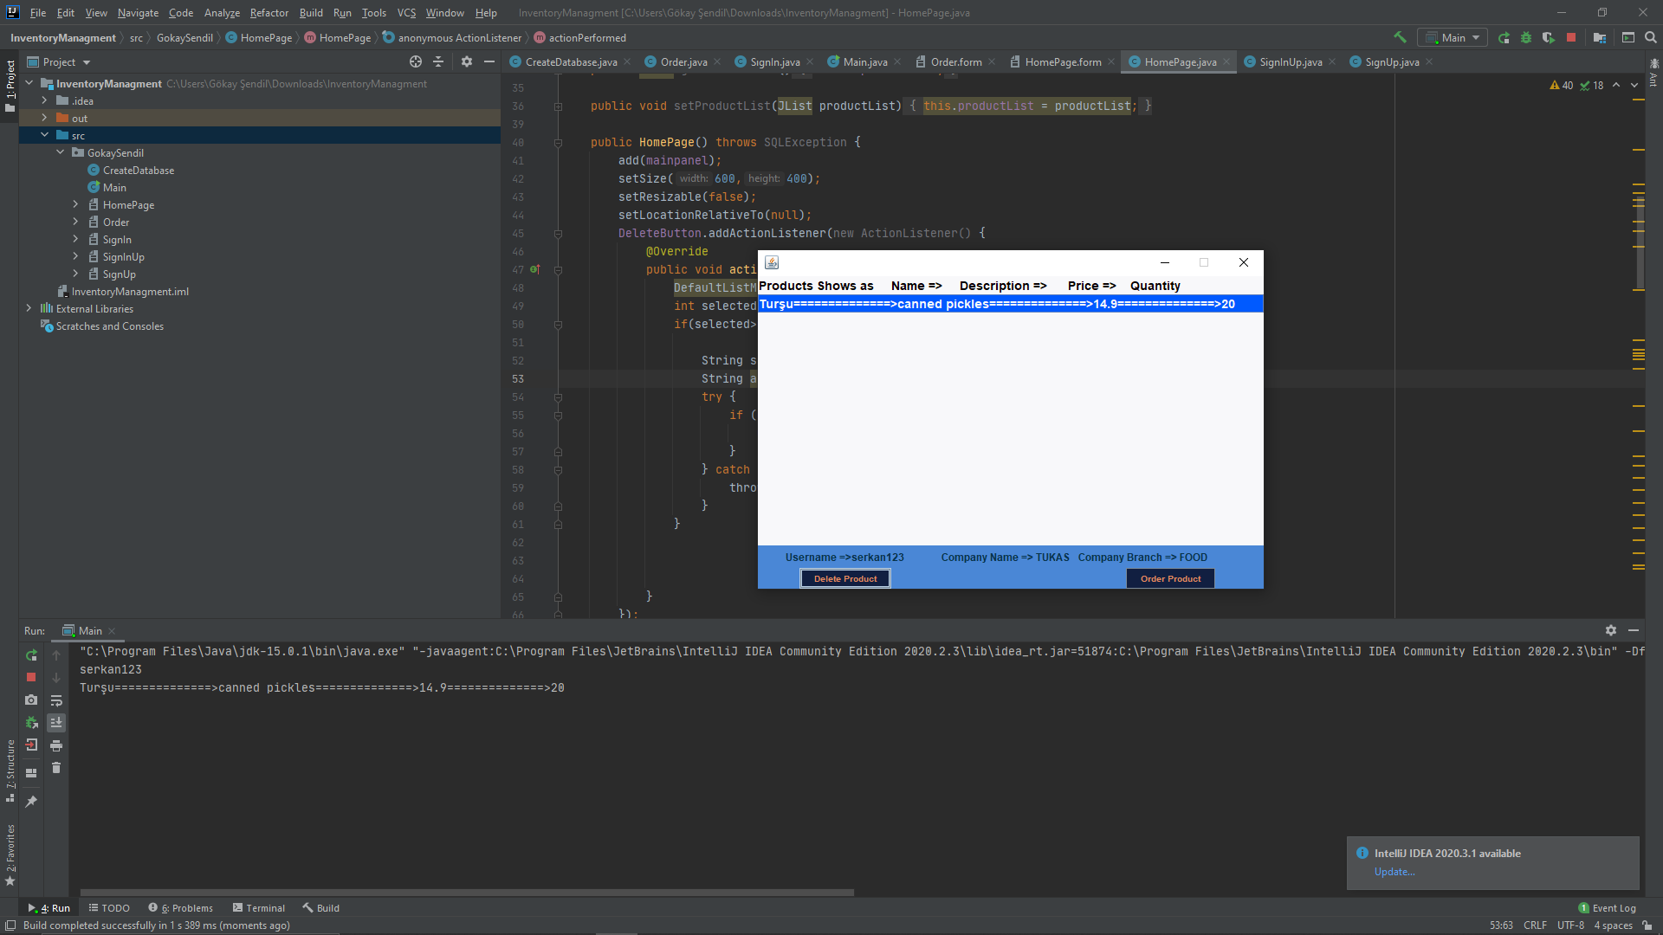
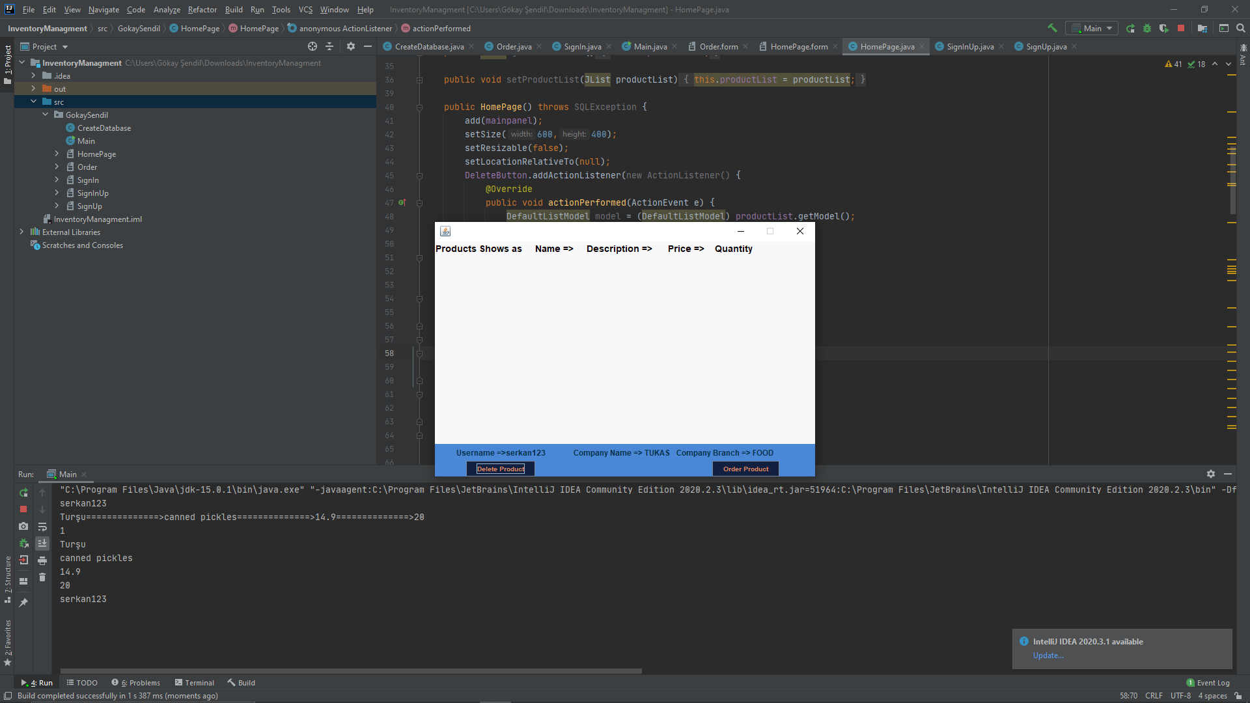
He can choose his own product and delete it by pressing the delete button after pressing the button so the list was cleared

Slide 13
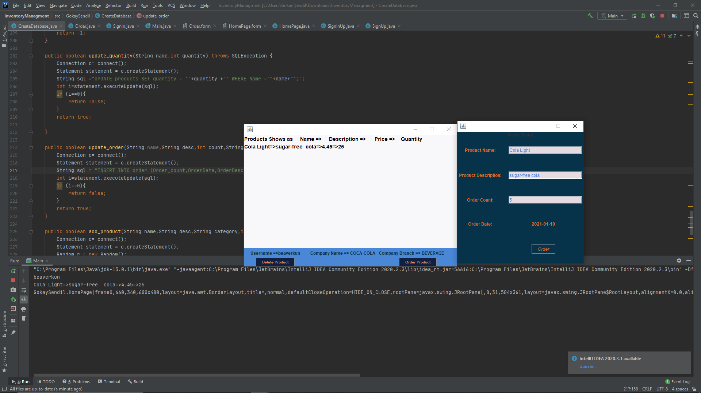
The user can add products to the inventory in this window that opens after clicking the order product button.
The date he entered the application will appear automatically in the order window.

Slide 14
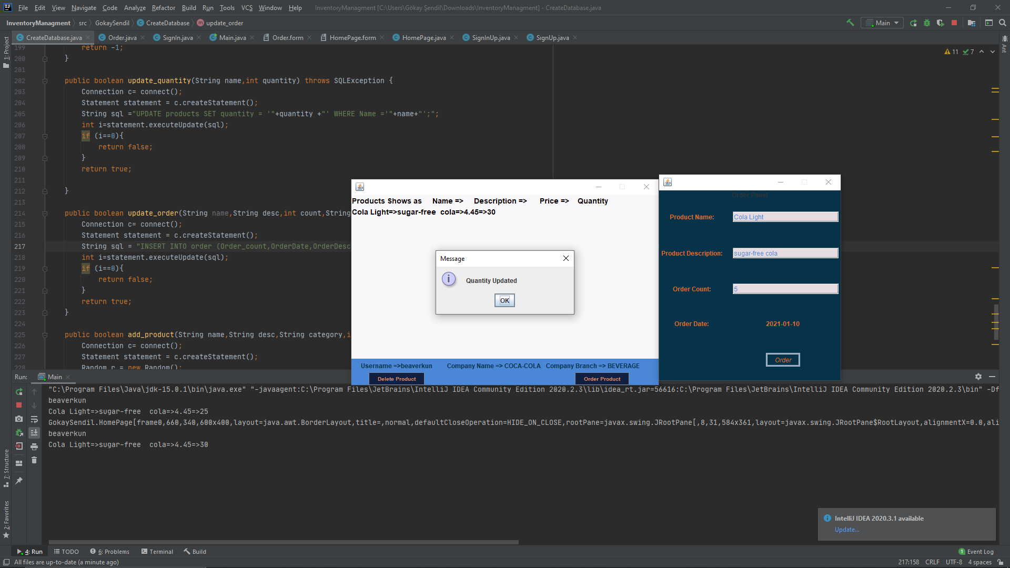
When the number of Coke was 25, 5 Coke was added and 30 Coke

Slide 15
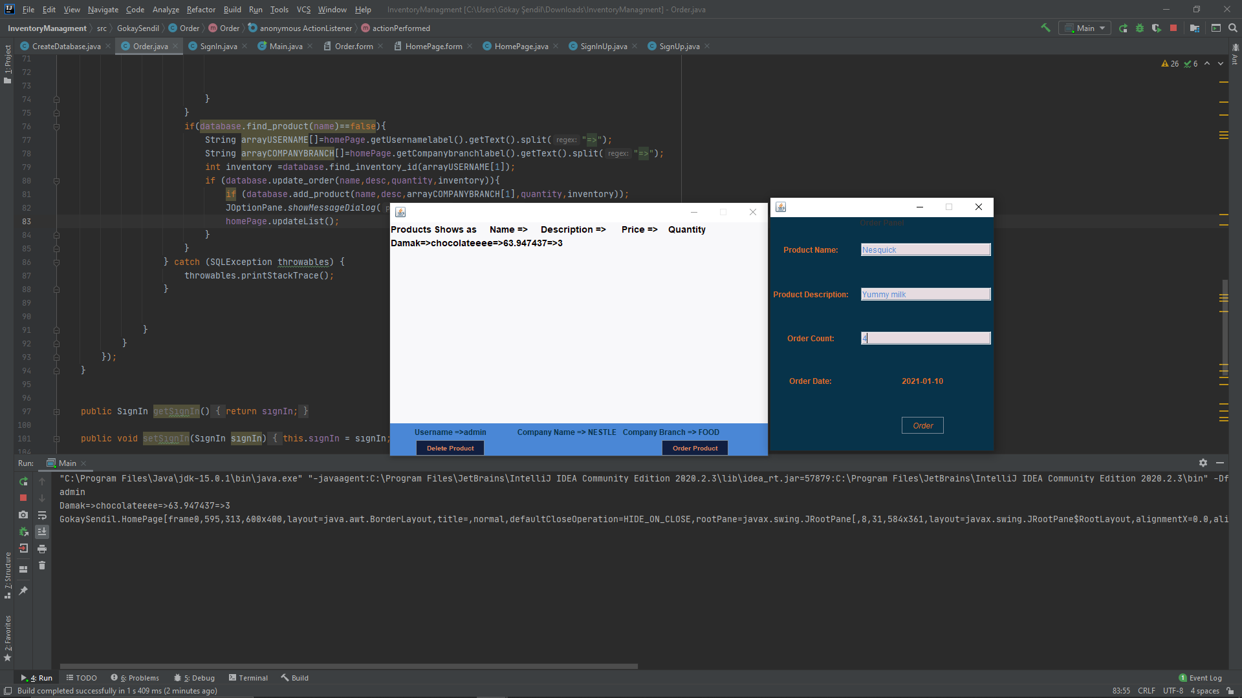

Slide 16
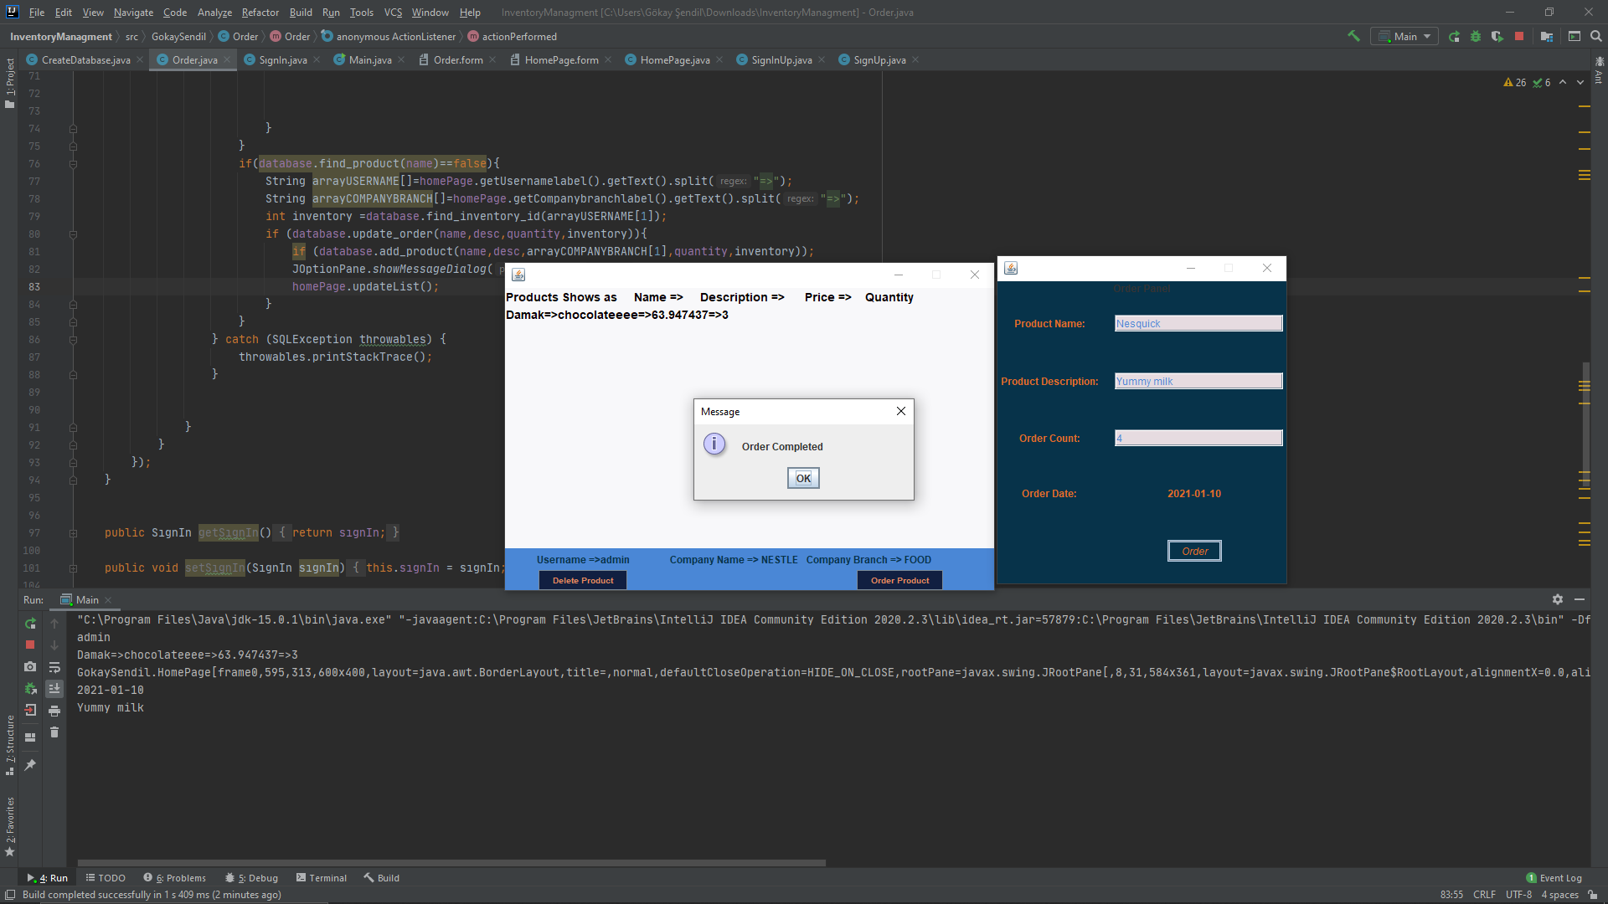

Slide 17
