Slide 1
A Hands-On .NET Solution Migration to EKS
An Application Refactoring Scenario Lab
Phil Pennington [AND OTHERS TBD]
July, 2019

Slide 2
Agenda
Let’s review the lab context.
How to access and configure your lab workstations.
Introducing the lab guide.
We’re here to support you… watch your time.
Q&A

Slide 3
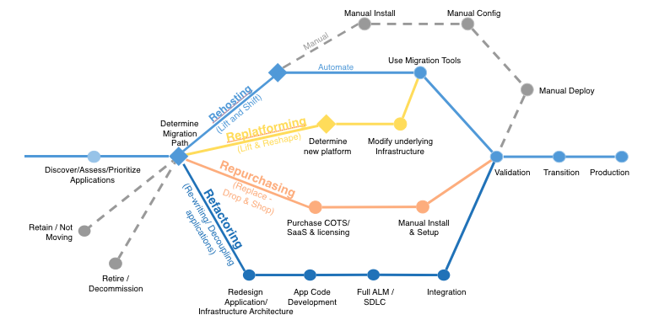
Application Migration Strategies

Slide 4
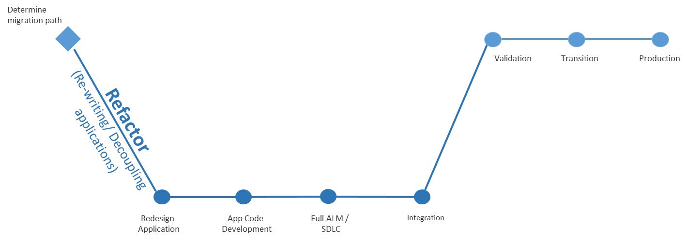
The Refactor Strategy
Pros:
Realize full potential of target cloud platform
Cons:
Requires the largest investment and level of effort to realize

Slide 5
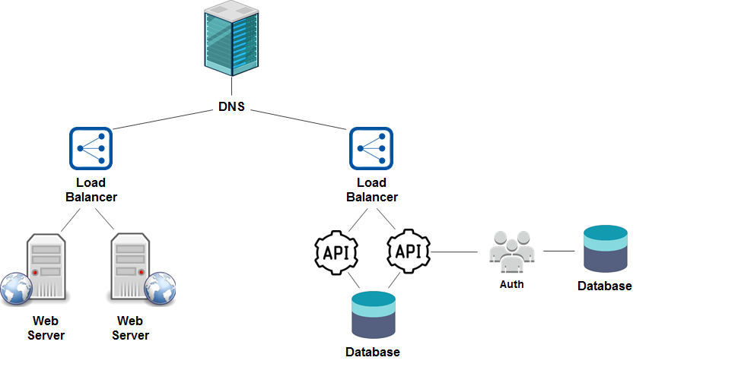
A Traditional Solution Architecture (before)

Slide 6
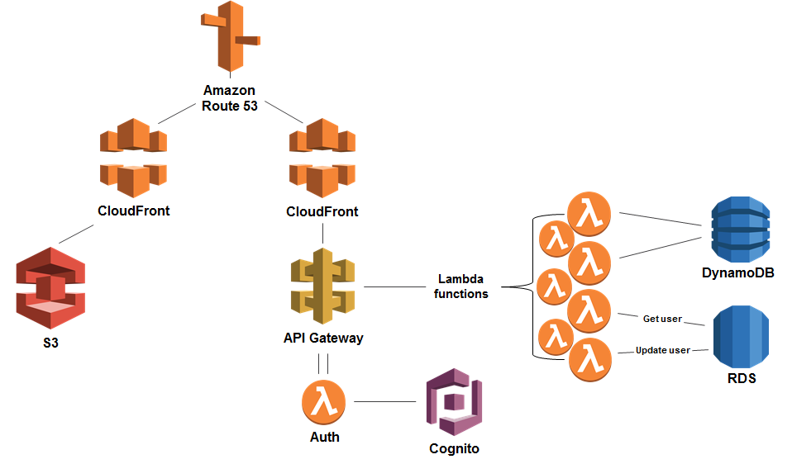
A Refactored Solution Architecture (after)

Slide 7




.NET Framework Application Migration Strategies
Deploy .NET Framework apps “as is” to EC2 Virtual Machines
Every app can have custom server configuration, different .NET Framework versions, IIS configuration, dependencies, etc.
Containerize in Windows Containers and orchestrate with ECS, Fargate, or EKS
Supports different .NET Framework versions, IIS configurations, dependencies
Reduces $$ for OS licensing costs (host only costs)
Port to .NET Core, and run in ECS, Fargate, or EKS as Linux Containers
No OS licensing costs, smaller containers
Also enables deploying apps to Lambda
Low…
Level of Effort
…High

Slide 8
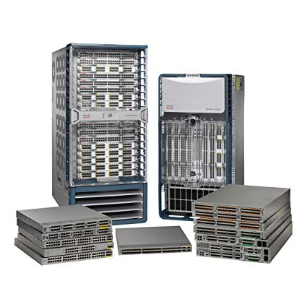
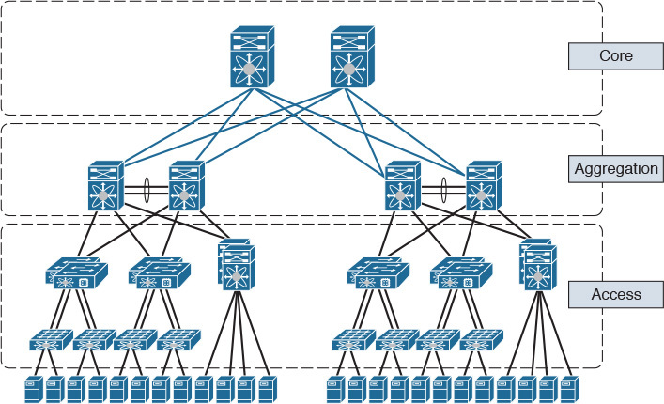
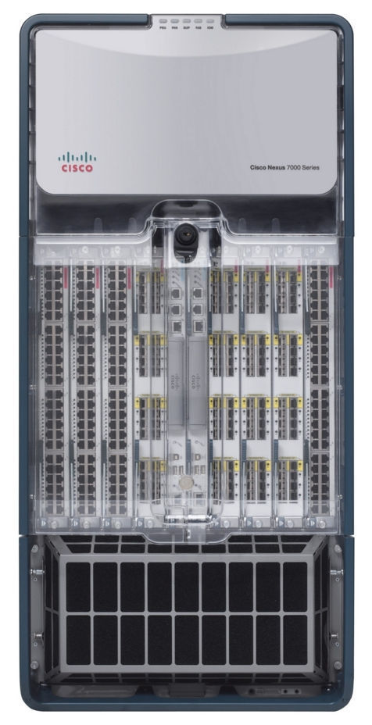
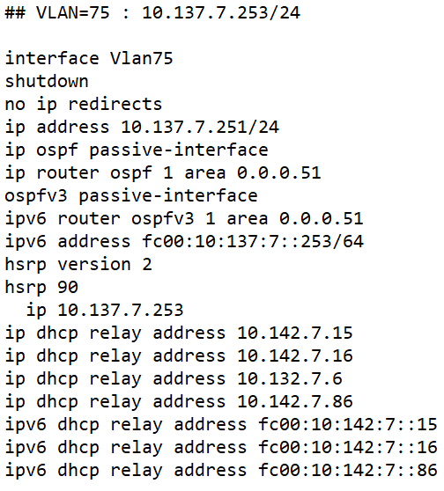
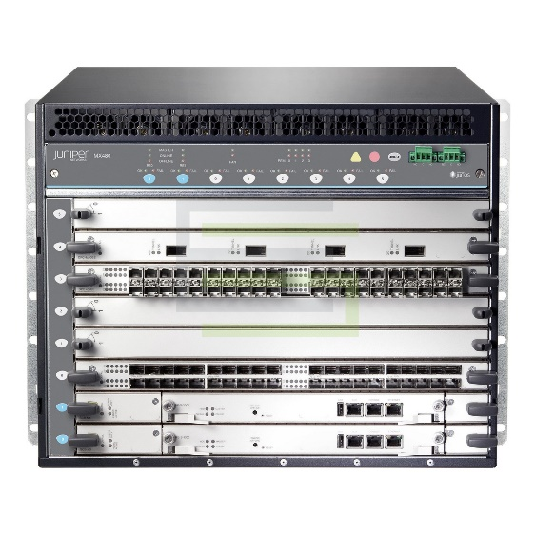
Our Simple but Real-World Application Scenario
A legacy enterprise-class data transformation problem
TRANSFORM
75 family inet address 10.137.7.253/24
Notes:
TODO : Introduce the Enterprise IT problem scenario…

Slide 9
Existing Application Architecture
[ADD DIAGRAM HERE]

Slide 10
Containerized Application Architecture
[ADD DIAGRAM HERE]

Slide 11
Demo Our example application – before & after…

Slide 12
Your Lab Workstations
Notes:
TODO : DOCUMENT THE ILLUSTRATION OF

Slide 13
Your Lab Workstations – Windows & Linux
[ADD DIAGRAM HERE]

Slide 14
The Lab Guide

Slide 15
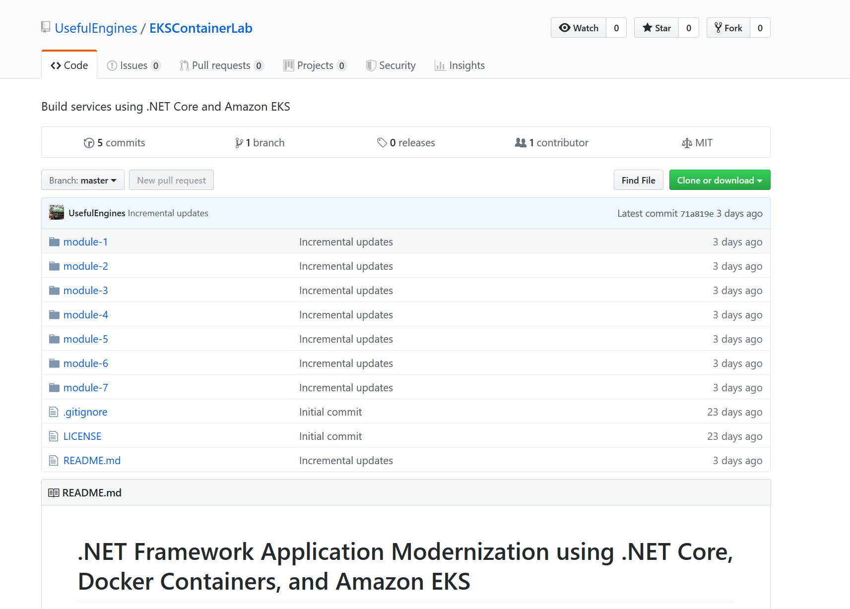
The Lab Guide
https://github.com/UsefulEngines/EKSContainerLab

Slide 16
Getting Help! Watch your time… but you can also complete later. It’s a learning exercise, not a race.

Slide 17
Q&A – Thank You!
Phil Pennington
@penninp

