Slide 1
A Hands-On .NET Solution Migration to EKS
An Application Refactoring Scenario Lab
Ethan Ferdosi
Sr. Partner Solutions Architect
August 2019

Slide 2
Agenda
Let’s review the lab context.
How to access and configure your lab workstations.
Introducing the lab guide.
We’re here to support you… watch your time.
Q&A

Slide 3
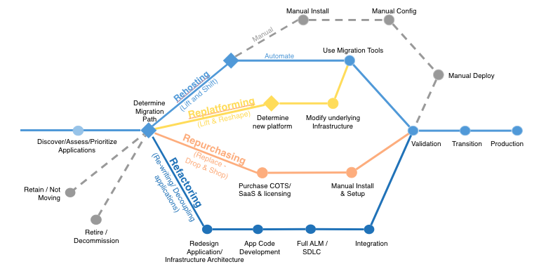
Application Migration Strategies

Slide 4
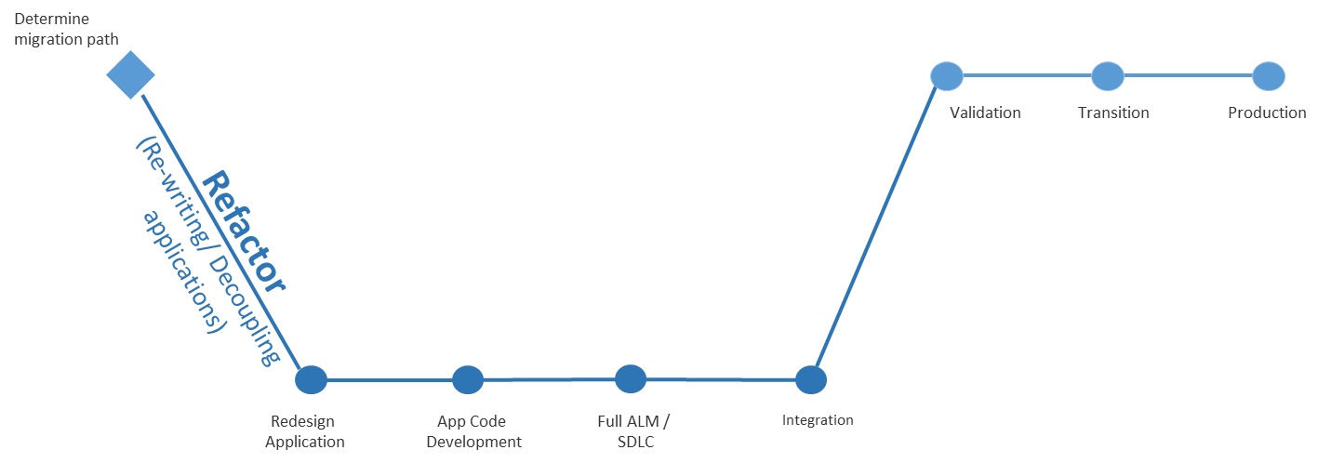
The Refactor Strategy
Pros:
Realize full potential of target cloud platform
Cons:
Requires the largest investment and level of effort to realize

Slide 5
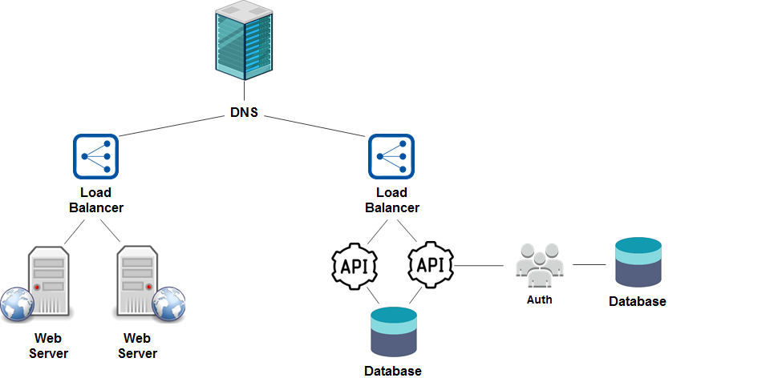
A Traditional Solution Architecture (before)

Slide 6
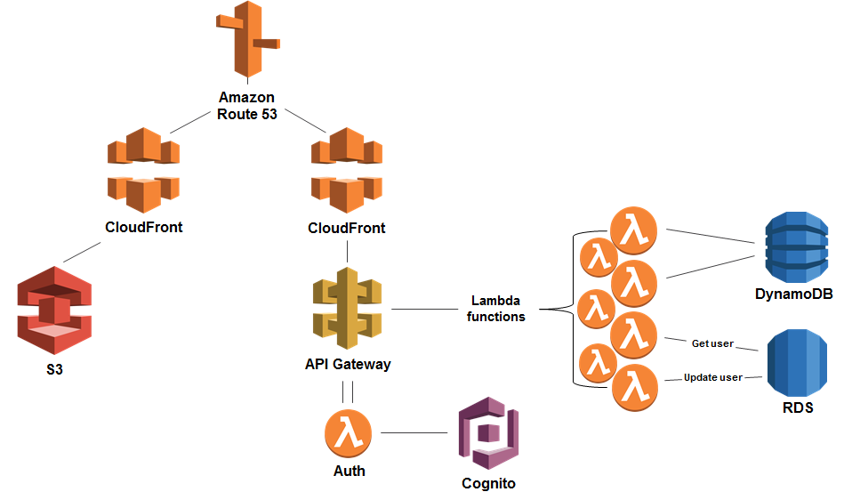
A Refactored Solution Architecture (after)

Slide 7




.NET Framework Application Migration Strategies
Deploy .NET Framework apps “as is” to EC2 Virtual Machines
Every app can have custom server configuration, different .NET Framework versions, IIS configuration, dependencies, etc.
Containerize in Windows Containers and orchestrate with ECS, Fargate, or EKS
Supports different .NET Framework versions, IIS configurations, dependencies
Reduces $$ for OS licensing costs (host only costs)
Port to .NET Core, and run in ECS, Fargate, or EKS as Linux Containers
No OS licensing costs, smaller containers
Also enables deploying apps to Lambda
Low…
Level of Effort
…High

Slide 8
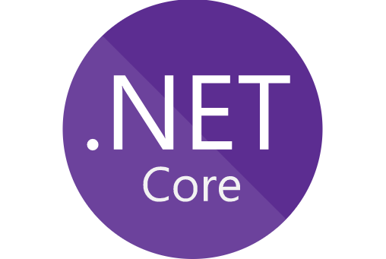
Why .Net Core?
Cross Platform Support (Windows, Mac & Linux)
Lightweight framework
Better Container Support
High performance and scalable
Notes:
.net core you get IoC as first class citizen
.net core configuration allows to use command line params and env variable

Slide 9
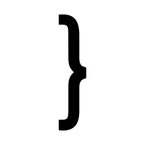

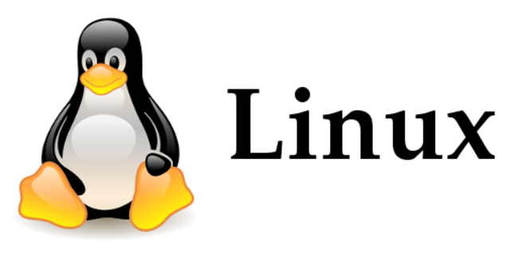

.Net Core on Linux
Higher Performance
Easier Maintenance
Lower Cost
Higher Reliability

Slide 10
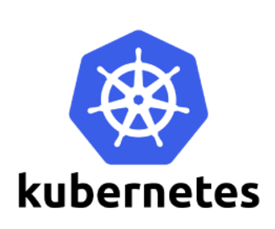
What is Kubernetes?
An open-source system for automating deployment, scaling, and management of containerized applications.
Supports:
Several Container Runtimes (Docker, CRI-O,…)
Linux and Windows Containers
Notes:
Linux containers are more mature and more lightweight to run in scale
Why K8:
K8 is a data center scale operating system with networking and workload scheduling features
Similar to EC2 ecosystem with its VPC, load balancer etc.
No cloud vendor lock in
Takes binary artifacts (images) and run it in containers.

Slide 11
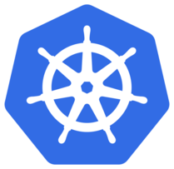
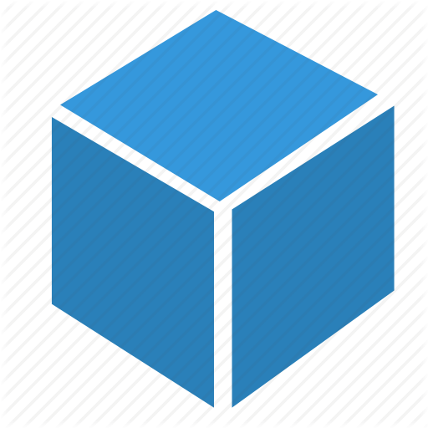
Kubernetes Architecture
Master Node
API Server
(Pods, Services, …)
Scheduler
Controller Manager
etcd
Cluster
ژمعسفثق
Kebelet
Kube-Proxy
Kebelet
Kube-Proxy
Kebelet
Kube-Proxy
Docker
Docker
Docker
Pod
Pod
Pod
Pod
Pod
Worker Node
Worker Node
Worker Node
Notes:
NODE: is the smallest unit of computing hardware in Kubernetes. It is a representation of a single machine in your cluster.
CLUSTER: A collection of Nodes.
CONTAINER:
POD: wraps one or more containers into a higher-level structure called a pod.
The Master node manages the cluster in this way:
The API server parses the YAML configuration and stores the configuration in the etcd key value store.
The etcd stores and replicates the current configuration and run state of the cluster.
The scheduler schedules pods on worker nodes.
The controller manager manages the state of non-terminating control loops, such as pod replicas.
The machines that make up a Kubernetes cluster are called nodes.
Nodes in a Kubernetes cluster may be physical, or virtual.
There are two types of nodes:
A Master-node type, which makes up the Control Plane, acts as the “brains” of the cluster.
A Worker-node type, which makes up the Data Plane, runs the actual container images (via pods).

Slide 12
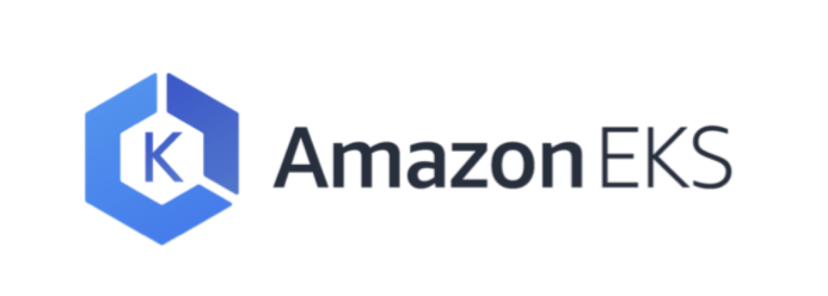
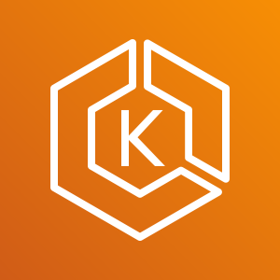
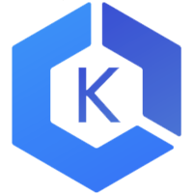

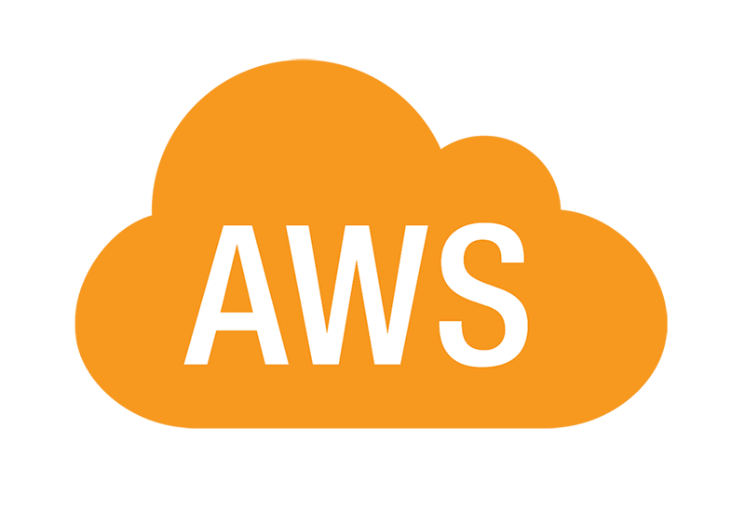
What is EKS? (& Why?)
Elastic Container Service for Kubernetes
kubectl
mycluster.eks.amazonaws.com
AZ1
AZ2
AZ3
YOUR AWS ACCOUNT

Slide 13
The Lab Guide

Slide 14
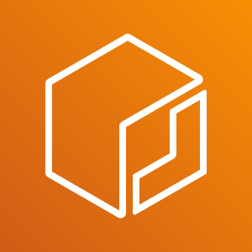

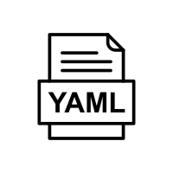
Your Lab Modules
1
3
Linux
Windows
kubectl
docker
VS 2019
AWS CLI
docker
AWS Toolkit for VS
eksctl
AWS CLI
5
Linux
Image
4
.Net Project
.Net Core
6
7
2
EKS
ECR
S3
Pod
8

Slide 15
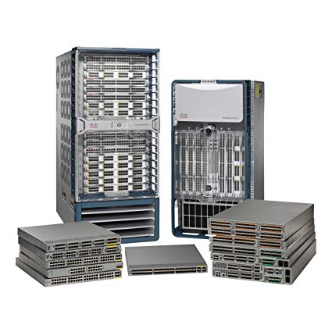
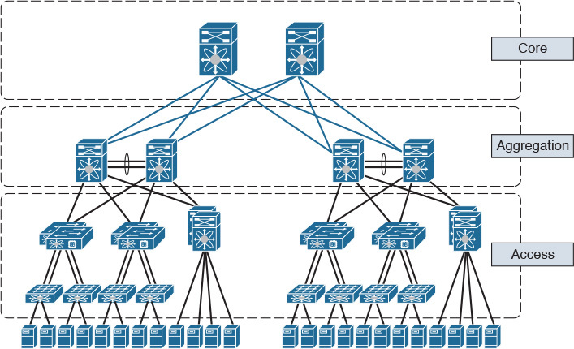
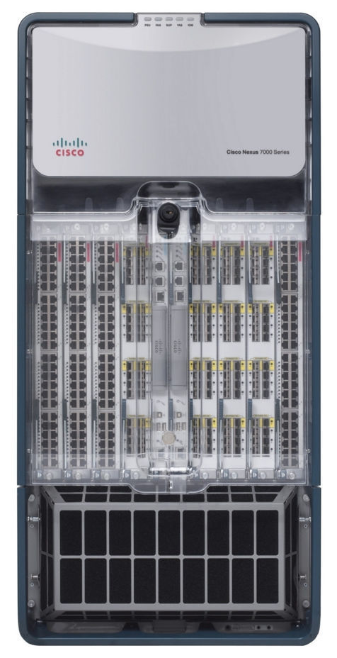
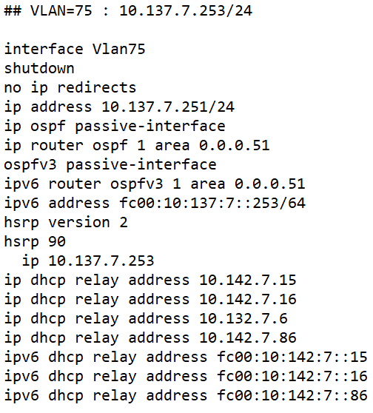
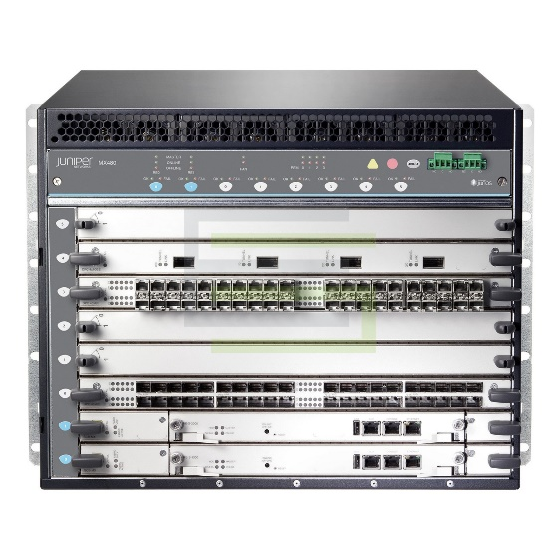
Our Simple but Real-World Application Scenario
A legacy enterprise-class data transformation problem
TRANSFORM
75 family inet address 10.137.7.253/24
Notes:
TODO : Introduce the Enterprise IT problem scenario…

Slide 16
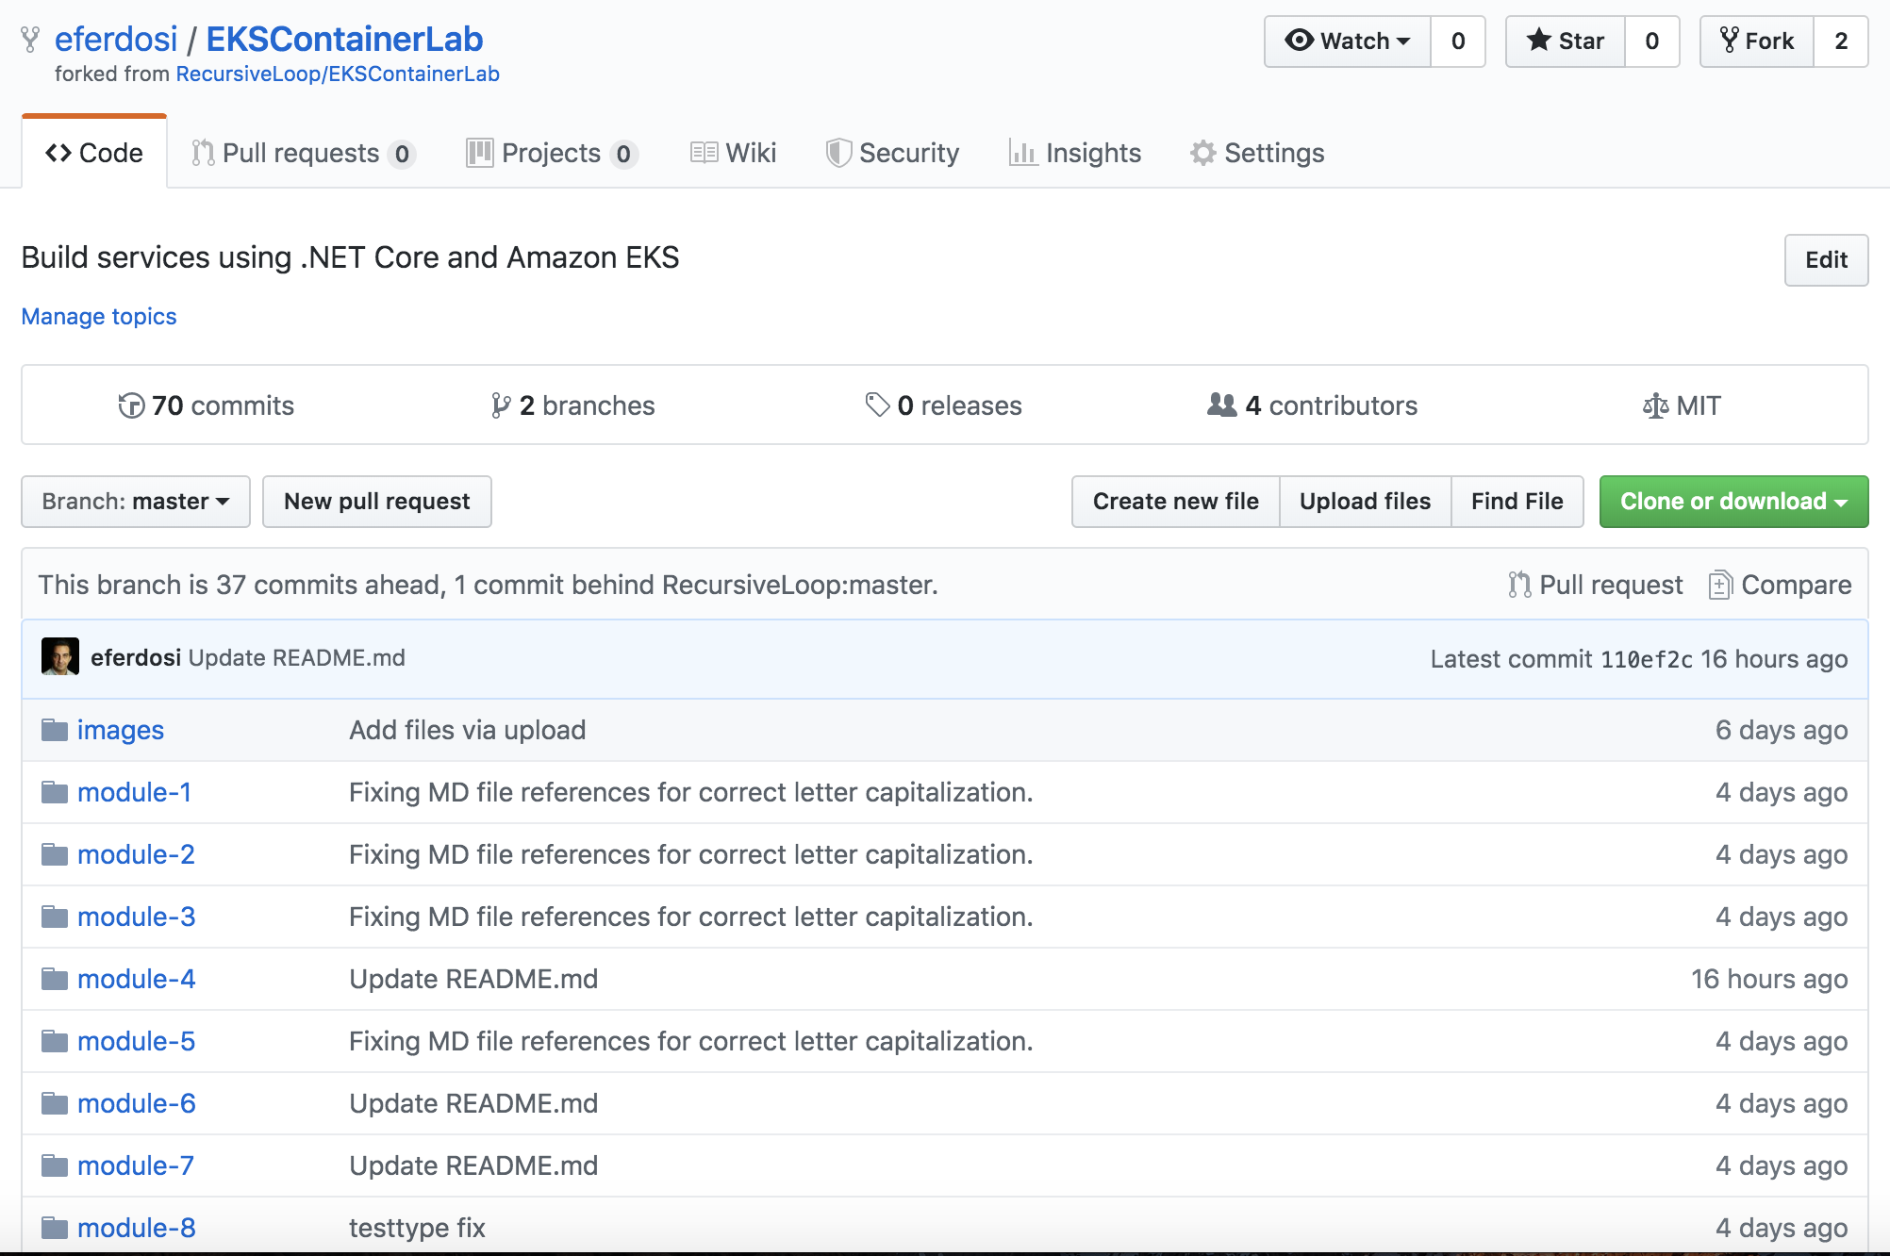
https://tinyurl.com/EKSLab
The Lab Guide
Support Team:
Shahab Mohsen
Vlad Hrybok

Slide 17
Getting Help! Watch your time… but you can also complete later. It’s a learning exercise, not a race.

Slide 18
Q&A – Thank You!
Ethan Ferdosi (@eferdosi)
Support:
Shahab Mohsen - Solutions Architect
Vlad Hybrok – Solutions Architect

Slide 19
Please complete the session survey
in the app

