Slide 1
IoT Meetup Denmark recap/goals 2016

Slide 2
Agenda
Your Inputs
IoT Meetup Denmark
Goals 2016

Slide 3
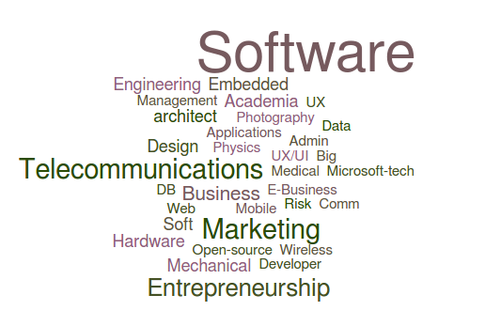
Who are we?
38

Slide 4
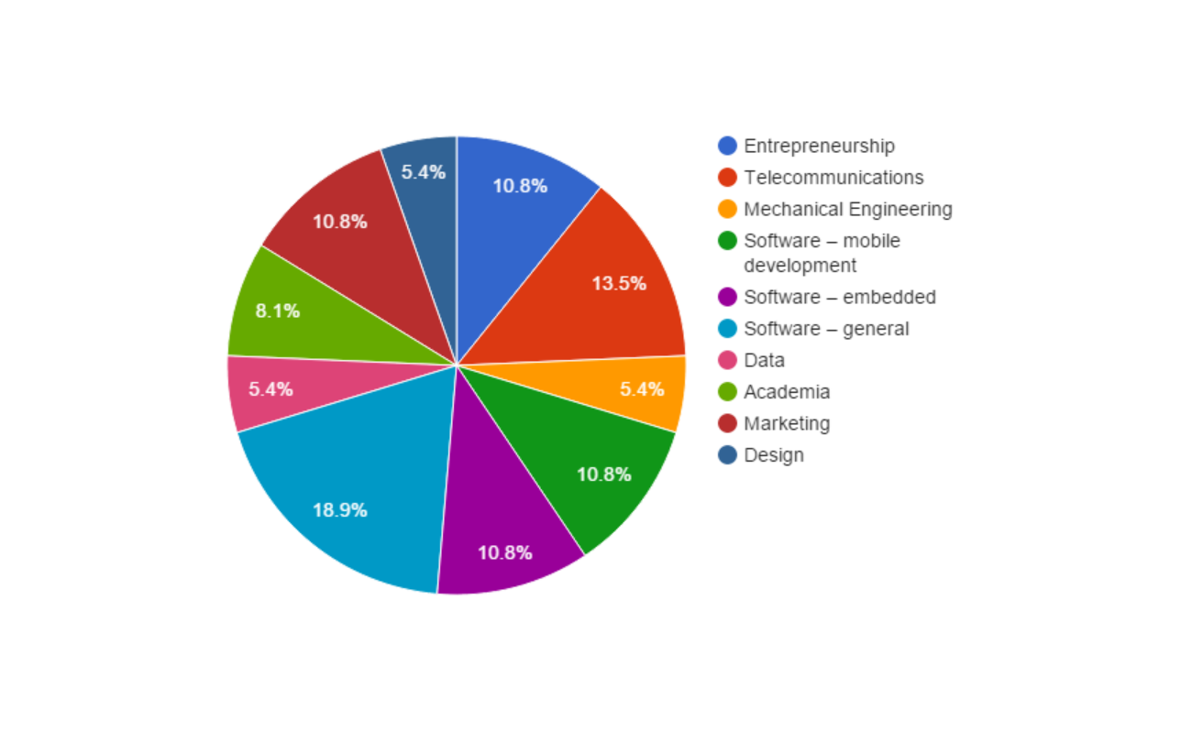
In other words:
21

Slide 5

Goals 2016
Meetups in total:
Workshops
External lectors
9
2
2
Different City
IoT Enthusiasts
IoT project initiated:
1
100 (double)
1
34

Slide 6
Your Input…
38

