Slide 1
IOT MEETUP #4
PLATFORMS AS A SERVICE (PAAS) AND INTERNET OF THINGS (IOT)
04-04-2016

Slide 2
INTRO
Welcome!
Agenda:
1. What is Paas?
2. Amazon Web Services for IoT + Example Cloud Architecture
3. Bluemix as IoT + Demo
4. Comparison and conclusion

Slide 3
ABOUT ME
My name is Radoslav Todorov
Enterprise Developer, 10 years of working experience
Known for teaching at IT University of Copenhagen, 6 years of presence
Newcomer to Aalborg

Slide 4
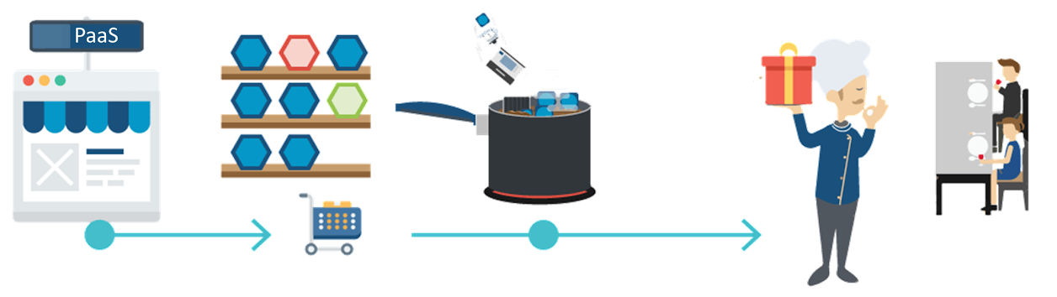
PLATFORM AS A SERVICE (PAAS) - DEFINITION
PaaS enables companies to rapidly build, deploy, and manage their cloud applications, while tapping a growing ecosystem of available services and runtime frameworks.

Slide 5


IOT APPROACHES
DIY
IaaS
PaaS
Platform-as-a-Service
Applications
Data
Infrastructure-as-a-Service
Runtime
Middle Ware
OS
Virtualization
Servers
Storage
Networking
Do-it-Yourself
What should you manage?
Notes:
We examined three different approaches.
We saw that the benefits from developing complete solution from scratch are slim compared to adopting/integrating/ PaaS, but the initial investment and time to market are substantially higher. That is why we looked into the available PaaS solutions.

Slide 6
AWS

Slide 7
WHAT IS AMAZON WEB SERVICES (AWS)
Definition – collection of cloud computing services
Web console to AWS - https://console.aws.amazon.com/
A little history… – estabilished in 2006
New services through the years were added rapidly and exponentially
Regions, Availability Zones – 12 regions, 33 availability zones (http://aws.amazon.com/about-aws/global-infrastructure/)
Free Tier – 1 year of… (http://aws.amazon.com/free/)
https://aws.amazon.com/about-aws/global-infrastructure/

Slide 8
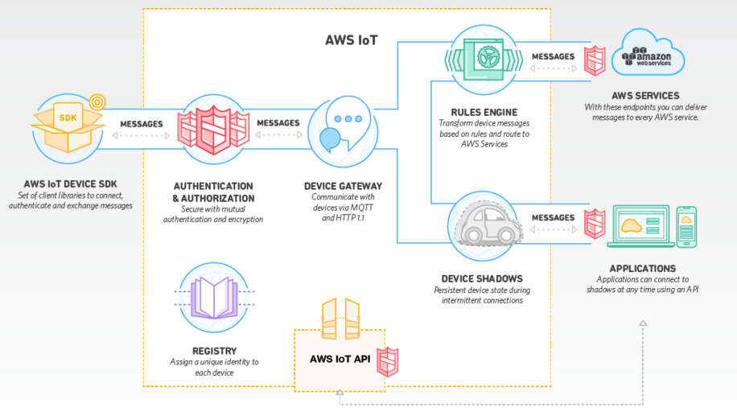
CORE COMPONENTS IN AWS IOT
Device registry
Gateway
Rules engine
Device shadows
Applications
Authentication & Authorization
SDKs (C++, Node.js)
Notes:
History (when was acquired, when was released) TODO
Competitors - IBM BlueMix, Microsoft Azure and other smaller players (find more)
Main protocols and connectivity options on devices
-----
The web interface
Authentication and Authorization mechanisms
Messages
The SDKs (C++, Node)
AWS IoT API
-------
Candyman
Cyclon js
Johny Five
Mraa
------
MQTT over TCP connections
WebSockets

Slide 9




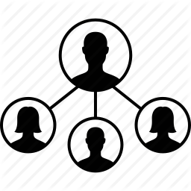


THE ”SMART FRIDGE” PROBLEM
Use your phone when you do shopping
Have a small “station” on your fridge which keeps tracking of all transactions
Designed to save you time and money. It will engage the home shoppers.
A cloud application which easily tracks
the flow of groceries at your home

Slide 10
Notifications via Email
HW Device with Scanner and Screen
AWS IoT
Android Smart Phone
DynamoDB

Slide 11
Notifications via Email
HW Device with Scanner and Screen
Publish to
‘products/remove’ topic
Subscribe to
‘products/add’ topic
AWS IoT
Android Smart Phone
DynamoDB
Notes:
cd /Users/radoslav/Desktop/IoTIntelEdison/Devices/MyMacBookAir/node_modules/aws-iot-device-sdk/examples
node device-example.js -f ~/Desktop/IoTIntelEdison/Devices/MyMacBookAir -F ~/Desktop/IoTIntelEdison/Devices/MyMacBookAir/config.json -g eu-west-1 -D -T=MyMacBookComputer

Slide 12
AWS IOT – FUNCTIONALITY FOR SMALL AUTONOMOUS DEVICES
Create and connect a device
Install SDK on the device (Node or C)
Configure a device
Publish and subscribe to a topic
Notes:
Remind about Shadow on a device
Show
Show delta
Update
Reset

Slide 13
Notifications via Email
HW Device with Scanner and Screen
AWS IoT
Publish to
‘products/add’ topic
Android Smart Phone
Subscribe to
‘products/remove’ topic
DynamoDB

Slide 14
AWS IOT – INTEGRATION WITH ANDROID APP
Create AWS Cognito Identity Pool to authenticate mobile app
Generate public/private keys and certificate inside mobile app. Assign policy.
Connect mobile app as a MQTT client
Publish and subscribe to a topic
Scan barcode or QR code. Publish the data to AWS IoT
Live demonstrate with ‘DroidAtScreen’ (a software for screen capturing)

Slide 15
Notifications via Email
HW Device with Scanner and Screen
AWS IoT
Android Smart Phone
DynamoDB
Execute rule which saves data in the DB

Slide 16
AWS IOT – RULES ENGINE AND DYNAMO DB
Create DynamoDB table
Create IoT rule
Assign role which has the required policy
Publish sample data in the table via client

Slide 17
Notifications via Email
HW Device with Scanner and Screen
Execute rule which sends
email via notification service
AWS IoT
Android Smart Phone
DynamoDB

Slide 18
AWS IOT – RULES ENGINE AND SNS SERVICE
Create topic
Create email subscription to topic
Confirm email
Publish sample data and test the notification

Slide 19
REFERENCES – FIRST HAND RESOURCES
https://aws.amazon.com/iot AWS/ IoT Official Page
https://aws.amazon.com/documentation/iot/ AWS IoT Documentation
https://aws.amazon.com/blogs/aws/ AWS Official blog

Slide 20
REFERENCES - TUTORIALS
https://www.youtube.com/watch?v=GdtV27LKGtQ AWS October 2015 Webinar Series - Essentials: Getting Started with AWS IoT
https://www.youtube.com/watch?v=tTazcL61JG8 AWS January 2016 Webinar Series - Getting Started with AWS IoT
https://www.youtube.com/watch?v=0Izh6ySpwb8 AWS January 2016 Webinar Series - Best Practices for Building IoT Backends with AWS IoT & AWS Lambda
https://www.youtube.com/watch?v=bac35yWJF08 AWS February 2016 Webinar Series - Best Practices for IoT Security in the Cloud
https://www.youtube.com/watch?v=0X54z4fzN9g AWS IoT Webinar for EMEA Analysts
https://www.youtube.com/watch?v=lUXFVJbDtUY AWS re:Invent 2015 | (MBL303) Build Mobile Apps for IoT Devices and IoT Apps for Devices

Slide 21
RESOURCES - PROJECTS
https://www.hackster.io/amazonwebservices AWS IoT Ideas
https://aws.amazon.com/blogs/aws/hackster-aws-iot-mega-contest Hackster AWS IoT Mega Contest

Slide 22
BLUEMIX

Slide 23
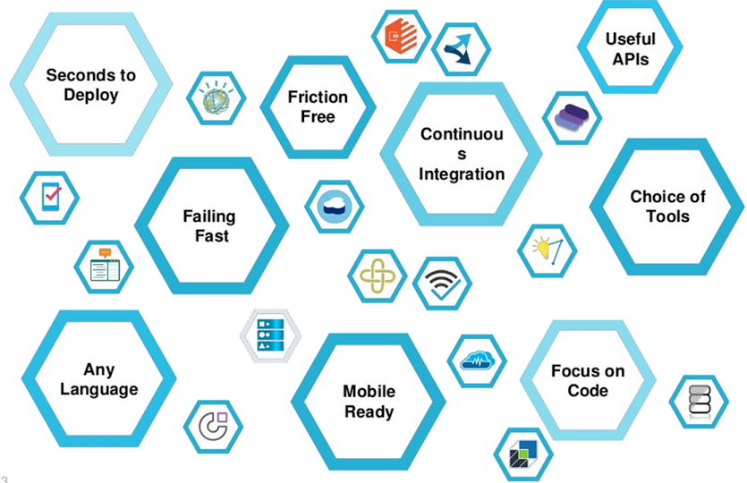
IBM BLUEMIX
Looking for early adopters. Willing to invest themselves in advising and consulting.
Initial investment in 1.2 B USD – 3B USD more planned in the next 4 years – (Bluemix will be around for a while.)
Flexible cloud – Offers: public, dedicated and local deployment models
Notes:
IBM Bluemix is a platform developed with a thought of Big Data and IoT trends in mind.

Slide 24
IBM BLUEMIX – KEY FACTS
Open Platform – Based on open-source standards/ platforms - Everybody could contribute with service.
Looking for early adopters. Willing to invest themselves in advising and consulting of companies and startups.
Offers IBM IoT Foundation Service
Flexible cloud – Offers: public, dedicated and local deployment models

Slide 25
IBM IOTF SERVICE
https://7lmfb9.internetofthings.ibmcloud.com/dashboard/#/overview
https://7lmfb9.internetofthings.ibmcloud.com/dashboard/#/devices/browse
https://7lmfb9.internetofthings.ibmcloud.com/dashboard/#/access/apikeys
Notes:
Screenshots and explanation for the MQTT server that is presented

Slide 26
FOOTPRINT OF THE DEMO
Cordova (Cross Platform App + MQTT JS client)
IBM IoTF Application API
Bluemix IoTF
IBM IoTF Device API
MQTT Publish
MQTT Subscribe
Smart Light (Node.js MQTT Client)
MQTT Subscribe
MQTT Publish

Slide 27
BONUS FOR STUDENTS – 6 MONTHS FREE
Sign up for a free trial period using below link (use your university email)
Validate your email (check your inbox)
Got to www.ibm.biz/IBMStudent/ Fill in your email address and password: IBMstudent4344
You will receive your student code in an email
Go to Bluemix, log in, click the calendar up right corner and choose apply promo code

Slide 28
COMPARISON OF AWS AND BLUEMIX

Slide 29
FEATURES
AMAZON WEB SERVICES
BLUEMIX
Device Registry
Device SDK (iOS, Android, Node.js, C)
Authentication and Authorization ('SigV4’, X.509 compatible certificates, Cognito, CLI)
Rules engine and integration (Lambda, Kinesis, S3, Amazon Machine Learning, DynamoDB, CloudWatch, and Elasticsearch Service with built-in Kibana integration)
Device Shadow
Device management
SDK (Every MQTT client is compatible)
Secure Communication (basic authentication over TLS)
Storage and access to data

Slide 30
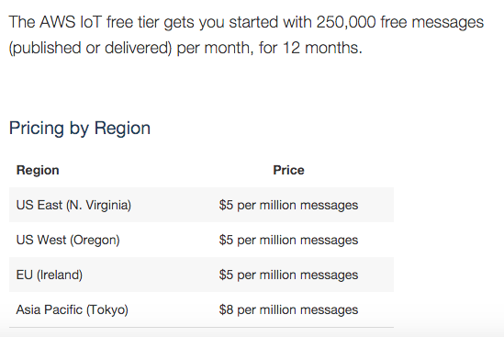
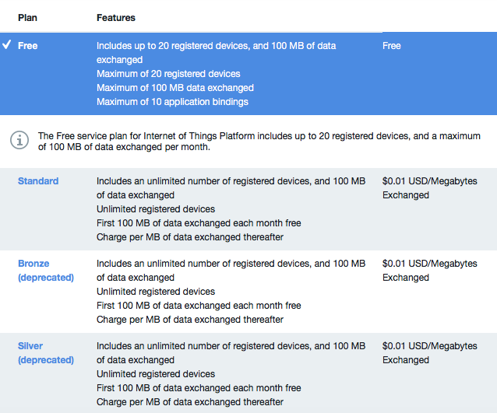
PRICING MODELS
Notes:
AWS 512 bytes is a message

Slide 31
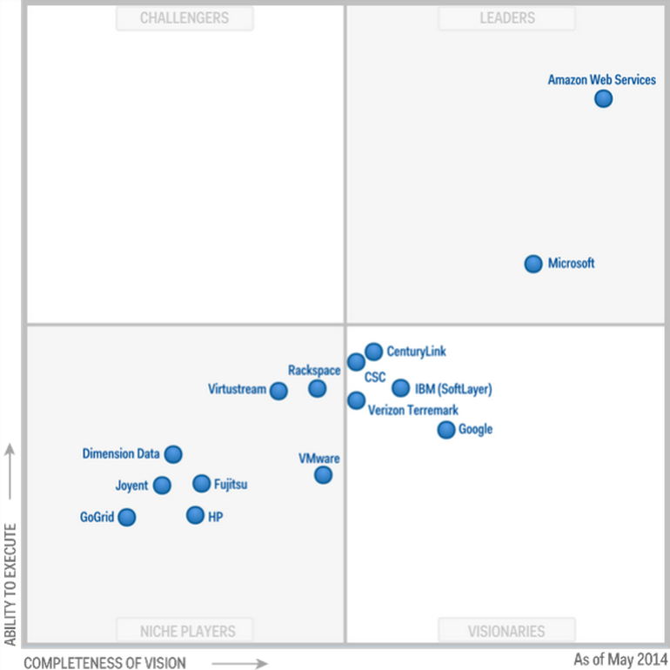
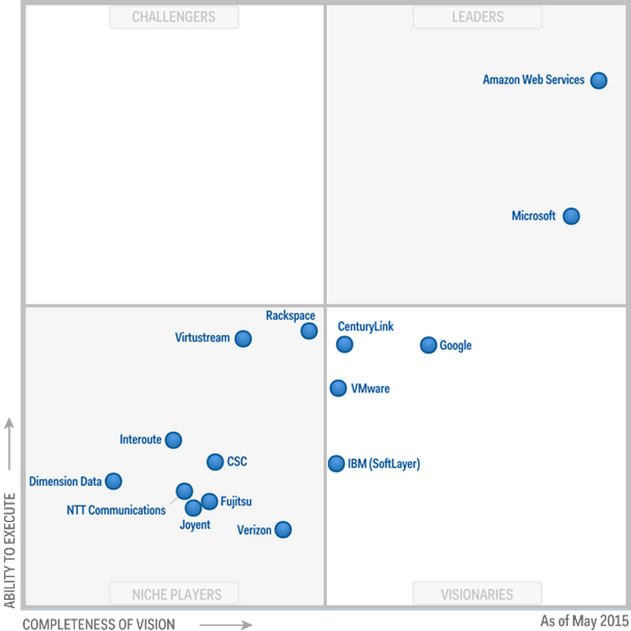
http://www.zdnet.com/article/microsoft-and-google-rise-while-ibm-sinks-in-gartners-latest-magic-quadrant-for-cloud-providers/
Notes:
IBM Bluemix June 2014 // MS Azure February 2010 // AWS 2006 // Google Platform April 2008

Slide 32
WHAT IS NEXT
Workshop in June – we will need your help
IoT Meetup #5: Business Models Within IoT
Notes:
TODO: Ask Uffe for space and time
TODO: To specify the workshop

Slide 33
THANK YOU!
You can reach Radoslav at radoslav.h.todorov@gmail.com

