Slide 1
Internet of Things Requirements and solutions

Slide 2
Agenda
IoT and M2M
Prospects
Requirements
Challenges
Solutions
Conclusions and discussion

Slide 3
IoT and M2M
Smart, connected devices
Collecting and exchanging data autonomously
Little or none human intervention

Slide 4
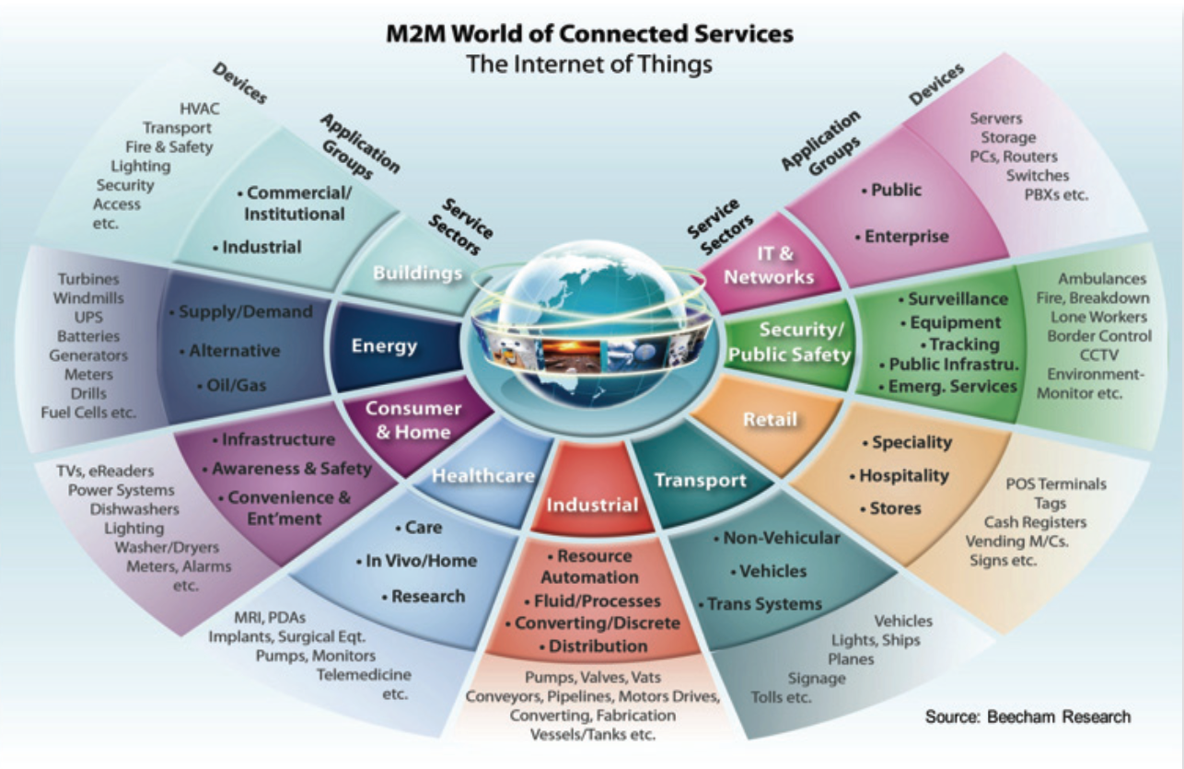

Slide 5
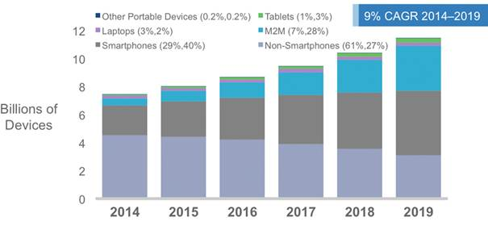
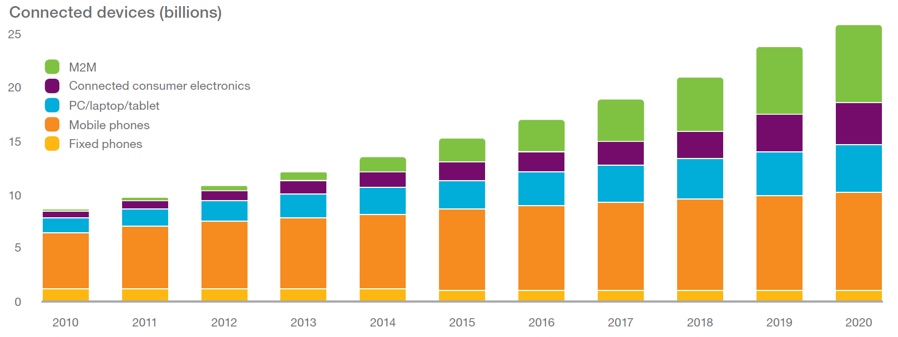
Prospects
2014 - Cisco
2015 - Ericsson

Slide 6
Drivers
Barriers
Diminishing prices for devices
Diminishing costs for data plans
Security & privacy
Large number of devices
Various (small) packet sizes
Various latency & reliability requirements
Billing

Slide 7
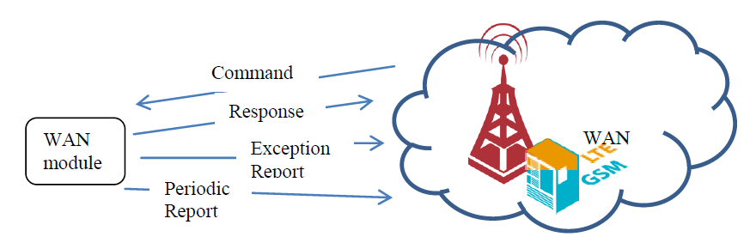
Requirements
Packet size
Packet arrival rate
Maximum latency
Energy efficiency
Reliability

Slide 8
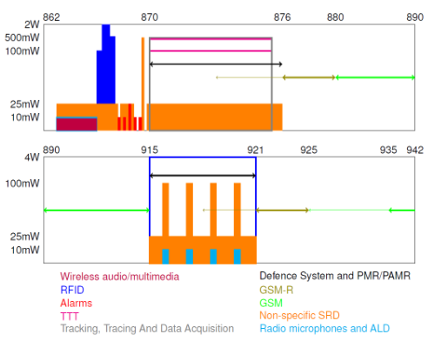
Challenges
Interference (unlicensed spectrum)
Delay – for CSMA-CA or due to collisions
Scheduled transmissions -> overhead
H2H LTE ~ 25 % overhead
NB-LTE ??
Non-scheduled -> Collisions
100 users x 10,000 KB ≠ 10,000 users x 100 KB
2015 Semester project – group 850 WCS

Slide 9
Solutions
Re-engineering
GSM
UMTS
LTE (NB-LTE)
New protocols
Sigfox
LoRa
Weightless
Wi-Fi 802.11ah
Ingenu RPMA
“Old” protocols
Bluetooth
ZigBee

Slide 10
GSM for M2M
Frequencies (licensed) – 850, 900 MHz preferred
GMSK modulation – low complexity PA
Data rate – 9.6 Kbps
Multiple access
FDMA – 125 channels
TDMA – 8 slots
Slotted random access
217 RACH/s
24 AGCH/s (enhanced to 24 x 4)

Slide 11
NB-LTE
Scheduled access – good or bad
Licensed frequency spectrum
64 preambles for random access
Preventing overload
Separate RACH resources for M2M and H2H
180 KHz UL & DL (SC-FDMA )

Slide 12
Sigfox
Sub 1-GHz unlicensed spectrum
Ultra narrow band + continuous frequency hopping
Range: 10 km urban / 50 km rural
Uplink: 100bps, 12 bytes/message, 140 messages/day
1 million devices per base-station
Base-stations 1000 times more efficient than GSM
3 msg/day & 2.5Ah battery => 20 years autonomy

Slide 13
LoRa
Sub 1-GHz unlicensed spectrum
125 KHz channels (8 in Europe, 64 in US)
Data rate – 50 kbps
Unlimited packets/day and up to 255 bytes/packet
Range: 5 km urban / 15 km rural
Over 1 million devices / base-station

Slide 14
Weightless
Little overhead
Weightless –N:
Narrowband, 200 Hz channels, unlicensed sub 1-GHz
Frequency hopping
Uplink only, 100 bps
Range: 3 km urban
Weighless –W: white space TV frequency (400-800 MHz)
UL & DL (TDD)
5 MHz channel, 10 Mbps

Slide 15
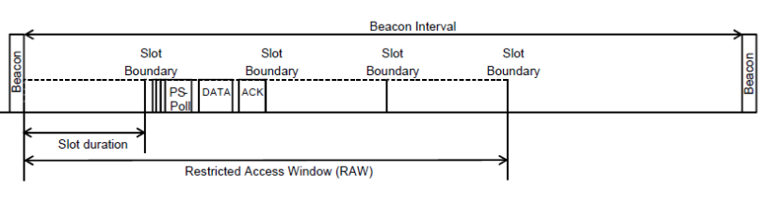
Wi-Fi 802.11ah
Unlicensed sub 1-GHz ISM spectrum
“Long range Wi-Fi” – up to 1.5 km rural
Channels: 1, 2, 4, 8, 16 MHz (Europe ISM band size ~ 6 MHz)
Restricted access window (RAW)
CSMA-CA
UL & DL
Up to 8000
devices

Slide 16
Others
Bluetooth & ZigBee
Short range
Cheap
Ingenu RPMA
2.4 GHz unlicensed band
“Carefully synchronized”
Signaling and power control required

Slide 17
Conclusions & Discussion
What to choose:
Unlicensed vs. licensed spectrum
Scheduled vs. random access
Range vs. power consumption
Many solutions, limited spectrum – what about interference

