Slide 1
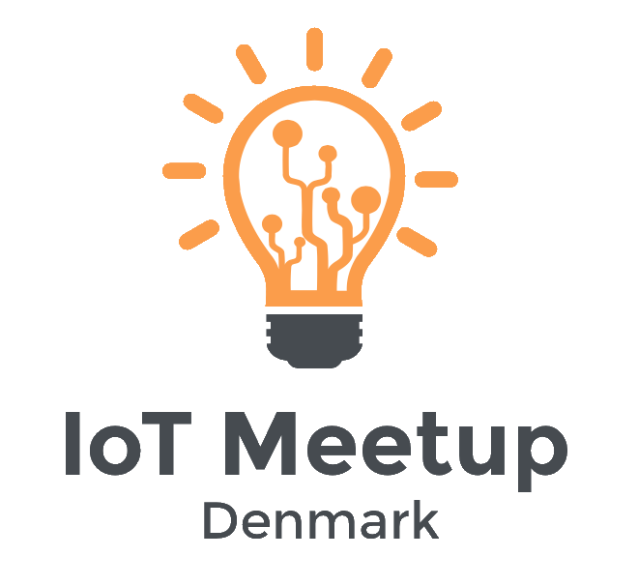
Welcome

Slide 2
AGENDA
Practicalities for the future.
Introduction into IoT
Break
IoT as a business opportunity
Start with IoT
Open discussion /in groups/
Networking

Slide 3
PRACTICALITIES
To keep it simple in the future we will use Meetup.com
Please use this medium to come forward with ideas and suggestions for the following meetups.

Slide 4
Why IoT Meetup Denmark was born?
Notes:
We wanted to meet people passionate about IoT and we looked for a meetup, but we weren’t able to find one. That’s why we decided to do our best and organize one ourselves.

Slide 5
WHAT IS IoT?
The IoT is connecting the physical world to the Internet.
That allows objects, animals and people to transfer data describing their being

Slide 6

HOW?
Think of IoT as nervous system
Identity
Connectivity
Sensors
Process

Slide 7
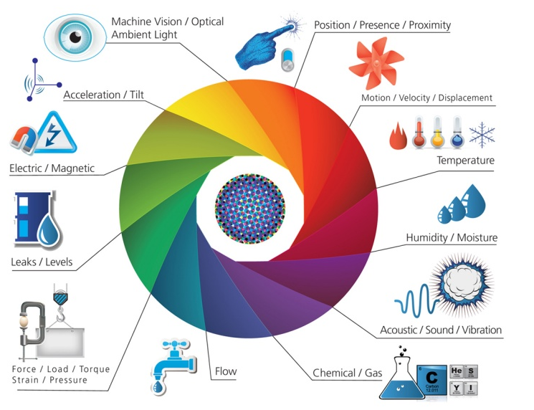
SENSORS
Source: postscapes.com
Notes:
What is “Smart” staying for?

Slide 8
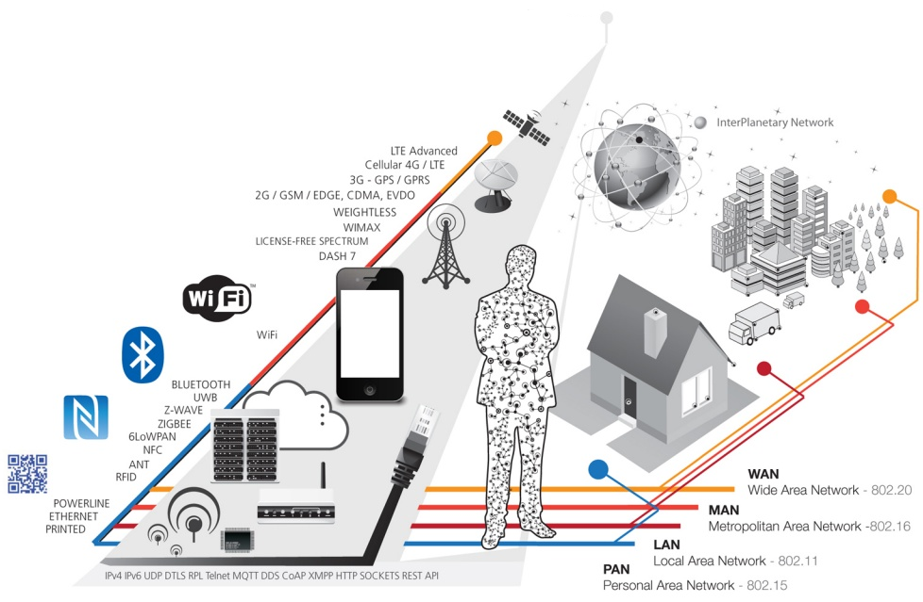
CONNECTIVITY
Source: postscapes.com

Slide 9
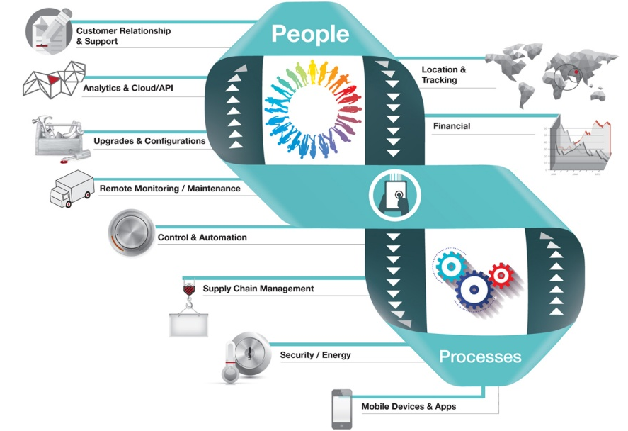
PROCESSES
Source: postscapes.com

Slide 10
APPLICATIONS
Home
Transport
Health
Building
Cities

Slide 11
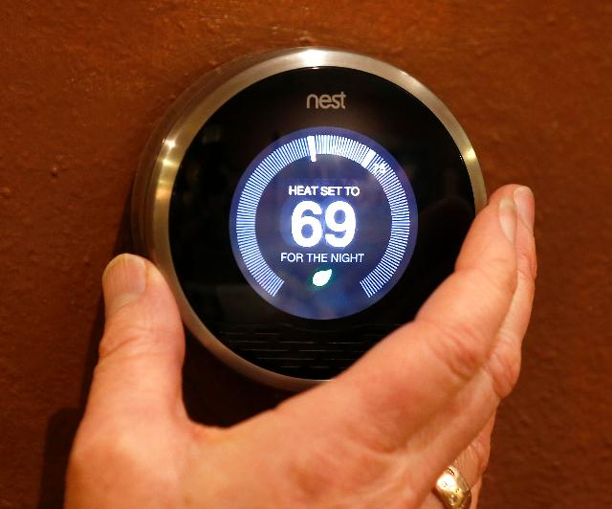
NEST
Notes:
Nest - http://www.forbes.com/sites/bernardmarr/2015/08/05/googles-nest-big-data-and-the-internet-of-things-in-the-connected-home/
Tesla The top automotive company is competing on grounds of internet of things. Tesla Cars have its software’s updated that can automatically update as and when needed and if the car needs any repairs or maintenance then can autonomously arrange a valet to pick the vehicle and get it to nearest Tesla service centre.This facility will ensure that you are not having any bad experience with third party garage and the customer service experience is enhanced. Tesla is continuously working on their autopilot system. The company has recently finished version 7 update drives the car with little to none input from the driver. ( modifyied - http://iotworm.com/internet-of-things-examples/)

Slide 12
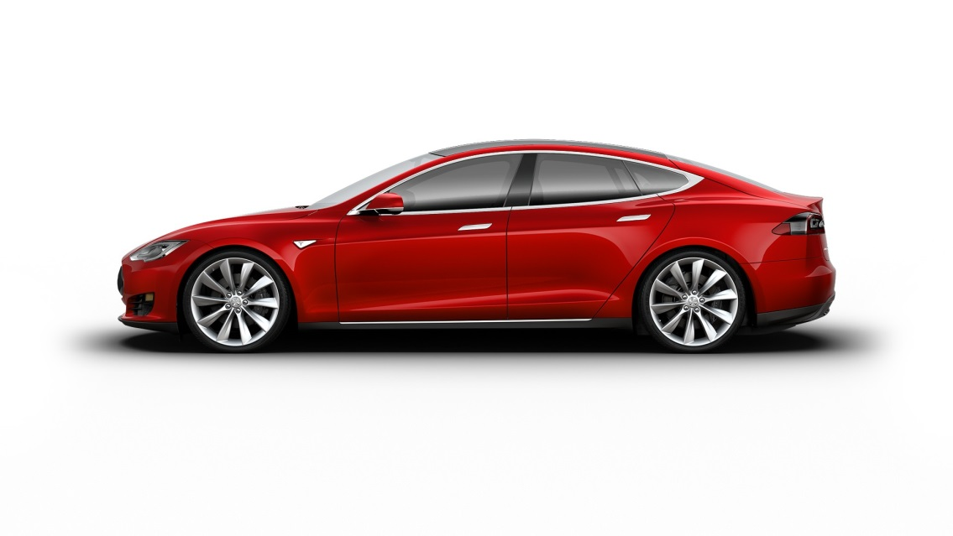
TESLA
Notes:
Nest - http://www.forbes.com/sites/bernardmarr/2015/08/05/googles-nest-big-data-and-the-internet-of-things-in-the-connected-home/
Tesla The top automotive company is competing on grounds of internet of things. Tesla Cars have its software’s updated that can automatically update as and when needed and if the car needs any repairs or maintenance then can autonomously arrange a valet to pick the vehicle and get it to nearest Tesla service centre.This facility will ensure that you are not having any bad experience with third party garage and the customer service experience is enhanced. Tesla is continuously working on their autopilot system. The company has recently finished version 7 update drives the car with little to none input from the driver. ( modifyied - http://iotworm.com/internet-of-things-examples/)

Slide 13
BREAK

Slide 14
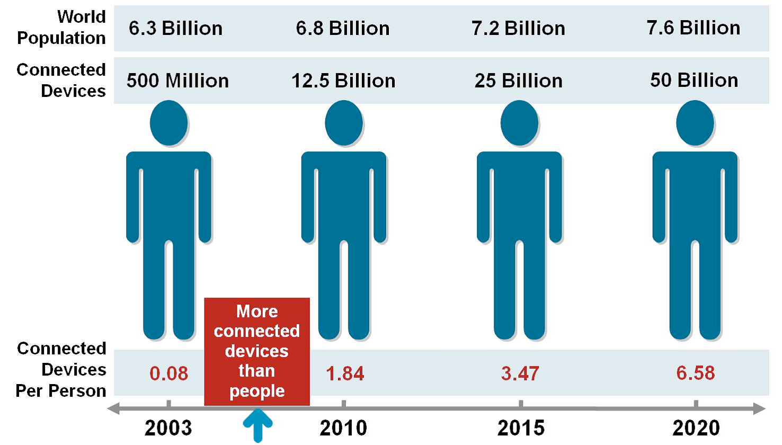
MARKET & BUSINESS
Source: Cisco

Slide 15
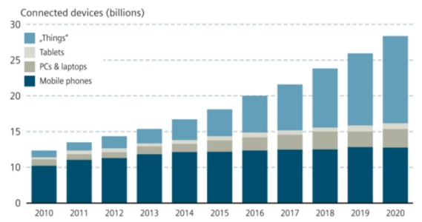
MARKET & BUSINESS
Source: MIT

Slide 16
And its easy to start

Slide 17
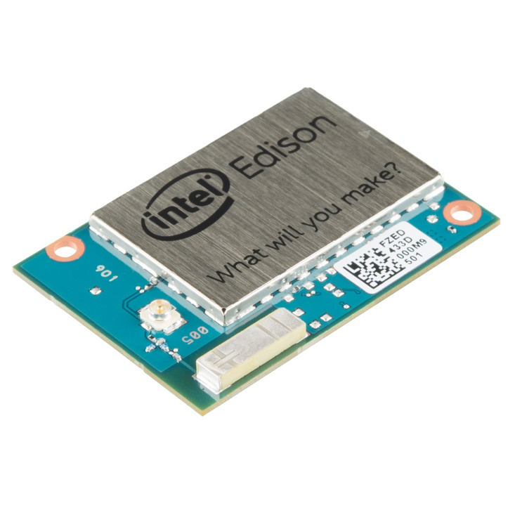
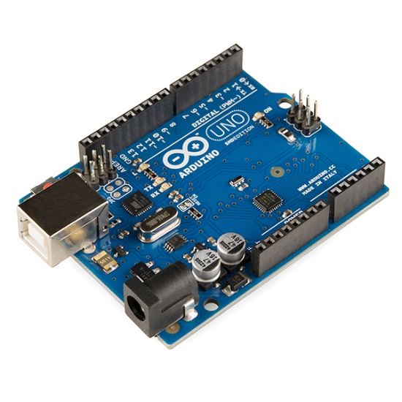
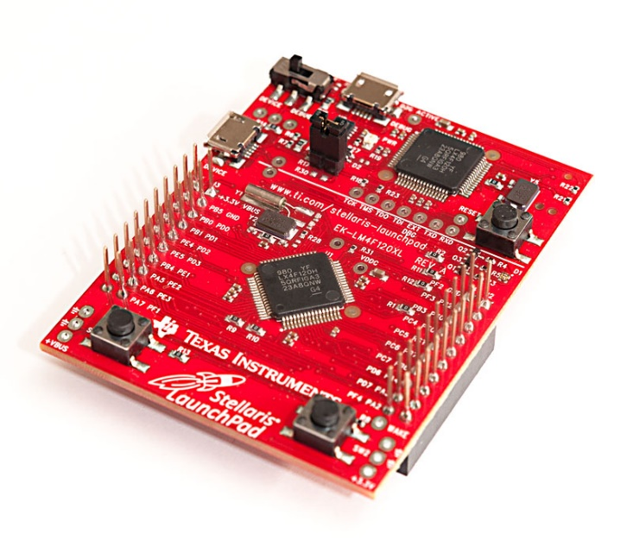
OFF THE SHELF MAKER PLATFORMS

Slide 18
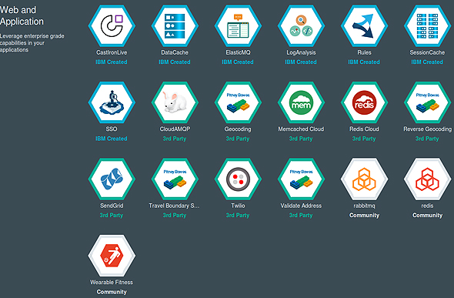
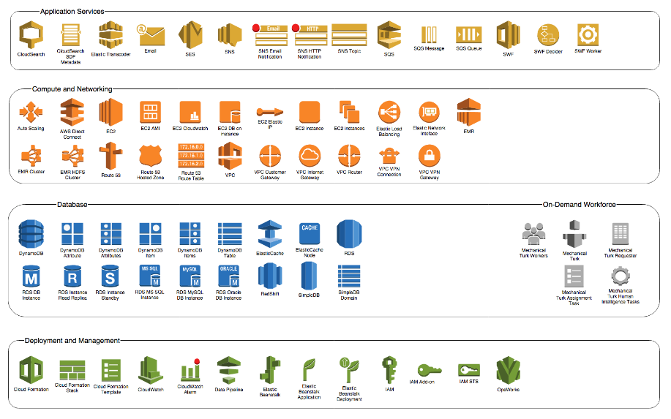
PaaS

Slide 19
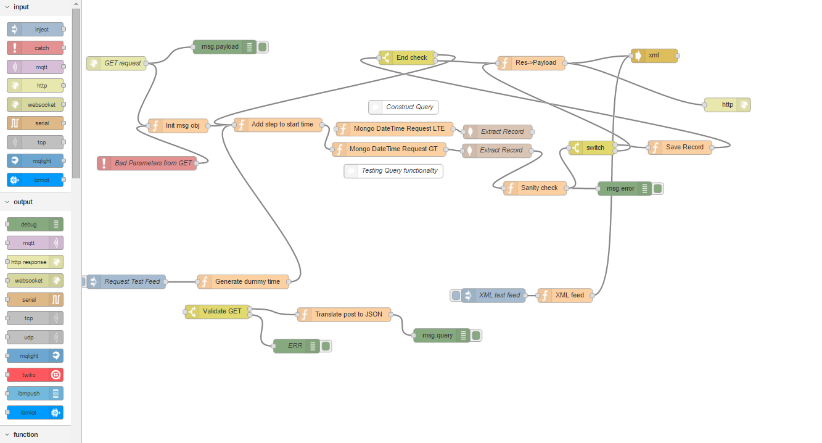
VISUAL TOOLS FOR PROTOTYPING

Slide 20
OPEN DISCUSSION
See who are you in a group with.
Introduce each other within the group – 5min
Discuss what do you want to see on the next Meetup. How could your group help? Do you want to share something?

Slide 21
Now lets connect!

