Slide 1
IoT Meetup #6
aka IoT Workshop #1

Slide 2
Electricity
The movement of electrons

Slide 3
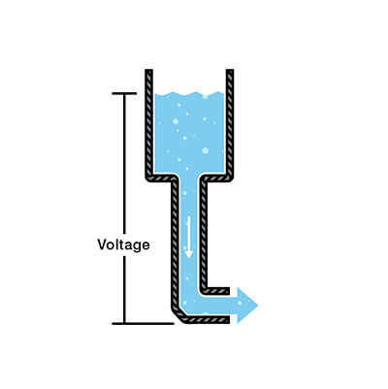
Voltage
The amount of potential energy between two points on a circuit. One point has more charge than another.
Measured in Volts (V)
Noted with U or V
Notes:
The pressure at the end of the hose can represent voltage. The water in the tank represents charge. The more water in the tank, the higher the charge, the more pressure is measured at the end of the hose.

Slide 4
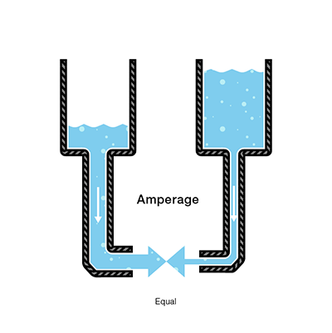
Current
The amount of charge flowing through the circuit over a period of time.
Measured in Amperes, Amps (A)
An ampere is defined as 6.241*10¹⁸ electrons passing through a point per second.
Noted with I

Slide 5
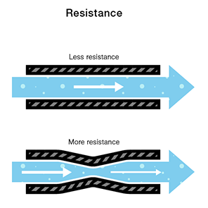
Resistance
The resistance is the restrictions on the pipes, the higher the resistance the lower the current.
It is measured in ohms - “Ω” (Greek letter omega)
Noted with R.

Slide 6
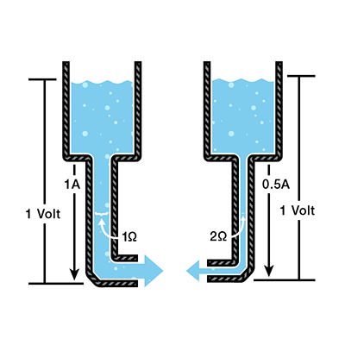
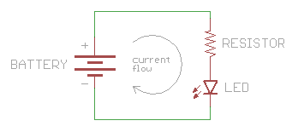

Ohms law
$I=\frac{U}{R}$
$U=I∗R$

Slide 7
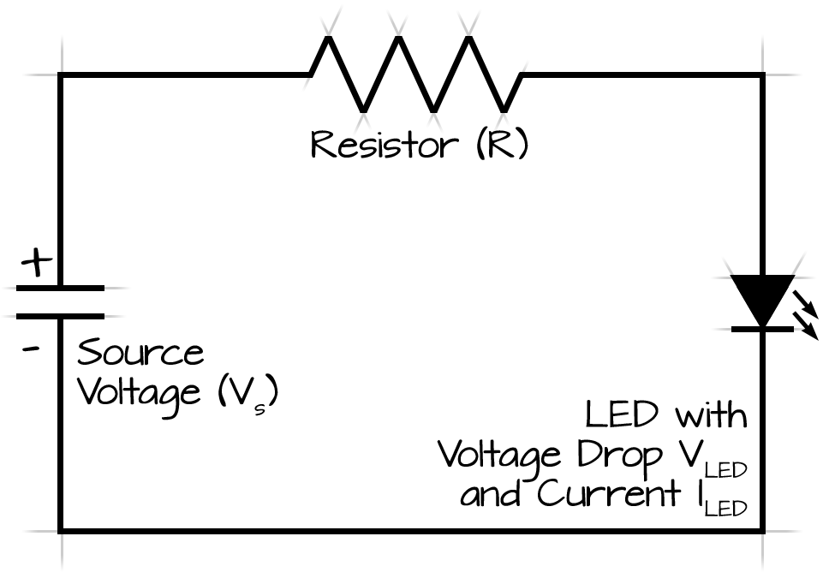
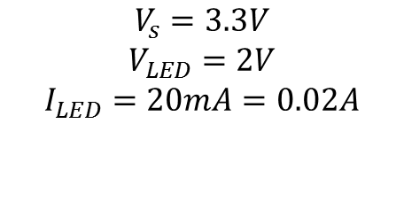
Example
$$V_{s}=3.3V$$
$$V_{LED}=2V$$
$$I_{LED}=20mA=0.02A$$
Lets calculate the value of R !

Slide 8

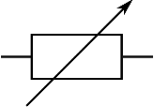
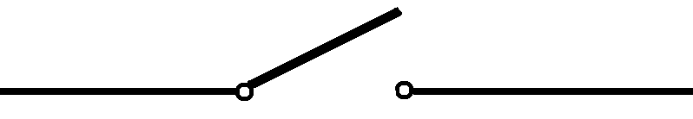

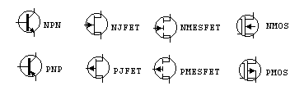
Some building blocks in electronics
Resistors
Variable Resistor
Switch/breaker
LED – Light emitting diode
Transistors – all kinds

Slide 9
Exercise 1: Button controlled LED

Slide 10


Slide 11
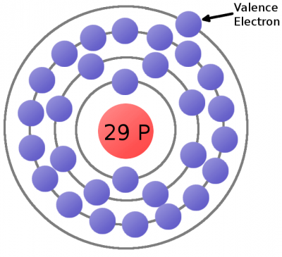
Conductors and isolators
Copper atom
Notes:
Some elemental types of atoms are better than others at releasing their electrons. To get the best possible electron flow we want to use atoms which don’t hold very tightly to their valence electrons. An element’s conductivity measures how tightly bound an electron is to an atom.
Elements with high conductivity, which have very mobile electrons, are called conductors. These are the types of materials we want to use to make wires and other components which aid in electron flow. Metals like copper, silver, and gold are usually our top choices for good conductors.
Elements with low conductivity are called insulators. Insulators serve a very important purpose: they prevent the flow of electrons. Popular insulators include glass, rubber, plastic, and air.

Slide 12
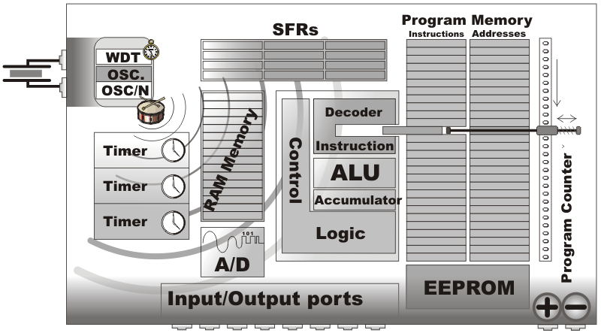
What is microcontroller
Notes:
Source: http://learn.mikroe.com/ebooks/8051programming/chapter/what-are-microcontrollers-and-what-are-they-used-for/
SFR = Special function registers
ALU = Arithmetic logical unit
WDT = watchdog timer
OSC = Oscillator
A/D = Analog-to-digital converter

Slide 13
Peripherals - Examples
GPIOs – General input/outputs
ADC – Analog-to-digital converter
DAC – Digital-to-analog converter
PWM – Pulse wave modulation
Peripheral interfaces:
SPI
UART
USB
And many more…

Slide 14
GPIO
If configured as input: Can read logical states (0,1) – acts like detector.
If configured as output: Can generate logical state (0,1) – acts like a switch.
Tristate when input – susceptible to noise.
Notes:
When input in tristate – susceptible to noise
When input – Sometimes pull up/down options available.

Slide 15
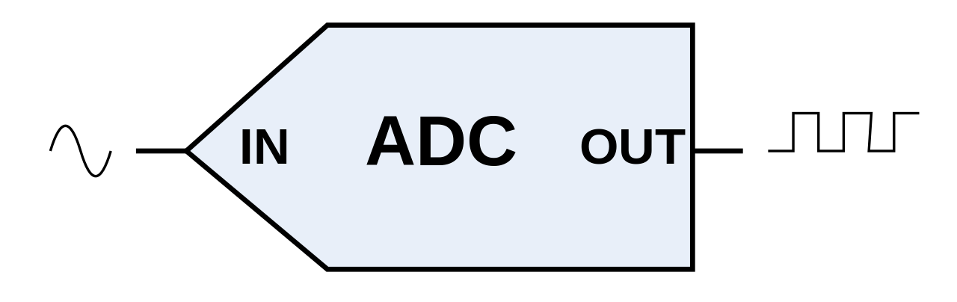
ADC – Analog-to-digital converter
Takes voltage and converts it into digital number
Notes:
An analog-to-digital converter (ADC, A/D, A–D, or A-to-D) is a device that converts a continuous physical quantity (usually voltage) to a digital number that represents the quantity's amplitude.

Slide 16
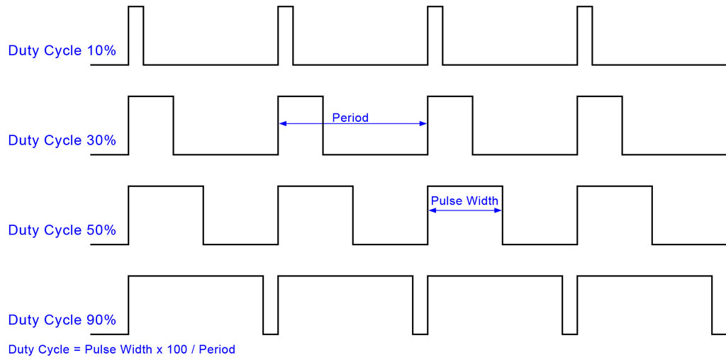
PWM – Pulse Wave Modulation
Quickly switches on and off
Duty cycle = what percentage of the time the state is on
Notes:
Pulse Width Modulation, or PWM, is a technique for getting analog results with digital means. Digital control is used to create a square wave, a signal switched between on and off.

Slide 17
What happens:
When Variable resistor meets ADC?
When LED meets PWM?

Slide 18
Exercise 2: Hello World

Slide 19
Exercise 2.2: What happens when: When Variable resistor meets ADC? When LED meets PWM?

Slide 20
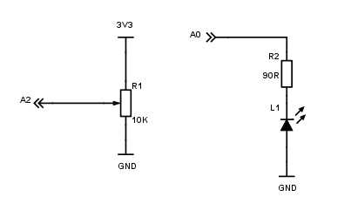
Exercise 2.2 Cheat sheet

Slide 21
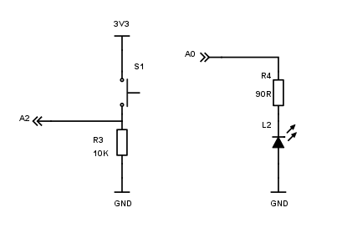
Cheat sheet

Slide 22
Intro
Now that we have things working locally how to make them connected?

Slide 23
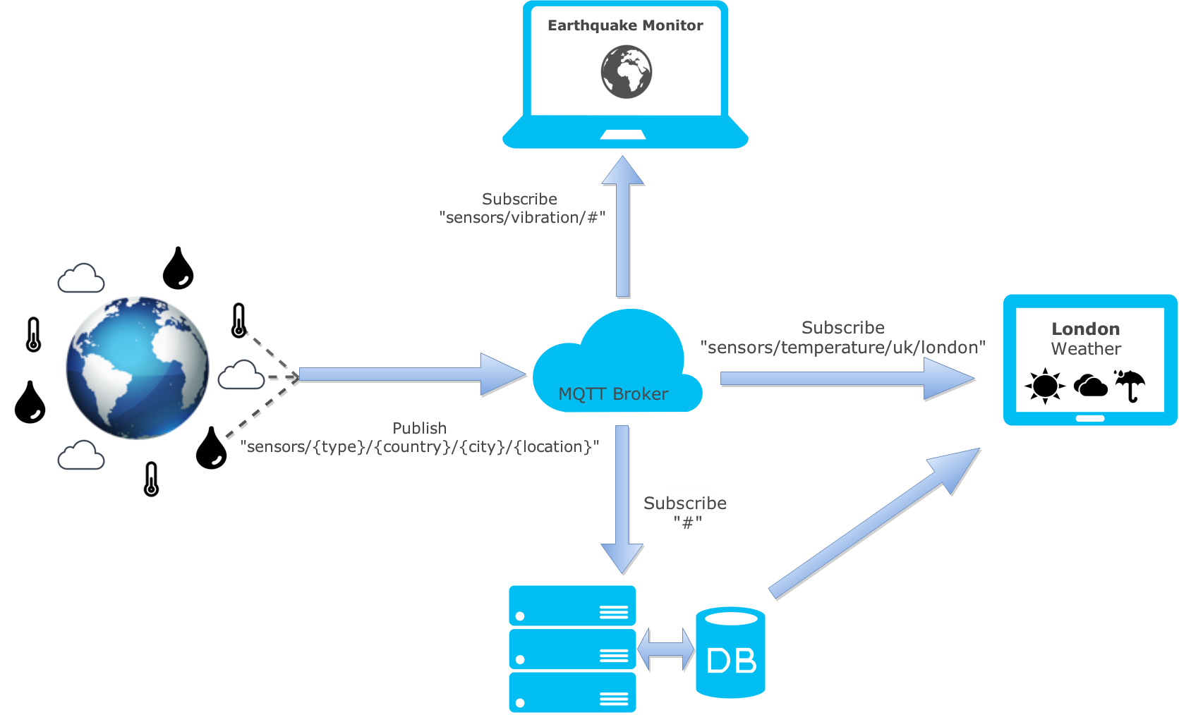
MQTT

Slide 24
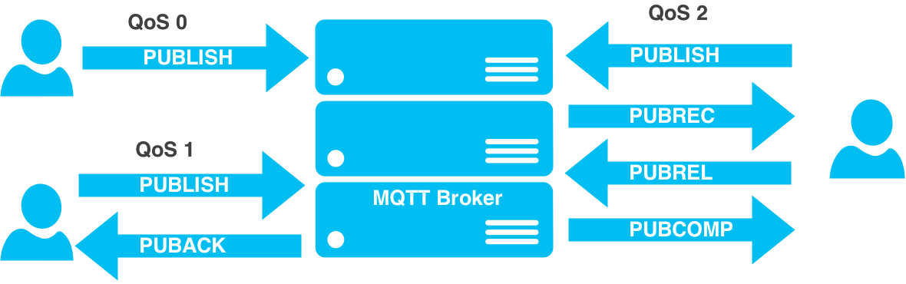
QoS

