Slide 1
sed & awk
Falko Goettsch

Slide 2
sed
grep's more hands-on cousin

Slide 3
A basic sed command
sed 's/xxx/yyy/g'
substitute
this
regular expression
with this
text
globally
i.e. all occurrences on the line
The single quotes are not part of sed. They tell the shell to pass their contents directly to sed without looking at them to see if it can "help."

Slide 4
A capturing sed command
s/:\([^:]*\):/ID: \1/
substitute all of this
with this
plus this
The sed command and the single quotes have been omitted.

Slide 5
A captivating sed command
s/.*could not.*/Error: &/
substitute all of this
with this
plus this

Slide 6
A slap-dash slash-hash sed command
s/\/share\/dex\//\/ihme\/dex-usa\//
s#/share/dex/#/ihme/dex-usa/#
\o/

Slide 7
awk
you can't spell awkward one-liner without a-w-k

Slide 8
A basic awk command
awk '{print $3}'
end block
start a block of instructions
print to the screen
reference a field
(column)
the 3rd field
The single quotes are not part of the awk command. They are there for the shell.

Slide 9
An intermediate awk command
awk –F',' '{print $NF}'
specify field separator
the last field
a comma
reference a field

Slide 10
An advanced awk command
–F(,| *) {print $3,$(NF-1)}
a comma
or
any number of spaces
3rd field
second-to-last field
and
The awk command and the single quotes have been omitted.

Slide 11
A pretty fancy awk command
/@/{print $3;tot+=$3}END{print tot}
instruction separator
on lines matching this regular expression
after the last line of the input
increment by
the variable tot

Slide 12
A History Lesson
Somebody please lock the doors…

Slide 13
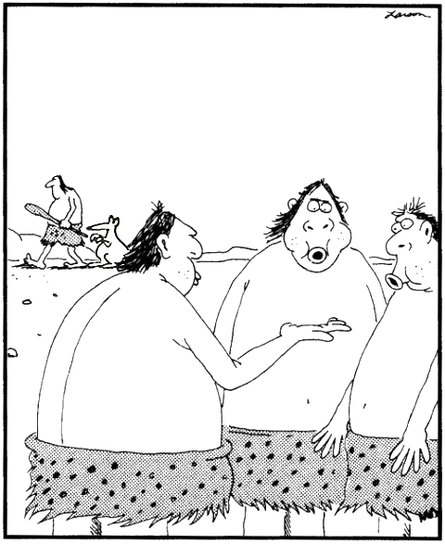
A long, long time ago…
grep
ed
vi
sed
ed
Aug 1969
1974
1976
ca. 11905200 BE
Nov 1974

Slide 14
printf
the print command that took mankind to the moon
…probably?

Slide 15
Formatting output with printf
printf "%s %3d/%3d (%5.1f%%)\n",$corr,$tot,$corr/$tot
an integer
(digits?)
a floating point
number
a literal '%'
template field
pad to 3 characters
one digit after the decimal point
a string
divide these

