Slide 1
COMPUTER
PRESENTED BY: EFFAT JAHAN
ID: 18101035
PRESENTED TO :GAZI MD HASANAT ZAHAN

Slide 2
OUTELINE
What is computer
Who invented computer
Classification of computer
Basic parts of computer
Generation of programming language
Uses of computer
What is computer virus

Slide 3
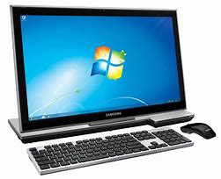
WHAT IS COMPUTER
The term computer is derived from the word compute. A computer is an electronic device that takes data and instruction as an input from the user, processes data and provide useful information known as output.

Slide 4
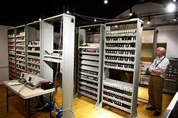
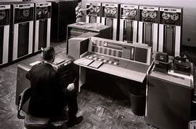
WHO INVENTED COMPUTER
Pascal invented Digital Calculating System in 1642
Charles Babbage originated the concept of computer in 1833
Haward Akin invented a machine in 1937

Slide 5
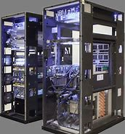
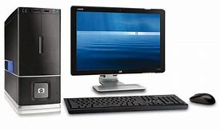
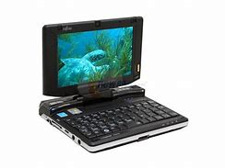
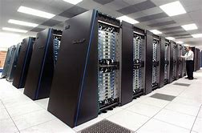
CLASSIFICATION OF COMPUTER
Supercomputer
Mainframe Computer
Minicomputer
Microcomputer

Slide 6
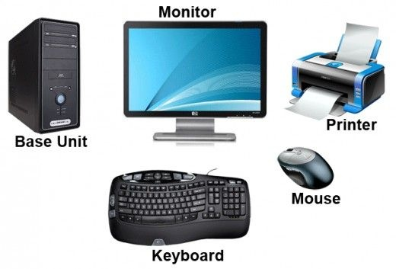
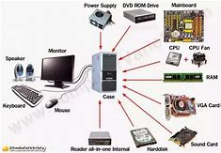
BASIC PARTS OF COMPUTER
Monitor
CPU
Keyboard
Mouse
Speakers
Printer

Slide 7
GENERATION OF PROGRAMMING LANGUAGES
Generation | Languages | Development Date
First | Machine Language | 1940s
Second | Assembly Language | 1950s
Third | High Level Language | 1960s
Fourth | Query & database Language | 1970s
Beyond Fourth | Natural & Intelligent Language | 1980s

Slide 8
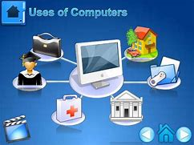
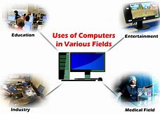
USES OF COMPUTER
Data Storage
Education
Communication
Defense Purpose
Office Work
Science and Technology
Training purposes
Transportation
E Learning
Medical Science

Slide 9
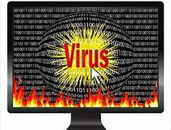

WHAT IS COMPUTER VIRUS
A Computer Virus is a program that can copy itself and infect a computer without the permission or knowledge of the users.

Slide 10
ANY QUESTION ?

Slide 11
THANK YOU

