Slide 1
Welcome To The Presentation

Slide 2
Zener Diode & It’s Characteristics
Submitted By :Ruhin Ara Rishat
Id : 18101011
Section : A

Slide 3
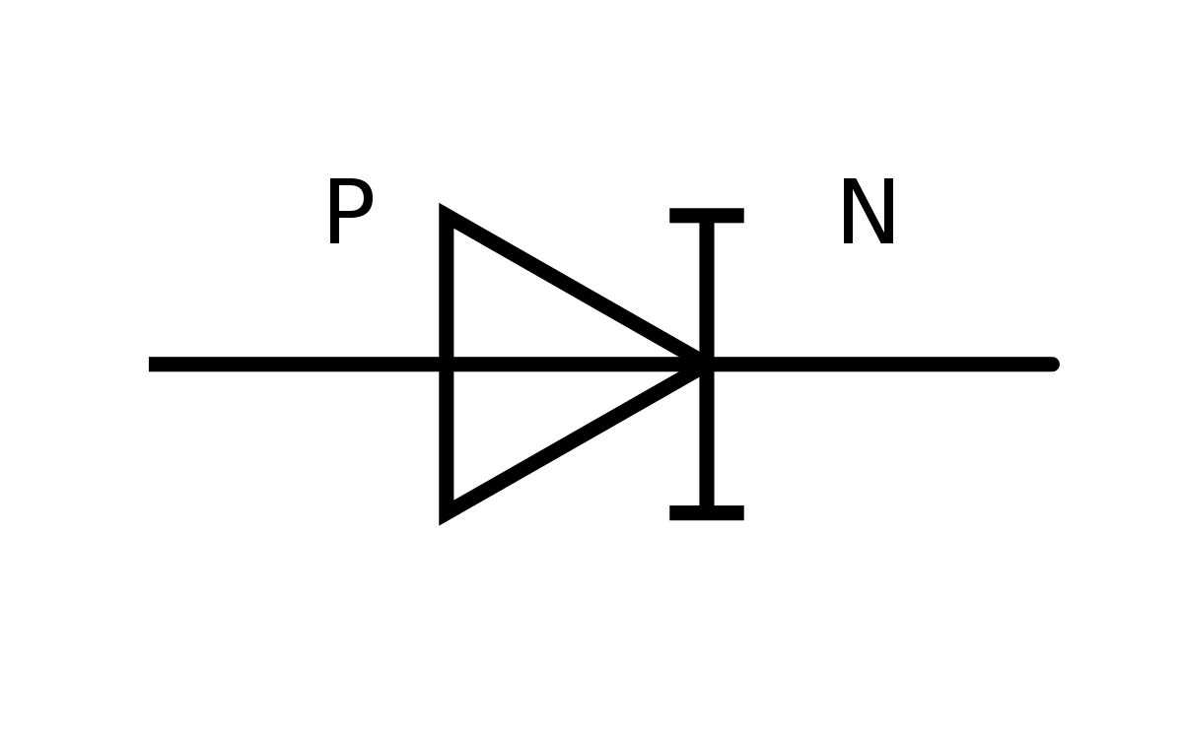
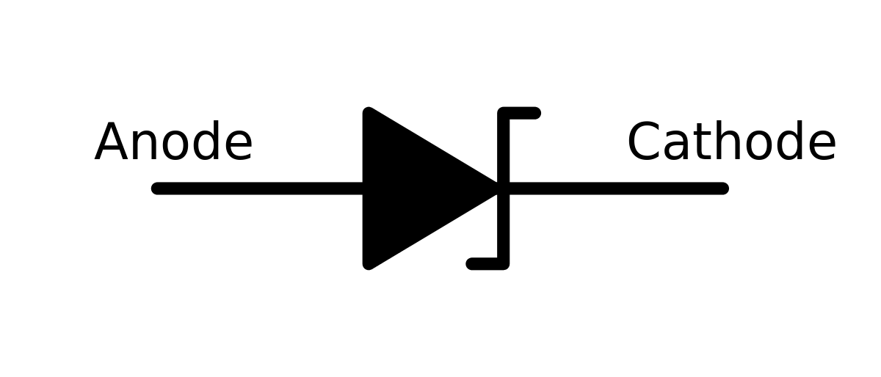
Diode: A Semiconductor device with two terminals typically allowing the flow of current in one direction only.
Diode
Zener diode
P-n junction diode

Slide 4
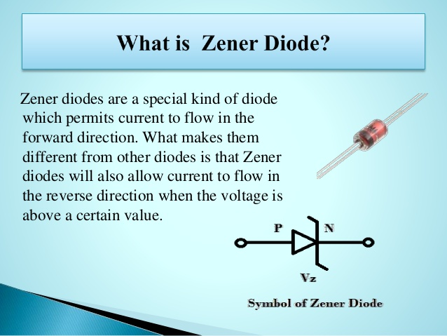

Slide 5

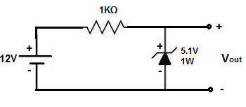
Zener Diode Circuit : The most basic Zener diode circuit consist of a single Zener diode and a resister

Slide 6
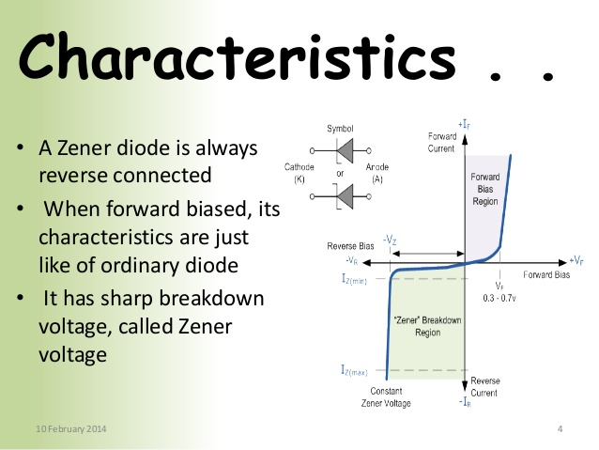

Slide 7
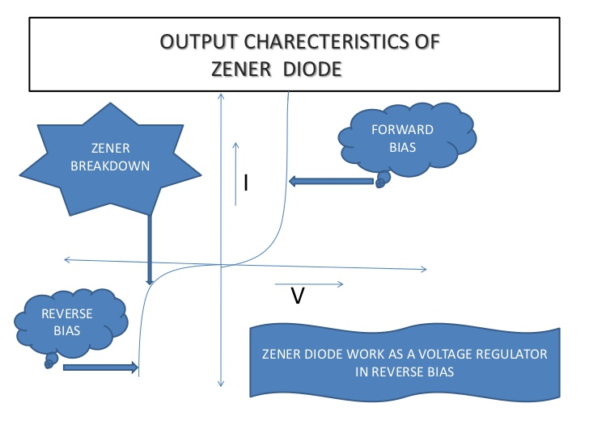

Slide 8
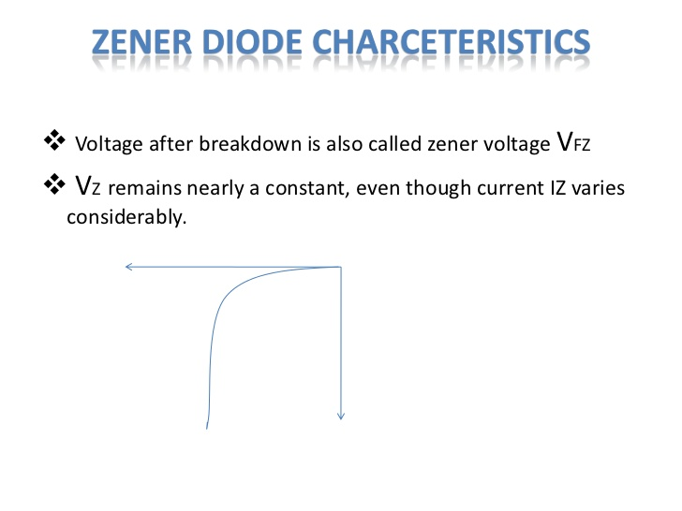

Slide 9
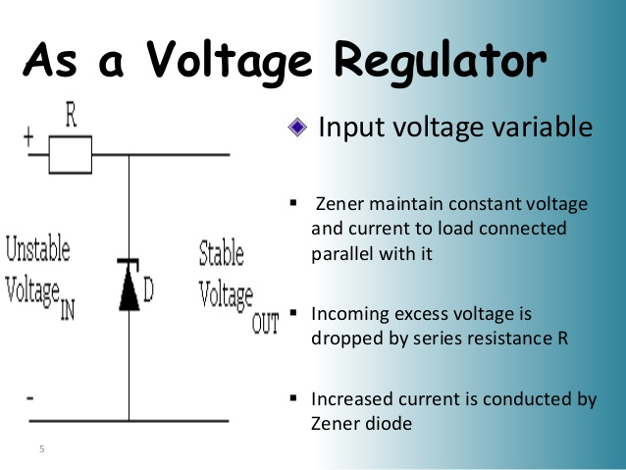

Slide 10
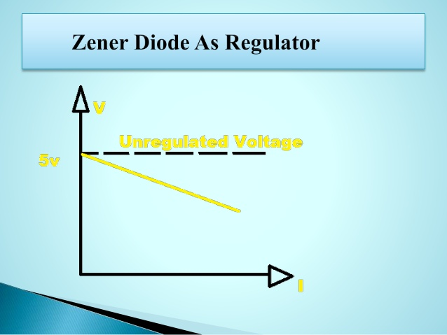

Slide 11
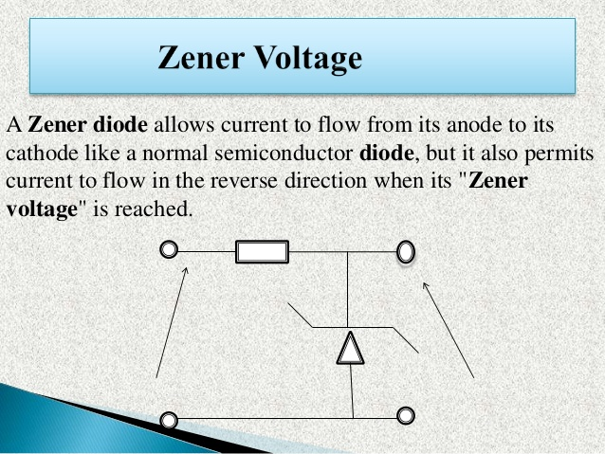

Slide 12
Thank You

