Slide 1
Inferring population size changes over time. Clustering of populations using haplotype-based and tree-based methods. Inference of coalescence rates and effective population sizes
Oscar Lao

Slide 2
Overview
Why infer Ne(t)?
Coalescence and recombination
SMC as an approximation to the ARG
HMM intuition for local genealogies
Main SMC-based methods
Interpretation, assumptions, and pitfalls

Slide 3
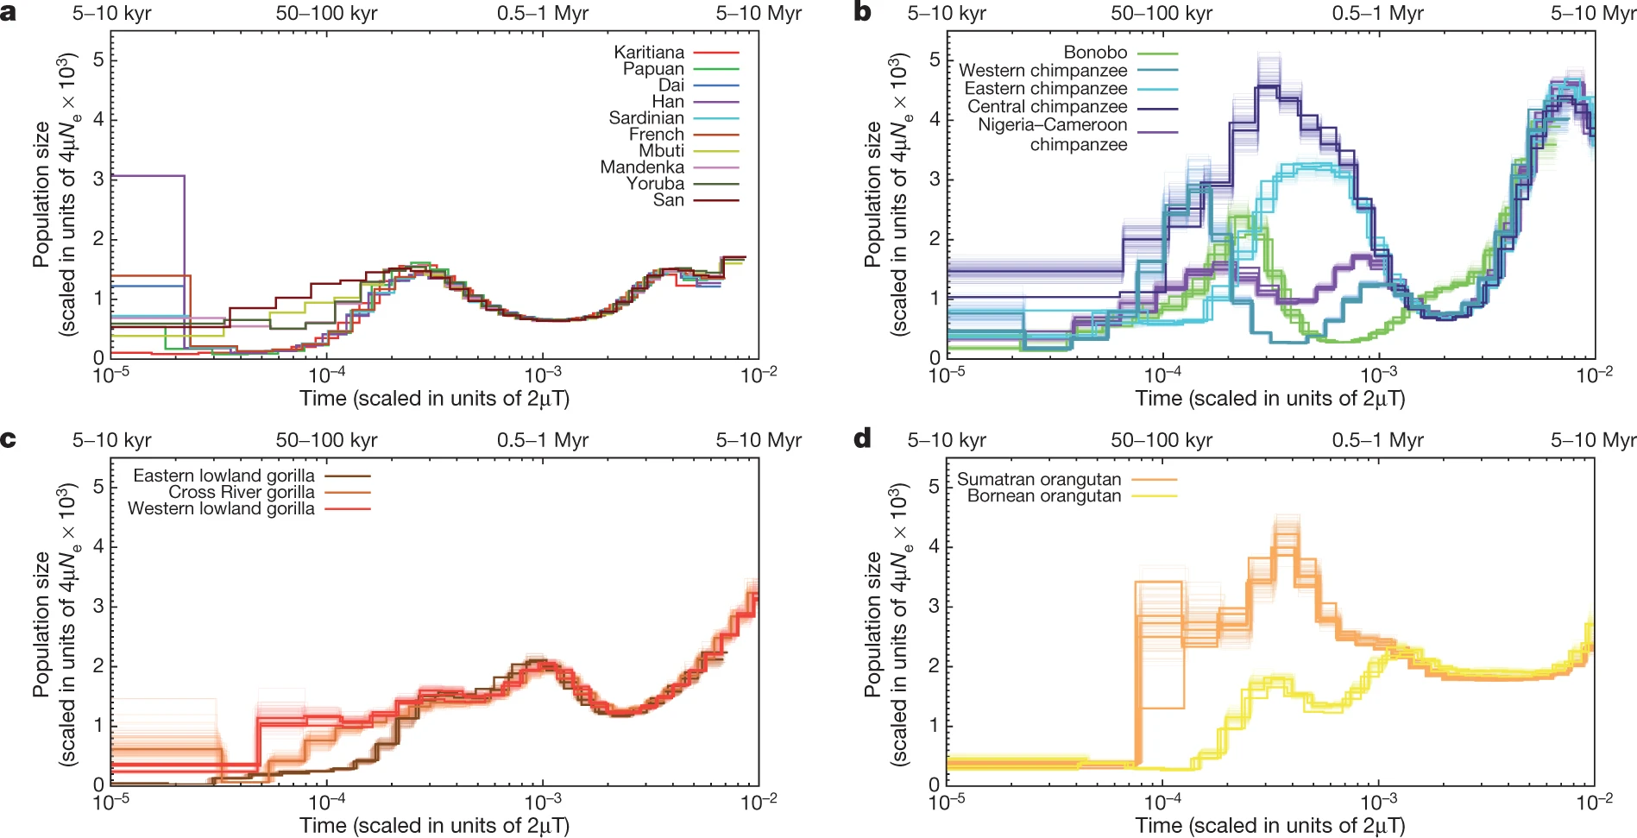

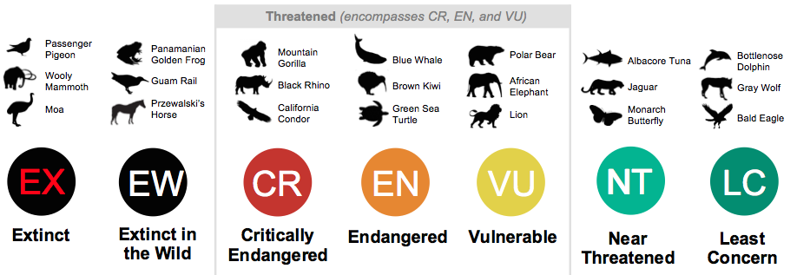
Conservation genetics and estimation of effective population size over time
Adapted from Alba Nieto

Slide 4
Interpreting Effective Population Size (Ne)
What is effective population size?
Drift-based interpretation
Long-term vs local-in-time Ne​
Why genetic diversity reflects coalescent history
“Ne is the size of an ideal population that would experience the same rate of genetic drift as the population in question.”
Journal of Heredity, 2022, 113, 371–379

Slide 5
Interpreting Effective Population Size (Ne)
What Ne​ is not
Not census size
Not always literal demography
Can reflect structure, linked selection, and admixture
“Effective population size is the number of individuals that contribute offspring to the next generation.”
Although it is possible to find scenarios where this statement holds, it is not true in any general sense.
Journal of Heredity, 2022, 113, 371–379

Slide 6
REMEMBER: ALL YOU NEED IS COALESCENCE
Ne

Slide 7
REMEMBER: ALL YOU NEED IS COALESCENCE
Ancestor of all the chromosomes of present
Time of the Most Recent Common Ancestor (TMRCA)

Slide 8
GOING BEYOND WRIGHT-FISHER BOTLENECKS
Higher probability of introducing rare mutations
Almost all coalescences occur in a very small amount of time
Sudden population reduction
Sudden population expansion
Notes:
Knock-out mice and inbreeding

Slide 9
GOING BEYOND WRIGHT-FISHER BOTLENECKS
TMRCA falls more likely within the bottleneck as the bottleneck becomes stronger (characterized by smaller effective population size, Ne, and longer duration).
Notes:
Knock-out mice and inbreeding

Slide 10
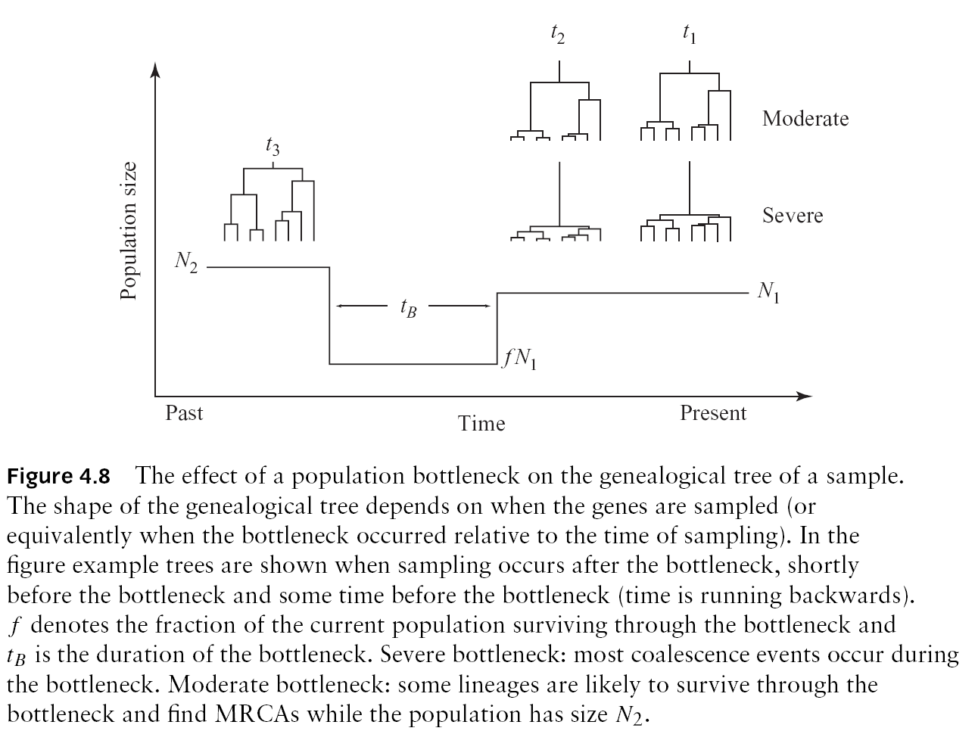
GOING BEYOND WRIGHT-FISHER BOTLENECKS

Slide 11
GOING BEYOND WRIGHT-FISHER POPULATION SUBSTRUCTURE

Slide 12
GOING BEYOND WRIGHT-FISHER POPULATION SUBSTRUCTURE AND COALESCENCE
Deme1
Ne
Barrier
Deme2
Demes evolve independently
Time of split

Slide 13
GOING BEYOND WRIGHT-FISHER POPULATION SUBSTRUCTURE AND COALESCENCE
TMRCA falls BEFORE the split between populations
Deme1
Ne
Deme2
Share the same genetic diversity within demes

Slide 14
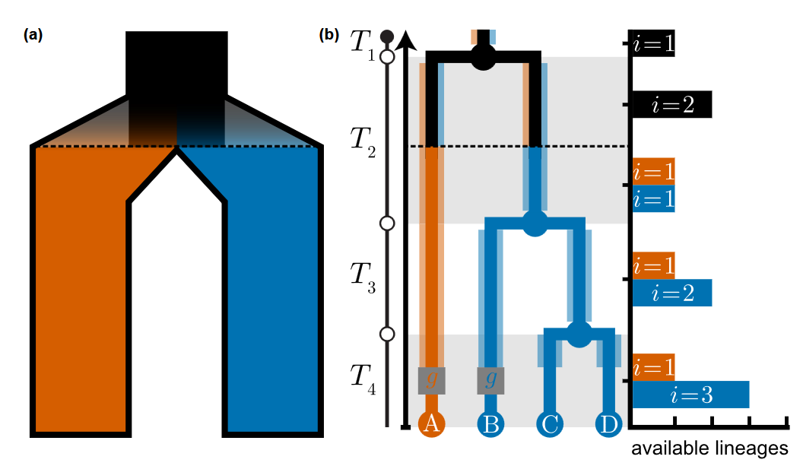
GOING BEYOND WRIGHT-FISHER POPULATION SUBSTRUCTURE AND COALESCENCE

Slide 15
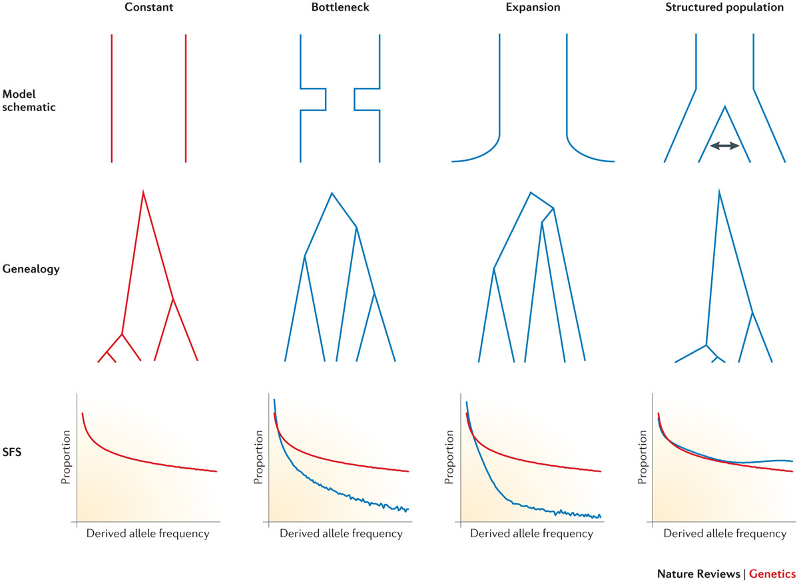
GOING BEYOND WRIGHT-FISHER POPULATION SUBSTRUCTURE AND COALESCENCE
Nature Reviews Genetics volume 16, 727–740 (2015)

Slide 16
GOING BEYOND WRIGHT-FISHER SELECTION AND COALESCENCE
Coalescences occur much faster than expected under W-F model before the mutation is fixed
The tree is not independent of the mutations. It becomes associated to the mutation under selection
After fixation, we go back to the W-F model under neutrality

Slide 17
Coalescence under strong selection
Reduced amount of diversity
Large number of private mutations
The shape of the tree is compressed
Large number of coalescence events in few generations
Notes:
Introduce example of cancer

Slide 18
Coalescence and inference
Frequency
t
t
Time TMRCA
Examples of execution of coalescence of two chromosomes under this model

Slide 19
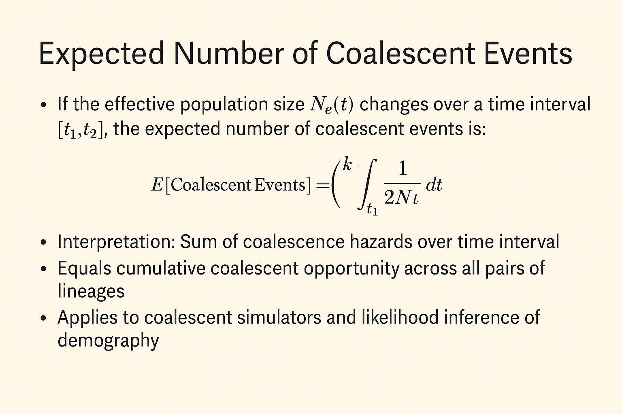
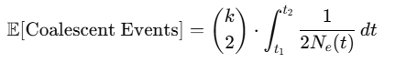
Coalescence events over time

Slide 20
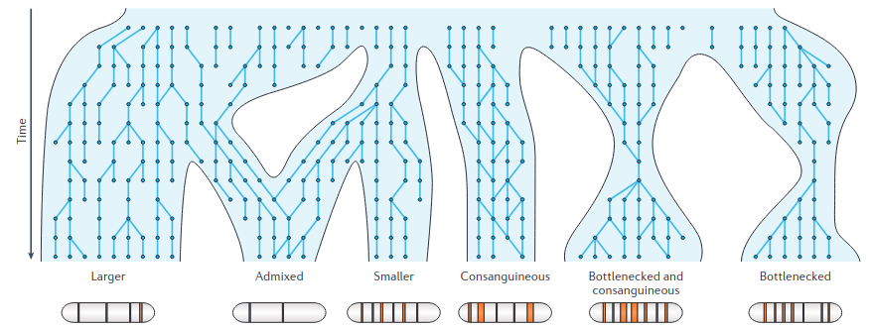


Coalescence events over time
Coalescent rate of a sample depends on all demographic and evolutionary process of its genealogy
Adapted from Alba Nieto

Slide 21
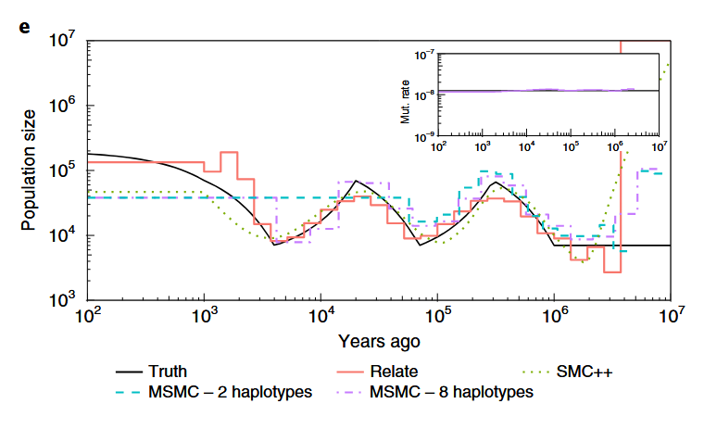
Estimating effective population size thanks to TMCRA
If we asume we have a single evolving population, then the coalescence rates are proxies for Ne

Slide 22
Diploid organisms also have RECOMBINATION
Parent 1
Parent 2
In forward
New Individual

Slide 23
Diploid organisms also have RECOMBINATION
Parent 1
Parent 2
In backward
New Individual

Slide 24
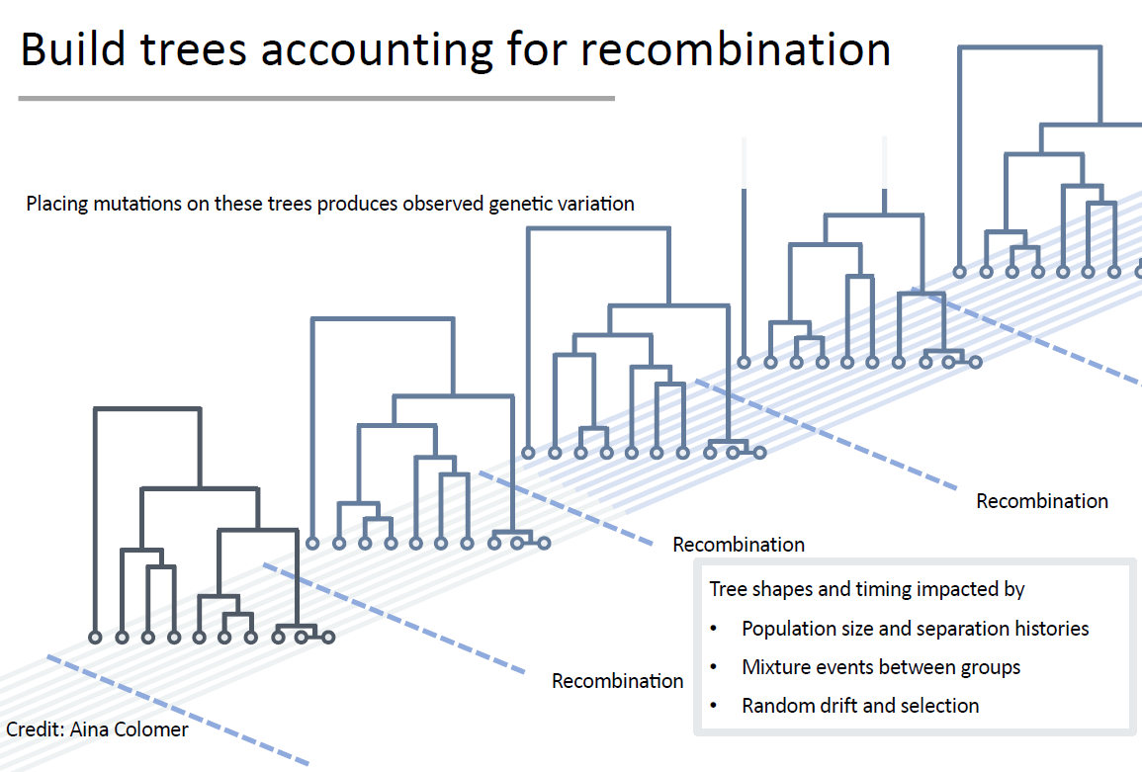
Modelling Coallescence with Recombination

Slide 25
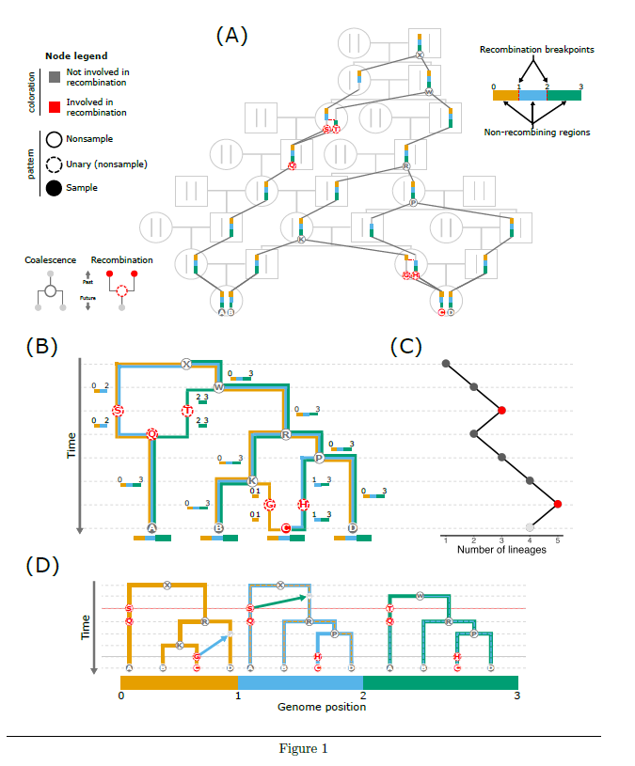
Diploid organisms also have RECOMBINATION
The era of the ARG: an empiricist’s guide to ancestral recombination graphs
ancestral recombination graphs

Slide 26
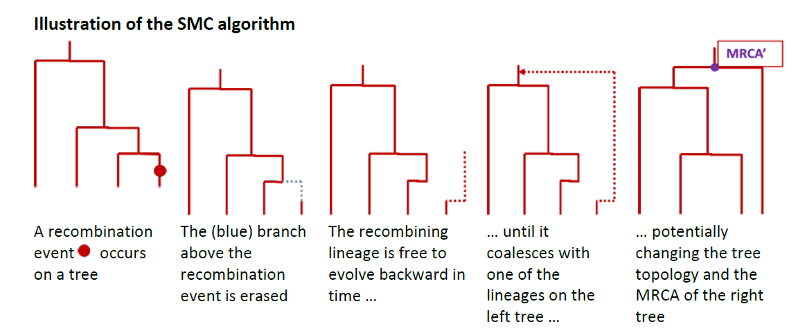
Diploid organisms also have RECOMBINATION
Secuential Markov Chain algorithm for simulating genomic regions with recombination
From fastSimcoal2 manual

Slide 27
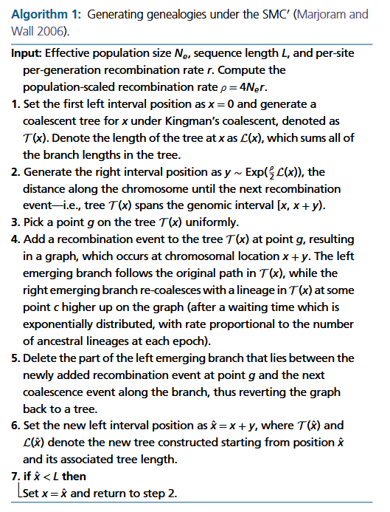
Diploid organisms also have RECOMBINATION
Not Just Ne Ne-more: New Applications for SMC from Ecology to Phylogenies

Slide 28
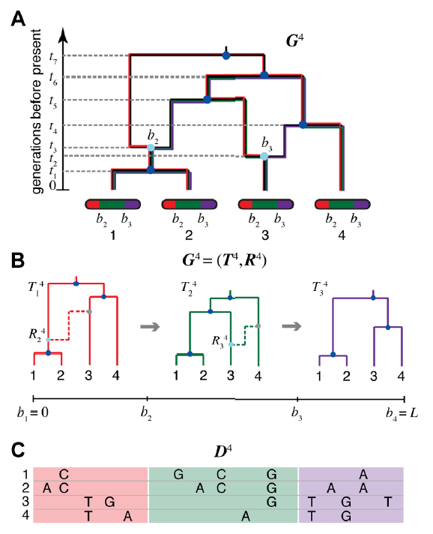
Remember: we have to infer it from the genomic data

Slide 29
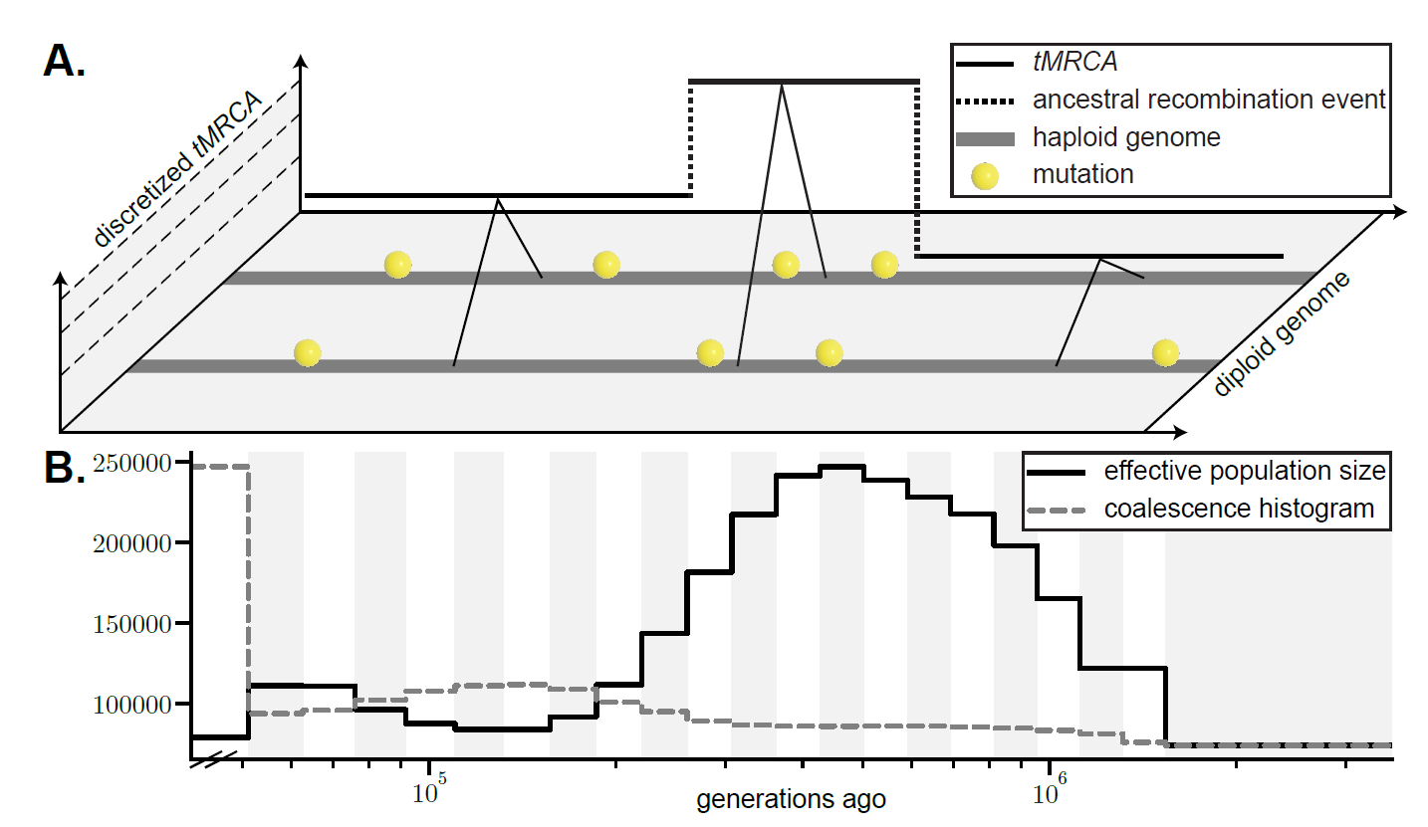
Identifying chuncks with the same tMRCA
Not Just Ne Ne-more: New Applications for SMC from Ecology to Phylogenies

Slide 30
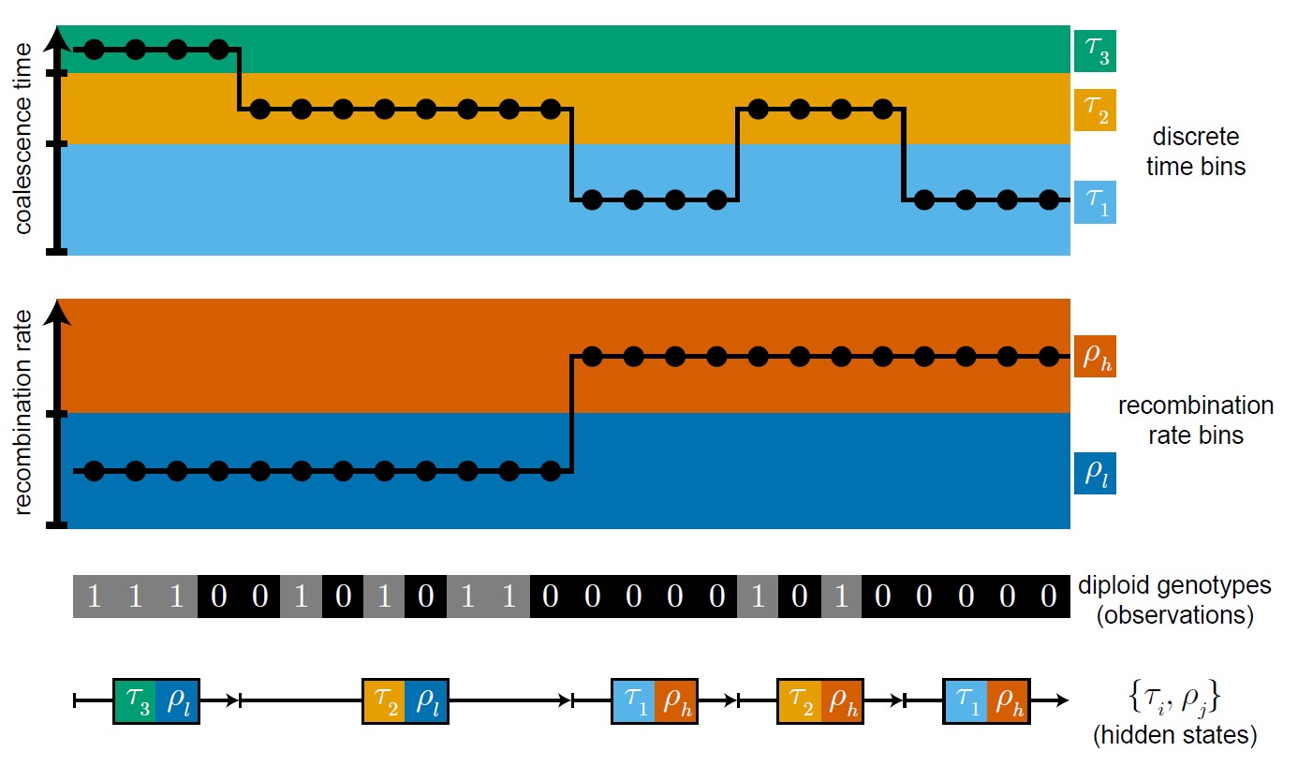
Remember: we have to infer it from the genomic data
How to estimate it?
Not Just Ne Ne-more: New Applications for SMC from Ecology to Phylogenies

Slide 31
SMC in one slide
hidden state = local genealogy / TMRCA interval
transitions = recombination
emissions = sequence variation / heterozygosity
output = coalescence rate history → iicr

Slide 32


HMM: A simple working case
The occasionally dishonest casino problem
With some probability, the casino uses a dice that is LOADED so the number six (the bench wins) occurs more often (P(6)=0.5 than expected at random.
HOW CAN WE KNOW WHEN IT IS LOADED OF FAIR?

Slide 33

HMM: A simple working case
The occasionally dishonest casino problem
0.95
State Fair
State Loaded
0.9
Probability of making a change from one state to another
0.1
0.05
Emission probabilities of fair dice
Emission probabilities of loaded dice
1 | 2 | 3 | 4 | 5 | 6
1/6 | 1/6 | 1/6 | 1/6 | 1/6 | 1/6
1 | 2 | 3 | 4 | 5 | 6
1/10 | 1/10 | 1/10 | 1/10 | 1/10 | 1/2
Fair (F) dice
Loaded (L) dice

Slide 34
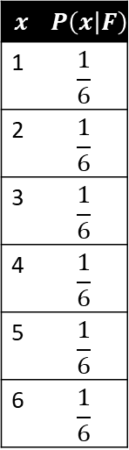


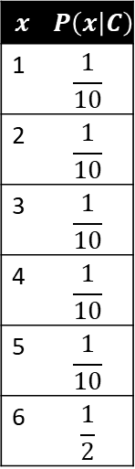
HMM: Probability of x given model?
P(1,3,4,5,1,2,6,6,3,6,6,2,1,2,4,5|HMM)
$$x$$ | $$P\left(x | F\right)$$
1 | $$\frac{1}{6}$$
2 | $$\frac{1}{6}$$
3 | $$\frac{1}{6}$$
4 | $$\frac{1}{6}$$
5 | $$\frac{1}{6}$$
6 | $$\frac{1}{6}$$
Transition probabilities
$$x$$ | $$P\left(x | C\right)$$
1 | $$\frac{1}{10}$$
2 | $$\frac{1}{10}$$
3 | $$\frac{1}{10}$$
4 | $$\frac{1}{10}$$
5 | $$\frac{1}{10}$$
6 | $$\frac{1}{2}$$
It refers to the values of emission and transmission that are used for the k considered states
$$P\left(C | F\right)=0.01$$
$$P\left(F | C\right)=0.1$$
Emission probabilities
of Fair
Emission probabilities
of Charged

Slide 35




HMM: Estimating the probability of an observed sequence of events
Probability of a sequence x given that the states of the sequence are known and we have the HMM model
Imagine we observe the sequence x
$$x=\left\langle x_{1},x_{2},x_{3}\right\rangle =\left\langle 6,1,6\right\rangle$$
Assume that the prior probability of starting at one state or at the other is the same (0.5)
What would be the probability
$$P(x,π)$$
if the state sequence was
$$π=\left\langle π_{1},π_{2},π_{3}\right\rangle =\left\langle F,F,F\right\rangle$$
$$P(x,π)=a_{0π}{\prod_{i}^{N}{e_{π_{i}}}\left(x_{i}\right)a}_{π_{i}π_{i}+1}$$
$$P\left(x,π\right)=0.5∗0.95∗\frac{1}{6}∗0.95∗\frac{1}{6}∗0.95∗\frac{1}{6}=0.001984664$$
Prior of starting at F
Prob of staying at state F
Emission prob of 6 at state F

Slide 36
HMM
What happens when the parameters are not known?
?
State Fair
State Loaded
?
Probability of making a change from one state to another
?
?
Emission probabilities of fair dice
Emission probabilities of loaded dice
1 | 2 | 3 | 4 | 5 | 6
? | ? | ? | ? | ? | ?
1 | 2 | 3 | 4 | 5 | 6
? | ? | ? | ? | ? | ?
Fair (F) dice
Loaded (L) dice
P(1,3,4,5,1,2,6,6,3,6,6,2,1,2,4,5|HMM)

Slide 37


HMM
The occasionally dishonest casino problem
Unknown paths
$$x$$
1,4,5,1,3,2,1,6,6,4,1,6,6,6,6,6,2,3,4,5,1,4,3,6,2,1,3,5,6,6,6,6,6,6,6,1,2,3,1,1,1,1,2,3,4,5,5,4
P(x|HMM=$a_{rk};e_{k}\left(b\right)$)
Likelihood of an observed sequence given a set of transition and emission probabilities from a given HMM, computed using the forward algorithm
How to find HMM that maximizes P(X|HMM)?
How to know at each position of the sequence which is the most likely state (i.e. tmrca class)?

Slide 38
HMM analogy mapped to SMC
hidden state = TMRCA class
observations = heterozygous / non-heterozygous sites
transition rates depend on recombination
emission rates depend on mutation

Slide 39
What the algorithm estimates
local state posterior probabilities
demographic parameters over time bins
likelihood of the data under the model
genealogies are simplified
discretization into time intervals
model misspecification matters

Slide 40
Algorithms to Infer Ne over Time
Method | Data Input | Time Scale | Assumptions | Software/Tool
PSMC | One diploid genome | Ancient (~10 kya to 1 Mya) | Constant mutation rate, recombination map | psmc
MSMC | Multiple phased haplotypes | Mid–ancient (~2 kya to 1 Mya) | Coalescent with recombination | msmc, msmc2
SMC++ | Many unphased genomes + SFS | Recent to ancient | Combines SFS and HMM; scalable | smc++
Stairway Plot | Site Frequency Spectrum (SFS) | Broad (user-defined bins) | Neutral model, correct SFS | stairway_plot
Relate | Large number of phased genomes | Fine-grained, genome-wide | Ancestral recombination graph; mutation rate known | relate
GONE | Linkage disequilibrium (LD) from genotypes | Recent (0–100 generations) | Random mating, LD-based | GONE
IBDNe | Segments of identity by descent (IBD) | Recent (up to ~200 gens) | Requires accurate IBD inference | IBDNe
NeON | SFS from low coverage or pooled data | Recent (decades–centuries) | Optimized for conservation/paleogenomics | NeON R package

Slide 41
Why so many methods?
one diploid genome → PSMC
a few phased genomes → MSMC/MSMC2
many genomes → SMC++
very recent history → GONE / IBDNe
explicit genealogies → Relate

Slide 42
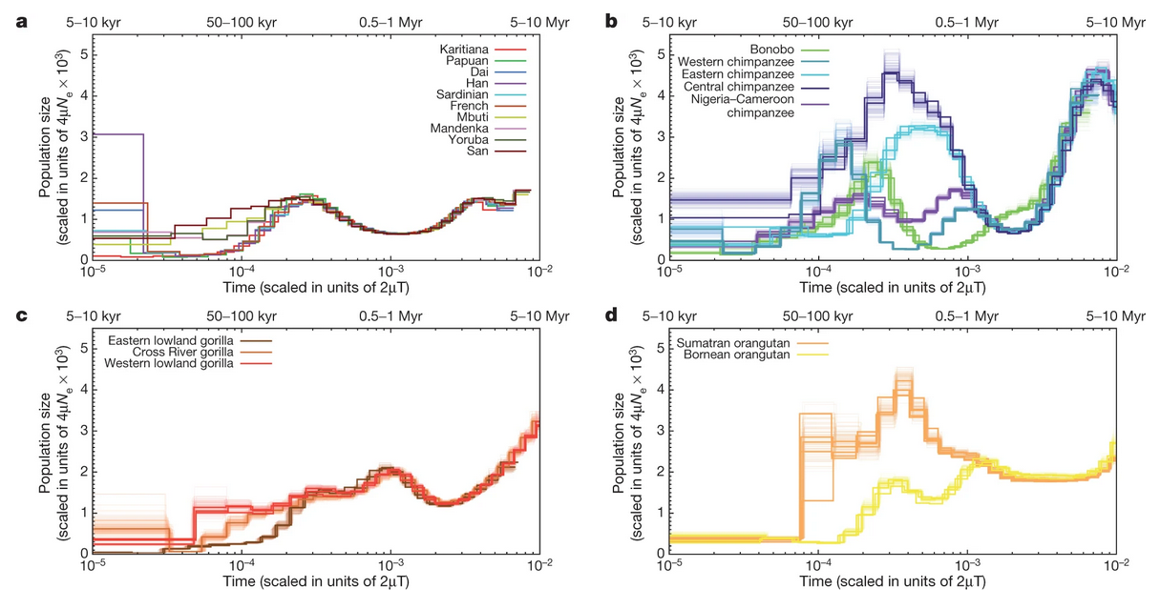
Example of PSMC output
Nature volume 499, pages 471–475 (2013)

Slide 43
Using Relate for Genome-Wide Coalescence
Relate infers genome-wide genealogies
Uses thousands of genomes
Outputs: Coalescence rates, Ne curves, tree sequences

Slide 44
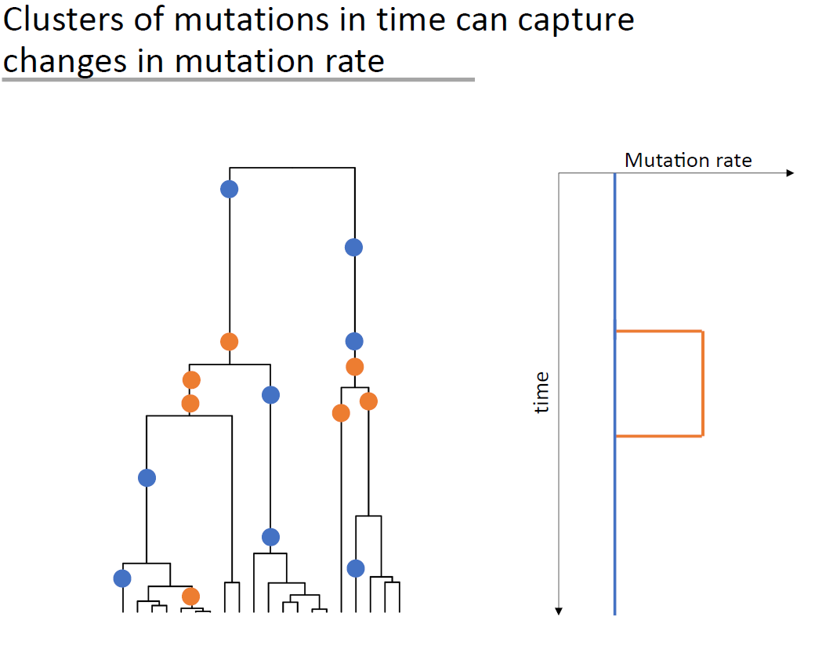
Relate & mutation rate
from Leo Speidel

Slide 45
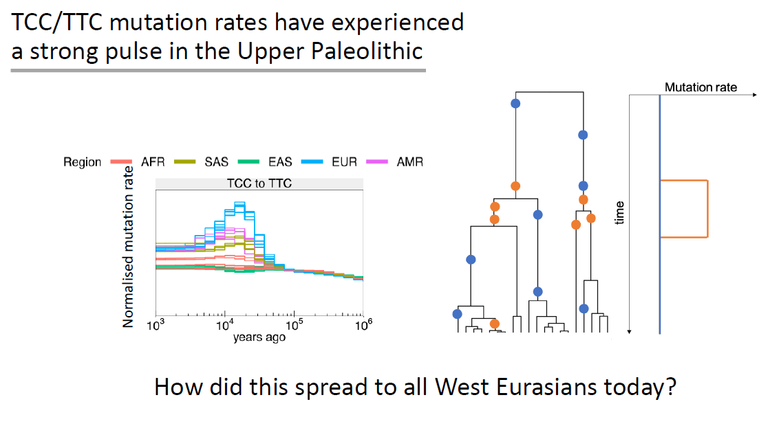
Relate & mutation rate
from Leo Speidel

Slide 46
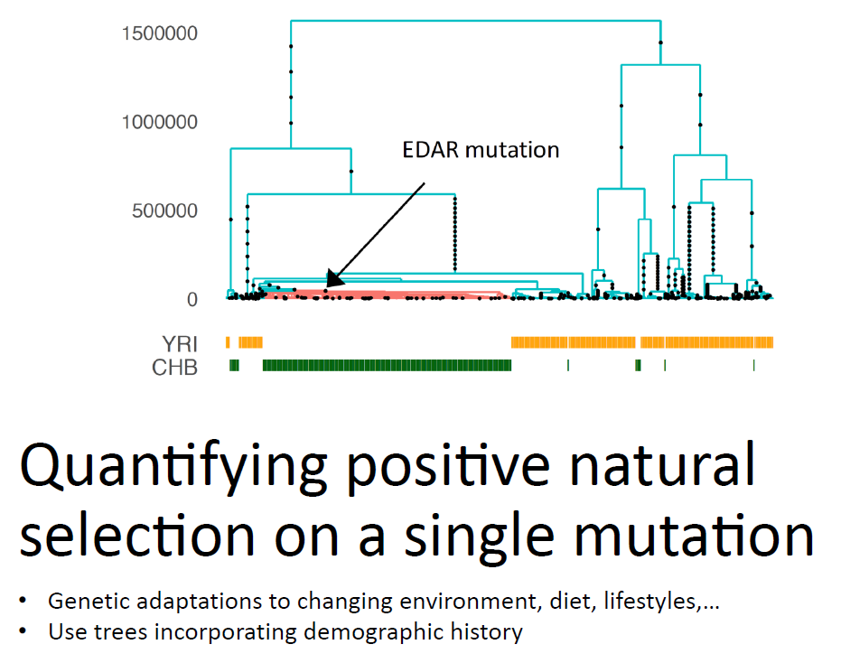
Relate & positive selection
from Leo Speidel

Slide 47
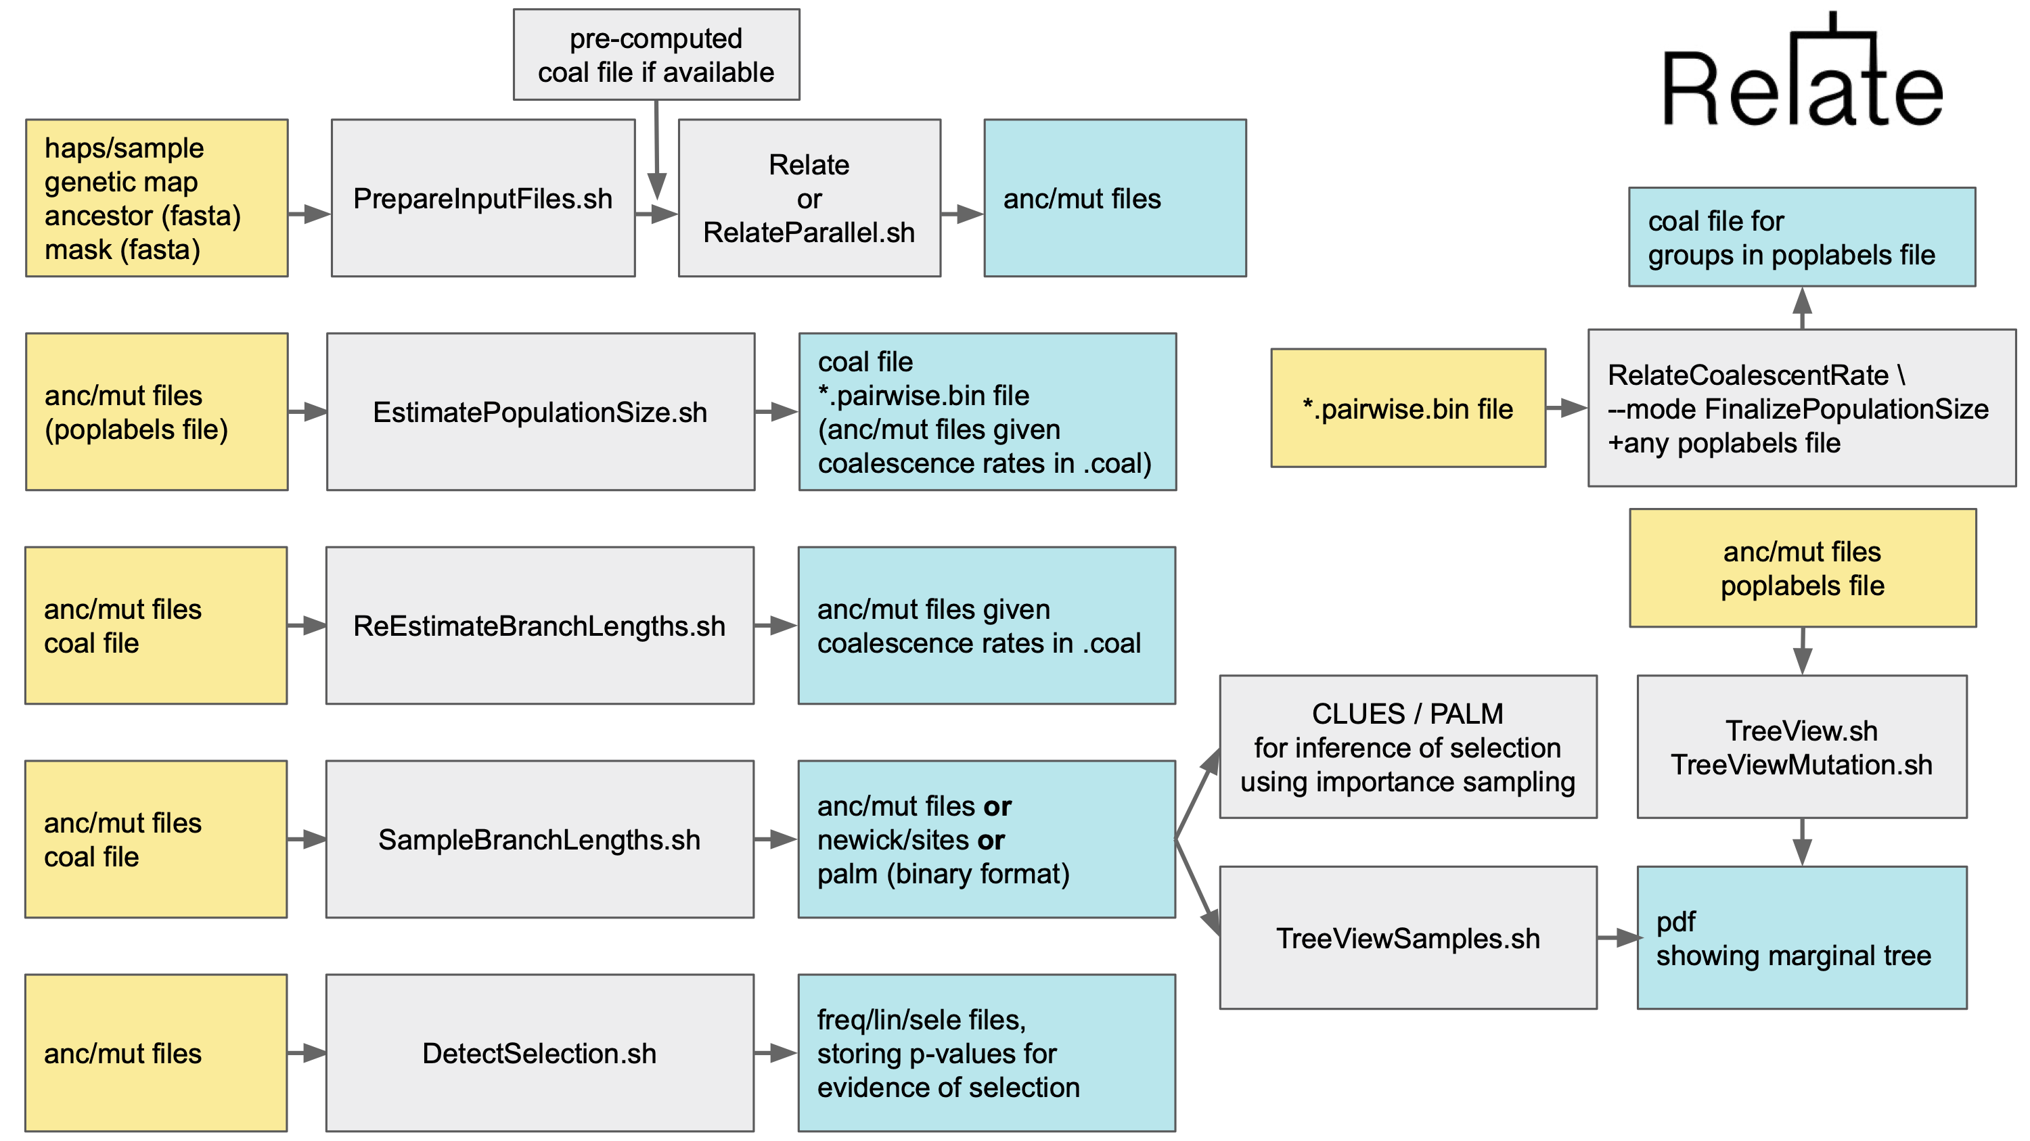
RELATE

Slide 48
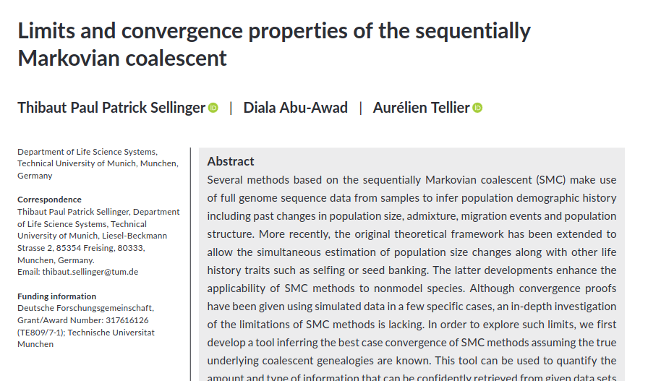
Limits of SMC-based models
Presence of transposons or repetitive elements
Extreme demographies
High recombination and mutation rates
Adapted from Alba Nieto

Slide 49
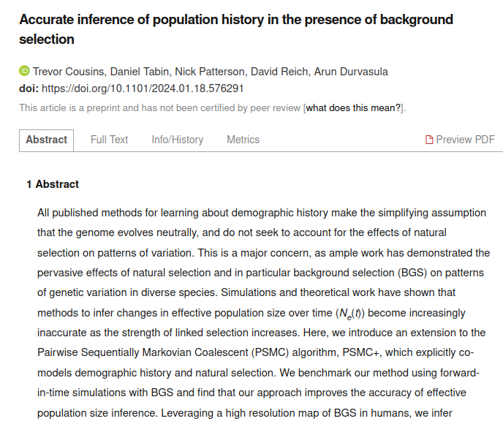
Limits of SMC-based models
Background selection
Adapted from Alba Nieto

Slide 50
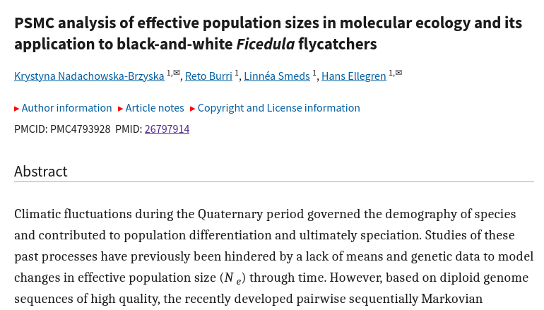
Limits of SMC-based models
Variant calling restrictions (quality)
Adapted from Alba Nieto

Slide 51
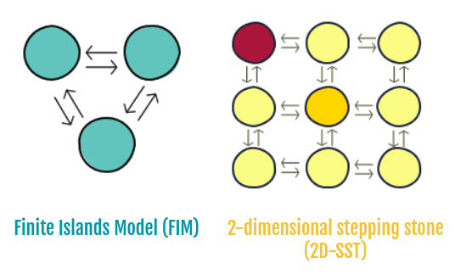
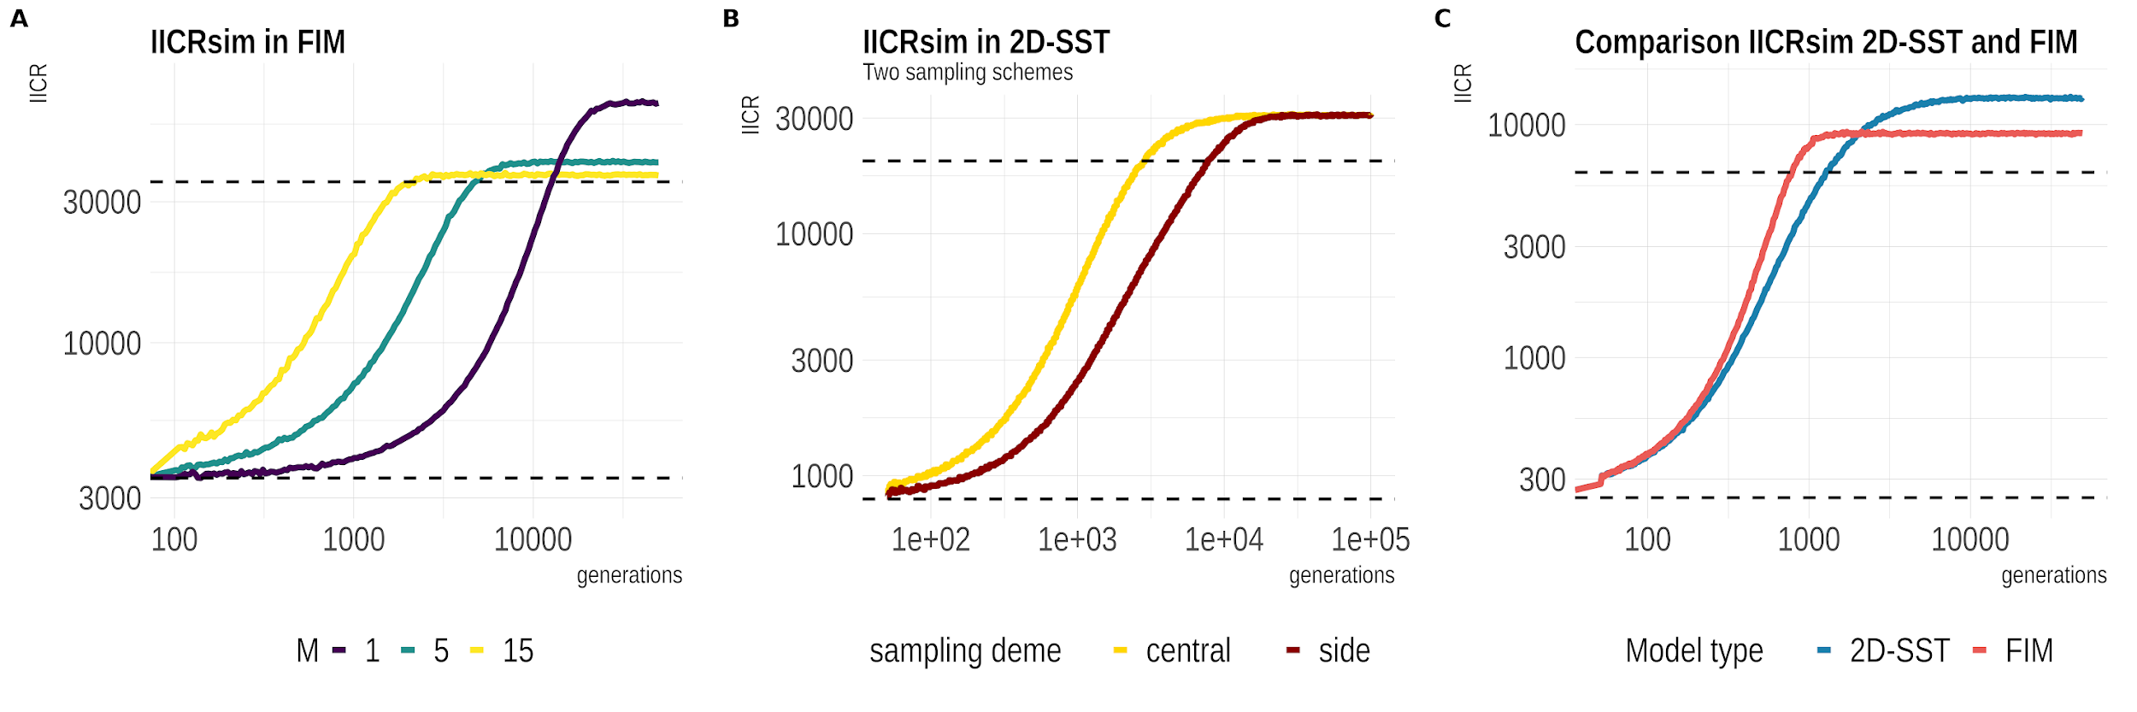
WARNING: ASSUMPTIONS!!!!!
Expected IICR under population structure
Demographic parameters
Sampling sites
Type of underlying model
Adapted from Alba Nieto

Slide 52
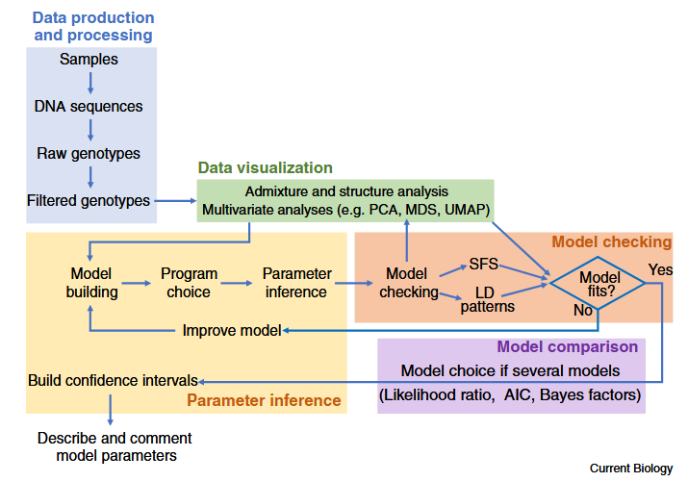
Demographic modelling

Slide 53
Best-practice workflow
define the biological question
choose the right method for the time scale and data type
apply strict masking and QC
calibrate with mutation rate and generation time
quantify uncertainty
validate with simulations or alternative summaries
interpret conservatively

Slide 54
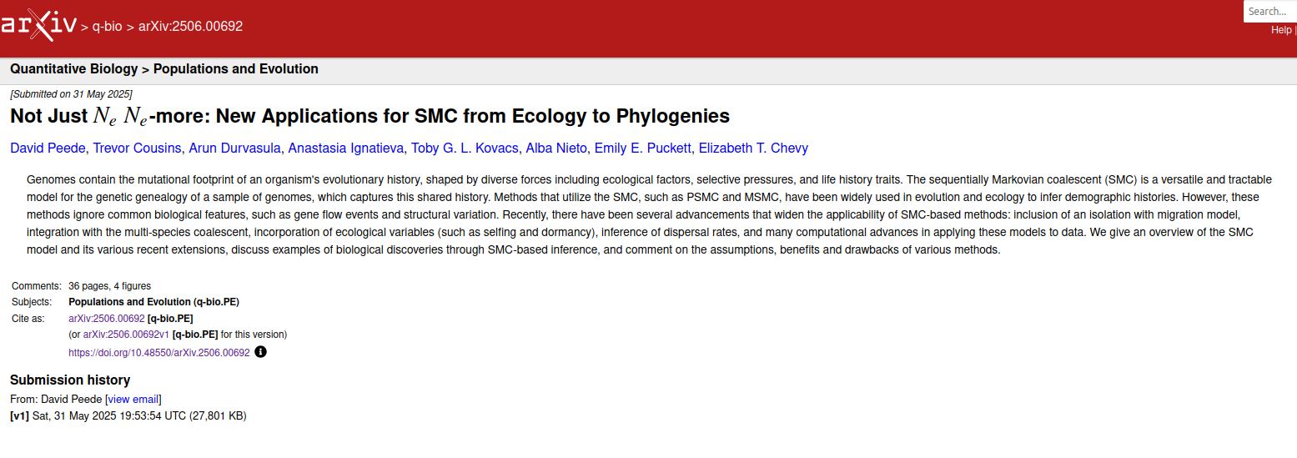
More on SMC-based models

Slide 55
SMC
all SMC methods infer history through local genealogical changes
recombination makes the genome informative about many coalescent events
hidden-state models make this computationally feasible
method choice depends on data and time scale
interpretation requires caution because structure, selection, and technical bias can mimic demography

Slide 56

Thank you very much!
oscar.lao@ibe.upf-csic.es

