Slide 1

Building a Simple Endpoint with Mongo, Express, and Node
Jesse Wheeler

Slide 2

Jesse Wheeler
https://www.linkedin.com/in/jesse-j-wheeler/
https://github.com/effekt
http://f8jessew.gblearn.com

Slide 3
About Me
Full Stack Developer (MEAN Stack) at Webrun Group Inc
Project Lead
Hobby Programmer
Machine Learning / AI Enthusiast
Image Recognition / OCR Junkie
Student Success Mentor / Tutor / Professor’s Assistant at George Brown College
Bootcamp Instructor

Slide 4
Before We Begin & Assumptions
Working knowledge of JavaScript
Comfortable with a terminal
Understanding of JavaScript Object Notation
Node.js installed (https://nodejs.org/en/)
MongoDB installed (https://www.mongodb.com/)
Robo 3T or any other DB viewer (https://robomongo.org/)
Postman installed (https://www.getpostman.com/)
VSCode or any other preferred IDE (https://code.visualstudio.com/)
GitHub Repo for Workshop (https://github.com/effekt/HackLassonde)
All important points will be highlighted in teal

Slide 5

Configuring Your Environment
Before we begin developing our simple API we need to set some things up. This includes creating a directory in which for us to work and ensuring all of our required software is installed. To install the required modules we require Node and NPM to be installed and in the systems global PATH variable.
If you’re using a Windows based machine such as I am, doing the following will ensure we’re all on a similar page:
Create a new, easily accessible directory (such as C:\HackLassonde)
Open a new terminal (if using VSCode, this can be done from the IDE) and navigate to your created directory (cd C:\HackLassonde)
From your terminal, issue the command: npm --v && node -v
You should receive output similar to mine (do not worry if the versions are different)

Slide 6
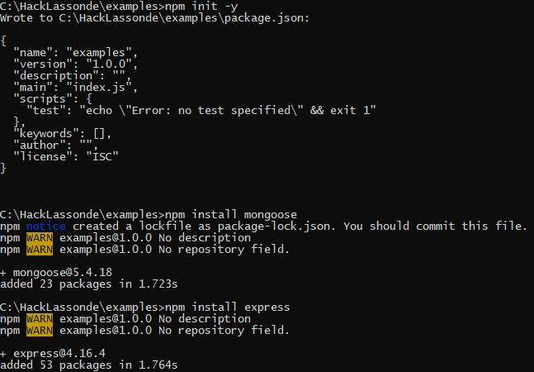
Initializing NPM and Installing Modules
To begin working with NPM (Node Package Manager, preinstalled with Node) we need to initialize the directory in which our packages will be installed. NPM will keep track of our applications dependencies and provides us with a package.json file that will be referred to if anything needs to be reinstalled at a later time or if sharing your project via GitHub or any other version control software.
Still in the terminal (at C:\HackLassonde), run npm init -y
This will create our package.json file and begin monitoring the packages we install. Next we will need our MongoDB driver (Mongoose) and Express to handle our endpoints.
npm install mongoose
npm install express
npm install -g nodemon
NodeMon is a great tool that will automatically watch your directory for changes and re-run your application when one is detected.

Slide 7
Creating Our Server
Now that we have our necessary components installed, we can move on creating our server.
In the IDE of your choice, create a file called server.js, this will be our main entry point into our application. Save this file in the root of our project folder (C:\HackLassonde)
Unlike the JavaScript you may be familiar with, Node.js allows us to run native JavaScript code on the backend using the same engine that Google Chrome runs on (V8) and works in an event loop that makes asynchronous programming possible. As such our application will be able to handle multiple requests at the same time from multiple clients.
In our C:\HackLassonde\server.js file, add the following:
const express = require('express');
const app = express();
const port = process.env.PORT || 3000;
app.get('/', (req, res) => {
res.send('Hello HackLassonde!');
});
app.listen(port, () => console.log(`HackLassonde is listening on port ${port}`));

Slide 8
What’s Happening?
The first thing we did is include Express, which will be used as our handler for incoming HTTP requests. Express can handle all of our standard request types (GET, POST, PUT, PATCH, etc.) and provides us with a quick and easy way to define our routes.
Next, we defined our application (app = express()) by assigning an instance of Express to the constant app.
We create another constant that will look at the current processes PORT environment variable or use 3000 if one is not set (depending on where you deploy your application, a port may already be set up, such as on Heroku).
Using our created app instance, we tell it to use root (‘/’) as one of our routes, then using the callback function which accepts two parameters, request and response, that will be called whenever a client navigates to this route. In our case, we tell Express to send the static string “Hello HackLassonde” as the body of the response.
Finally, we use the listen method of our Express app to tell Express to listen to all requests incoming on the port we defined earlier. If all is successful, we should see a log in our console notifying us which port the application is running on.

Slide 9


Let’s Test It!
In your terminal, issue the command nodemon server
If all was successful you should see:
Which means we should be able to navigate to “localhost:3000” in any browser to see our Hello HackLassonde!

Slide 10
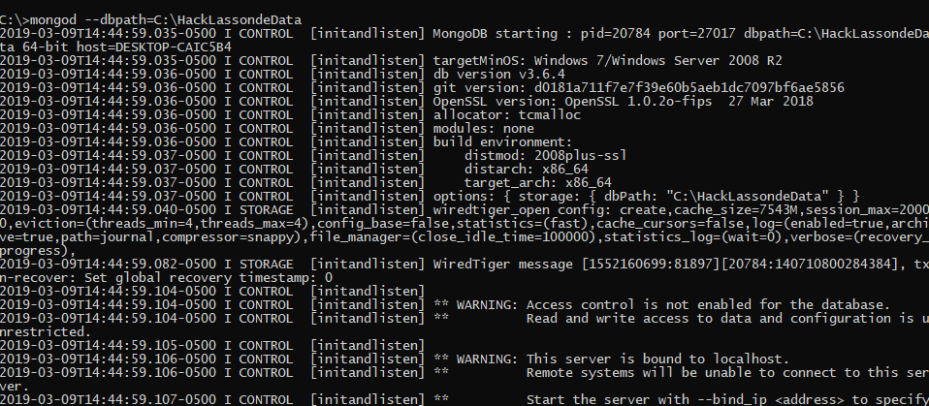
Starting MongoDB
To begin using MongoDB in our application we need to first run the mongod server to accept our database connection (by default runs on port 27017). We need to create a new directory that will store the data (in this example I’ll be using C:\HackLassondeData).
To initiate our server issue the following command after creating your directory, mongod --dbpath=C:\HackLassondeData
If all is successful you should see a lot of output from the service starting.

Slide 11
Connecting to MongoDB in Node
We need to add a requirement to our server.js file to include our MongoDB driver, in our case this will be Mongoose. Mongoose provides an easy to use wrapper around the MongoDB functions. We will then create the connection to our machine using mongoose.connect(…). useNewUrlParser: true is required as the old one is being deprecated. We’ll add a callback function to inform us of the connections state. Our connection string is broken into multiple parts, the driver, the domain, the port, and finally the collection.
Our server.js file should now look like the following:
const express = require('express');
const app = express();
const port = process.env.PORT || 3000;
const mongoose = require('mongoose');
mongoose.connect('mongodb://localhost:27017/hacklassonde', {useNewUrlParser: true}, (err) => {
console.log(err ? 'Could not connect to database.' : 'Successfully connected to database.')
});
app.get('/', (req, res) => {
res.send('Hello HackLassonde!');
});
app.listen(port, () => console.log(`HackLassonde is listening on port ${port}`));

Slide 12
Creating Our First Model
We use models to represent our data, these typically consist of a template in which the data is expected to follow, much like a class in languages such as C# or Java. On this model we can define the fields, methods, and statics that will be attached to it.
In this demo, we will be creating a single model (messages) that will have the fields “sender”, “text”, and “time”.
Let’s first create a new folder in our root directory (C:\HackLassonde) named models, and within that new directory create a new file named message.js. This file will contain our model.

Slide 13
Message.js
const mongoose = require('mongoose');
const Schema = mongoose.Schema;
let model = "Message";
let messageSchema = new Schema({
sender: String,
text: String,
time: {type: Date, default: Date.now()}
});
messageSchema.statics.getAll = function(cb, asc = true) {
mongoose.model(model)
.find({})
.sort({time: asc ? 'asc' : 'desc’})
.exec((err, res) => {
if (err)
console.log(err);
cb(res);
});
}
messageSchema.statics.addMessage = function(message, cb) {
let msg = this(message);
msg.save((err, res) => {
if (err)
console.log(err);
cb(res);
});
}
module.exports = mongoose.model(model, messageSchema);
To the right is the contents of our message.js file and there is quite a bit going on.
First, we require mongoose again, allowing us to work with the library.
Then for ease of access we define a constant “Schema” to point to the Schema object in mongoose.
Next we define our model name and the schema itself, which contains three fields as mentioned before. The Schema constructor takes an object as a parameter containing field names and data types. There are a lot more than what’s presented.
Afterward, we define two static functions for our model, getAll(…) and addMessage(…).
The getAll takes a callback (remember, asynchronous?) and an optional sort parameter. The addMessage takes a message object and a callback.
We can chain a series of commands to issue to our model very easily with Mongoose, as demonstrated by the .find(…).sort(…).exec(…).
Finally, we export our newly created model for importing into other parts of our project.

Slide 14
Testing Our Model
Let’s test whether or not our model is working. We can do so in the callback function of our mongoose.connect in our server.js file by interacting directly with it.
Just like our other requires, we have to include our message model in the script. Right after
const mongoose = require('mongoose’);
add the line
const Message = require(‘./models/message’);

Slide 15

Adding a Message
Within the body of the mongoose connection callback, let’s add a new message every time it successfully connects. This way we’ll have data that we can work with at a later time. If you recall back to when we were creating our message model, we wrote a static method that can add a message with the parameters of an object, and a callback. We will use this method to add the new message.
const Message = require('./models/message');
mongoose.connect('mongodb://localhost:27017/hacklassonde', {useNewUrlParser: true}, (err) => {
console.log(err ? 'Could not connect to database.' : 'Successfully connected to database.’);
if (!err)
Message.addMessage({sender: 'SYSTEM', text: 'Successfully connected to database.'}, (err, res) => {
console.log(err ? err : 'Message added.’);
});
});
Great Success!

Slide 16
Message API Endpoint
Similarly to the instructions for our message model, we’ll perform a similar separation of concerns for our API endpoints. We’ll start by creating an api directory in the root of our application and another message.js file within this directory.
The first line of this file will be our require for our Message model
const Message = require(‘../models/message’)
After which we’ll have everything else in the module.exports so we can integrate it into our Express server. Our interaction will happen in the callbacks of the post and get.
const Message = require('../models/message');
module.exports = (app) => {
app.post('/api/message', (req, res) => {
});
app.get('/api/message', (req, res) => {
res.send(‘In the message API!’);
});
}

Slide 17

Connecting the Endpoints
Now that we have a file dedicated to handling our message endpoints, we need to integrate them to the Express app. In server.js, add
require(‘./api/message’)(app);
Just before app.get(‘/’…). This will tell the Express app to listen to these endpoints defined in the file.
Now, you should be able to navigate to localhost:3000/api/message and see the response.

Slide 18
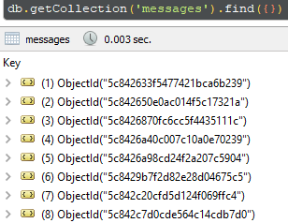
Browsing Data With Robo 3T
Open Robo 3T
Click on “Create”
The defaults should be fine
Click “Save”
Click “Connect”
On the left hand side, expand the database “hacklassonde”
Under that dropdown expand “Collections”
Double-click on “messages”
You should see all of the messages that have been created

Slide 19
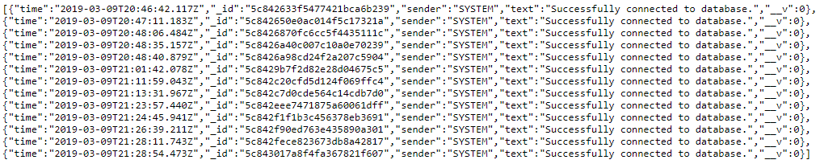
Returning Messages From API
Now that we know we can access our message api endpoints, we need to use them for what they were designed for, adding and retrieving.
We’ll start with the easiest of the two, since we have data that we can now access. In the /api/message.js file, we’re going to replace the res.send(‘In the message API’) with something that actually finds our messages and outputs them using the getAll functionality of our model. The left is what we changed the endpoint to and the output of localhost:3000/api/message should now match the output on the right.
app.get('/api/message', (req, res) => {
Message.getAll((err, data) => {
if (!err)
res.json(data);
});
});

Slide 20
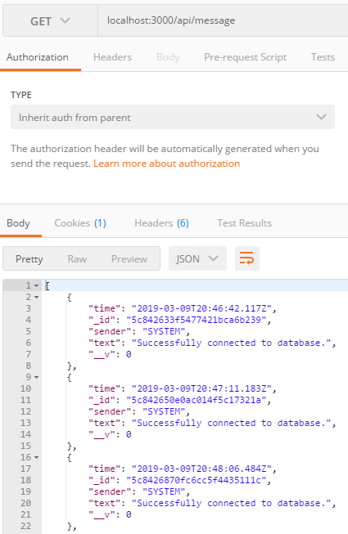
Making a GET Request With Postman
Open Postman
Close the startup window
Where it says “Enter request URL” input localhost:3000/message
You should see a nicely formatted output of all the messages
Note: We will be using Postman for our POST requests shortly

Slide 21
Configuring Our Post API Endpoint
Adding a message via our endpoint isn’t something that can be done by simply navigating to it since it requires a body. As such we left this for last so we can use Postman to demonstrate. If you recall in our main server.js file, we add a message by manually passing the body to the model’s function. We can do the same thing with the body parameter of the Express request object (in our case, req.body).
First we need to set up Express to handle URLEncoded requests. In server.js, add
const bodyParser = require('body-parser’);
app.use(bodyParser.urlencoded({ extended: true }));
After the Message require. This will allow us to post to the server and use the body property of a request.
After this, the rest is simple.

Slide 22
Continued…
To finish up our POST endpoint all we have to do is add in the missing logic to add the Message. Since we configured Express to accept URLEncoded requests, we now have direct access to the body of a request which we can use to construct our Message. Our final endpoint will look like this:
Now all that’s left is to test it with Postman!
app.post('/api/message', (req, res) => {
Message.addMessage(req.body, (err, data) => {
if (!err)
res.json(data);
});
});

Slide 23
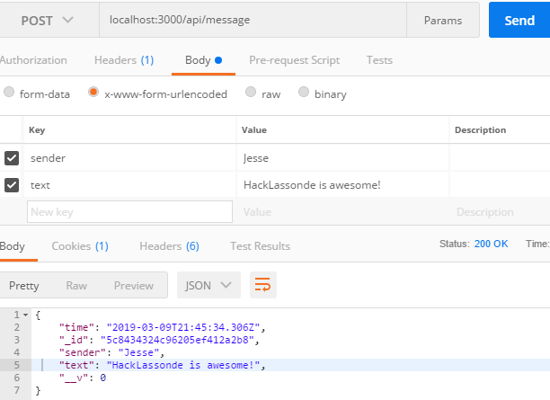
Posting With Postman
Now that we’ve got all of our endpoints set up, we can make an actual post request to our server.
Click on GET beside our URL
In the dropdown select POST
Under the URL where it says Authorization, Headers, etc., select “Body”
From the checkboxes, select x-www-form-urlencoded
Provide the keys “sender” and “text” and give them some text
Click on Send
You should see a JSON object in the body of the return

Slide 24
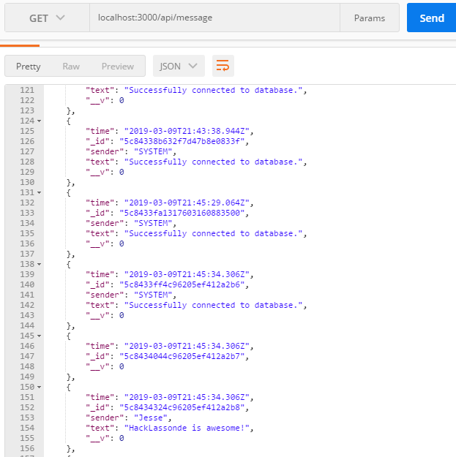
Finishing Up
If you navigate back to localhost:3000/api/message through the browser OR send another GET request using Postman you should see the newly created Message.
Obviously there is a lot more that can be done, including authentication, more advanced Schemas, making this semi-relational by ObjectId, etc. and I encourage you to look further into more advanced scenarios and possibly even implementing Angular or React to interact with your endpoints.

Slide 25
Final Words
Thank you all for having me and I wish you all the best of luck in the HackLassonde competition!
These files are available at https://github.com/effekt/HackLassonde

