Slide 1


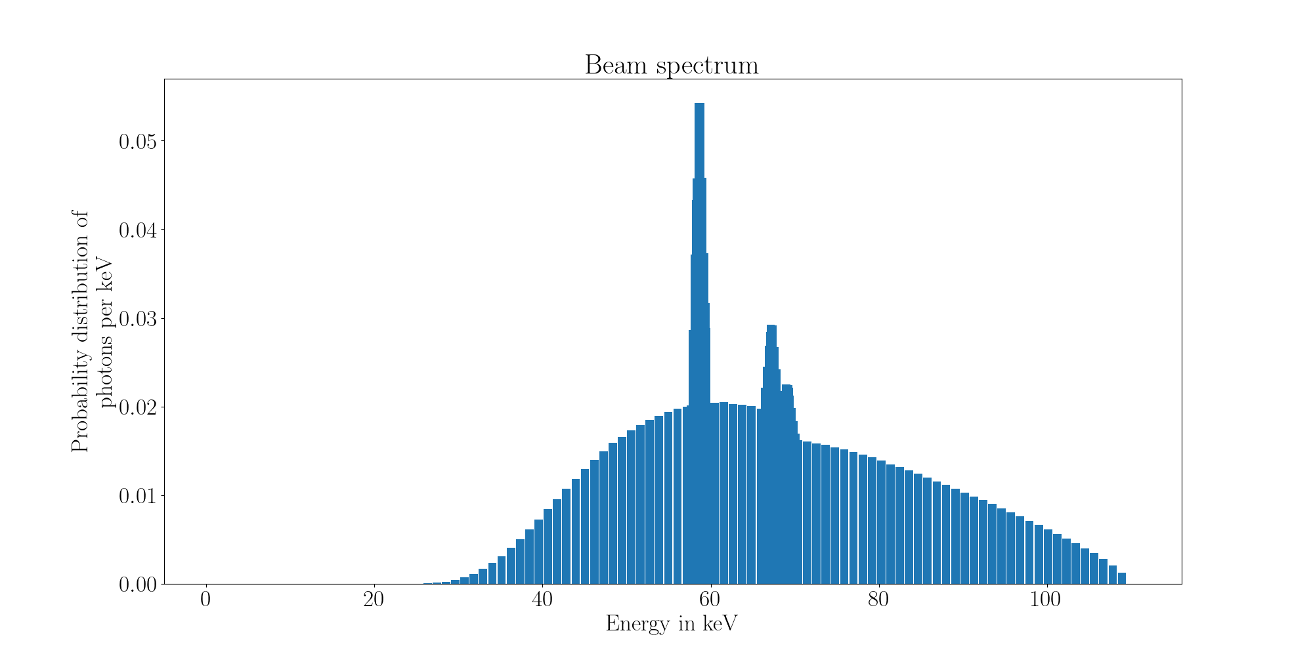
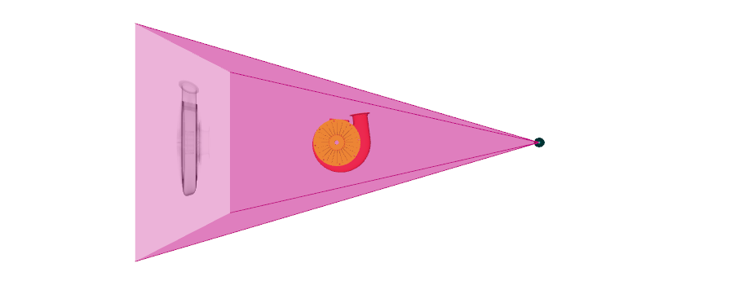
X-ray simulation on GPU
from CAD models
CT reconstruction
The detector parameters
The source parameters
The sample parameters,
inc. material
Integrate
The data acquisition
- Position
- Tube voltage
- Exposure (TBA)
- Filtration

