Slide 1
BDD: Behavior Driven Development
Felipe Kaufmann

Slide 2
So what is BDD?
An agile software development technique
Aims to bring developers and non-technical stakeholders closer together

Slide 3
Originally coined in 2003 by Dan North, author of JBehave, the first BDD tool
Evolved from an extension of TDD (TDD done well) to much more
Critics still say it’s just a fancy word for TDD, but make your own opinion on that!

Slide 4

The RSpec Book

Slide 5
The RSpec Book says…
Behavior Driven Development is about implementing an application by describing its behavior from the perspective of its stakeholders
Writing software that matters

Slide 6
BDD Principles
Enough is enough (don’t plan to much ahead)
Up-Front analysis, design and planning all have a diminishing return over time

Slide 7
BDD Principles
Deliver stakeholder value (don’t do it if it does not add value)
Any feature should have an identified, verifiable value to the business

Slide 8
BDD Principles
It’s all behavior (everything can be described in behavior)
Business and Technology should refer to the same feature in the same way

Slide 9
TDD (reminder/short intro)
Write tests before you code (let them drive the code)
red/green/refactor
YAGNI

Slide 10
Some issues with TDD (practical issues of the developers)
Where to start
What to test and what not to test
How much to test in one go
How to understand why a test fails and what it means

Slide 11
More issues with TDD (organizational issues)
(hopefully) written acceptance criteria on story cards
(maybe, some kind of) acceptance criteria in the code (tests)
Duplication and/or divergence!

Slide 12
Divergence
The tests in the code do not correspond to the acceptance criteria in a user story
Why not?
They are much lower level and to abstract to match any kind of relevant business logic

Slide 13
Duplication
The tests in the code do test the business logic, and thus do, to some extent, repreent acceptance criteria. But are not understood by stakeholders
Why not?
The stakeholders are non-technical and can not make sense out of Unit Tests etc.

Slide 14
We don’t know what we are doing!
Because developers and stakeholders have two different points of view
Because we don’t know what to test and where to start testing
Because we don’t understand what it means when a test fails

Slide 15
Inspect and adapt!
We need a better TDD!
Tests that work on a higher level and correspond to acceptance criteria of a user story
Tests (or test output) that are understandable by non-technical stakeholders

Slide 16
Pick your tool
Cucumber (Ruby, Java)
RSpec (Ruby)
Concordion (Java)
Jbehave (Java)
EasyB (Java)
…

Slide 17

Cucumber: The Holy Grail of BDD?

Slide 18
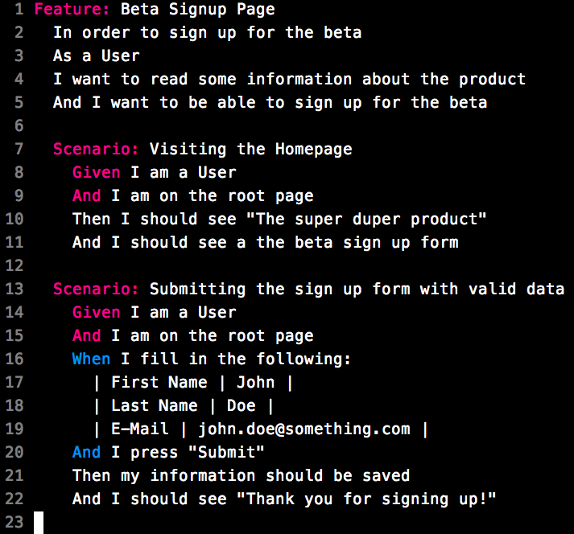
Cucumber Example Input

Slide 19
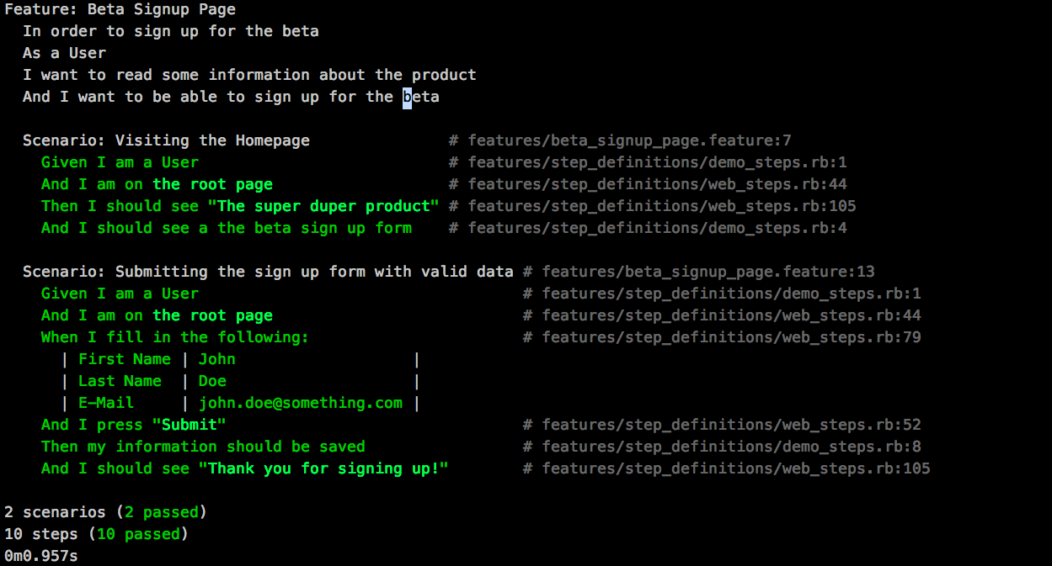
Cucumber Example Output

Slide 20
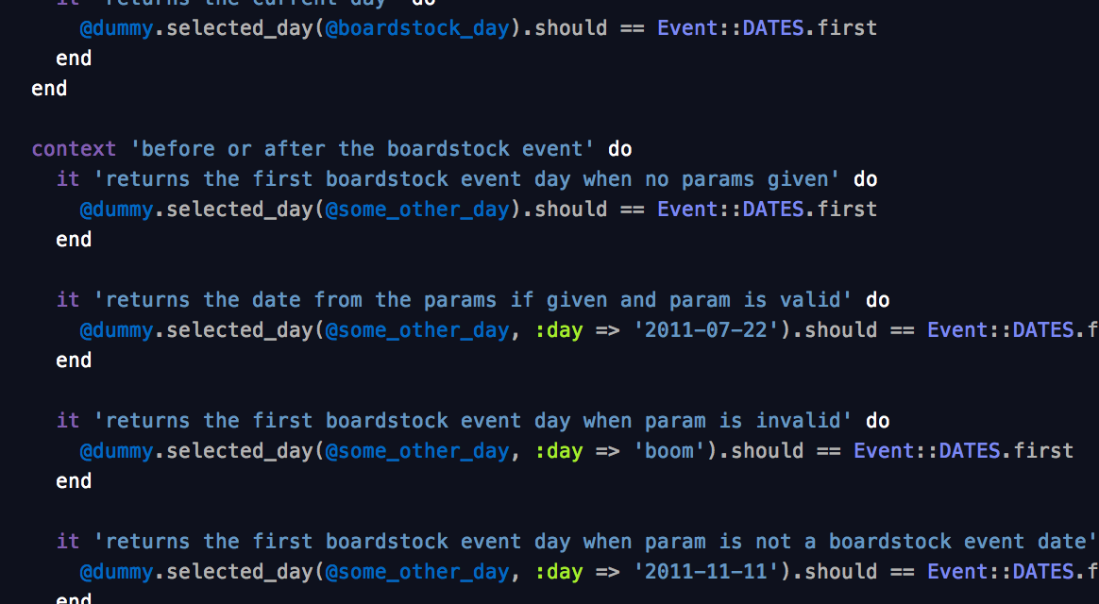
RSpecExample Input

Slide 21
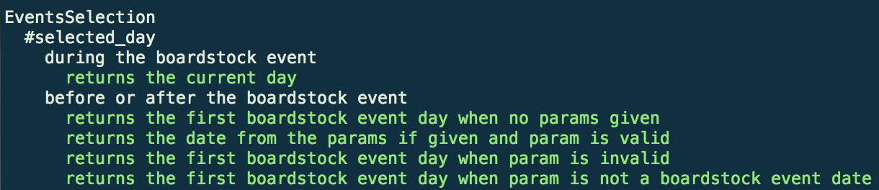
RSpecExample Output

Slide 22
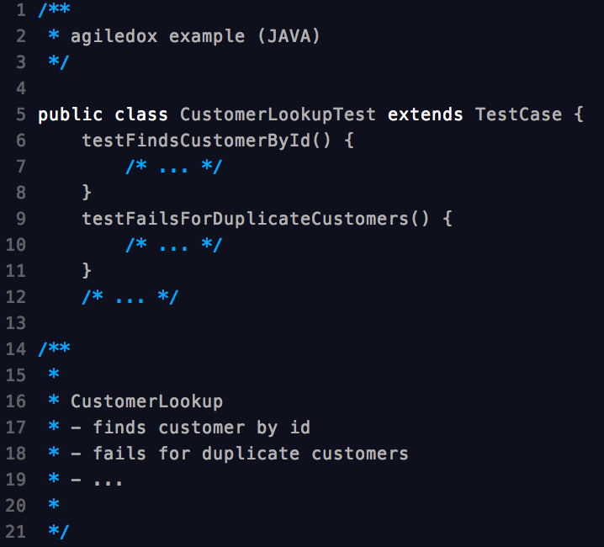
Agiledox example

Slide 23
Inspect and adapt!
Clear workflow
From a business requirement/vision
To features & user stories
To acceptance tests and unit tests
That drive the actual implementation

Slide 24
BDD Workflow: Planning
Priorization first:
Establish next best “vision” that will deliver value to the business
Example: we need potential users for our beta launch

Slide 25
BDD Workflow: Planning
Establish what is needed to achieve the vision, e.g:
Product Owner wants to inform potential users about the product
The users want to be able to sign up for the beta
The developer that will work with the data want that only valid email adresses get trough the signup process

Slide 26
BDD Workflow
Formalize the requirements with scenarios and examples
See: https://github.com/effkay/bdd-presentation/blob/master/EXAMPLE_APPLICATION/features/beta_signup_page.feature for an example cucumber feature

Slide 27
BDD Workflow: BDD Cycle
Outside in development workflow
Run tests all the time, automatically, while coding

Slide 28
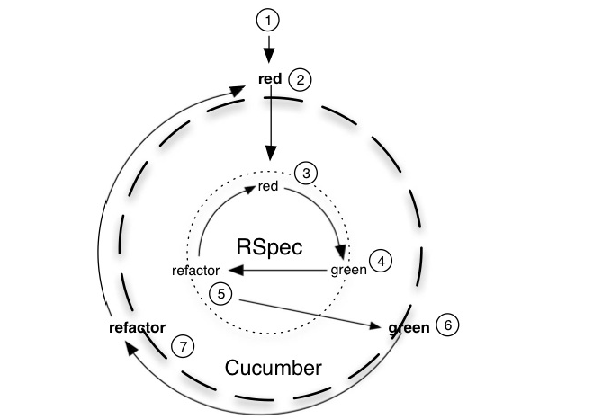
BDD Cycle

Slide 29
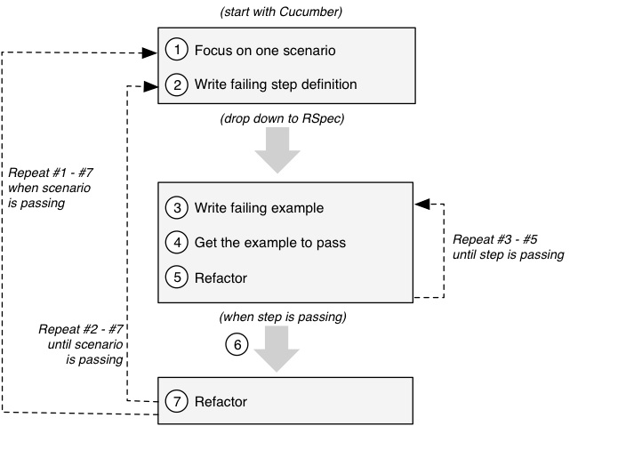
BDD Cycle

Slide 30
The added value of BDD
Acceptance criterias of a user story can be formalized
One clear definition of what is necessary for the user story to be complete
Automated testing of the acceptance criteria

Slide 31
The added value of BDD
Tracebility of any code back to specific stakeholders need
Clear path for developers on TDD/BDD best-practices and workflow

Slide 32
Criticisim
BDD is just a fancy word for TDD?
Tools add a new layer of abstraction/complexity and mean more work
Tools might be to focused on web development

Slide 33
Demo Time!
Find the demo application code on: https://github.com/effkay/bdd-presentation/tree/master/EXAMPLE_APPLICATION

Slide 34
Conclusion
BDD helps when you get stuck with TDD (workflow)
Improves inter-project communication trough clearer and formalized acceptance tests
Improves developer involvement due to traceability of business value
Once you try it, you either hate it or never code without it

Slide 35
Questions?

Slide 36
The RSpec Book (ISBN: 978-1-93435-637-1)
http://dannorth/introducing-bdd
http://behaviour-driven.org
http://forums.pragprog.com/forums/95/topics/3035
All resources on: https://github.com/effkay/bdd-presentation

