Slide 1
Ansor: Generating High-Performance Tensor Programs for Deep Learning

Slide 2
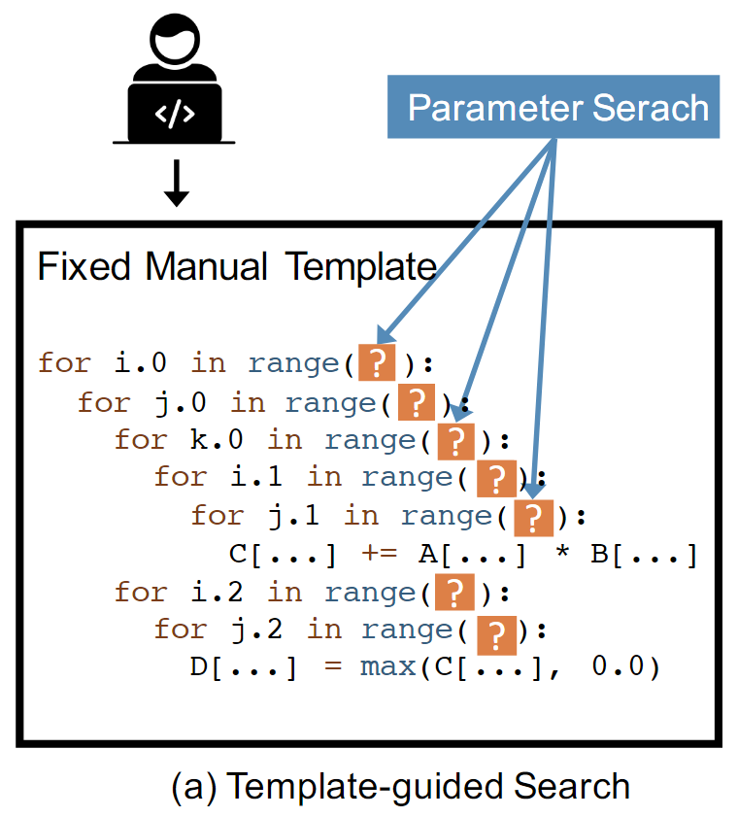
Background
AutoTVM: Template-guided search
Drawbacks
Not fully-automated -> Requires huge manual effort
Limited search space -> Does not achieve optimal performance

Slide 3
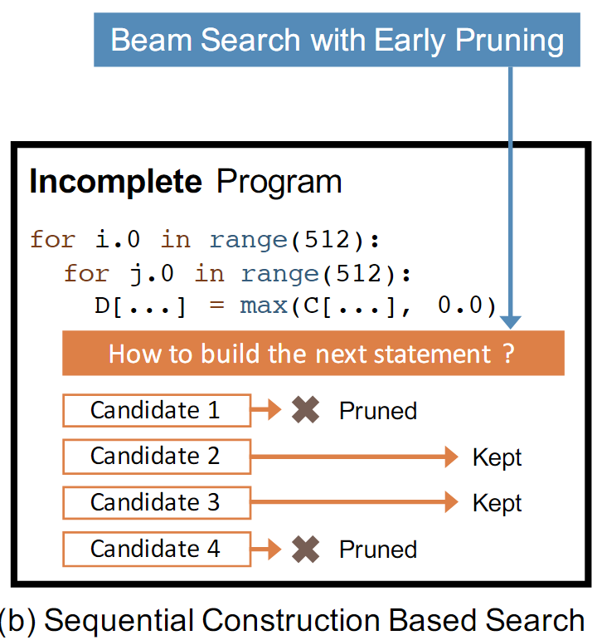
Background
Halide: Sequential construction based search
Drawbacks
Intermediate candidates are incomplete programs-> The cost model cannot do accurate prediction
Sequential order
The error accumulates
Limits the design of the search space

Slide 4
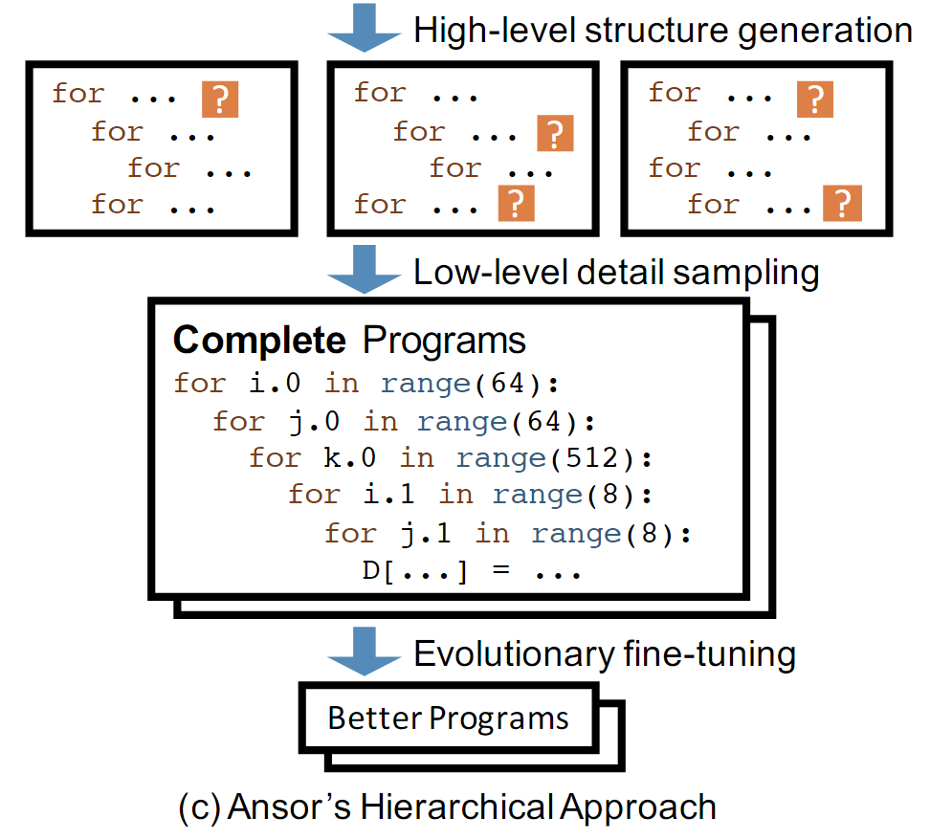
Ansor’s Hierachical Approach
Hierachical Search Space
Sample complete programs and fine-tune them

Slide 5
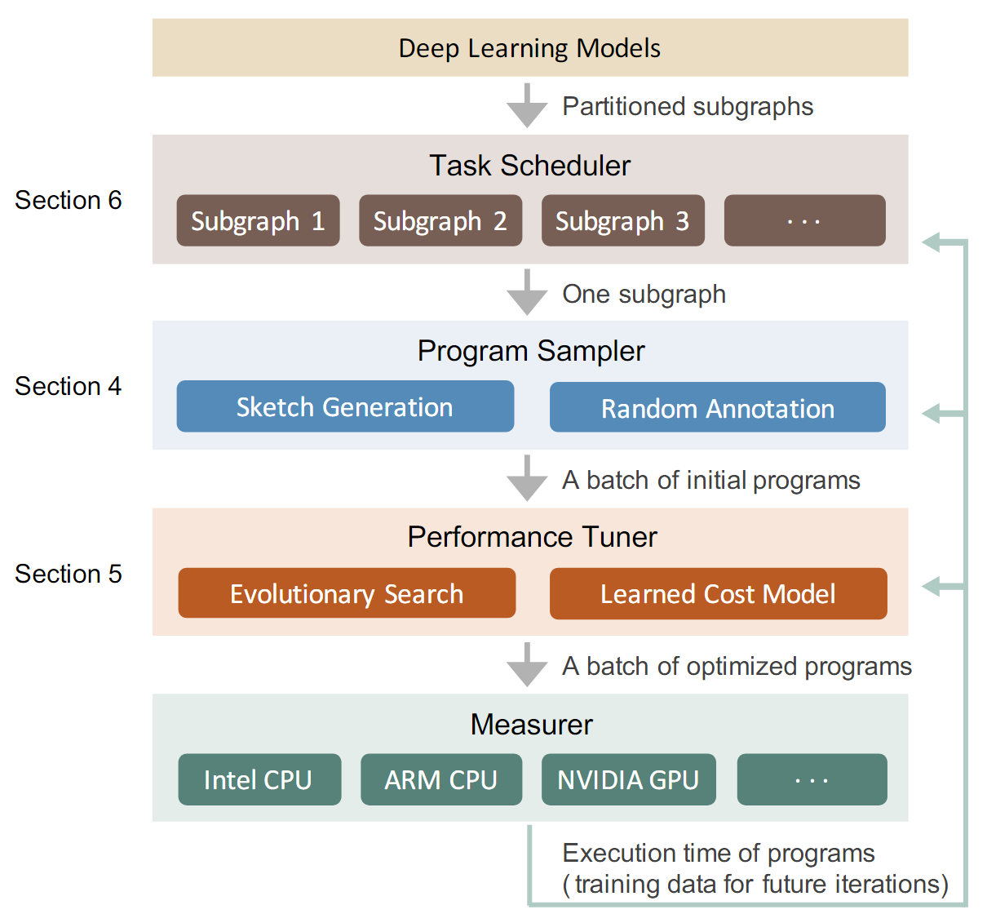
Design

Slide 6

Programming Sampling
Goal: automatically construct a large search space and uniformly sample from the space
Approach
Two-level hierarchical search space: Sketch + Annotation
Sketch: a few good high-level structures
Annotation: billions of low-level details
Sampling process:

Slide 7
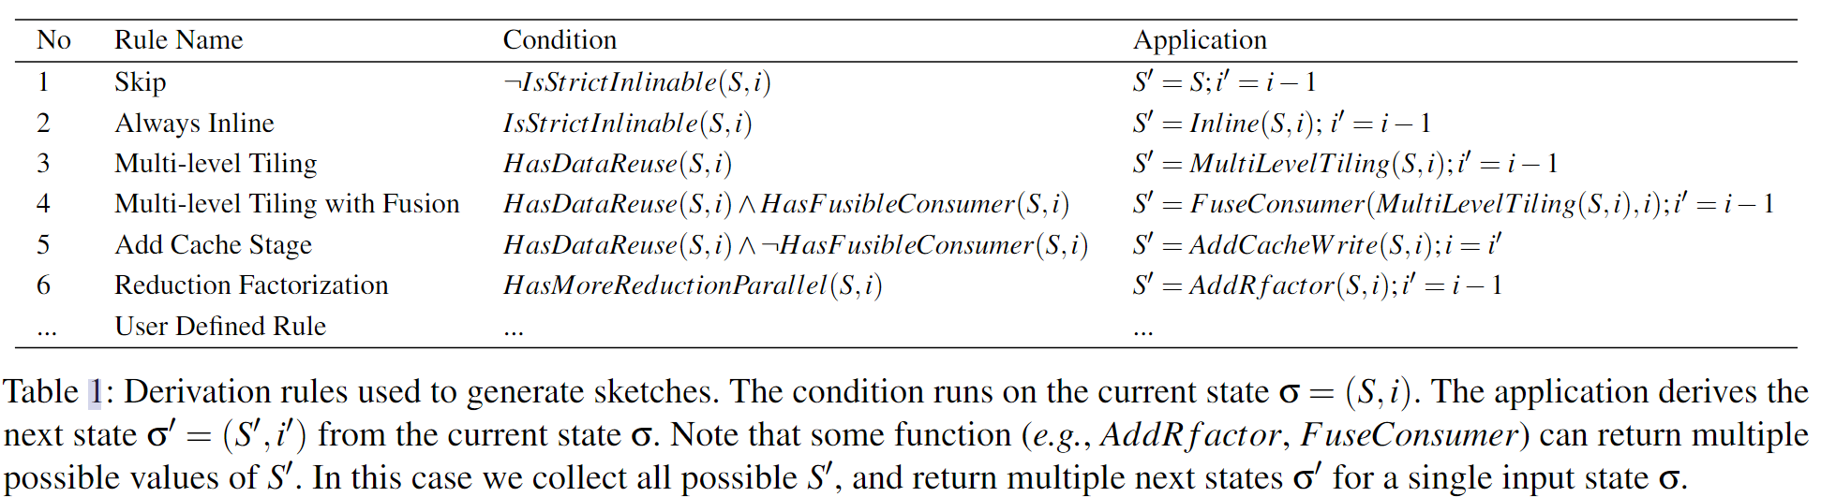
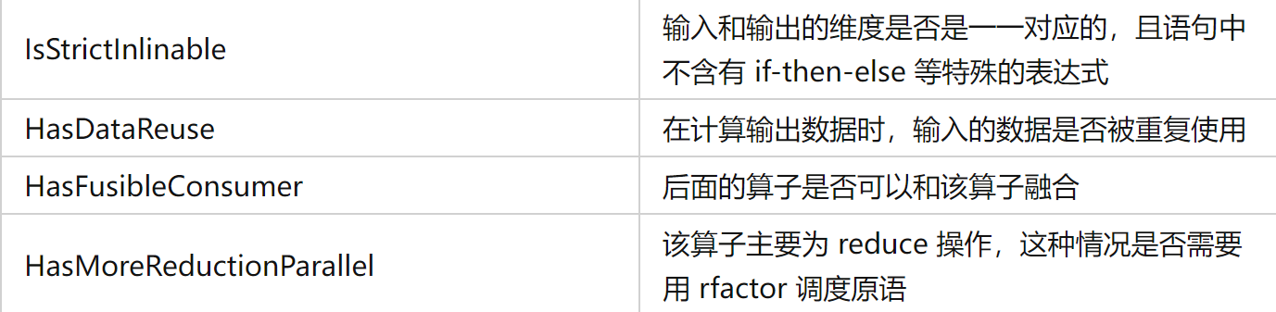

Slide 8
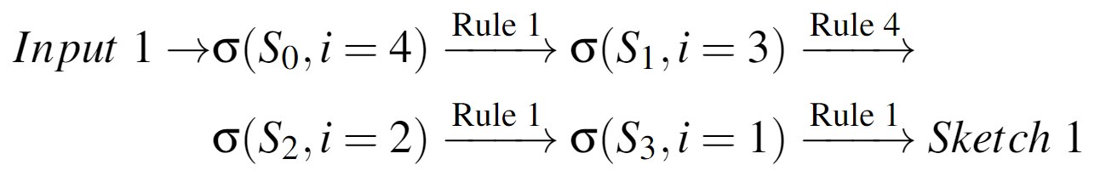
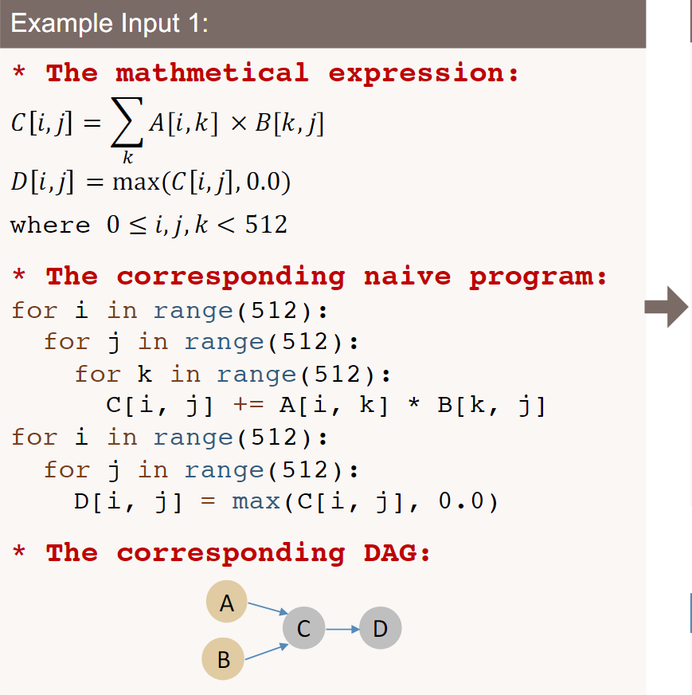
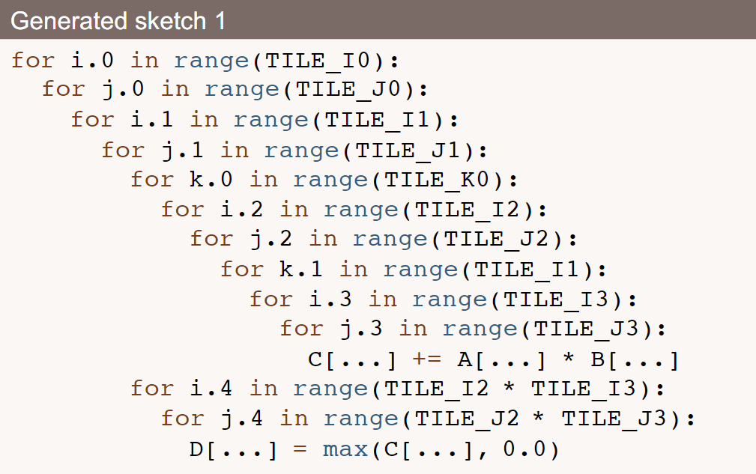
Programming Sampling
Deviation:
Notes:
Sketch Generation Examples 1/2

Slide 9
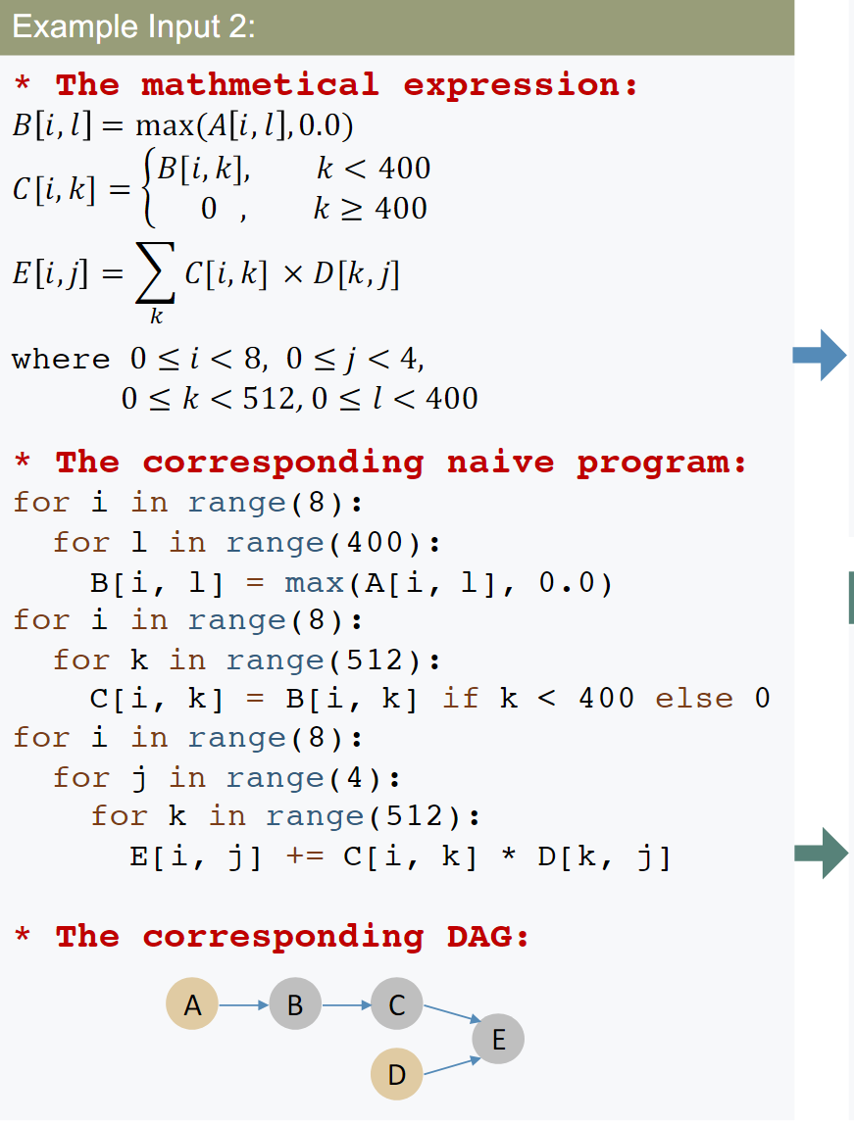
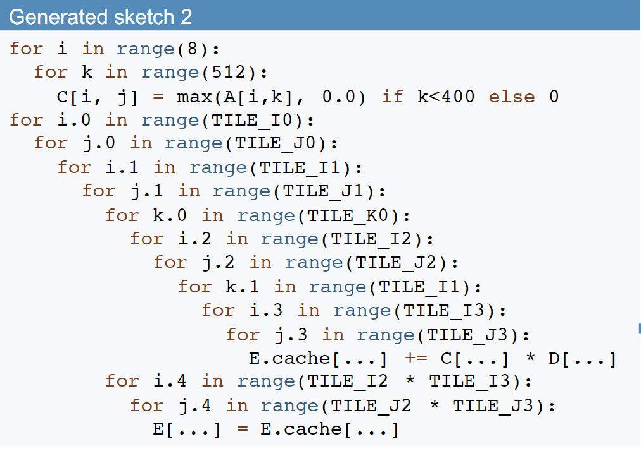
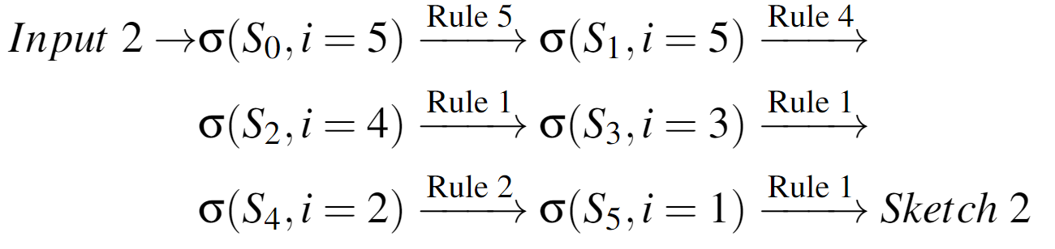
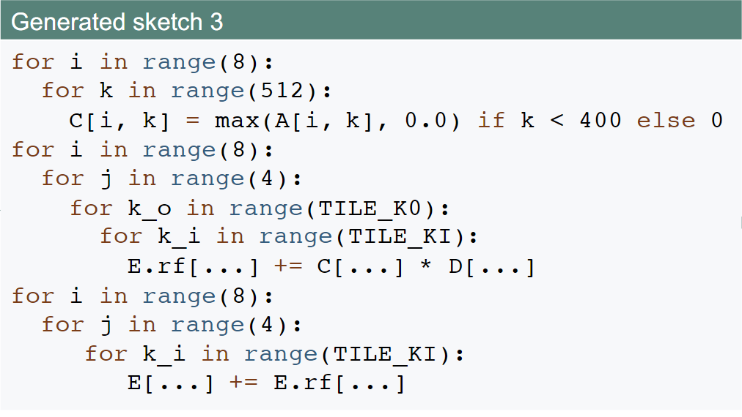
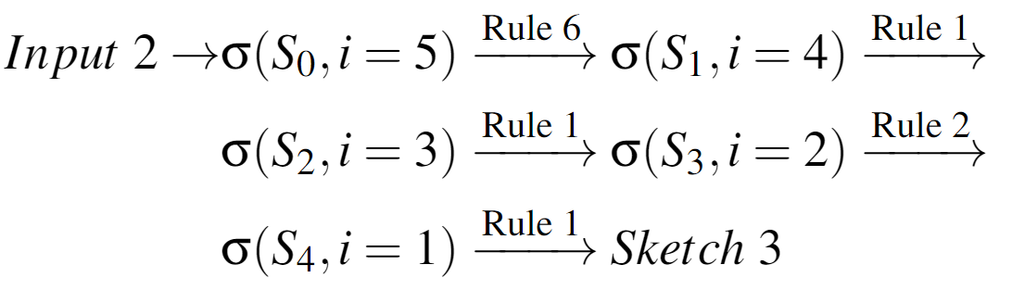
Programming Sampling
Notes:
Sketch Generation Examples 2/2

Slide 10
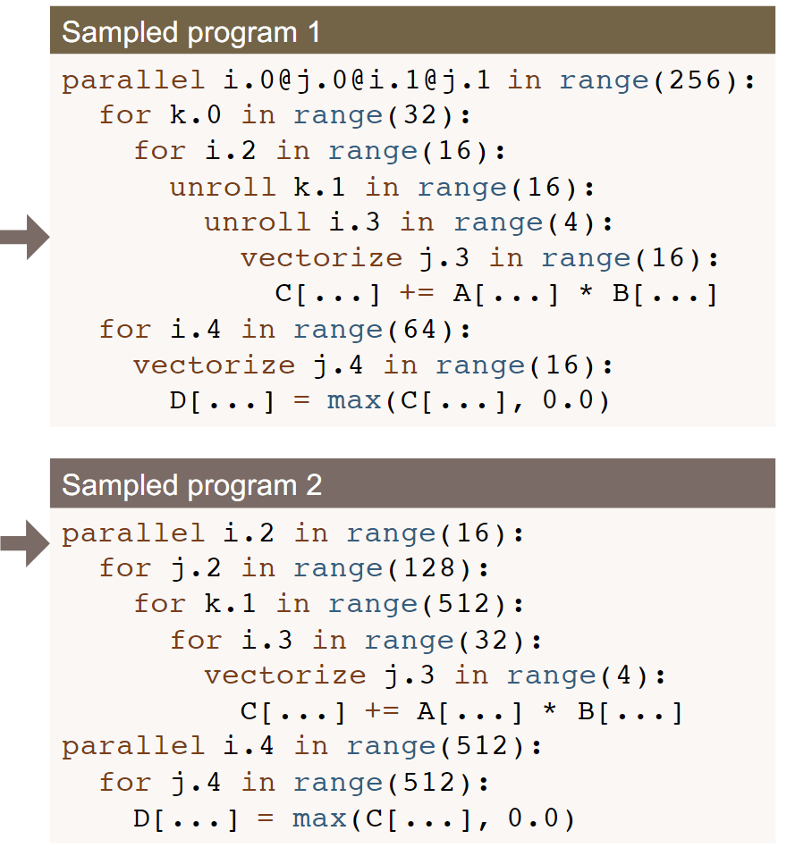
Programming Sampling
Notes:
Sketch Generation Examples 1/2

Slide 11
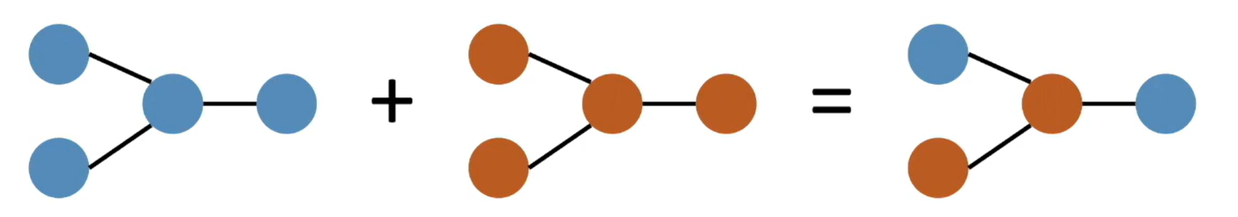
Evolutionary search
Random sampling does not guarantee the performance
Perform evolutionary search with learned cost model on sampled programs
Mutation
Randomly mutate tile size
Randomly mutate parallel/unroll/vectorize factor and granularity
Randomly mutate computation location
crossover
Notes:
Performance fine-tuning

Slide 12
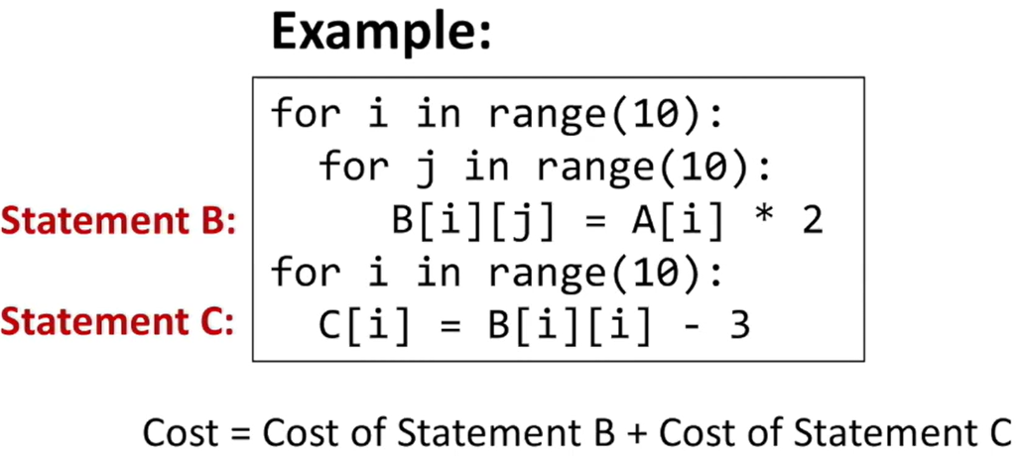
Learned cost model
Predict the score of each non-loop innermost statement
Extract features for every non-loop innermost statement:
used cache lines, used memory, reuse distance, arithmetic intensity, ...
Train on-the-fly with measured programs (typically less than 30,000)
Notes:
Performance Fine-tuning

Slide 13
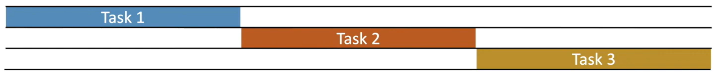
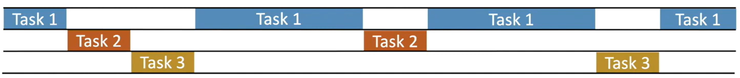
Task Scheduler
There are many subgraphs (search tasks) in a network
Example: ResNet-50 has 29 unique subgraphs after partition
Existing systems: sequential optimization with a fixed allocation
Ansor task scheduler: slice the time and prioritize important subgraphs
Predict each task's impact on the end-to-end objective function
Using optimistic guess and similarity between tasks

Slide 14

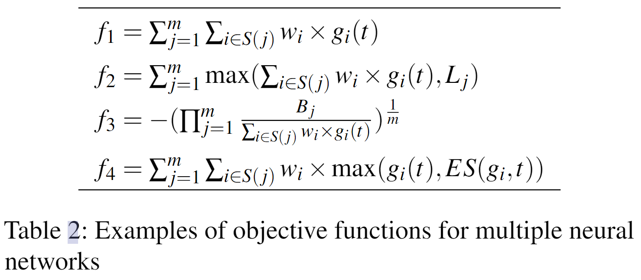
Task Scheduler-Problem Formulation
Notes:
Problem Formulation

Slide 15
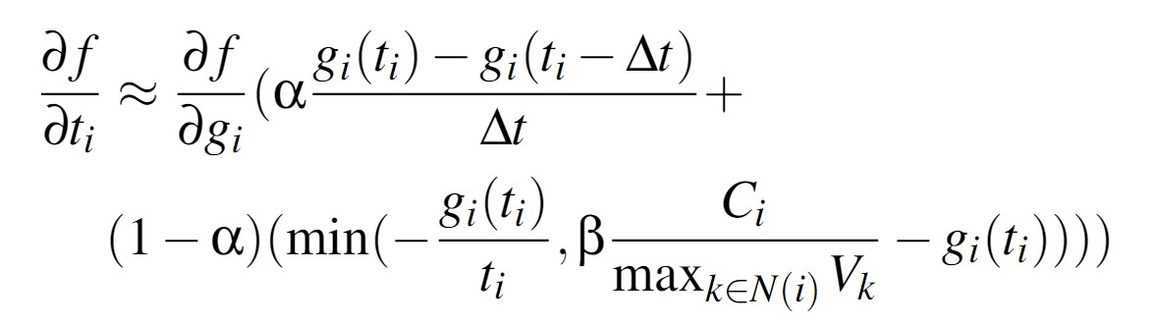
Task Scheduler-Optimizing with Gradient Descent
Notes:
Optimizing with Gradient Descent

Slide 16
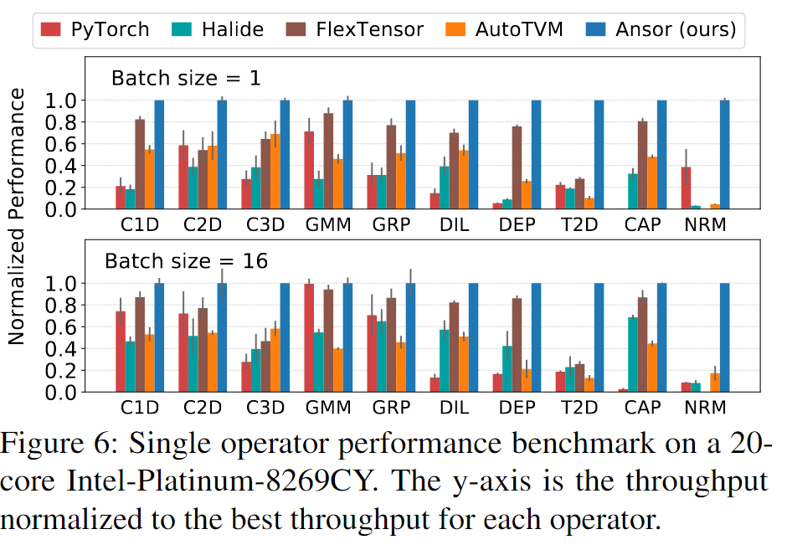
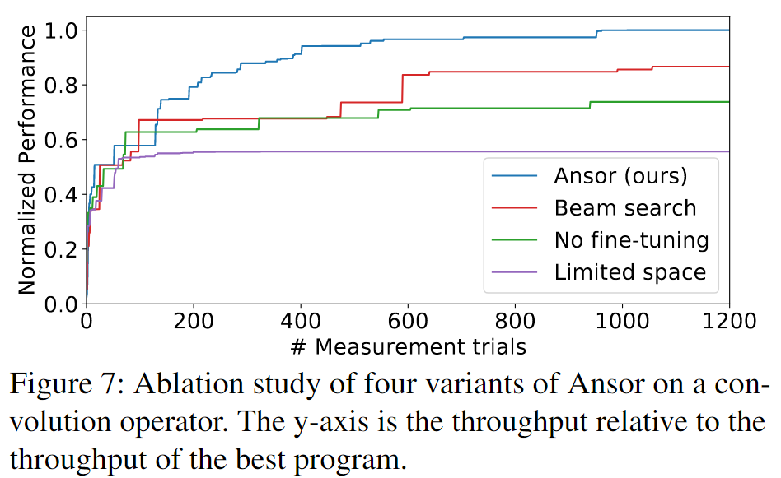
Evaluation

Slide 17
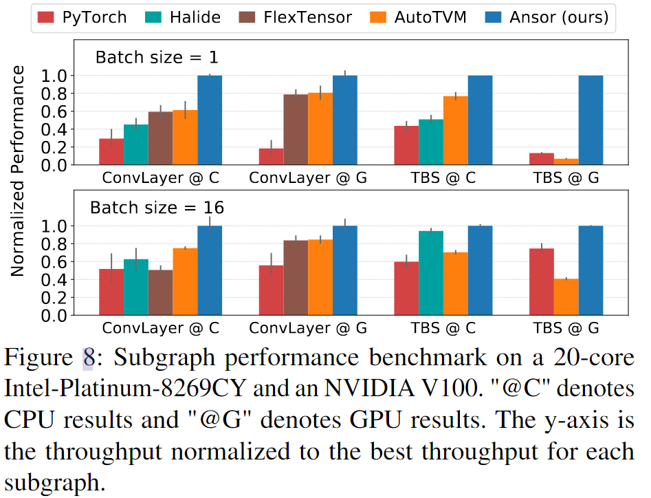
Evaluation

Slide 18
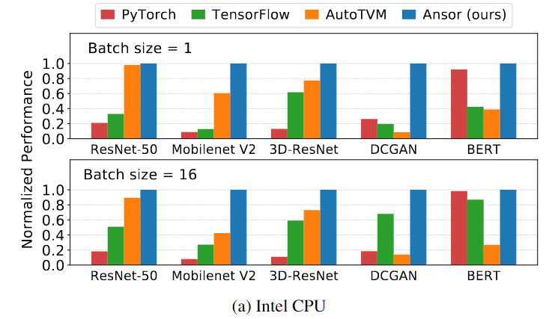
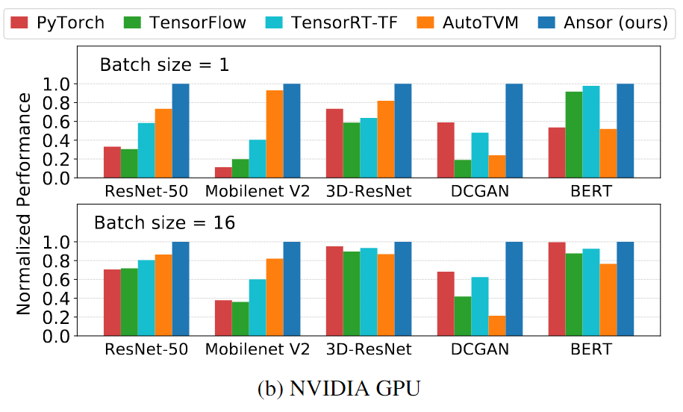
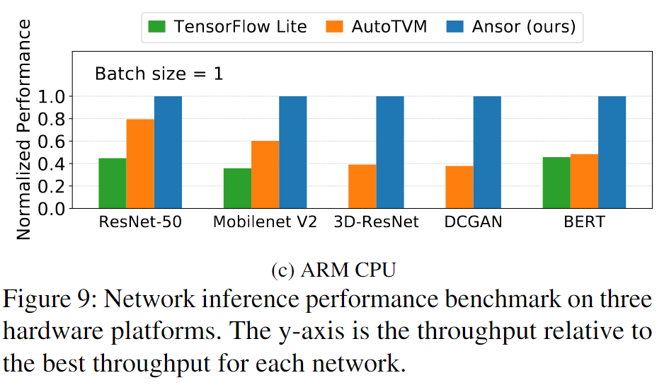
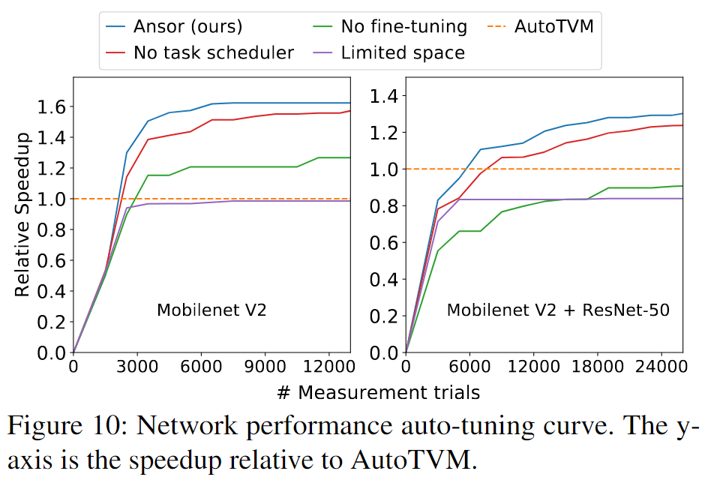
Evaluation

Slide 19
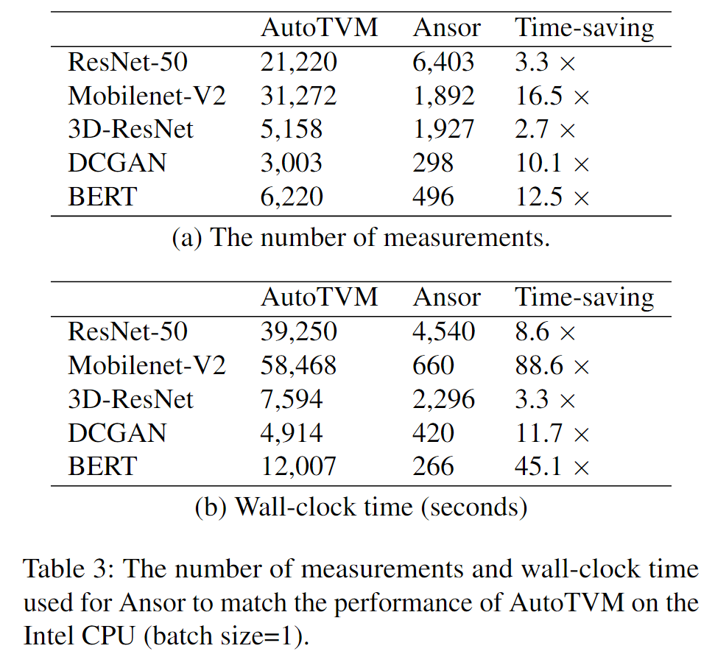
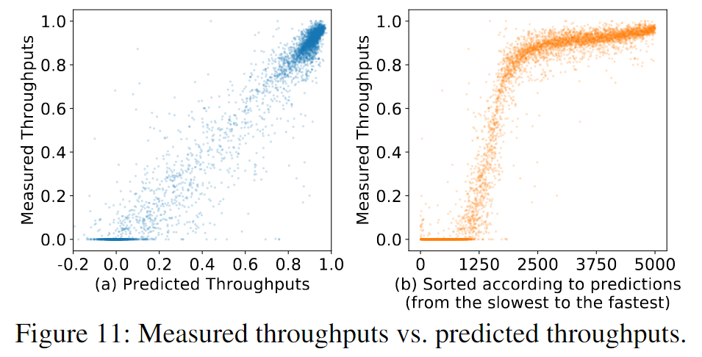
Evaluation

