Slide 1
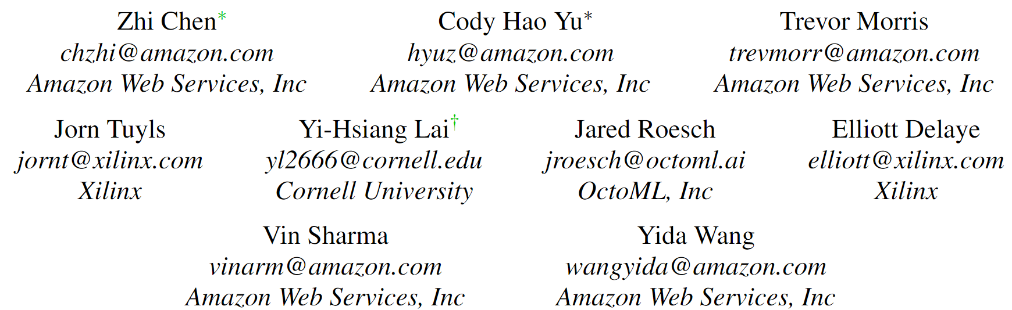
Bring Your Own Codegen to Deep Learning Compiler

Slide 2
Introduction
Challenges:
Failing to execute: The evolution of deep learning models occurs rapidly which may lead to significant changes in the model architecture over time.
Inefficient to execute: simple dataflow but complex control logic.
Demanding to execute: the lack of a unified framework.
a unified framework decouples DLC to the shared part and the accelerator-exclusive part.
Solutions:
For 1: Vendors contribute the to the shared part.
For 2: partitioning framework.
For 3: the accessibility to the widely used DLC optimizations.

Slide 3
Contributions
We propose a unified framework to allow different hardware accelerator vendors to obtain as many as possible hardware-agnostic optimizations for free by integrating their codegen tools in a plug-and-play manner.
We provide flexible interfaces for developers to 1) annotate and partition a computational graph with various strategies, 2) apply hardware-specific optimizations on the partitioned graphs to further improve the performance.
We conduct a number of case studies using multiple popular edge accelerators to demonstrate the different ways of codegen integration with on average only ∼2K LOC, largely saving the engineering efforts and time to the market.
The proposed framework has been adopted by several production edge accelerators' compilation pipelines to alleviate the development efforts of the full software stack.

Slide 4
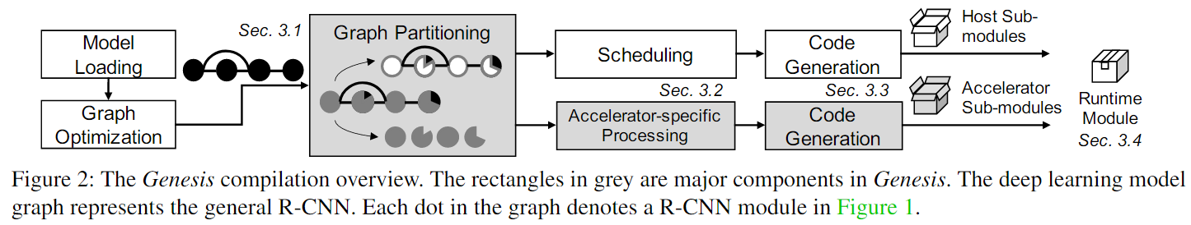
Framework Design and Implementation
Graph Partitioning
Accelerator-Specific Processing
Code Generation
Runtime

Slide 5
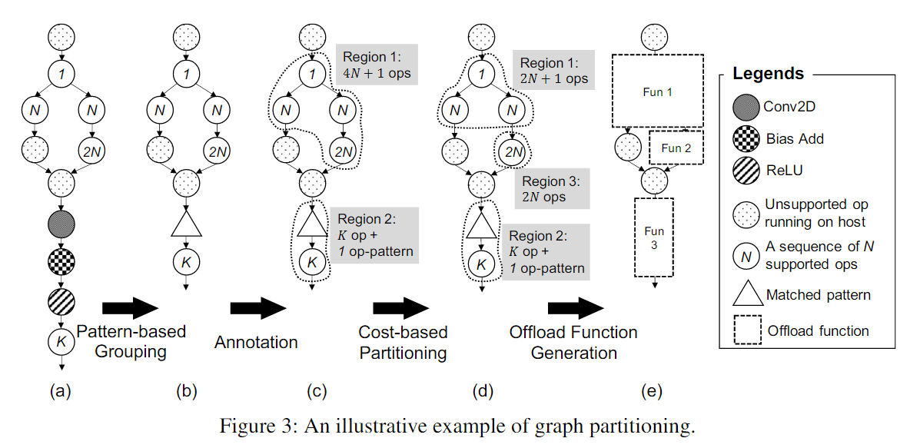
Graph Partitioning
Which IR level we should partition and offload the subgraphs?
Partion and offload at High-level IR for two reasons:
some hardware vendors handcraft a kernel library with limited inter-operator optimizations.
Vendors can choose to use their own IR or the builtin low-level IR in existing deep learning compilers.

Slide 6
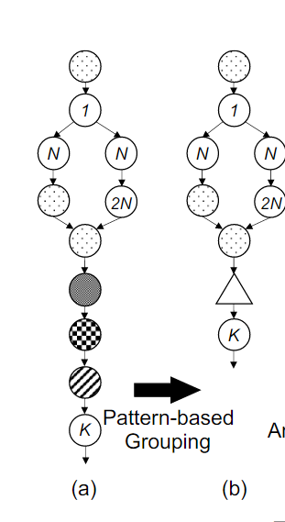
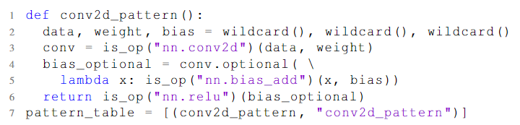
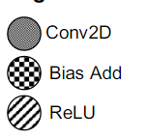
Pattern-based Grouping

Slide 7
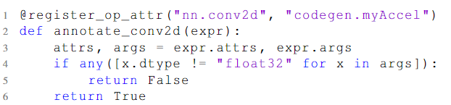
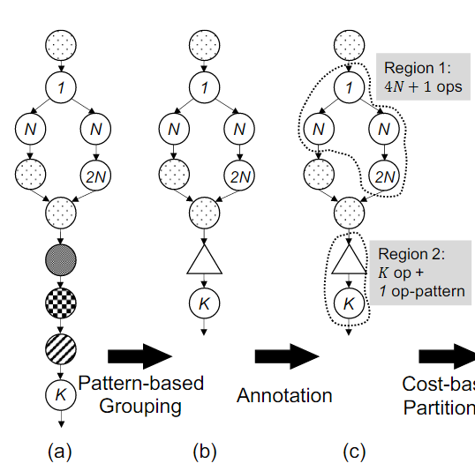
Annotation
greedily merge consecutive supported operators to one region and pass them together to the code generator.
allow users to specify the priority

Slide 8
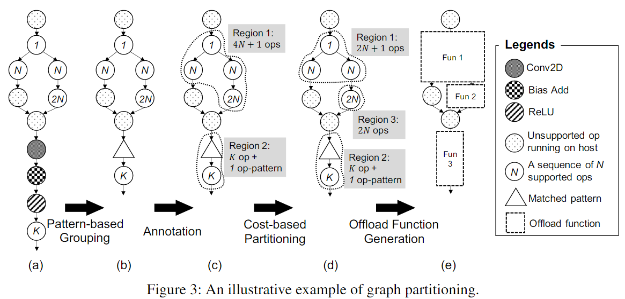
Cost-based Partitioning
cost-based partitioning mechanism to split regions based on user-defined criteria.

Slide 9
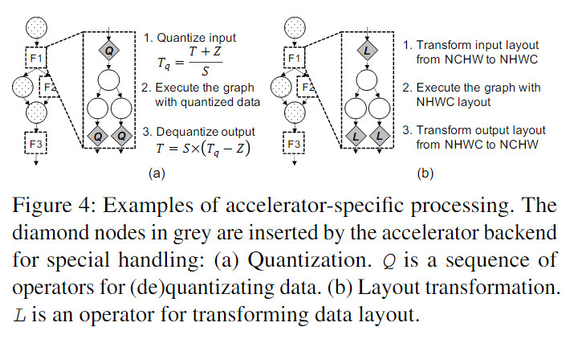
Accelerator-Specific Processing
Notes:
图切分后，各个区域会调用相应的计算后端执行计算。
对于主机端的部分如Arm CPU，会使用深度学习编译器中预设对该CPU设定的常见标准的优化流程，而加速器部分则需要硬件特定的优化：操作合并，化简，数据排布变换，量化等。其中，量化和数据排布变换是两个常见的加速器相关的处理。

Slide 10
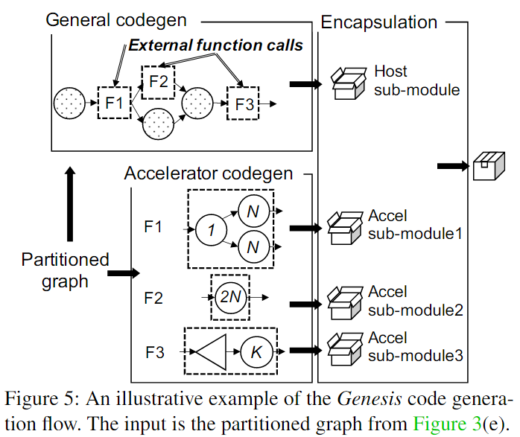
Code Generation
For accelerator vendors, code generation means using TVM Relay IR to generate a format code supported by their own accelerator inference engine.
Option 1: Standard graph representation: JSON as default.
Option 2: Standard C code.
Option 3: Custom graph representation.

Slide 11
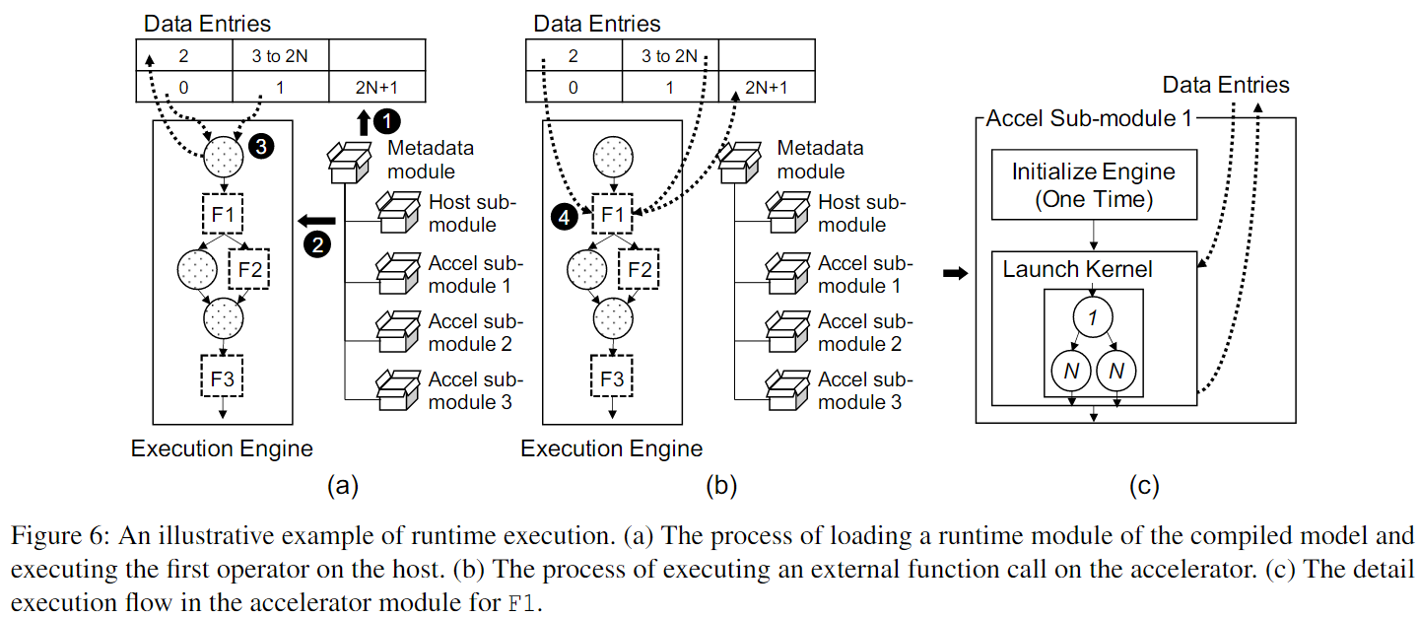
Runtime
Initiate the metadata module.
Execute graph nodes on the host.
Execute the graph nodes on the accelerator.

Slide 12
总结
BYOC框架的目的在接入硬件，用上现有深度学习编译器的切异构子图的切图能力，以及更上层的图优化等，减少工作量。
This paper proposed a unified framework to allow accelerator vendors to easily integrate their codegen and runtime systems to state-of-the-art deep learning compilers. This enables vendors to only focus on the development of the in-house code generator and greatly benefit from the development of standard compiler and deep learning optimization techniques in existing deep learning compilers.

Slide 13
Case Study
What is the obtainable speedup of the models compared to the selected baseline on the studied platforms?
How many operators can be offloaded to the target platform?
What is the percentage of the MACs the offloaded graphs account for?
How much is the offloading overhead?

Slide 14
NVIDIA Jetson AGX Xavier GPUs

Slide 15
Xilinx Edge and Cloud FPGAs

