Slide 1
CORTEX: A COMPILER FOR RECURSIVE DEEP LEARNING MODELS

Slide 2
Introduction
Past work on recursive and dynamic models such as DyNet, Cavs and PyTorch has relied on hardware-specific, highly-optimized vendor libraries.
However, vendor libraries have disadvantages in terms of model coverage and development effort, contain implementations only for the most commonly used models and kernels.
Moreover, each kernel in a vendor library is optimized in isolation. This often precludes optimizations such as kernel fusion, Model persistence.

Slide 3
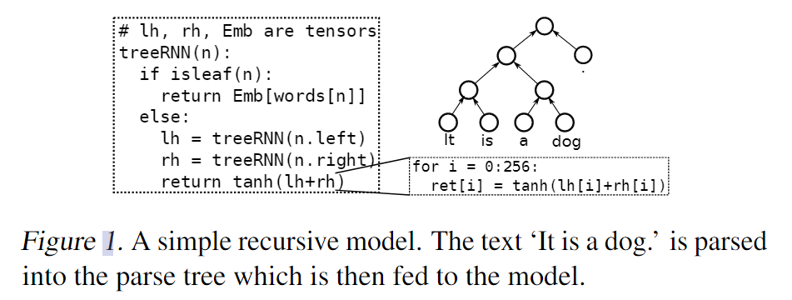
Introduction
Challenges:
Effective representation of recursive control flow
Optimizing recursive control flow
Static optimizations(compiler-based)
CORTEX: compiler-based approach

Slide 4
Overview
P.1 All control flow depends on the connectivity of the data structure, and not on dynamically computed data.
P.2 All recursive calls can be made before performing any tensor computation.
P.3 Recursive calls to the children of a data structure node are independent of each other: the arguments to one call do not depend on the results of a previous call.
Notes:
所有控制流都依赖于数据结构的连通性，而不是动态计算的数据。
在执行任何张量计算之前都可以进行所有递归调用。
对数据结构节点子节点的递归调用是相互独立的：一个调用的参数不依赖于前一个调用的结果。

Slide 5
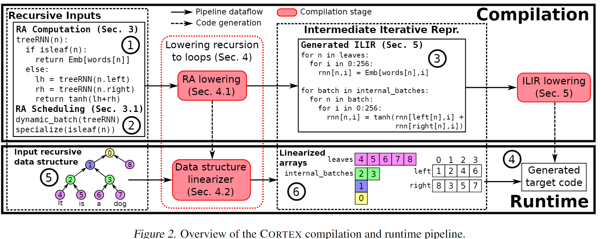
Overview

Slide 6
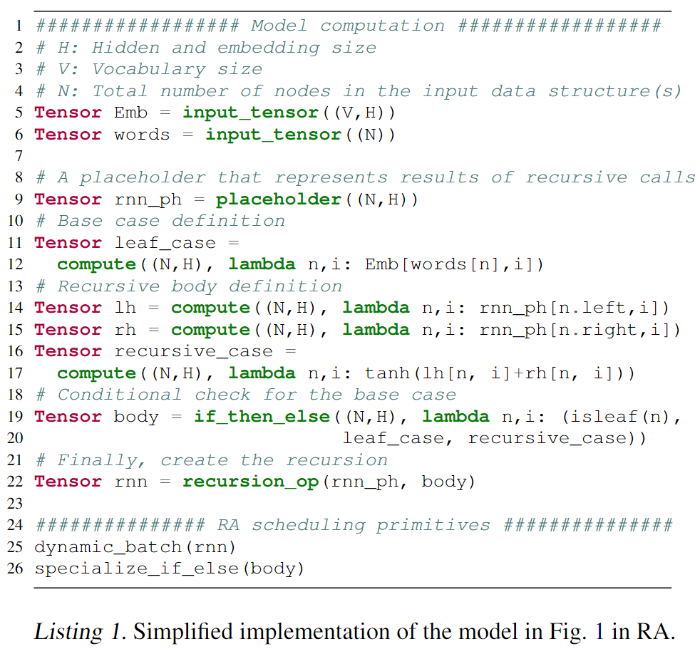
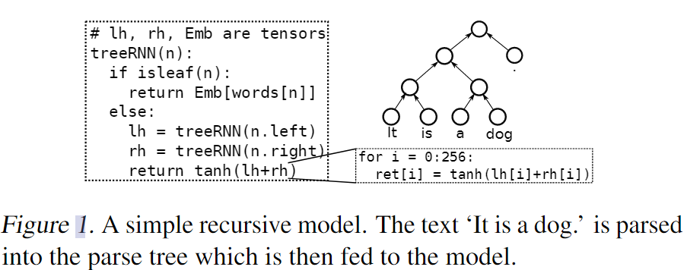
Recursive API ( RA )
used during compilation,
verified at runtime

Slide 7
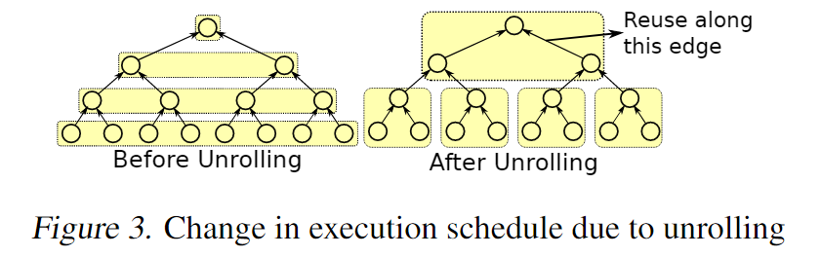
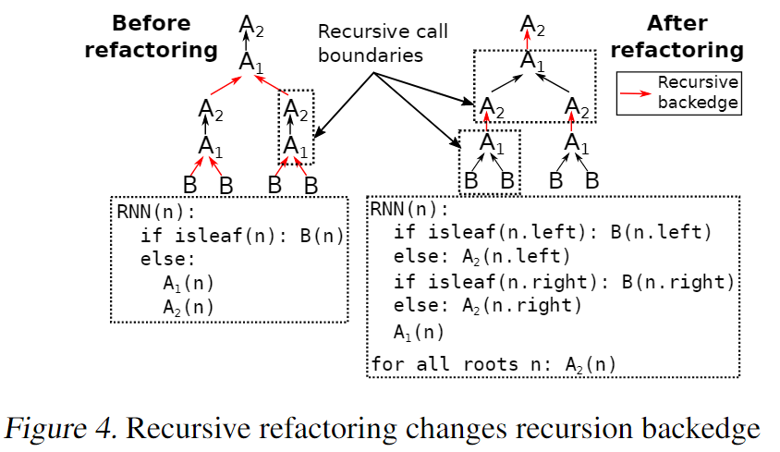
Recursion Scheduling Primitives
Dynamic Batching: property P.1
Specialization: allow the user to specialize the program for the two branches of a conditional check
Unrolling
Recursive Refactoring

Slide 8
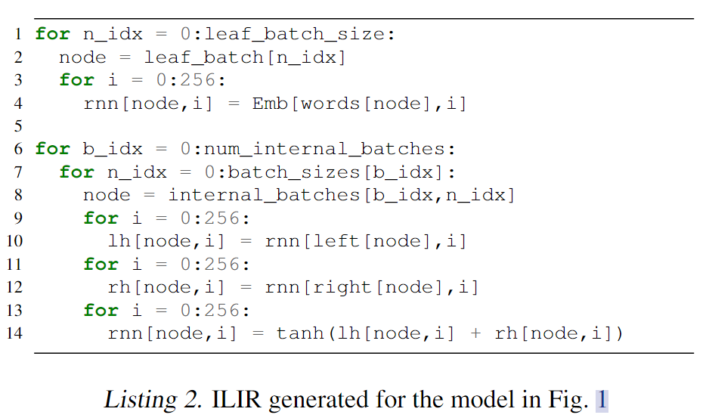
Lowering Recursion to Loops – RA Lowering

Slide 9
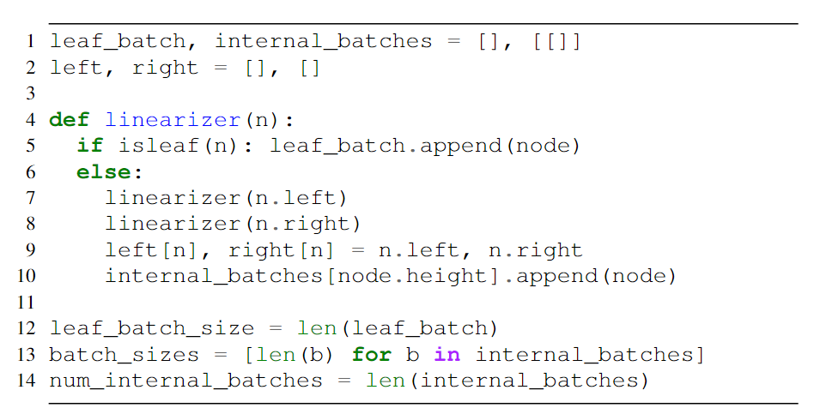
Lowering Recursion to Loops – Data Structure Linearization

Slide 10
Lowering Recursion to Loops – Computation Hoisting and Constant Propagation
递归和迭代模型通常对基本情况使用初始值。如果所有叶子的初始值都相同，则对所有叶子执行相同的冗余计算。当降低到ILIR时，这样的计算被提升到递归之外。我们还特别优化了初值为零张量的情况

Slide 11
Irregular Loops IR (ILIR)
Problem:
indirect memory accesses and loops with variable loop bounds:
non-affine function of the loop variable n_idx.
variable bound in node_batch iratation.
Solution:
(1) non-affine index expressions,
(2) loops with variable bounds,
(3) conditional operators.

Slide 12
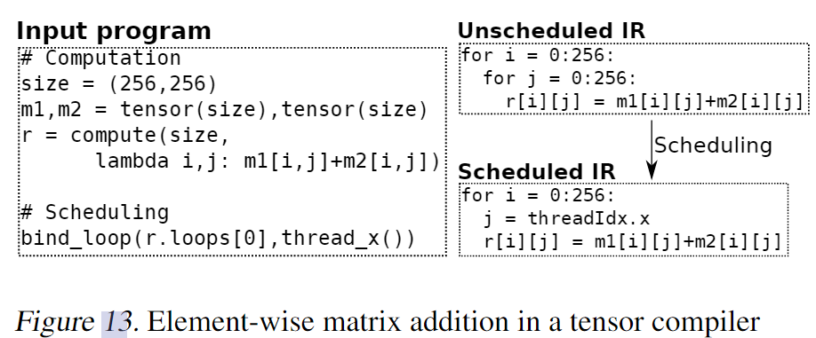
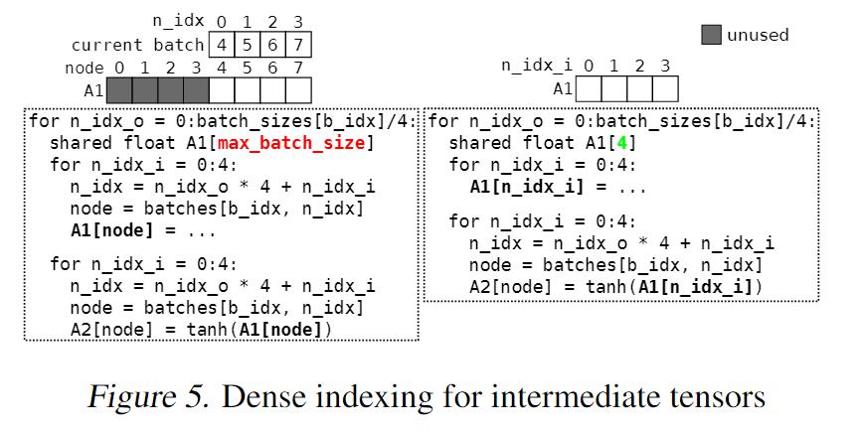
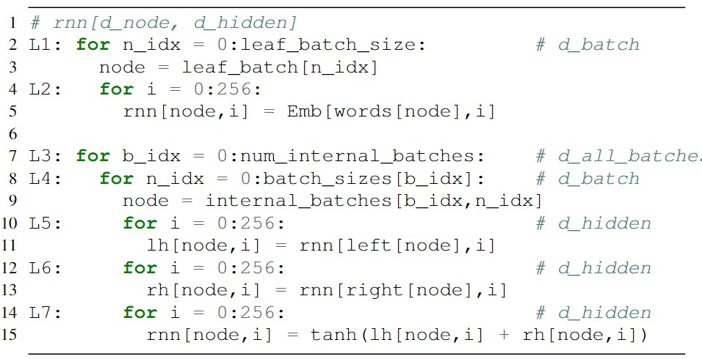
Irregular Loops IR (ILIR) - Indirect Memory Accesses

Slide 13
Irregular Loops IR (ILIR) - Conditional Operator
为了降低模型中的isleaf检查等条件检查，我们向ILIR添加了一个条件操作符。它接受两个子图和一个条件检查作为输入，并降低为if语句。如果用户没有专门化叶子检查，则会在ILIR中为我们正在运行的示例生成条件操作符。
Loop Peeling: The generated ILIR in CORTEX involves loops with variable loop bounds. Splitting such loops gives rise to bounds checks in the bodies of the loops. We employ loop peeling to ensure that such checks are only employed for the last few iterations of the loop.Rational Approximations of Nonlinear Functions: We use rational approximations for the tanh and sigmoid functions, which makes exploiting SIMD instructions on CPUs easier.

Slide 14
Implemention
RA Lowering: As part of RA lowering, we have implemented support for dynamic batching and specialization, for the common case of leaf checks.
ILIR Lowering: We extend TVM (Chen et al., 2018a) v0.6, a deep learning framework and a tensor compiler. Our current prototype implementation does not perform autoscheduling on the generated ILIR. Therefore, the model implementations used for evaluation were based on manuallydefined schedules. We then performed auto-tuning via grid search to search the space of certain schedule parameters. Prior work on auto-scheduling is complementary to our techniques, and could readily be applied to the prototype.
Data Structure Linearizers: We implemented data structure linearizers (one each for trees and DAGs) for our evaluation. We use a numbering scheme, described in § B of the appendix, for data structures nodes that generally reduces the costs of leaf checks and iterating over batches.

