Slide 1
NIMBLE: EFFICIENTLY COMPILING DYNAMIC NEURAL NETWORKS FORMODEL INFERENCE

Slide 2
Challenges
An IR for representing dynamism
A set of dynamic-oriented optimizations
A symbolic kernel code generator
A light-weight and cross-platform runtime.

Slide 3
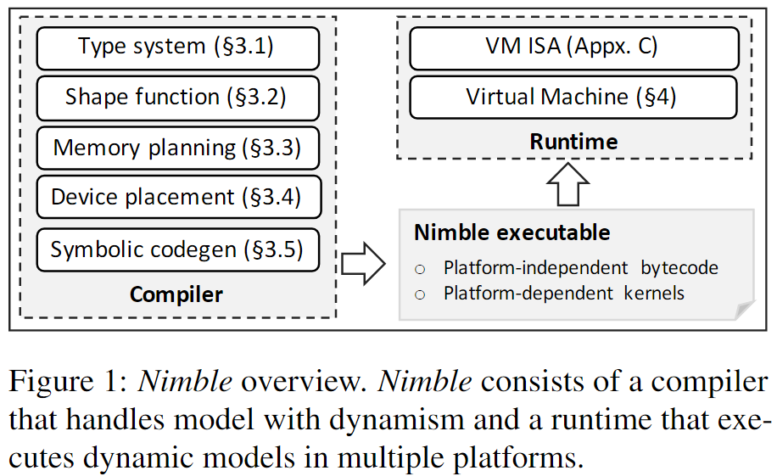
Approaches
Supporting dynamic models
Being portable and light-weight
Enabling high performance

Slide 4
An extended type system which enables static tracking of dynamic shapes
A series of optimization passes that make dynamic output shapes, allocation, and device placement explicit
A set of codegen techniques for producing code of kernels with dynamic input and output shapes.

Slide 5
Typing
Operator Type Relationship
A type relation describes the relationship between types of operator inputs and outputs.
broadcast_rel(Any, 1) → Any
broadcast_rel(Any, d) → d (d > 1)
broadcast_rel(Any, Any) → Any
Type Inference
To limit the loss of precision introduced by using Any dimensions, we introduce sub-shaping to the type system.
Tensor[(128, 128), f32] --> Tensor[(any, 128), f32]

Slide 6
Shape Function
Compute the output shape for storage allocation and verify the type relation in accord with the semantics of every operator.
data independent, data dependent, and upper bound.
To avoid the redundant computation, we use an upper bound shape function to quickly estimate an upper bound shape for the output. We require such operators to return the output shape along with output value, so as to use the real shape to slice the output tensors into precise output shape and layout
Notes:
为了避免冗余计算，我们使用上界形状函数来快速估计输出的上界形状。我们要求这些运算符将输出形状连同输出值一起返回，以便使用真实的形状将输出张量切割成精确的输出形状和布局。

Slide 7
Memory Planning
extended TVM to transform its IR with implicit memory allocations to one with explicit buffer allocation and manipulation.
(a) invoke_mut(op, inputs, outputs)which takes outputs as mutable in-out arguments,
(b) alloc_storage(size, alignment, device)which allocates a region of memory of a particular size,
(c) alloc_tensor(storage, offset, shape, dtype, attrs) which allocates a tensor at a particular storage offset with a shape and data type,
(d)kill(tensor) which frees a tensor before its reference count becomes zero due to exiting the frame.

Slide 8
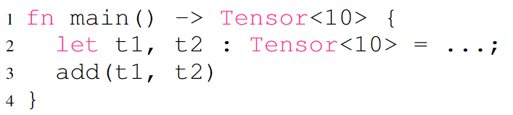
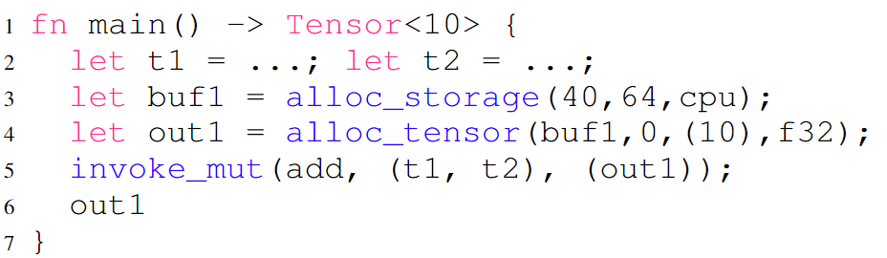

Slide 9
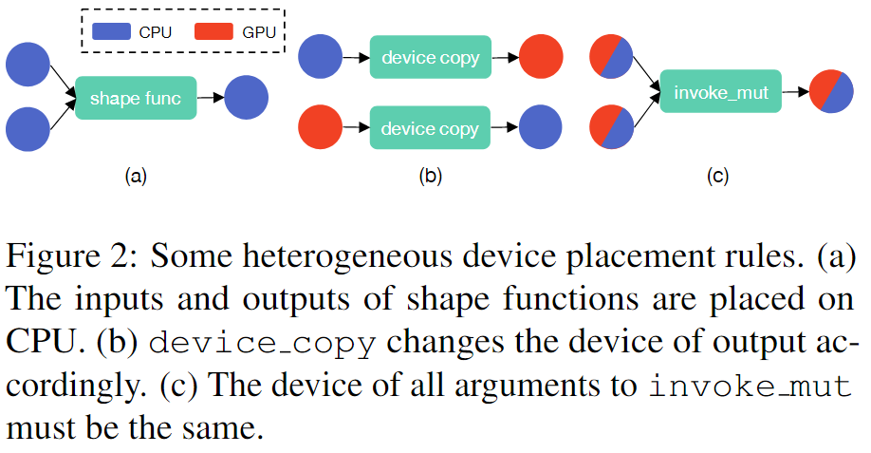
Heterogeneous Device Placement
introduce a unification based analysis for computing the correct device placement and allocation based on the previous scheduling of the compute kernels
DeviceDomain: represents the domain of a device
device_copy: represents a data transfer between different devices and is inserted when a cross-device data copy is mandatory
Notes:
我们的分析被表述为一组设备放置规则，这些规则描述了设备约束如何流动，然后我们使用(unification)统一，这是一种在类型推理和编译器中常见的技术，来计算精确的设备放置

Slide 10
Symbolic Codegen
Challenges:
How to achieve the same performance of kernels generated with symbolic shapes as that with static shapes when applying the same schedule?
How to extend the machine learning based approach to tune kernels with symbolic shapes?
1. First replace the symbolic dimensions by a large enough value (e.g., 64) so that the search space can cover most possibilities, and run the tuning algorithm on the static shape for a sufficient number of iterations.
2. Pick top k configurations, apply them to a selection of other shapes, and evaluate their performance.
3. Pick the configuration that performs best on average among shapes previously evaluated.

Slide 11
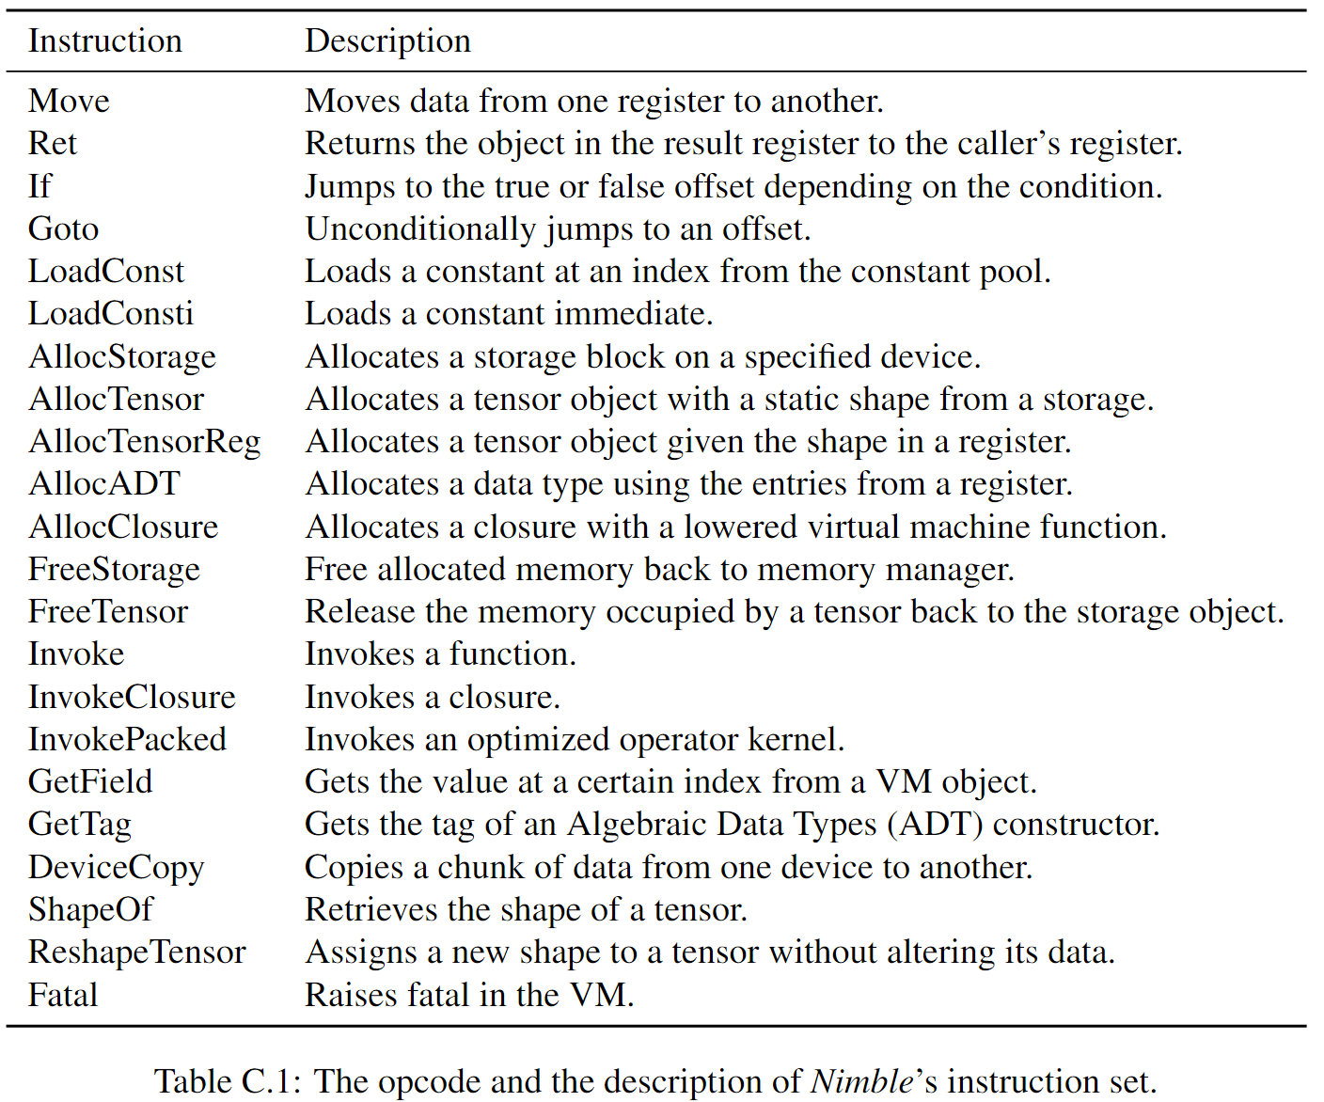
VIRTUAL MACHINE
The conventional runtime of existing deep learning compilers which naively executes a model operator by operator in topological order does not work for executing the compiled modules of dynamic models.
Notes:
现有深度学习编译器的传统运行时是按拓扑顺序天真地执行一个操作符一个操作符的模型，不适用于执行已编译的动态模型模块

