Slide 1
DietCode: Automatic Optimization For Dynamic Tensor Programs

Slide 2
Introduction
The key challenge faced by existing auto-schedulers when handling a dynamic-shape workload is that they cannot construct a unified search space for all the possible shapes of the workload, because their search space is shape-dependent.
Find and address the key challenges in making auto-scheduling practical for the important class of dynamic shape workloads by using a shape-generic search space.
Build DietCode, a new auto-scheduler framework for dynamic-shape workloads that adopts the joint learning approach that optimizes all the possible shapes of the workload collectively within the same shape-generic search space, and learns the same shape-generic cost model.

Slide 3
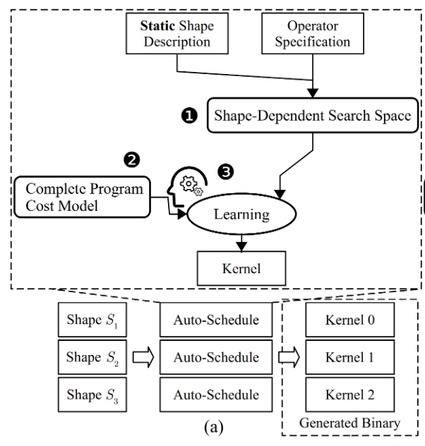
Background and Motivation
Vendor Libraries and Existing Auto-Schedulers
in-depth expertise across the software and hardware stacks;
significant amount of engineering effort which lead to prolonged release cycle for vendor libraries to support new operators on new hardware
Static!

Slide 4
Background and Motivation
Dynamic Tensor Programs
Neural architecture search
A predefined search space of hyperparameters.
Dynamic by design
Sequence learning domain: Each sequence length again corresponds to a network of layers with distinct shapes.
Varying shapes with different layer positions
Operator classes can exhibit distinct shapes at different positions of the model.

Slide 5
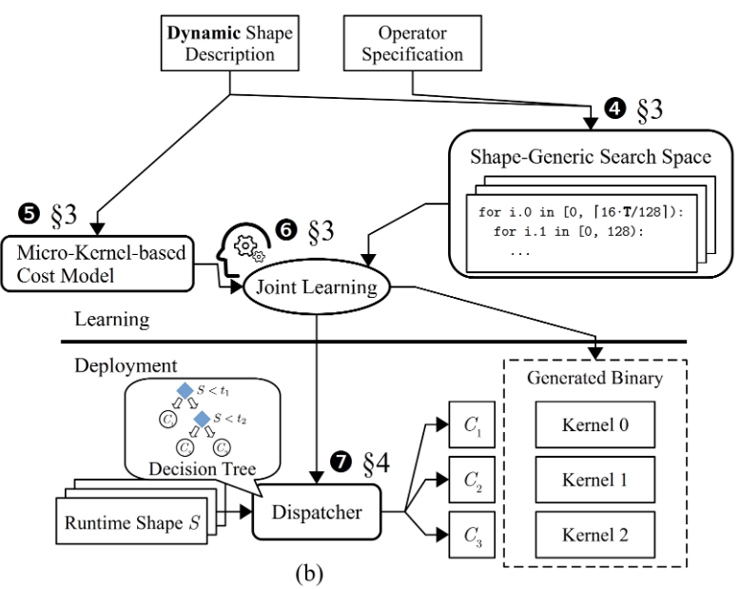
Background and Motivation
Why A New Auto-Scheduler Framework?
Vendor libraries
sub-optimality: redundant compute operations; latency stair-casing.
Existing Auto-schedulers
Extensions based on the existing auto-schedulers
Selective tuning heuristically groups static-shape workloads into clusters and optimizes for each cluster separately ---- expertise, not fully auto.
Nimble ---- a large shape->sub-optimal
Bucketing ---- extra padding and slicing operations; many computations are useless.

Slide 6
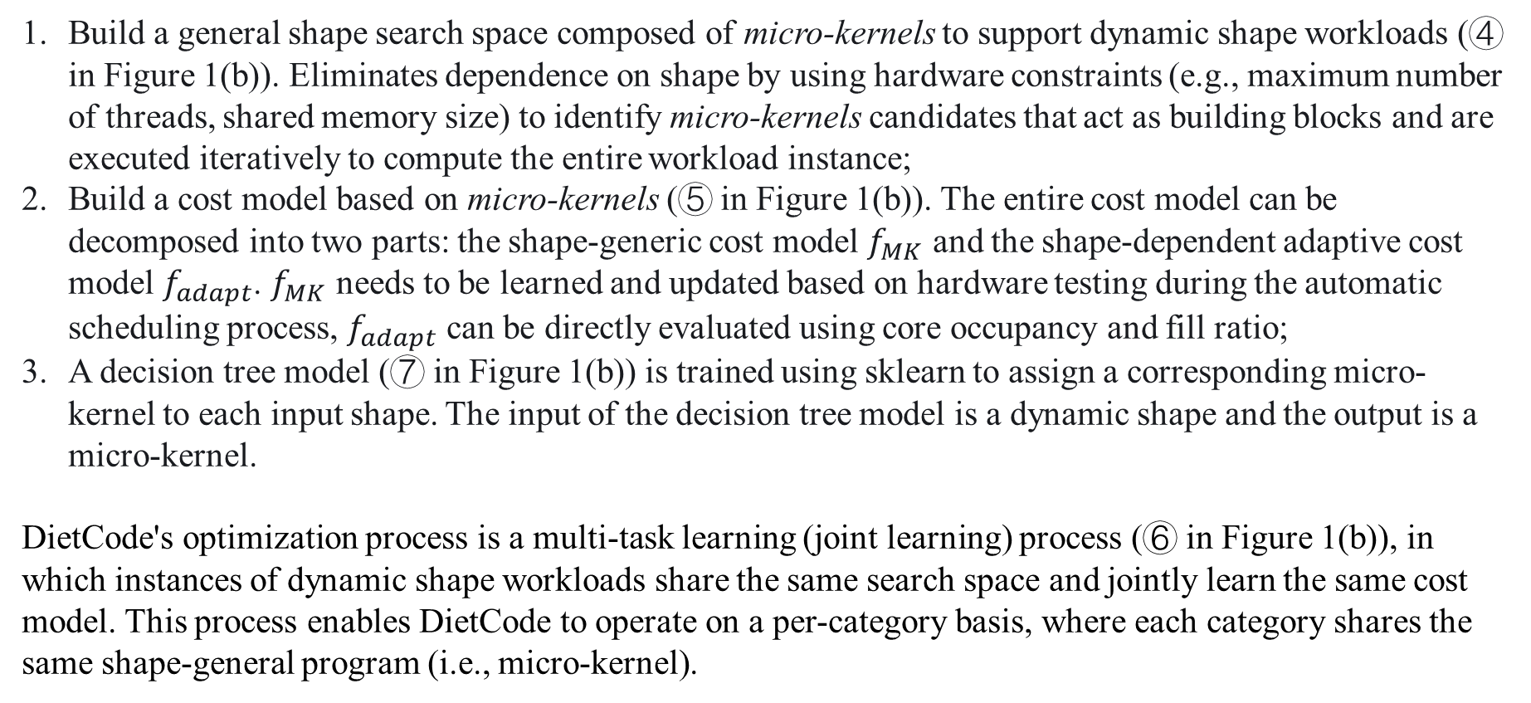
Joint Learning with DietCode
Build a general shape search space composed of micro-kernels to support dynamic shape workloads (④ in Figure 1(b)). Eliminates dependence on shape by using hardware constraints (e.g., maximum number of threads, shared memory size) to identify micro-kernels candidates that act as building blocks and are executed iteratively to compute the entire workload instance;
Build a cost model based on micro-kernels (⑤ in Figure 1(b)). The entire cost model can be decomposed into two parts: the shape-generic cost model $f_{MK}$ and the shape-dependent adaptive cost model $f_{adapt}$. $f_{MK}$ needs to be learned and updated based on hardware testing during the automatic scheduling process, $f_{adapt}$ can be directly evaluated using core occupancy and fill ratio;
A decision tree model (⑦ in Figure 1(b)) is trained using sklearn to assign a corresponding micro-kernel to each input shape. The input of the decision tree model is a dynamic shape and the output is a micro-kernel.
DietCode's optimization process is a multi-task learning (joint learning) process (⑥ in Figure 1(b)), in which instances of dynamic shape workloads share the same search space and jointly learn the same cost model. This process enables DietCode to operate on a per-category basis, where each category shares the same shape-general program (i.e., micro-kernel).

Slide 7
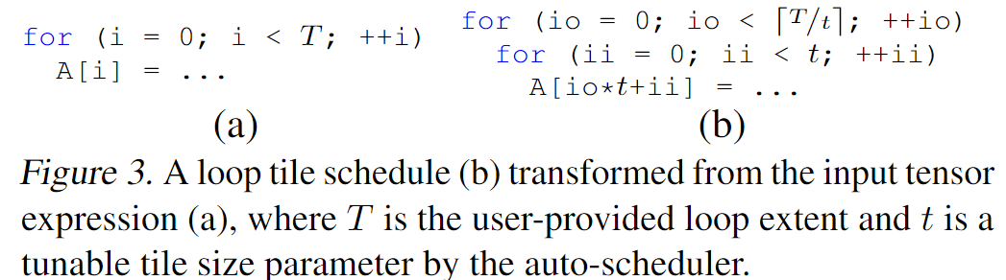
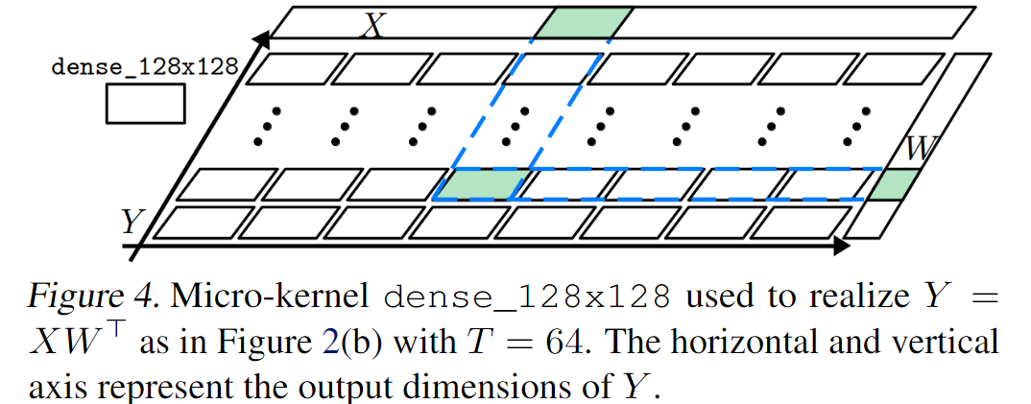
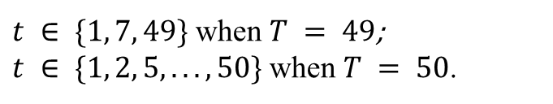
Shape-Generic Search Space
$t ∈ \{1, 7, 49\}$ when $T = 49$;
$t ∈ \{1, 2, 5, . . . , 50\}$ when $T = 50$.

Slide 8
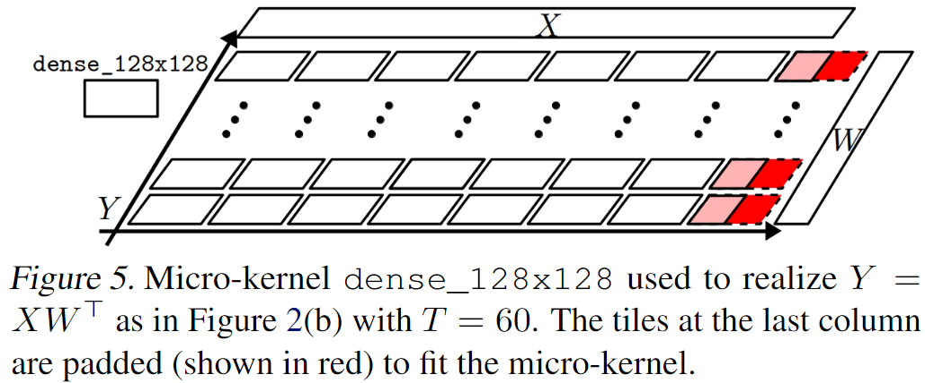

Slide 9
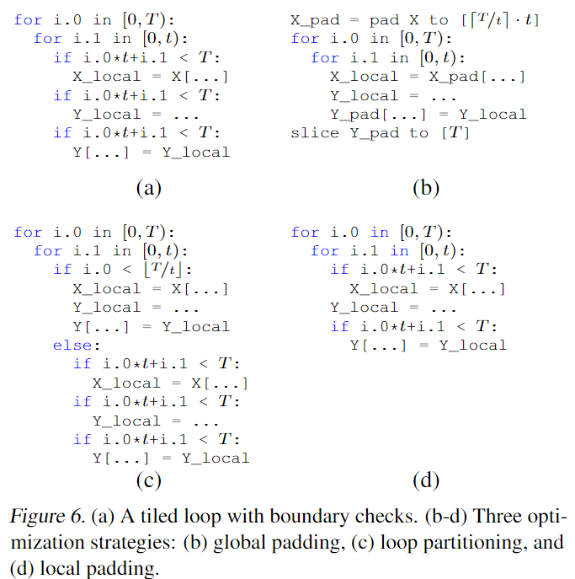
Local Padding
Global padding. Bounds checking can be eliminated during kernel calculations, but pad and slice require additional storage and calculations;
Loop partitioning. It is divided into the eliminable area and the non-eliminable area for boundary checking, and it will only benefit when t << T;
Local padding. Keep bounds checking in the fetch from memory and write back phases, while removing bounds checks in the computation phase (the computation phase has the main impact, the fetch from memory and write back phases can be hidden by memory transfer delays).

Slide 10
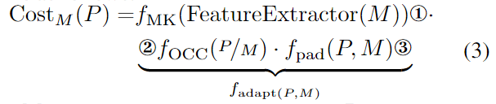
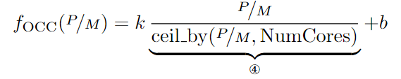

Micro-Kernel-based Cost Model
① the performance of the micro-kernel;
② the hardware core occupancy penalty, which correlates to the number of times this micro-kernel is executed to compose the complete program;
③ the padding penalty

Slide 11
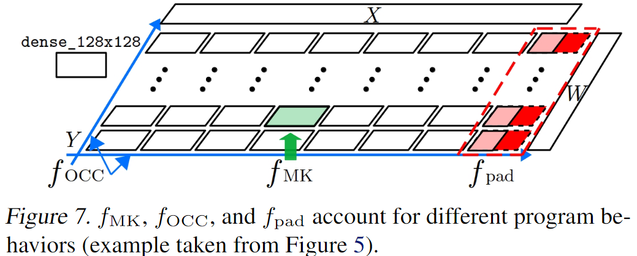
Micro-Kernel-based Cost Model

Slide 12
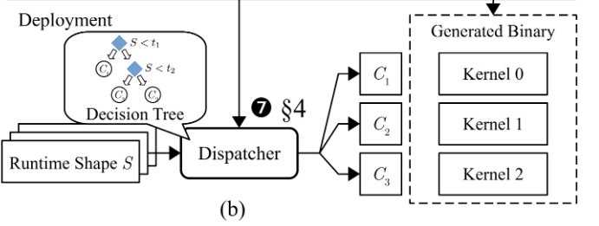
Automatic Dispatching
The input to the decision tree is all the possible shapes and the output labels are their selected micro-kernels.
The generated decision tree automatically categorizes shapes that select the same micro-kernel together, and is exported in the C-style source code format for efficient dispatching from the input shape to its corresponding micro-kernel at runtime.

Slide 13
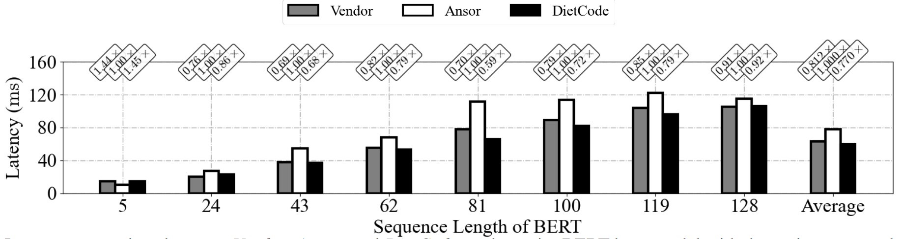
EVALUATION

