Slide 1
Chameleon: Adaptive Code Optimization for Expedited Deep Neural Network Compilation

Slide 2
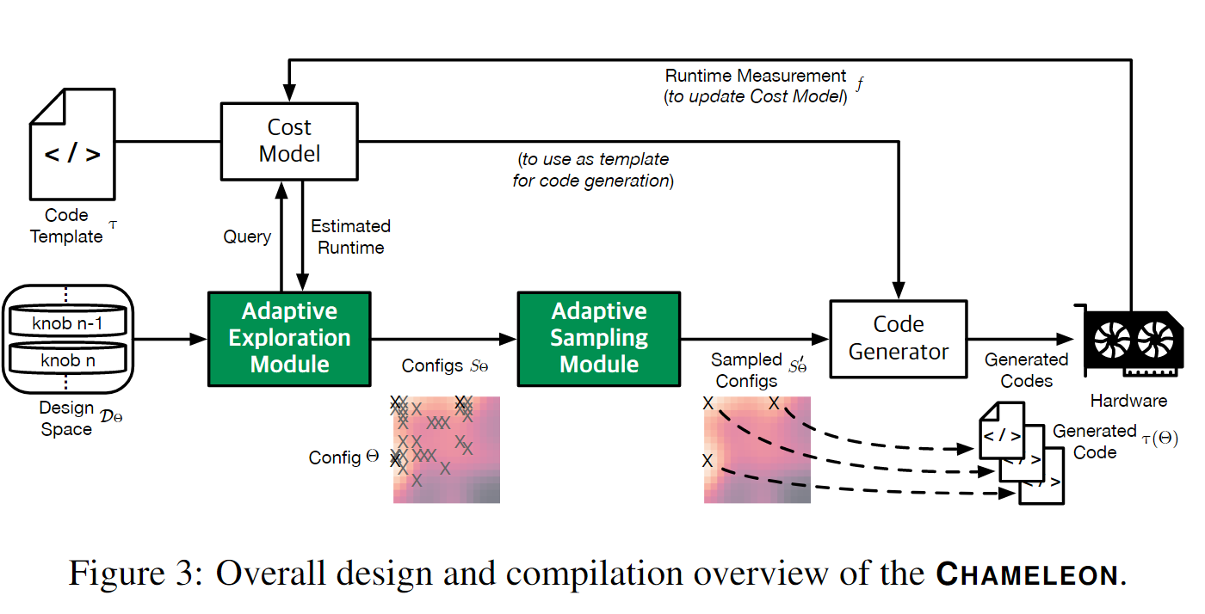
Chameleon(变色龙)是一种能够适应环境的动物，这有助于它们生存。 在这篇论文中，CHAMELEON 是一个适应设计空间的变化和候选配置分布的实体，能够加速深度神经网络编译。

Slide 3
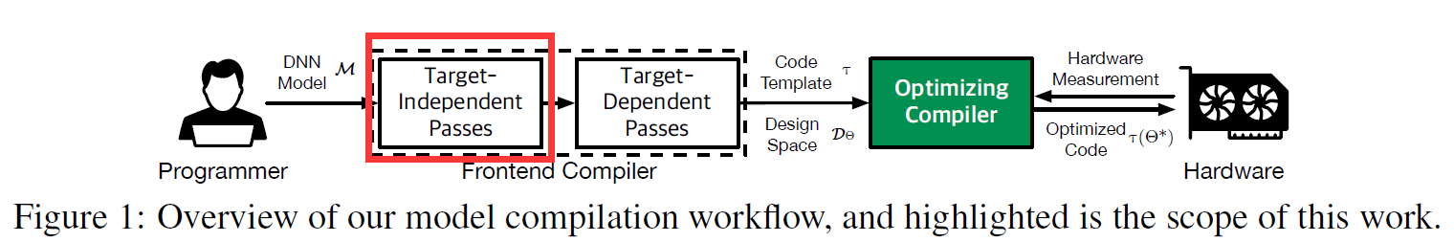
Model Complation Workflow
Target-independent Pass
Optimizations in code model semantics + traditional compiler frontend Optimizations
Operator fusion, data layout transformation
Dead code elimination, constant folding, ...

Slide 4
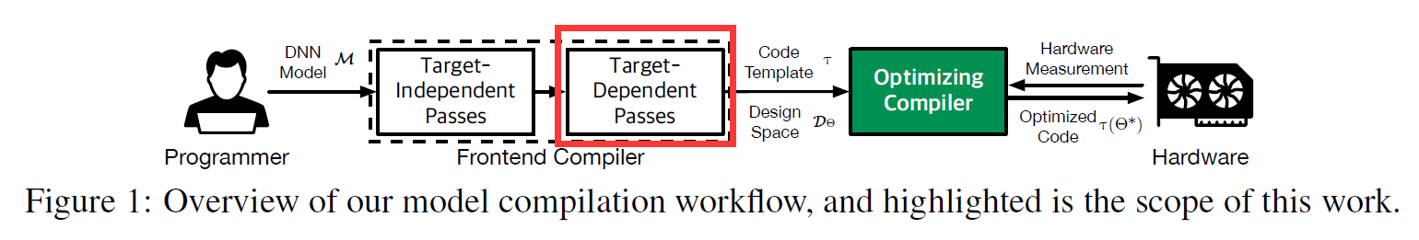
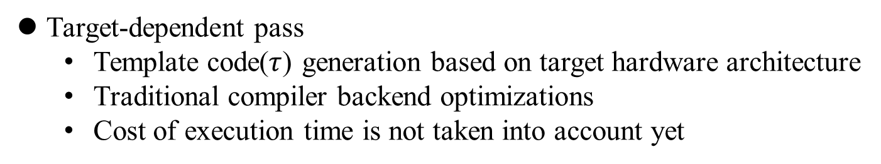
Model Complation Workflow
Target-dependent pass
Template code($τ$) generation based on target hardware architecture
Traditional compiler backend optimizations
Cost of execution time is not taken into account yet

Slide 5
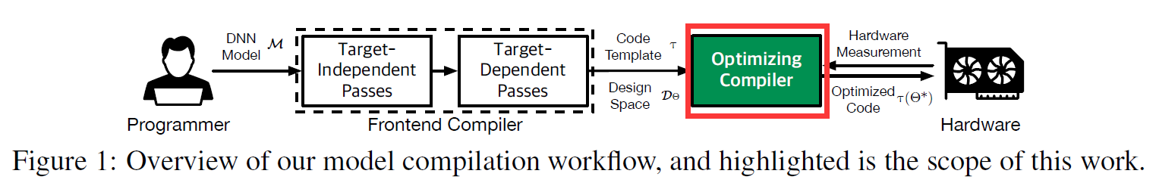
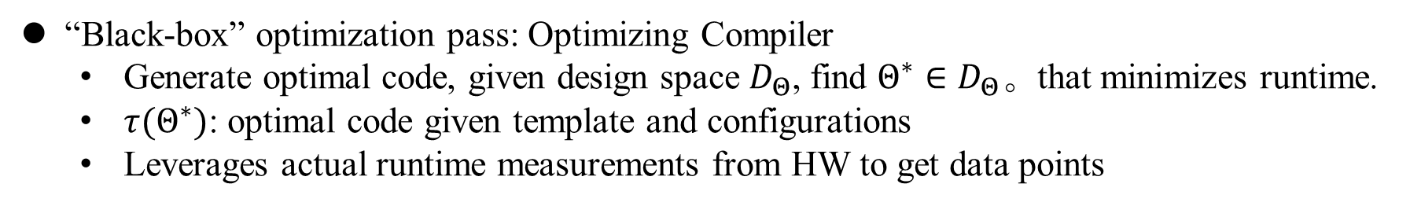
Model Complation Workflow
“Black-box” optimization pass: Optimizing Compiler
Generate optimal code, given design space $D_{Θ}$, find $Θ^{∗}∈D_{Θ}$。that minimizes runtime.
$τ(Θ^{∗})$: optimal code given template and configurations
Leverages actual runtime measurements from HW to get data points

Slide 6
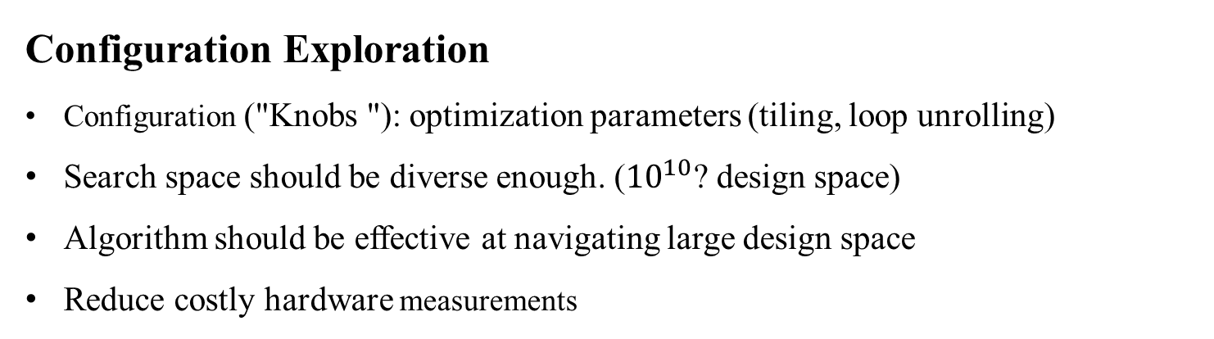
Optimizing Compiler: Components and Requirements
Configuration Exploration
Configuration ("Knobs "): optimization parameters (tiling, loop unrolling)
Search space should be diverse enough. (${10}^{10}$? design space)
Algorithm should be effective at navigating large design space
Reduce costly hardware measurements
Cost Estimation
Estimate runtime (fitness) based on code. (Same as AutoTVM)
Avoid overfitting to specific set of configurations

Slide 7
Optimizing Compiler: Previous approaches
Configuration Exploration
Hand-optimized libraries, compiler heuristics
Genetic algorithm (TensorComprehension)
Stochastic methods (Simulated annealing - AutoTVM)
Diversity-aware exploration (AutoTVM)
Cost Estimation
Actual HW measurements
ML-based approach
XGBoost(GBT)/TreeGRU- AutoTVM, Chameleon
GNN + LSTM/Transformer- XL A

Slide 8
Optimizing Compiler: Components and Requirements
Configuration Exploration
Takes too much iterations and time
Similar configurations -> redundant calculations -> waste of computing resource
Invalid randomly sampled configuration -> hardware failure -> reset time needed
Cost Estimation
Greedy sampling based on cost model -> hard to explore untried configs

Slide 9
Chameleon: Key contributions in Configuration Exploration
Adaptive Exploration
RL based approach - novel method in this domain
Adapt to unseen design space
Adaptive Sampling
Clustering of similar configurations: reduce redundant calculations
Sample synthesis domain knowledge: generate novel configurations that are non-invalid, by taking “safe” choices
Result:
4.45x improvement in optimizing compilation time
5.56% improvement in inference time (Vs. AutoTVM)

Slide 10
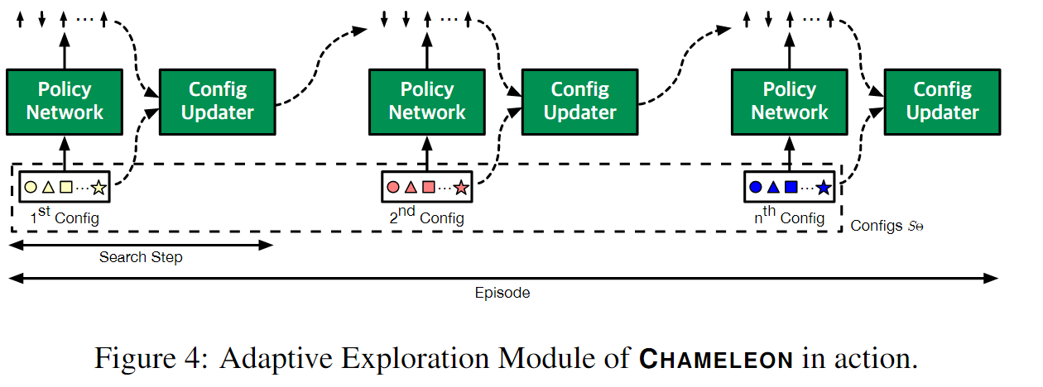
Adaptive Exploration
Actor-critic style RL
“actor” proposes config updates (turn each “knob” up/down/stay)
“critic” gets fitness (predicted execution time) as reward, and then gives “actor” a feedback.
Critic learns design space while getting reward and giving feedback

Slide 11
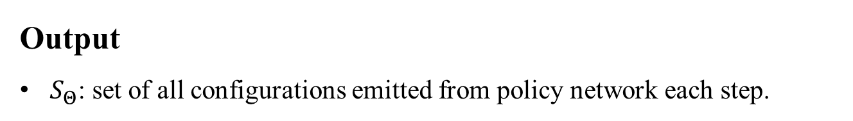
Adaptive Exploration
Policy network suggests good configurations as the iteration goes
Value network assists this by learning value function: design space -> fitness
Used PPO(Proximal policy optimization) algorithm
Performed architecture search to find tradeoff between performance VS network latency
Output
$S_{Θ}$: set of all configurations emitted from policy network each step.

Slide 12
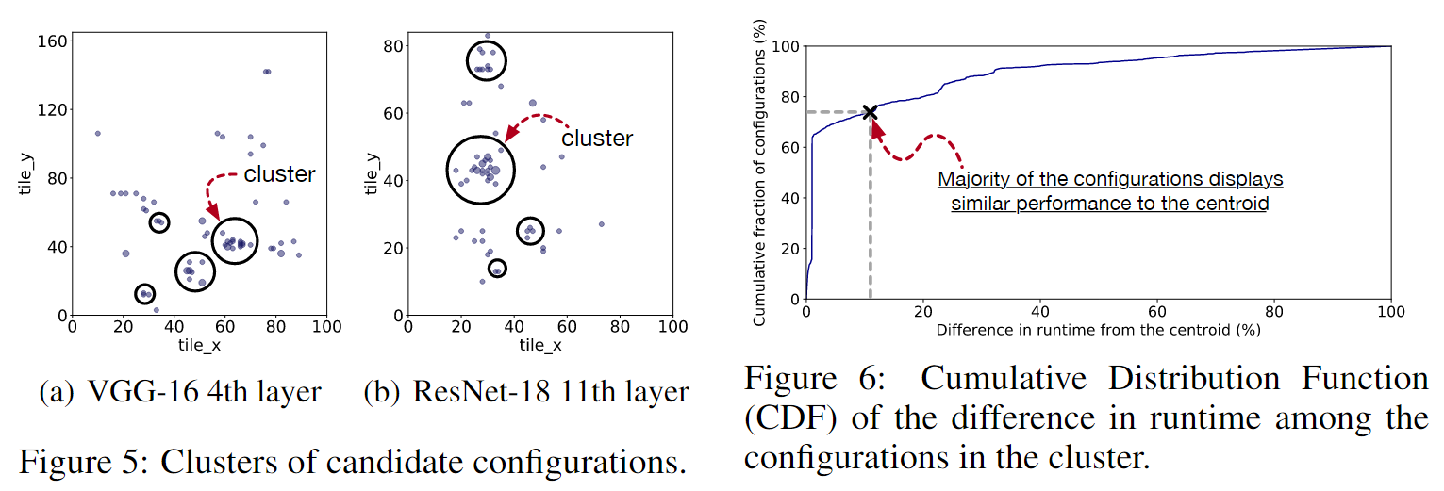
Adaptive Sampling
Explored configurations are clustered
For each cluster, most of configurations has runtime really close to the centroid configuration (80% of configs has 20% diff)

Slide 13
Adaptive Sampling: Sample Synthesis
K-means remove redundancy within iteration
Overfit cost model preferes already seen configurations -> redundancy among iterations when greedily sampling best configurations.
Unvisited regions will usually have lower fitness, and thus ignored
Randomly generated new samples would be often invalid. ex) too large tile -> memory error. -> H/W reset required
When a config is already explored - replace with mode of proposed configurations(S)

Slide 14
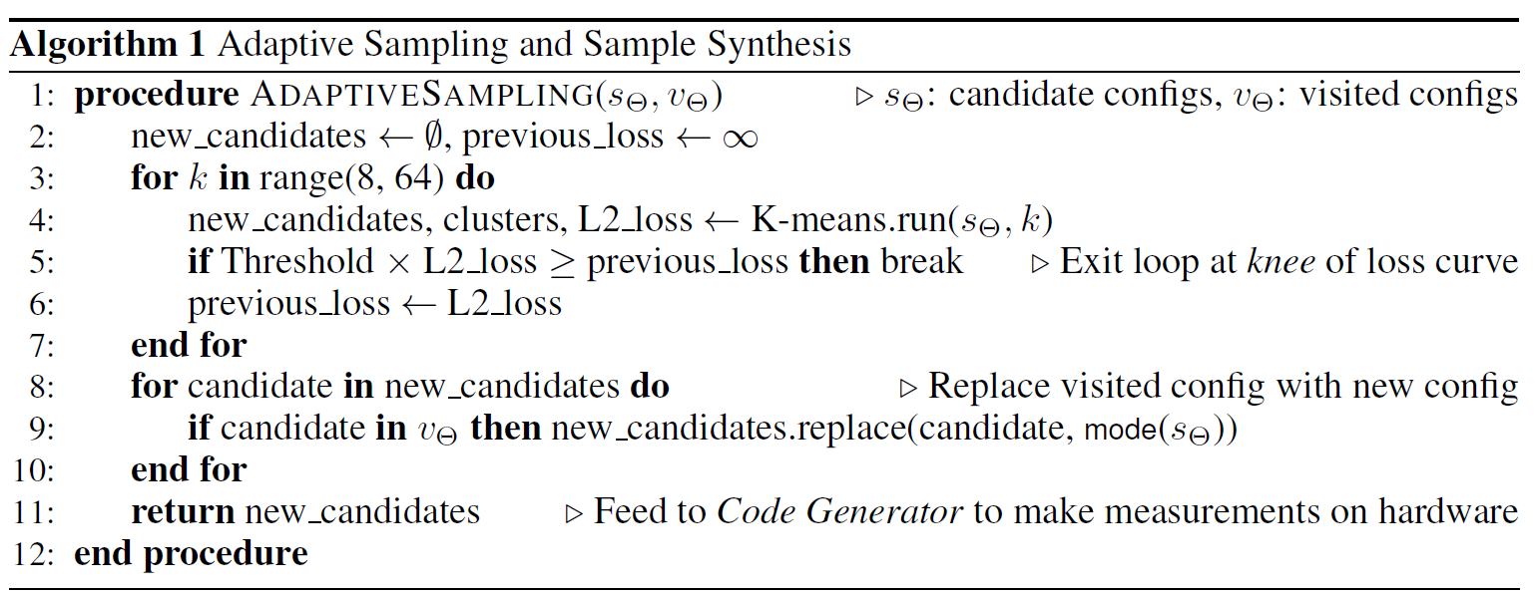

Slide 15
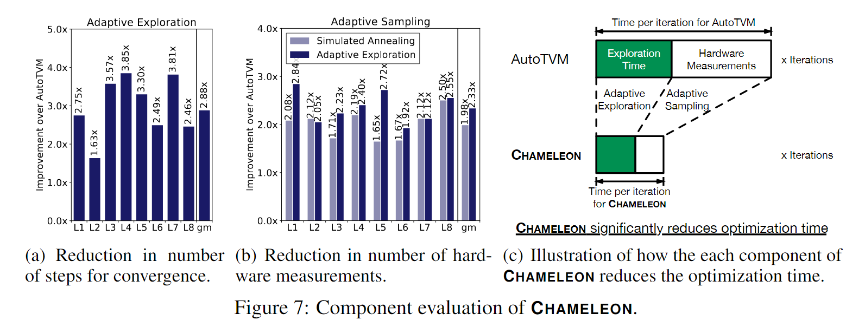
Results

Slide 16
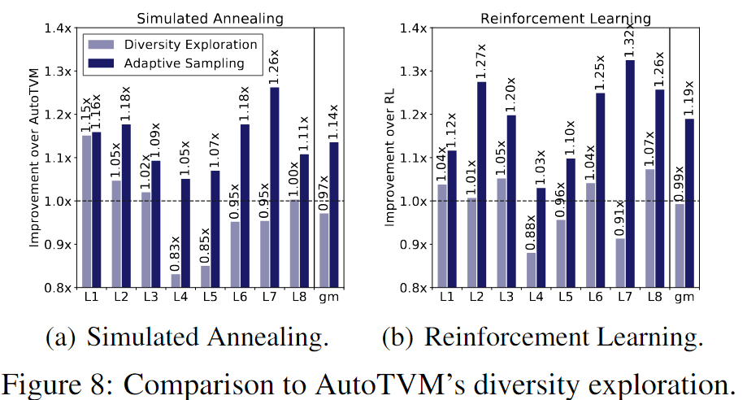
Results

Slide 17
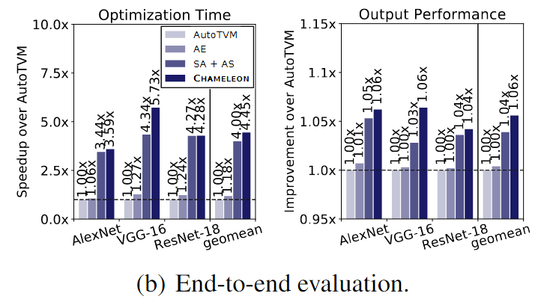
Results

Slide 18
Limitations
RL seems noble, but not so much improvement (1.18x) despite significant reduction in number of steps (2 .88x)
Runtime performance improvement is also not impressive with RL only. Value network can't generalize its value function beyond what it has seen.
Limited result in pretty simple convolution models. Not sure if it can begeneralized to more complex models (e.g. NASNet, Inception)
Only convolution performance is considered - maybe MatMul is already highlyoptimized?

Slide 19
