Slide 1
Glimpse: Mathematical Embedding of Hardware Specification for Neural Compilation
Notes:
DCL

Slide 2
Introduction
在深度学习编译领域当中，硬件厂商所提供的手动调优库（cuNN or Intel MKL）是深度学习框架的后端，用来达到DNN当中更高的性能。然而，在最近的编译器研究当中跳过了这种方法，而采用了随即搜索算法进行调优。也诞生了许多相关简化搜索空间或提高搜索速度的研究，但这种方式终究是一种黑盒优化，都会花费大量的代价。在当前的研究的范例（paradigm）中，与硬件无关的神经编译器需要花费hours, even days, weeks来优化一个小模型。
因此这篇论文尝试提出一种新的方式，一种带有更高洞察力（perception）的新方式；就好像瞥一眼Blueprint就能更好的指导搜索算法。
作者首先使用Blueprint生成一组不同维度搜索空间的先验分布。然后又设计了一个轻量级的neural acquisition function，该函数使用Meta-Learning-based的算法学习，该算法在权衡Exploration-Exploitation的同时考虑了Blueprint与硬件的一致性。最后，作者从Blueprint中生成一个预测器集合，这些预测器共同投票否决无效的二进制样本。

Slide 3
Challenges
Neural Compilation for Model Deployment
black-box;
search spaces 𝑆 is astronomically large;
search spaces are not differentiable, and the optimal configurations are sparsely distributed throughout the search space making;
Challenges and Opportunities in Neural Compilation
narrow focus on a single hardware - formidable task: n tuned version for n hardware;
ignore and reuse the optimized configuration from another hardware – not desired result;
Transfer learning – performance degradation;
One tuned for one hardware – costly, and constant evolution;
hardware-awareness!!!

Slide 4
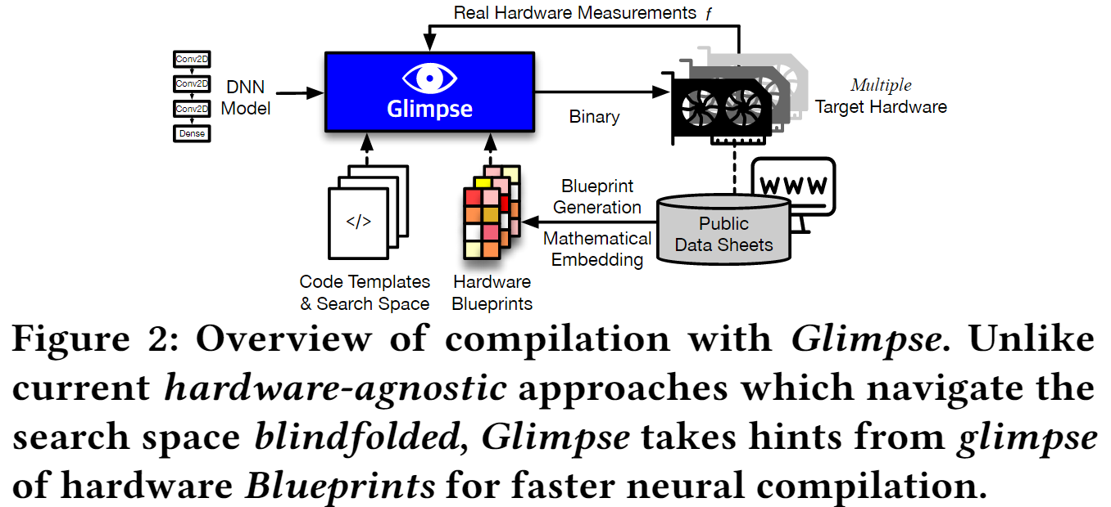
Glimpse - Overview

Slide 5
Glimpse - Blueprint
Blueprint: the mathematical embedding of the hardware specification of the GPU accelerators.
Design
a novel abstraction of the hardware;
Two key consideration: (i) minimizing the loss of information; (ii) maintaining low overhead;
perform a dimensionality reduction of the original feature vectors using Principal Component Analysis (PCA) to get get the minimal mathematical embedding vector that summarizes the hardware;
DNN-self dim-reduction.
Prior distribution generation from Blueprint
Consider neural compilation as a Bayesian optimization problem – original is ineffective;
Use Blueprint to speedup Bayesian optimization;

Slide 6
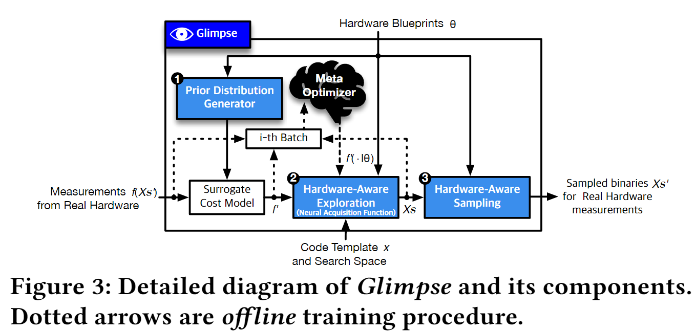
Glimpse – Hard-ware Exploration
Past work
the cost model - significant number of real hardware measurements;
Reuse in different hardware – sub-optimal;
Glimpse
leverages the information encapsulated in Blueprints to improve the hardware-awareness of the exploration process.
Meta-Optimizer;

Slide 7
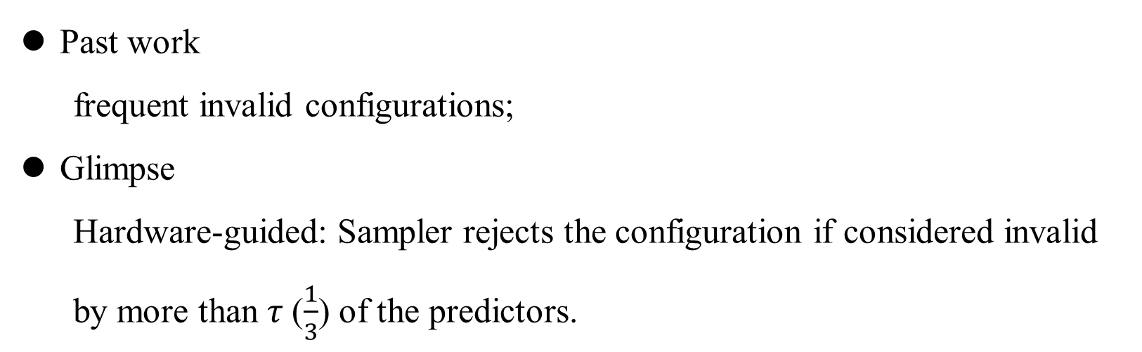
Glimpse – Hard-ware Sampling
Past work
frequent invalid configurations;
Glimpse
Hardware-guided: Sampler rejects the configuration if considered invalid by more than 𝜏 ($\frac{1}{3}$) of the predictors.
Light-weight predictors – two reasons.

Slide 8
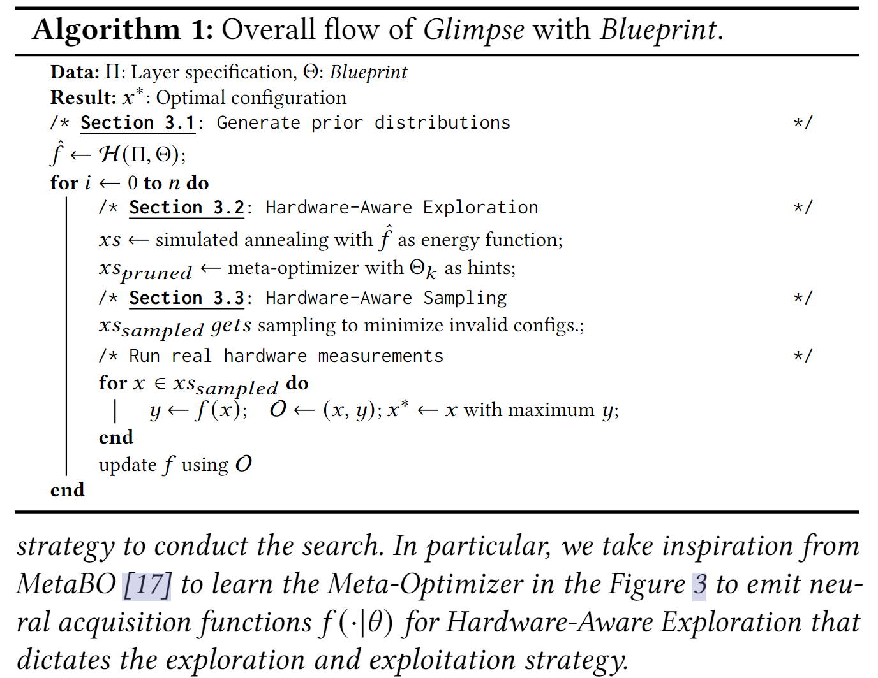
Glimpse – Overall Flow

Slide 9
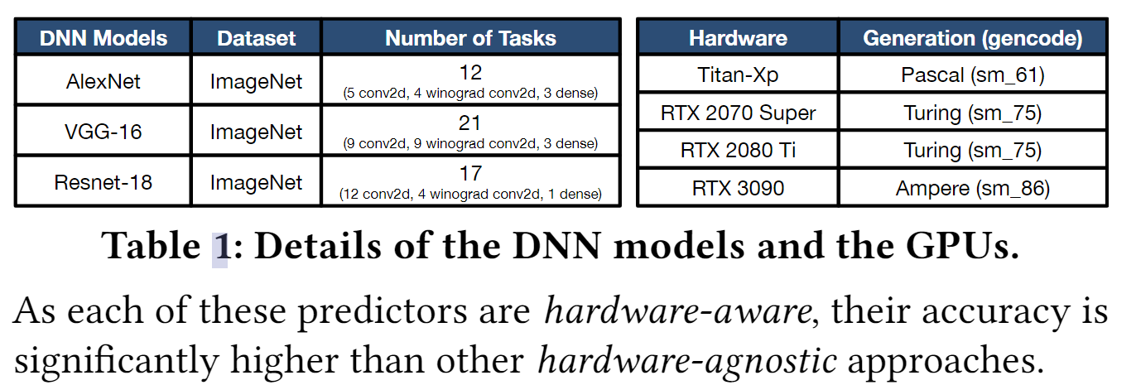
Evaluation – Models and GPUs

Slide 10
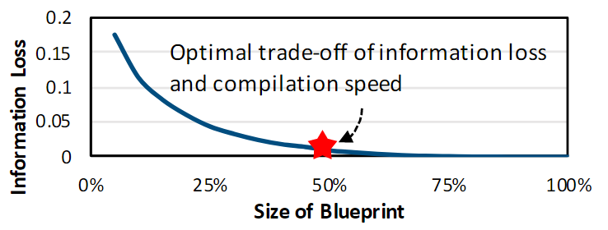
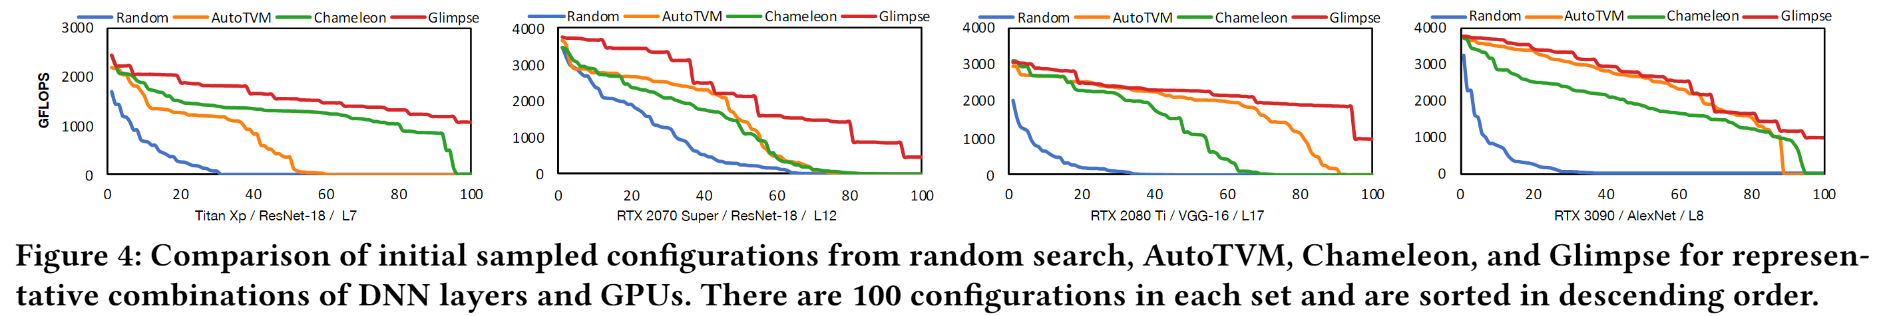
Evaluation - Blueprint

Slide 11
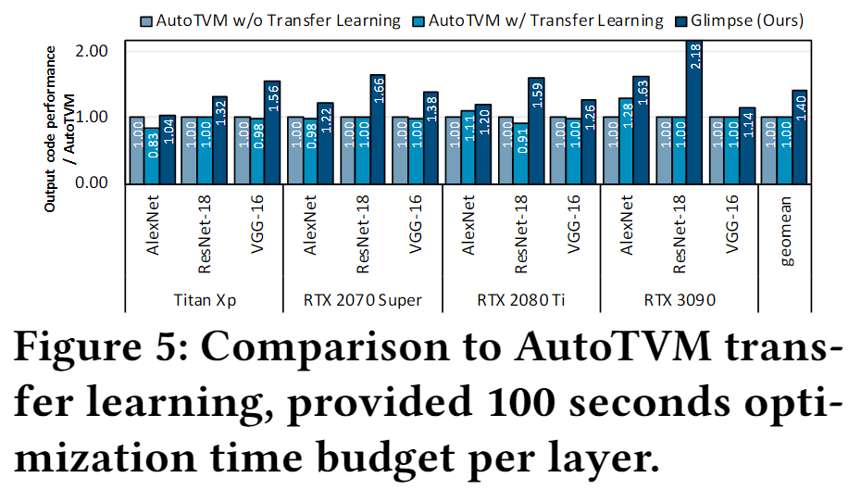
Evaluation - Blueprint

Slide 12
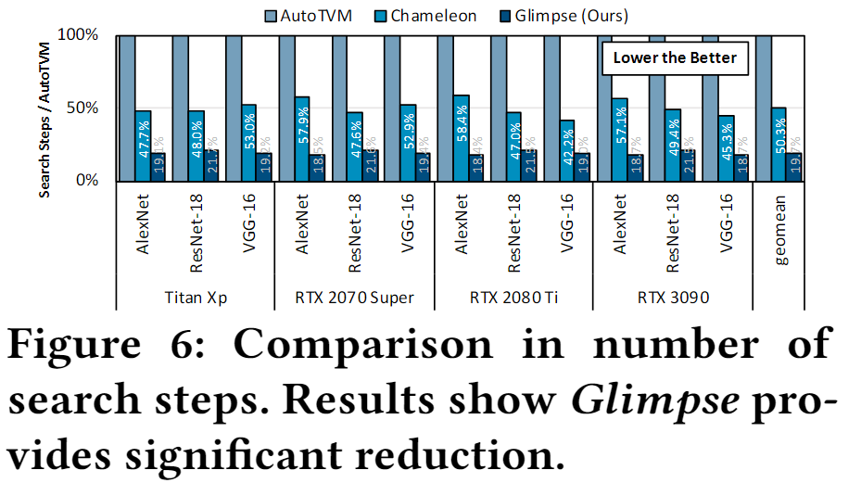
Evaluation – Hard-ware Exploration

Slide 13
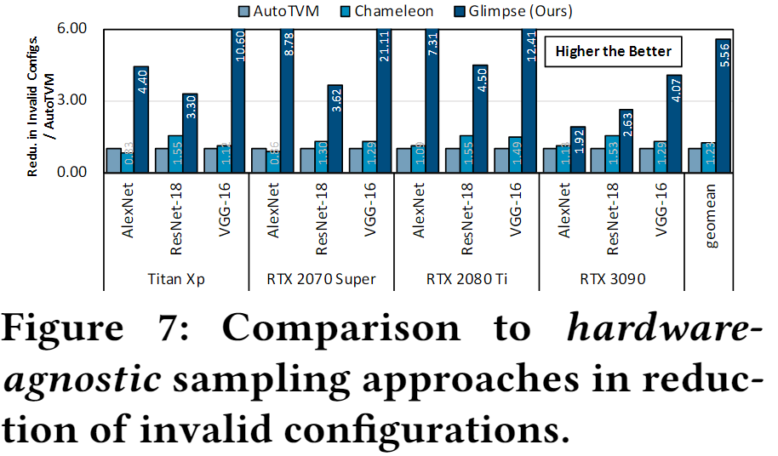
Evaluation – Hard-ware Sampling

Slide 14
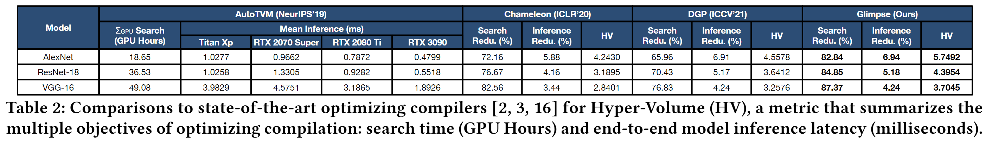
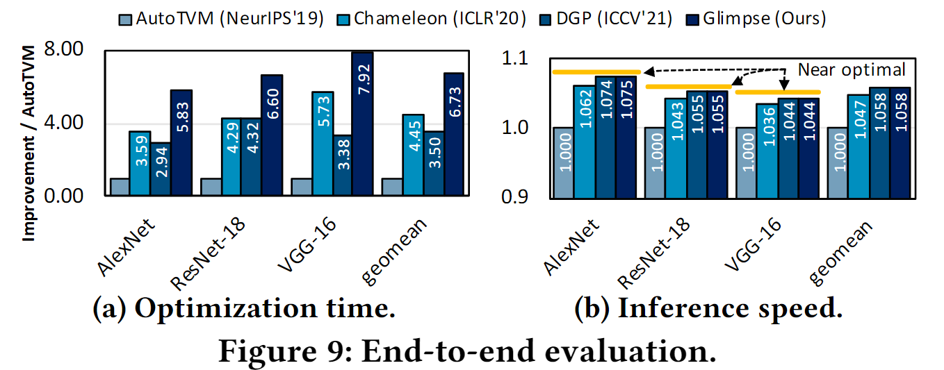
Evaluation - Together

Slide 15
Related works
Nerual compilers
AutoTVM, GGA, and Chameleon explored simulated annealing, guided genetic algorithm, and reinforcement learning to further improve the search efficacy.
《Fast and Efficient DNN Deployment via Deep Gaussian Transfer Learning》 explored deep Gaussian process to transfer knowledge to different layers on a single target GPU
Meta-learning for neural compilation
MetaBO explored meta-learning in the context of Bayesian optimization for more sample efficient optimiation. In the context of neural compilation;
MetaTune leverages metalearning to expedite the convergence of the cost models.

