Slide 1

Lorien: Efficient Deep Learning Workloads Delivery

Slide 2
Introduction
How to promptly deliver schedules with reasonably good performance upon user requests?
- Tune in advance, and store into a database or file system.
Challenges:
Tuning Process Scalability and Stability
Tuning Result Management
Time to Deliver an Efficient Schedule
Lorien = dialect + distribute system + general data model(Database) + zero-shot tuning&AutoML

Slide 3
Background
Template-based auto-tuning frameworks
AutoTVM and FlexTensor - leverage operator-based schedule templates written by domain experts.
One workload one tuning task;
Parallel;
Reusability.
Auto-scheduling frameworks
Tensor Comprehensions and Halide auto-scheduler - generates schedules by directly analyzing the model graph. (only be applied to the model it was generated from)
Ansor - partitions the model graph into several subgraphs.
subgraphs in parallel.
shared with the identical subgraph in another model.

Slide 4
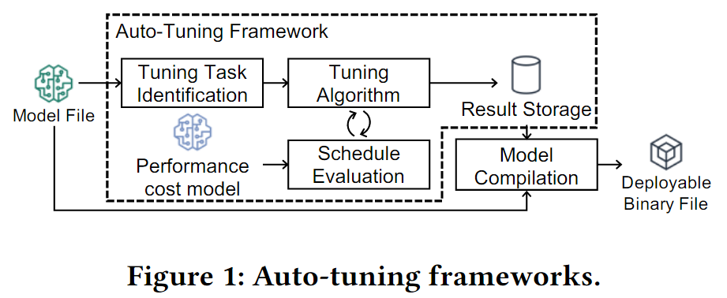
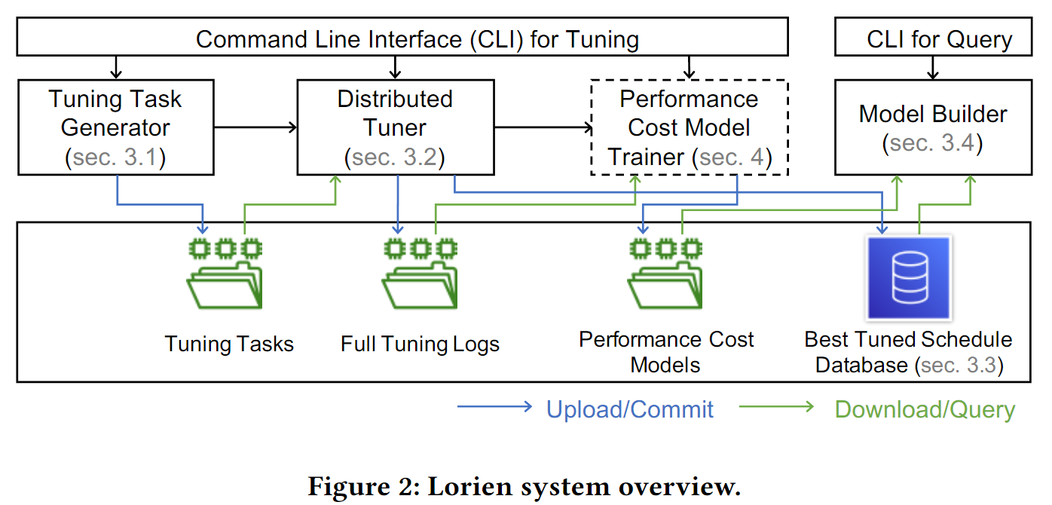
LORIEN INFRASTRUCTURE
Tuning Task Generator
Distributed Tuner
Database and file system
Model Builder
Performance cost model trainer

Slide 5
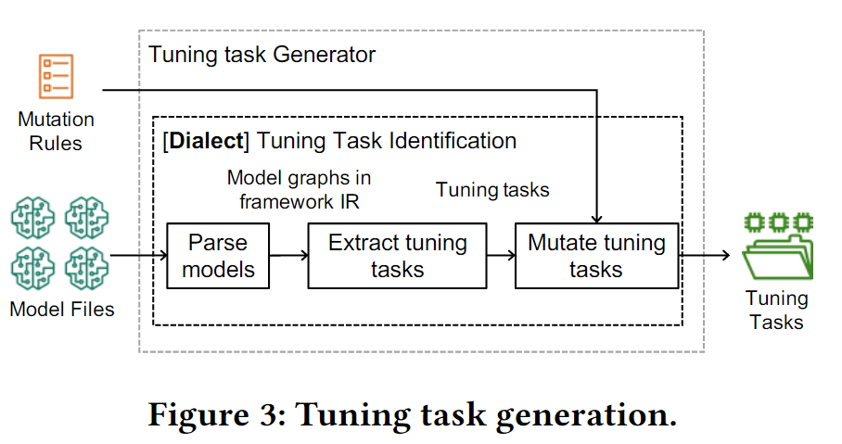
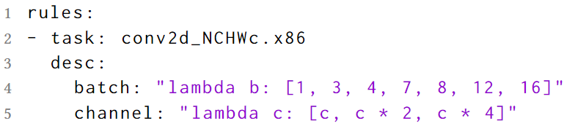
Tuning Task Generator
Model sources:
Commonly used deep learning models;
GluonCV & GluonNLP model zoo.
Deep learning models with variants.
Different batchs, channel numbers or stride value et al.

Slide 6
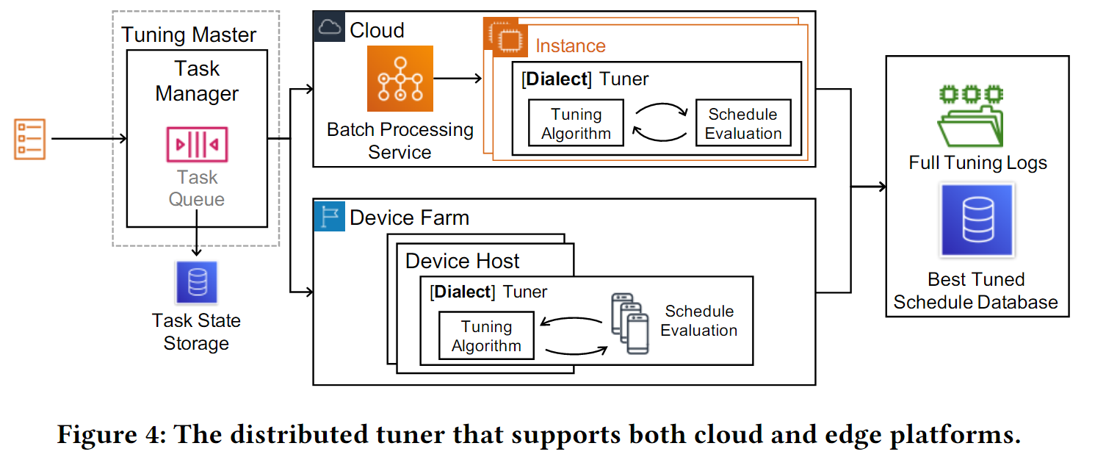
Distributed Tuner
Lorien tuner is designed in the master-worker pattern;
YAML format(just a few KBs) - network overhead is acceptable.
auto-tuning framework dialect:
the best schedule searching;
schedule quality evaluation.
Best schedules -> Database; Full logs -> File system.

Slide 7
Distributed Tuner
Tuning tasks on cloud
Existing batch processing services - scalability and reliability.
If require, then deploy, if terminate, then resubmit.
jobs that use auto-tuning framework dialect to tune one task -> batch processing services.
Tuning tasks on edge
Device farm and cluster system – Lorien task manager does.
Client register to be a worker.
Difference from other distribute system: the worker request tasks actively.
Flexible!
Transparent!

Slide 8
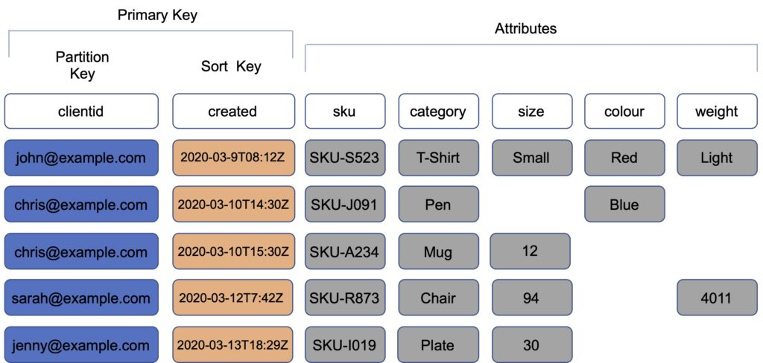
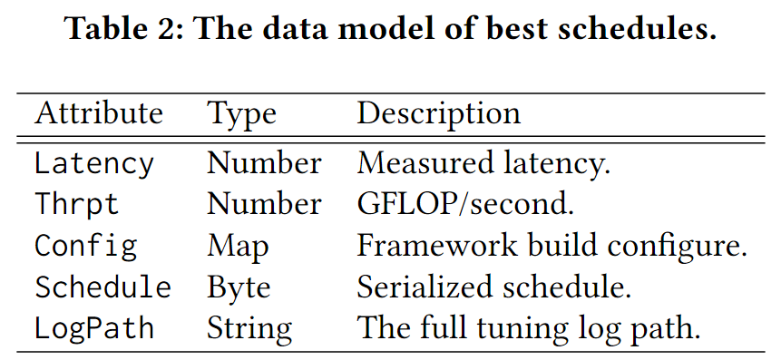
The Data Model
First, most queries are sent separately from different workers, so they can barely be batched.
Second, one query will contain tuning results of one task.
Third, tuning results of different tasks may have different attributes, because the argument list and schedule parameters of each task may vary.
Fourth, tuning results of different tasks are mostly independent.
flexible attributes
Indices determine how data will be stored - simple key or composite key
target platform and tuning task key.
Target – Partition Key;
TaskKey – Sort Key.
best schedule item:
the auto-tuning framework configurations;
he full tuning log path in the file system.
Notes:
在向DynamoDB提交任务的新调优结果时，我们还检查由相同框架使用相同框架配置调优的现有调度(如果有的话)，并保留更好的调度。同时，为了向后兼容，将保留由不同框架或配置调整过的调度。具有过时框架配置的时间表可以通过单独的Lorien API进行清理，并且该操作可以在常规维护期间脱机完成。

Slide 9
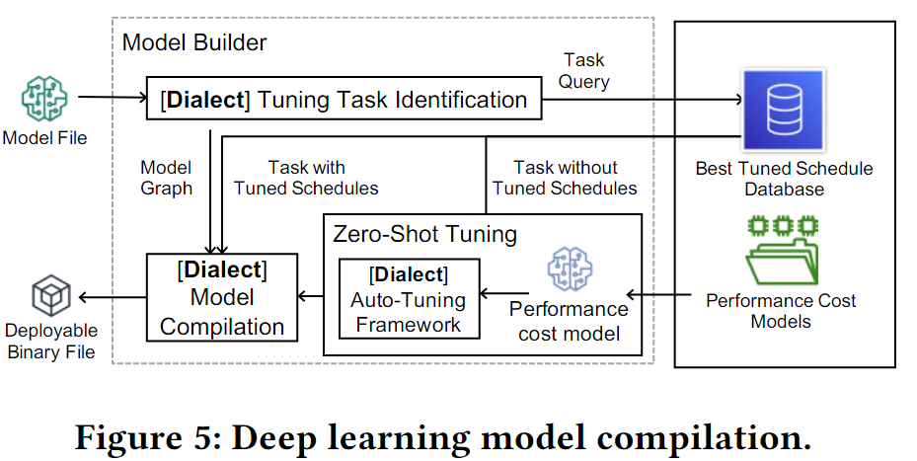
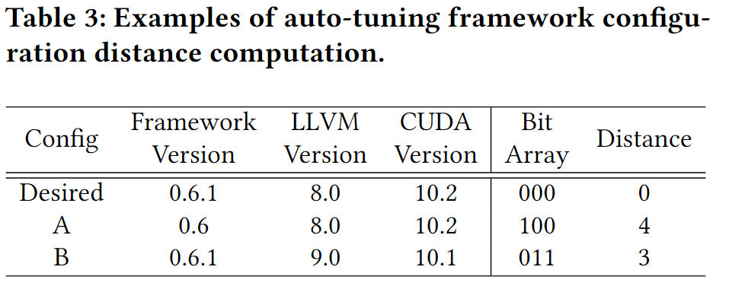
Deep Learning Model Builder
Just do batch querying for exactly the same Config.
different framework configurations might be acceptable sometimes(by allow users to specify a list of acceptable configuration fields)
Similar device is also allowed, but none one-for all.

Slide 10
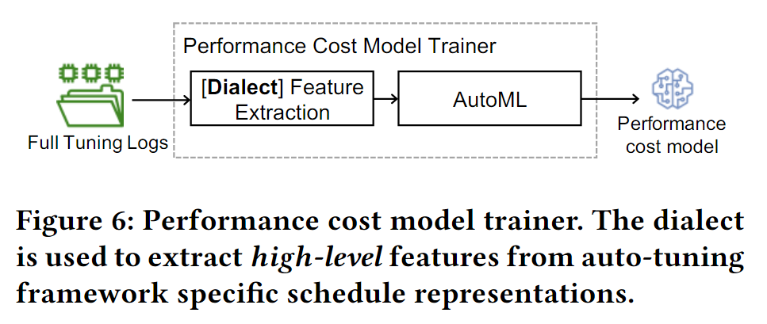
Performance Cost Model and Zero-Shot Tuning
Zero-shot Tuning:
when the performance cost model is capable of accurately ranking the quality of schedule candidates, we can obtain the optimal schedule by purely leveraging the performance cost model without any on-device measurement.
Challenge 1: Portability: can’t guarantee sufficient accuracy.
Challenge 2: Model fine-tuning on device.
AutoML

Slide 11
For challenge 1 – Portability:
Train the model on high-level features extracted from an auto-tuning framework specific dialect, which simply parses and formalizes measured schedules in framework specific representation.
These generated features are hardware independent.
For Challenge 2 - Model fine-tuning:
Lorien will first randomly sample thousands of scheduling candidates and rank them with the cost model, and it only evaluates the top few candidates (e.g., 8 or fewer) on device.

