Slide 1
Relay: A High-Level Compiler for Deep Learning

Slide 2
Three-pronged extensibility challenge for DL IRs:
Expressivity: It should be straightforward to write models involving control flow, first-class functions and data structures (e.g., trees, graphs, and lists).
Composability: It should be straightforward to add and compose new optimizations with existing ones (e.g., quantization, operator fusion, and partial evaluation).
Portability: It should be straightforward to add new hardware targets (e.g., TPU, Inferentia).
Relay’s design demonstrates how a unified IR can provide expressivity, composability, and portability without compromising performance.

Slide 3
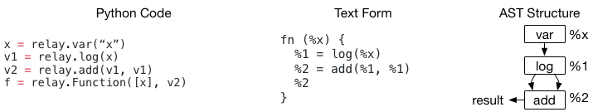
Support traditional data flow-style programming and transformations.
Support functional-style scoping, let-binding and making it a fully featured differentiable language.
Being able to allow the user to mix the two programming styles

Slide 4
Make the following contributions
The Relay IR, a tensor-oriented, statically typed functional IR.
The insight that common features in ML frameworks, such as quantization and shape inference, can be reframed as standard compiler passes.
A platform-agnostic representation of operators and domain specific optimizations which work in concert to provide portability across hardware backends.

Slide 5
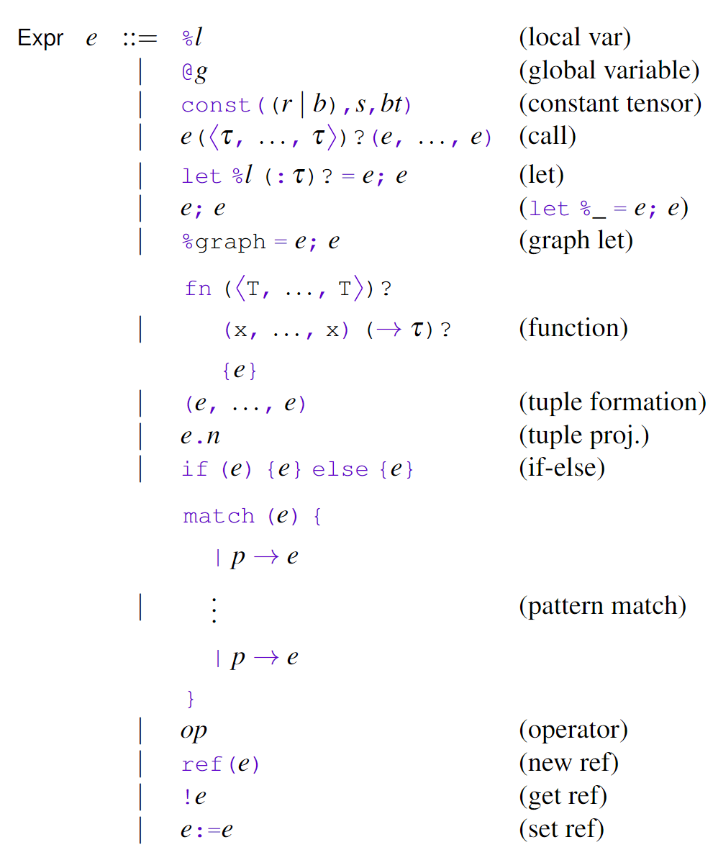
A functional IR, an Let-Binding language tailored to machine learning.
Features closures, reference, ADTs, and primitive operators, and tensors as the primary value type.
Relay can represent full-models including a generative RNN and training loops.
The functional design enables analysis and transform of pure data-flow.

Slide 6
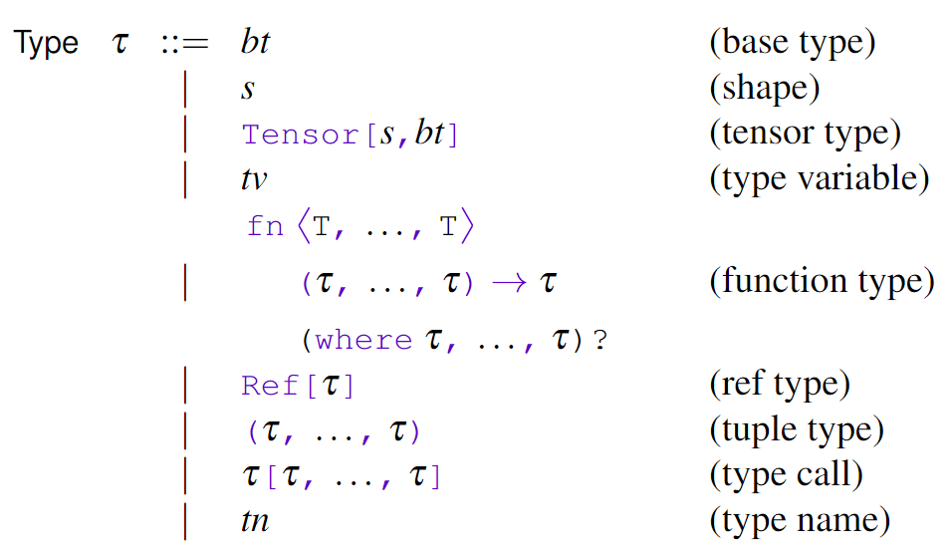
Type system with integrated shape information, shape analysis + type inference.
To incorporate type relations into Relay's type system, enriched a Hindley-Milner-style type inference algorithm with a constraint solver.

Slide 7
transform::Legalize()
transform::SimplifyInference()
transform::EliminateCommonSubexpr(fskip))
transform::CombineParallelConv2D(3)
transform::CombineParallelDense(3)
transform::FoldConstant()
transform::FoldScaleAxis()
transform::CanonicalizeCast()
transform::AlterOpLayout()
transform::FuseOps()
…
Notes:
In /tvm/include/tvm/relay/transform.h

Slide 8
Fusion enables better sharing of computation, removal of intermediate allocations, and facilitates further optimization by combining loop nests.
Relay performs fusion in two steps, detailed below.
Extraction First, Relay identifies subexpressions containing fusion-eligible and factors them into local functions that are marked as primitive
Lowering In a second step, the Relay compiler converts the generated primitive function into platform and shape specific code.

Slide 9
Extraction: Relay通过后序支配树来进行Subexpressions的分等价类（equivalance class)，然后以该等价类构造一个表达式(expression)收集其自由变量，构造一个以表达式为主体，以变量为参数的函数，mark it as primitive.
Lowering: 将extraction部分生成的原语函数转换为platform and shape specific code.
Notes:
4.1 Operator Fusion部分

Slide 10
The three steps of the generic quantization flow: annotation, calibration, and realization.
Annotate Annotation rewrites the program to insert simulated quantization operations according to annotation rule for each operator.
Calibrate Without calibration the model can be wildly inaccurate.
Realize Finally, after the algorithm has set the parameters appropriately, it applies realization.
Notes:
Optimizations - Quantization

Slide 11
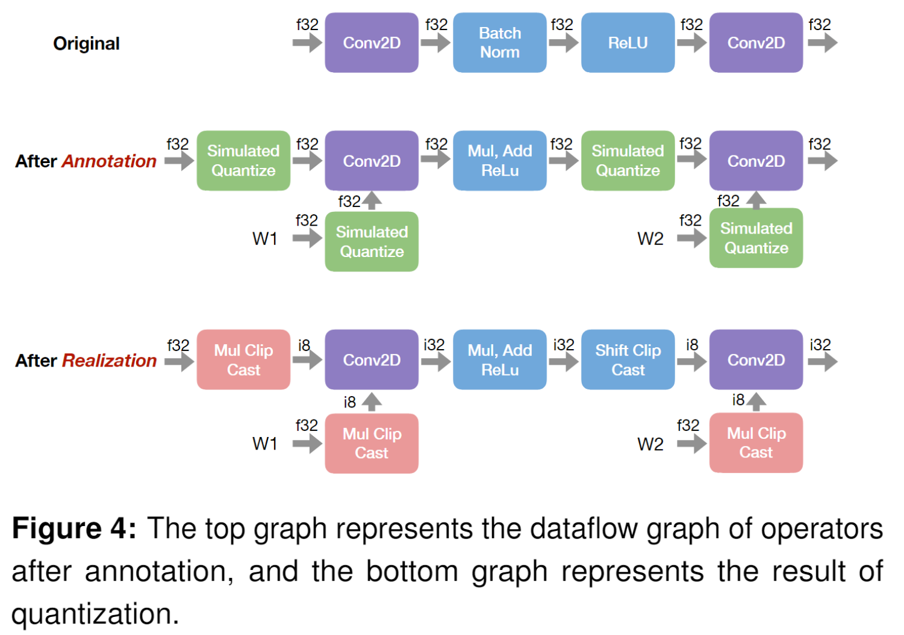

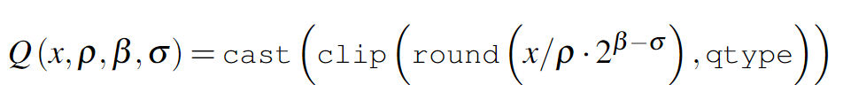
Notes:
4.2 Quantization Framework: annotation, calibration, and realization.

Slide 12
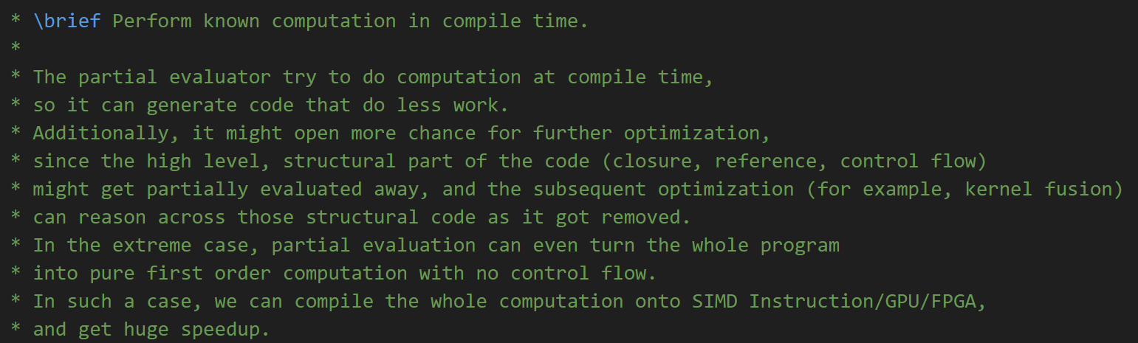
Partial Evaluator
Solved Problems: managing effectful computations and handling references.

Slide 13
Accelerator-Specific Optimizations
Axis scale folding is an optimization: removes scaling operations that occur before or after convolution-like operators
Parallel convolution combination: specialized optimization that fuses multiple 2D convolutions that share the same input.

