Slide 1
TVM: An Automated End-to-End Optimizing Compiler for Deep Learning

Slide 2
Introduction
identify the major optimization challenges in providing performance portability to deep learning workloads across diverse hardware back-ends.
introduce novel schedule primitives that take advantage of cross-thread memory reuse, novel hardware intrinsics, and latency hiding.
propose and implement a machine learning based optimization system to automatically explore and search for optimized tensor operators.
build an end-to-end compilation and optimization stack that allows the deployment of deep learning workloads specified in high-level frameworks (including TensorFlow, MXNet, PyTorch, Keras, CNTK) to diverse hardware back-ends (including CPUs, server GPUs, mobile GPUs, and FPGA-based accelerators). The open-sourced TVM is in production use inside several major companies

Slide 3
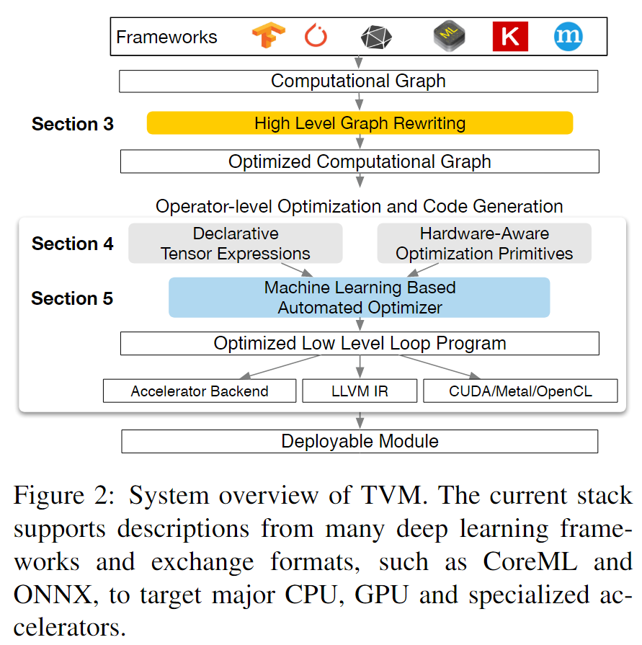
Overview
es

Slide 4
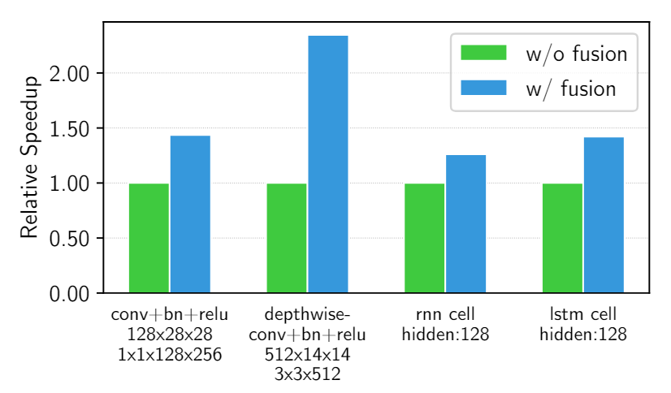
Optimizing Computational Graphs-Operator Fusion
(1) injective (one-to-one map, e.g., add),
(2) reduction (e.g., sum),
(3) complexout-fusable (can fuse element-wise map to output, e.g., conv2d),
(4) opaque (cannot be fused, e.g., sort).

Slide 5
Optimizing Computational Graphs-Data Layout Transformation
Data Layout optimization converts a computational graph into one that can use better internal data layouts for execution on the target hardware.
首先根据 memory hierarchies 为每个 operator 指定 prefered data layout
然后根据 producer 和 consumer 在 operator 之间进行 proper layout transformation

Slide 6
Generating Tensor Operations
es
Notes:
decoupling descriptions from computation rules (or schedule optimizations) and extends it to support new optimizations (nested parallelism, tensorization, and latency hiding)

Slide 7
Generating Tensor Operations
es

Slide 8
Generating Tensor Operations
es

Slide 9
Generating Tensor Operations
es

Slide 10
Automating Optimization
es

Slide 11
Automating Optimization
es

Slide 12
Automating Optimization
es

Slide 13
Automating Optimization
es

Slide 16
