Slide 1

Tensor Program Optimization with Probabilistic Programs
36th Conference on Neural Information Processing Systems (NeurIPS 2022).
Notes:
This paper introduces MetaSchedule, a domain-specific probabilistic programming language abstraction to construct a rich search space of tensor programs.
本文介绍了 MetaSchedule，这是一种特定领域的概率编程语言抽象，用于构建张量程序的丰富搜索空间

Slide 2
Introduction
Two vital elements of automatic tensor program optimizations:
a search space
learning-based search algorithms
Most of the current approaches use pre-defined search spaces
a simple yet powerful probabilistic language abstraction for tensor program search space construction.
a learning-driven framework to find optimized tensor programs specified by the search space constructed using our abstraction.
an end-to-end system that can take prior knowledge from domain experts to construct optimization search space to optimize deep learning deployment on multiple platforms.

Slide 3
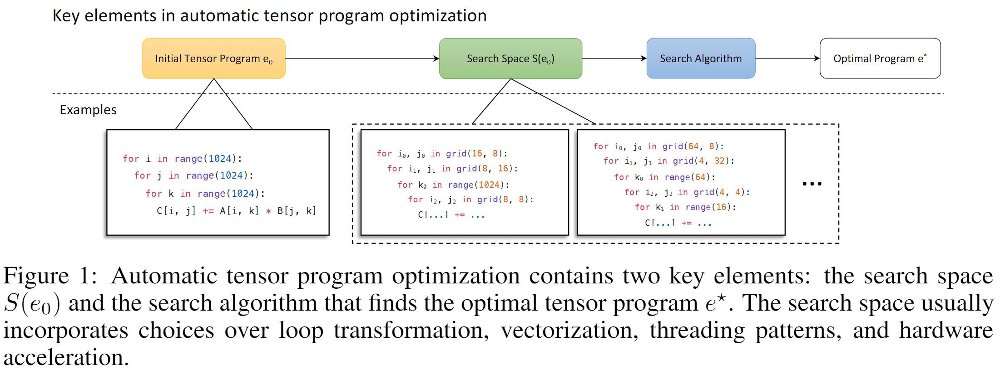
Background and Overview
Expressiveness.
Modularity
Designed for learning

Slide 4
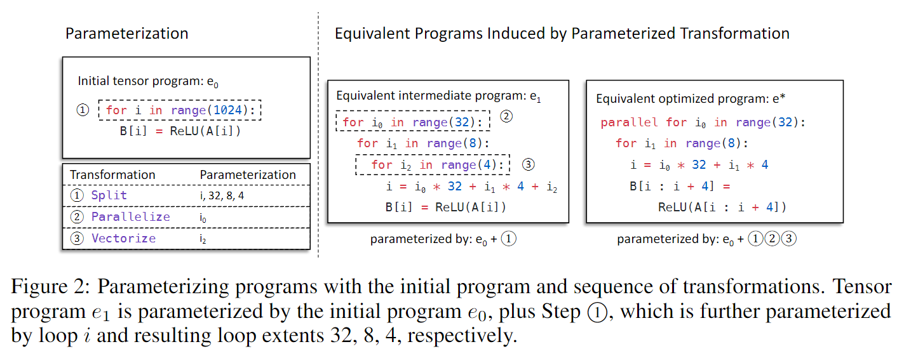
Composable Search Space Parameterization

Slide 5
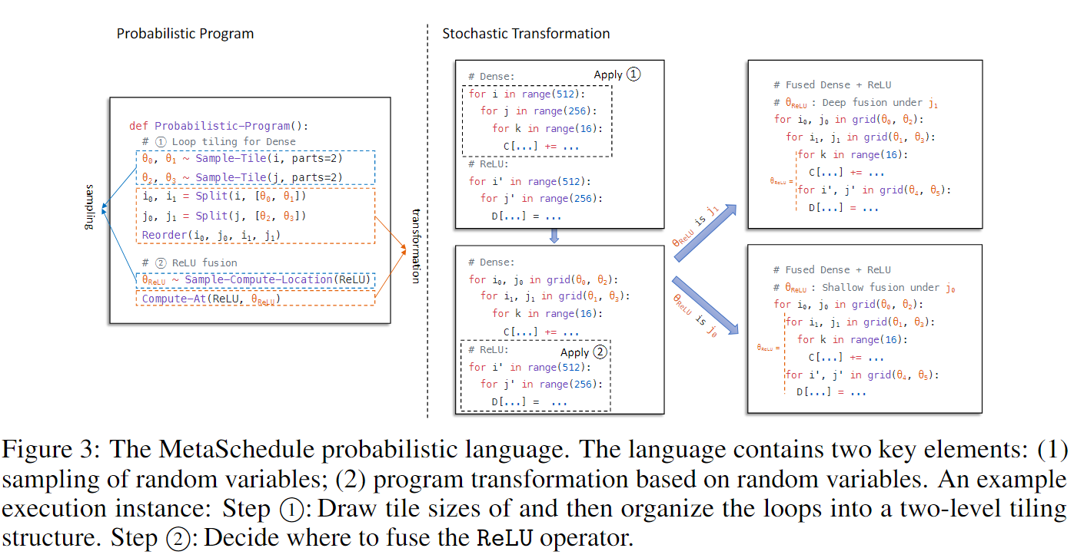
Stochastic Search Space Construction

Slide 6
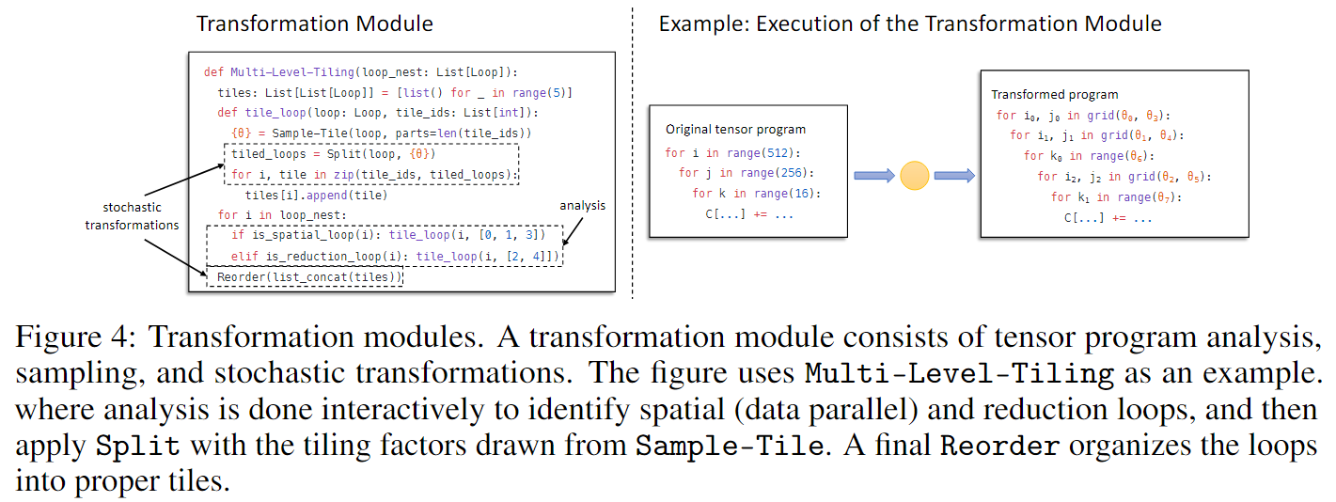
Modular Search Space Composition

Slide 7
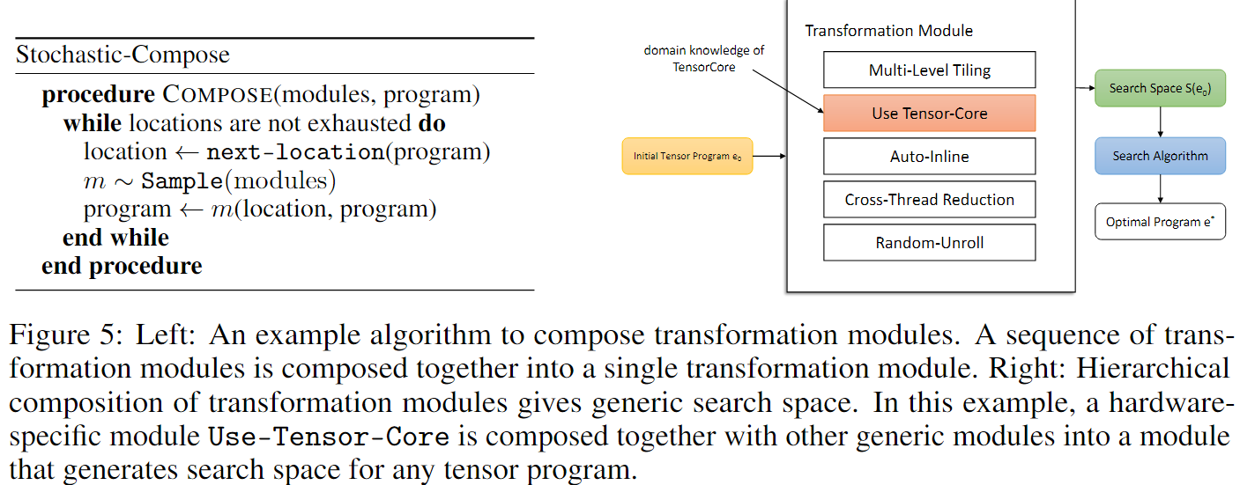
Modular Search Space Composition

Slide 8
Relation to Existing Tensor Program Optimization Methods
Domain specific languages for program transformations
Halide, TVM, Tiramisu, etc.
Template-guided auto-tuning
Chameleon, AdaTune, etc.
Auto-scheduling
Ansor, FlexTensor, Protuner, etc.

Slide 9
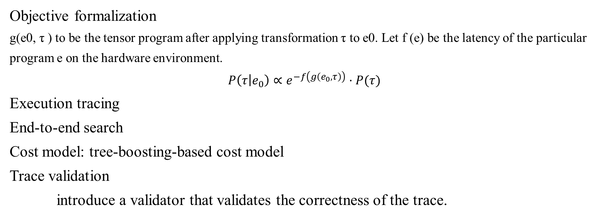
Learning-driven Search
Objective formalization
g(e0, τ ) to be the tensor program after applying transformation τ to e0. Let f (e) be the latency of the particular program e on the hardware environment.
$$P\left(τ | e_{0}\right)∝e^{−f\left(g\left(e_{0},τ\right)\right)}·P(τ)$$
Execution tracing
End-to-end search
Cost model: tree-boosting-based cost model
Trace validation
introduce a validator that validates the correctness of the trace.

Slide 10
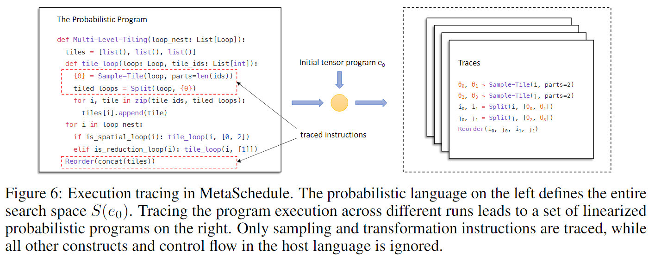
Learning-driven Search
Notes:
Execution tracing

Slide 11
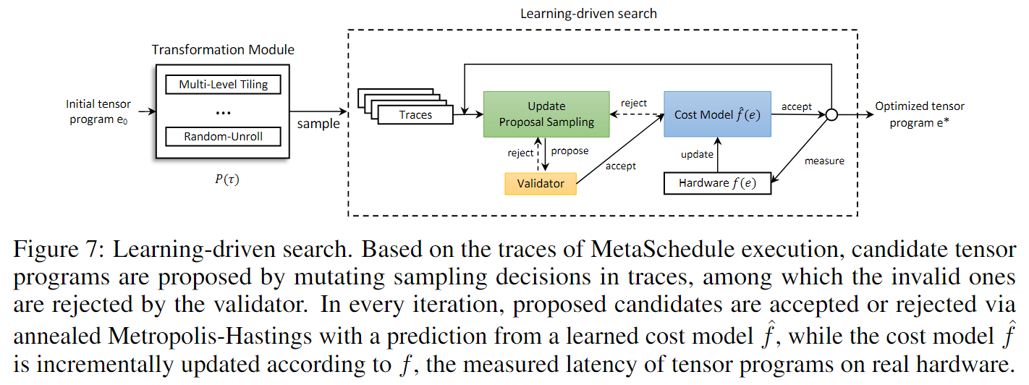
Learning-driven Search
Notes:
End-to-end search

Slide 12
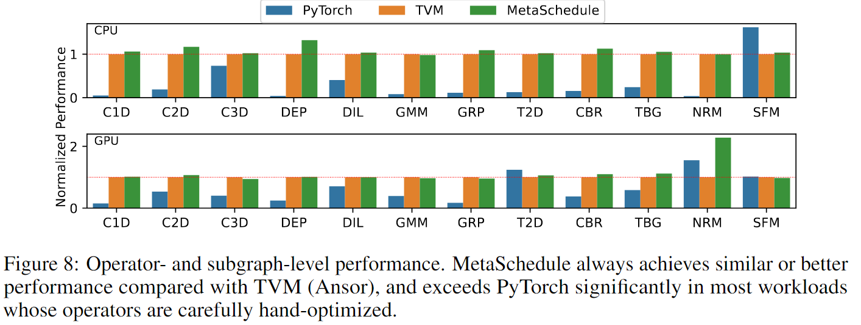
Experiments
Notes:
Expressiveness to Cover Common Optimization Techniques

Slide 13
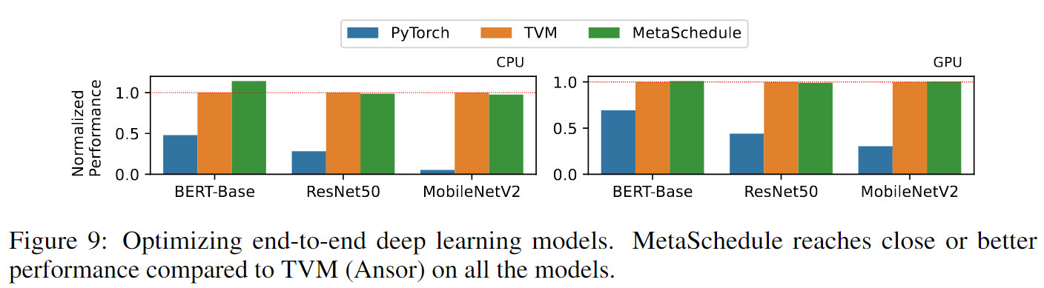
Experiments
Notes:
Optimizing End-to-End Deep Learning Models

Slide 14
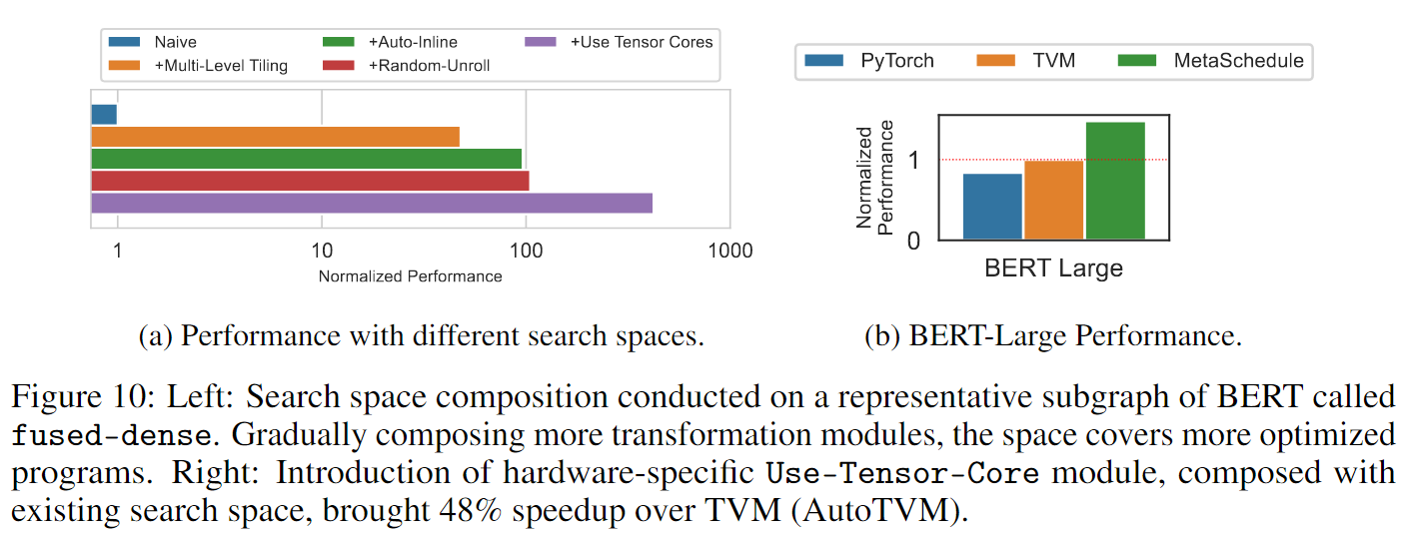
Experiments
Notes:
Search Space Composition and Hardware-Specific Modules

