Slide 1
UNIT: Unifying Tensorized Instruction Compilation

Slide 2
Introduction
Matmul and Conv are a series of multiply-accumulate (MAC) operations, which perform accumulation over a number of elementwise multiplications.
To capture the reduction behavior and perform it more efficiently, recent general-purpose processors offer native tensor operation specialized instructions(tensorized instructions).
“horizontal computation”
tensorized instructions are often mixed-precision
these instructions essentially handle a similar compute pattern, i.e., elementwise multiplication and then horizontal accumulation. They primarily differ in the number of elementwise computation lanes and the accepting data types.
Goal: develop a unified approach to compile these tensorized instructions on multiple platforms to optimize the tensor operations in deep learning workloads

Slide 3
Introduction
Instructions Integration: Instead of building a new specialized compiler for each new instruction, it is desirable to create a unified and extensible compilation flow;
Detecting the applicability: Given a tensorized instruction, a first question is whether and how this instruction can be applied to the target tensor operation, which may require loop reorganization to make it applicable;
Code rewriting: When applicable, the compiler must determine how the loops involved should be rewritten by the tensorized instruction, and how the loops should be rearranged to achieve high performance.
UNIT takes the tensorized instructions (e.g., Intel VNNI instructions on CPUs, or Nvidia Tensor Core instructions on GPUs) and a deep learning model as input, lowers the tensor operations of the model into loop-based IRs to identify the tensorizable components, and inserts the tensorized instructions by transforming and rewriting the loop.

Slide 4
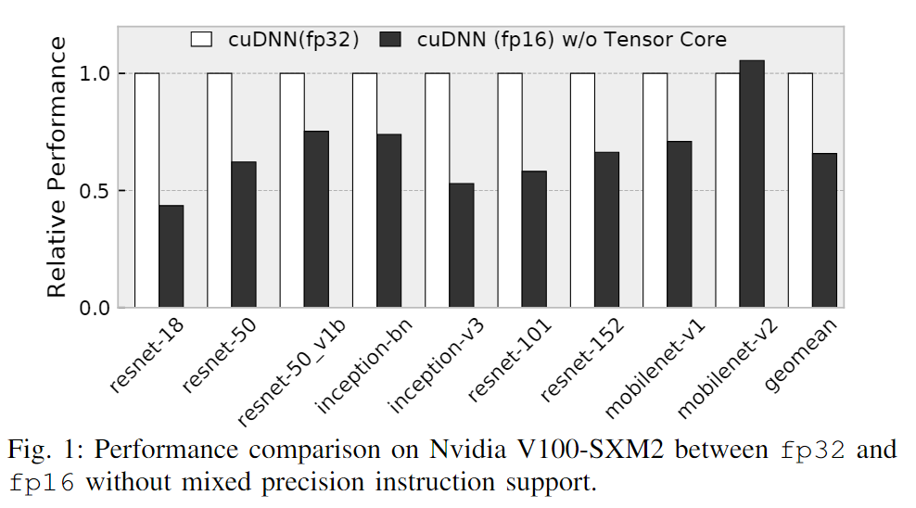
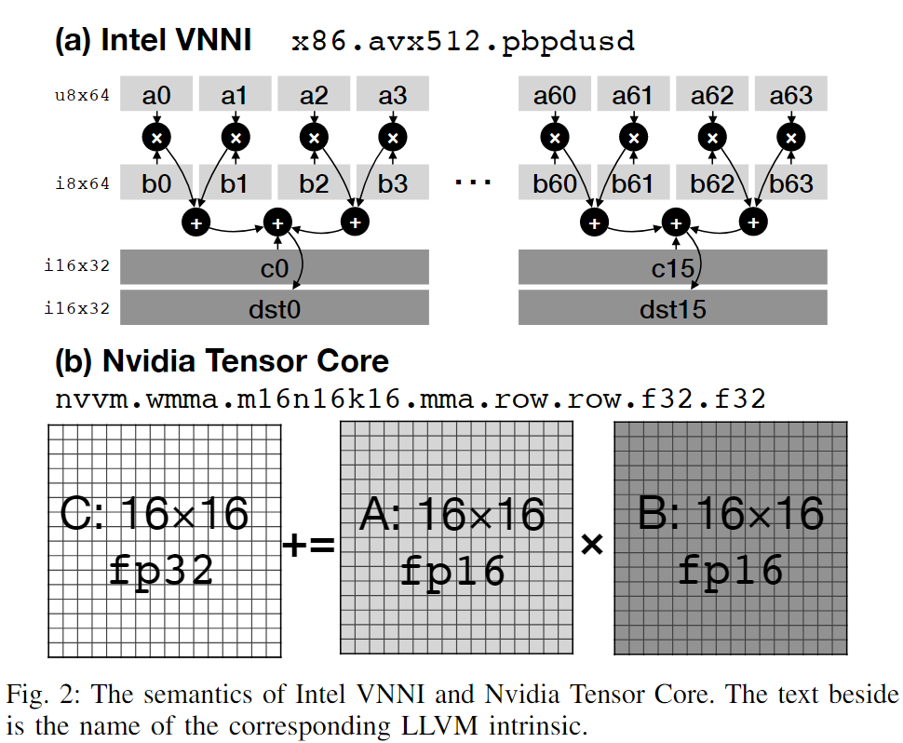
Background - Mixed Precision Tensorized Instructions
quantization for integer values
horizontal accumulation
Notes:
Nvidia Tensor core: numbers of entries and data types

Slide 5
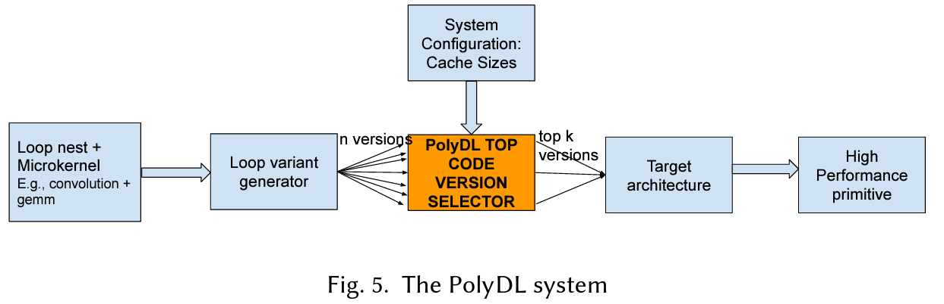
Background - Limitations of Existing Solutions
conventional loop vectorizers find it hard to exploit the profitability of these tensorized instructions, as they are not designed to work with the horizontal reduction idiom.
conventional loop vectorizers focus on either analyzing the innermost loop body or combining instructions in the unrolled loop bodies. When it comes to the horizontal reduction idiom, these compilers often reorder the computation and generate epilogue reduction, preventing us from using the tensorized instructions.
A generic solution to handle tensorized instructions from multiple platforms together is still missing.

Slide 6
Background - Multi-Level Intermediate Representation
Graph-Level IR: useful for inter-tensoroperation optimization, like tensor shape padding, operation fusion, and choosing the proper data layout. Our tensorized analysis relies on tensor padding so that loops can be tiled by the number of lanes of the instruction perfectly
Tensor DSL: tensor Op data structure. analysis on the tensor Op data structure level
Tensor IR: performs transformation on the tensor IR
Low-Level IR: assembly code generation.
Notes:
尽管张量 IR 提供了基本相同的分析信息，如上所述，但通过张量 Op 数据结构更容易重组循环。

Slide 7
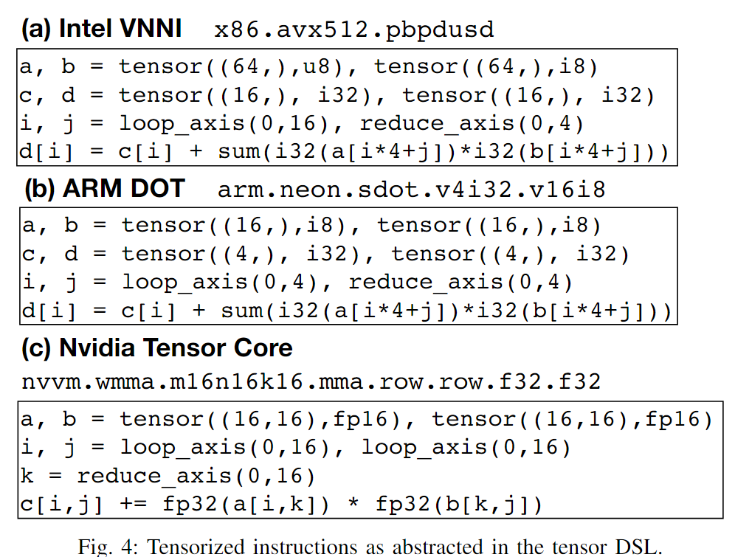
Unified Tensorization - Semantics Abstraction - Tensor DSL
How to have a unified description of the semantics of tensorized instructions？
All mixed precision tensorized instructions perform some elementwise operations for vectors, followed by a horizontal reduction. Each tensorized instruction, therefore, can be regarded as a small tensor operation program written in the tensor DSL.
Compiler pipeline parses the operation into tensor Op.
Notes:
a key difference in Nvidia Tensor Core: 它需要累加器寄存器与加法寄存器相同（注意 +=）。这是因为 Tensor Core 指令的数据类型不透明性，这使我们无法为累加器提供任意初始值。

Slide 8
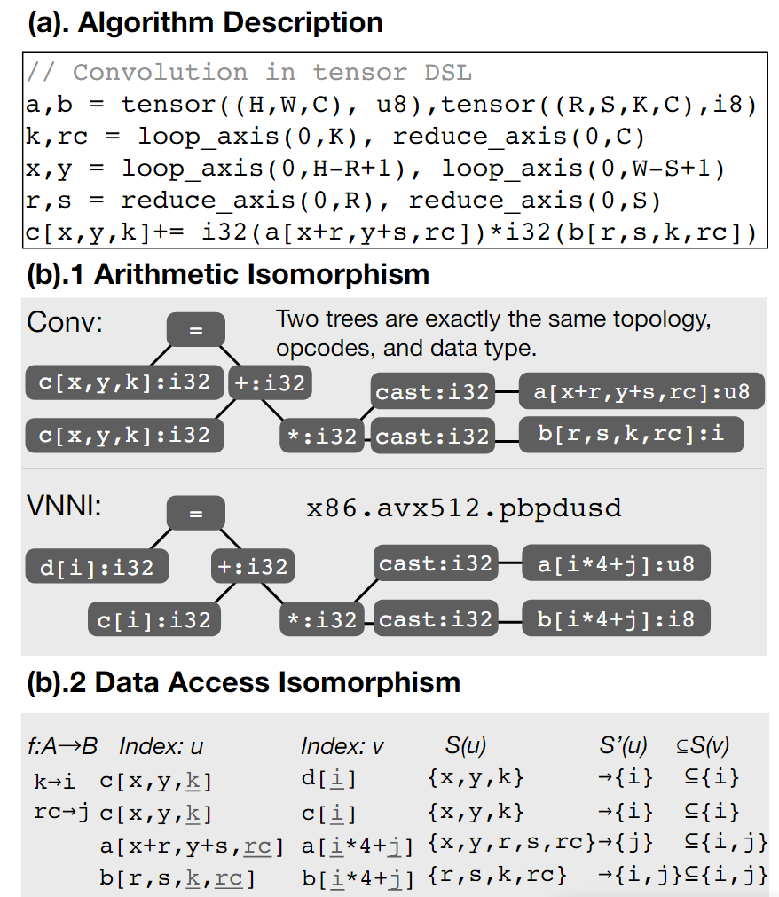
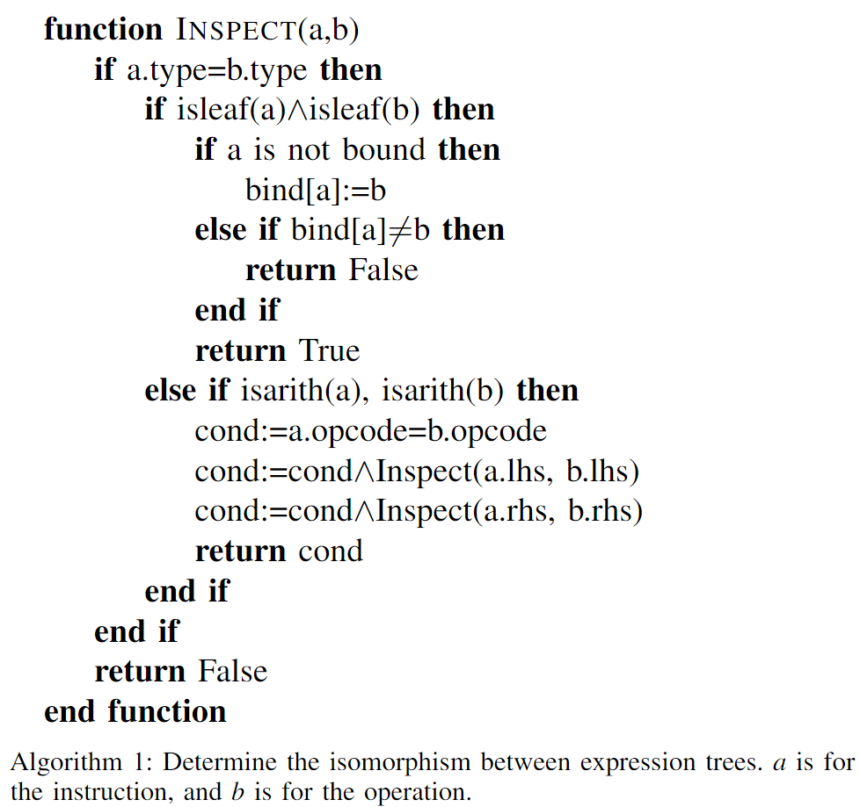
Unified Tensorization - Applicability Detection - Inspector
Compute Isomorphism

Slide 9
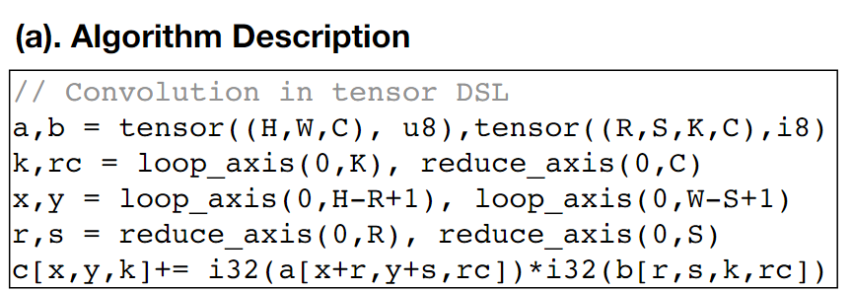
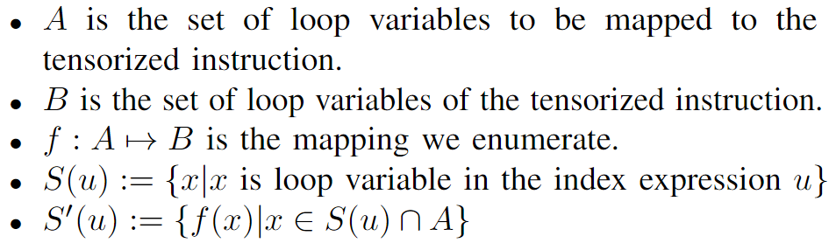
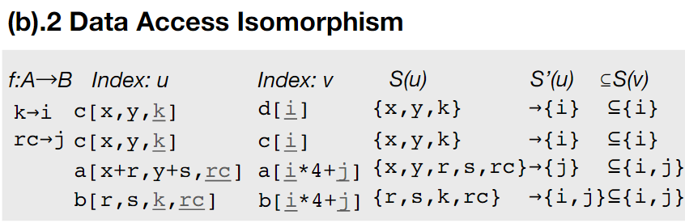
Unified Tensorization - Applicability Detection - Inspector
Array Access Isomorphism

Slide 10
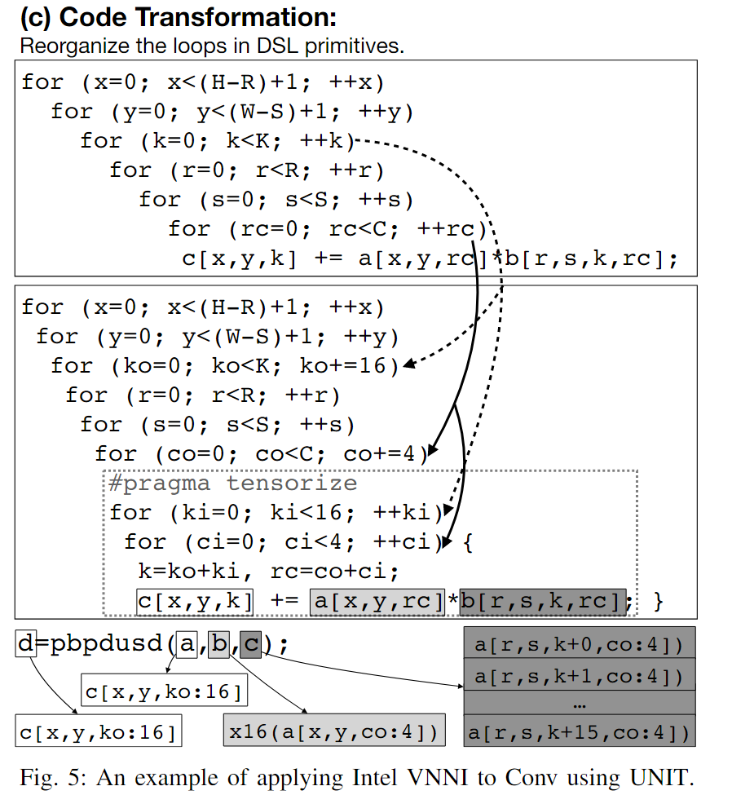
Unified Tensorization - Code Transformation - Rewriter
Loop Reorganization: tile these loops and reorder them to the innermost loop levels so that those innermost loops perform exactly the same semantics as the instruction.(Tensor DSL provided)
Tensorized Instruction Replacement: formalize a unified programming interface to compiler developers to manually specify the rule of operand generation.
Tuner: CPU & GPU

Slide 11
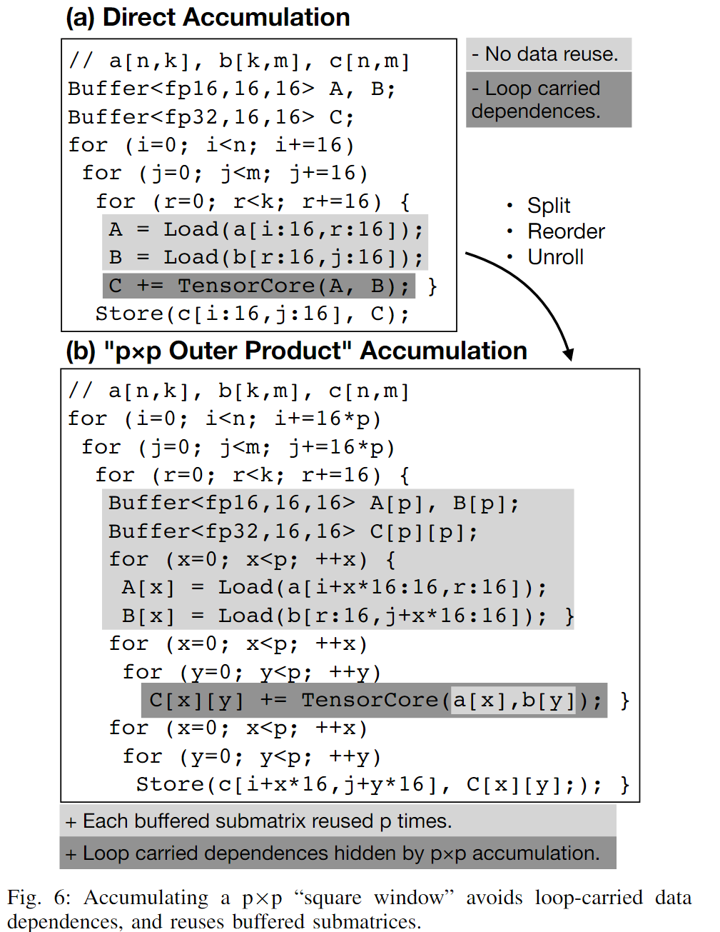
Unified Tensorization - Code Transformation - Rewriter
CPU Tuning:
GPU Tuning:
To avoid RAW hazards penalty, and achieve instruction-level parallelism, we reorder and unroll a small degree of data parallel loops below the innermost reduction loop.
The tuning space in CPU, two dimensions:
unrolling and parallelization
dimension fusion
split reduction
Notes:
如果展开程度太小，则没有足够的独立指令来填补 RAW 危害引起的空闲惩罚周期。如果太大，将导致I-cache丢失。类似地，线程的数量既不太少也不太多。如果太少，计算内核的利用率不足，内存延迟不会隐藏。太多的线程引入了上下文切换开销

Slide 12
Methodology
Target Hardware Platforms
Intel x86 CPU: We use Amazon EC2 C5.12xlarge instance as our x86 platform with 24-core Intel Xeon Platinum 8275CL CPU @3.00GHz (codename: Cascade Lake) and 96GB memory.
ARM CPU: We use Amazon EC2 M6g.8xlarge instance as our ARM platform with AWS Graviton2 CPU, which features 32-core ARM Cortex-A72 CPU @2.30GHz and 128GB memory.
Nvidia GPU: We use Amazon EC2 P3.2xlarge instance as our GPU platform with Nvidia Tesla V100 SXM2 GPU that has 16GB host memory.
Software Frameworks
Code Generation: Apache TVM are emitted to LLVM IR for code generation
Baseline: vendor-provided libraries for baseline performance of operators whenever possible
Workloads: DNN Models

Slide 13
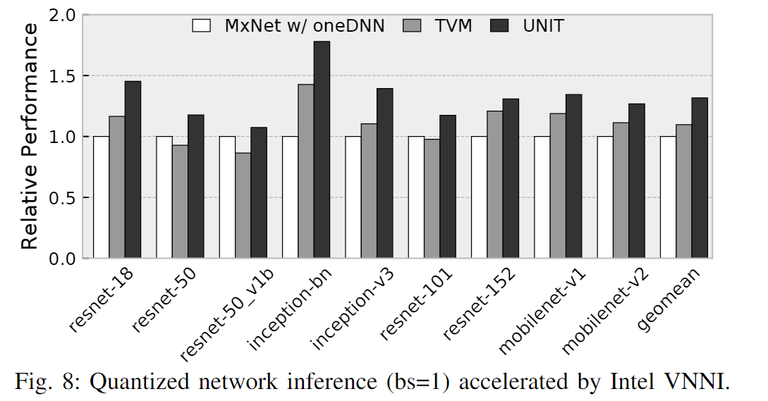
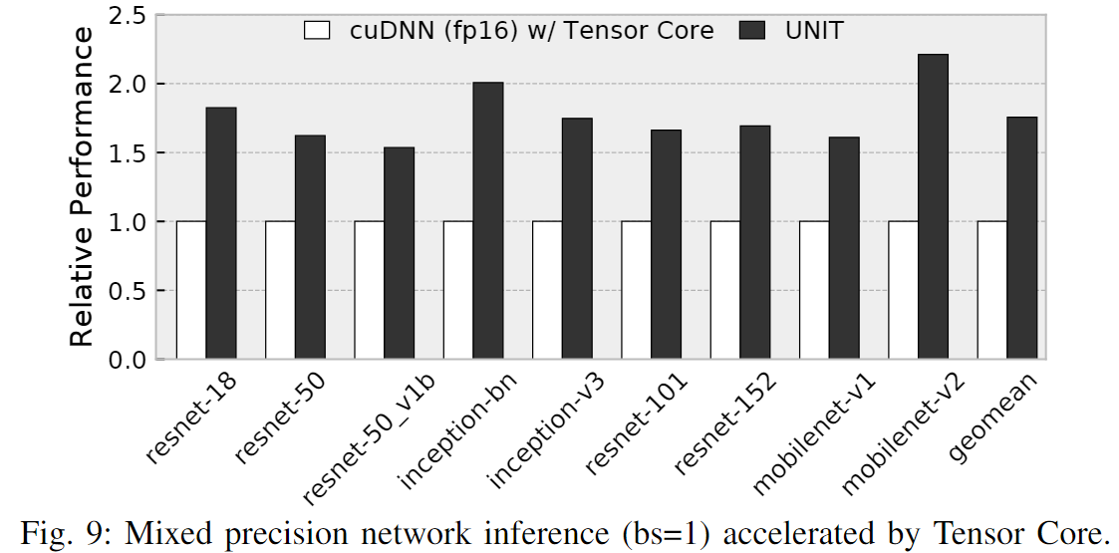
Evaluation – End-to-end performance

Slide 14
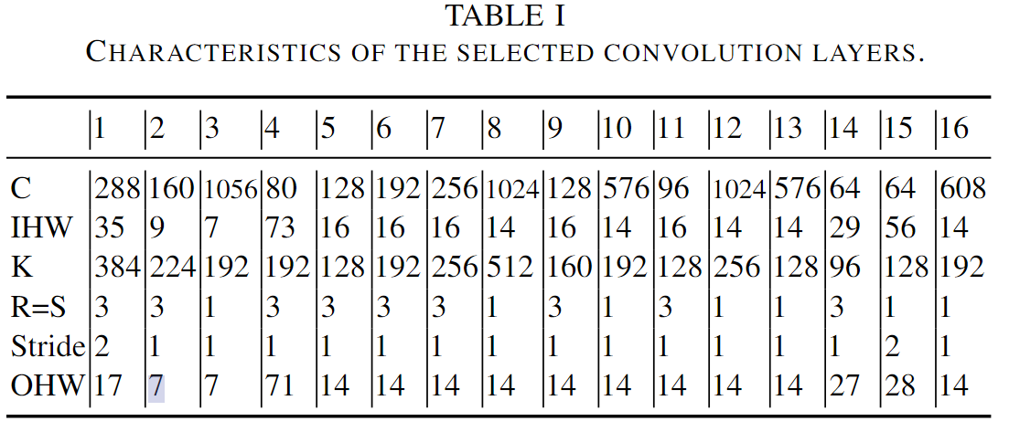
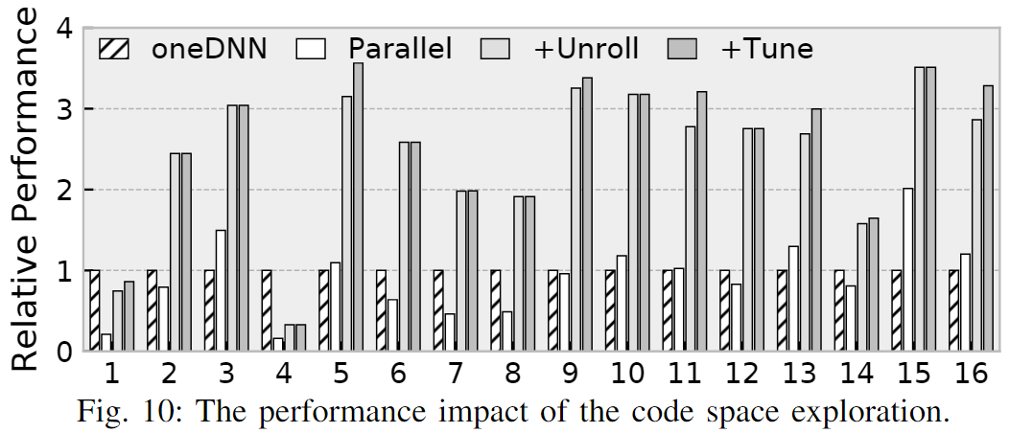
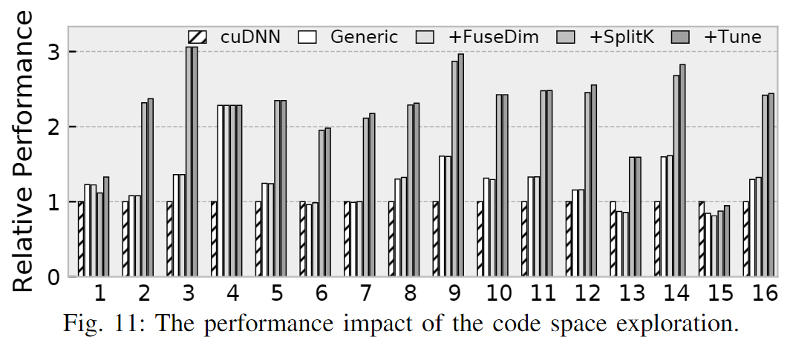
Evaluation - Optimization Implications

Slide 15
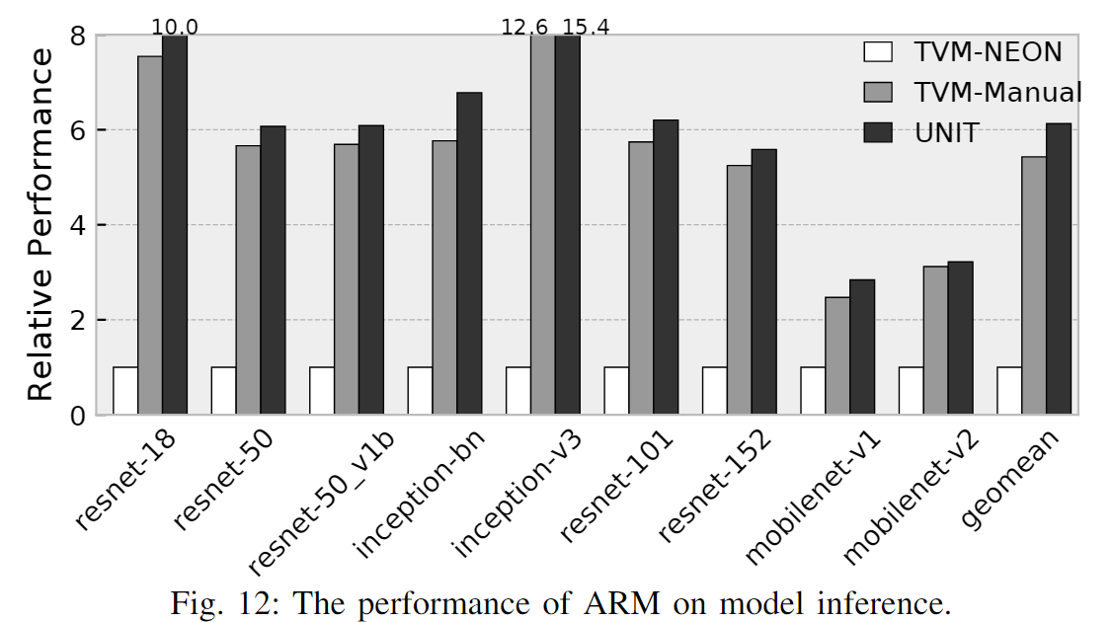
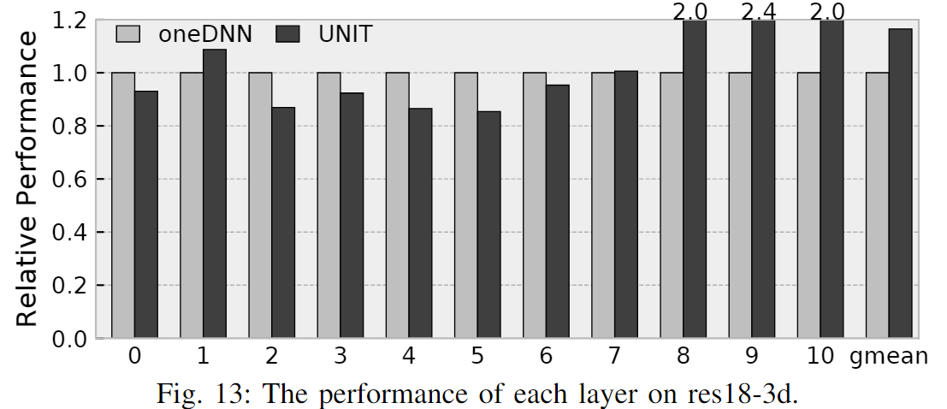
Evaluation - Extensibility

