Slide 1
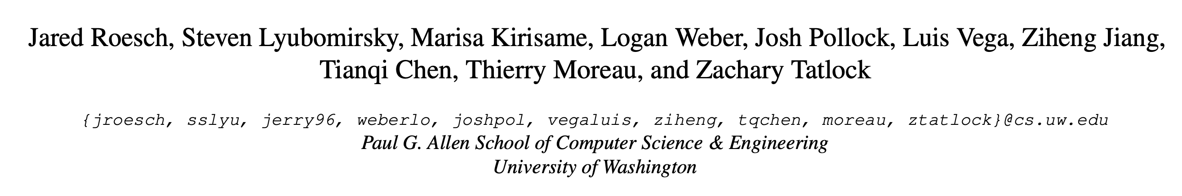

Relay: A High-Level Compiler for Deep Learning

Slide 2
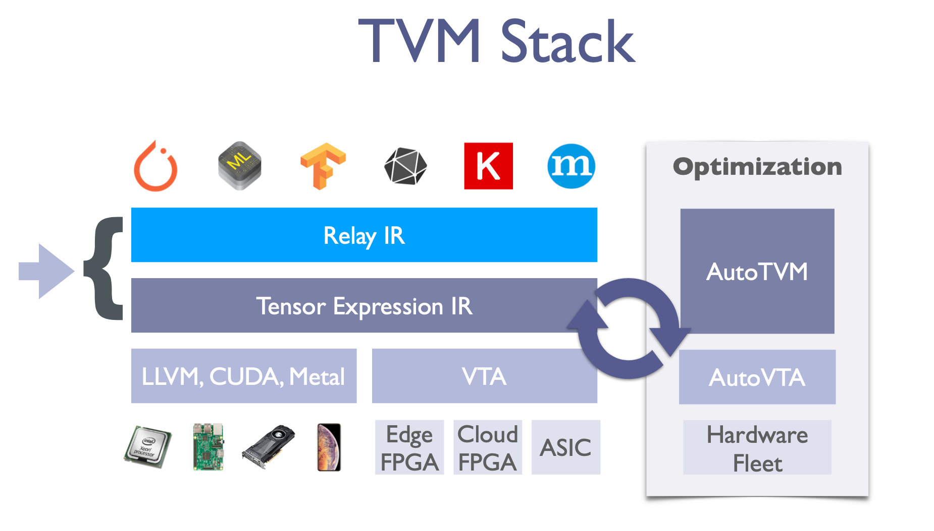
Challenges
How do we represent complex models involving control-flow, recursion/iteration, functional abstraction, and data types?
How do we perform generic optimizations such quantization?
How do we target the huge number of hardware accelerators emerging?

Slide 3
Intro
Three-pronged extensibility challenge for DL IRs:
Expressivity: It should be straightforward to write models involving control flow, first-class functions and data structures (e.g., trees, graphs, and lists).
Composability: It should be straightforward to add and compose new optimizations with existing ones (e.g., quantization, operator fusion, and partial evaluation).
Portability: It should be straightforward to add new hardware targets (e.g., TPU, Inferentia).
Relay’s design demonstrates how a unified IR can provide expressivity, composability, and portability without compromising performance.

Slide 4
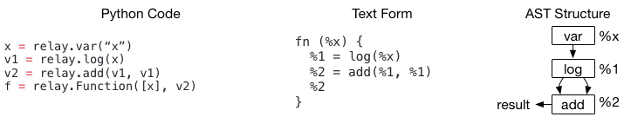
Build a Computational Graph with Relay
Support traditional data flow-style programming and transformations.
Support functional-style scoping, let-binding and making it a fully featured differentiable language.
Being able to allow the user to mix the two programming styles

Slide 5
Contributions
We make the following contributions
The Relay IR, a tensor-oriented, statically typed functional IR.
The insight that common features in ML frameworks, such as quantization and shape inference, can be reframed as standard compiler passes.
A platform-agnostic representation of operators and domain specific optimizations which work in concert to provide portability across hardware backends.

Slide 6
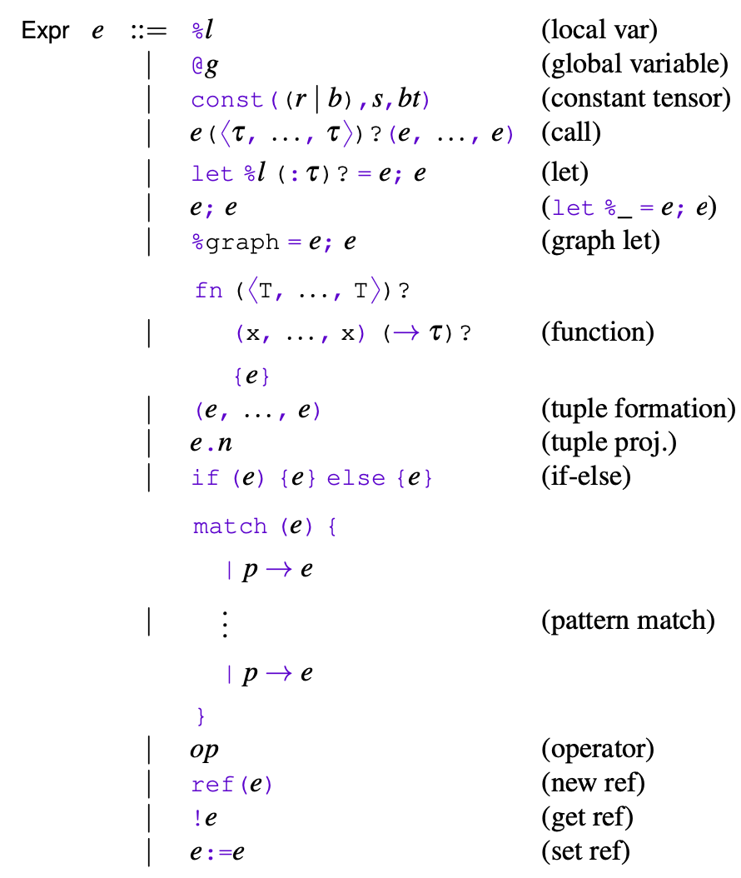
Relay IR
A functional IR, an ML-like (ReasonML, OCaml, SML, ...) language tailored to machine learning.
Features closures, reference, ADTs, and primitive operators, and tensors as the primary value type.
Relay can represent full-models including a generative RNN and training loops.
The functional design enables analysis and transform of pure data-flow.

Slide 7
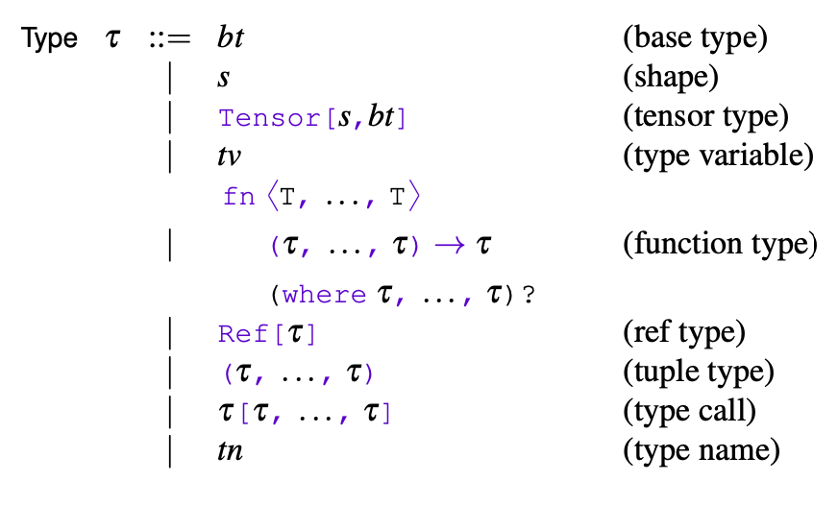
Type System
Type system with integrated shape information, shape analysis + type inference.

Slide 8
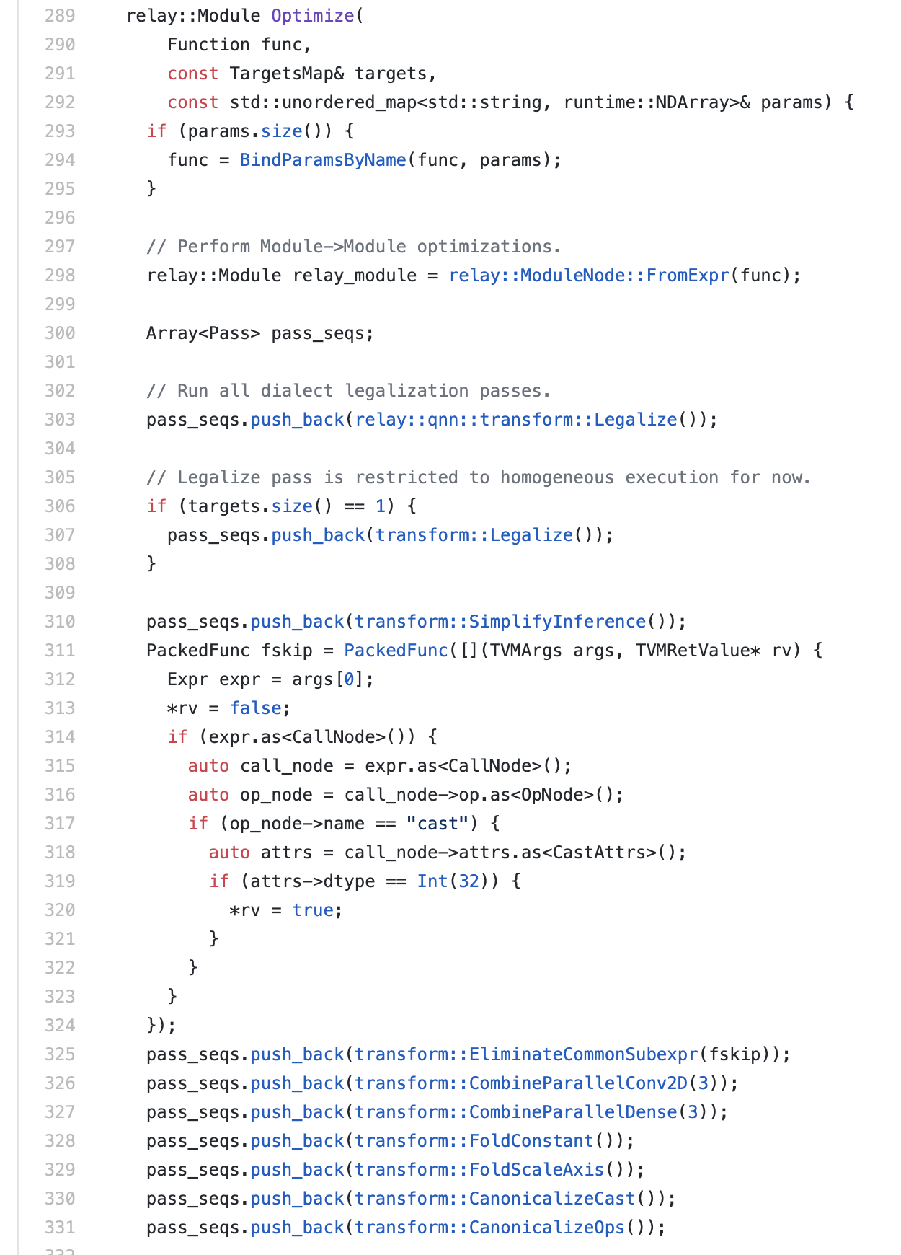
Optimizations
transform::Legalize()
transform::SimplifyInference()
transform::EliminateCommonSubexpr(fskip))
transform::CombineParallelConv2D(3)
transform::CombineParallelDense(3)
transform::FoldConstant()
transform::FoldScaleAxis()
transform::CanonicalizeCast()
transform::AlterOpLayout()
transform::FuseOps()

Slide 9
Optimizations - Operator Fusion
Fusion enables better sharing of computation, removal of intermediate allocations, and facilitates further optimization by combining loop nests.
Relay performs fusion in two steps, detailed below.
Extraction First, Relay identifies subexpressions containing fusion-eligible and factors them into local functions that are marked as primitive
Lowering In a second step, the Relay compiler converts the generated primitive function into platform and shape specific code.

Slide 10
Optimizations - Quantization
The three steps of the generic quantization flow: annotation, calibration, and realization.
Annotate Annotation rewrites the program to insert simulated quantization operations according to annotation rule for each operator.
Calibrate Without calibration the model can be wildly inaccurate.
Realize Finally, after the algorithm has set the parameters appropriately, it applies realization.

Slide 11
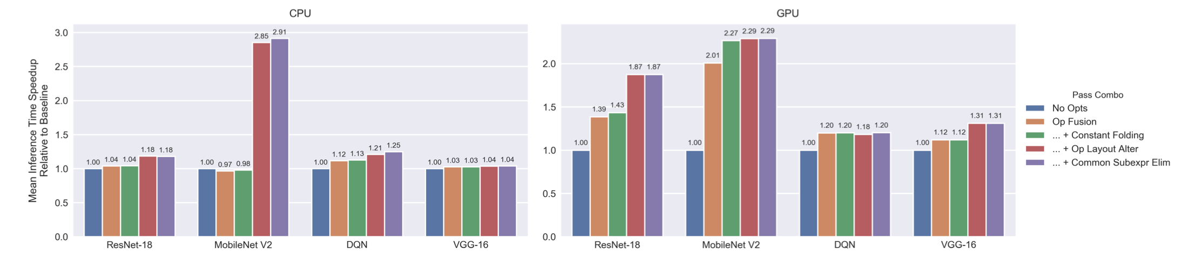
Evaluation
Speedup from successively layering compiler passes in Relay on CPU and GPU.
The “Op Fusion” bars represent the application of operator fusion
The “... + Constant Folding” bars represent the application of operator fusion and constant folding, and so on.
We find that composing passes can steadily increase performance.
The effectiveness of each pass is both model- and device-dependent.
In particular, the most effective passes for CPU and GPU are operator layout alteration and operator fusion, respectively.

Slide 12
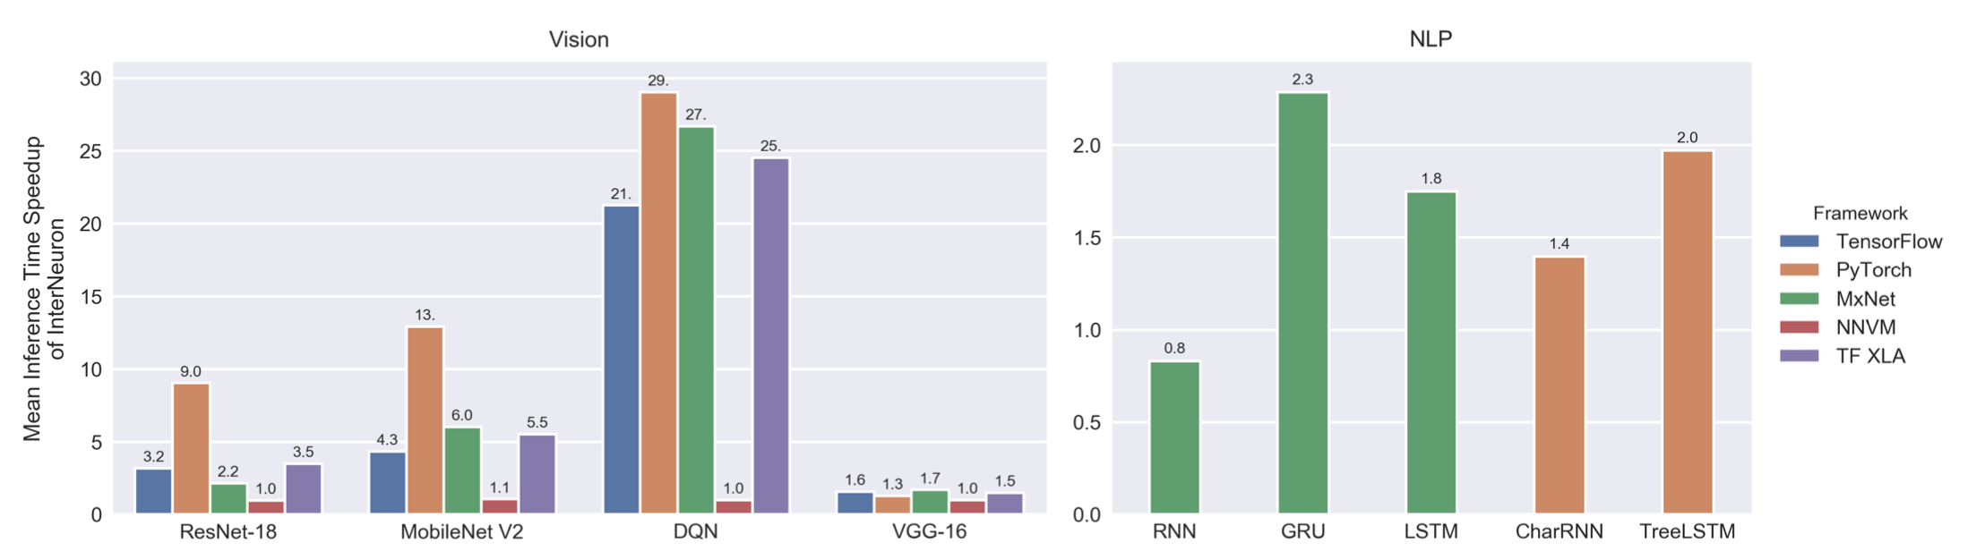
Evaluation
Inference speedup of Relay relative to popular frameworks on vision and NLP benchmarks.

Slide 13
Conclusion
Relay is the high level IR of the TVM stack.
Generalize computation graphs to differentiable programs.
Enables whole-program optimization for deep learning.
Composed of new IR, auto-diff, optimizer, and backends.
Uses HalideIR to represent, platform independent operators.

Slide 14
谢谢！

