Slide 1
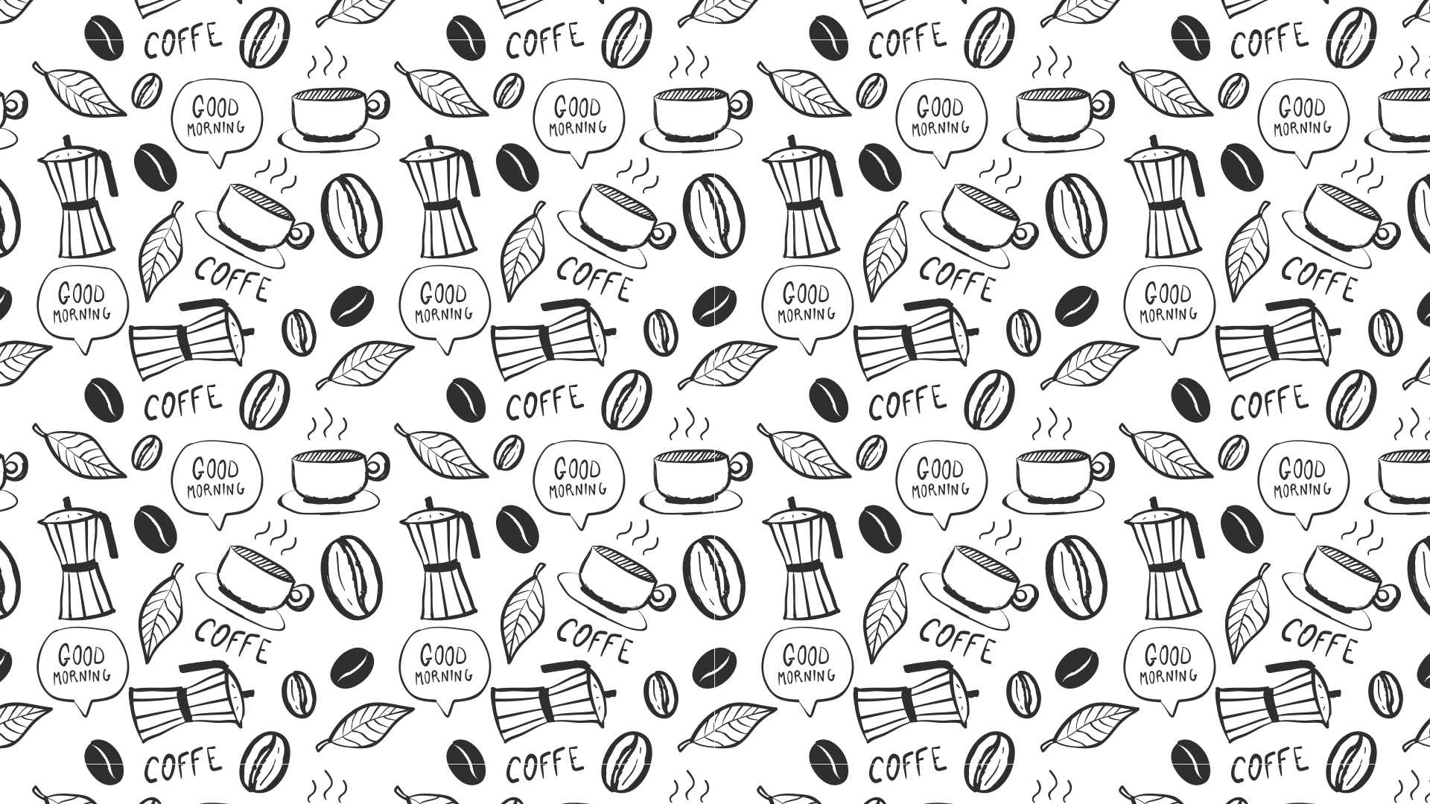

Slide 1
CHICAGO COFFEE SHOPS
ANALYZING THE COFFEE SHOP INDUSTRY

Slide 2


Slide 2
SCOPE
To analyze the coffee shop industry in downtown Chicago and provide business insights for a major European coffee brand planning to enter the US market.
Starbucks business will be analyzed in more details being the industry leader

Slide 3
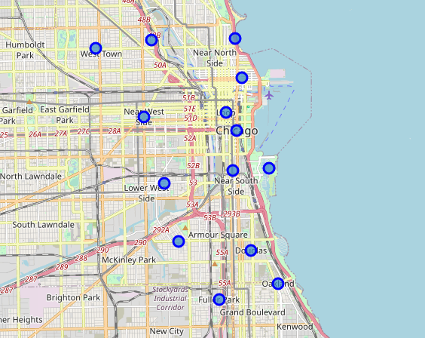
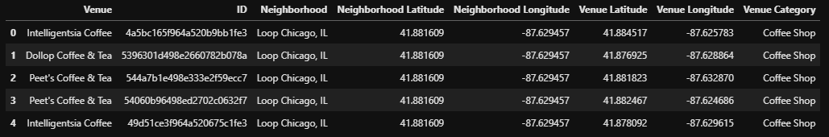
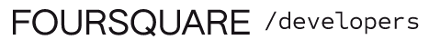
Slide 2
THE DATA
CHICAGO NEIBOURHOOD FROM GEOPY.GEOCODERS LIBRARY
CHICAGO COFFEE SHOPS DATA EXTRACTED USING FOURSQUARE API
STARBUCKS AND ITS NEIBOURING VENUES DATA USING FOURSQUARE API

Slide 4
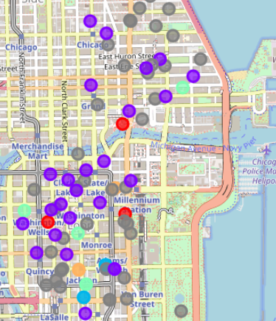
Slide 2
METHODOLOGY – PART I
DATA EXTRACTION USING FOURSQUARE API AND CREATING A PANDAS DATAFRAME
DATA EXPLORATION AND VISUALIZATION USING LIBRARIES LIKE FOLIUM, MATPLOTLIB, PANDAS, NUMPY… TO DETERMINE COFFEE SHOPS BY FOURSQUARE RATINGS AND OTHER INFORMATION
APPLYING K-MEANS MACHINE LEARNING ALGORITHM TO UNDERSTAND STARBUCKS COFFEE SHOPS LOCATION SELECTION

Slide 5
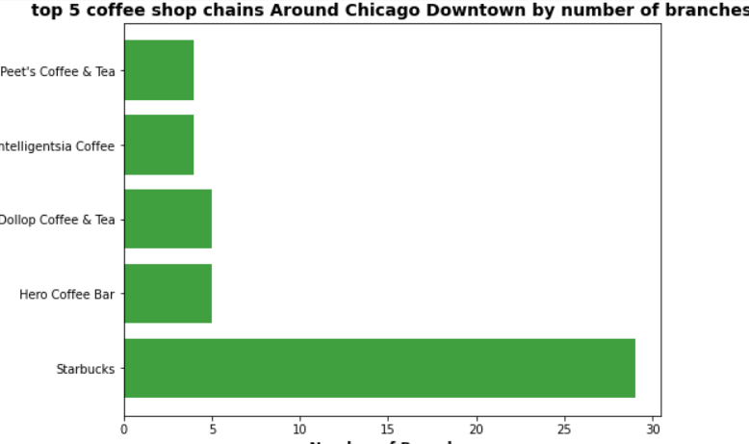
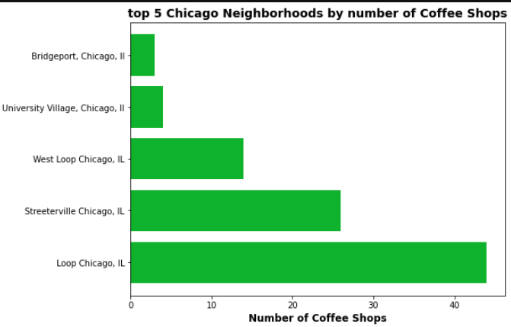
Slide 2
METHODOLOGY – PART II

Slide 6
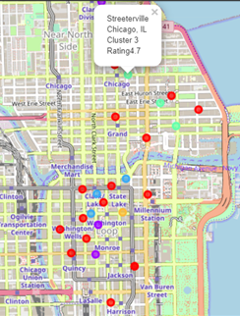
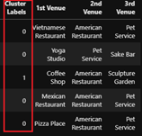
Slide 2
METHODOLOGY – PART III

Slide 7
Slide 2
RESULTS SUMMARY
105 coffee shops are found on Foursquare in Downtown Chicago and its surroundings.
29 Starbucks branches were found.
Starbucks is not among the 5 top rated coffee shops and its average customer rating is 7.25/10 after ignoring the outlier branches.
Applying K-means clustering model on Starbucks branches considering their top neighboring venues, help us identify the best type of locations to open a coffee shops. It is mainly at the Loop, Chicago.
We also discovered that Starbucks branches located at Streeterville, Chicago had an unusual low rating on Foursquare.

