Slide 1

Wireless Networks
WIRELESS COMMUNICATIONS 371-1-1903 - SPRING 2020

Slide 2



Wireless Networks
WIRELESS COMMUNICATIONS 371-1-1903 - SPRING 2020
Practical Laboratory Session
LAB 1 - Digital Wireless Communication

Slide 3



VPN
VPN

Slide 4
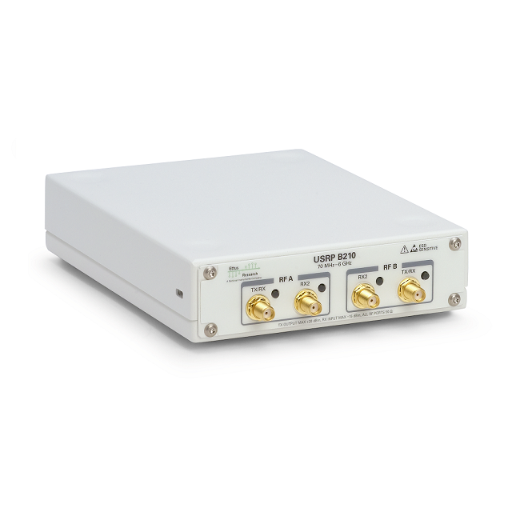
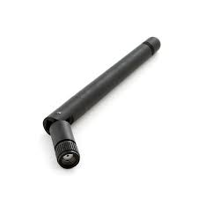
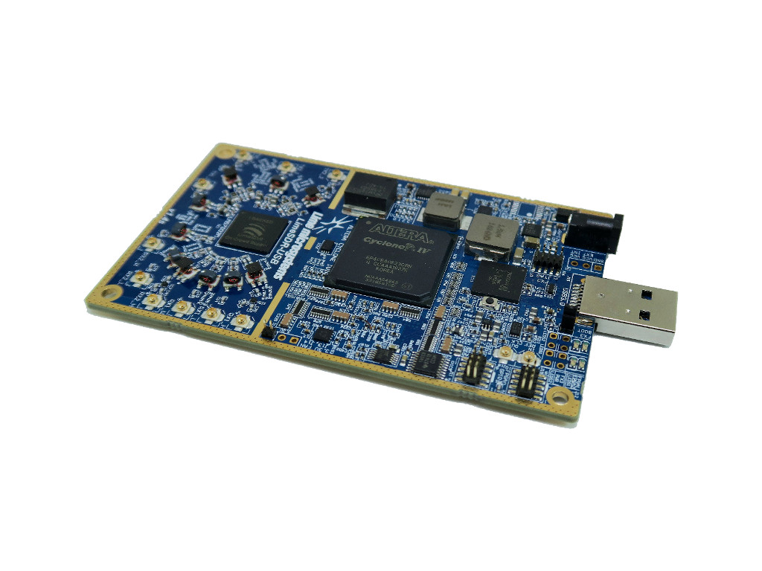
NI USRP B210
Lime SDR
https://www.youtube.com/watch?v=cygDXeZaiOM&feature=emb_logo

Slide 5
Send “Alice”, receive “Bob”
1.Open:
LAB1 - Digital Wireless Communication Practical Laboratory Session
(Moodle)
2. Self Work

