Slide 1
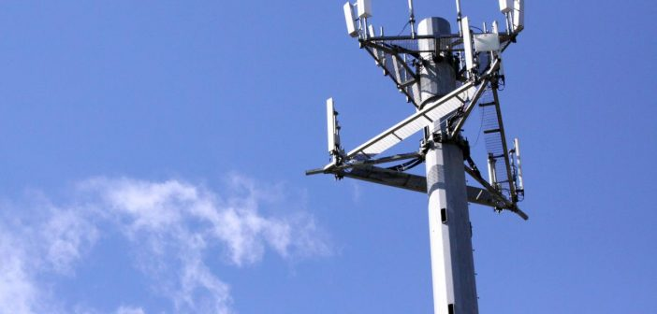

Wireless Networks
WIRELESS COMMUNICATIONS 371-1-1903 - SPRING 2020
Cellular Networks

Slide 2

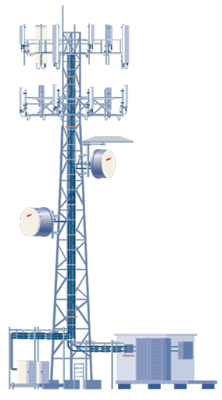


Slide 3

Multiple Access

Slide 4
Cellular Concept

Slide 5
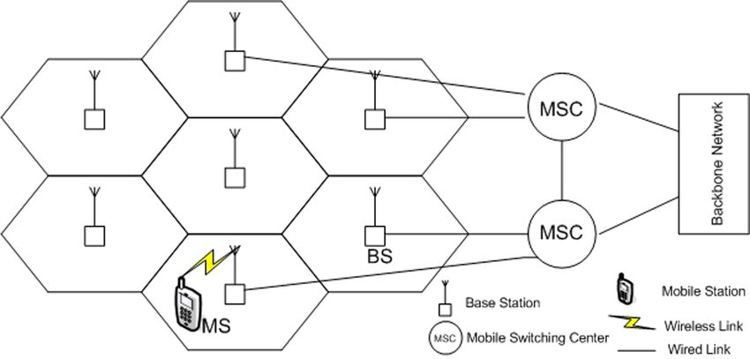
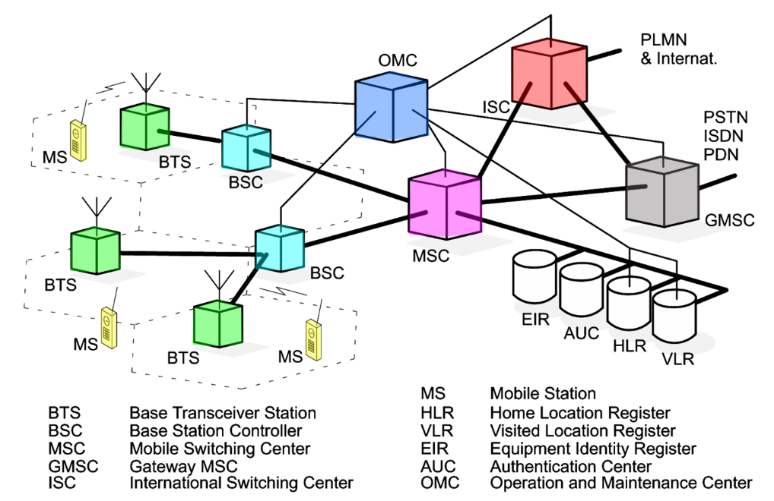
Network Architecture

Slide 7
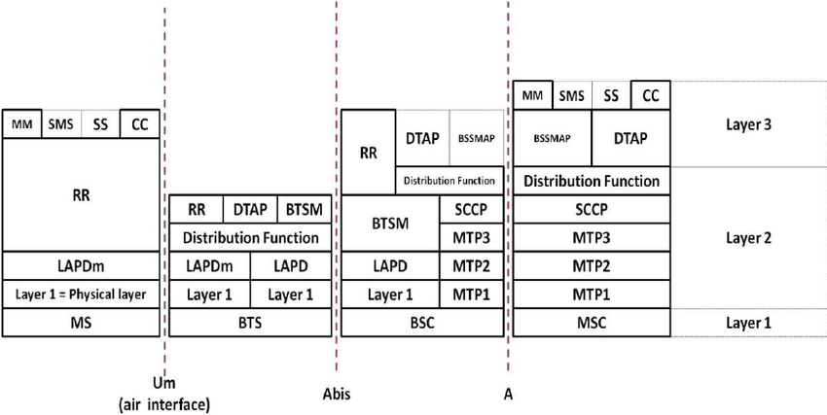

Slide 8



VPN

Slide 9
Let’s see the work…

