Slide 1

CEN314 FUNDAMENTALS OF DATA VISUALIZATION FINAL PROJECT
Natural Disasters & Economic Impact Dashboard
An interactive analytical tool examining the human and economic consequences of natural disasters worldwide from 1900 to 2021 — built with R Shiny and powered by global data.
Analyzing Global Disasters (1900–2021)
Interactive R Shiny Application
Efil Saylam & Emre Kıran

Slide 2

PROJECT OVERVIEW
Project Overview & Research Objectives
This project builds an interactive dashboard that analyses the human and economic impact of natural disasters across 120+ years of global data. Three core research questions drive the investigation.
RQ-1
RQ-2
RQ-3
Income & Economic Damage
Disaster Type Trends
Continental Variation
How does economic damage relate to a country's income level? Do wealthier nations absorb losses differently?
Which disaster types cause the most damage, and how has this shifted since 1900?
How do disaster frequencies and economic losses vary across different continents and income groups?

Slide 3


DATA COLLECTION
Data Sources & Integration
EM-DAT Global Disaster Database
The primary dataset, EM-DAT, tracks natural disaster events worldwide from 1900 to 2021, recording casualties, economic damages, and affected populations. It is the international standard for disaster epidemiology.
World Bank API Integration
The wbstats R package was used to fetch live World Bank data dynamically. Country Income Levels, CPI (Inflation) Rates, and GDP figures were merged via ISO-3 country codes, enriching every disaster record with macroeconomic context.

Slide 4

DATA PREPARATION
Data Cleaning & Preprocessing
Raw data was heavily processed using the tidyverse package in R before any analysis was conducted. Rigorous cleaning ensured analytical accuracy and consistency across the 120-year timeline.
Key Preprocessing Steps
Top 6 Disaster Types Analysed
Feature Selection: Removed irrelevant columns; retained Year, Country, Damages, and Deaths
Missing Values: Filtered out rows with NA damage values for accurate economic analysis
Disaster Filtering: Limited dataset to the top 6 most destructive event types
Deduplication: Applied distinct() to remove duplicate rows from complex API joins
🌪 Storm
🌊 Flood
🌍 Earthquake
🏜 Drought
🔥 Wildfire
⛰ Landslide

Slide 5
METHODOLOGY
Inflation Adjustment & GDP Normalization
Raw economic loss figures cannot be compared across decades without accounting for inflation and differences in national economic scale. Two normalization methods were applied to ensure fair, meaningful comparisons.
CPI Adjustment (Constant 2021 USD)
GDP Normalisation
All nominal damage values were converted into Constant 2021 USD using Consumer Price Index data (World Bank) . This removes inflation bias, ensuring a $1 billion loss in 1950 is comparable to a $1 billion loss in 2020.
Damage was expressed as a percentage of national GDP, revealing the true economic burden on each country. A $10 billion loss affects a low-income nation far more severely than a high-income one — this metric captures that disparity.
Damage % GDP = (Economic Damage ÷ GDP) × 100

Slide 6
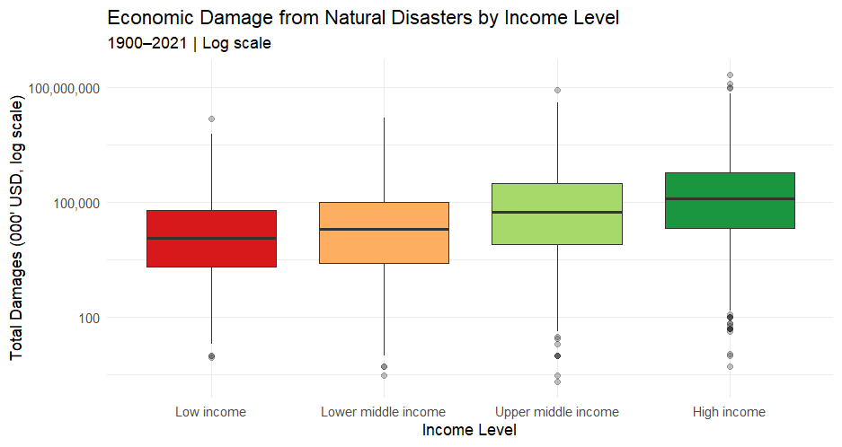
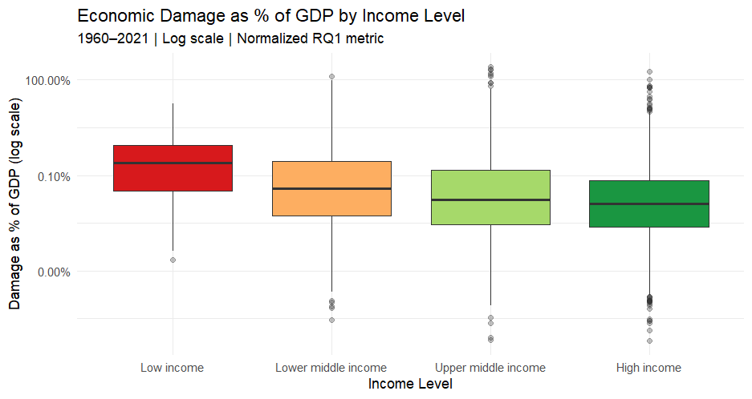
Who Really Pays the Price?
RQ1- How does economic damage relate to a country's income level?
While high-income countries report the highest absolute dollar losses due to their expensive infrastructure, relying solely on raw data is misleading. By normalizing the damage relative to GDP, we reveal the true economic burden: natural disasters disproportionately cripple the economies of low-income nations, leaving the heaviest financial toll on poorer countries

Slide 7
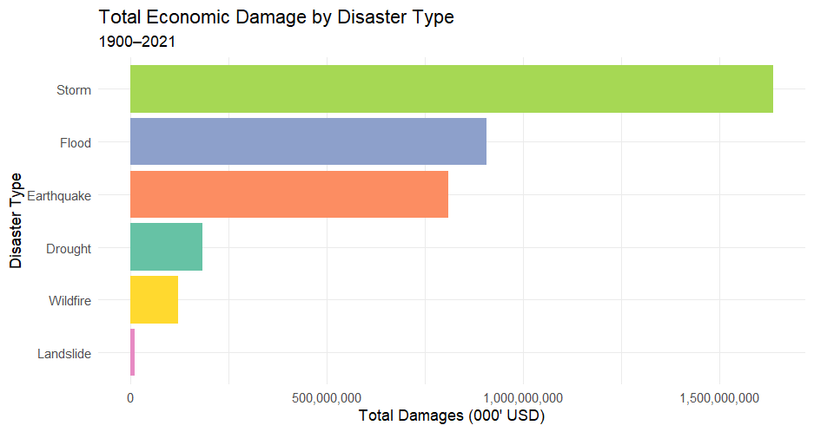
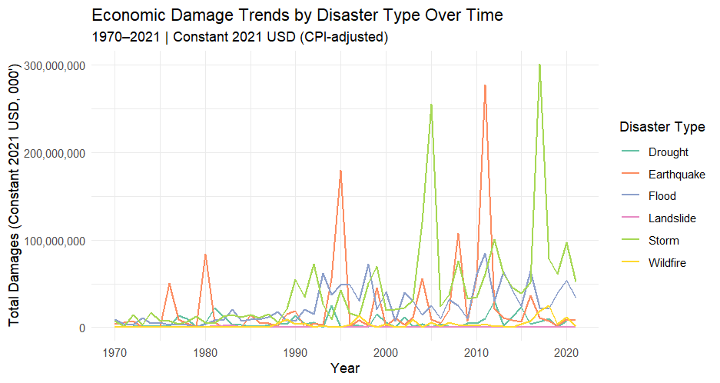
The Rising Cost of Nature
RQ2- Which disaster types cause the most economic damage, and has this changed over time?
Storms and Floods cause the highest total economic damage globally, with event frequencies rising exponentially since 1970 — consistent with climate change literature
The massive spikes in the timeline perfectly align with historic extreme events, such as Hurricane Katrina (2005), the Japan Earthquake (2011)

Slide 8
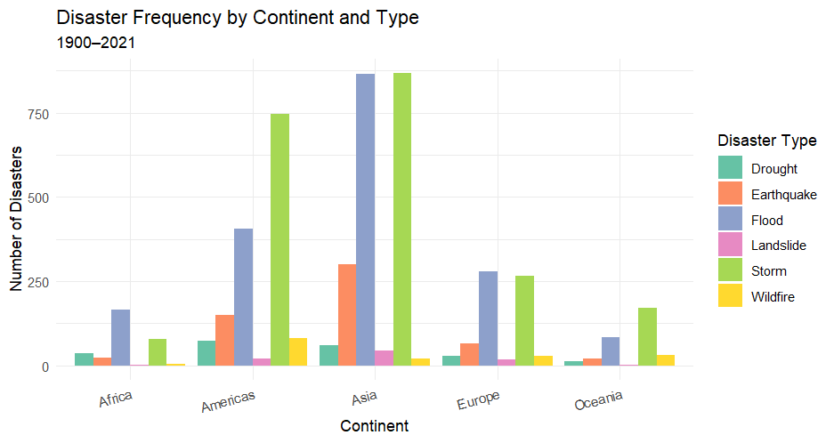
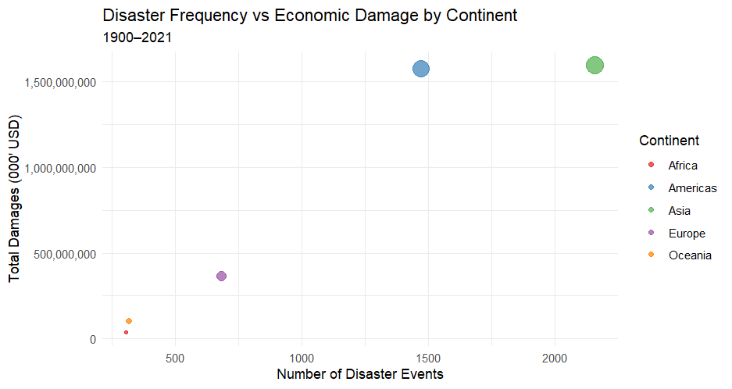
The Geography of Destruction
RQ3- How do disaster frequencies and economic losses vary across different continents?
Geographical analysis reveals a stark contrast: While Asia experiences the highest frequency of disaster events, the Americas endure the highest average economic damage per event, largely driven by catastrophic storms.

