Slide 1
M.E.M.P
Marine Environment Monitoring Platform

Slide 2
High Level Overview
MEMP (Marine Environment Monitoring Platform) is a platform for monitoring, cataloguing and analysing data from marine environments.
MEMP can be used to keep up-to-date on key environmental factors and enable you to better monitor and respond to changes in the environment.

Slide 3
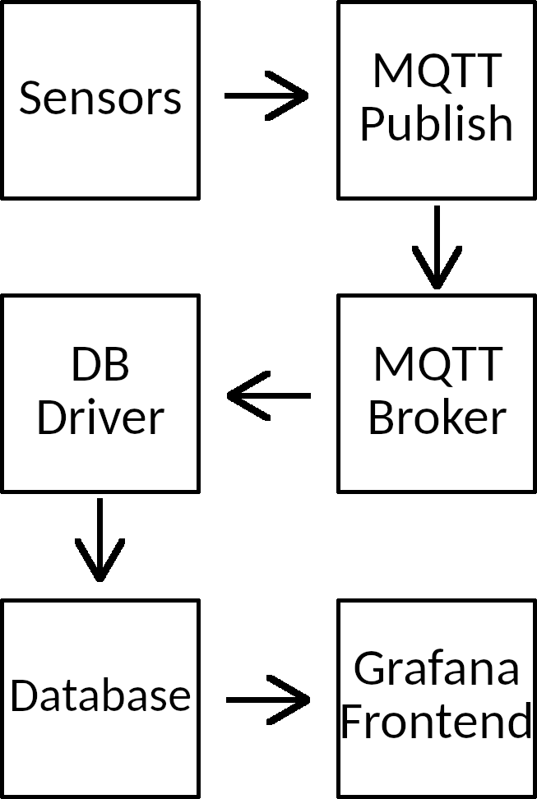
High Level Overview
The stack:
ERDDAP sensor data
PI gateway, publishes to MQTT broker
MQTT Broker running Mosquitto
MQTT subscriber
Database (InfluxDB / SQLite)
Grafana frontend

Slide 4

Technical Overview - ERDDAP
ERDDAP is a data server for hosting scientific data, created by the U.S. government.
The Irish Marine Institute hosts an ERDDAP server for several monitoring stations.
This is where MEMPs data is sourced from.

Slide 5
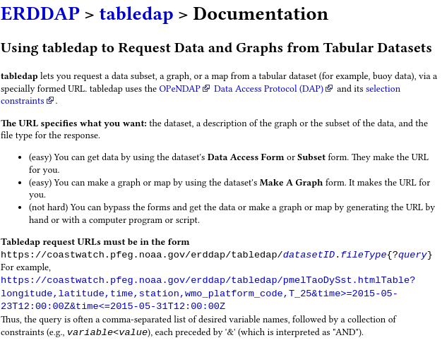
ERDDAP - Continued
The server is publicly accessible and includes documentation.
Data can be fetched over HTTP via a REST API
The returned data can be constrained using query parameters
Supports multiple different formats; JSON, CSV, plaintext, etc.

Slide 6
ERDDAP - Continued
Example query parameters:
&station_id=~"M[2-6]"&orderByMax("station_id,time")
Each parameter starts with an ‘&’ character
The station_id is matched against the regular expression M[2-6]
The orderByMax function returns the reading with the latest (max) time for each station_id
Most non-alphanumeric characters need to be percent-escaped to work!

Slide 7
Technical Overview - MQTT Publisher
The MQTT publisher is a python script that periodically fetches data from ERDDAP and publishes it over MQTT.
This is run on the Raspberry Pi and act as a ‘gateway’ between the sensors and the MQTT broker.
MQTT connection is secured by TLS.

Slide 8
Technical Overview - MQTT Broker
Mosquitto is used as the MQTT broker.
RSMB (Really Small Message Broker) was the first choice but was untenable as it does not support TLS.
But wait, how do we actually set up TLS?

Slide 9
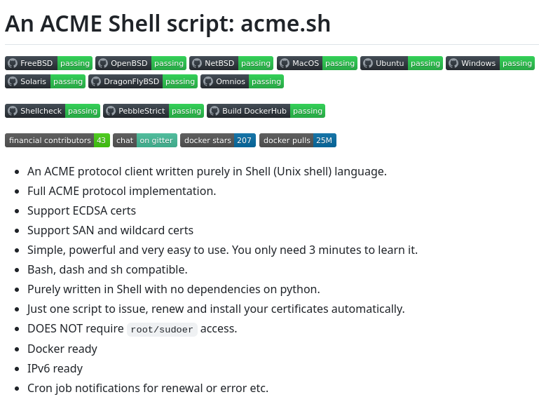
Technical Overview - TLS
All network traffic in MEMP is encrypted with TLS.
This requires generating TLS certificates for domains you own.
acme.sh is a very convenient TLS certificate manager, which can be used to generate and renew certificates.

Slide 10

TLS - Continued
To generate certificates we need a domain name.
Cannot use the default domain for an AWS instance.
Duckdns is a service that provides subdomains which you can point to any IP address you want.
We can generate certificates for duckdns subdomains using acme.sh

Slide 11
TLS - Continued
acme.sh is very easy to use from the command line
Install: $ curl https://get.acme.sh | sh -s
Set certificate authority: $ acme.sh --set-default-ca --server letsencrypt
Issue certificate: $ acme.sh --issue --dns dns_duckdns --domain yourdomain.duckdns.org
Install certificates:
$ acme.sh --install-cert --domain yourdomain.duckdns.org --cert-file "certificate.pem" --fullchain-file "fullchain.pem" --key-file "key.pem"

Slide 12
TLS - Continued
The generated certificate files are used by Mosquitto for TLS connections:
Edit mosquitto.conf to contain:
listener 1884
allow_anonymous true
cafile /path/to/fullchain.pem
certfile /path/to/certificate.pem
keyfile /path/to/key.pem
Use TLS on client connections (python, paho.mqtt.client):
client.tls_set(tls_version=ssl.PROTOCOL_TLSv1_2)
MQTT traffic is now encrypted!

Slide 13
Technical Overview - Database
Data needs to be stored in a database
MEMP supports two databases: InfluxDB & SQLite. Why?

Slide 14

InfluxDB
Time series database, great query performance
Easy downsampling to make queries over a huge range of data extremely fast
Intuitive web UI for remote management.

Slide 15
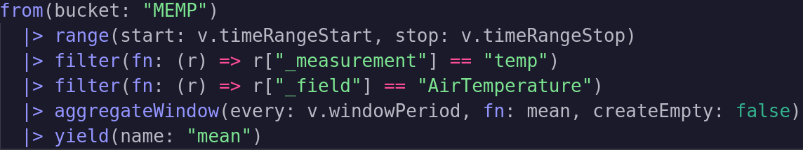
InfluxDB - Example Query
- aggregateWindow provides very easy downsampling!

Slide 16
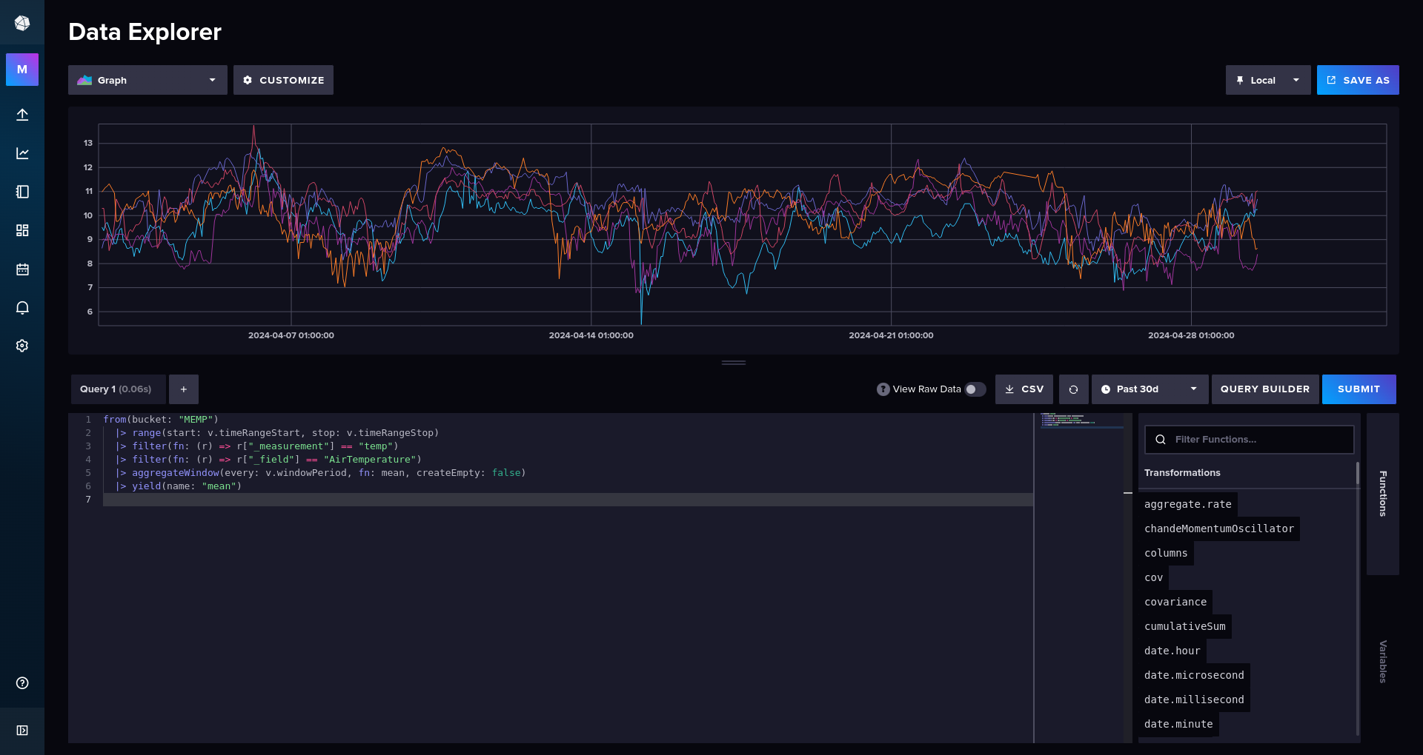
InfluxDB - Web View

Slide 17

InfluxDB - Continued
Uses a lot of memory. A relatively small dataset of 15000 points used around 1GB of memory.
AWS free tier only has 900MB of RAM, causing the OOM killer to run in this case.
Using a swap file prevents OOM, but entire instance becomes extremely slow and unresponsive.
Ran great locally on a laptop.

Slide 18

SQLite
SQLite is a general purpose database, whereas InfluxDB is optimized for time series data.
SQLite still performs very well for smaller data sets of time series data (<50,000 rows)
Downsampling is significantly more complicated, making large datasets hard to handle.
Full dataset of 750,000 rows was unusable without downsampling.

Slide 19
SQLite - Continued
SQLite is far less memory intensive than InfluxDB
Should only be used if your server has a hard time running InfluxDB
InfluxDB is superior for time series data, when your server can actually handle it.

Slide 20
Database Drivers
The database drivers are programs that glue together the MQTT broker and the database.
Subscribe to the relevant topic on the MQTT broker
Write data to the database when a message is published over MQTT
InfluxDB driver is written in python
SQLite driver is written in Zig. Why? Because I like it.
Both use TLS to connect to the broker.

Slide 21
Technical Overview - Database
LONGEST PART!!! Screenshots of Influx webview.
Talk at length about InfluxDB resource consumption issues. OOM image.
“So I used SQLite instead…”
Explain downsides of using SQLite instead of time series; query speed & downsampling
Explain drivers

Slide 22

Technical Overview - Grafana
Grafana is used as the primary visualisation tool in MEMP.
Grafana is a web server that provides tools to create dashboards connected to data from different databases.
Has data source plugins for InfluxDB and SQLite.

Slide 23
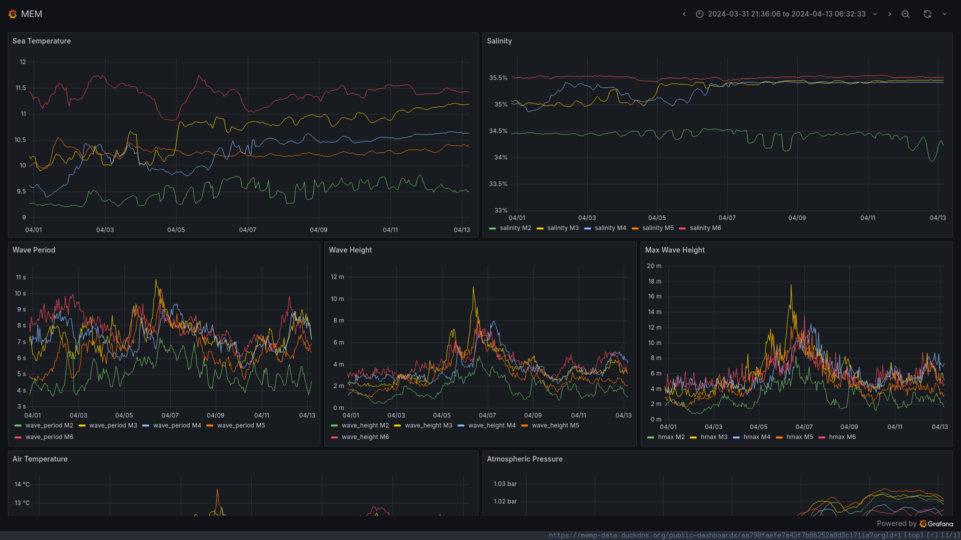
Grafana - Continued
Public dashboard is available at https://memp-data.duckdns.org/public-dashboards/aa798faefe7a43f7b86252a8d3c1711a?orgId=1

Slide 24
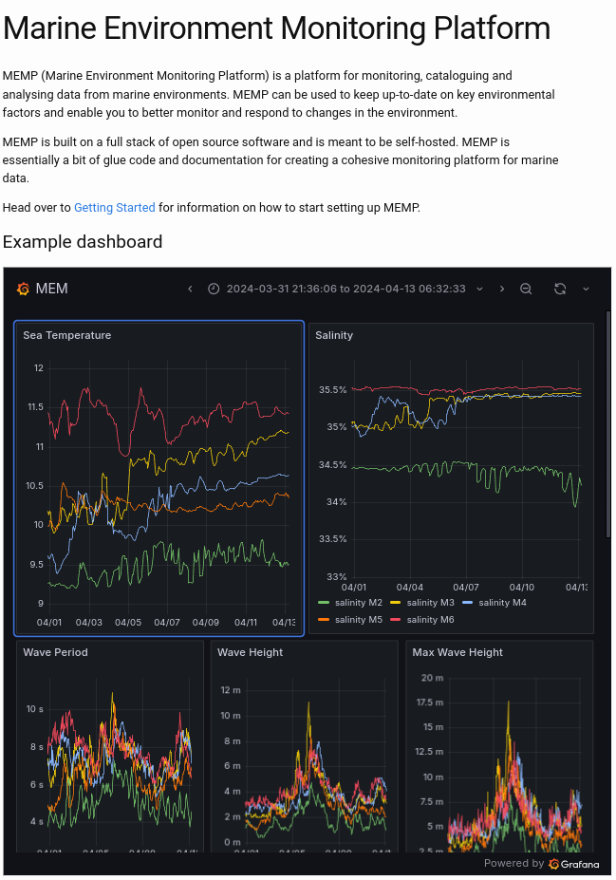
Grafana - Continued
Dashboards can be made public
Setting ‘allow_embedding true’ in grafana.ini allows dashboards to be embedded via HTMLs iframe tag
TLS is enabled via the cert_file and cert_key options in grafana.ini
Embedded dashboard

Slide 25
Technical Overview - Documentation
MEMPs documentation is hosted on GitHub Pages.
Makes it easy to deploy your on documentation if you fork the project.
Initially wanted to host a web backend using Zig
Didn’t need to serve any dynamic content, everything was static
So a static site generator like Jekyll ended up being perfect

Slide 26
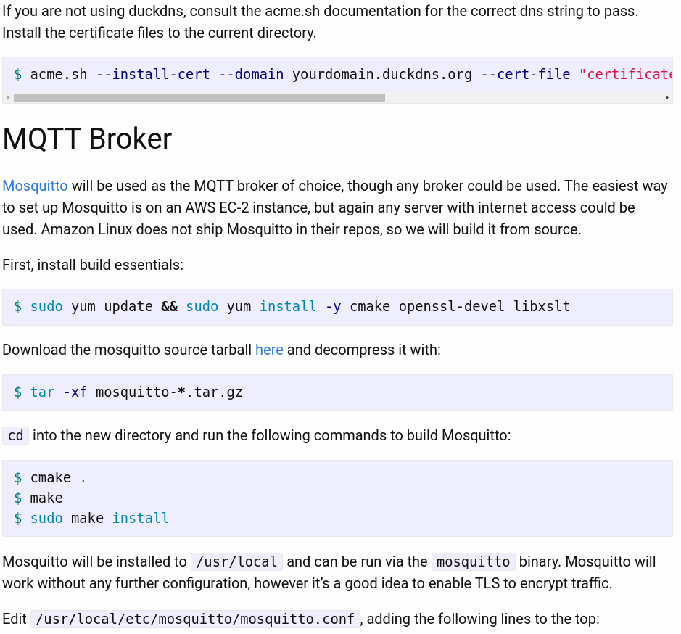
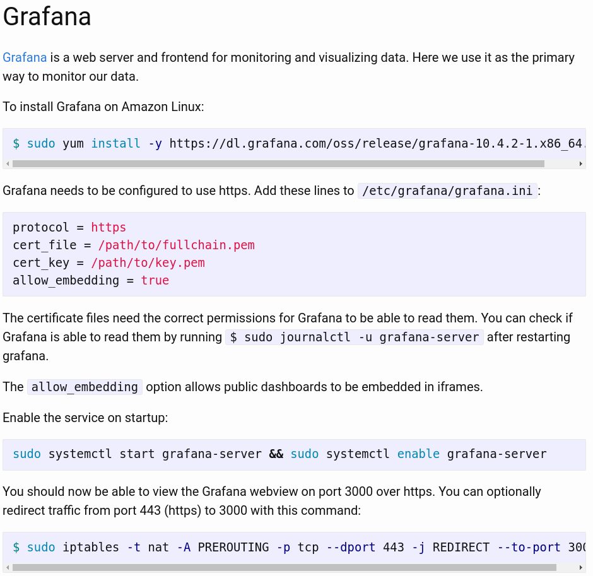
Documentation - Images

Slide 27
Thanks for listening!
Go to https://efjimm.github.io/MEMP to get started using MEMP.

